Slide 1

Introduction to Economics
Chapter 2:
Demand and Supply in a context of a
Market Economy

Slide 3
Syllabus
Elementary notions
II- The Supply
III- The Market Demand and Supply
I- The Demand
IV- Movements and shits along supply and demand curves
The Equilibrium of the Market
Notes:
free market: a system in which the prices for goods and services are self-regulated by buyers and sellers negotiating in an open market.

Slide 4

A- Market Economies -1-
Elementary notions
1- Market
2 - Market Economy
3- Types of Markets
Notes:
free market: a system in which the prices for goods and services are self-regulated by buyers and sellers negotiating in an open market.

Slide 5
A- Market Economies -2-
1- Market:
A place where buyers and sellers can meet to facilitate the exchange or transaction of goods and services.
Markets can be:
physical like a clothes store,
virtual like an e-clothes store. ...
Markets establish the prices of goods and services that are determined by supply and demand.
Notes:
free market: a system in which the prices for goods and services are self-regulated by buyers and sellers negotiating in an open market.

Slide 6

A- Market Economies -3-
The theoretical basis for market economies was developed by classical economists, such as Adam Smith , David Ricardo, and Jean-Baptiste Say.
These classically liberal free market advocates believed that the “invisible hand” of the profit motive and market incentives generally guided economic decisions down more productive and efficient paths than government planning of the economy.
Notes:
free market: a system in which the prices for goods and services are self-regulated by buyers and sellers negotiating in an open market.

Slide 7
A- Market Economies -4-
Government intervention often tended to lead to economic inefficiencies that actually made people worse off.
« The Invisible hand »:
In the 18th-century, the Scottish philosopher and economist Adam Smith, introduced the concept of « the invisible hand » which is a metaphor for the unseen forces that move the free market economy.

Slide 8
A- Market Economies -4’-
The Invisible Hand is part of laissez-faire, meaning "let do/let go," approach to the market.
In other words, the approach holds that the market will find its equilibrium without government or other interventions forcing it into unnatural patterns.

Slide 9

A- Market Economies -5-
2- Market Economy is an economic system in which economic decisions and the pricing of goods and services are guided by the interactions of a country's individual citizens and businesses.
There may be some government intervention or central planning, but usually this term refers to an economy that is more market oriented in general.

Slide 10
A- Market Economies -6-
In a market economy, most economic decision making is done through voluntary transactions according to the laws of supply and demand.
A market economy gives entrepreneurs the freedom to pursue profit by creating outputs that are more valuable than the inputs they use up, and free to fail and go out of business if they do not.

Slide 11
A- Market Economies -7-
Economists broadly agree that market-oriented economies produce better economic outcomes, but differ on the precise balance between markets and central planning that is best for a nation's long-term wellbeing.
Every market transaction involves an exchange and thus some element of both supply and demand.

Slide 12
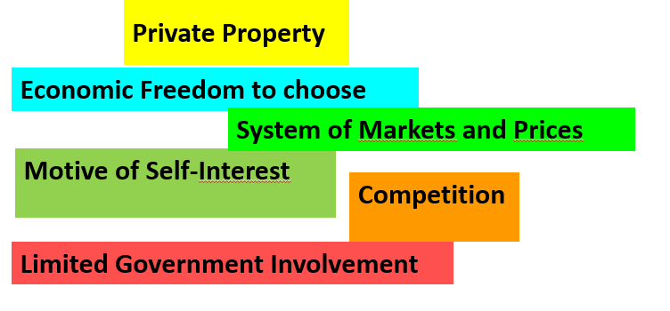
A- Market Economies -8-
Main Characteristics of a Market Economy (free enterprise)

Slide 13
A- Market Economies -9-
3- Types of Markets
  a- The market of goods and services
  The goods and services market is where households purchase consumable items and businesses sell their wares.
  The market includes stores, the Internet, and any other place where consumer goods and services are exchanged.

Slide 14
A- Market Economies -10-
b- The market of production factors
In Economics, a factor market is a market where factors of production are bought and sold.
Factor market allocates factors of production, including land, labour and capital, and distribute income to the owners of productive resources, such as wages, rents

Slide 15
A- Market Economies -11-
c- The market of money
The money market is a component of the economy which provides short-term funds.
The money market deals in short-term loans, generally for a period of a year or less.

Slide 16
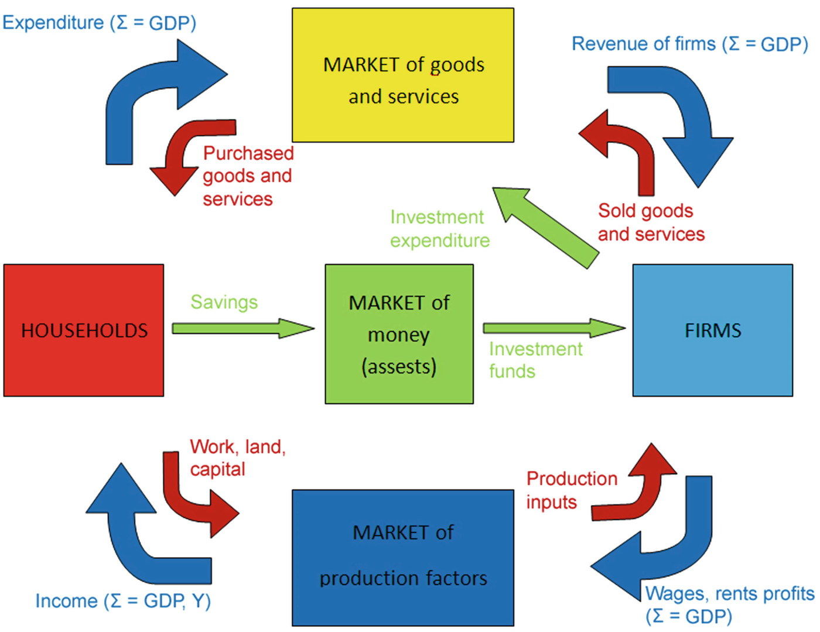

Slide 17

B- the Laws of Supply and Demand -1-
The Law of Supply and Demand: a theory that explains the interaction between the sellers of a resource and the buyers for that resource.
The theory defines the relationship between the price of a given good or product and the willingness of people to either buy or sell it.

Slide 18
B- the Laws of Supply and Demand -2-
Generally, as price increases, people are willing to supply more and demand less and vice versa when the price falls.
The theory is based on two separate « laws » :
    the law of demand
    the law of supply
The two laws interact to determine:
    the actual market price
    The volume of goods on a market.

Slide 19
C- Movements v/s Shifts -1-
For economics, the "movements" and "shifts" in relation to the supply and demand curves represent very different market phenomena.
Movement refers to a change along a curve.
On the demand curve, a movement denotes a change in both price and quantity demanded from one point to another on the curve.

Slide 20
C- Movements v/s Shifts -2-
The movement implies that the demand relationship remains consistent. It’s occurs when a change in the quantity demanded is caused only by a change in price, and vice versa.
A shift in a demand or supply curve occurs when a good's quantity demanded or supplied changes even though the price remains the same.

Slide 21

I- The Demand
I-1- Individual Demand
I-2- Determinants of Demand
I-3- Law of Demand
I-4- Demand Schedule
I-5- Demand Curve
I-6- Movements v/s shifts in Demand

Slide 22
I- The Demand -1-
I-1- Individual Demand
A demand exists only if someone is both willing and able to pay for a product.
How much someone is willing to pay for something is determined by his/her income and the opportunity cost.
The Opportunity cost is the most desired goods or services foregone in order to obtain something else.

Slide 23
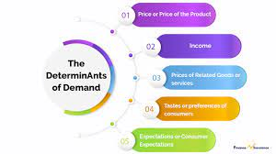
I- The fuction of Demand -2-
I-2- Determinants of Demand

Slide 24
I- The Demand -3-
I-3- Function of Demand
Individual Demand is a Function of:
Dx=f(Px, I, Pr, E, T)
Demand of Commodity x (Dx)
Function of commodity x (f)
Price of good or service (Px)
Incomes of consumers (I)
Prices of related goods & services (PR )
Future Expectation of product (E)
Taste patterns of consumers (T)

Slide 25
I- The Demand -4-
I-4- Law of Demand
The quantity of a good demanded in a given time period increases as its price falls, ceteris paribus.
ceteris paribus: literally "holding other things constant," is a latin phrase that is commonly translated into English as
"all else being equal."
It’s a dominant assumption in mainstream economic thinking.

Slide 26
I- The Demand -4’-
There is an inverse or negative relationship between price and quantity demanded, ceteris paribus.
The law of demand says that at higher prices, buyers will demand less of an economic good.

Slide 27
I- The Demand -5-
I-5-Demand Schedule
A table showing the quantities of a good a consumer is willing and able to buy at alternative prices in a given time period, ceteris paribus.
Demand is an expression of buyer intentions, of a willingness to buy, not a statement of actual purchases.
Notes:
ceteris paribus:

Slide 28
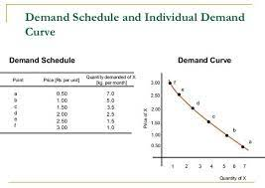
I- The Demand -6-

Slide 29
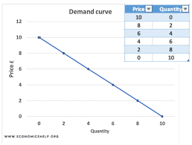
I- The Demand -7-
I-6- Demand Curve
A curve describing the quantities of a good a consumer is willing and able to buy at alternative prices in a given time period, ceteris paribus.
The demand curve does not state actual purchases, rather only what consumers are willing and able to purchase.

Slide 30
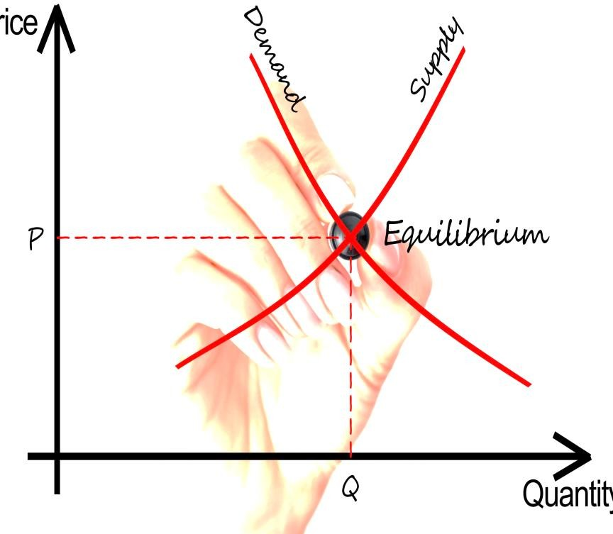
I- The Demand -8-
The Use of Demand Curves
Show how much consumers will spend at different prices.
Predict the amount to produce at a given price.
Determine the price that will result in desired output levels.

Slide 31
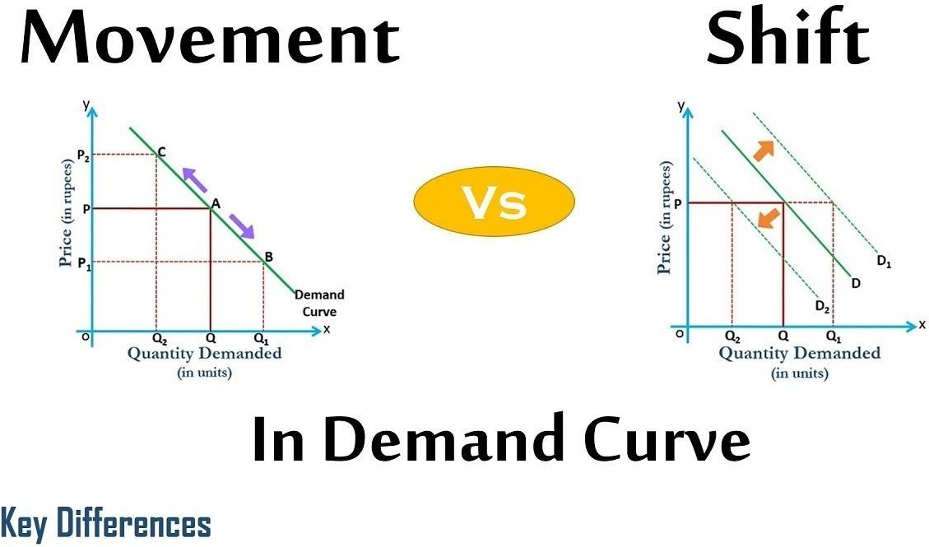
I-2- Movement v/s Shift in Demand -1 -
Movements along a demand curve are a response to price changes for that good.
Shifts of the demand curve occur only when the determinants of demand change.

Slide 32
I-2- Movement v/s Shift in Demand -2 -
The demand schedule and curve remain unchanged only so long as the underlying determinants of demand remain constant.
Changes in any of the determinants of demand will cause the demand curve to shift.
The quantity demanded at any (every) given price changes.
The demand curve always shifts only to the right or to the left.

Slide 33
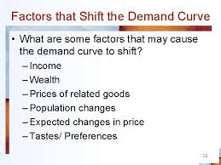
I-2- Movement v/s Shift in Demand -4 -

Slide 34

II- The Supply
II-1- Individual Supply
II-2- Determinants of Supply
II-3- Law of Supply
II-4- Supply Schedule
II-5- Supply Curve
II-6- Movements v/s shifts in Supply

Slide 35
II- The Supply -1-
II-1- Individual Supply
Supply is defined as the quantity of a specific good or service that producers are willing to provide over a given period of time.
Individual supply describes the willingness of an individual firm to provide a specific quantity of a good or service to the market over a given period of time.

Slide 36
II- The Supply -2-
II-2- Determinants of Supply
Technology
Factor (or resource) costs
Other goods
Taxes and subsidies
Expectations
Number of sellers

Slide 37
II- The Supply -3-
II-3- Function of Supply
Individual Supply is a Function of:
Sx = f (Px, PI, T, W, GP)
Sx = sup
f = function of commodity x
Px = Price of commodity x
PI = Price of inputs
T = Technology
W = Weather conditions
GP = Government Policy

Slide 38
II- The Supply -4-
II-4- Law of Supply
The law Supply The quantity of a good supplied in a given time period increases as its price increases, ceteris paribus.
There is a direct or positive relationship between price and quantity supplied, ceteris paribus.

Slide 39
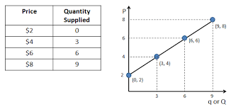
II- The Supply -5-
II-5- Supply schedule
Supply schedule is a chart that shows how much product a supplier will have to produce to meet consumer demand at a specified price based on the supply curve. In other words, it’s basically a supply graph in spreadsheet form listing the quantity that needs to be produced at each product price level.

Slide 40
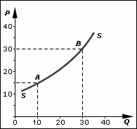
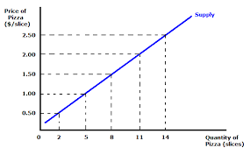
II- The Supply -6-
II-6- Supply curve
The supply curve is a graphic representation of the correlation between the cost of a good or service and the quantity supplied for a given period. I
In a typical illustration, the price will appear on the left vertical axis, while the quantity supplied will appear on the horizontal axis.

Slide 41

III- The Market Demand and Supply
III-1- Market Demand
III-2- Market Supply

Slide 42
III- The Market Demand and Supply -1-
III-1- Market Demand
a- Definition
The total quantities of a good or service people are willing and able to buy at alternative prices in a given time period.
The sum of individual demands.
Market demand is determined by the number of potential
buyers and their respective tastes, incomes, other goods, and expectations.

Slide 43
III- The Market Demand and Supply -1-
b- Function of Demand
Market Demand is a Function of: D_{x} = f(P_{x}, P_{r}, Y, T, F, P_{D}, S, D)
D_{x} = Market demand of commodity x
P_{x} = Price of given commodity x;
P_{r} = Prices of Related Goods
Y = Income of the consumers;
P₀ = Size and Composition of population;
S = Season and Weather;
D = Distribution of Income.

Slide 44
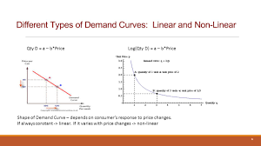
III- The Market Demand and Supply -2-
c- Market demand curves
A picture of the total quantities demanded by all consumers within a market at different prices.

Slide 45
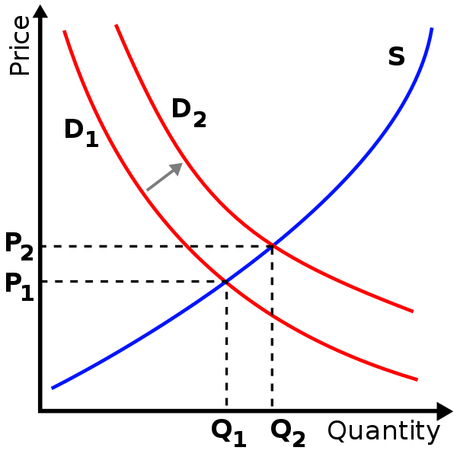
III- The Market Demand and Supply -3-
d- Shift in Demand
A shift in the demand curve is when a determinant of demand other than price changes. It occurs when demand for goods and services changes even though the price didn't. ... It's guided by the law of demand which says people will buy fewer units as the price increases.

Slide 46
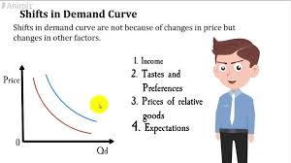
III- The Market Demand and Supply -4-
e- Factors that shift demand curves

Slide 47

Lecture 2
III- The Market Demand and Supply -5-
III-2- Market Supply
a- Definition
Supply interacts with demand to determine the price that will be charged.
Market supply is an expression of sellers’ intentions—of the ability and willingness to sell—not a statement of actual sales.
The total quantities of a good or service that sellers are willing and able to sell at alternative prices in a given time period, ceteris paribus.
The sum of individual supplies.

Slide 48
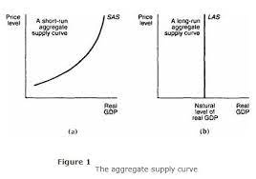
III- The Market Demand and Supply -6-
b- Market supply curves

Slide 49
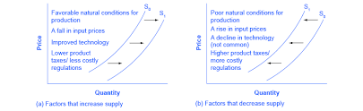
III- The Market Demand and Supply -7-
c- Shift in Supply

Slide 50
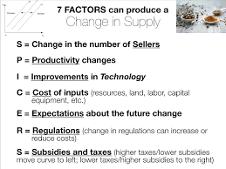
III- The Market Demand and Supply -8-
d- Factors that shift supply curves

Slide 51
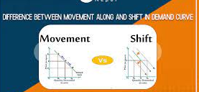
IV- Movements and shits along supply and demand curves
IV-1- Movements along curves
IV-2- Shift along curves

Slide 52
IV- Movements and shits along supply and demand curves -1-
IV-1- Movements along curves
a movement along the supply curve means that the supply relationship remains consistent.
Therefore, a movement along the supply curve will occur when the price of the good changes and the quantity supplied changes in accordance to the original supply relationship.
In other words, a movement occurs when a change in quantity supplied is caused only by a change in price, and vice versa.

Slide 53
IV- Movements and shits along supply and demand curves -2-
IV-2- Shift along curves
Shift in a demand or supply curve occurs when a good's quantity demanded or supplied changes even though the price remains the same.
Shifts in the demand curve imply that the original demand relationship has changed, meaning that quantity demand is affected by a factor other than price.

Slide 54
IV- Movements and shits along supply and demand curves -3-
IV-2-1- Shift in Supply
Change in supply refers to a shift, either to the left or right, in the entire price-quantity relationship that defines a supply curve.
Essentially, a change in supply is an increase or decrease in the quantity supplied that is paired with a higher or lower supply price.

Slide 55
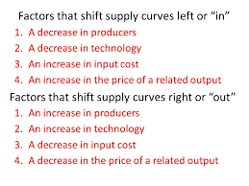
IV- Movements and shits along supply and demand curves -4- -4-
IV-2-2- Factors that shift supply curves

Slide 56
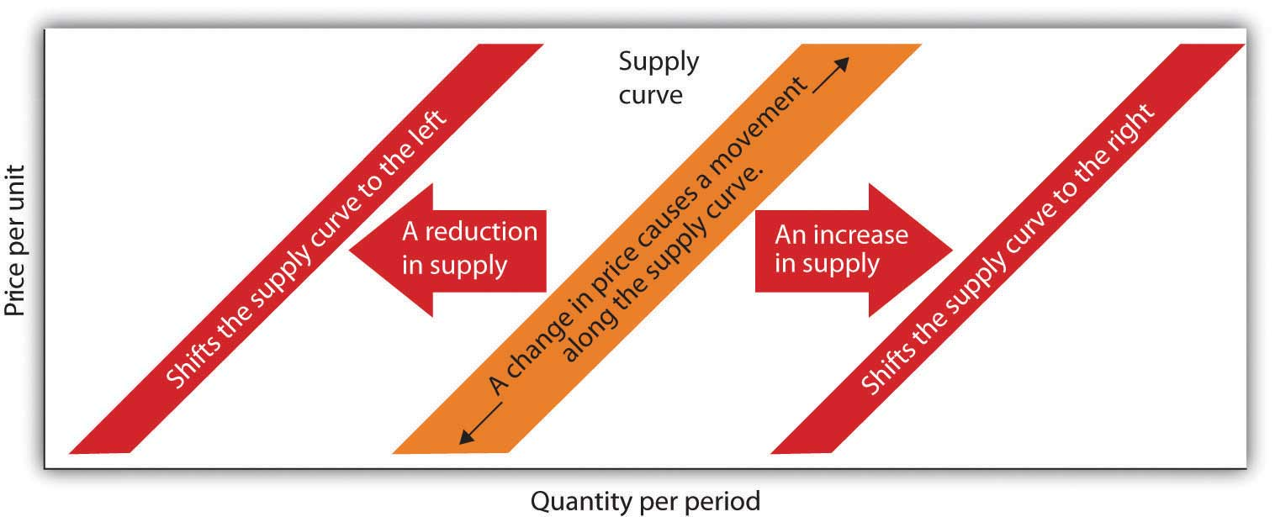
IV- Movements and shits along supply and demand curves -5-

Slide 57
IV- Movements and shits along supply and demand curves -6 -5-
IV-2-3-Shift in Demand
A shift in demand means that at any price (and at every price), the quantity demanded will be different than it was before.
Following is an example of a shift in demand due to an income increase.

Slide 58
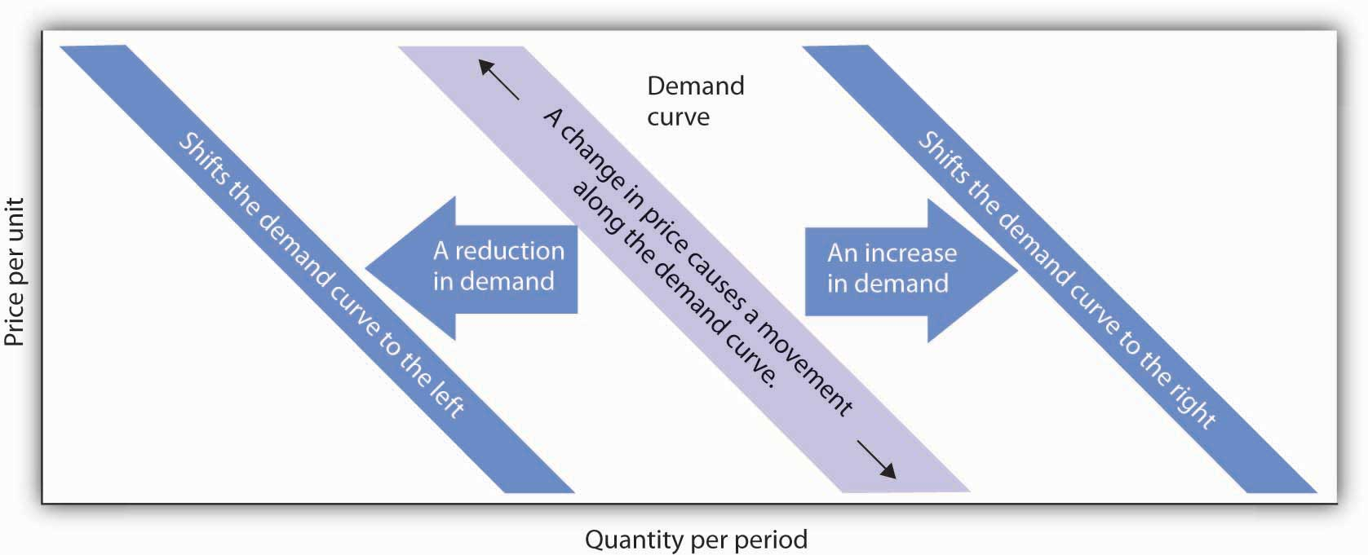
IV- Movements and shits along supply and demand curves -7-

Slide 59
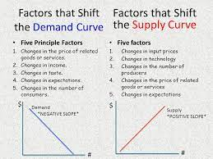
IV- Movements and shits along supply and demand curves -8-

Slide 60
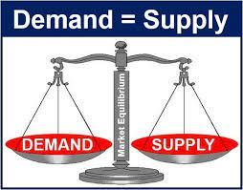
V- The Equilibrium of the Market

Slide 61
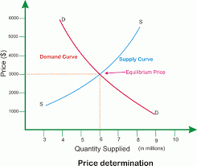
V- Equilibrium of the Market -1-
When the supply and demand curves intersect, the market is in equilibrium.
This is where the quantity demanded and quantity supplied are equal:
The corresponding price is the equilibrium price or market-clearing price
the quantity is the equilibrium quantity.

Slide 62
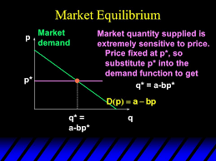
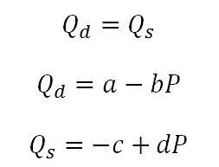
V- Equilibrium of the Market -2-

Slide 63


Slide 64

Market Economy

Slide 66
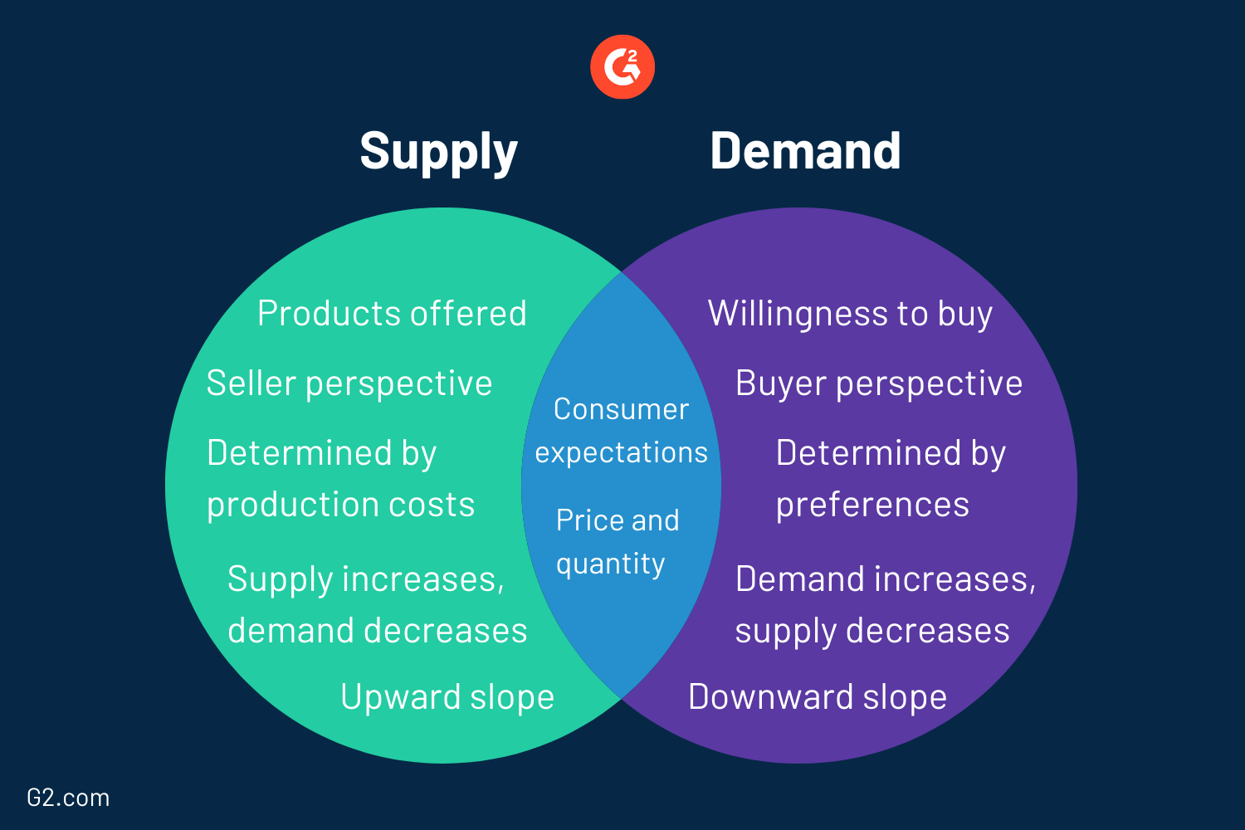
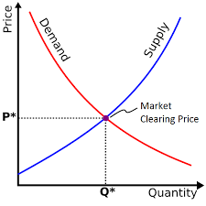
Demand & Supply -2-

Slide 67
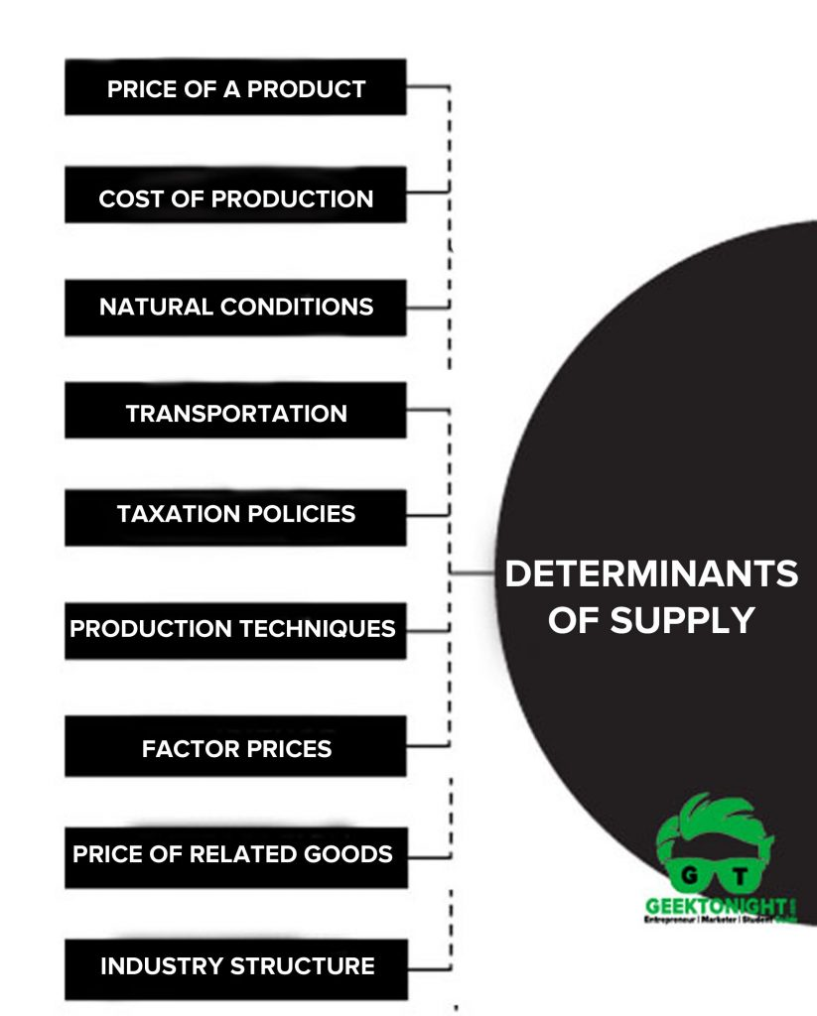
Determinants of Demand &Supply

Slide 68
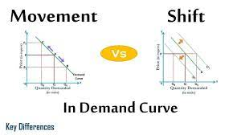
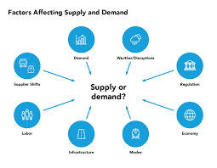
Factors affecting Demand & Supply

Slide 69
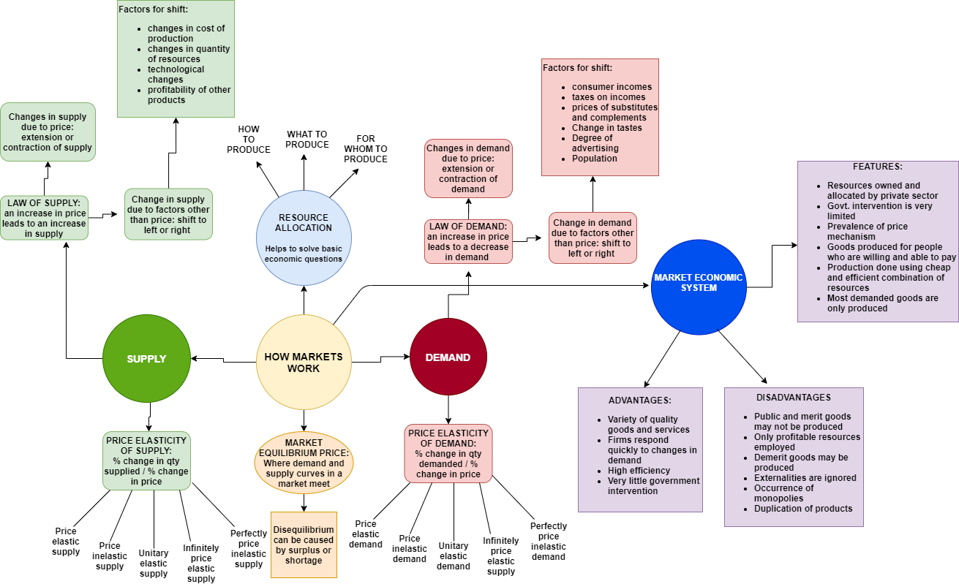
How markets work:
Factors affecting Supply & Demand

Slide 70
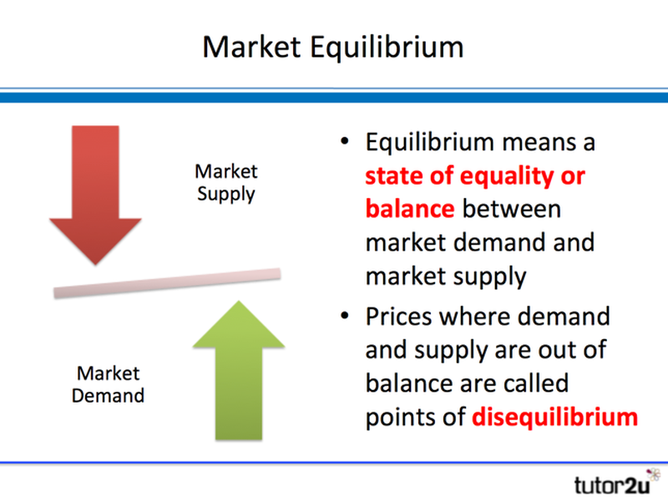
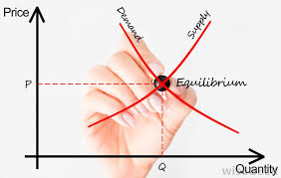
2 Market Equilibrum

Slide 71


