Slide 1



Enterprise Risk Management
PMG 611
Lecture 4
ERM Frameworks
Prepared by
Dr. Eng. Abdullah Jameel Halawany

Slide 2

Lecture
Session Outline
04
Introduction
COSO ERM Framework
ISO 31000:2018
Where’s the Value?
4–2

Slide 3
Lecture
Introduction
04
ERM Frameworks
PMG 611
Enterprise Risk Management
4–3

Slide 4
Lecture
Introduction
04
Every enterprise, whether for-profit commercial, not-for-profit, or a governmental agency, exists to provide value for its stakeholders.
That stakeholder value is created, preserved, or even can be eroded through management decisions at all levels of the enterprise and in all of its activities, ranging from day-to-day regular operations to setting strategies for future but uncertain endeavors.
All of them are subject to uncertainties or risks.
4–4

Slide 5
Lecture
Introduction
04
Over past years, enterprises generally have had two problems with this risk versus adjusted return decision model.
had not been a good and consistently accepted definition of risk across the overall enterprise.
often do not think of risks in a total enterprise sense but usually only on the basis of risk component by component.
4–5

Slide 6
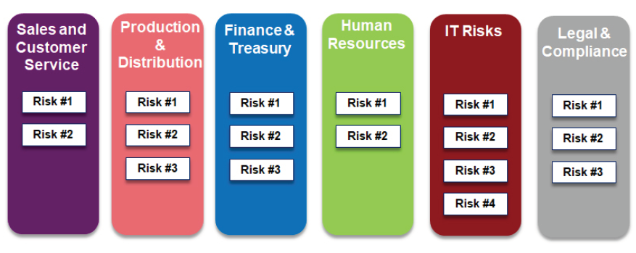
Lecture
Traditional Approach to Risk Management
04
4–6

Slide 7
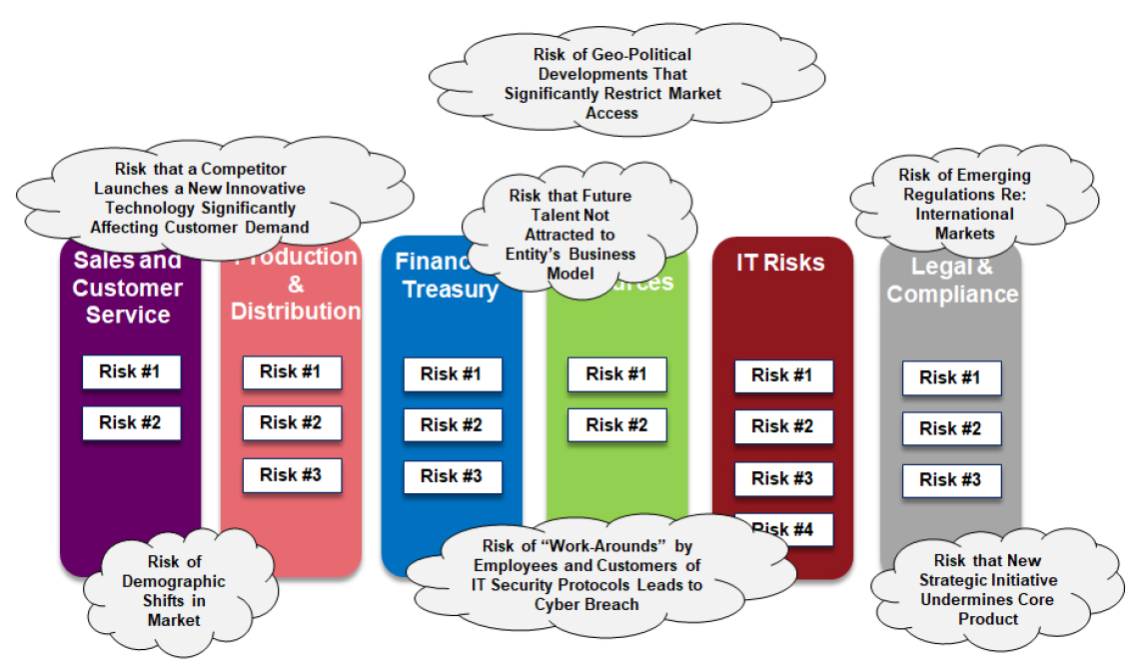
Lecture
Currently Unknown, But Knowable Risks Overlooked by Traditional Risk Management
04
4–7

Slide 8
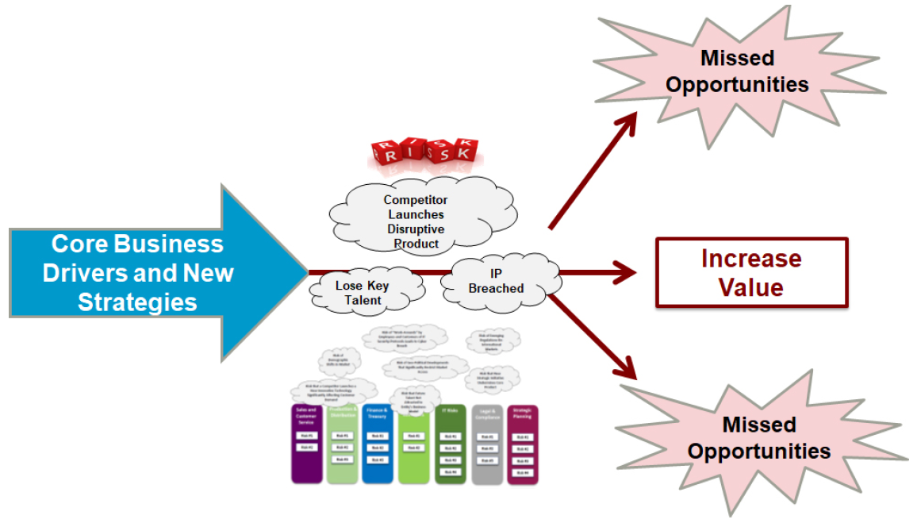
Lecture
ERM Should Inform Strategy of the Business
04
4–8

Slide 9
Lecture
ERM
04
Provides a comprehensive and systematic approach to more proactive and holistic risk management
Provides a common lexicon of risk terminology, and provides direction and guidance for implementing ERM
Requires that organizations examine their complete portfolio of risks, consider how those risks interrelate, and that management develops an appropriate risk mitigation approach to address these risks in a manner that is consistent with the organization’s strategy and risk appetite
4–9

Slide 10
Lecture
ERM
04
ERM process begins with a rich understanding of what’s most important for the business’ short-term and long-term success.
ERM uses a strategic lens to pinpoint emerging risks potentially affecting current core business drives and new strategic initiatives.
The goal of an ERM process is to generate an understanding of the top risks that management collectively believes are the current most critical risks to the strategic success of the enterprise.
4–10

Slide 11
4–11

Slide 12
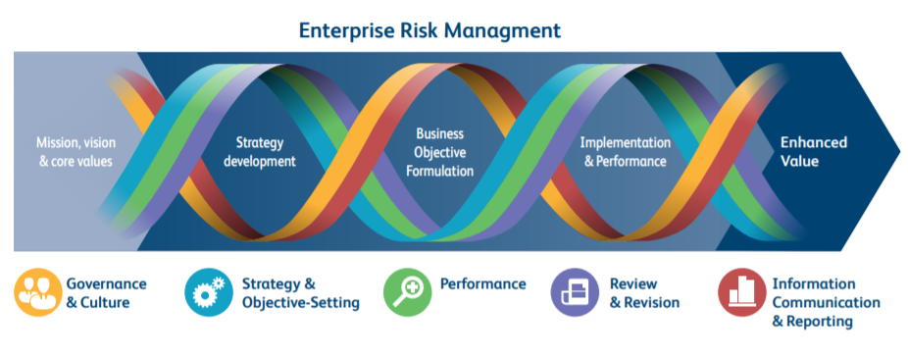
COSO ERM Framework
4–12

Slide 13
Lecture
COSO Definition for ERM
04
Enterprise Risk Management (ERM) is defined by the Committee of Sponsoring Organizations (COSO) as
“a process, effected by an entity’s board of directors, management and other personnel, applied in strategy-setting and across the enterprise, designed to identify potential events that may affect the entity, and manage risk to be within its risk appetite, to provide reasonable assurance regarding the achievement of entity objectives.”
4–13

Slide 14

Lecture
COSO ERM Frameworks
04
Enterprise Risk Management Integrated Framework (2004)
Enterprise Risk Management–Integrating with Strategy and Performance (2017)
4–14

Slide 15
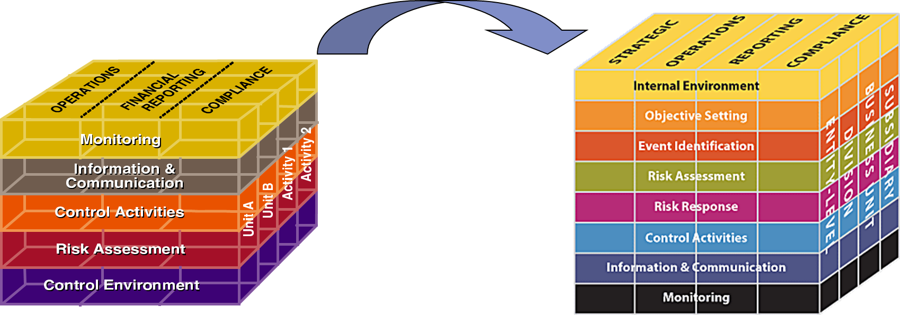
Lecture
COSO ERM Integrated Framework
04
To help assist with the implementation of the ERM process, COSO developed the ERM Integrated Framework (2004), also known as the COSO Cube. This cube is an update to the initial COSO I framework developed in 1992:
4–15

Slide 16
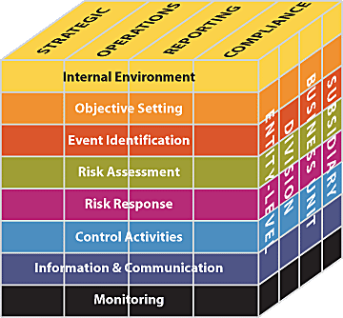
Lecture
COSO ERM Integrated Framework
04
These are the high-level goals that are aligned with and support the institution’s mission.
4–16

Slide 17
Lecture
COSO ERM Integrated Framework
04
Relate to the ongoing management process and daily activities of the organization.
4–17

Slide 18
Lecture
COSO ERM Integrated Framework
04
Relates to the protection of the organization’s assets and quality of financial reporting.
4–18

Slide 19
Lecture
COSO ERM Integrated Framework
04
Relates to the organization’s adherence to applicable laws and regulations.
4–19

Slide 20
Lecture
COSO ERM Integrated Framework
04
The Internal Environment relates to the general culture, values and environment in which an organization or entity operates (e.g. – Tone at the top)
4–20

Slide 21
Lecture
COSO ERM Integrated Framework
04
Objective Setting relates to the process management uses to set its strategic goals and objectives. Establishes the organization’s risk appetite and risk tolerance.
Risk Appetite is the amount of risk, on a broad level, that an
enterprise and its individual managers are willing to accept in their pursuit of value.
Risk Tolerance sets the acceptable minimum and maximum variation levels for a company, business unit, individual initiative, or specific risk category.
4–21

Slide 22
Lecture
COSO ERM Integrated Framework
04
Event Identification is the process by which an organization identifies events that influence strategy and objectives or could affect an organization’s ability to achieve its objectives.
4–22

Slide 23
Lecture
COSO ERM Integrated Framework
04
Risk Assessment relates to the organization’s process of evaluating the impact and likelihood of events and prioritizing related risks.
4–23

Slide 24
Lecture
COSO ERM Integrated Framework
04
Risk Response relates to determining how management will respond to the risks an organization faces. Will they avoid the risk, share the risk, or mitigate the risk through updated practices and policies.
4–24

Slide 25
Lecture
COSO ERM Integrated Framework
04
Control Activities represent policies and procedures that an institution implements to address the risks the organization chooses to accept.
4–25

Slide 26
Lecture
COSO ERM Integrated Framework
04
Information and Communication relate to those practices that ensure that the right information is communicated at the right time to the right people.
4–26

Slide 27
Lecture
COSO ERM Integrated Framework
04
Monitoring consists of ongoing evaluations to ensure controls are functioning as designed and taking corrective action to enhance control activities if needed.
4–27

Slide 28
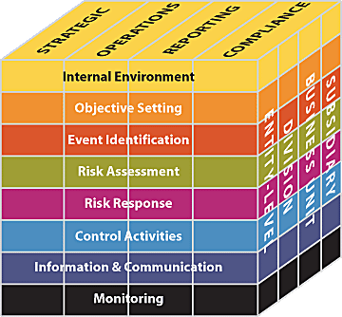
Lecture
COSO ERM Integrated Framework
04
Evaluate Performance
Implement
Confirm next steps
Evaluate options
Identify and prioritize risks
Goal setting
Culture
Internal Environment
Event Identification
Risk Response
Control Activities
Information & Communication
Objective Setting
Risk Assessment
Monitoring
4–28

Slide 29
Lecture
COSO ERM Integrated Framework
04
Each of these components are considered at multiple levels of the organization, rather than within a single function, unit, or department.
4–29

Slide 30
Lecture
COSO ERM Frameworks
04
Enterprise Risk Management Integrated Framework (2004)
Enterprise Risk Management–Integrating with Strategy and Performance (2017)
4–30

Slide 31
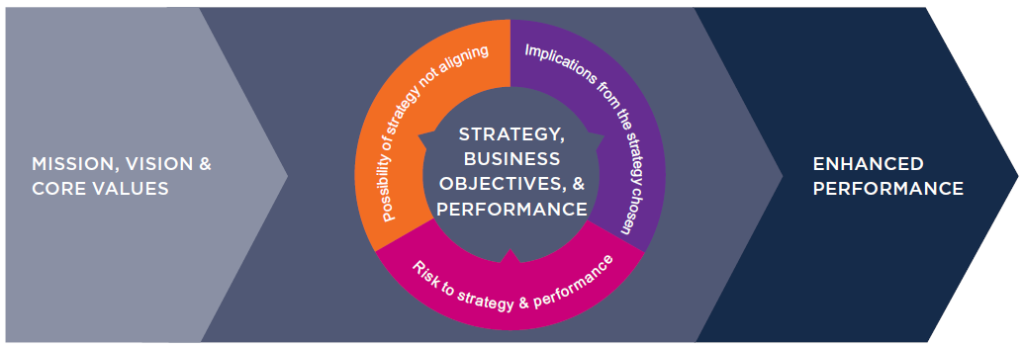
Lecture
COSO ERM Integrating with Strategy and Performance
04
The updated Framework elevates the discussion of integrating strategy and risk through three different dimensions:
The possibility of strategy not aligning with mission, vision and core values.
The implications from the strategy chosen.
Risk to strategy and performance.
4–31

Slide 32
Lecture
COSO ERM Integrating with Strategy and Performance
04
The Framework recognizes the importance of enterprise risk management keeping pace with technological developments
  Emphasizes how enterprise risk management practices and capabilities need to align with the velocity of changes to the business context, emerging and changing risks.
  Information, Communication and Reporting principles now have a greater focus on integrated risk and performance reporting.
  Developments in data generation and analytics including ‘big data’, artificial intelligence and social media have been acknowledged.
4–32

Slide 33
Lecture
COSO ERM Integrating with Strategy and Performance
04
Culture now features in the definition of ERM and is part of the Framework’s Governance and Culture Component.
Principles on culture are now more focused on decision-making and the alignment to expected behaviors in line with the core values of the organization
4–33

Slide 34
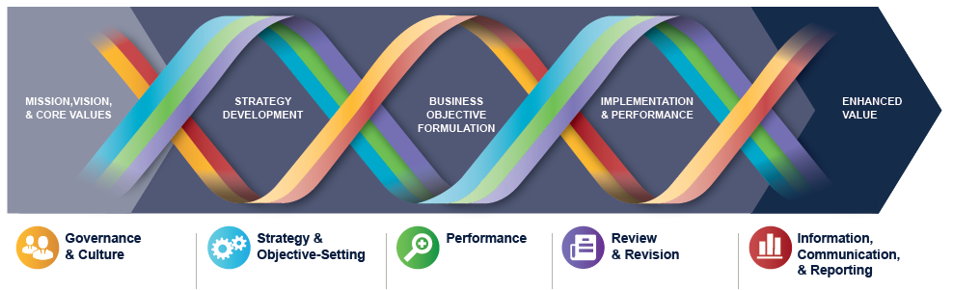
Lecture
COSO ERM Integrating with Strategy and Performance
04
4–34

Slide 35
Lecture
COSO ERM Integrating with Strategy and Performance
04
The Framework itself is a set of principles organized into five interrelated components:
1- Governance and Culture
2- Strategy and Objective-Setting
3- Performance
4- Review and Revision
5- Information, Communication, and Reporting
4–35

Slide 36
Lecture
COSO ERM Integrating with Strategy and Performance
04
1- Governance and Culture
  Governance sets the organization’s tone, reinforcing the importance of, and establishing oversight responsibilities for, enterprise risk management.
  Culture pertains to ethical values, desired behaviors, and understanding of risk in the entity.
2- Strategy and Objective-Setting
  ERM, strategy, and objective-setting work together in the strategic-planning process.
  A risk appetite is established and aligned with strategy.
  Business objectives put strategy into practice while serving as a basis for identifying, assessing, and responding to risk.
4–36

Slide 37
Lecture
COSO ERM Integrating with Strategy and Performance
04
3- Performance
  Risks that may impact the achievement of strategy and business objectives need to be identified and assessed.
  Risks are prioritized by severity in the context of risk appetite.
  The organization then selects risk responses and takes a portfolio view of the amount of risk it has assumed.
  The results of this process are reported to key risk stakeholders.
4–37

Slide 38
Lecture
COSO ERM Integrating with Strategy and Performance
04
4- Review and Revision
  By reviewing entity performance, an organization can consider how well the enterprise risk management components are functioning over time and in light of substantial changes, and what revisions are needed.
5- Information, Communication, and Reporting
  Enterprise risk management requires a continual process of obtaining and sharing necessary information, from both internal and external sources, which flows up, down, and across the organization.
4–38

Slide 39

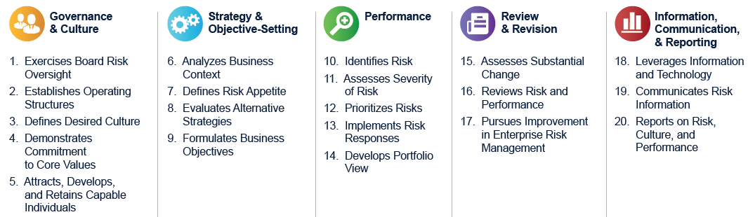
Lecture
COSO ERM Integrating with Strategy and Performance
04
4–39

Slide 40
Lecture
ISO 31000:2018
04
ERM Frameworks
PMG 611
Enterprise Risk Management
4–40

Slide 41
Lecture
ISO
04
The International Organization For Standardization’s (ISO) international standards cover a wide range of areas, ranging from defining the dimensions of fastener screw threads in an automobile engine to the thickness of a personal credit card to information technology (IT) quality standards.
These standards also have been expanded over the years to cover areas that are important for enterprise governance and quality.
4–41

Slide 42
Lecture
ISO 31000:2018
04
The concept behind ISO 31000 is that there are international companies operating in many countries around the globe who all need to set priorities and address risks in a consistent manner.
There is a need for a ‘‘common look and feel’’ for these various countries to demonstrate to outside viewers that effective and reliable standards have been used.
It should be emphasized that ISO 31000 is not a prescriptive set of rules but a set of principles and generic guidelines.
4–42

Slide 43
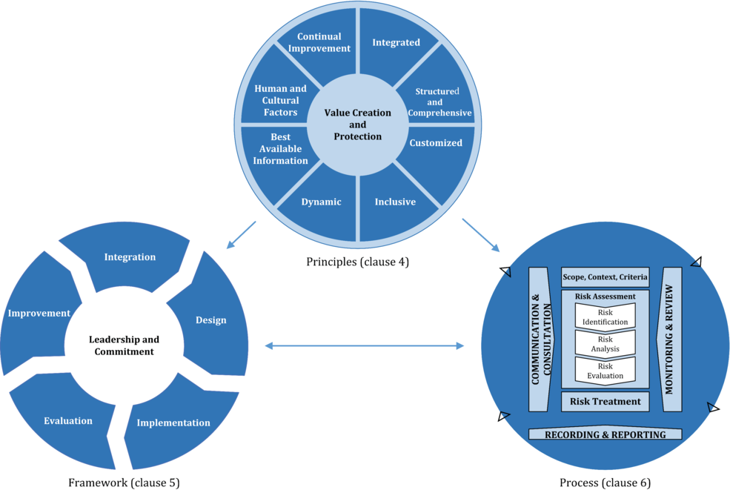
Lecture
ISO 31000:2018
04
https://www.iso.org/obp/ui/#iso:std:iso:31000:ed-2:v1:en
4–43

Slide 44
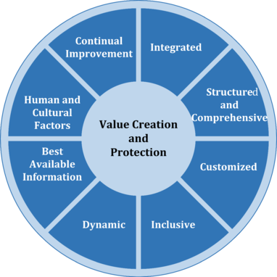
Lecture
ISO 31000:2018
04
Principles
4–44

Slide 45
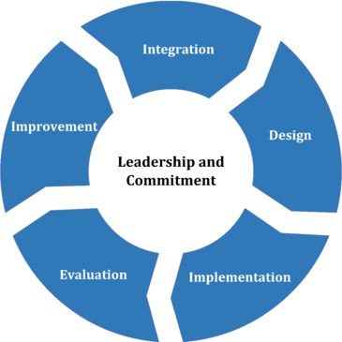
Lecture
ISO 31000:2018
04
Framework
4–45

Slide 46
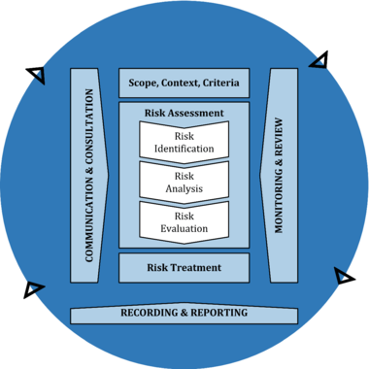
Lecture
ISO 31000:2018
04
Process
4–46

Slide 47
Lecture
Where’s the Value?
04
ERM Frameworks
PMG 611
Enterprise Risk Management
4–47

Slide 48
Lecture
Where’s the Value?
04
Organizations are increasingly looking to expand their risk management functions to help reduce potential future losses through:
  Improved monitoring and reporting
  Better risk identification and response
  More risk-based decision making
The biggest value in each of these frameworks lay in their promotion of continuous improvement, diligent management practices and ongoing monitoring.
4–48

Slide 49
Lecture
ERM is not…
04
A silver bullet to prevent risks from occurring
A methodology or a checklist of items that need to be completed that guaranteed results
The only way organizations can take a more proactive approach to managing risk
4–49

Slide 50
Lecture
Summary
04
ERM Frameworks
PMG 611
Enterprise Risk Management
4–50

Slide 51
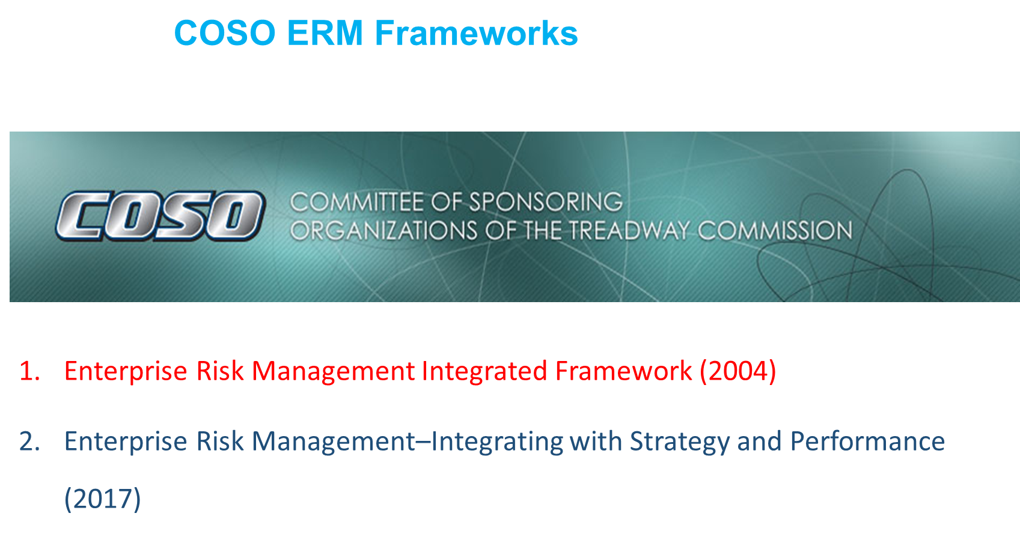
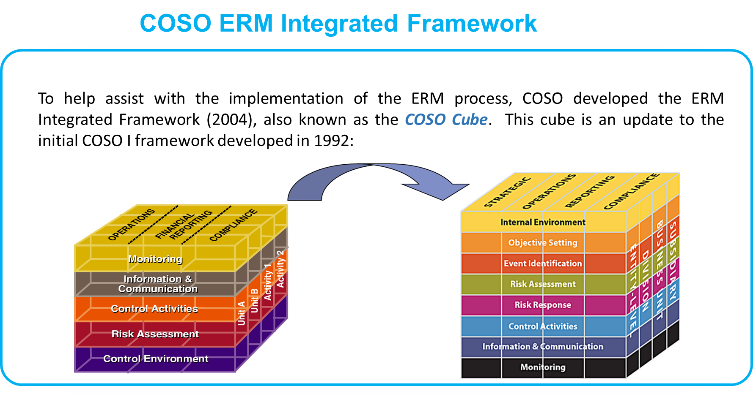
4–51

Slide 52
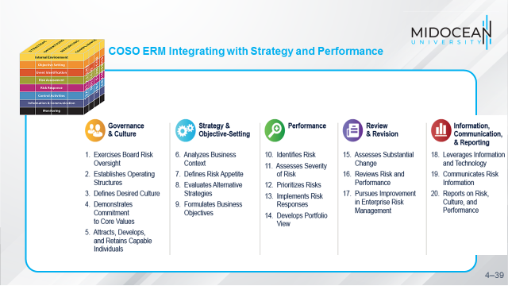
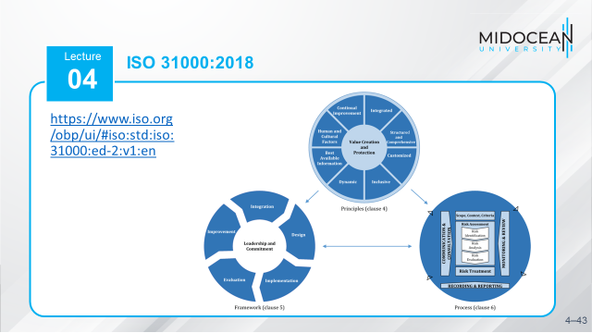
4–52

Slide 53
References
COSO Enterprise Risk Management: Establishing Effective Governance, Risk, and Compliance Processes. Robert R. Moeller.
2017-COSO-ERM-Integrating-with-Strategy-and-Performance-Executive-Summary. https://www.coso.org/Pages/guidance.aspx
ISO 31000:2018(en) Risk management — Guidelines. https://www.iso.org/obp/ui/#iso:std:iso:31000:ed-2:v1:en
4-53

Slide 54



Thank You

