Slide 1



Project Resources and Time Management
PMG 605
Lecture 1
Introduction and Review
Prepared by
Dr. Eng. Abdullah Jameel Halawany

Slide 2



Lecture
Session Outline
01
- Brief Description
- Topics
- Learning Outcomes
- References
Introduction to the course
- What is a Project?
- Project Characteristics
- Project Life Cycle
- Defining the Project Steps
- Summary
Review of Project Management Fundamentals
1–2

Slide 3
Lecture
Introduction
01
Introduction and Review
PMG 605
Project Resources and Time Management
1–3

Slide 4
Lecture
Brief Description of The Course
01
Project Resources and Time Management
This course deals with acquiring and assigning resourcing to projects, and the management of those resources. It addresses estimating and quantifying the required resources. It covers Resource Management, Acceleration and Schedule Compression, The Schedule, The Budget, Estimating Project Times and Costs, Developing a Project Plan, Scheduling Resources and Costs, Reducing Project Duration, Outsourcing: Managing Inter organizational Relations, Progress and Performance Measurement and Evaluation.
1–4

Slide 5
Lecture
Topics
01
Estimating Project Times and Costs.
Developing a Project Plan.
Resource Management.
Scheduling Resources and Costs.
Acceleration and Schedule Compression, Time‐Cost Trade‐off Analysis.
The Schedule.
The Budget.
Reducing Project Duration.
Outsourcing: Managing Inter organizational Relations.
Progress and Performance Measurement and Evaluation
1–5

Slide 6
Lecture
Course Learning Outcomes
01
Identify necessary labor and material resources, including contracted resources, and estimate the units of each that are required to meet stakeholder expectations.
Apply appropriate resource management tools and methods in each project context, including organizational breakdown structures, responsibility assignment matrices, and other means, to document and communicate project roles and responsibilities.
Evaluate and select commonly accepted methods for project managers to acquire, develop, and manage human resources that are appropriate in a specific project context and consistent with established policies.
1–6

Slide 7
Lecture
References
01
Project management: The managerial process
By Larson, E. W., & Gray, C. F.
Project Control: Integrating Cost and Schedule in Construction
By: Wayne J. Del Pico, CPE
1–7

Slide 8
Lecture
Review of Project Management Fundamentals
01
Introduction and Review
PMG 605
Project Resources and Time Management
1–8

Slide 9
Lecture
What is a Project?
01
Project Defined
A complex, non routine, one-time effort limited by time, budget, resources, and performance specifications designed to meet customer needs.
A project is a temporary endeavor undertaken to create a unique product, service, or result. (PMBoK 5th edition)
1-9

Slide 10
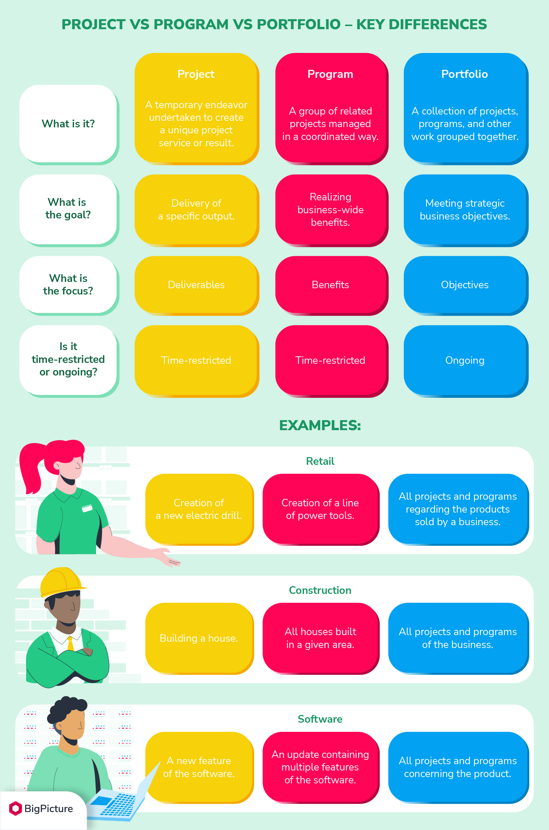
Lecture
Project, Program And Portfolio
01
1-10

Slide 11
Lecture
Project, Program And Portfolio
01
1–11

Slide 12
Lecture
Project Management
01
Project Manager
  Manages temporary, non-repetitive activities and frequently acts independently of the formal organization.
      Marshal resources for the project.
      Is linked directly to the customer interface.
      Provides direction, coordination, and integration to the project team.
      Is responsible for performance and success of the project.
  Must induce the right people at the right time to address the right issues and make the right decisions.
1–12

Slide 13

Lecture
Project Characteristics
01
1- Defined start and finish
  A point where it starts……a ‘time zero’
  A point where it finishes…..’delivery’
2- Time frame for completion
  The implication is a time scale
3- Uniqueness
  A Unique Need distinguished from day-to-day operations
4- Involvement of several people
  The project team
  Those affected by the project (eg new plant operators)
  Provision for specific skills and approaches
5- Limited resources
  People, materials, money and time all constrained
6- Sequencing of activities
  Interdependence of some activities
  Step by step progress
  Opportunity for overlapping
  Need for careful planning of step order
1–13

Slide 14
Lecture
Project Life Cycle
01
1–14

Slide 15
Lecture
Defining the Project Steps
01
Step 1
Step 2
Step 3
Step 4
Step 5
Defining the Project Scope
Establishing Project Priorities
Creating the Work Breakdown Structure
Integrating the WBS with the Organization
Coding the WBS for the Information System
1–15

Slide 16
Lecture
Step 1: Defining the Project Scope
01
Project Scope
  A definition of the end result or mission of the project -a product or service for the client/customer- in specific, tangible, and measurable terms.
Purpose of the Scope Statement
  To clearly define the deliverable(s) for the end user.
  To focus the project on successful completion of its goals.
  To be used by the project owner and participants as a planning tool and for measuring project success.
1–16

Slide 17
Project
Scope Generic
Checklist
1- Project objective
2- Deliverables
3- Milestones
4- Technical requirements
5- Limits and exclusions
6- Reviews with customer
1–17

Slide 18
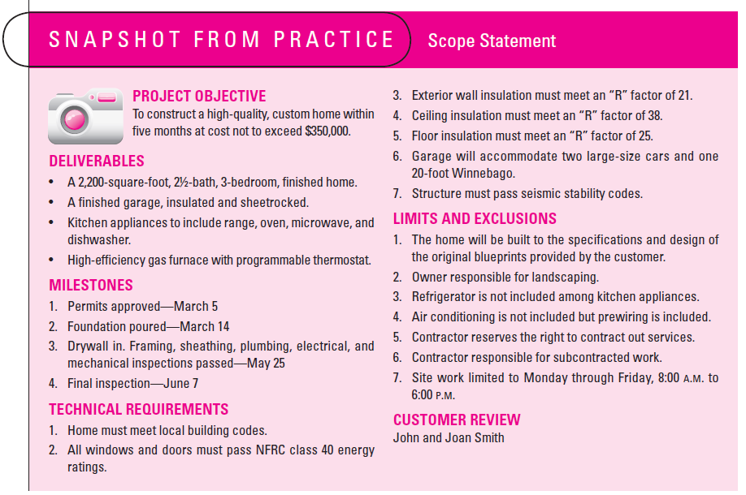
Project
Scope:
Snapshot
from
Practice
1–18

Slide 19
Project Scope:
Terms and Definitions
Scope
Statements
Scope Statements
  Also called statements of work (SOW)
Project
Charter
Project Charter
  Can contain an expanded version of scope statement
  A document authorizing the project manager to initiate and lead the project.
Scope
Creep
Scope Creep
  The tendency for the project scope to expand over time due to changing requirements, specifications, and priorities.
1–19

Slide 20
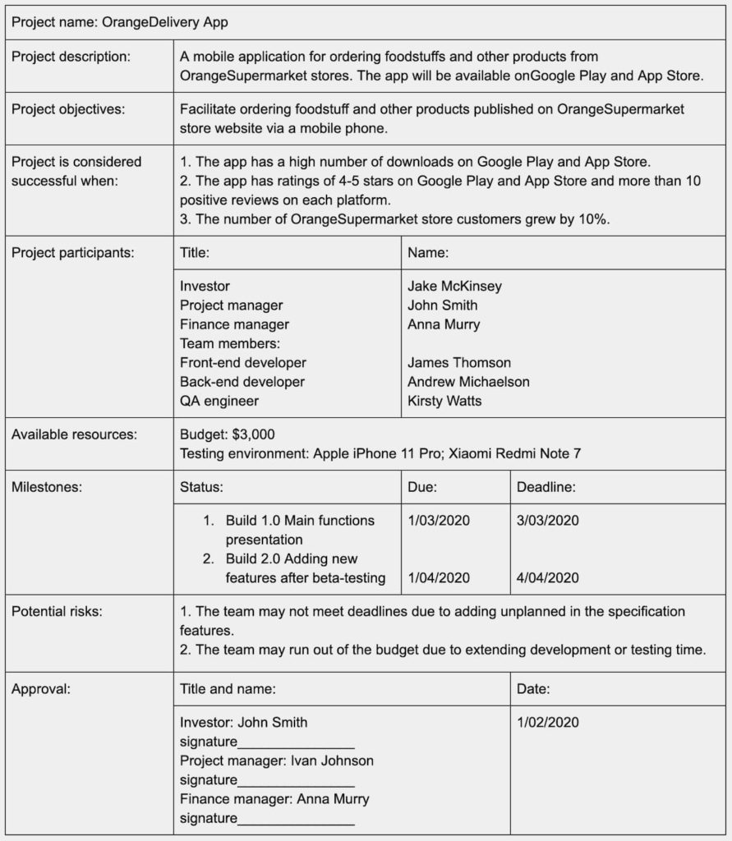
Project
Charter Example
NEVER accept verbal orders
1–20

Slide 21
Lecture
Step 2: Establishing Project Priorities
01
Causes of Project Trade-offs
  Shifts in the relative importance of criterions related to cost, time, and performance parameters
    TIME - completion by the due date
    COST - completion within the budget limit
    PERFORMANCE - to the required standard (e.g. quality)
Managing the Priorities of Project Trade-offs
  Constrain: a parameter is a fixed requirement.
  Enhance: optimizing a criterion over others.
  Accept: reducing (or not meeting) a criterion requirement.
1–21

Slide 22
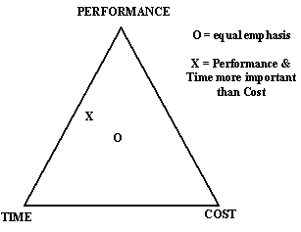
Project Management Trade-offs
The O symbol in the figure represents the positioning of a project where all three objectives are equally important.
The positioning of a project which must reach the required performance standard within the specified time, and cost is not a priority is represented by the X symbol.
1–22

Slide 23
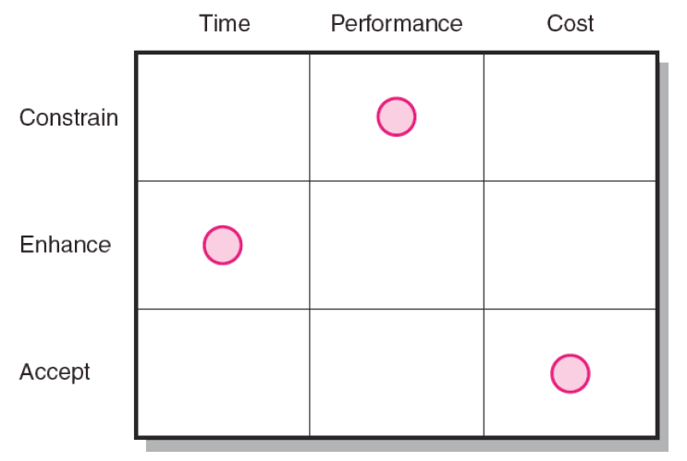
Project Priority Matrix
The figure displays the priority matrix for the development of a new wireless modem.
Because time to market is important to sales, the project manager is instructed to take advantage of every opportunity to reduce completion time.
In doing so, going over budget is acceptable though not desirable.
At the same time, the original performance specifications for the modem as well as reliability standards cannot be compromised.
1–23

Slide 24
Lecture
01
Step 3: Creating the Work Breakdown Structure
Work Breakdown Structure (WBS)
A hierarchical outline (map) that identifies the products and work elements involved in a project.
Defines the relationship of the final deliverable (the project) to its sub deliverables, and in turn, their relationships to work packages.
Best suited for design and build projects that have tangible outcomes rather than process-oriented projects.
1–24

Slide 25
Facilitates evaluation of cost, time, and technical performance of the organization on a project.
Provides management with information appropriate to each organizational level.
Helps in the development of the organization breakdown structure (OBS). which assigns project responsibilities to organizational units and individuals
Helps manage plan, schedule, and budget.
Defines communication channels and assists in coordinating the various project elements.
How WBS
Helps the Project Manager
1–25

Slide 26
Work Package
The lowest level of the WBS and it is output-oriented in that it:
Defines work (what).
Identifies time to complete a work package (how long).
Identifies a time-phased budget to complete work package (cost).
Identifies resources needed to complete a work package (how much).
Identifies a person responsible for units of work (who).
Identifies monitoring points (milestones) for measuring success.
Work
Packages
1–26

Slide 27
Work Breakdown Structure (WBS)
Level 1
Develop Windows 8 Operating System
1.0
Level 2
Software Design
1.1
Cost Management Plan
1.2
System Testing
1.3
Level 3
Develop GUIs
1.1.1
Design Cost Tracking Reports
1.2.1
Module Testing
1.3.1
Ensure Compatibility with Earlier Versions
1.1.2
Develop Cost/Schedule Interface
1.2.2
Defect Testing
1.3.2
Level 4
Compatible with Windows 7
1.1.2.1
(Work packages)
Compatible with Windows Vista
1.1.2.2
Compatible with Windows XP
1.1.2.3
1–27

Slide 28
Work
Breakdown
Structure
(WBS)
Levels:
  The depth of the WBS is dependent upon the size and complexity of the project and the level of detail needed to plan and manage it.
The 100% Rule:
  This rule states that the WBS includes 100% of the work defined by the project scope and captures all work deliverables to be completed, including project management.
  The rule applies to all levels within the hierarchy.
1–28

Slide 29

Work
Breakdown
Structure
(WBS)
Wait for a minute…did you clearly understand what you just read on the slide before?
This is quite important…as a project manager your role is to achieve the project’s objectives. Therefore, the deliverables must be captured effectively by the project team as part of the WBS. If it is not part of the WBS, it is not part of the project. Very simple, right?
Unfortunately, it is not that easy, and a lot of projects have what is called “scope creep” resulting in projects that are over budget and behind schedule.
1–29

Slide 30
Lecture
01
Step 4: Integrating the WBS with the Organization
Organizational Breakdown Structure (OBS)
Depicts how the firm is organized to discharge its work responsibility for a project.
  Provides a framework to summarize organization work unit performance.
  Identifies organization units responsible for work packages.
  Ties the organizational units to cost control accounts.
1–30

Slide 31
Integrating the WBS with OBS
1–31

Slide 32
Lecture
01
Step 5: Coding the WBS for the Information System
WBS Coding System
Defines:
  Levels and elements of the WBS
  Organization elements
  Work packages
  Budget and cost information
Allows reports to be consolidated at any level in the organization structure
1–32

Slide 33
WBS Coding
with the
1–33

Slide 34
Also called a linear responsibility chart.
Summarizes the tasks to be accomplished and who is responsible for what on the project.
  Lists project activities and participants.
  Clarifies critical interfaces between units and individuals that need coordination.
  Provide a means for all participants to view their responsibilities and agree on their assignments.
  Clarifies the extent or type of authority that can be exercised by each participant.
Responsibility Matrix (RM)
1–34

Slide 35
Responsibility Matrix for a Research Project
1–35

Slide 36
RM for the Conveyor Belt Project
1–36

Slide 37
Lecture
Summary
01
Introduction and Review
PMG 605
Project Resources and Time Management
1–37

Slide 38
Lecture
Management of Projects
01
Planning - goal setting, defining the project, team organization
Scheduling - relate people, money, and supplies to specific activities and activities to each other
Controlling - monitor resources, costs, quality, and budgets; revise plans and shift resources to meet time and cost demands
1–38

Slide 39
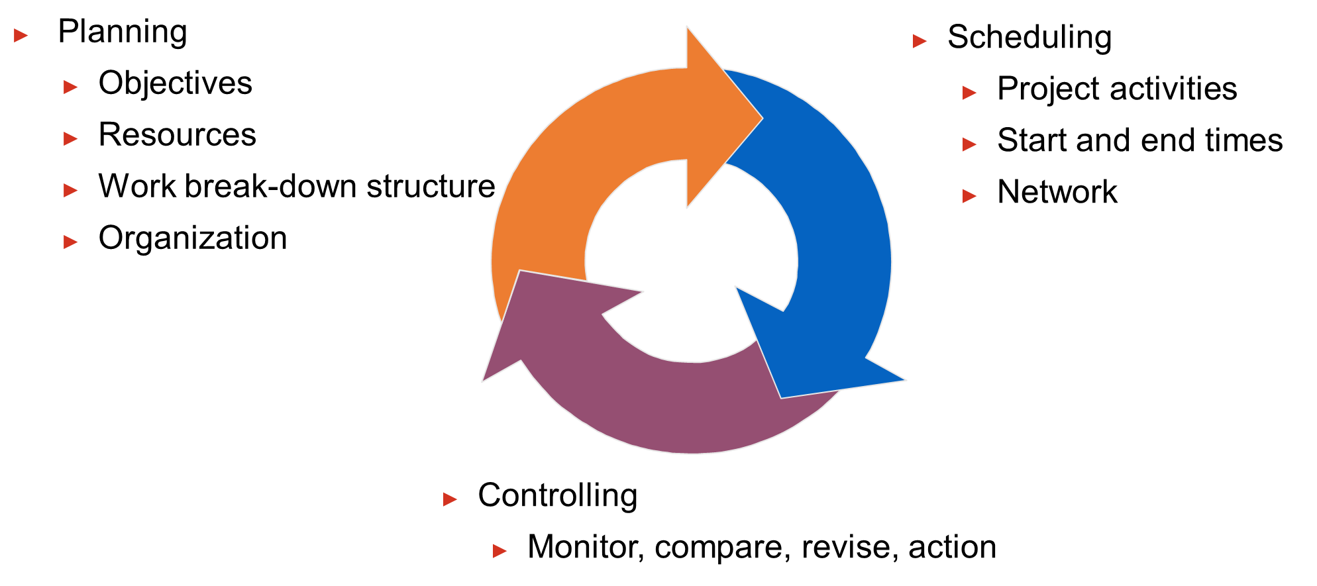
Lecture
Project Management Activities
01
1–39

Slide 40
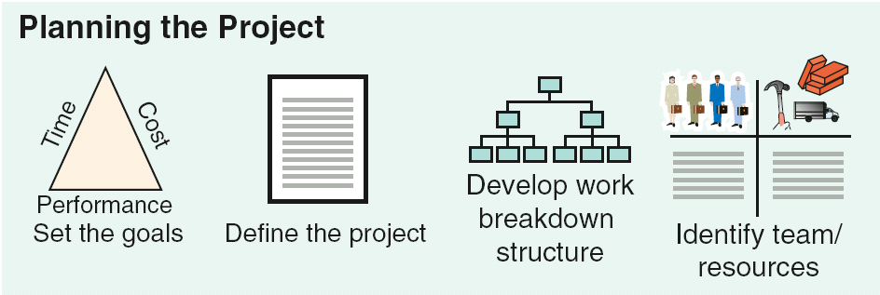
Lecture
Project Planning, Scheduling, and Controlling
01
1–40

Slide 41
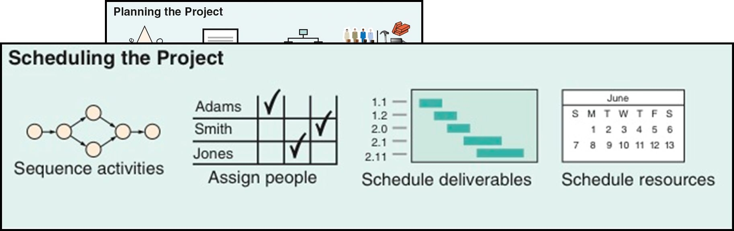
Lecture
Project Planning, Scheduling, and Controlling
01
1–41

Slide 42
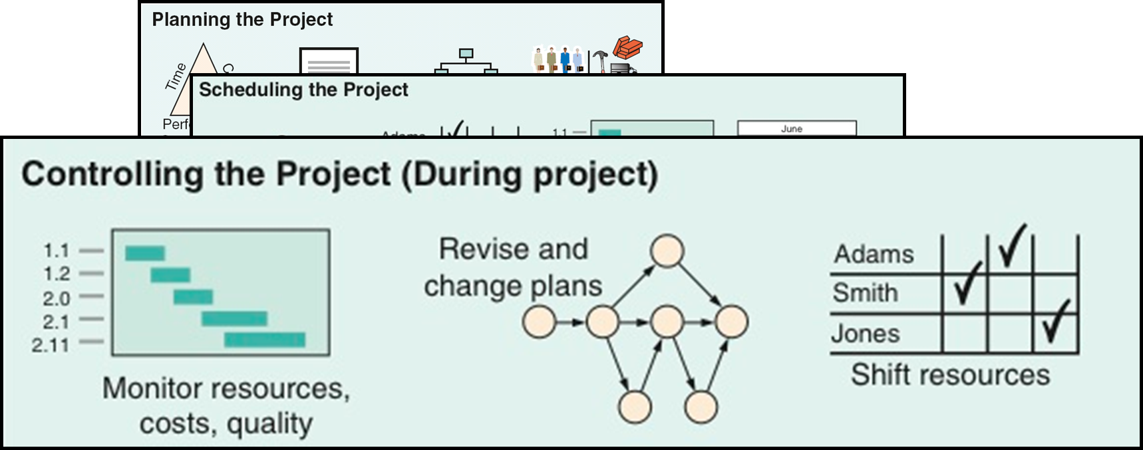
Lecture
Project Planning, Scheduling, and Controlling
01
1–42

Slide 43
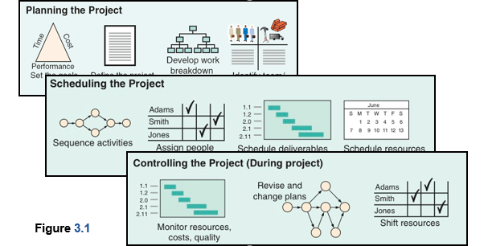
Lecture
Project Planning, Scheduling, and Controlling
01
1–43

Slide 44
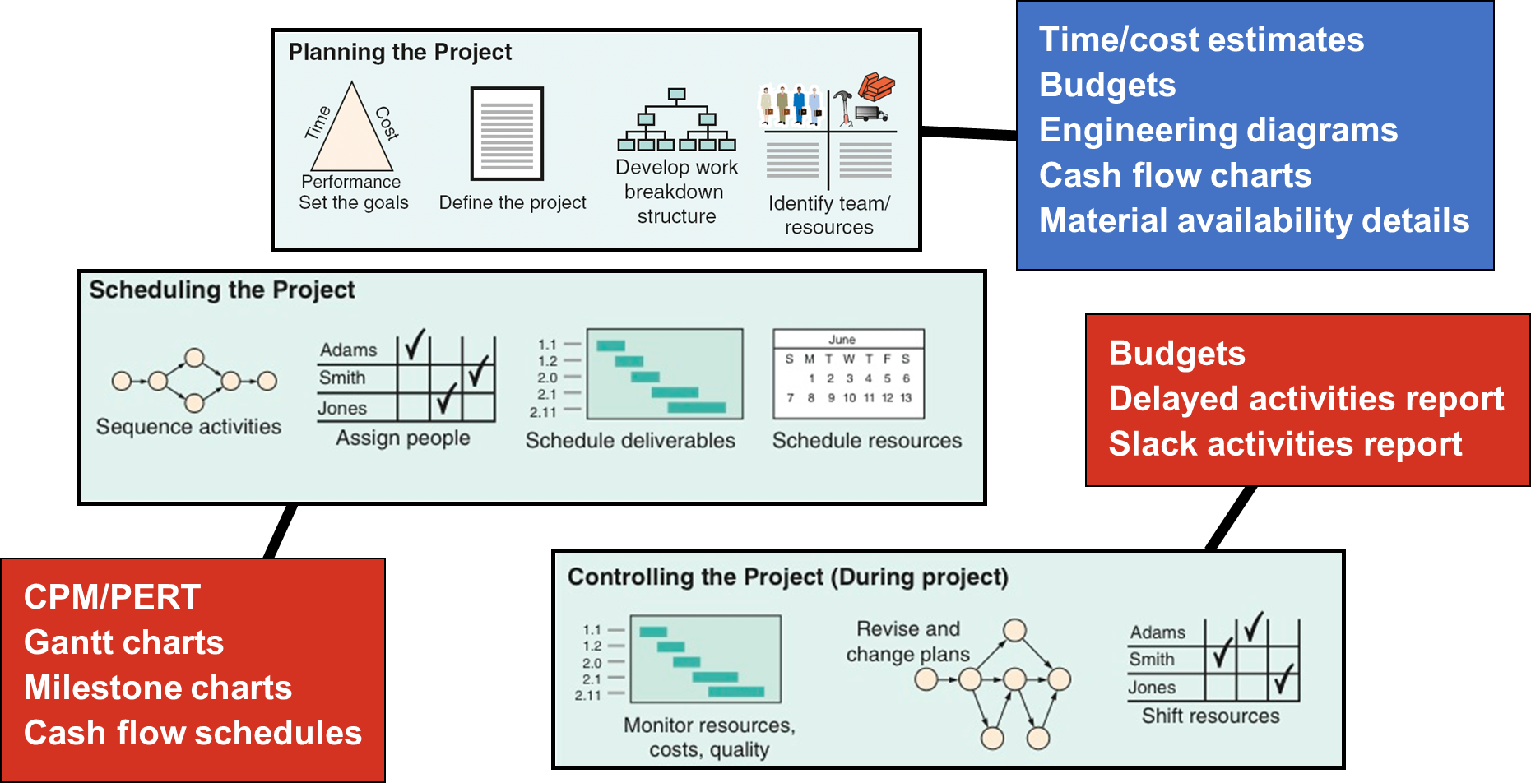
Lecture
Project Planning, Scheduling, and Controlling
01
1–44

Slide 45
Lecture Resources
Project Management
The Managerial Process
Fifth Edition
By: Erik W. Larson
Oregon State University
Clifford F. Gray
Oregon State University
1–45

Slide 46



Thank You

