Slide 1



PMG663
Design and Evaluation of Global Supply Chain Considering Disruption Risk
Lecture 9
Prepared by
Dr. Badur elgasim
www.midocean.ae

Slide 2
Chapter
09
Learning Objectives
Classlfiaction of supply chain risks
The model design
Supply chain resiliency
Components a resilient supply chain
www.midocean.ae

Slide 3
Chapter
09
The assumption that whatever is manufactured can be sold is no longer true. Today, the manufacturing industry needs to determine optimal output and supply levels for production efficiency because of factors such as diversification of consumer needs, globalization of business competition, and decreasing life cycle of products entering into the market
www.midocean.ae

Slide 4
Chapter
09
Up until now, the manufacturing industry aimed to improve production efficiency by shortening lead time and reducing costs through efficient management of the supply chain, from raw material procurement to manufacture, distribution, and sales. The breakdown in production following the Great East Japan Earthquake and the floods in Thailand in 2011 was inevitable, especially for automobile and semiconductor manufacturers
www.midocean.ae

Slide 5
Chapter
09
This disrupted the supply chain for these manufacturers,
This disrupted the supply chain for these manufacturers,
seriously affecting not only Japan but the whole world . Thus, supply chain disruption became a serious issue at the time, but it was supposedly due to the fact that supply chain management stressed efficiency and aimed at shorter lead times and lower costs, and risk management was not seriously considered.
www.midocean.ae

Slide 6
Chapter
09
However, with increasing globalization of business, the environment of supply chain management is transforming in a significant way. This is because one must take into account not only certain new factors, such as natural disasters, exchange rate fluctuations, and the uncertainty of demand, but also the unique components of a global supply chain, such as political risks, corporation taxes, and transfer prices
www.midocean.ae

Slide 7
Chapter
09
In addition to optimizing the supply chain used so far, at designing a global supply chain model incorporating disruption risks.
We also conduct numerical experiments using the model designed, and obtain insight about disruption risk reduction.
www.midocean.ae

Slide 8
Chapter
09
determined the traffic, transfer price, and shipping cost distribution ratio for global supply chains, and proposed a determination process to maximize post-tax profits.
Transfer price is the price applied for transactions within a given company.
www.midocean.ae

Slide 9
Chapter
09
By skillfully using this transfer price, it becomes possible to transfer profits from one country to another.
As a result, by gathering pre-tax profits into countries with low corporate tax rates, it is possible to maximize profits for the entire company
www.midocean.ae

Slide 10
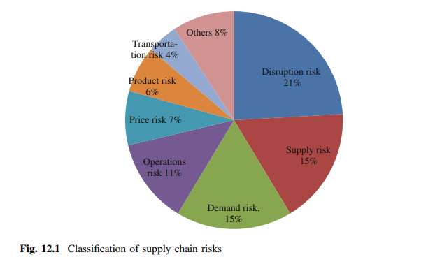
Chapter
09
shows categorized risks considered in the recent 50 studies concerning supply chain risk management. Of these, 87 risks could be considered repeated; they can be categorized, in descending order of repetition, as disruption risk, supply risk, demand risk, and operating risk. Furthermore, considered the conceivable risks in the supply chain: (1) foreign exchange risks, (2) quality risks, (3) production interruption risks, and (4) supplier debt default risk.
www.midocean.ae

Slide 11
Chapter
09
By focusing on foreign exchange risk, they developed determination models for in-house manufacturing and outsourcing.
From the viewpoint of creating a supply chain, there is a great number of risks other than the ones classified sources of supply chain risk into four risks (supply risk, process risk, demand risk, and control risk) and identified the relationship among them as depicted in Fig. 12.2
www.midocean.ae

Slide 12
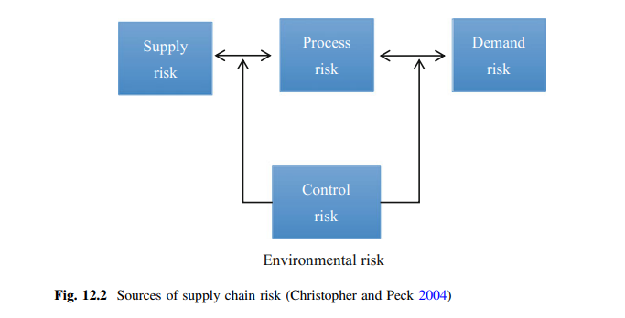
Chapter
09
www.midocean.ae

Slide 13
Chapter
09
broadly categorized risks into delays, disruptions, forecast inaccuracies, systems breakdowns, intellectual property breaches, procurement failures, inventory problems, and capacity issues.
indicated that the significant disruption has a typical profile in terms of its effect on company performance
www.midocean.ae

Slide 14
Chapter
09
They pointed out that the nature of the disruption and dynamics of the company response can be divided into eight phases as follows:
preparation, disruptive event, first response, initial impact, time of full impact, preparation for recovery, recovery and long-term impact.
www.midocean.ae

Slide 15
Chapter
09
Considering the unique components of global supply chains, covered such things as
(1) the great uncertainty of demand and foreign exchange,
(2) the risk of disasters or accidents such as terrorism and flooding, (3) product supply and production considerations such as import taxes and import substitution rates, and
(4) profit distribution legality due to differences in corporate tax.
www.midocean.ae

Slide 16
Chapter
09
The demonstrated approaches based on each of these factors and researched the current status and issues of global supply chain optimization models.
defined agility as the speedily reaction to sudden changes in demand or supply .determined that in order to remove supply chain vulnerability, supply chain resilience (SCR) is necessary.
www.midocean.ae

Slide 17
Chapter
09
carried out a systematic analysis of supply chain risk, investigated supply chain vulnerability, classified abilities necessary to implement SCR, performed case analyses, and presented a decision-making model for operational strategic determination of SCR implementation.
www.midocean.ae

Slide 18
Chapter
09
The Model 12.3.1 Model Design
According to the relevant studies, many risks need to be considered in a global supply chain, but now focuses only on disruption risk, and designs a model that takes into account supplier decentralization for risk response.
www.midocean.ae

Slide 19
Chapter
09
The Model 12.3.1 Model Design
In both cases, we assume one manufacturer location and one customer location, with two locations possible for suppliers only. Of the suppliers s1;s2;s3;s4, suppliers s1;s3 are located in the developed country and s2;s4 are located in the developing country. Similarly, manufacturers are m1; m2, customers are c1; c2, with m1; c1 being a manufacturer and customer located in the developed country, and m2; c2 being a manufacturer and customer in the developing country
www.midocean.ae

Slide 20
Chapter
09
Notations
The following notations are used in the proposed model.
Sets
S set of all suppliers s (s 2 S)
M set of all manufacturers m (m 2 M)
C set of all customers c (c 2 C).
www.midocean.ae

Slide 21
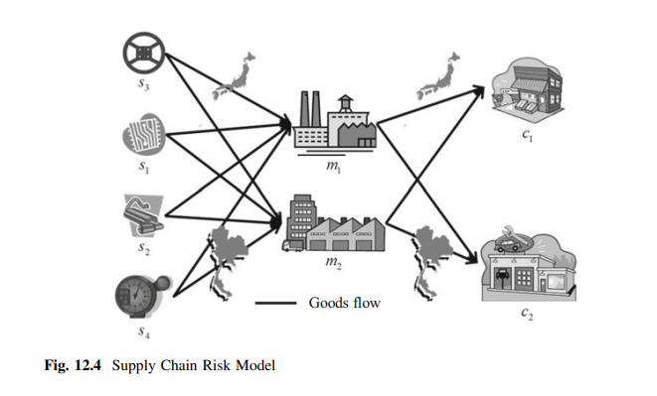
Chapter
09
Figure 12.4 shows the model, which considers supplier decentralization. This chapter supposes a global supply chain that spans two countries, a developed and a developing country, and consists of three levels: supplier, manufacturer, and customer.
Figure 12.4 shows the model, which considers supplier decentralization. supposes a global supply chain that spans two countries, a developed and a developing country, and consists of three levels: supplier, manufacturer, and customer.
www.midocean.ae

Slide 22
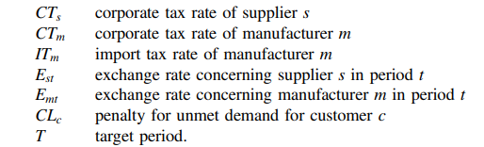
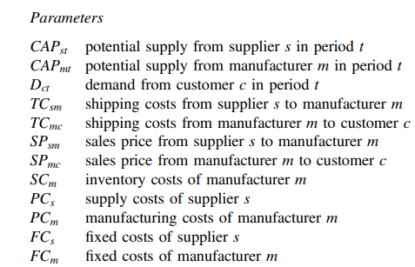
Chapter
09
www.midocean.ae

Slide 23
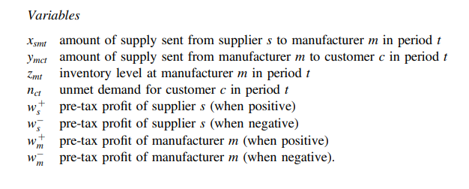
Chapter
09
www.midocean.ae

Slide 24
Chapter
09
Supply Chain Resiliency
The challenge in defining resiliency for a supply chain lies in the fact that the terms uncertainty, risk, vulnerability and resilience are often used interchangeably to define supply chain characteristics.
Supply chain uncertainty is often used in place of supply chain risk and vice versa. Some authors make a clear distinction between uncertainty and risk
www.midocean.ae

Slide 25
Chapter
09
For example natural disaster based disruptions to supply chain will have serious negative consequences however demand based disruptions may either swing towards positive or negative side. gave a clear distinction between uncertainty and risk: “if you don’t know the for sure what will happen, but you know the odds, that’s risk, and if you don’t even know the odds, that’s uncertainty.” A suitable definition for supply chain uncertainty according to.
www.midocean.ae

Slide 26
Chapter
09
Decision-making situations in the supply-chain in which the decision-maker does not know definitely what to decide as he [or she] is indistinct about the objectives; lacks information about (or understanding of) the supply-chain or its environment; lacks information processing capacities; is unable to accurately predict the impact of possible control actions on supply-chain behavior; or, lacks effective control actions (non-controllability)
www.midocean.ae

Slide 27
Chapter
09
developed three classifications of decision processes, delineated by supply chain information available; certainty, risk and uncertainty. Under certainty all parameters are deterministic and known.
The relationship between input and output is unambiguous. Decision making under risk relies on probability distributions, which govern the relation between input and output
www.midocean.ae

Slide 28
Chapter
09
Decision making under uncertainty needs to be made despite the lack of information about the likelihood of parameter changes. Most authors adopt this categorization and refer to supply chain risk as how much information is available about randomly changing supply chain parameters— assuming probability specifications are at hand. Yet information processing needs to respect the fact that supply chain scenarios are dynamic and the information contained therein has varying degree of relevance and reliability
www.midocean.ae

Slide 29
Chapter
09
Supply chain managers, however, still need to make decisions in the absence of pertinent information about the risk of a supply chain. Supply chain risk therefore addresses both decision-making under risk and decision-making under uncertainty. The type of process used to describe the development of uncertain parameters is depicted by uncertainty models
www.midocean.ae

Slide 30
Chapter
09
They distinguished between probabilistic approaches and scenario planning approaches.
While the former explicitly considers probability distributions, the latter evaluates generated sets of possible future values, which can be, but are not required to be, weighted by discrete probability values
www.midocean.ae

Slide 31
Chapter
09
In assessing supply chain risk, triggering events are modeled as a function of their severity in terms of impact on the supply chain goals and their frequency of occurrence.
Different terms are often used synonymously to refer to triggering events, e.g. disturbance , disruption , disaster, hazard or crisis.
www.midocean.ae

Slide 32
Chapter
09
a disruption is characterized by its:
probability,
severity
and effects.
A disruption is further described as a combination of the triggering event, which is characterized through frequency of occurrence and magnitude, and a consequential situation, which threatens the normal course of business operations.
www.midocean.ae

Slide 33
Chapter
09
A disruption is regarded as more severe and often persists for a longer period in time than a disturbance. combined the availability of probability information and the extent of impact related to each triggering event.
The distinguish between random, which have a single instance, hazardous events, which occur repeatedly, and uncertain events, about which very little information exists.
www.midocean.ae

Slide 34
Chapter
09
Supply Chain Risk and Vulnerability
Often in academic literature the term vulnerability is used in conjunction with the term risk. supply chain vulnerability (SCV) defined as “exposure to serious disturbance, arising from risks within the supply chain as well as risks external to the supply chain” and as “a condition that is caused by time and relationship dependencies in a company’s activities in a supply chain.”
www.midocean.ae

Slide 35
Chapter
09
SCV in relation to risk defined as “at risk; vulnerable: likely to be lost or damaged.” They suggested that supply chains link organizations, industries and economies, and hence SCV should be addressed at multiple levels of analysis.
What is “at risk” could be the performance or survival of a process, vital assets or infrastructure, an organization, an inter-organizational network, an economy, or society
www.midocean.ae

Slide 36
Chapter
09
In general, SCV is the susceptibility of the supply chain to the likelihood and consequences of disruptions and hence often coupled with risk. In some papers SCV is defined as the exposure of the supply chain to risks characteristic of any supply chain system.
SCV is a latent condition which only becomes manifest if a disruptive event occurs
www.midocean.ae

Slide 37
Chapter
09
Higher SCV is more likely to lead to a disruptive event with severe consequences. As a latent condition, SCV can be analyzed by measuring the exposure of the supply chain to environmental, supply network and organizational risks .
As a manifest condition, the impact of a supply chain disruption indicates the degree of vulnerability .
www.midocean.ae

Slide 38
Chapter
09
Supply chain resilience (SCR) addresses the supply chain’s ability to cope with the consequences of unavoidable risk events in order to return to its original operational state or to move to a new, more desirable state after being disturbed defined supply chain resilience as “the adaptive capability of the supply chain to prepare for unexpected events, respond to disruptions, and recover from them by maintaining continuity of operations at the desired level of connectedness and control over structure and function.
www.midocean.ae

Slide 39
Chapter
09
” SCR focuses on the system’s adaptive capability to deal with temporary disruptive events .These disruptions imply a certain level of turbulence and uncertainty in the supply chain .which together cause threats to the current operations Depending on the magnitude of these threatening events, the terms disruption (crisis or even disaster are used
www.midocean.ae

Slide 40
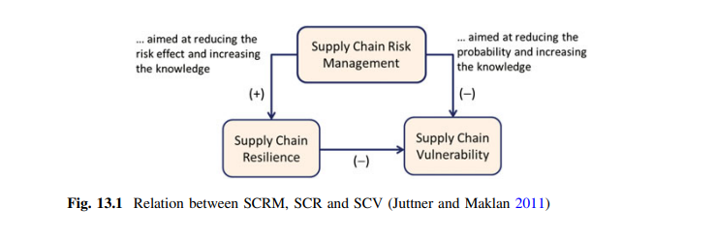
Chapter
09
In addition to how SCR is defined, we need to understand its relationship with SCV and supply chain risk management (SCRM). gave a clear relationship map between the above mentioned three concepts (see Fig. 13.1). Since lowering the impact of a supply chain disruption is also the key target of SCR, it can be assumed that both concepts are related.
www.midocean.ae

Slide 41
Chapter
09
More specifically, if SCR decreases the negative consequences of supply chain risk events by ensuring a fast return to its original or improved operation, it should, at the same time, decrease the SCV in the case of a manifest risk event
www.midocean.ae

Slide 42
Chapter
09
The main objective of SCRM is to reduce SCV and increase SCR noted that this essentially puts emphasis on managing and mitigating risk and thereby fostering resilience of the supply chain.
However, the authors also note that a supply chain risk measure does not necessarily reduce the vulnerability of the supply chain and, at the same time, increase its resilience. Likewise, a supply chain with high vulnerability could either have high or low resilience
www.midocean.ae

Slide 43
Chapter
09
If a SCRM initiative only lowers the probability of a disruptive event, the SCV, here defined as the supply chain’s latent exposure to supply chain risks, is reduced but will not necessarily have an effect on the SCR. In this sense, a supply chain risk strategy which avoids certain geographical risk areas has lowered the likelihood of a disruption caused, e.g. by political instability in the region. It has, however, not increased its capability to response to recover from a disruption if it still occurred. However, if a supply chain risk initiative successfully addresses the risk effects, the SCR increases as well
www.midocean.ae

Slide 44
Chapter
09
Components of a Resilient Supply Chain
Similarly, components of SCR are also detailed in the literature. Alternative
terminologies for SCR include: capabilities of resilient supply chain, characteristics
of resilient supply chain, and formative resilient capabilities. Sheffi and Rice (2005)
divided supply chain disruptions into three phases: (1) readiness, (2) responsiveness, and (3) recovery. In order to secure these three disruption phases, four key
resilient capabilities are frequently discussed in the literature. They are (1) flexibility, (2) velocity, (3) visibility, and (4) collaboration (Juttner and Maklan 2011
Alternative terminologies for SCR include: capabilities of resilient supply chain, characteristics of resilient supply chain, and formative resilient capabilities. divided supply chain disruptions into three phases: (1) readiness, (2) responsiveness, and (3) recovery. In order to secure these three disruption phases, four key resilient capabilities are frequently . They are (1) flexibility, (2) velocity, (3) visibility, and (4) collaboration
www.midocean.ae

Slide 45
Chapter
09
Reference
Supply Chain Risk Management Advanced Tools, Models, and Developments
By: Yacob Khojasteh
-ISBN 978-981-10-4106-8 (eBook)
Chapter 9
www.midocean.ae

Slide 46




Thank You

