Slide 1

Strategic and Operational Risk Management
Prepared by Dr. Nael Zabel
Lecture 9
PMG 630
treatment of risk

Slide 2

Lecture 9
IMPLEMENTATION OF THE ACTION PLAN
In the fourth and final step—implementation of the action plan—usually falls under the purview of the party responsible for the overall plan, for example, safety officer.
How can the plan be improved? Since this is a long-term responsibility, part the implementation is the continuous improvement of the plan.

Slide 3
Lecture 9
IMPLEMENTATION OF THE ACTION PLAN
Based on experience of which part of the plan works and which do not, based on changes internal to the system, for example, new product line and realization of new target risk events, as well as changes external to the system, for example, evolving detection and control technologies, new insurance products and services, and legal and regulatory changes.

Slide 4
Lecture 9
IMPLEMENTATION OF THE ACTION PLAN
What are the residual and emerging risks? We need to recognize that there will be no plan that can totally eliminate the target risk events, rather the plan simply reduces their likelihood or consequence to acceptable levels—these are termed as residual risks.

Slide 5
Lecture 9
IMPLEMENTATION OF THE ACTION PLAN
But due to the dynamic nature of systems, these levels need to be continually monitored and the plan must be periodically revised to keep the residual risks within acceptable level. This monitoring and periodic evaluation of the plan also enables the identification of emerging risk events—those that may have not been previously identified, or that were identified but were not deemed worth any treatment.

Slide 6
Lecture 9
RISK Treatment and Risk retention or acceptance:
An important aspect of risk treatment is the recognition that there will be more risk events than there are resources to treat them all. Even for
those risk events that are subjected to treatment, there will always be some residual risks, albeit at acceptable levels. Hence, part of the bigger picture of operational RM is the realization that it is only practical to expect some degree of risks that will have to be retained and accepted even after treatment.

Slide 7
Lecture 9
Systems Perspective On treating Risks
In Chapter 1, the importance of systems approach to managing operational risks was discussed. Here are some important notes on risk treatment based on the recognition that systems are collections of interrelated elements contributing toward a common goal and the environment wherein these systems are parts of.

Slide 8
Lecture 9
MULTICAUSAL NATURE OF RISK EVENTS
Table 4.1 provides an illustrative example of a causal chain of events leading to a particular target risk event. Even in a fairly simple real scenario, causal events may not be linear, there could be multiple ways for the target risk to occur, and some of these causes may not be easily evident.

Slide 9
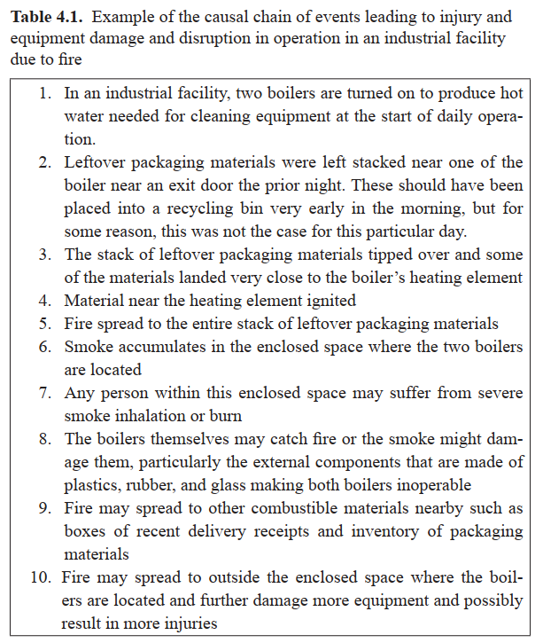

Slide 10
Lecture 9
SYNERGISTIC EFFECTS OF RISK
TREATMENT STRATEGIES:
Aside from reducing the target risks, the same set of mitigation strategies may also have the synergistic benefit of reducing other none-targeted risks whether intentional or not. As an example from segment 2 from Table 4.1, keeping floor space near the boiler free from any material may help pre-vent fire and may also prevent accidents as personnel try to use the exit door near that area.

Slide 11
Lecture 9
CREATION OF COUNTERVAILING RISKS
In contrast to having a synergistic effect, some risk treatment strategies may result in increasing other events than the target risk events. As an example from segment 9 from Table 4.1, having duplication of receipts in electronic format may also create risks of confidential data pilferage due to cyber hacking.

Slide 12
Lecture 9
RATIONALIZING COST OF TREATMENT
Similar to the traditional cost estimation and investment accounting, the cost of implementing risk treatment plans needs to be rationalizedترشيد by comparing the benefits and the costs. However, risk events are inherently uncertain and do not lend themselves to the traditional benefit–cost analysis. Thomson approach is to classify the various cost of the strategies based on (a) cost of prevention meant to reduce the chances of occurrence of risk event, (b) cost of reducing the consequence if the risk event occurs, and (c) the residual consequences of the risk event.

Slide 13
Lecture 9
BENEFITS OF RISK AVOIDANCE
A well-rationalized risk treatment plan would be one in which the benefit of avoiding some of the direct consequences of risk events are more than the sum of the cost of prevention and the cost of reduction in the consequence if the risk events occur.
However, estimating these benefits to allow comparison with the costs can be challenging.

Slide 14
Lecture 9
BENEFITS OF RISK AVOIDANCE
As an example, the traditional cost analysis may estimate cost in terms of monetary unit, while the treatment of system safety risk events may have the benefits of avoided injuries or lives saved.

Slide 15
Lecture 9
ECONOMICS OF RISK TRANSFERS
Why would someone assume the risk you are not willing to assume your-self? The underlying assumption in transferring risk is that another system, for example, insurance companies (also known as the insurer) will be willing to assume some if not all the financial burden resulting from a particular risk event in return for a predetermined amount of money such as insurance premiums from the original risk holder (the insured).

Slide 16
Lecture 9
ECONOMICS OF RISK TRANSFERS
To put it simply, this transfer of risk will happen if the insurer has the ability to pool or bring together enough of this money from many insured such that the expected payout if the risk event occurs is significantly less than the sum of the collected insurance premiums. This pooling of risks enables the insurer to operate at a profit and still satisfy its obligation for payouts to the insured.

Slide 17
Lecture 9
ECONOMICS OF RISK TRANSFERS
This is common for risk events with high consequences but low chance of occurrence. Common examples of such insurable risks are health insurance and drivers’ accident insurance in which there is enough number of those willing to pay the premium and the chance that every-one will need a payout all at the same time is very low. From a systems perspective, this highlights the wide range of environments in which the insured systems are operating.

Slide 18
Lecture 9
Risk monitoring
After identifying and assessing the risk and selecting risk treatment response plans, the next important function is risk monitoring, reporting, and review, as shown in Figure 5.1. Here the purpose is to monitor the implementation of the risk response plans and actions and evaluate the effectiveness of the current risk management processes. A key part of this function is assessing how the present risk management plans and processes can be improved to respond to the current and emerging environments.

Slide 19
Lecture 9
Risk monitoring Objectives
1. To determine whether the particular operational risks (and their causal chain of events) are under control or not. This includes tracking identified risks and checking that significant risks remain within acceptable risk levels.
2. To assess the effectiveness of the risk treatment, response plans, and actions in addressing the identified risks. This includes gaining relevant information during the monitoring and review process to further assess, control, and eliminate critical risk events.

Slide 20
Lecture 9
Risk monitoring Objectives
3. To evaluate the robustness متانهof risk controls over time as the system evolves. This also includes monitoring residual risks, identifying gaps and new risks.
4. To keep track of the evolving needs الاحتياجات المتطورة and requirements of the systems.

Slide 21
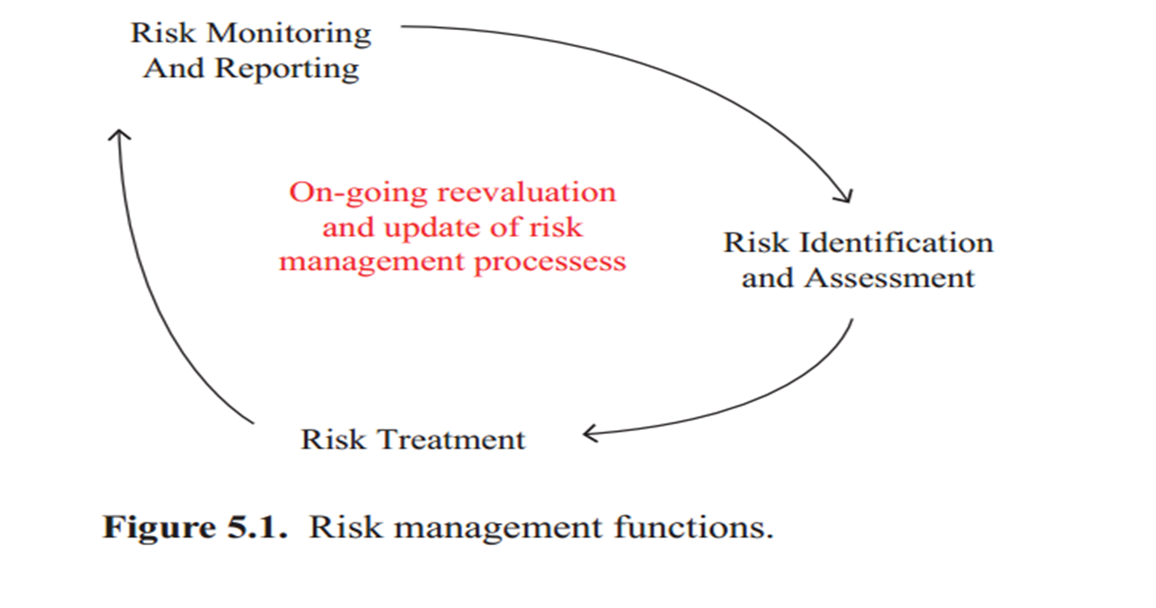
Lecture 9
Risk monitoring

Slide 22
Lecture 9
Risk monitoring
Monitoring and management of risks is one of the main elements in the risk treatment and risk management process. There is no one specific methodology or process that can be applied to monitor operational risks in all systems. For example, monitoring operational risks in a bank is different from monitoring operational risks in a production system.

Slide 23
Lecture 9
Risk monitoring
• Performance monitoring requires both an understanding of the context of the risk event and the methodology used for the performance monitoring as well as an appreciation of the uniqueness of the operational risk of the system.

Slide 24
Lecture 9
Risk monitoring
• For a reliable monitoring process, comprehensive treatment and assessment of risk events are necessary. It is essential to have a clear set of definitions of the operational risk under monitor. This includes identifying the appropriate risk indicators.

Slide 25
Lecture 9
Risk monitoring
• The development of flexible methodology to accommodate any adjustment or changes in the system. It is naive ساذجto consider that the operation environment is always static, and therefore, operational risk can be controlled or avoided in the systems all at once.

Slide 26
Lecture 9
Risk monitoring
• Full appreciation of the surrounding environments where systems operate. It is essential to understand the nature of the operations’ environment. In the static environment, the system is bounded apart from the environment, which means that there is no or minimal interaction between the system and the environment.

Slide 27
Lecture 9
Risk monitoring
In the dynamic environment, there is continuous interaction between the system and the environment. While it is relatively easy to monitor the operational risk in a static environment, it is a much more difficult task in a turbulent shifting environment.

Slide 28
Lecture 9
The Baseline: Risk Management Plan
The culmination تتويجof the risk processes discussed in Chapters 1 to 4 is a document often called the risk management plan. This report typically becomes the baseline for any risk monitoring process. In general, the report should include the following parts.

Slide 29
Lecture 9
The Baseline: Risk Management Plan
1. Description of the scope of the risk management plan (refer to
Chapter 2)
2. Risk identification and assessment (refer to Chapter 3)
3. Risk treatment, response, and action plan (refer to Chapter 4)

Slide 30
Lecture 9
The Baseline: Risk Management Plan
The risk management plan is essentially a compilation of the broader system’s risk profile or risk portfolio. Note that the report should cover the 6 + 1 questions (Table 2.1) as discussed in Chapter 2. It defines the scope of the risks being tracked and quantifies or measures the risks in terms of their estimated likelihood and impacts.

Slide 31
Lecture 9
The Baseline: Risk Management Plan
It should further describe established acceptable risk level (i.e., As Low as Reasonably Practicable [ALARP] from Chapter 3) and detail the treatment response plans and actions for each identified risks. Included in the plan are the processes established for detecting, tracking, and documenting risks, as well as persons responsible for each risk response and actions.

Slide 32
Lecture 9
Tracking: Risk Database
The most common database compiled for risk is what is known as the risk register or risk log. The database and information requirements are extracted from the risk management plan. It often replicates or digitizes the tabular forms in Chapter 3. Though, more importantly, the risk register tracks the actual occurrences of the risk events.

Slide 33
Lecture 9
Tracking: Risk Database
Further, the risk register can document conditions leading up to the risk event, the response and actions taken, as well as the actual outcomes. The specifics are often included in an incident report. An incident report or accident report is a form that is filled out in order to record the details of the risk event.

Slide 34
Lecture 9
Tracking: Risk Database
Other types of risks such as cost risk, schedule risk, programmatic risk, and technical risk have certain indicators that may be used to monitor status for signs of risk. Tracking the progress of key system parameters can be an indicator of risk or key risk indicator (KRI).

Slide 35
Lecture 9
Tracking: Risk Database
The risk register when translated into a digital database or information architecture offers several enhanced functions. A database can handle the recording and compilation of detailed historical risk information. Also, a database can enable automated tracking and signaling. It can be used to identify risks that are within acceptable levels, risks that are out of control, and risks that are trending toward out of control. These KRIs can be captured and stored as digital data to be used for future planning and decision making.

Slide 36
Lecture 9
Tracking: Risk Database
Further, the risk database should track the implementation of treatment and response plans, plans that are implemented, plans that are not implemented or partially implemented (including schedules and milestones), as well as their costs and effectiveness in addressing the risks (including any instances of over controlled risks). Figure 5.2 shows a screenshot example of a simple risk database.

Slide 37
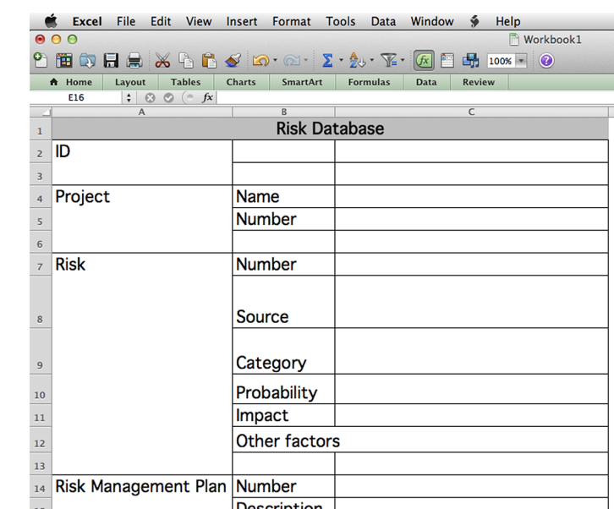

Slide 38
Resources:
Operational Risk Management
C. Ariel Pinto
Luna Mylene Magpili
Raed M. Jaradat
Chapter 4

