Slide 1


Prepared by Dr. Omar Al-kasasbeh
FNT 615
Finance Concepts
Lecture 0

Slide 2



Finance Concepts
FNT 615
Finance Concepts
Lecture 0
Prepared by
Dr. Omar Al-kasasbeh
www.midocean.km

Slide 3
Lecture
Introduction to Finance
1
1. Understand the importance of Finance in an Organization.
2. Gain insights into the various Concepts of Time and Value.

Slide 4
Lecture
1

Slide 5
Lecture
Economic Foundations: Money and Rates
2
Understand the principles of Microeconomics and Macroeconomics.
Explain mechanisms of Business Cycles and Economic Activity.
Study foreign exchange rate systems.
Identify reliable and official sources and characteristics of economic data.

Slide 6
Lecture
2

Slide 7
Lecture
Financial Markets
3
Explain the structure and main functions of financial markets.
Differentiate between the major types of financial markets and instruments.
Analyze the role of financial markets in facilitating capital formation and economic growth.

Slide 8
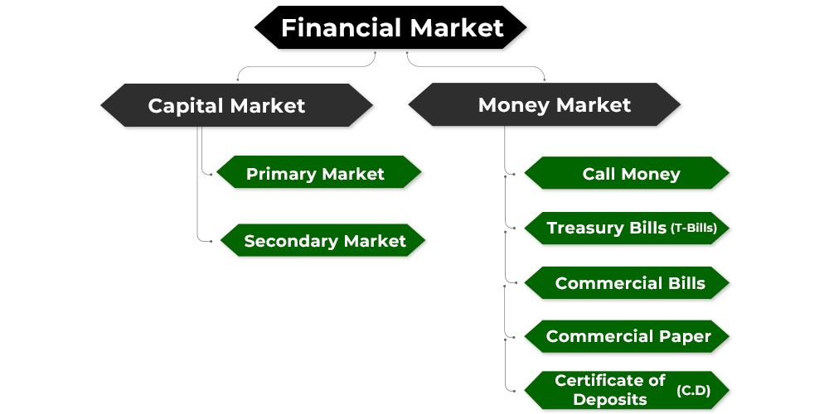
Lecture
3

Slide 9
Lecture
Financial Statements
4
Understand the structure and purpose of the Income Statement.
Explain the components and significance of the Balance Sheet.
Analyze the Statement of Cash Flows and its importance in assessing liquidity.

Slide 10
Lecture
4

Slide 11
Lecture
Time Value of Money
5
1. Understand the basic principles of the Time Value of Money (TVM).
2. Apply methods to solve Time Value of Money problems.
3. Explain applications of Time Value of Money in finance.

Slide 12
Lecture
5

Slide 13
Lecture
The Meaning and Measurement of Risk and Return
6
Compare the historical relationship between risk and rates of return in capital markets.
Explain the relationship between an investor’s required rate of return and the riskiness of an investment.

Slide 14

Lecture
6

Slide 15
Lecture
Bonds and Stocks
7
Understand characteristics of bonds and the principles of bond valuation.
Use the yield curve to analyze interest rates and investment decisions.
Apply multiple approaches to stock valuation.

Slide 16
Lecture
7

Slide 17
Lecture
The cost of capital
8
Understand the concepts underlying the
firm’s cost of capital.
2. Evaluate the costs of the individual
sources of capital.

Slide 18
Lecture
8

Slide 19


Thank You

