Slide 1


Research Title
AI Impact on Crowd Management Using CCTV Footage in Riyadh Metro Operations
Prepared By:
Waleed ABDELGAWAD, M.Sc. AI
ID/253002839
Dr. Amjad Qataish

Slide 2
Introduction
Urban Metro Systems and Effective Crowd Management
The expansion of metro systems necessitates advanced AI solutions for efficient crowd management in urban environments.

Slide 3
The current reliance on human operators for monitoring CCTV footage in the Riyadh Metro presents significant challenges. Operators often juggle multiple video streams simultaneously, leading to increased complexity and fatigue. This situation results in delayed detection of congestion or unusual crowd behavior, ultimately compromising passenger safety and operational efficiency. To address these issues, there is a pressing need for advanced AI-based CCTV analytics that can provide real-time, scalable, and reliable crowd management solutions.
Problem
Statement

Slide 4
Research Objectives for Enhanced Crowd Monitoring
Improve Real-time Insights
Optimize Operational Efficiency
Ensure Ethical Deployment
Leverage AI to enhance real-time monitoring capabilities, enabling immediate insights into passenger flow and crowd dynamics during peak hours.
Address ethical considerations and privacy concerns surrounding AI surveillance, promoting responsible usage and governance in Riyadh Metro operations.
Evaluate AI-driven analytics to streamline operations, ensuring timely responses to congestion and abnormal behaviors while maintaining service continuity.

Slide 5
Research Contributions
This research connects AI theory with real-world challenges in metro operations, enhancing the understanding of crowd dynamics through innovative analytics and operational frameworks.
The findings provide practical guidance for transportation authorities to integrate AI solutions effectively, balancing performance with ethical considerations and sustainable governance for metro systems.
Additionally, the study offers a structured approach for scaling AI-based crowd monitoring, addressing both technical limitations and deployment challenges to improve safety and efficiency in Riyadh Metro.

Slide 6
The Role of AI in Modern Metro Systems
AI enhances operational efficiency by enabling proactive crowd management, predictive maintenance, and improved passenger experiences in metro systems.

Slide 7
The Role of Computer Vision in Crowd Management
Computer vision automates CCTV analytics, enabling real-time interpretation of crowded metro environments for enhanced operational performance.

Slide 8
Dynamic Flow Analysis
Improving Transfer Station Efficiency
This study models passenger flow using CCTV and real-time data, demonstrating how AI can enhance operational efficiency by reducing dwell time and optimizing staffing strategies at transfer stations.

Slide 9


Common Themes and Divergences
Common Connections
Conflicting Approaches
All studies emphasize real-time monitoring for crowd dynamics.
Different methods highlight trade-offs in model accuracy.

Slide 10

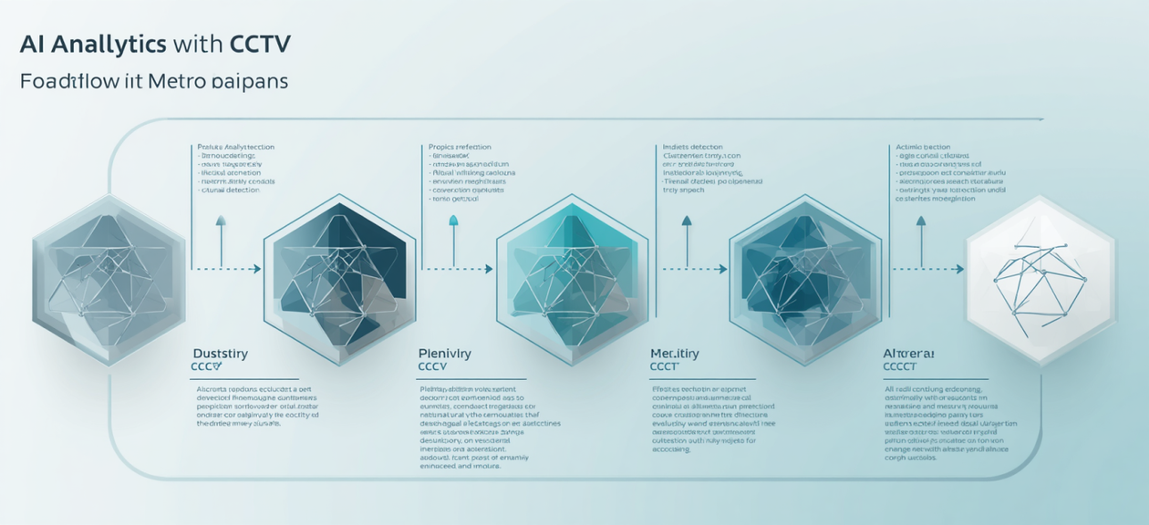
Data source
1. CCTV video
2. AFC data and sensors: For validating passenger
3. Operational data: Incident data and dwell time.

Slide 11


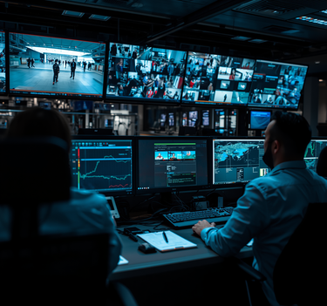

Future Enhancements for AI
Real-time Analytics
Operator Training
Privacy Considerations
Integration Framework
Implementing faster data processing for immediate insights.
Enhancing skills for utilizing AI-driven insights effectively.
Developing strategies to protect passenger data integrity.
Establishing protocols for seamless AI deployment and operation.

Slide 12

CCTV and Metro Operations
Metro Surveillance
Enhancing security through intelligent monitoring systems.

Slide 13



Comparative Literature Review for 15 Papers

Slide 14
Comparative Analysis Table Among Papers

Slide 15
Comparative Analysis Table Among Papers

Slide 16
Comparative Analysis Table Among Papers

Slide 17
Comparative Analysis Table Among Papers

Slide 18
Comparative Analysis Table Among Papers

Slide 19
Comparative Analysis Table Among Papers

Slide 20
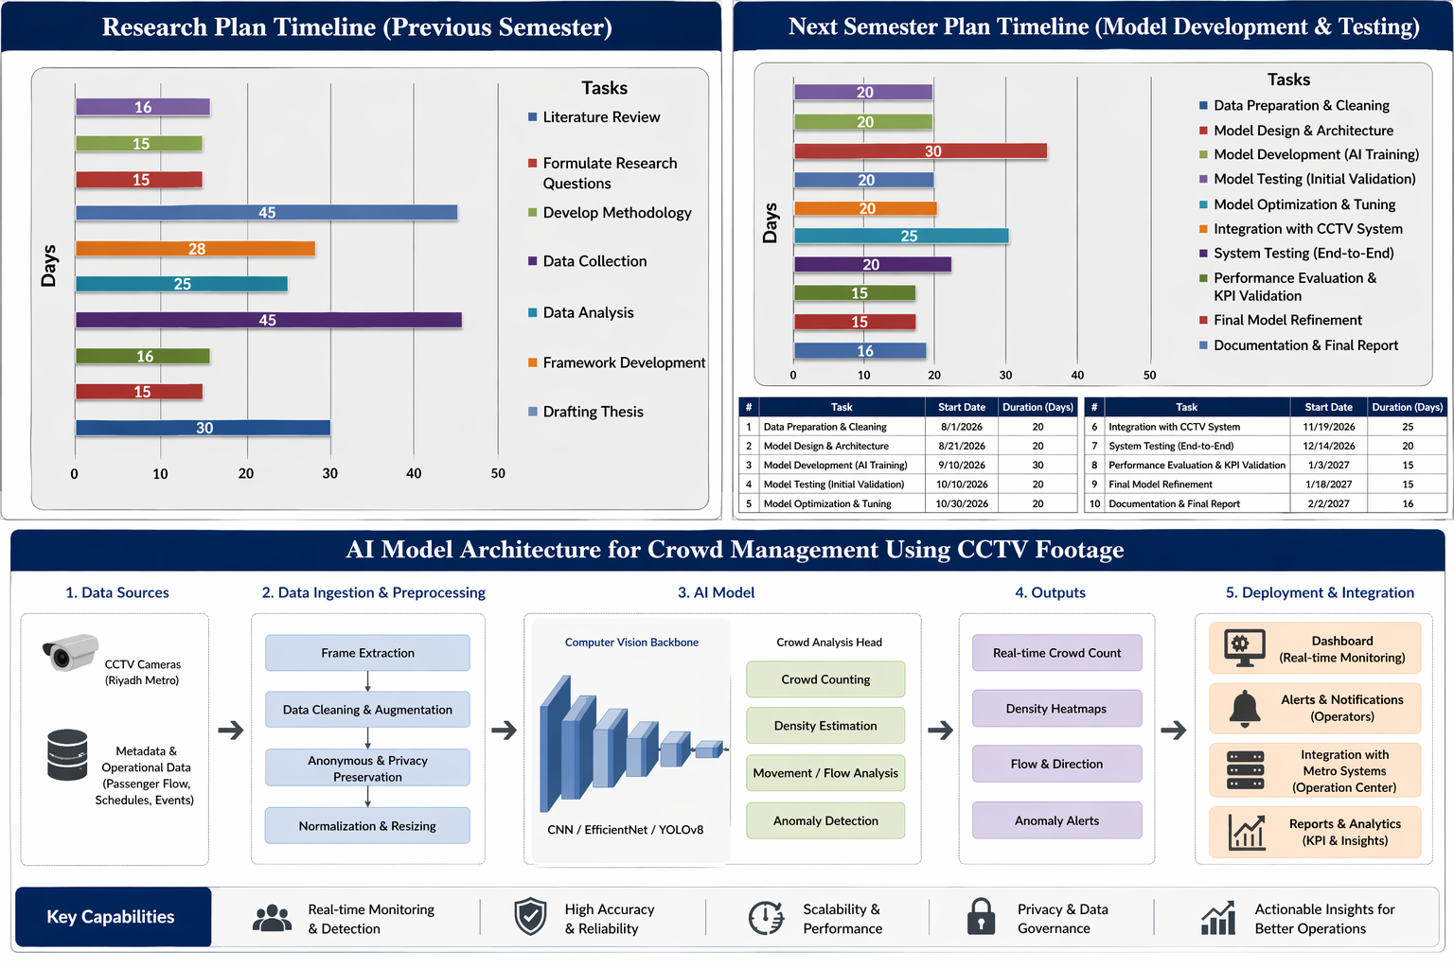

Slide 21
The implementation of AI-based CCTV analytics is anticipated to significantly enhance operational efficiency in Riyadh Metro. By improving real-time detection of congestion and movement anomalies, the system should reduce response times and enhance situational awareness for operators. Expected results will include measurable improvements in passenger flow management, increased safety, and higher operational reliability. This discussion will address the balance between technical accuracy and practical usability to ensure effective deployment in dynamic metro environments.
Expected Outcomes

Slide 22
Thank You
Questions and discussion are welcome
EMAIL
253002839@st.midocean.edu.km
PHONE
+966-537115213
SOCIAL MEDIA
https://www.linkedin.com/in/waleed-abduljawad-99a418a8/

