Slide 1



English Language 1
Prepared by Ahmed Soliman
ENG 101

Slide 2



English Language 1
Introductory Lecture
ENG 101
Prepared by
Ahmed Soliman
www.midocean.ae

Slide 3
Who Am I?
Ahmed Soliman
Former Assistant Lecturer, Faculty of Languages and Translation, Badr University in Cairo (BUC).
Former Foreign Language Teaching Assistant, The University of Kansas, USA.
Part-time ESL Instructor, School of Continuing Education, The British University in Egypt.
Former Supervisor of English, Real Soft House Company.
www.midocean.ae

Slide 4
Main Aims of the Course
This course aims to:
Develop basic skills to deal with people in business situations
Increase knowledge of key business concepts worldwide
Manage and actively participate in meetings
Write and read basic business emails
Expand vocabulary related to general business situations
Develop confidence to deal with people and basic issues in the business world
www.midocean.ae

Slide 5

Learning Resources
Required Textbooks
Market Leader Elementary 3rd Edition COURSE BOOK
Market Leader 3rd Edition Elementary Practice File
Essential References
A Dictionary
www.midocean.ae

Slide 6
About the Coursebook
Market Leader is a multi-level business English course for businesspeople and students of business English. It has been developed in association with the Financial Times, one of the leading sources of business information in the world. It consists of 12 units based on topics of great interest to everyone involved in international business.
www.midocean.ae

Slide 7
Course Content
List of Topics | Week No.
Unit 1: Introductions | 2nd
Unit 2: Work and Leisure | 3rd
Unit 3: Problems | 4th
Unit 4: Travel | 5th
Unit 5: Food and Entertaining | 6th
Unit 6: Buying and Selling | 7th
Unit 7: People | 8th
Unit 8: Advertising | 9th
Unit 9: Companies | 10th
www.midocean.ae

Slide 8
Assessment
Short Exams (Quizzes) 80%
10 weekly quizzes ( open on Saturday at 10:00 PM KSA Time and close next Saturday at 9:00 PM KSA Time).
The duration of each quiz is 24 minutes (3 minutes for each question)
Each quiz includes 8 questions (8 Marks)
Final Exam 20%
www.midocean.ae

Slide 9

Assessment
www.midocean.ae

Slide 10
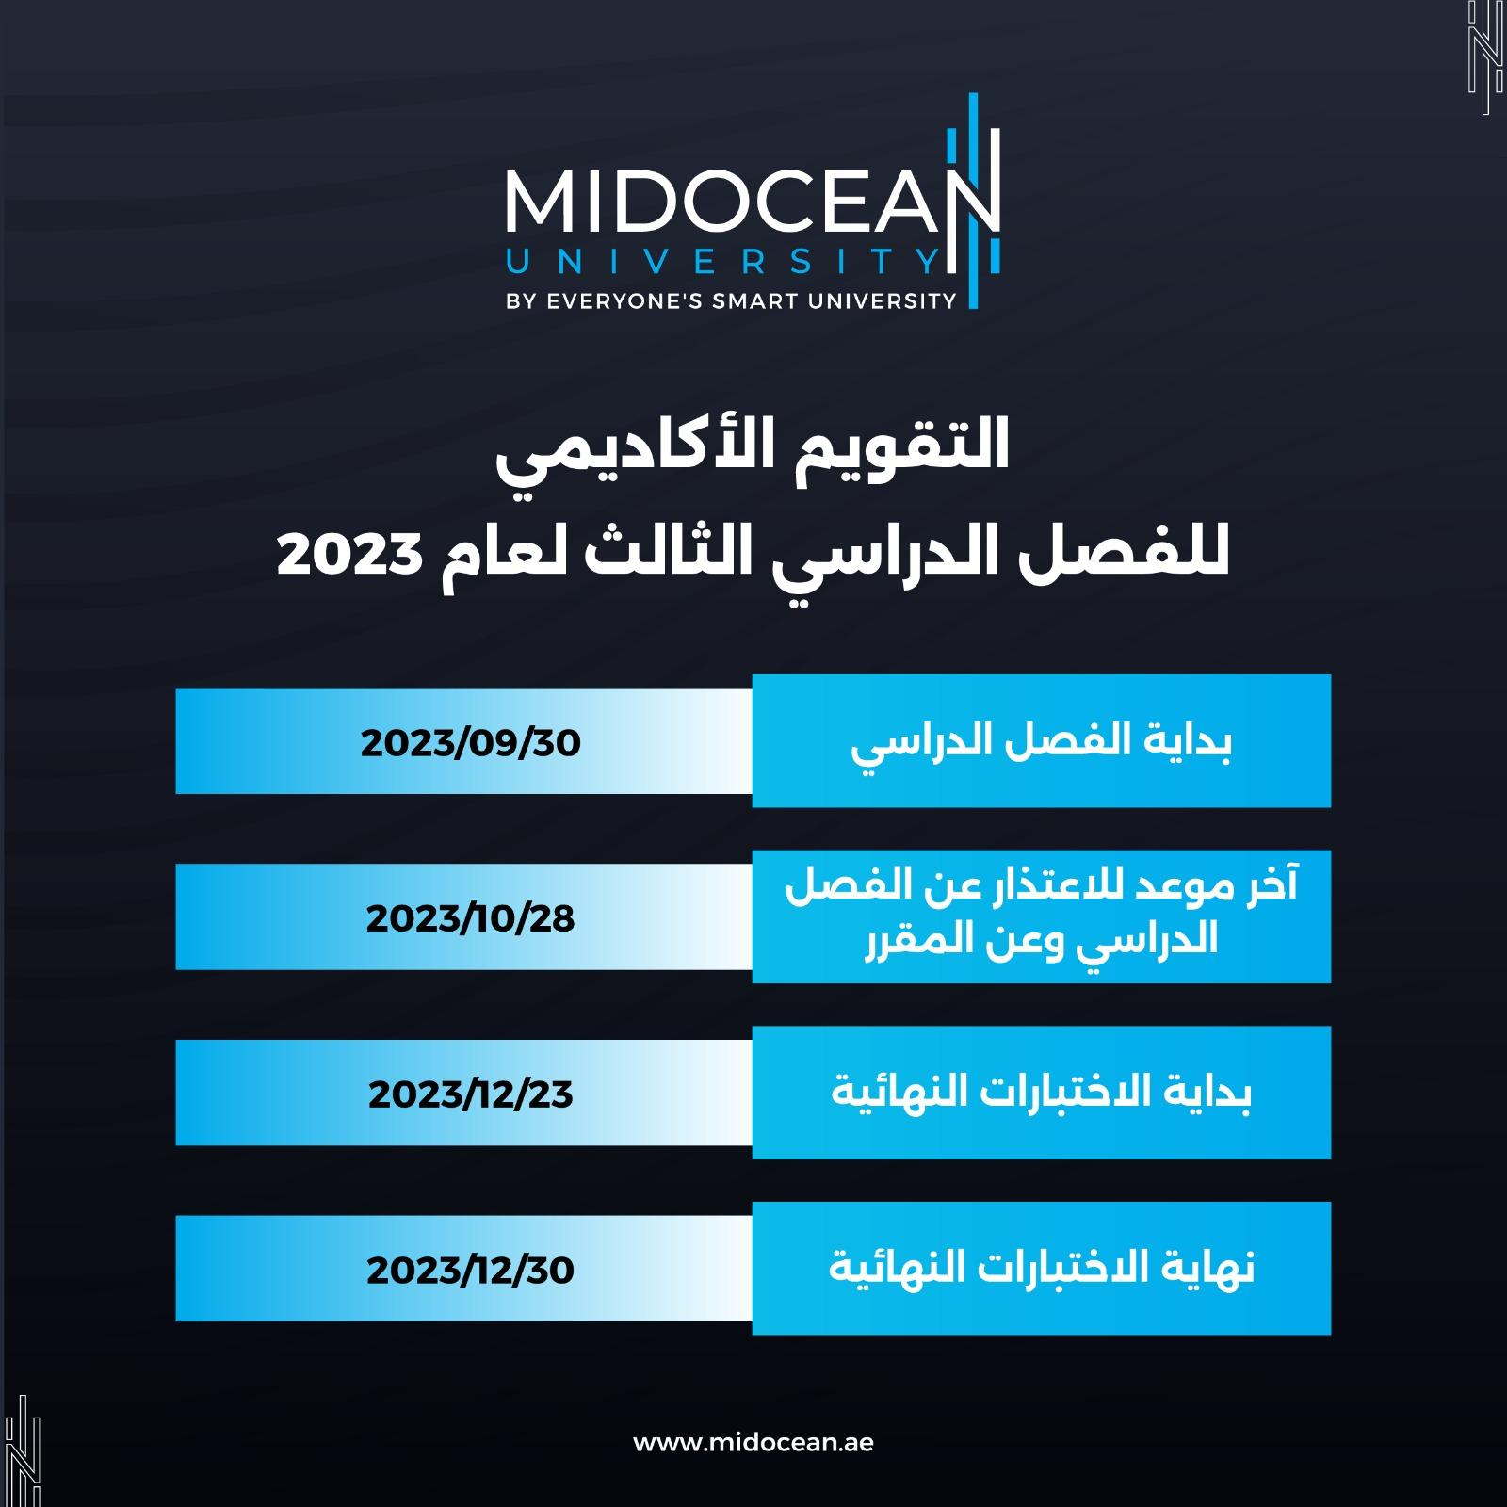
Academic Calendar
www.midocean.ae

Slide 11
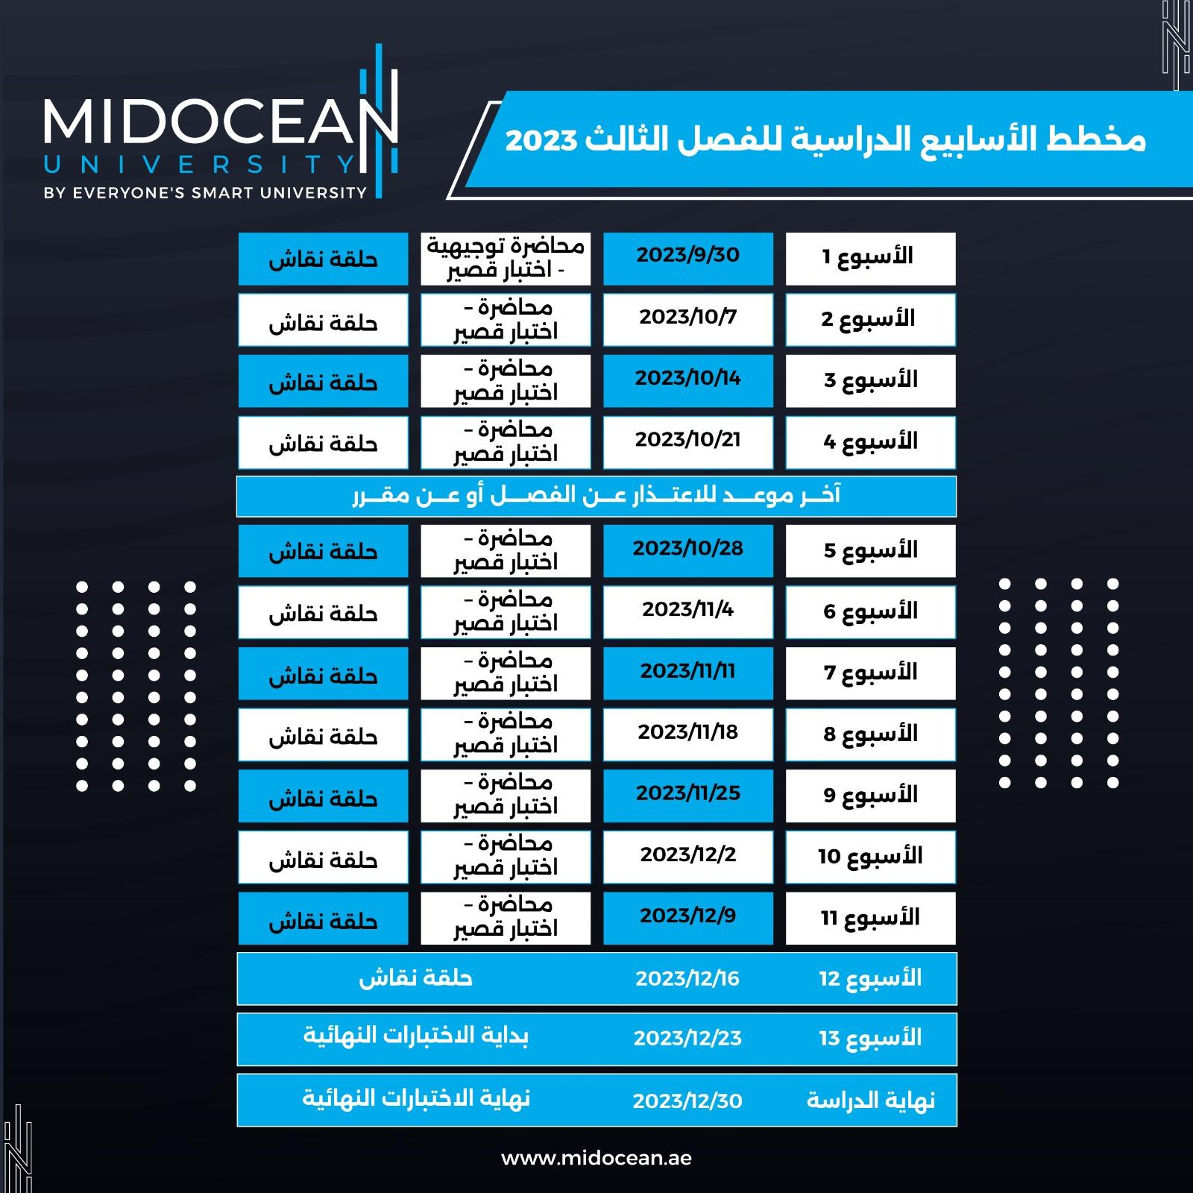
Academic Calendar
www.midocean.ae

Slide 12

Zoom Discussion
Wednesday (6:30 - 7:30)
Zoom Discussion
www.midocean.ae

Slide 13


Thank You

