Slide 1
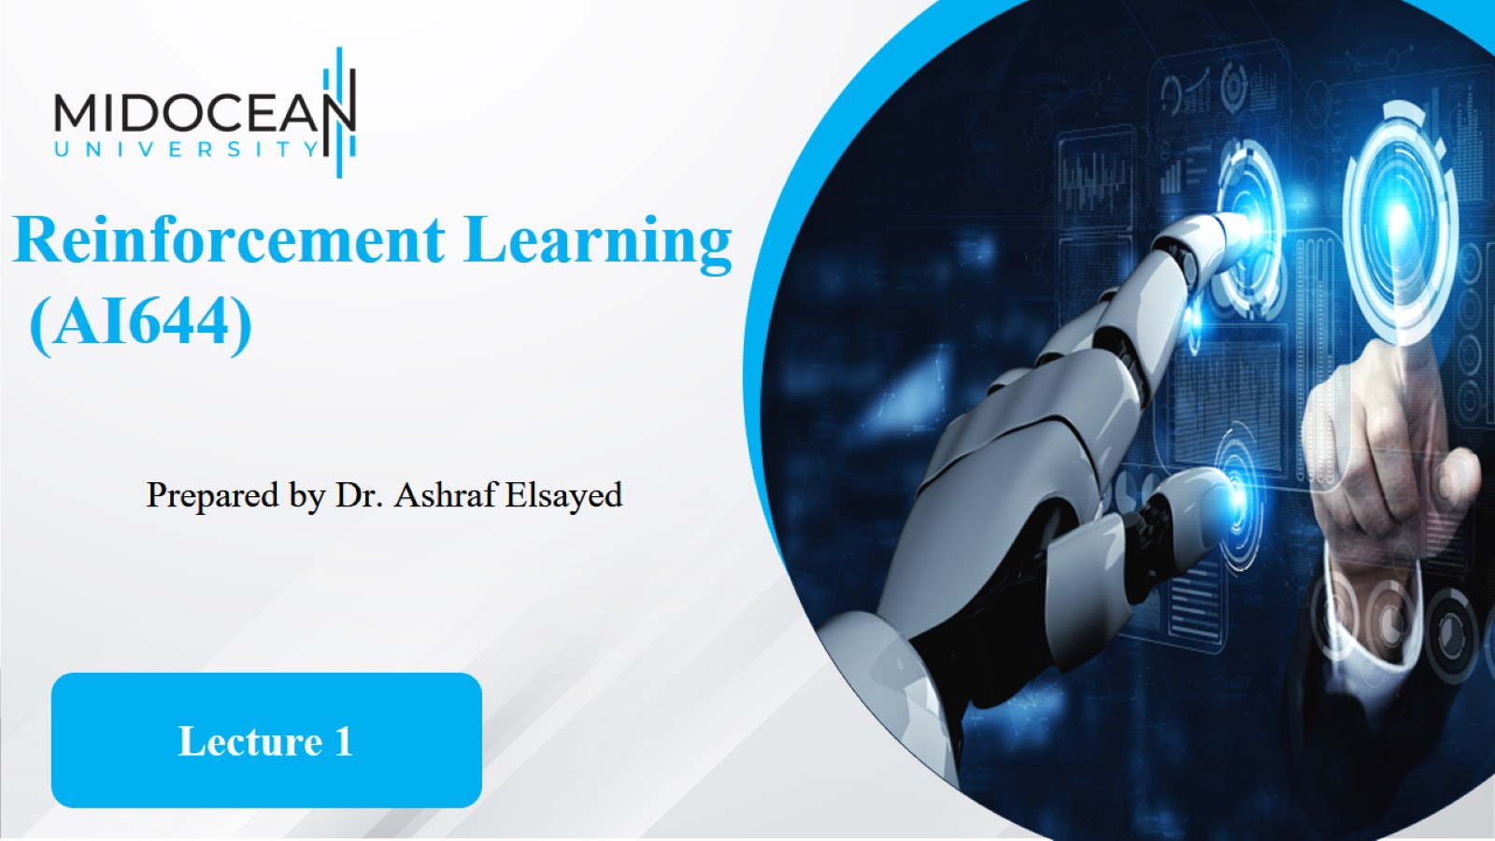

Slide 2


Slide 3
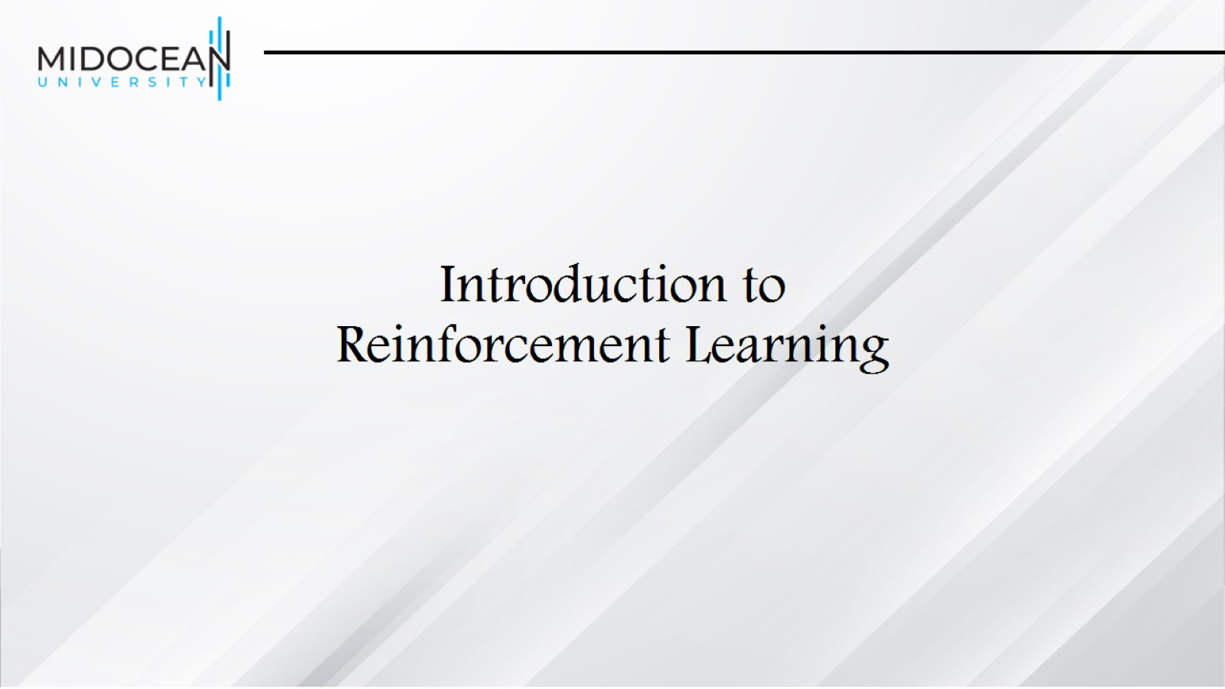
Introduction to
Reinforcement Learning

Slide 4
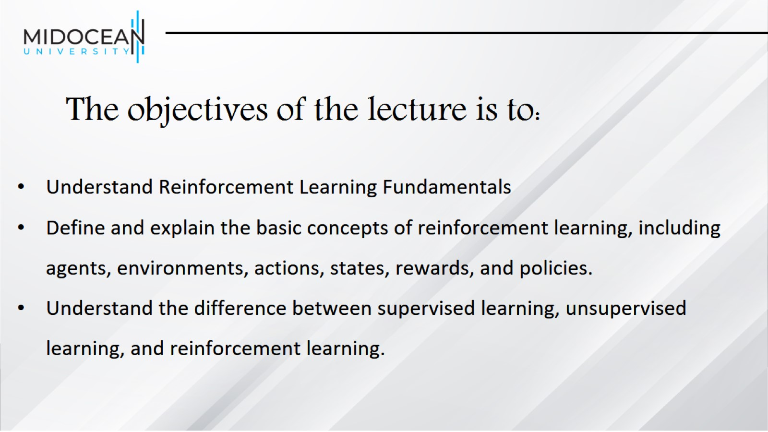
The objectives of the lecture is to:

Slide 5
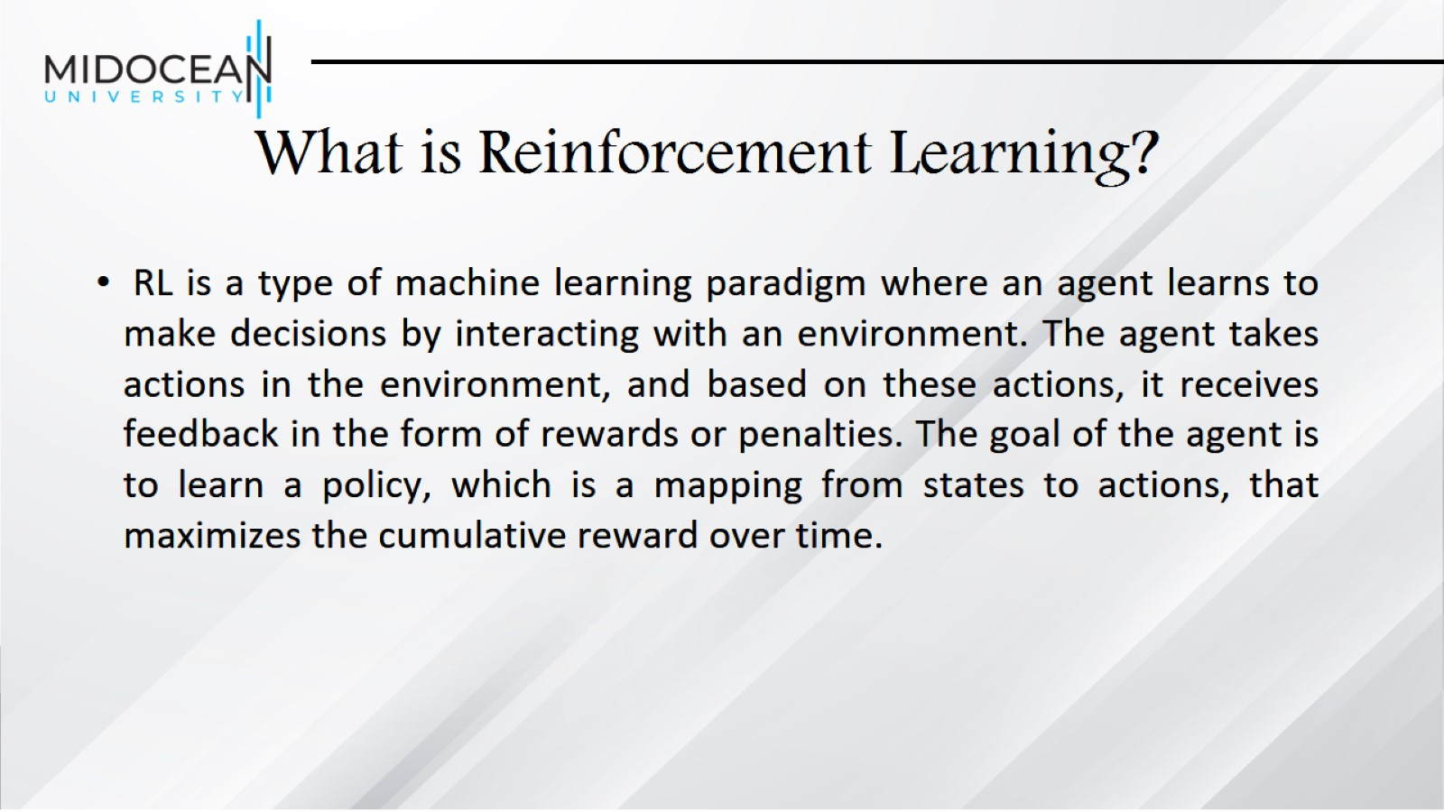
What is Reinforcement Learning?

Slide 6
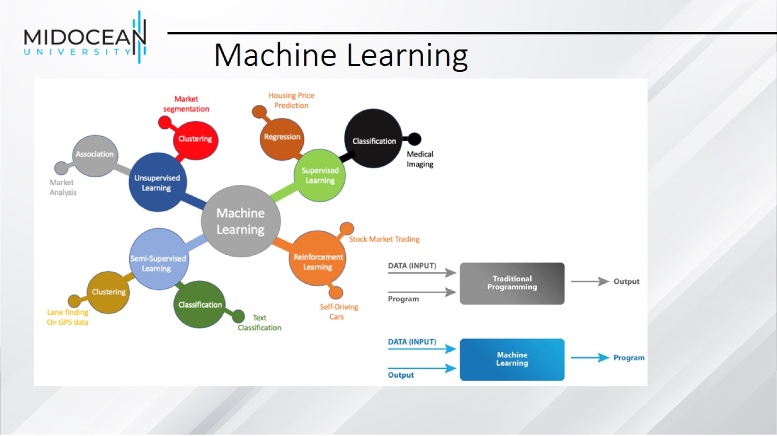
Machine Learning

Slide 7
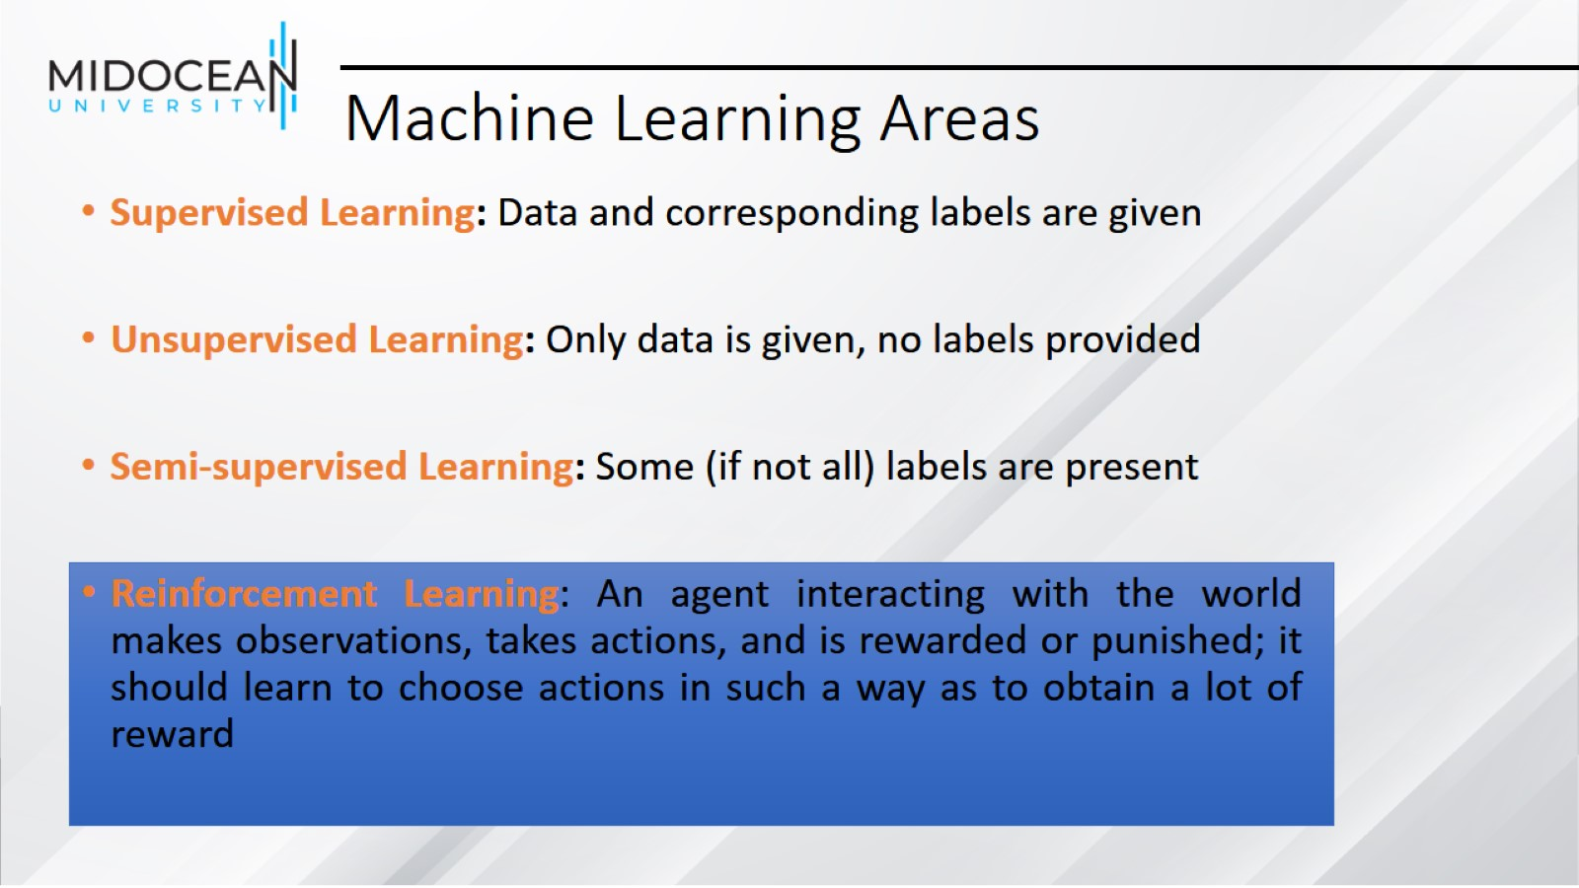
Machine Learning Areas

Slide 8
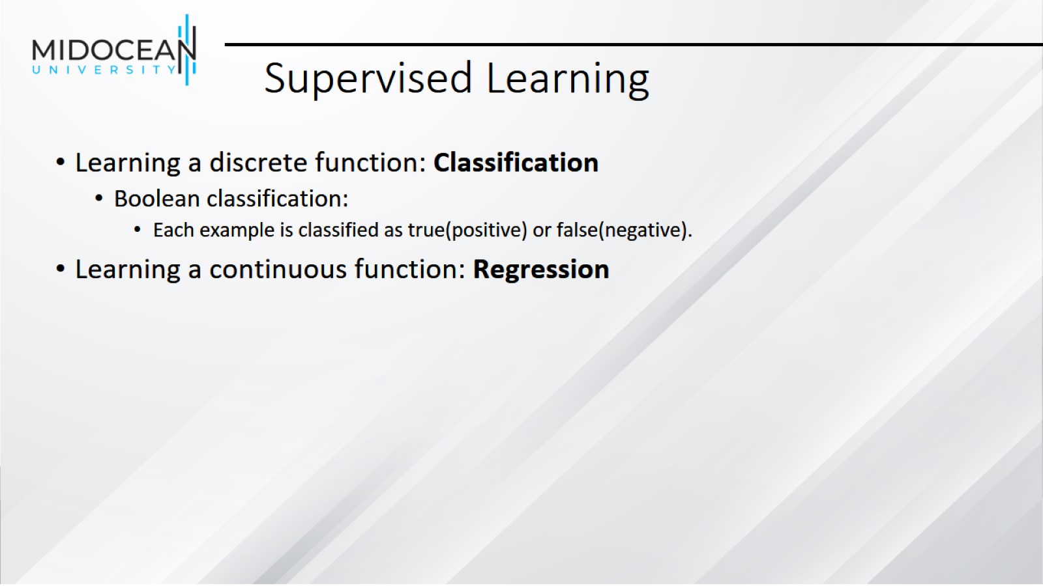
Supervised Learning

Slide 9
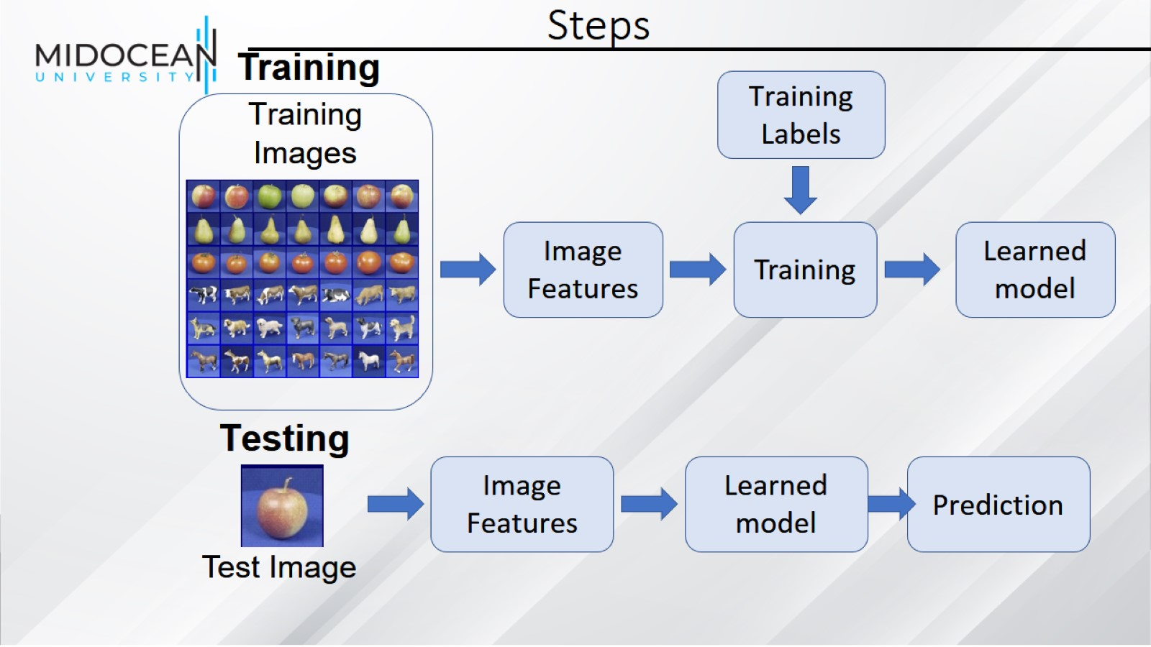
Steps

Slide 10
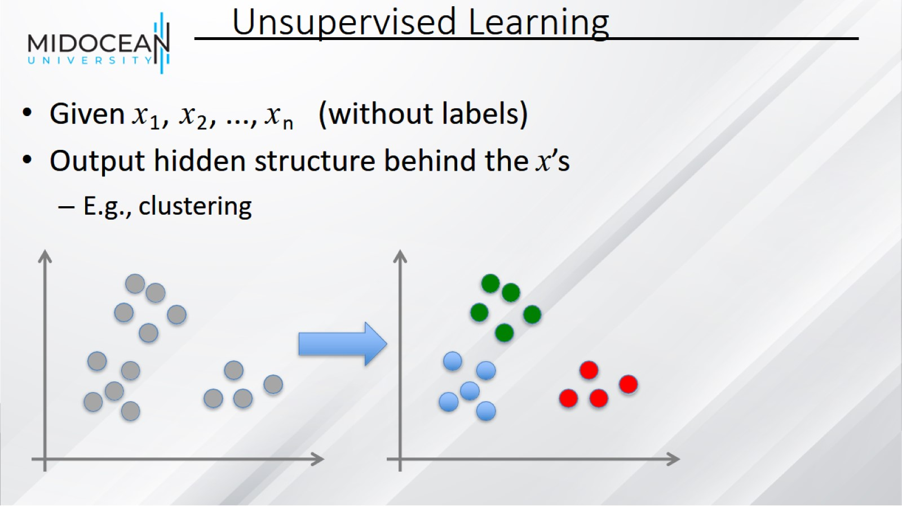
Unsupervised Learning

Slide 11
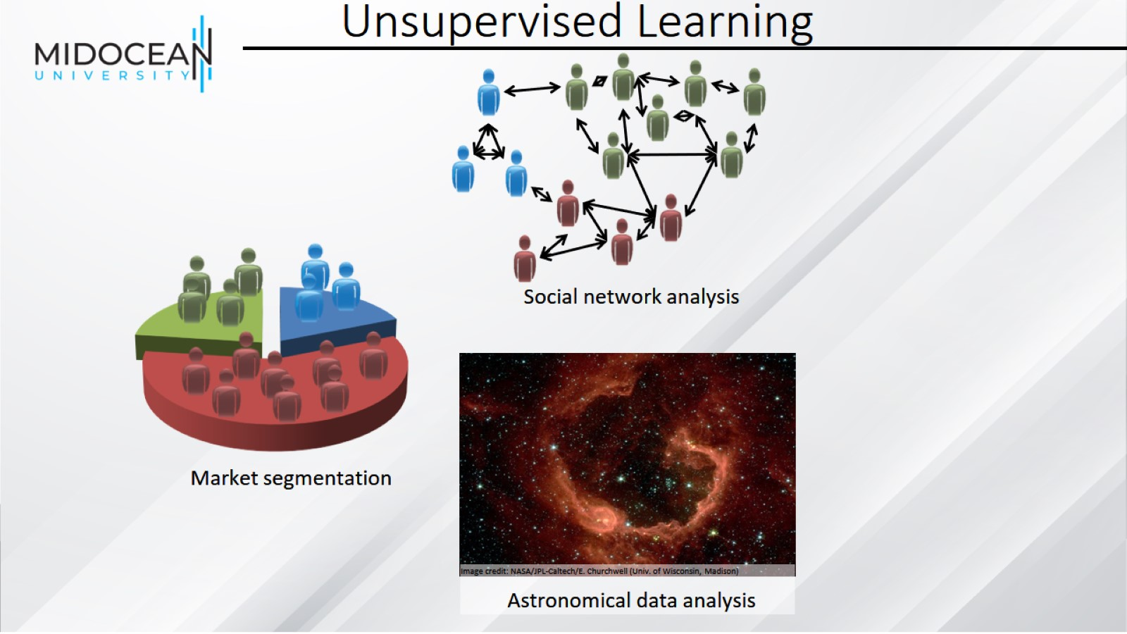
Unsupervised Learning

Slide 12
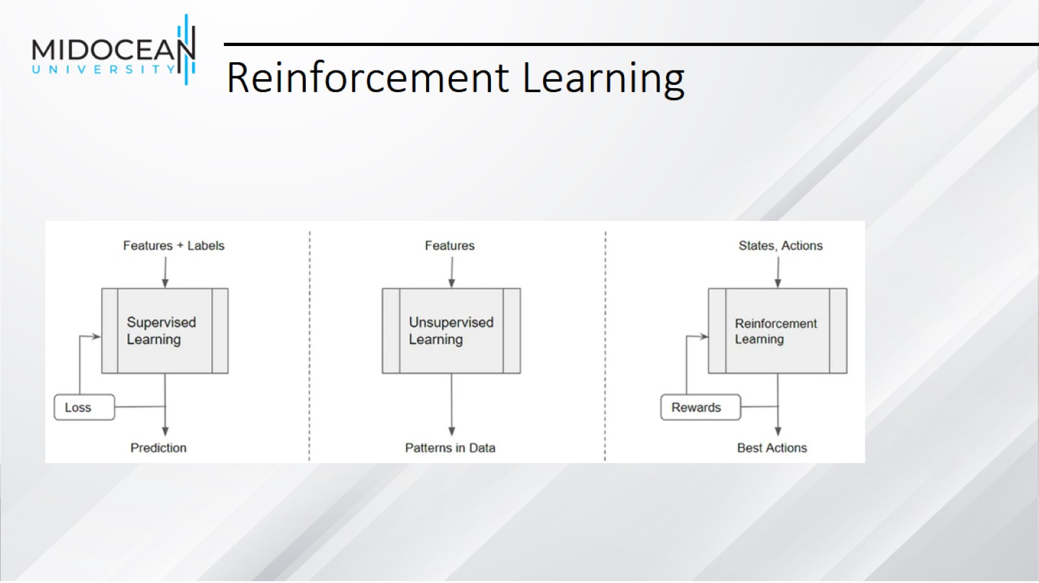
Reinforcement Learning

Slide 13
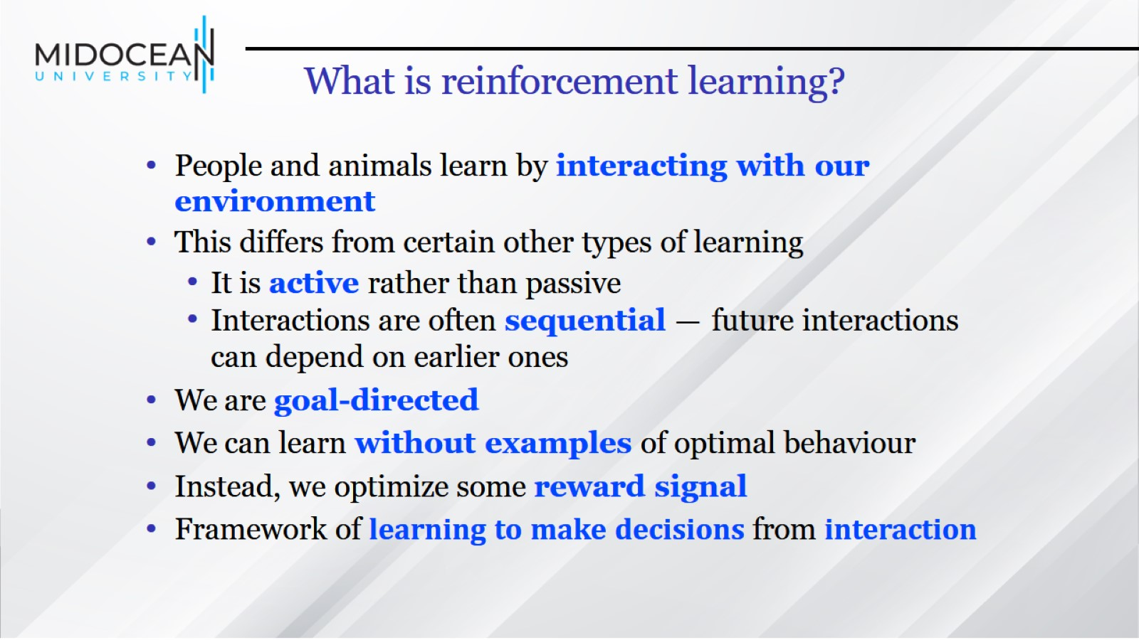
What is reinforcement learning?

Slide 14
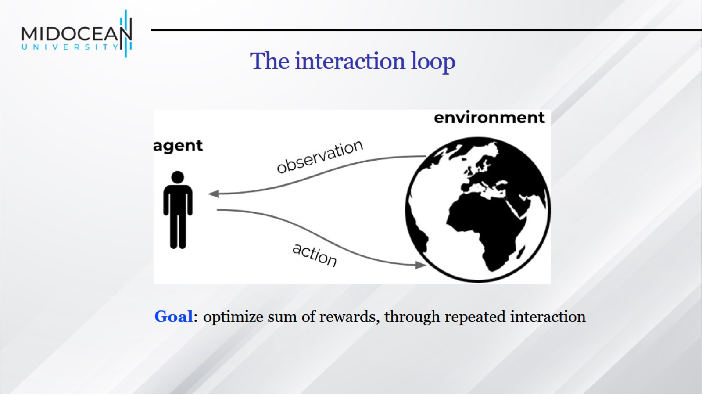

Slide 15
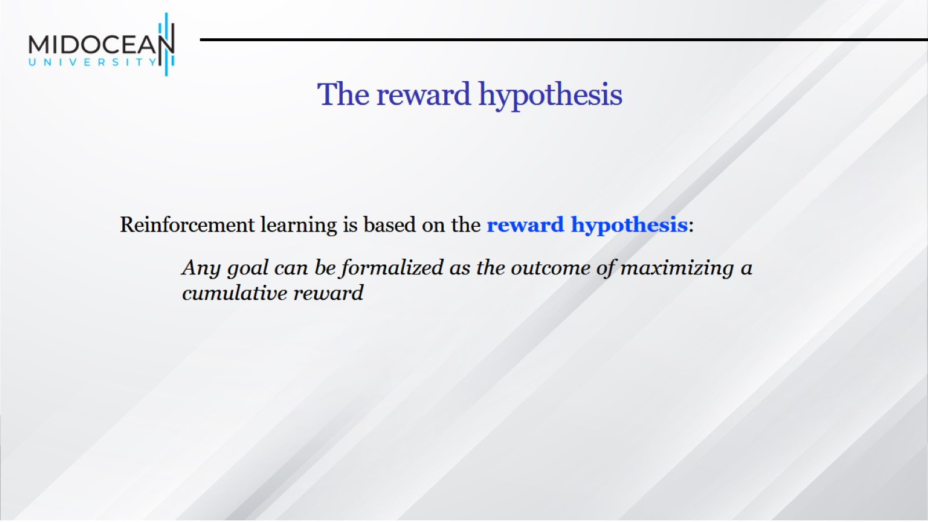

Slide 16
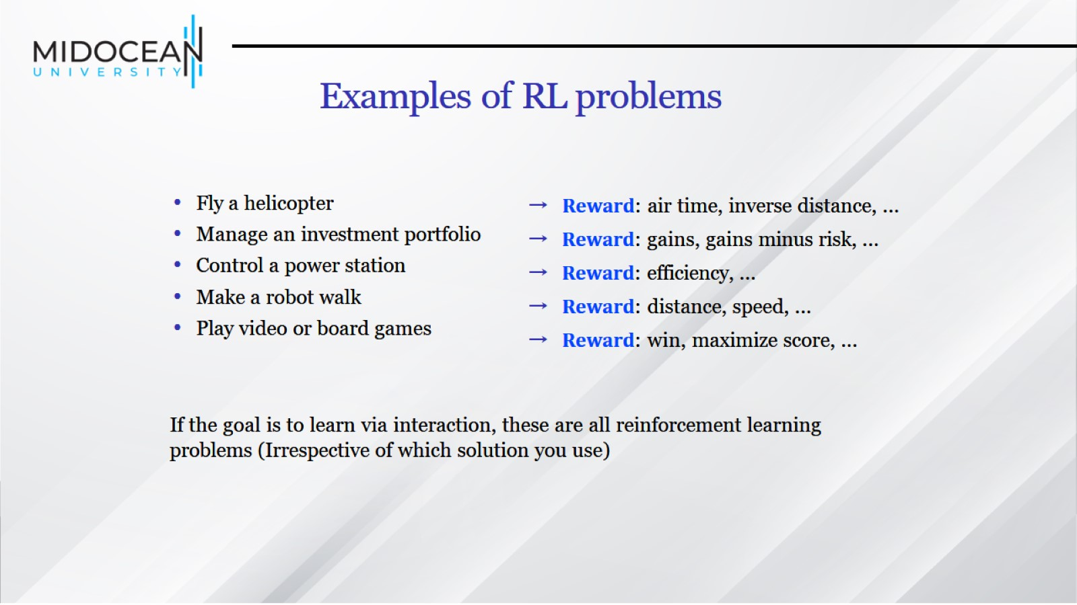
Examples of RL problems

Slide 17
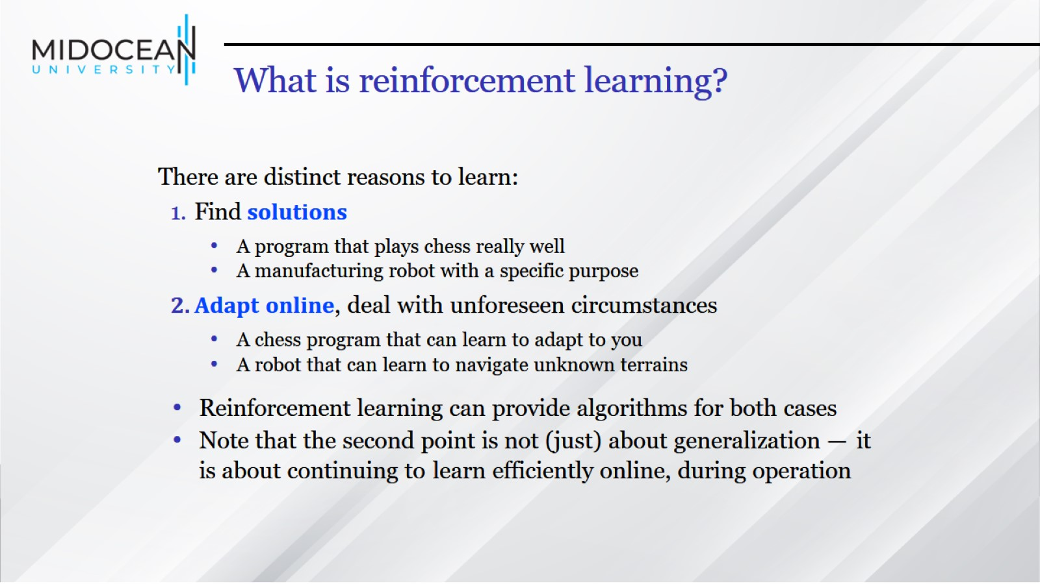
What is reinforcement learning?

Slide 18
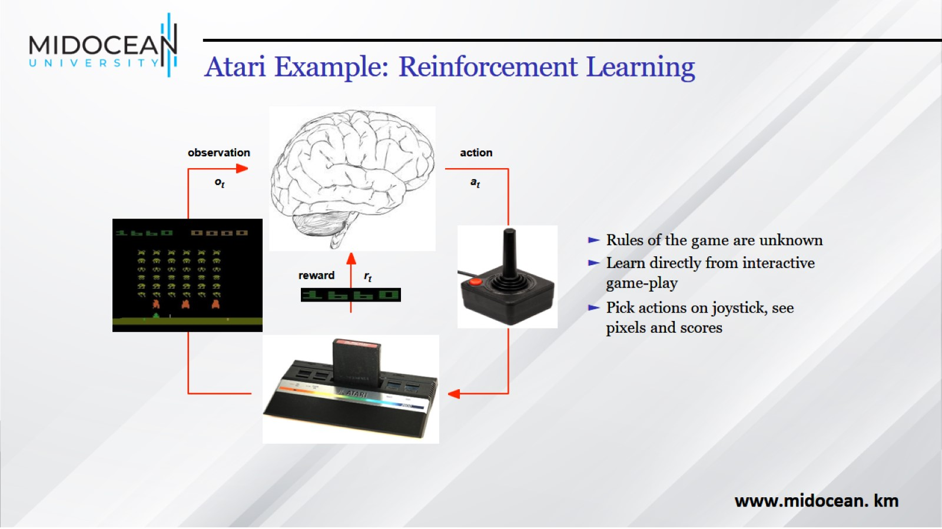
Atari Example: Reinforcement Learning

Slide 19
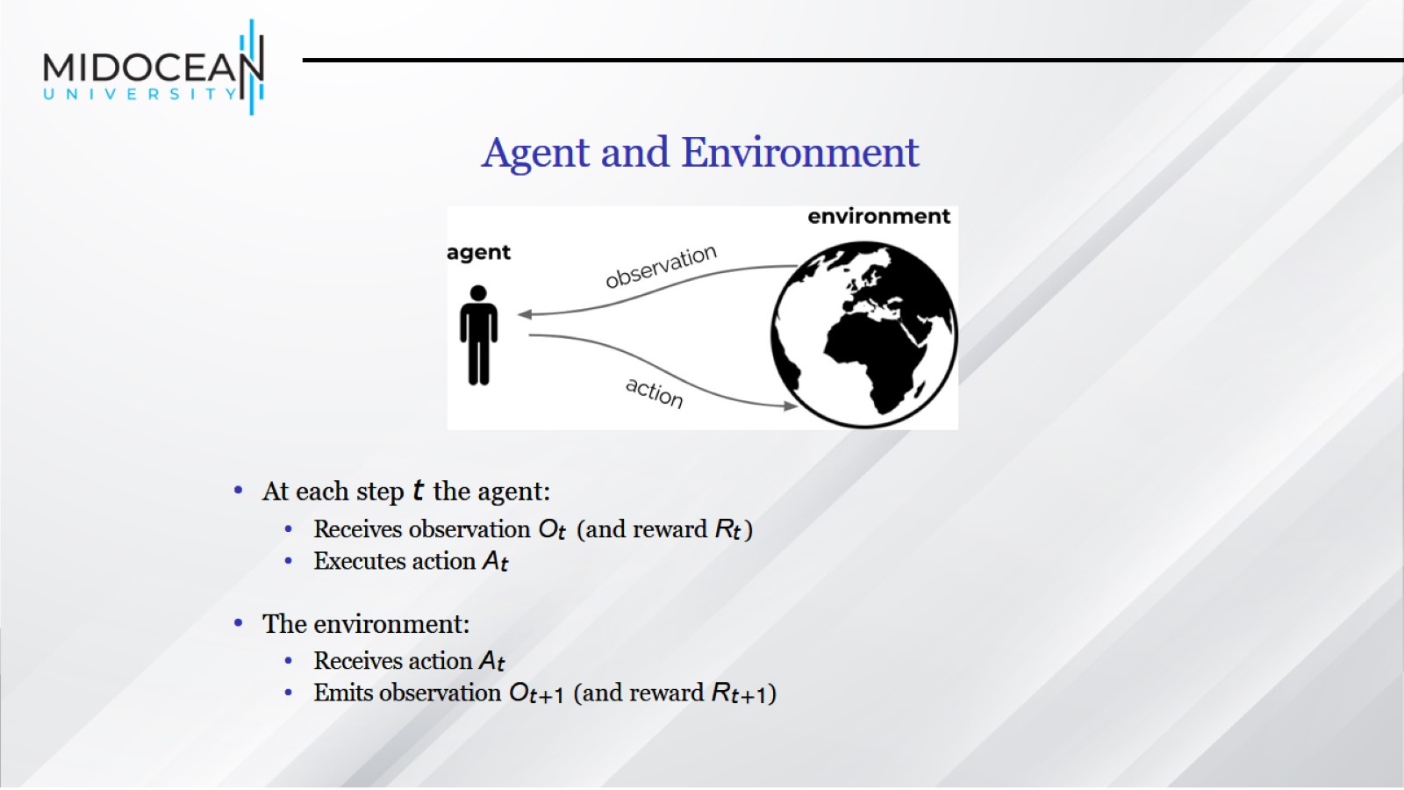
Agent and Environment

Slide 20
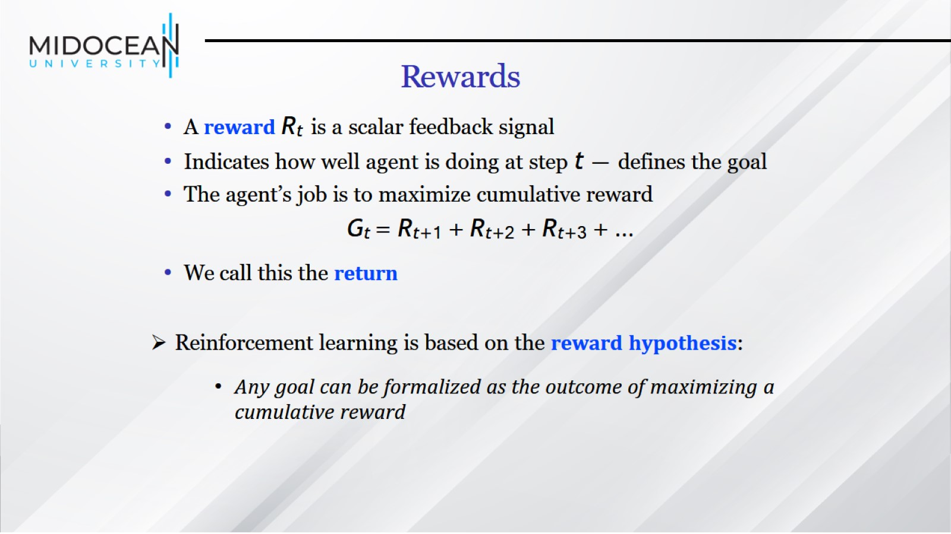
Rewards

Slide 21
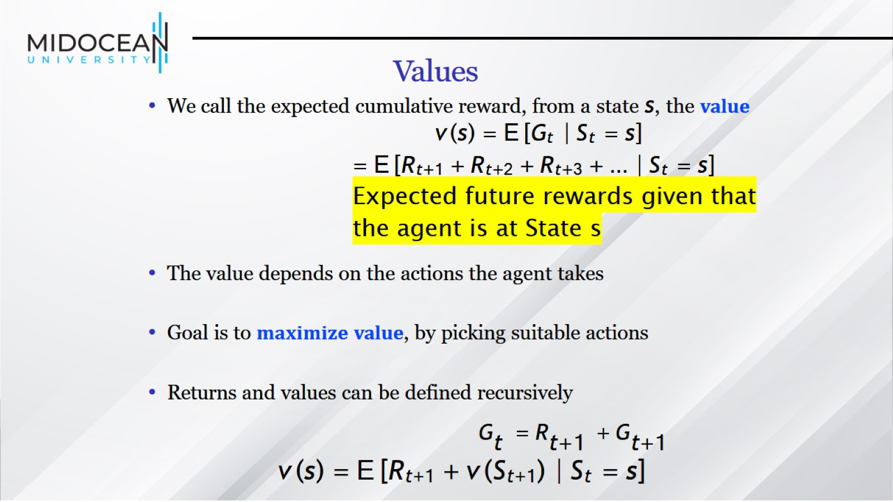
Values

Slide 22
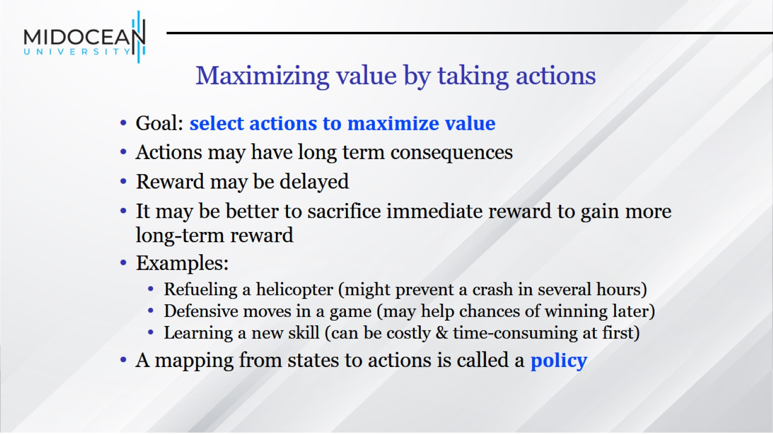
Maximizing value by taking actions

Slide 23
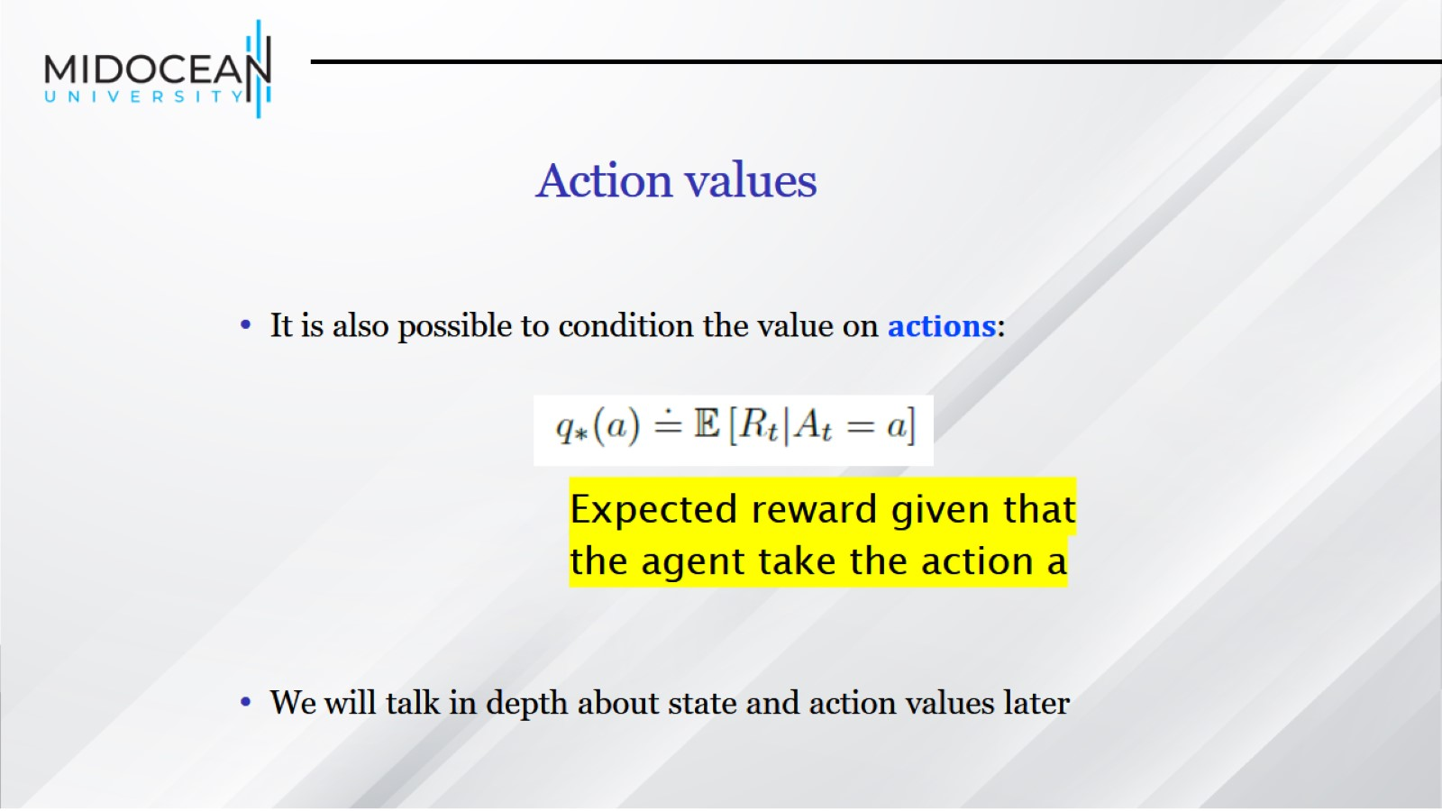
Action values

Slide 24
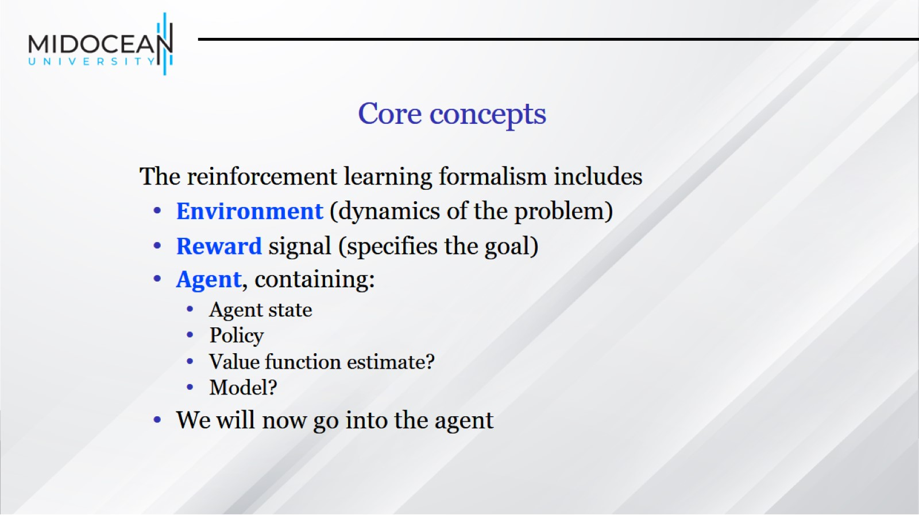
Core concepts

Slide 25
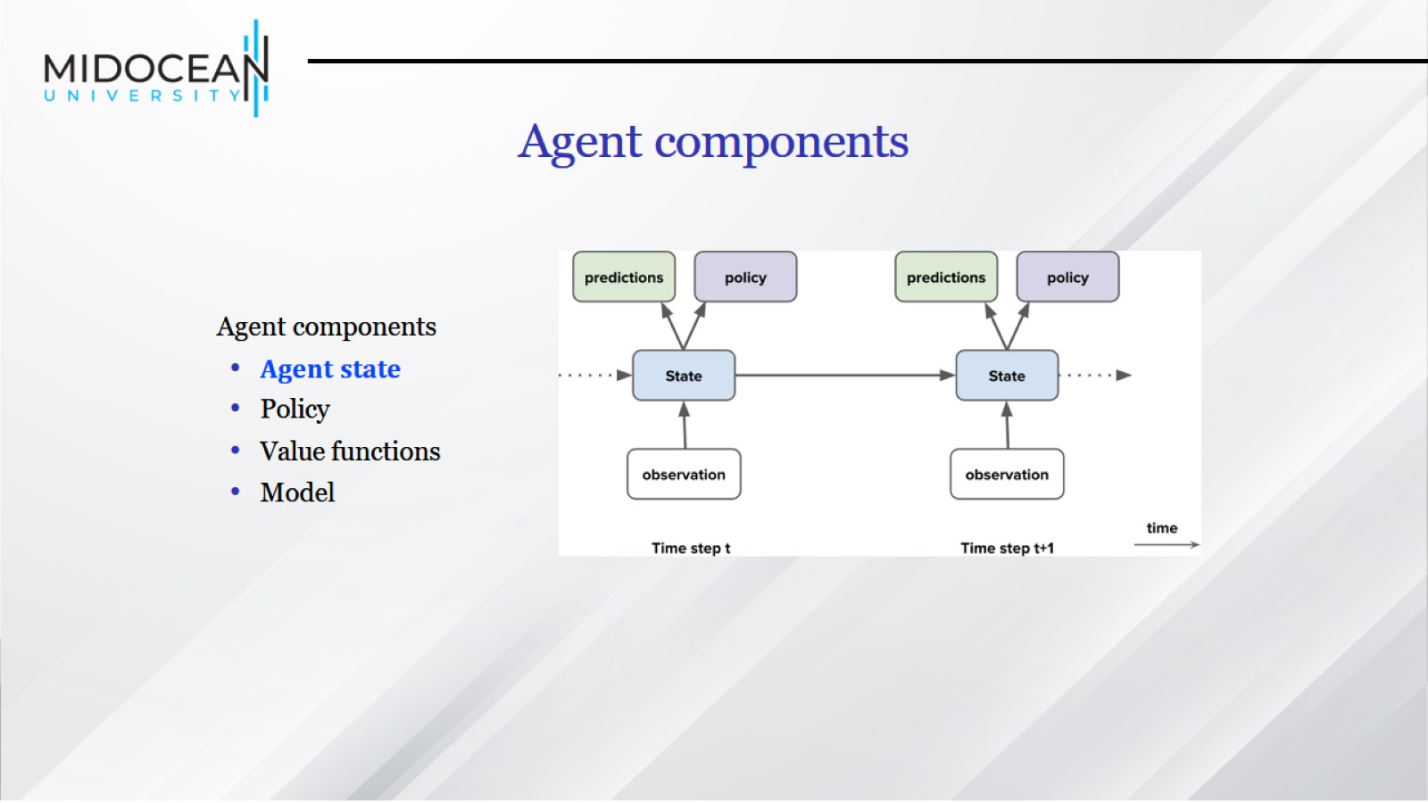

Slide 26
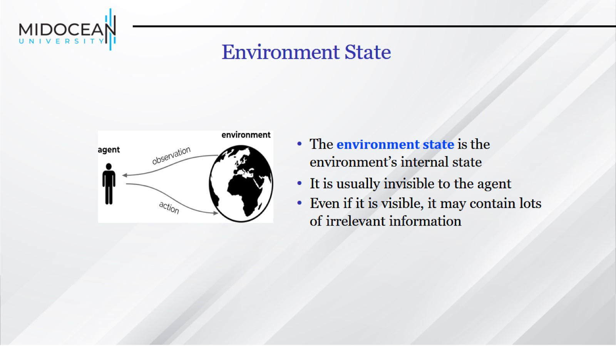
Environment State

Slide 27
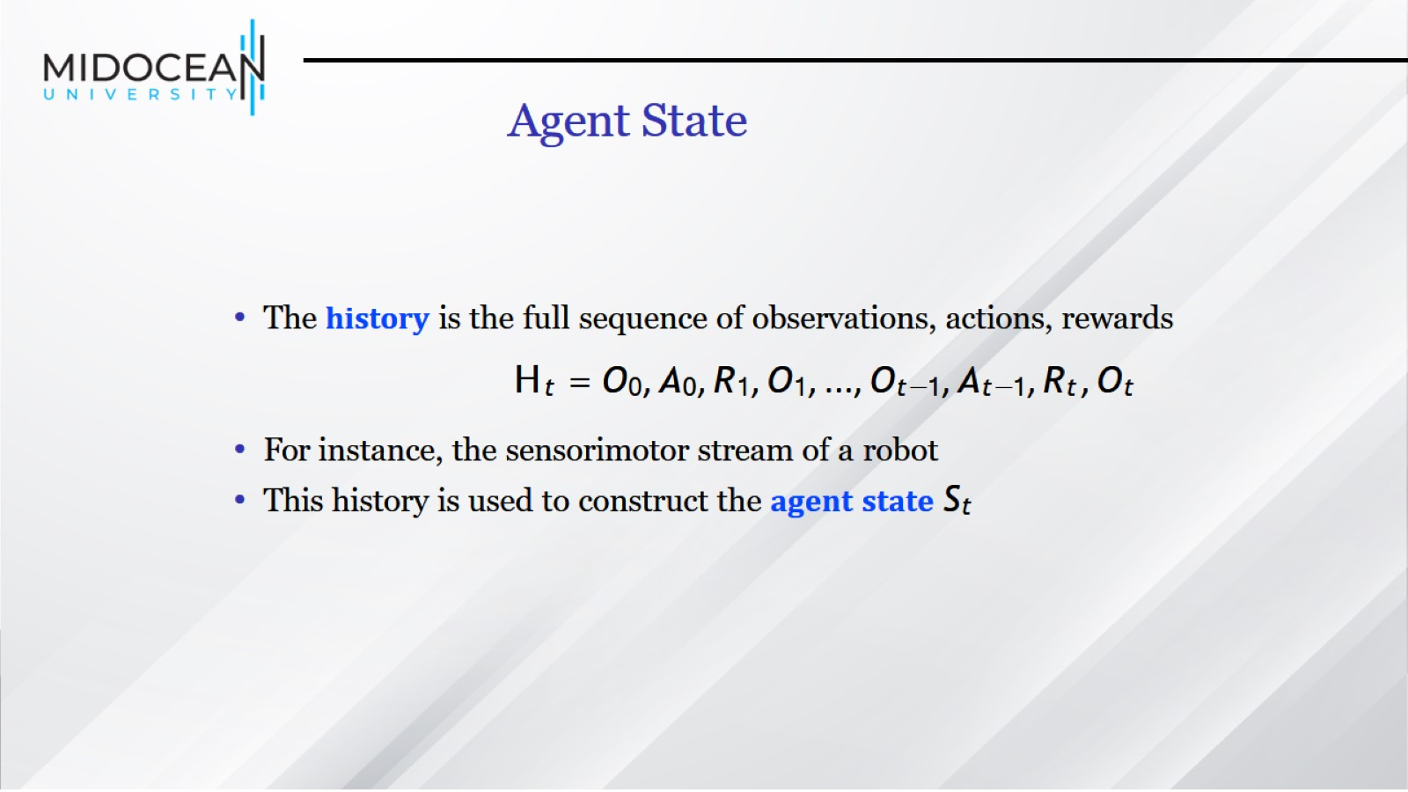
Agent State

Slide 28
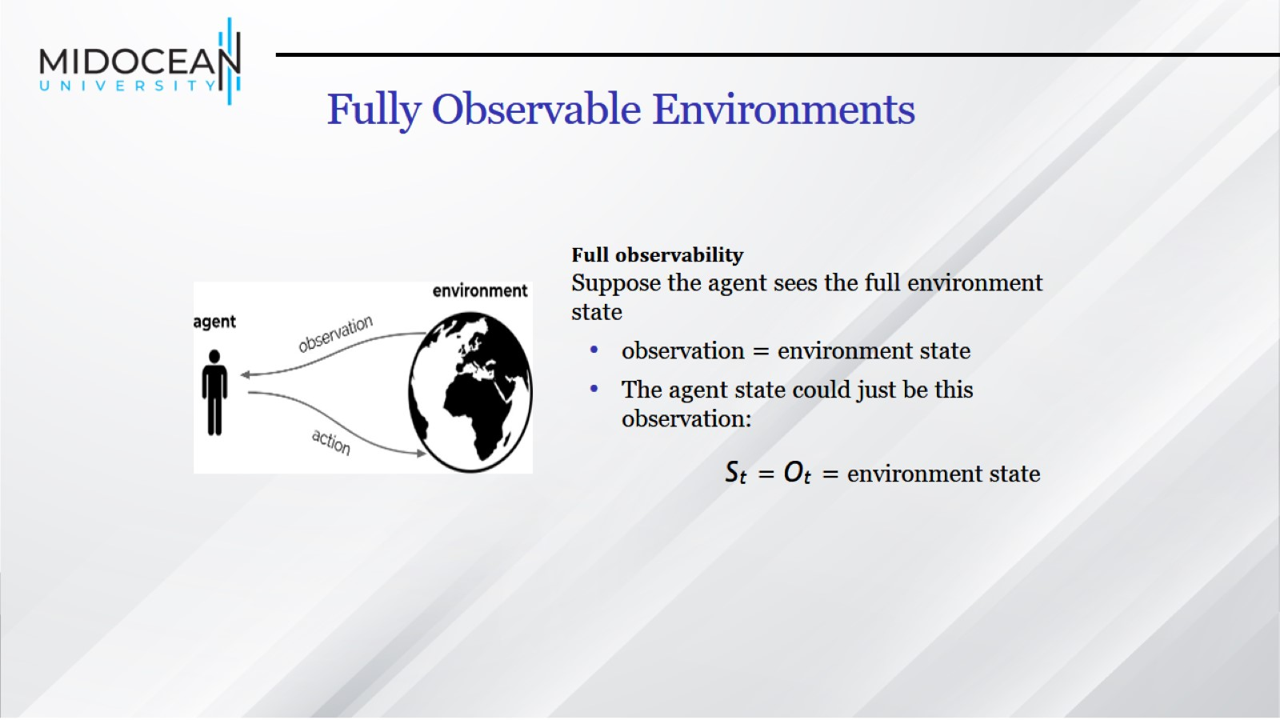
Fully Observable Environments

Slide 29
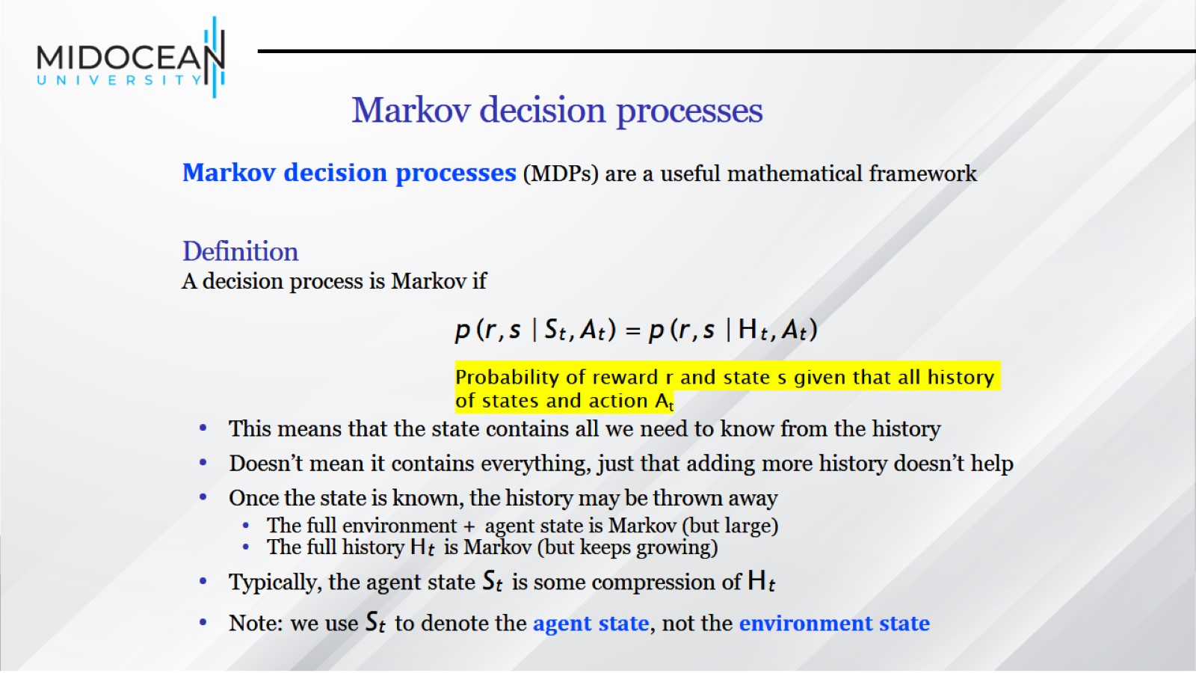
Markov decision processes

Slide 30
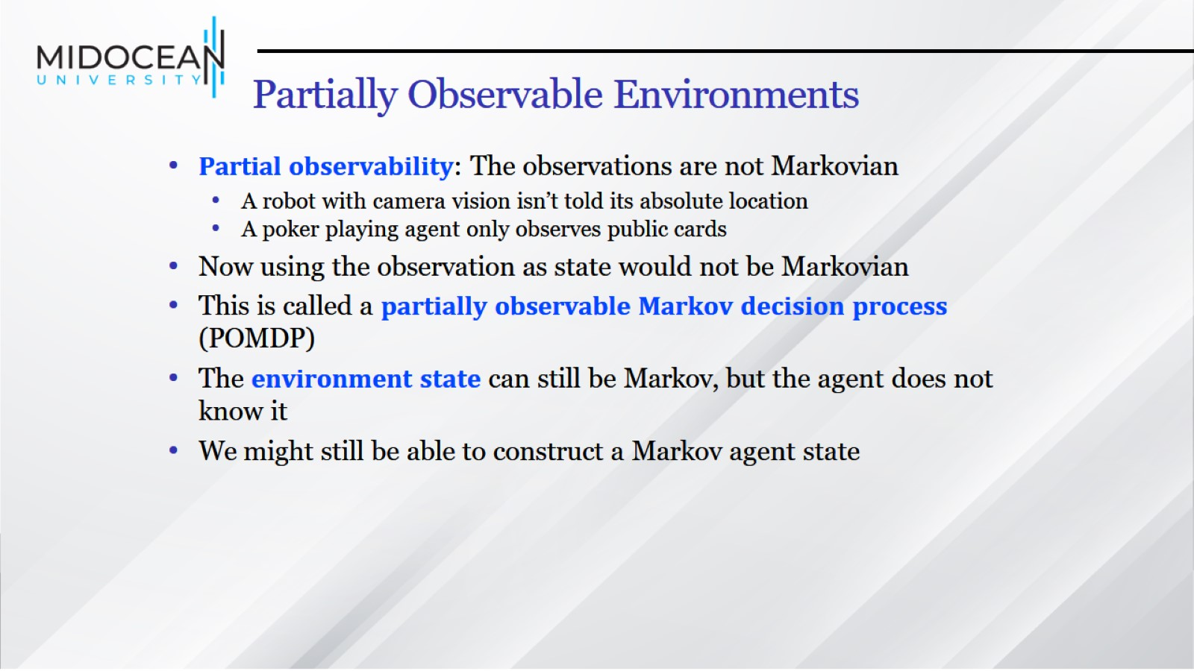
Partially Observable Environments

Slide 31
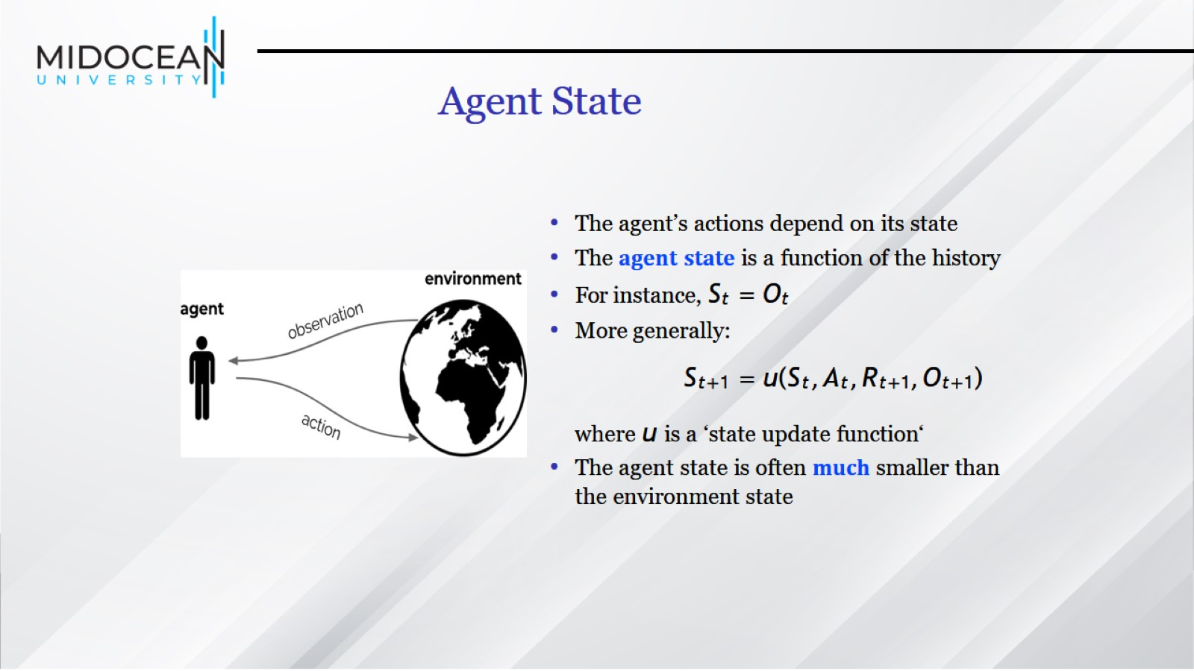
Agent State

Slide 32


Slide 33


Slide 34
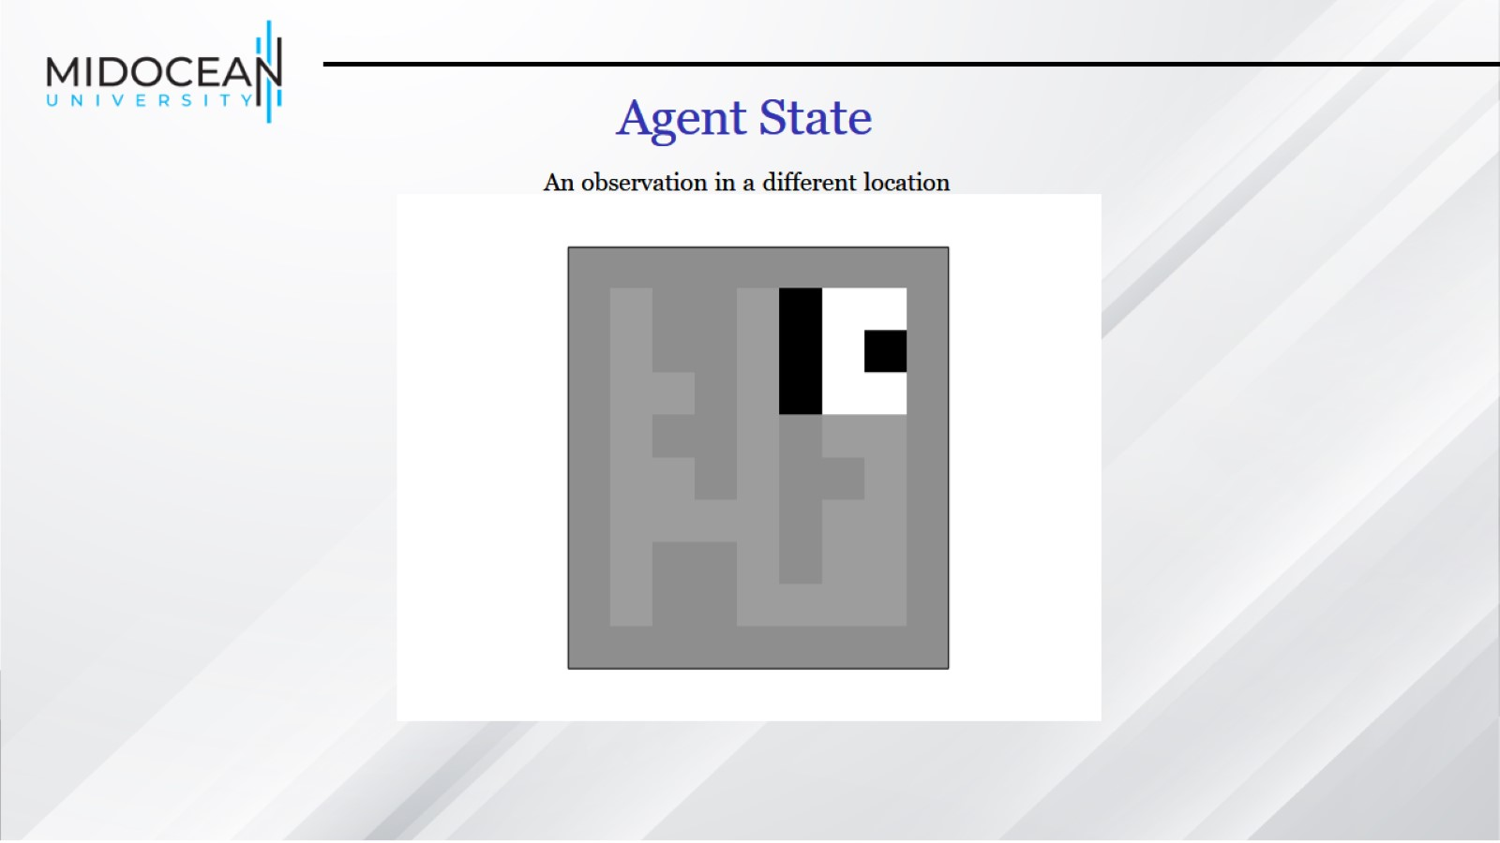

Slide 35
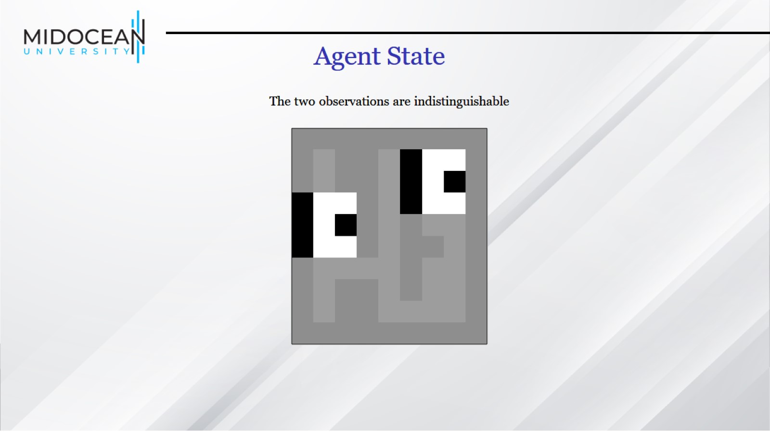

Slide 36
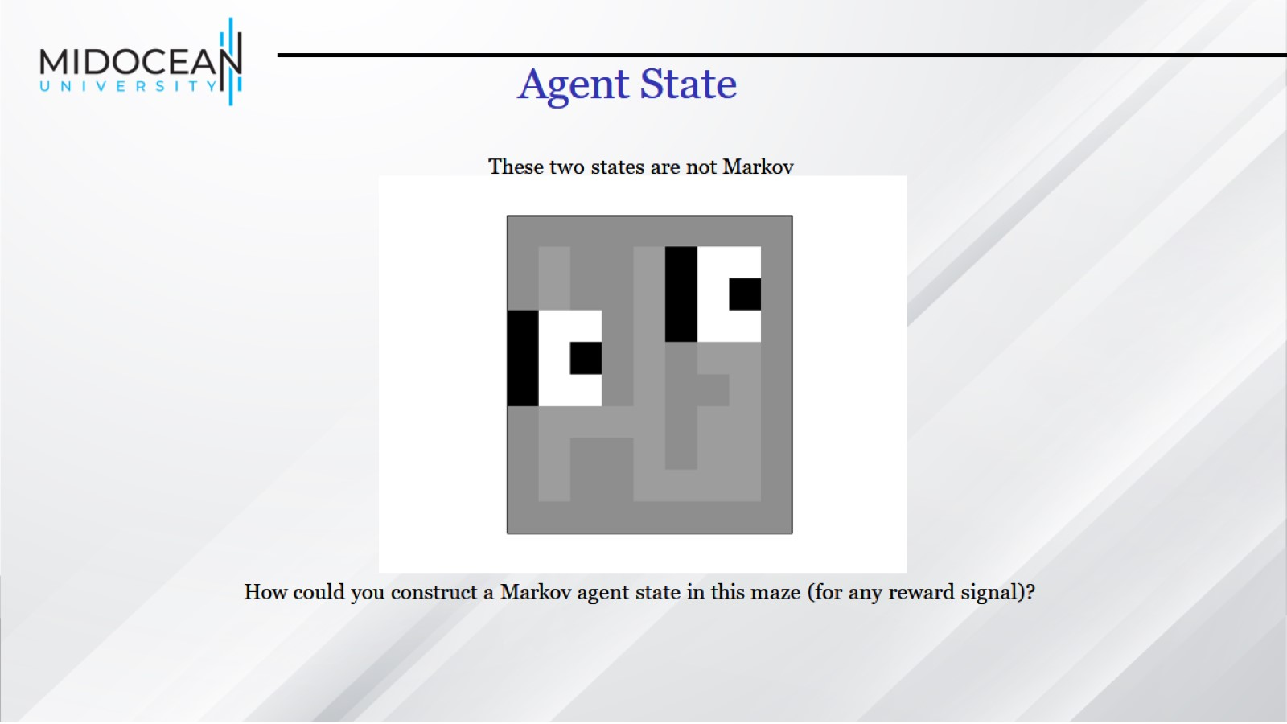

Slide 37
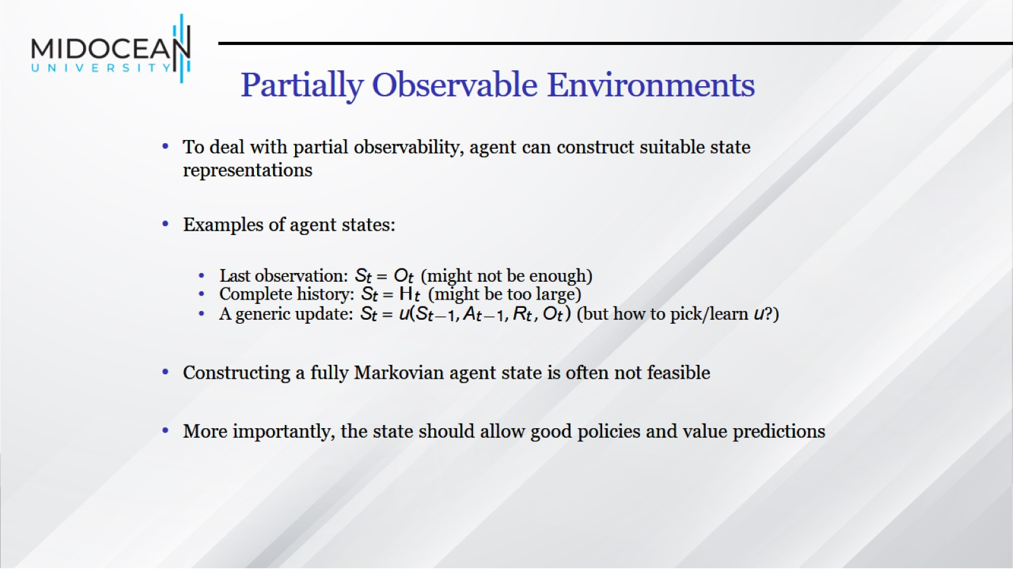
Partially Observable Environments

Slide 38
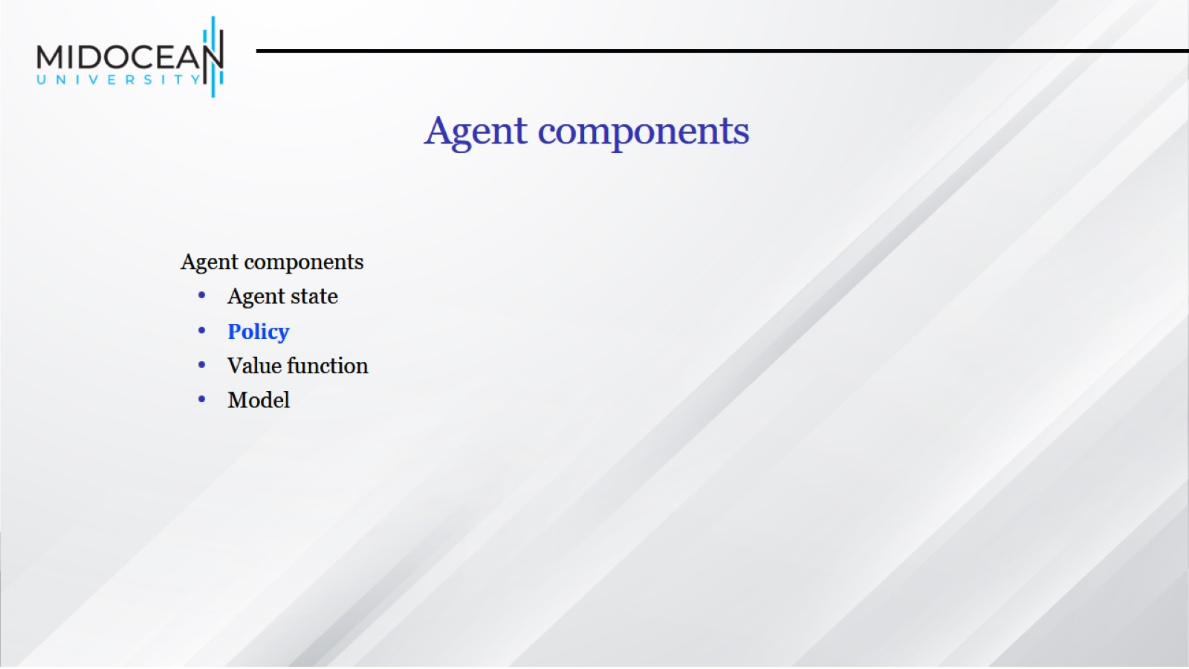

Slide 39
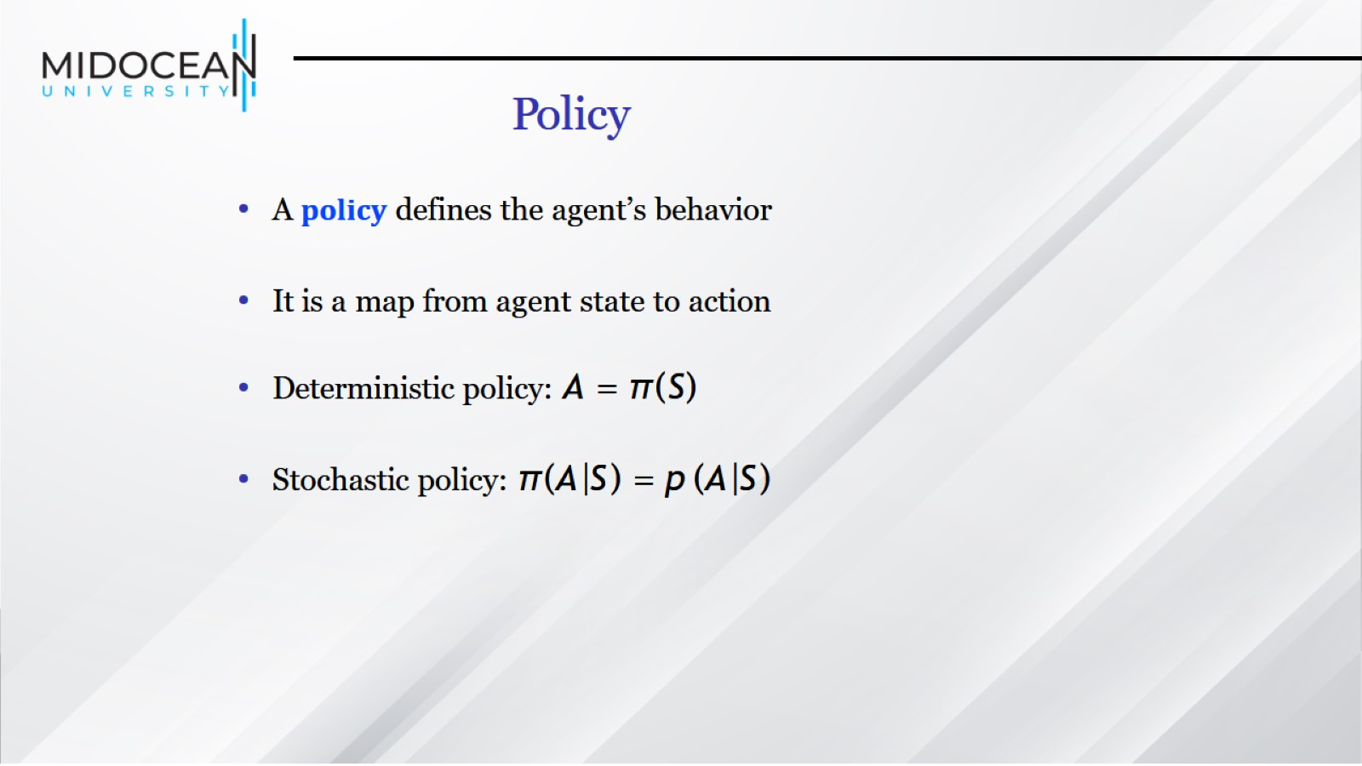
Policy

Slide 40
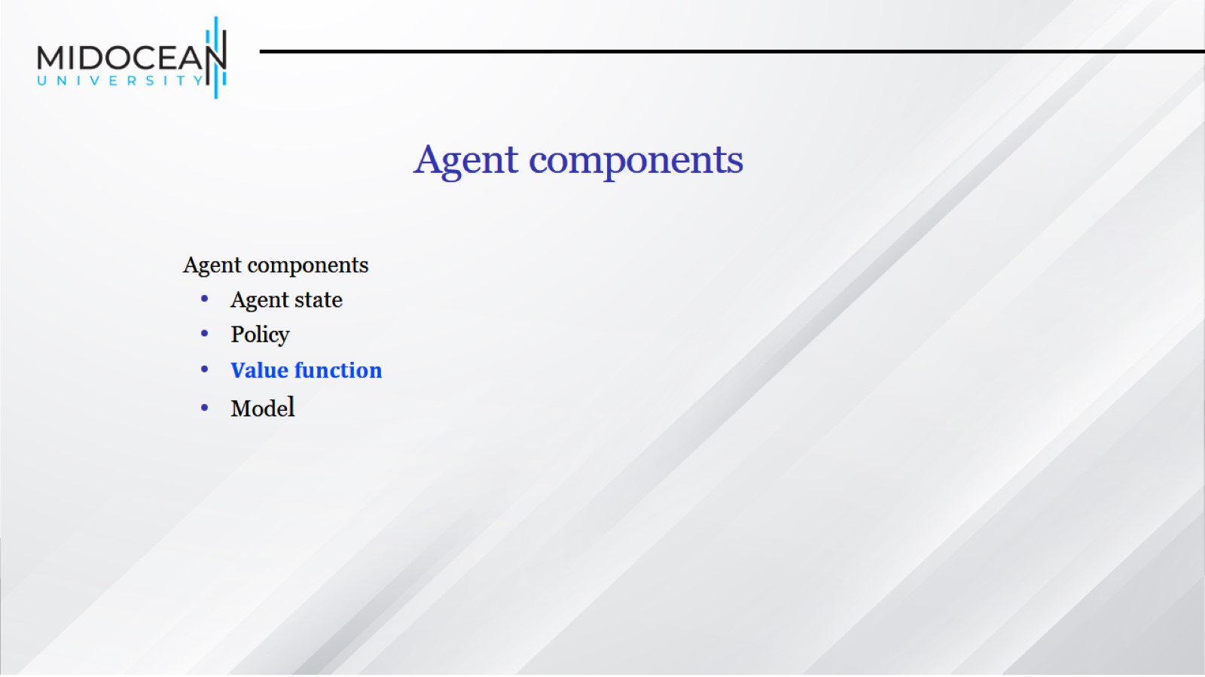

Slide 41
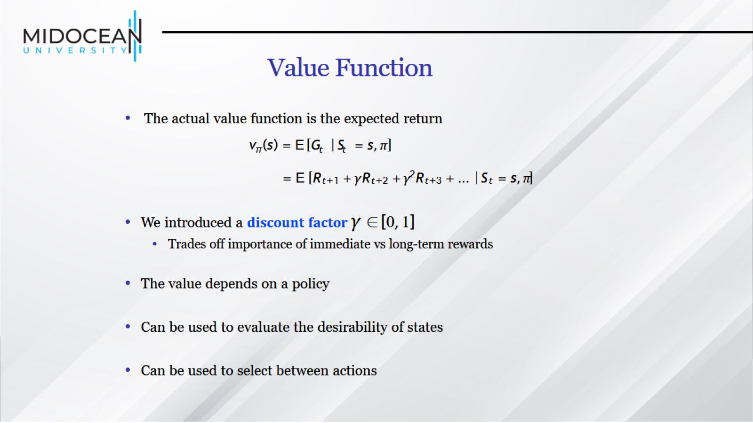
Value Function

Slide 42
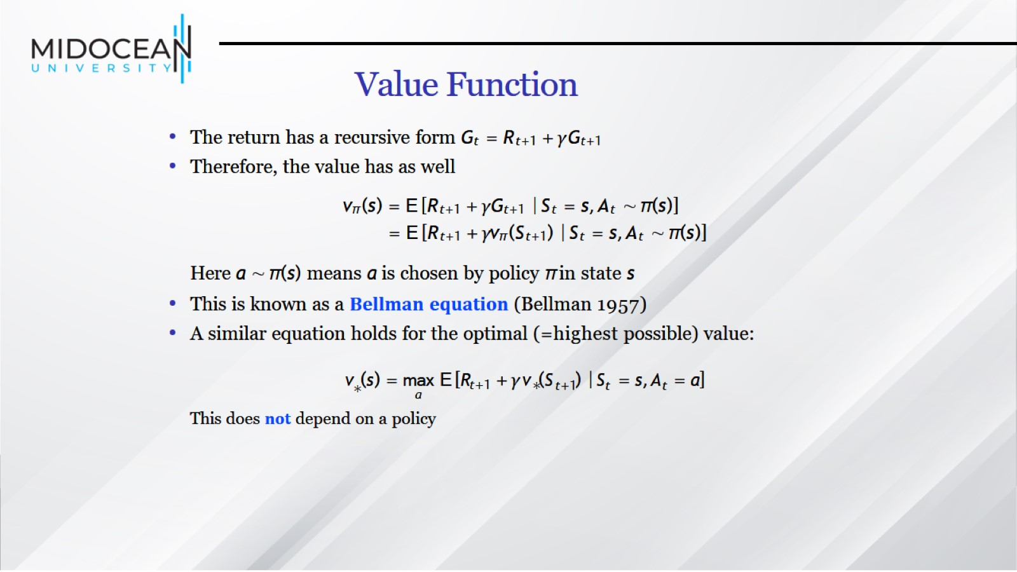
Value Function

Slide 43
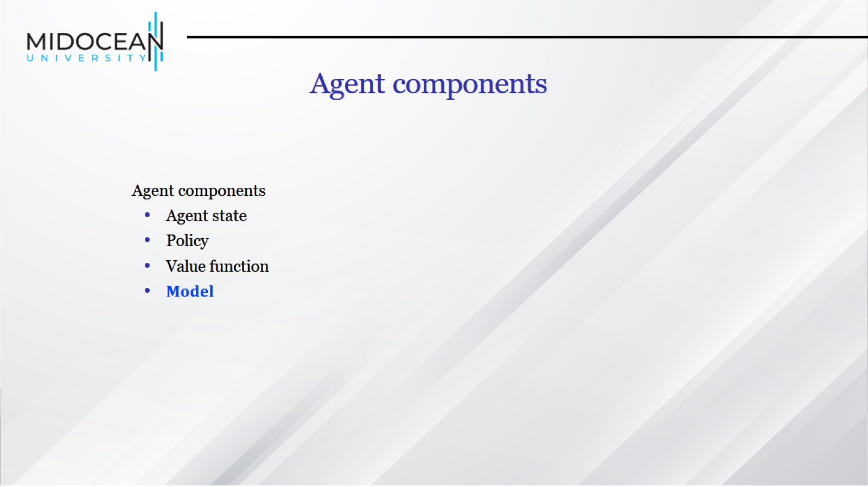

Slide 44
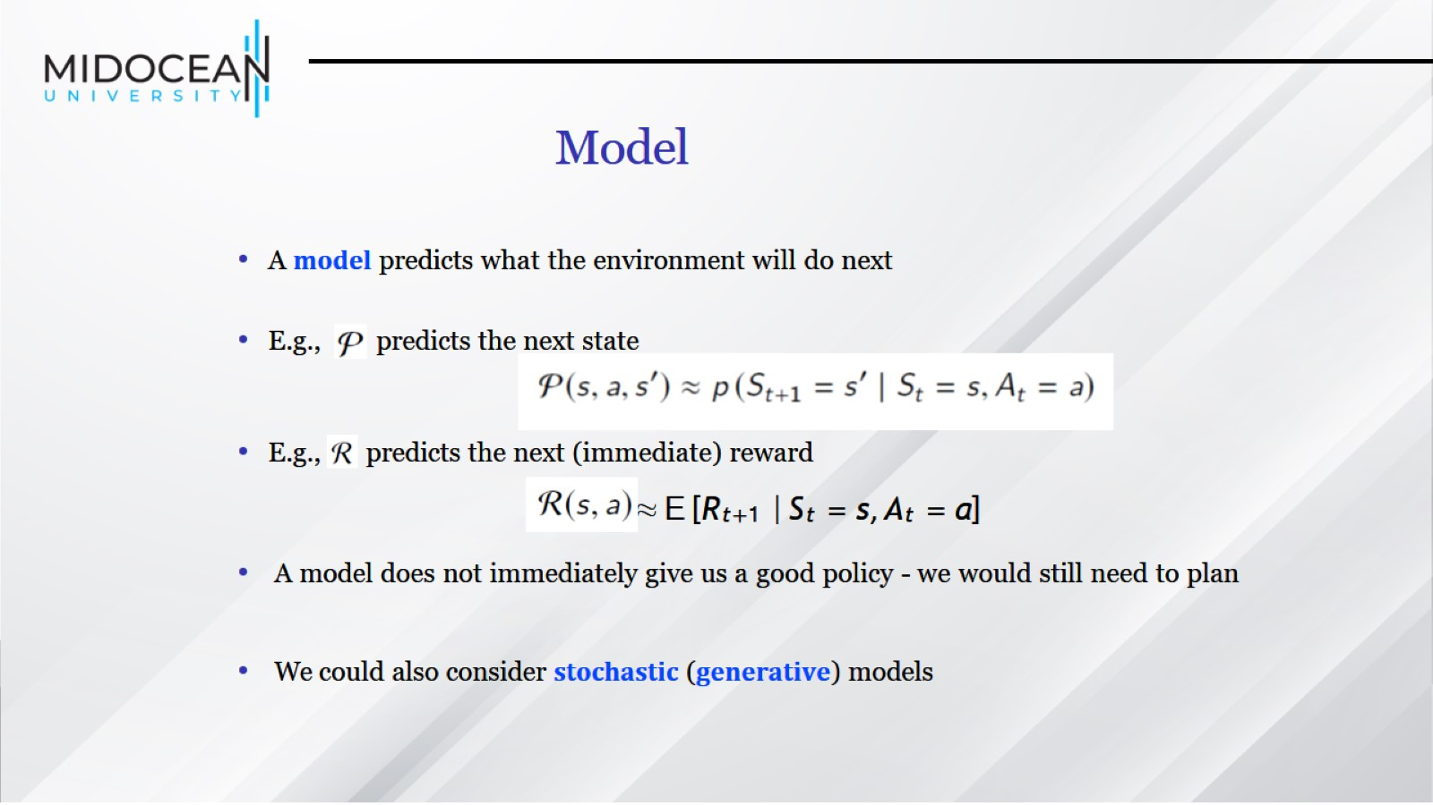
Model

Slide 45
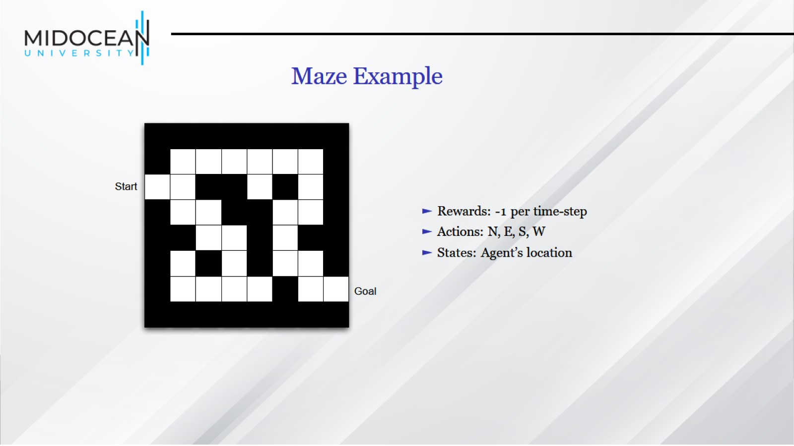
Maze Example

Slide 46
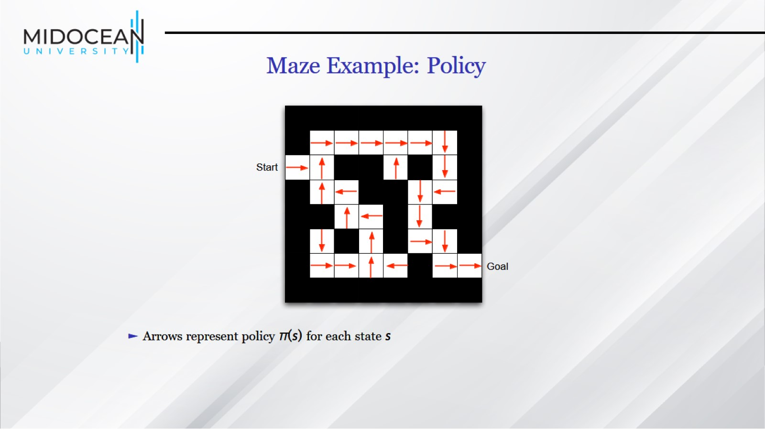

Slide 47
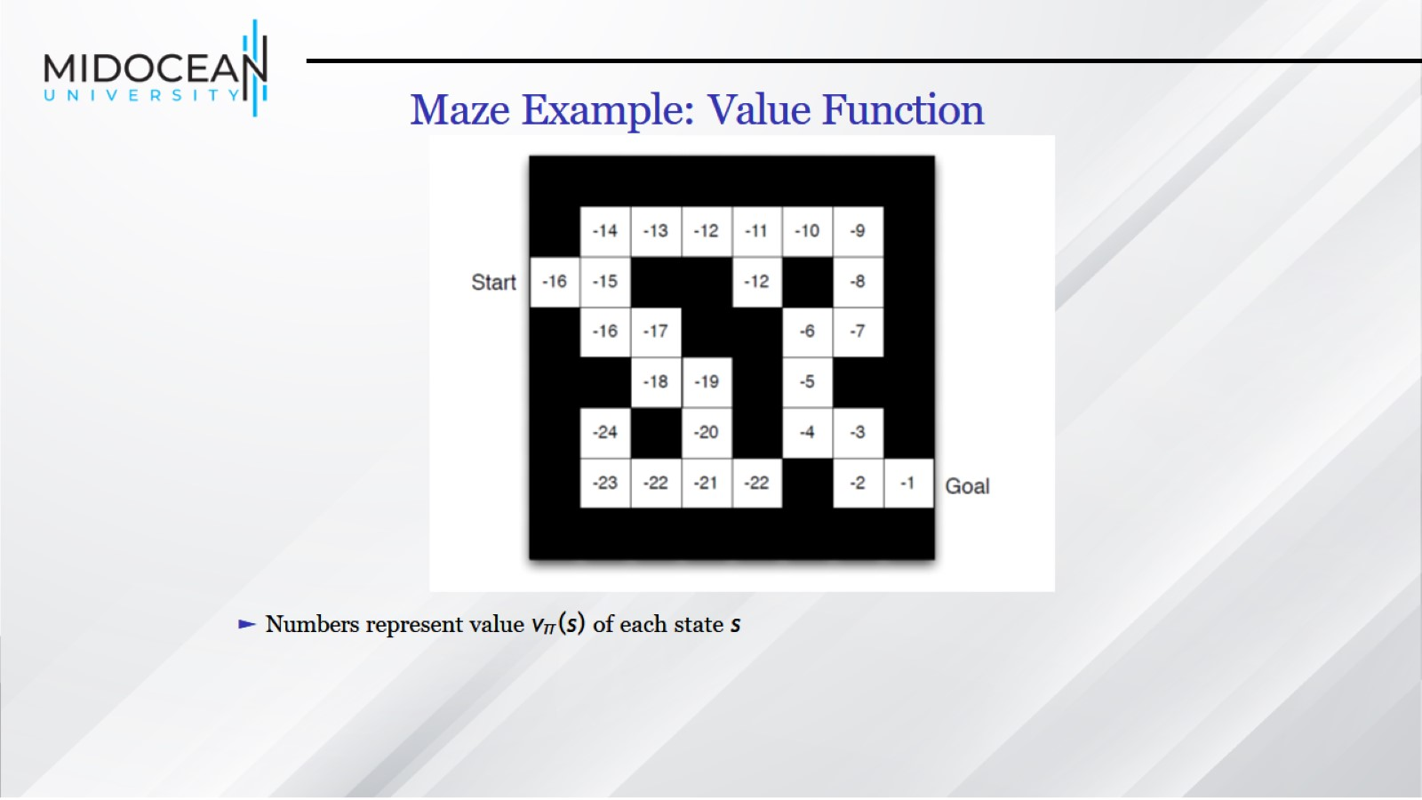

Slide 48
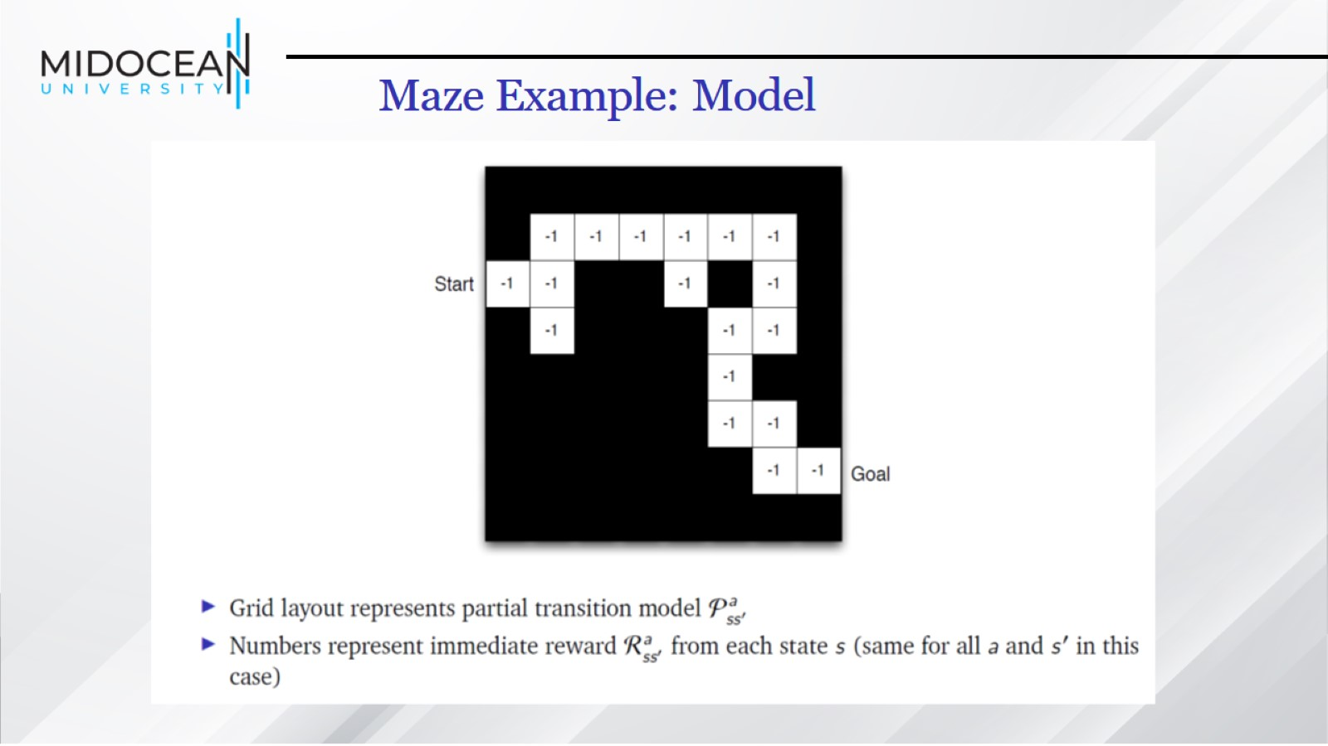
Maze Example: Model

Slide 49
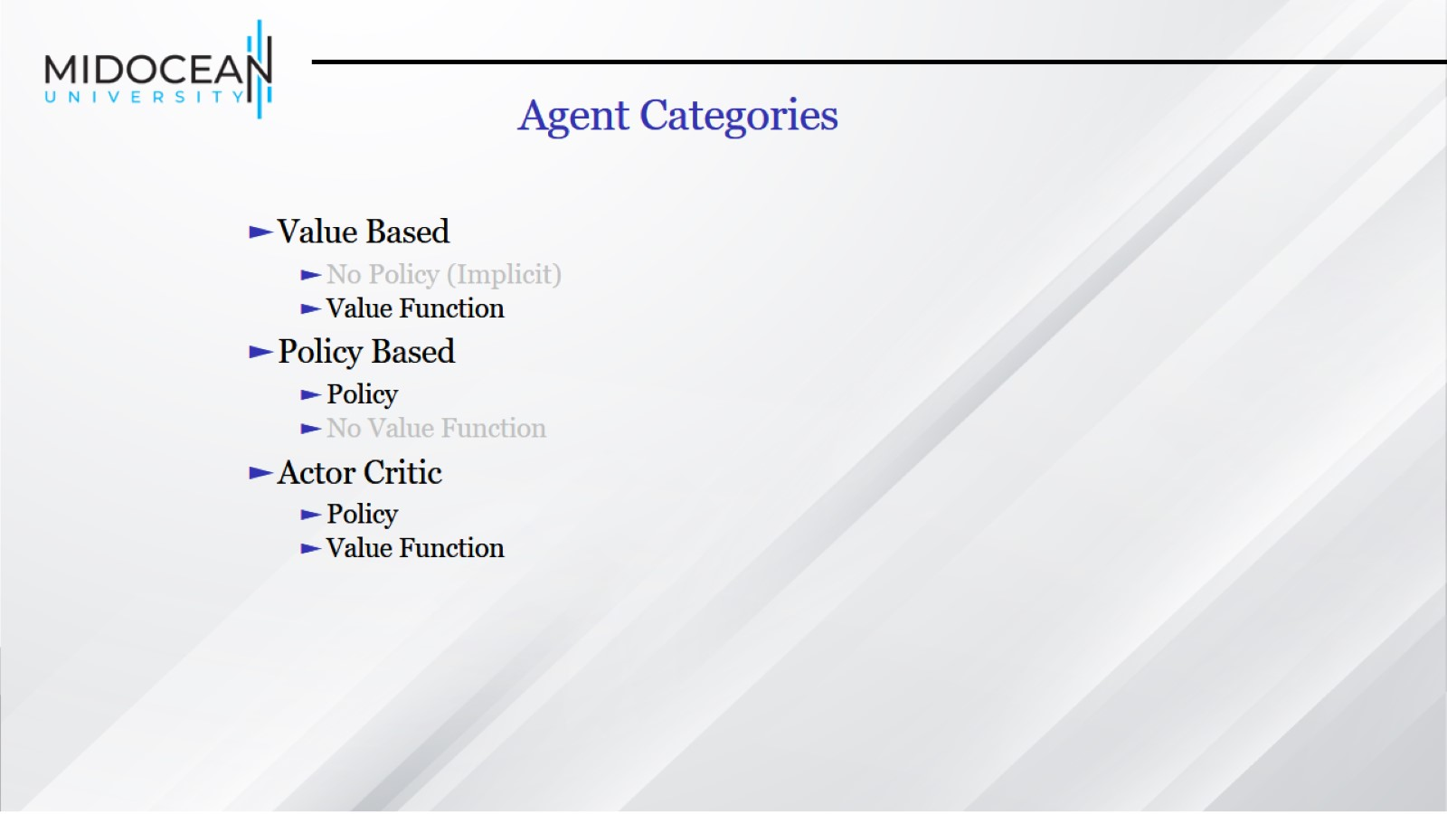
Agent Categories

Slide 50
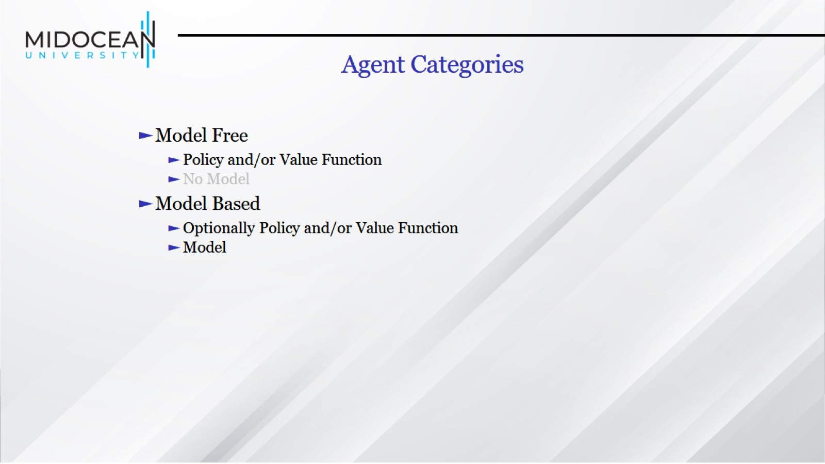

Slide 51
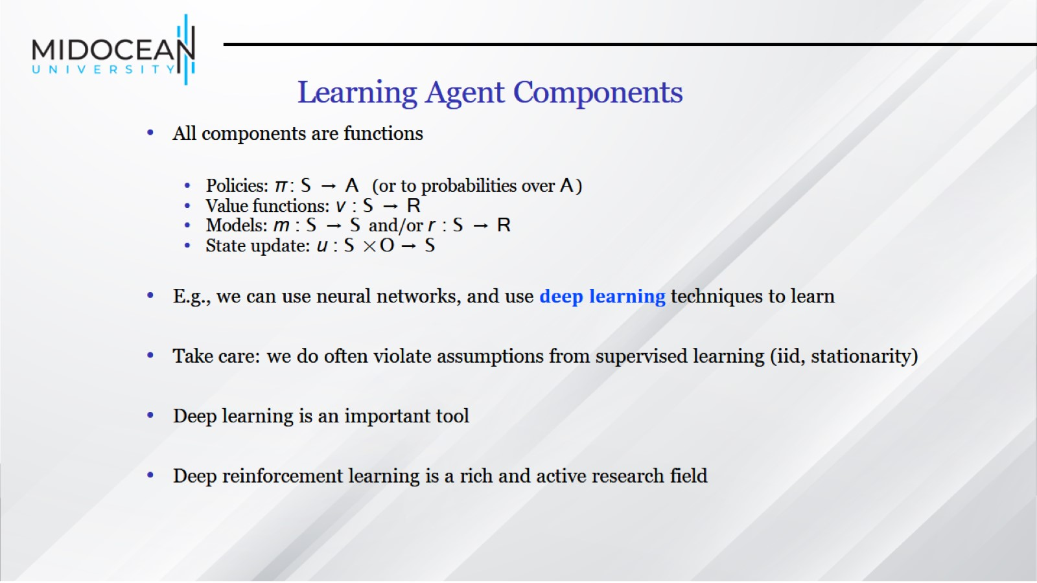
Learning Agent Components

Slide 52
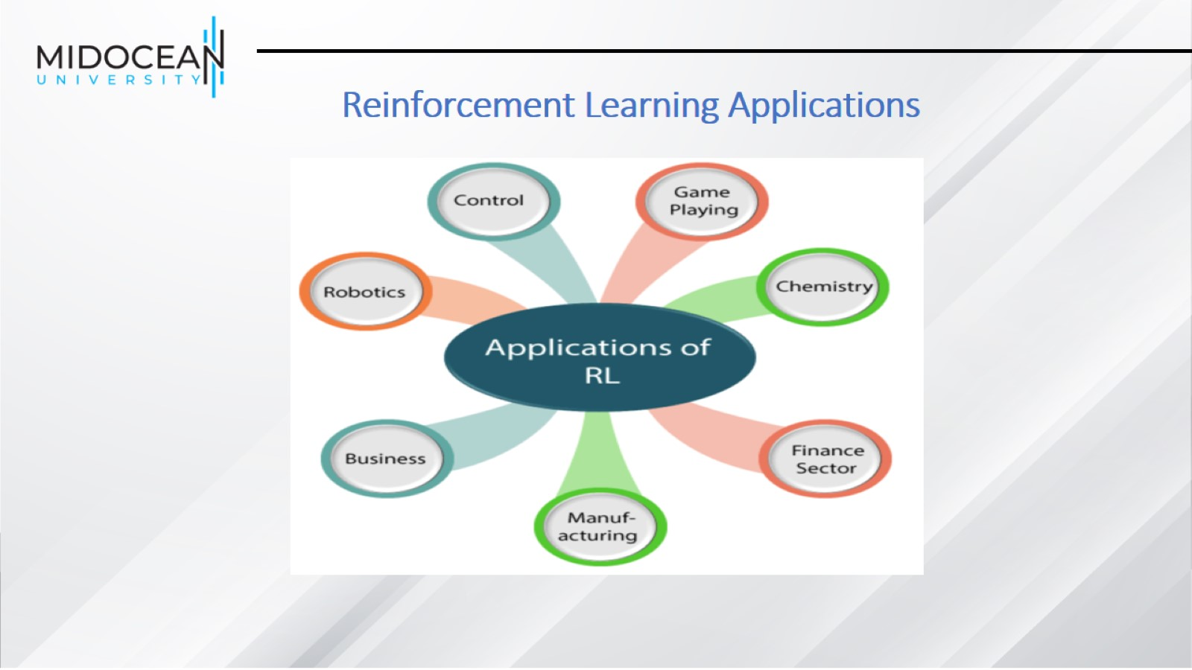
Reinforcement Learning Applications

Slide 53
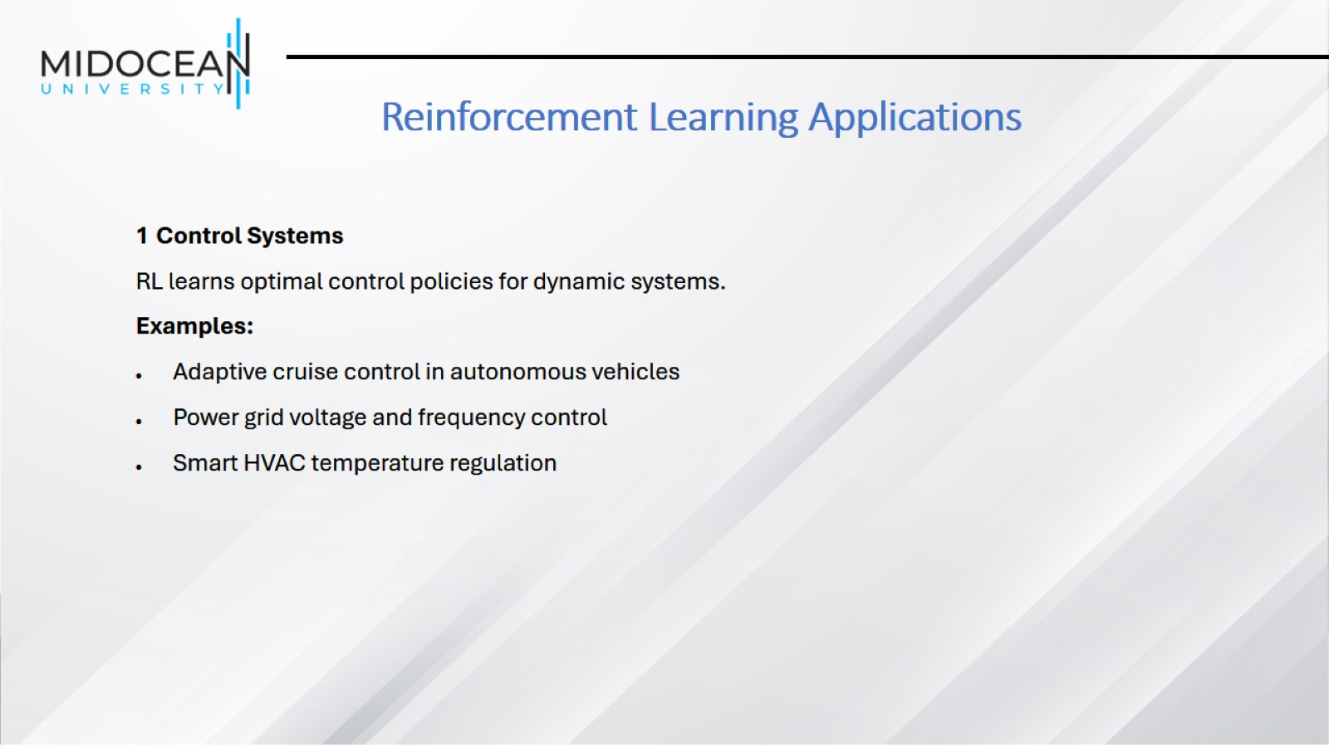
Reinforcement Learning Applications

Slide 54

Reinforcement Learning Applications

Slide 55

Reinforcement Learning Applications

Slide 56

Reinforcement Learning Applications

Slide 57

Reinforcement Learning Applications

Slide 58

Reinforcement Learning Applications

Slide 59

Reinforcement Learning Applications

Slide 60

Supervised vs. Unsupervised vs. Reinforcement Learning

Slide 61

Term Used in Reinforcement Learning

Slide 62

Elements of Reinforcement Learning

Slide 63

Reinforcement Learning Categories

Slide 64

Passive vs. Active learning

Slide 65

Model-Based vs. Model-Free RL

Slide 66


