Slide 1



Transport Layer
Lecture 7
CCNA – Introduction to Networks V7.0 (ITN)
Prepared by
Dr. Abdelrhman Ahmed

Slide 2
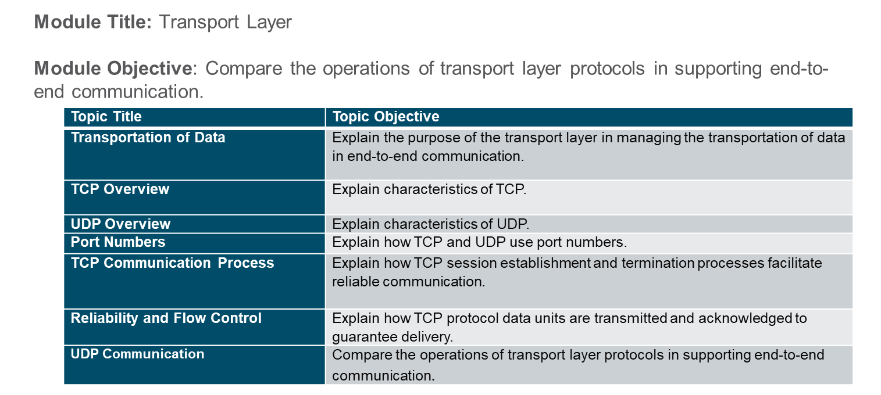
Chapter
Module Objectives
07

Slide 3
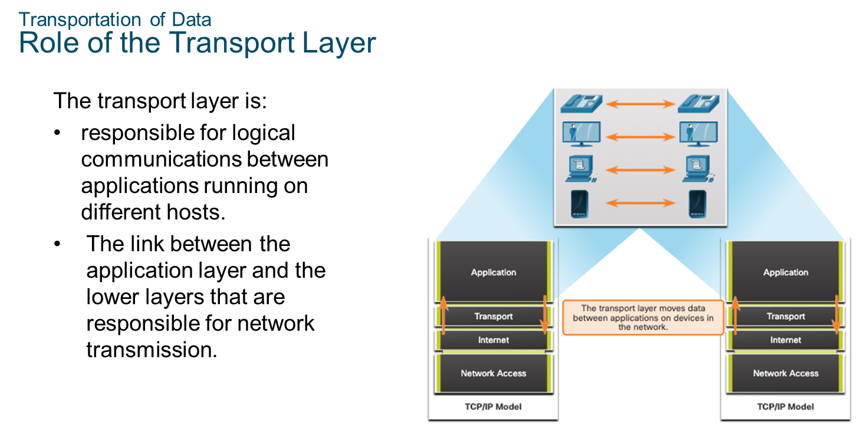
Chapter
Transportation of Data
07

Slide 4
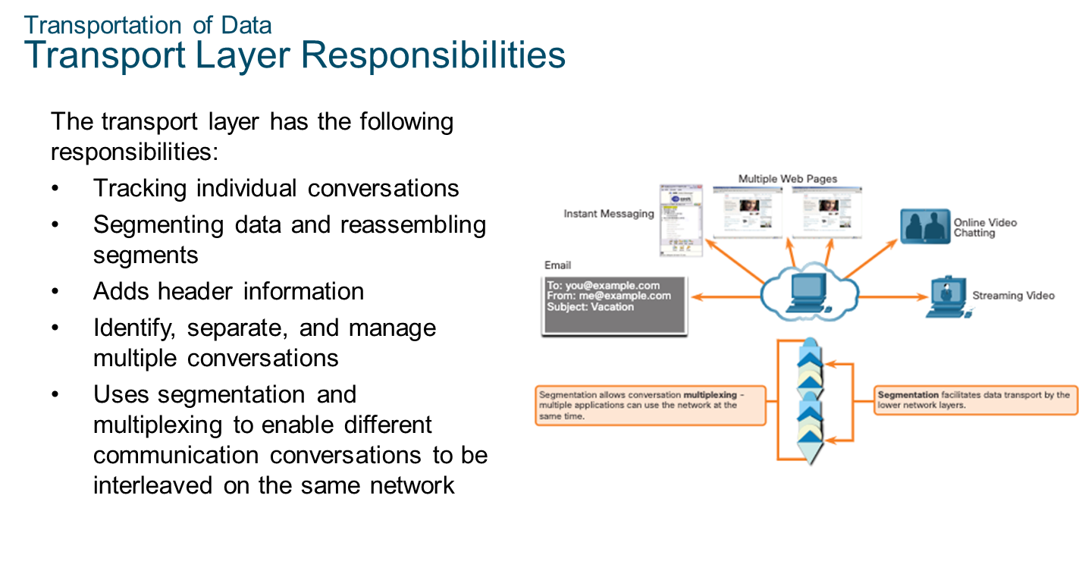
Chapter
Transportation of Data
07

Slide 5
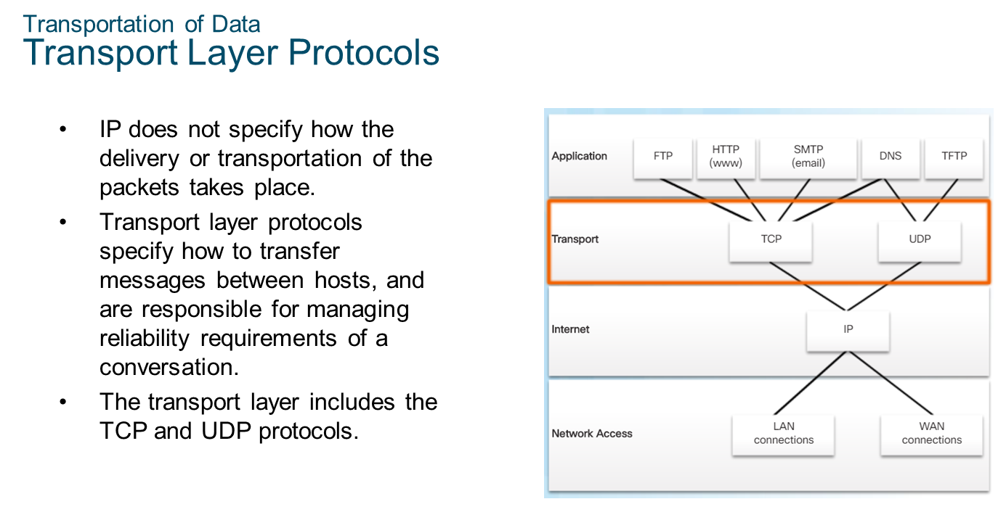
Chapter
Transportation of Data
07

Slide 6
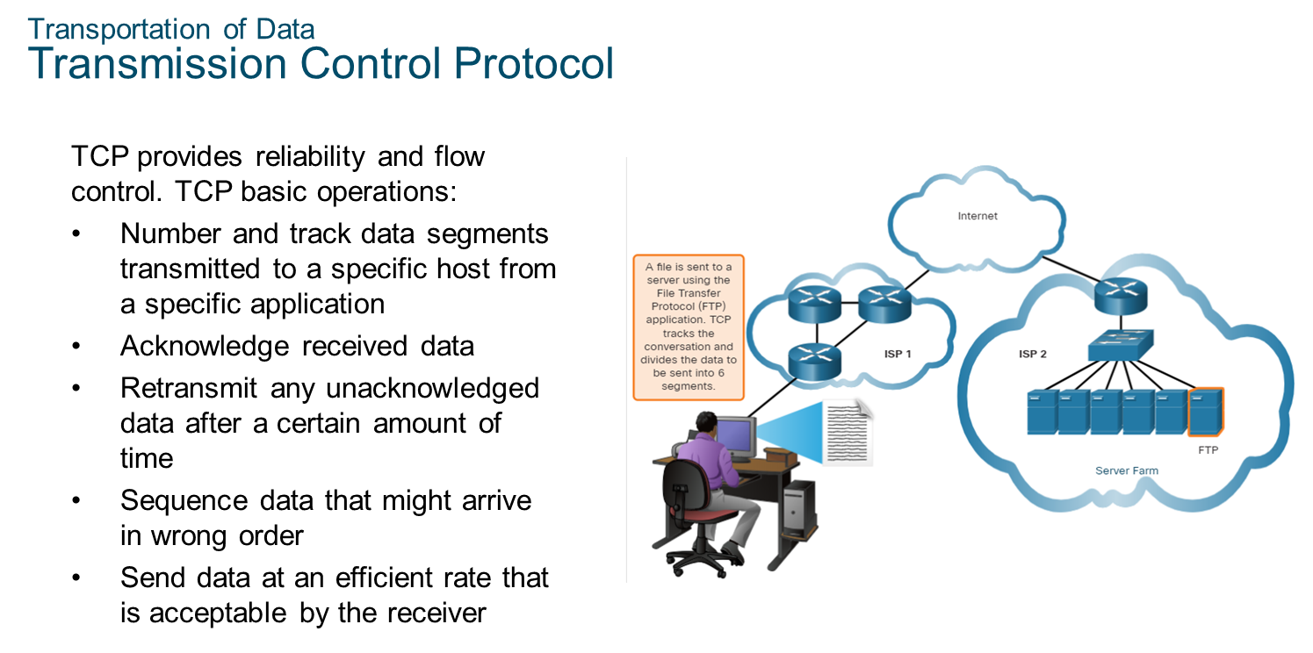
Chapter
Transportation of Data
07

Slide 7
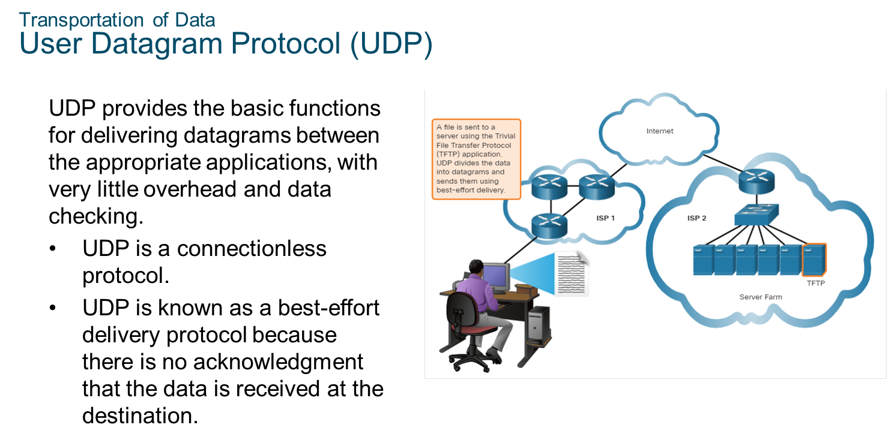
Chapter
Transportation of Data
07

Slide 8
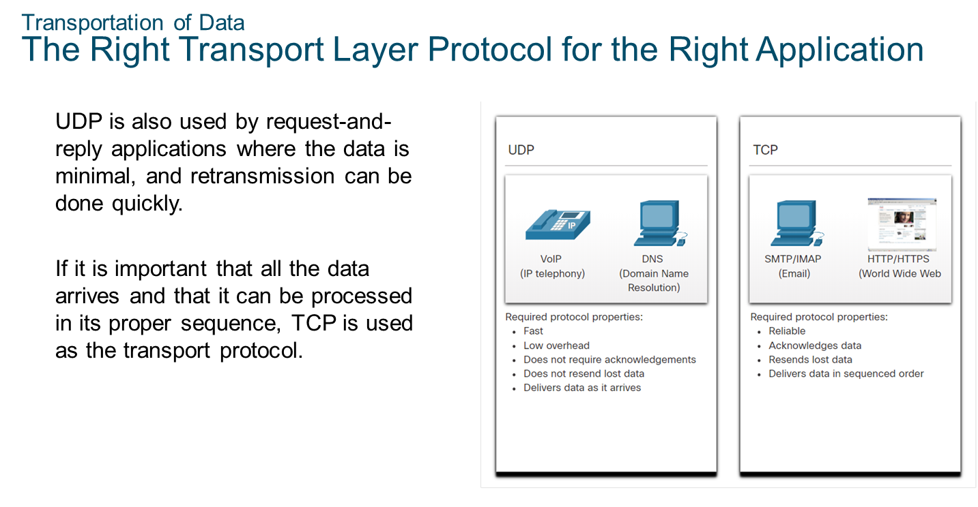
Chapter
Transportation of Data
07

Slide 9
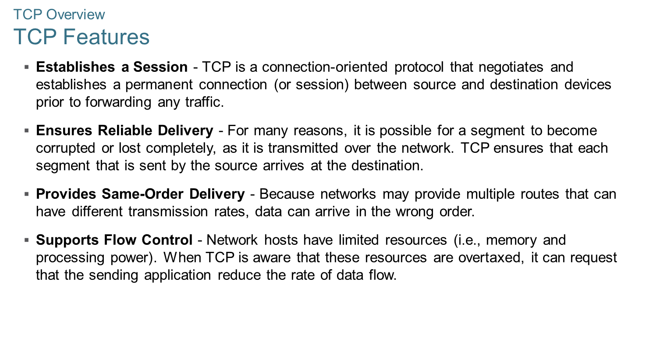
Chapter
TCP Overview
07

Slide 10
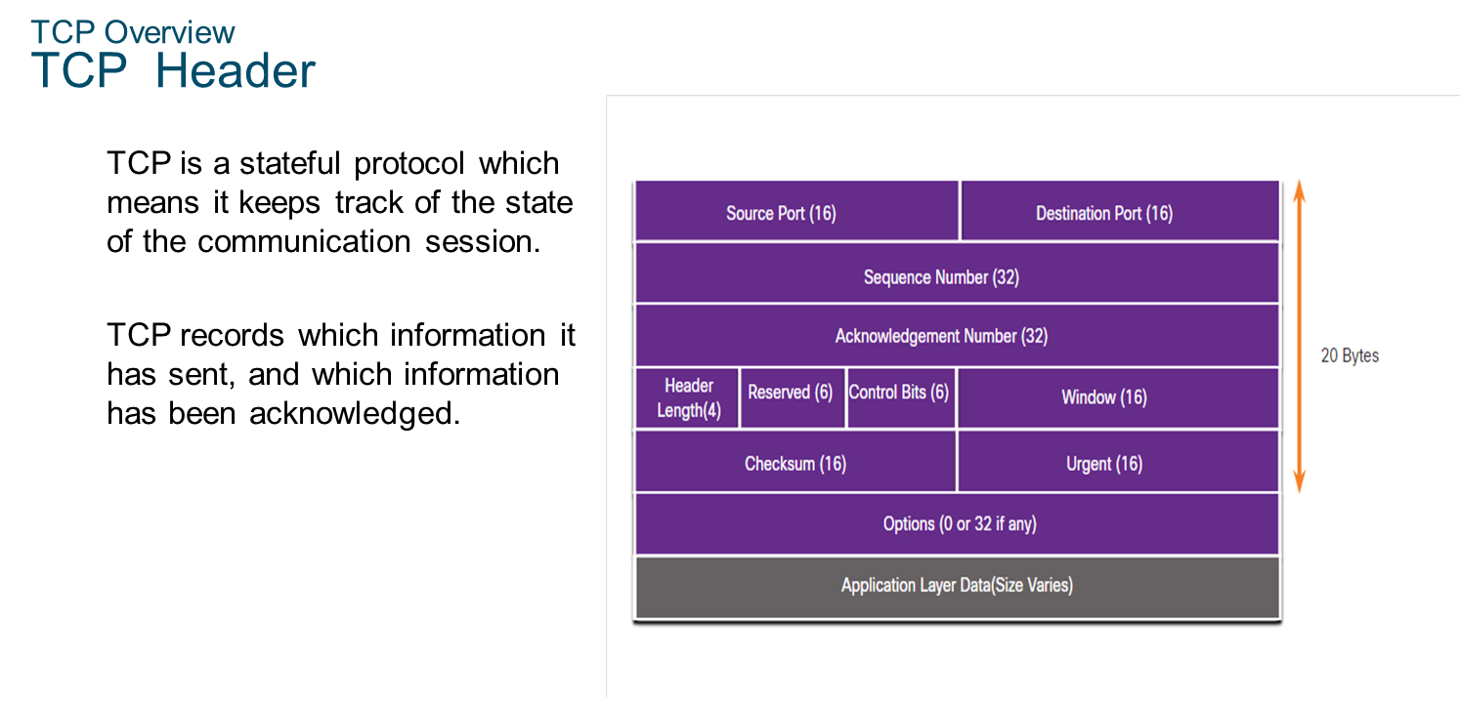
Chapter
TCP Overview
07

Slide 11
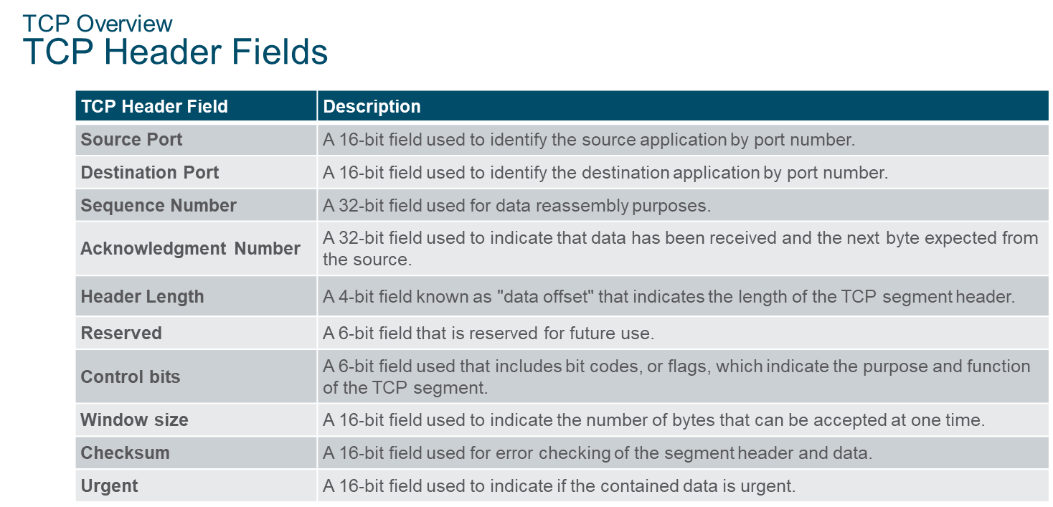
Chapter
07
TCP Overview

Slide 12
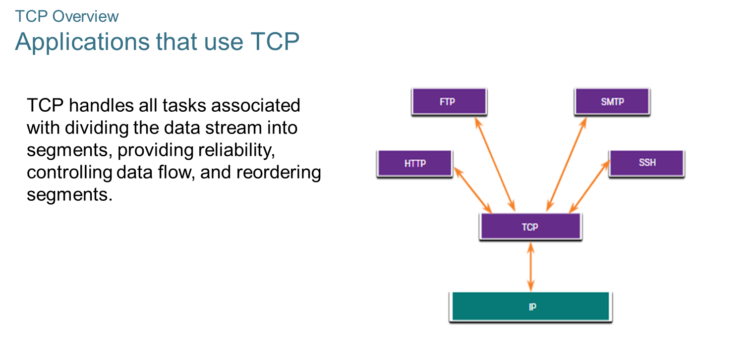
Chapter
07
TCP Overview

Slide 13
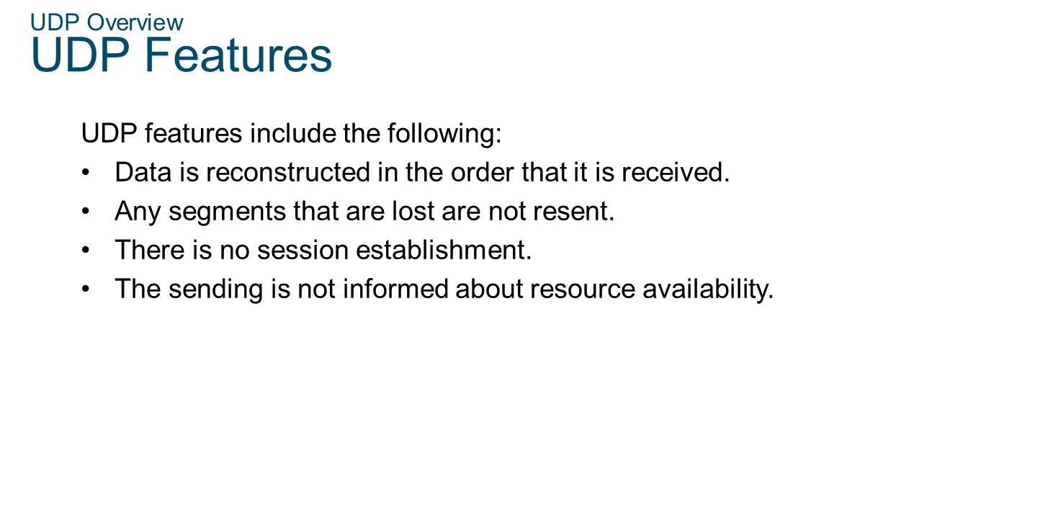
Chapter
07
UDP Overview

Slide 14
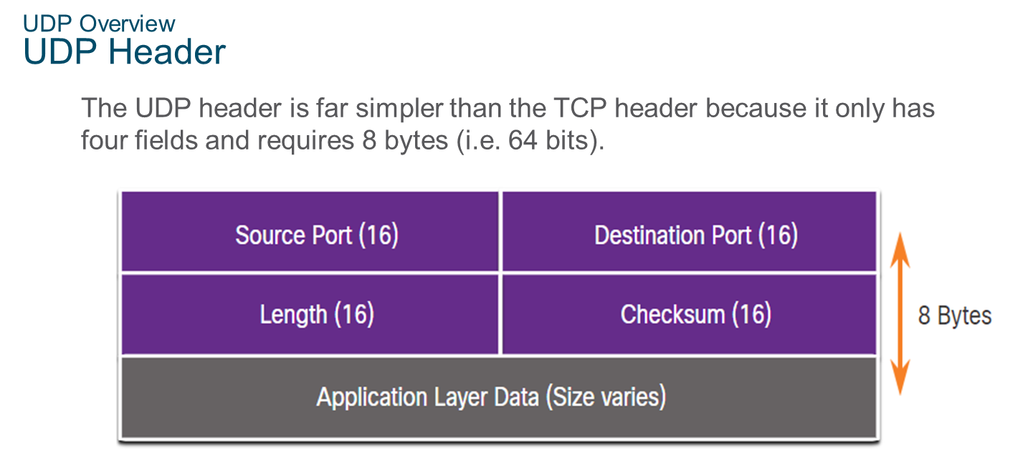
Chapter
07
UDP Overview

Slide 15
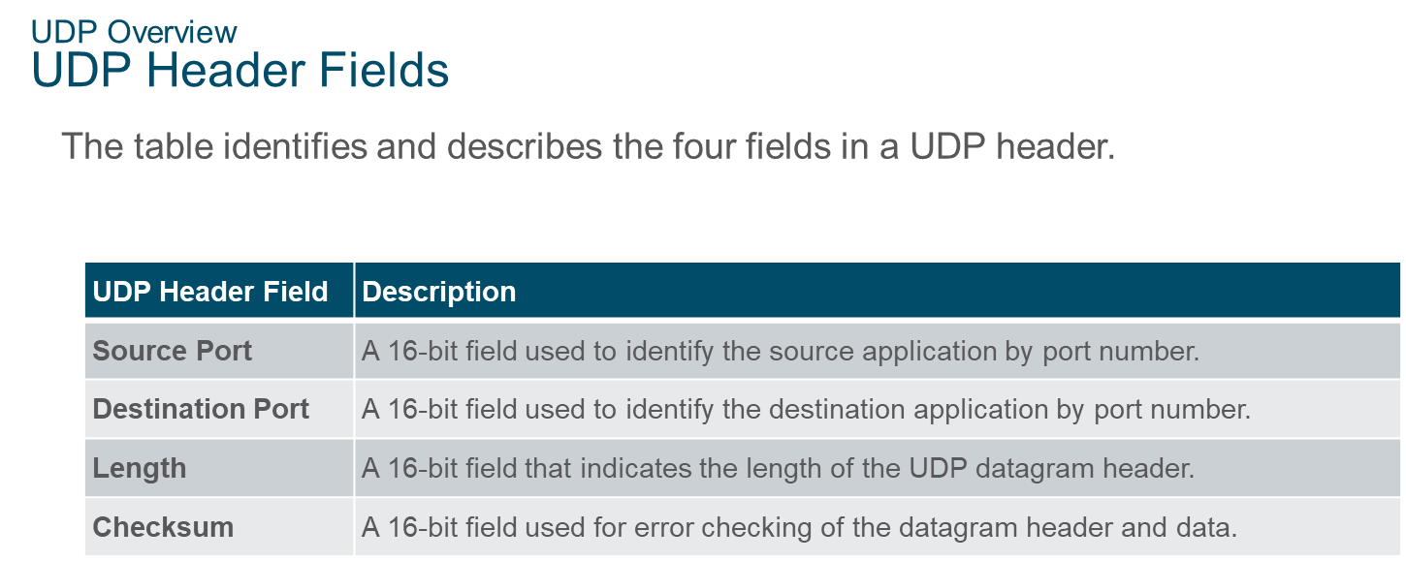
Chapter
07
UDP Overview

Slide 16
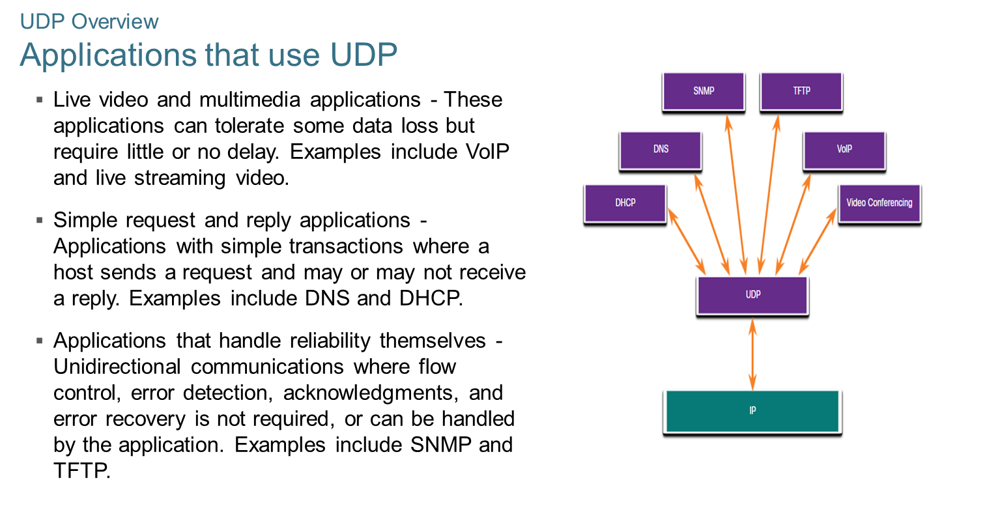
Chapter
07
UDP Overview

Slide 17
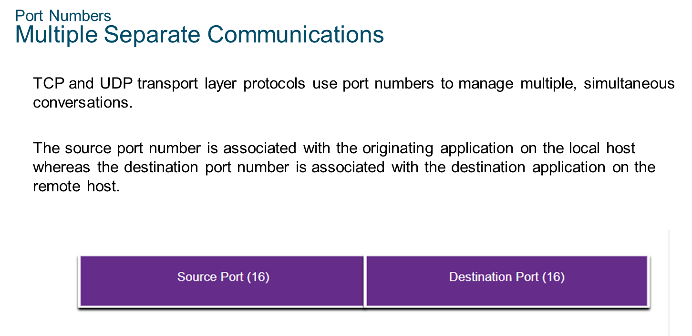
Chapter
07
Port Numbers

Slide 18
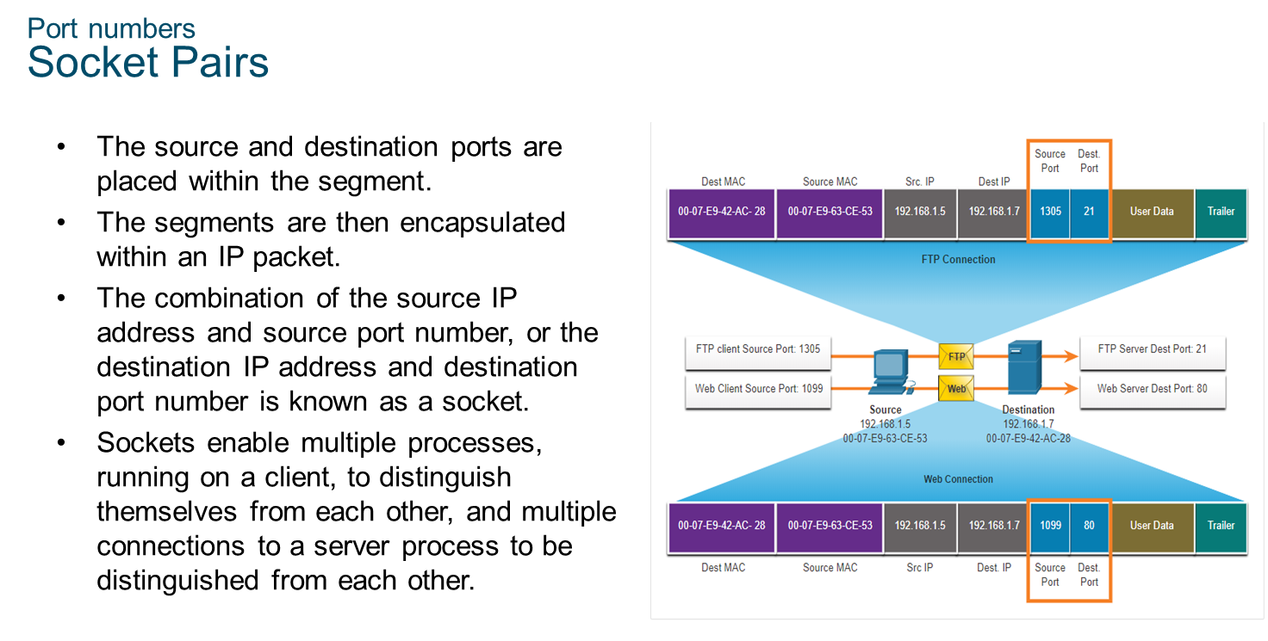
Chapter
07
Port Numbers

Slide 19

Chapter
07
Port Numbers

Slide 20
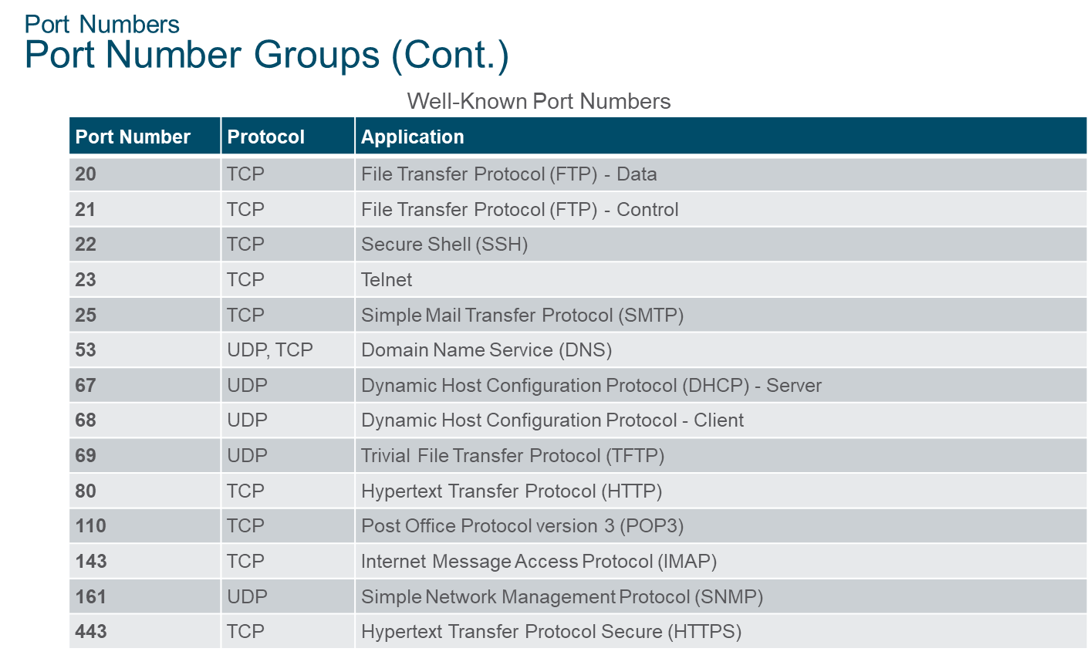
Chapter
07
Port Numbers

Slide 21
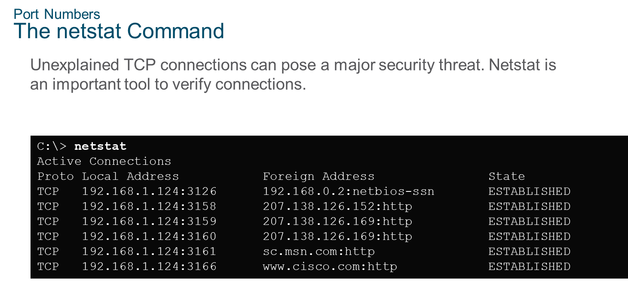
Chapter
07
Port Numbers

Slide 22
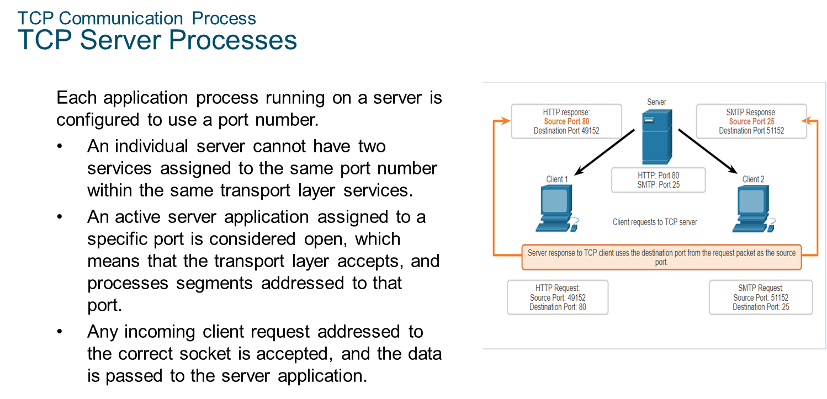
Chapter
07
TCP Communication Process

Slide 23
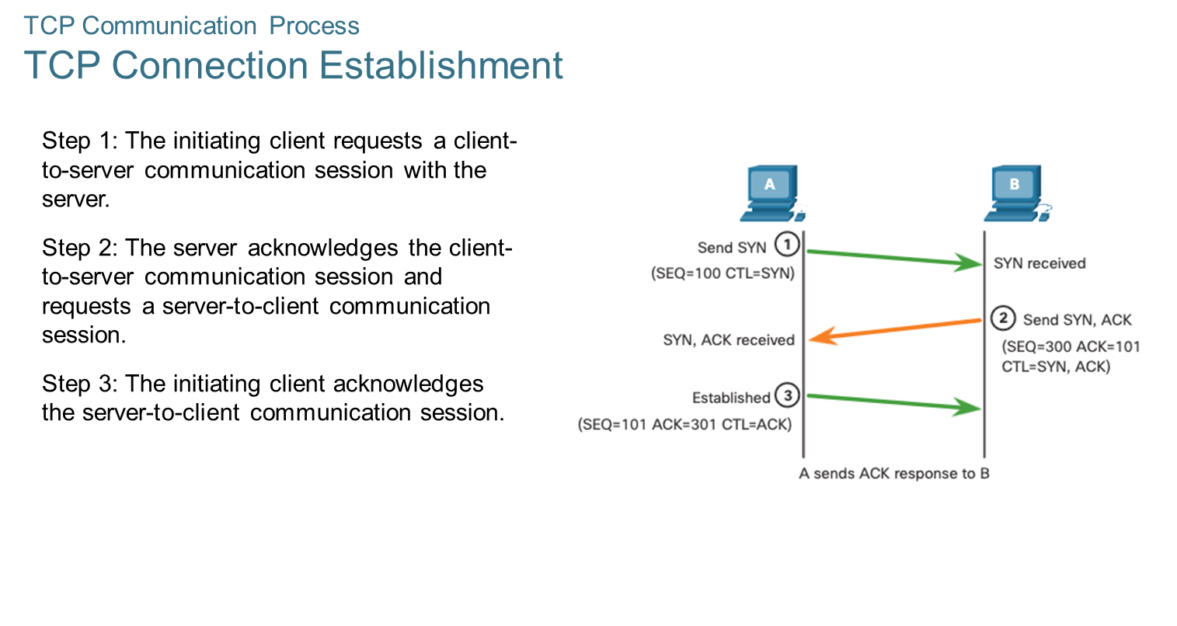
Chapter
07
TCP Communication Process

Slide 24
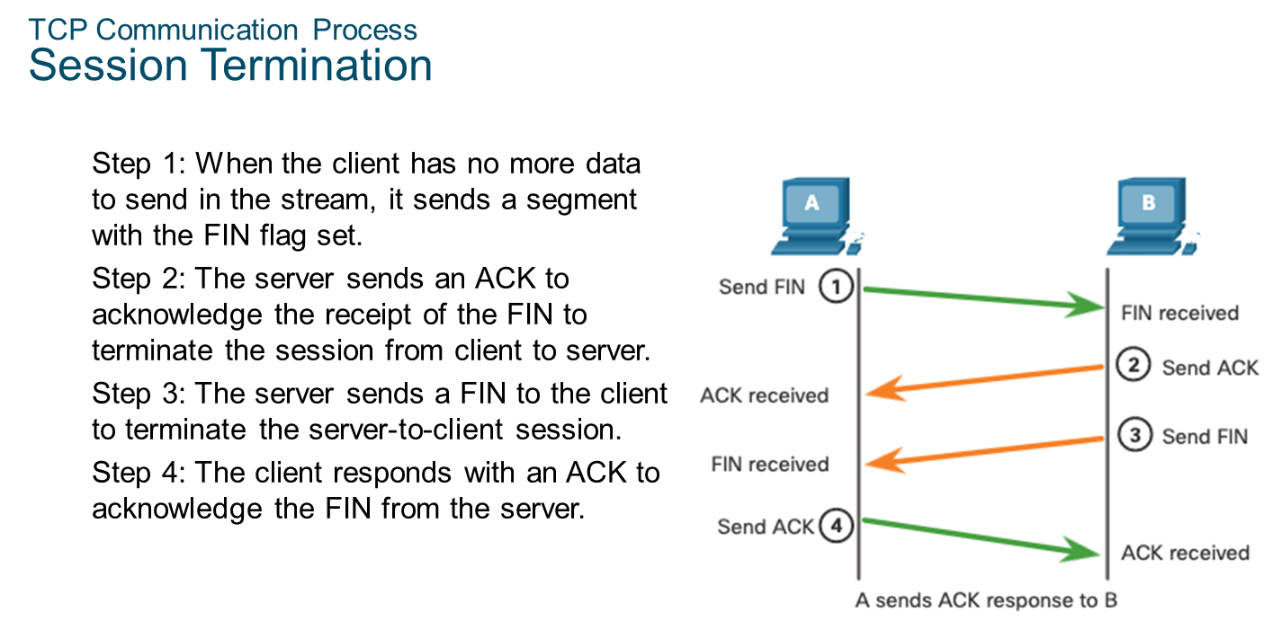
Chapter
07
TCP Communication Process

Slide 25
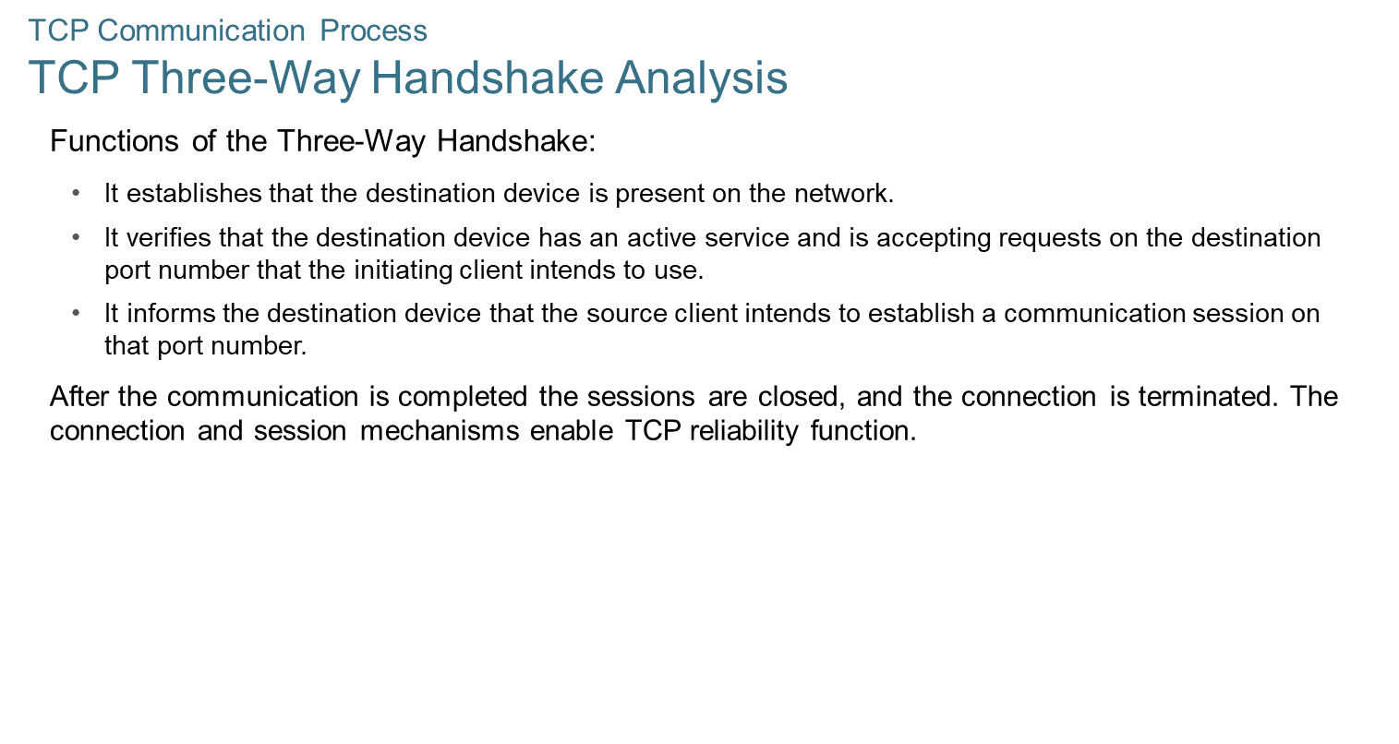
Chapter
07
TCP Communication Process

Slide 26
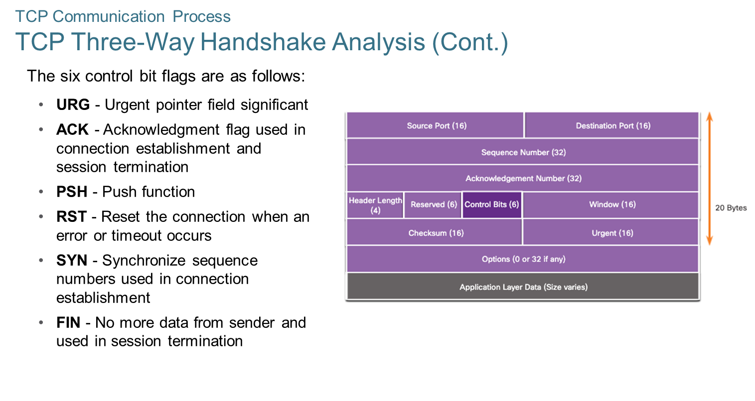
Chapter
07
TCP Communication Process

Slide 27
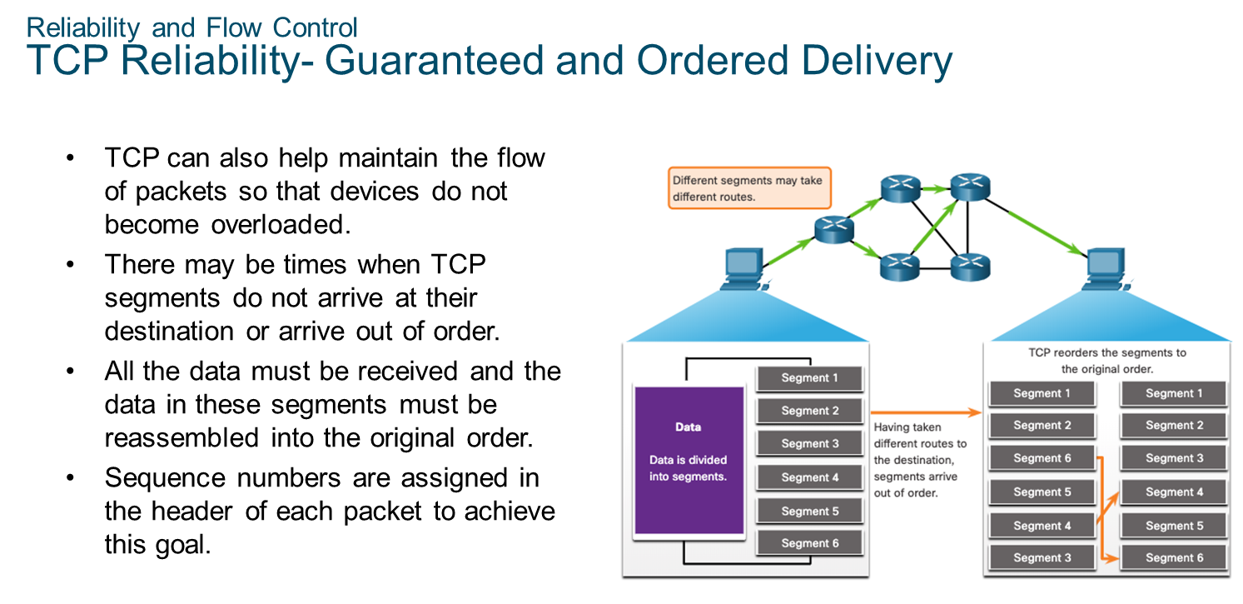
Chapter
07
Reliability and Flow Control

Slide 28
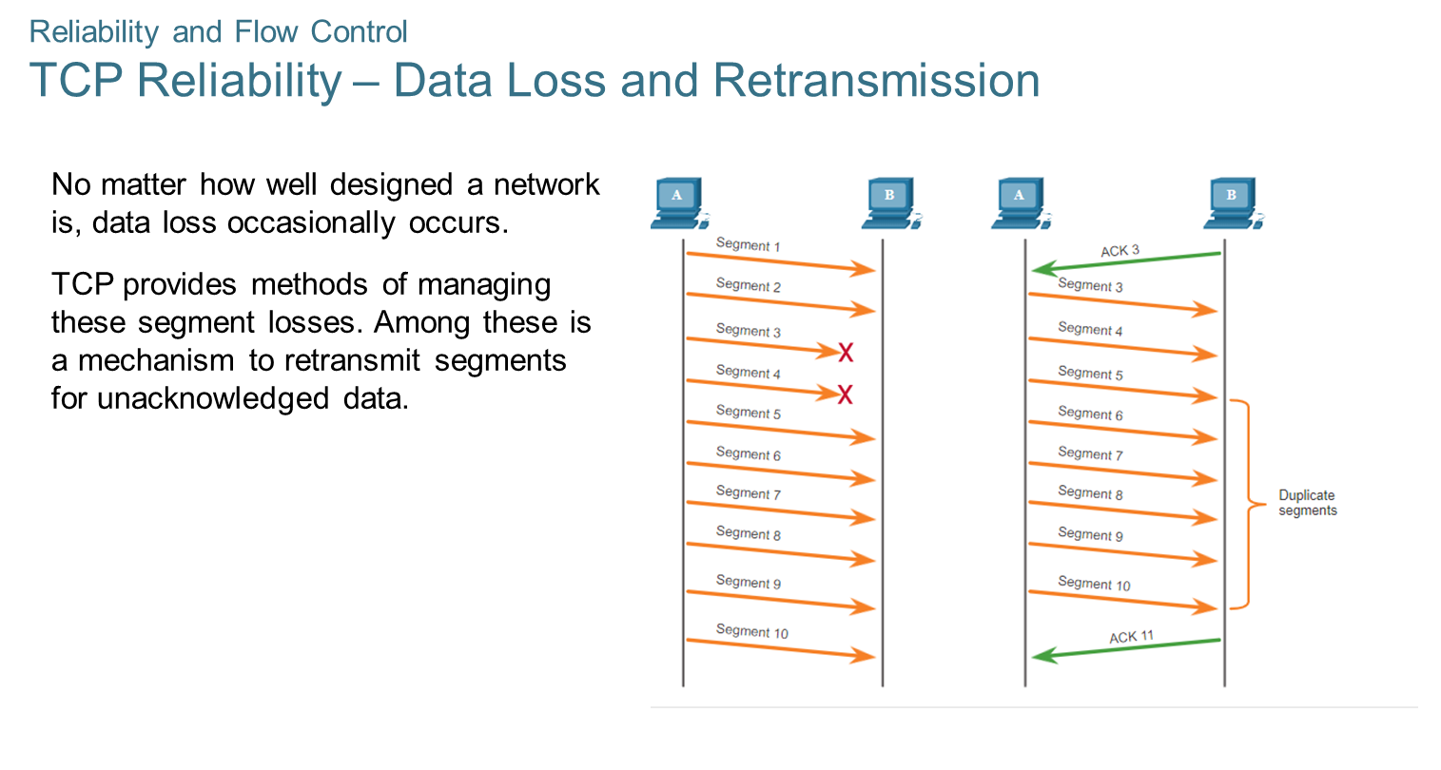
Chapter
07
Reliability and Flow Control

Slide 29
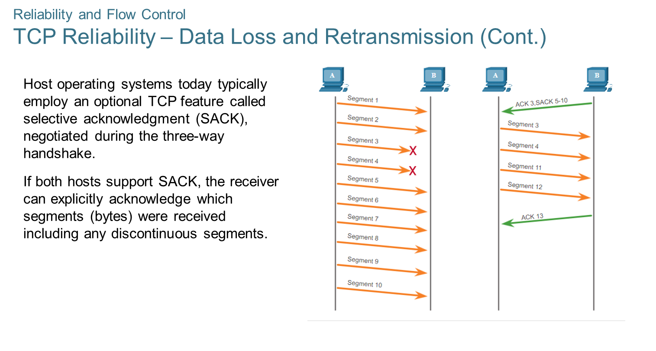
Chapter
07
Reliability and Flow Control

Slide 30
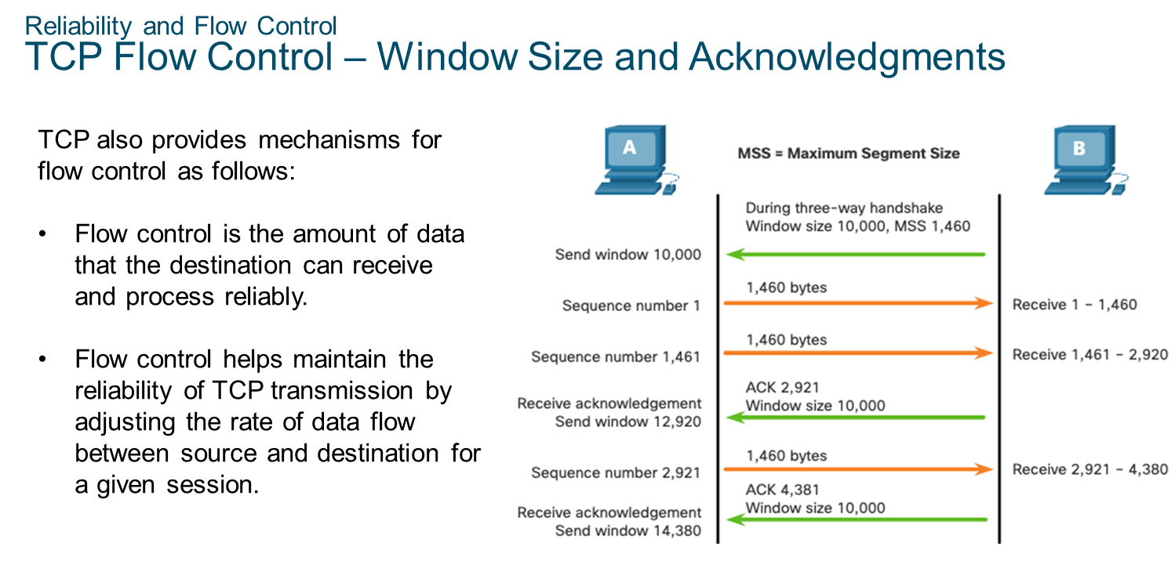
Chapter
07
Reliability and Flow Control

Slide 31
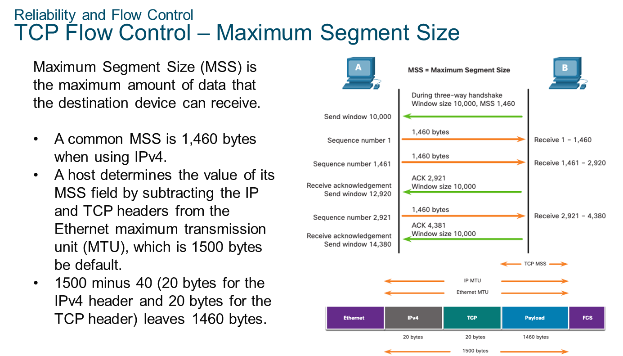
Chapter
07
Reliability and Flow Control

Slide 32
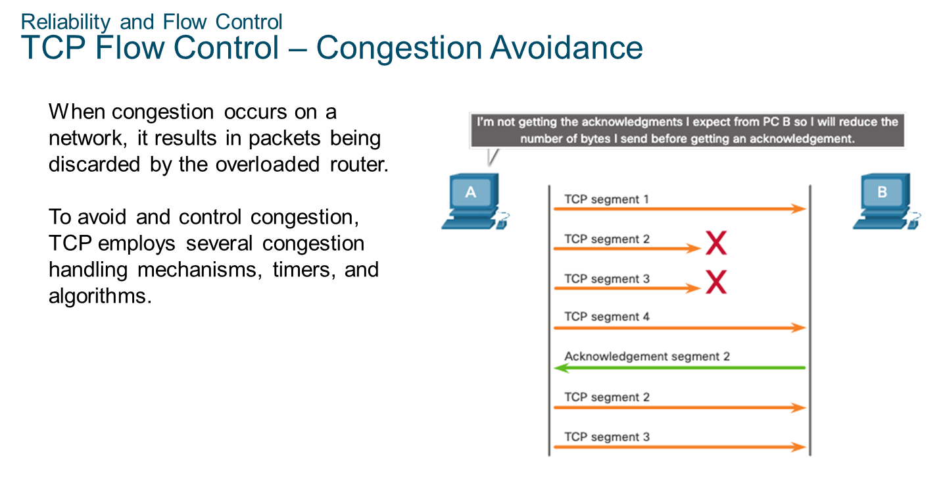
Chapter
07
Reliability and Flow Control

Slide 33
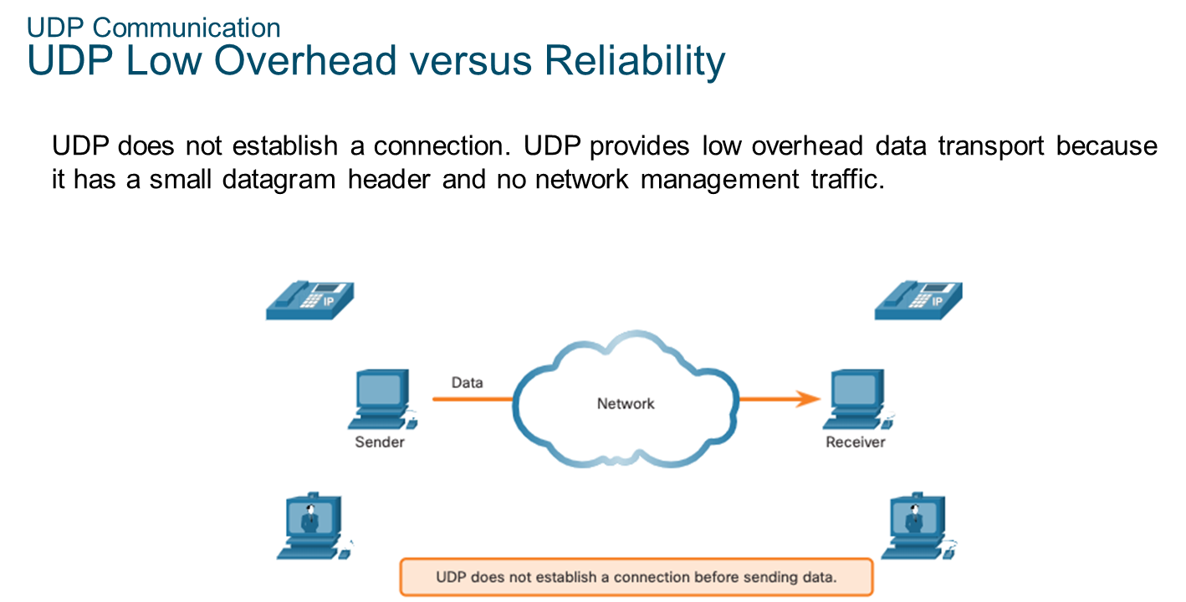
Chapter
07
UDP Communication

Slide 34
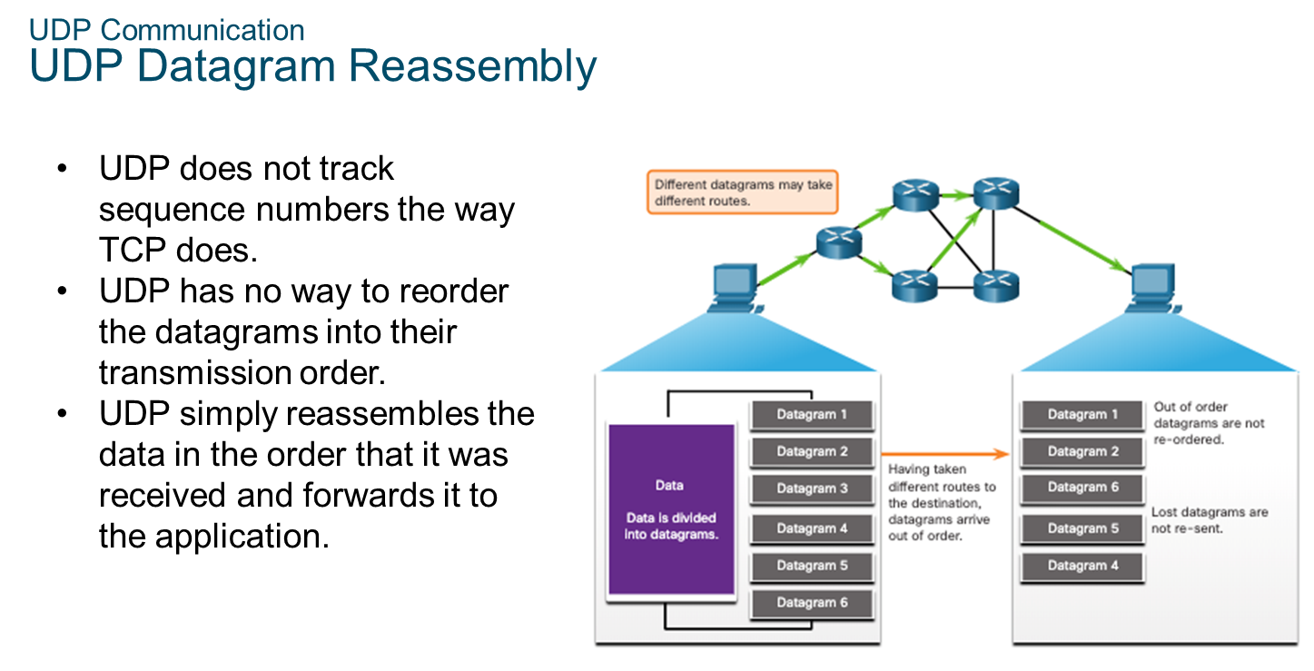
Chapter
07
UDP Communication

Slide 35
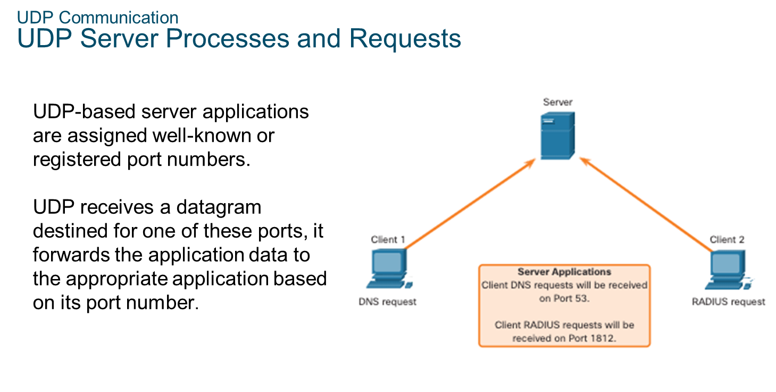
Chapter
07
UDP Communication

Slide 36
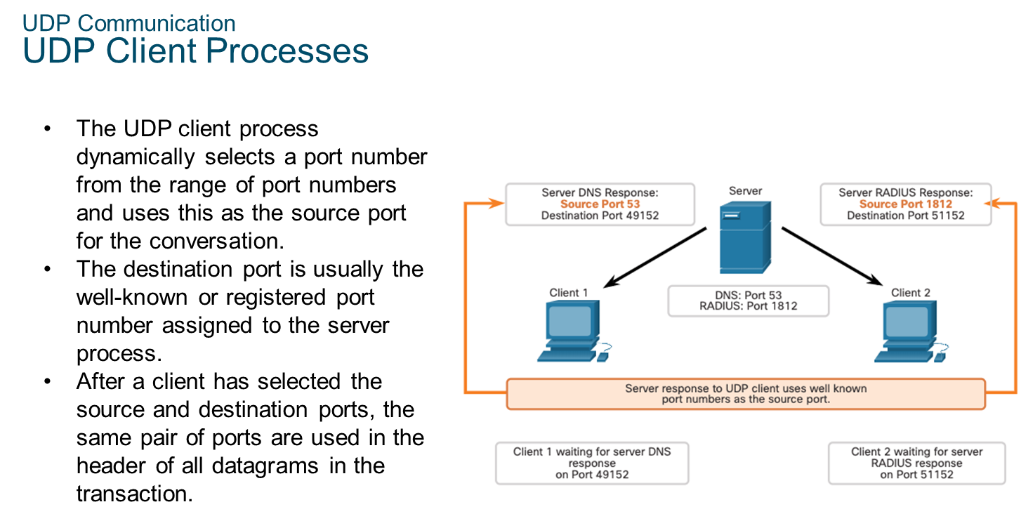
Chapter
07
UDP Communication

Slide 37



Thank You

