Slide 1


Introduction to
Research Methods
Prepared by Associate Professor/
Ahmed Rageh Ismail
MGM333
Introduction to Research Methods
Lecture 6

Slide 2

Chapter
Learning Outcomes
6
Explain the importance of simultaneous data collection and analysis in grounded theory and describe the iterative approach involved.
Understand theoretical sampling methods to select information-rich cases and achieve theoretical saturation in grounded theory research.
Learn data coding and construct categories from empirical data, ensuring the emergence of grounded theory from data rather than preconceived notions.
www.midocean.ae

Slide 3
Chapter
Learning Outcomes
6
Utilize memo writing for theory advancement
How to conduct various types of research interviews, including structured and unstructured formats, to collect qualitative, descriptive, and in-depth data.
Implement and analyze interview data
www.midocean.ae

Slide 4
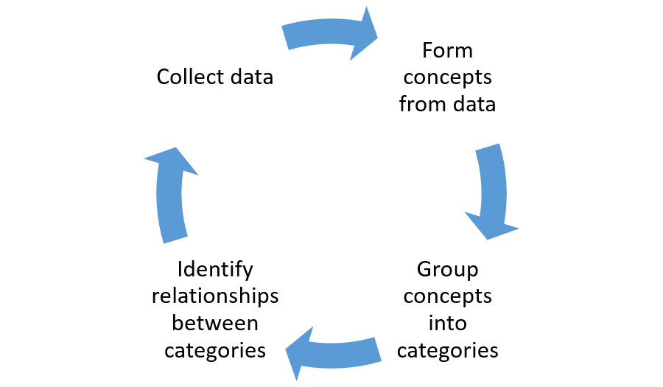
Chapter
Defining Grounded Theory
6
Not a Specific Research Method
Grounded theory is not tied to a particular method but involves key principles in any research design, such as ethnographic studies, case studies, or action research.
www.midocean.ae

Slide 5

Chapter
An example of using grounded theory in business
6
One example of how grounded theory may be used in business is to support HR teams by analyzing data to explore reasons why people leave a company.
For example, a company with a high attrition rate that has not done any research on this area before may choose grounded theory to understand key reasons why people choose to leave.
www.midocean.ae

Slide 6

Chapter
6
Researchers may start looking at the quantitative data around departures over the year and look for patterns.
Coupled with this, they may conduct qualitative data research through employee engagement surveys, interview panels for current employees, and exit interviews with leaving employees.
www.midocean.ae

Slide 7
Chapter
6
From this information, they may start coding transcripts to find similarities and differences (coding) picking up on general themes and concepts. For example, a group of excepts like:
“The hours I worked were far too long and I hated traveling home in the dark”
“My manager didn’t appreciate the work I was doing, especially when I worked late”
There are no good night bus routes home that I could take safely”
www.midocean.ae

Slide 8
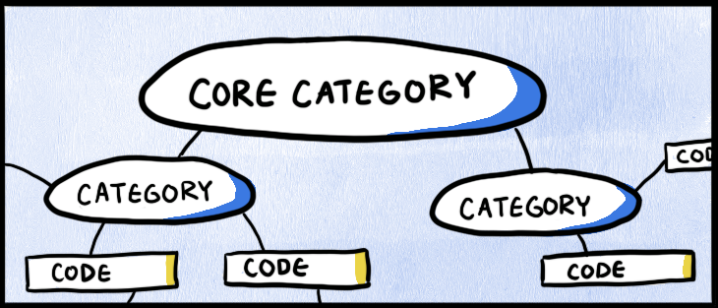
Chapter
6
Using open coding, a researcher could compare excerpts and suggest the themes of managerial issues, a culture of long hours and lack of traveling routes at night.
With more samples and information, through axial coding, stronger themes of lack of recognition and having too much work (which led people to working late), could be drawn out from the summaries of the concepts and themes.
www.midocean.ae

Slide 9
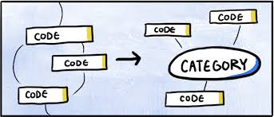
Chapter
6
This could lead to a selective coding conclusion that people left because they were ‘overworked and under-appreciated’.
With this information, a grounded theory can help HR teams look at what teams do day to day, exploring ways to spread workloads or reduce them. Also, there could be training supplied to management and employees to engage professional development conversations better.
www.midocean.ae

Slide 10
Chapter
Major Principles
6
Research Question
Begins with a broad, open-ended question focused on discovery.
Simultaneous Data Collection and Analysis
Data is collected and analyzed simultaneously to inform ongoing research.
Sampling Towards Theory Construction
Sampling continues until theoretical saturation is achieved, meaning no new information is found.
www.midocean.ae

Slide 11

Chapter
6
Constructing Data Categories
Empirical data is used to develop categories that help in understanding the phenomena being studied.
Developing Theory Continuously
Theory is developed throughout data collection and analysis phases.
Memo-Writing
Writing memos helps in advancing the theory by documenting insights and reflections (Charmaz, 2006).
www.midocean.ae

Slide 12
Chapter
Research Question and Process
6
Grounded theory research aims to discover new insights rather than answer specific questions or test hypotheses.
Suitable for studying individual processes, interpersonal relations, and interactions within larger social contexts (Charmaz, 1995).
Research begins with a very open question, such as "How do people engage in the information seeking process?" The focus is on understanding the process and the user group involved.
As research progresses, specific focuses and questions emerge based on observations and data collection.
www.midocean.ae

Slide 13

Chapter
Engaging in Questioning
6
Observation Techniques (Charmaz, 2006)
Watch for Actions and Processes: Pay attention to what people do and the processes they engage in, not just what they say.
Contextual Understanding: Carefully note the context in which actions occur to understand underlying reasons and conditions.
www.midocean.ae

Slide 14
Chapter
6
Detailed Recording: Record details of who did what, why, and under what conditions to capture the complexity of interactions.
Identifying Conditions: Determine the conditions that influence actions, intentions, and processes.
Flexible Exploration: Start with an open question and explore its many facets, allowing salient issues to emerge naturally.
Avoiding Preconceptions: Grounded theory research avoids rigid preconceptions and allows specific, detailed questions to arise organically during the research process.
www.midocean.ae

Slide 15

Chapter
Simultaneous Data Collection and Analysis
6
Key Principle
Emphasizes the simultaneous involvement in data collection and analysis phases (Charmaz, 1995).
Inductive Analysis
Ongoing process from the outset; essential for formulating a theory grounded in raw data.
www.midocean.ae

Slide 16

Chapter
6
Iterative Approach
Data collection and analysis occur together, promoting the emergence of substantive theory (Marshall and Rossman, 1995).
Initial Data Analysis
First step in analysis, providing preliminary categories and guiding subsequent data collection decisions.
www.midocean.ae

Slide 17

Chapter
Iterative Data Collection and Analysis
6
Continuous Process
Avoids a linear approach by constantly moving between data collection and analysis.
Guiding Further Steps
Initial data analysis informs what types of data are needed next and who to collect it from.
www.midocean.ae

Slide 18

Chapter
6
Rich Data
Requires detailed and full descriptions of events, emotions, reactions, etc.
Intensive Interviews and Observations
Essential for gathering rich data, requiring careful scheduling to allow for transcription and initial analysis before the next data collection activity.
www.midocean.ae

Slide 19
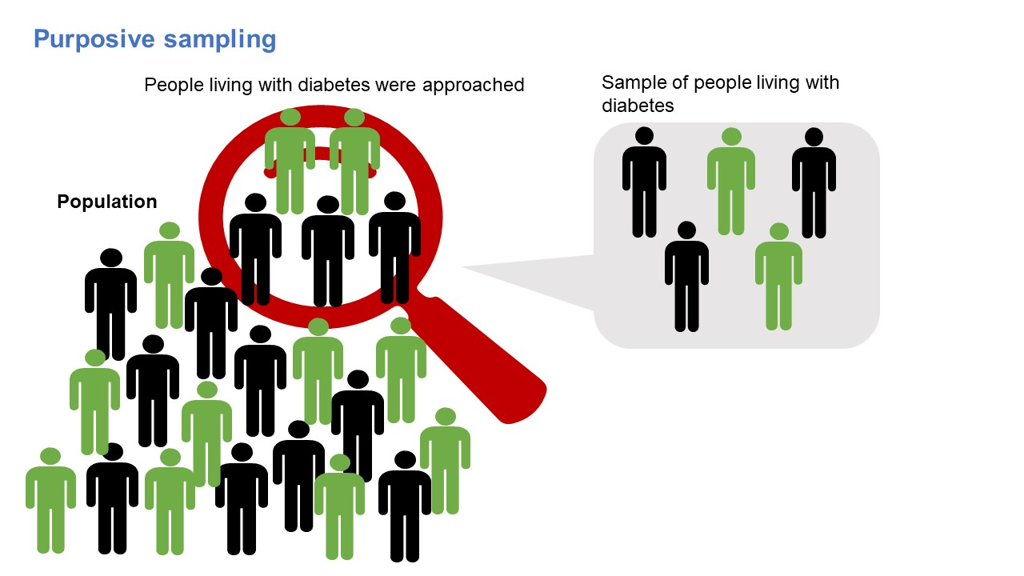
Chapter
Sampling Towards Theory Construction
6
Purposeful Sampling
Selecting information-rich cases to learn about central research issues (Patton, 2002).
Theoretical Sampling
Driven by data; no a priori identification of precise participants.
www.midocean.ae

Slide 20

Chapter
6
Empirical Inquiry
Starts with data, constructs tentative ideas, and examines these ideas through further empirical inquiry (Charmaz, 2006).
Sample Size and Saturation
Sample size and structure are not predetermined; sampling continues until theoretical saturation is achieved (Glaser and Strauss, 1967).
www.midocean.ae

Slide 21
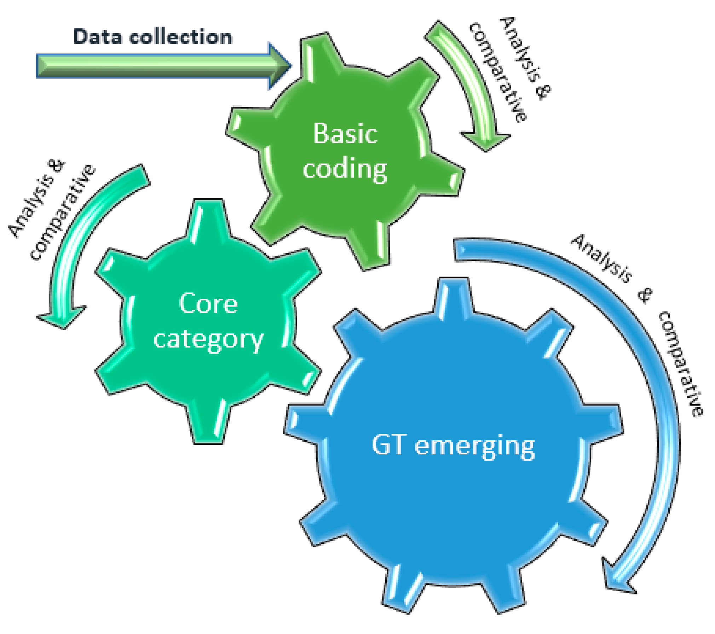
Chapter
Constructing Categories from Empirical Data
6
Coding as a Pivotal Link
Coding connects data collection to theory development (Charmaz, 2006).
Emergence of Categories
Categories emerge from coding rules, serving as higher-level concepts.
www.midocean.ae

Slide 22
Chapter
6
Empirical Evidence
Categories must arise from data, not be preconceived by researchers.
Role of Existing Theories
Prior theories can guide but not influence new data collection and analysis. They act as conceptual bridges and cognitive structures (Stake, 1995).
Testing in Real Situations
Codes and categories are tested in real-world contexts to validate them.
www.midocean.ae

Slide 23
Chapter
Continuous Theory Development
6
Empirical Basis
Theory is derived from data and illustrated with data examples (Glaser and Strauss, 1967).
Interpretivist Approach
Relies on researcher interpretations of evidence, not absolute truth.
www.midocean.ae

Slide 24
Chapter
6
Early and Ongoing Process
Theory development starts early and evolves with ongoing data analysis.
Substantive Theory
Initial theory related to specific research context and events.
Formal Theory
Higher abstraction level, usually emerging from multiple studies.
www.midocean.ae

Slide 25
Chapter
Emergence and Application of Theory
6
Real-world Relevance
Theory must align closely with data to be practical and applicable (Glaser and Strauss, 1967).
Stages of Theory Development
Substantive theory emerges first, followed by formal theory from broader empirical knowledge.
www.midocean.ae

Slide 26

Chapter
6
Understanding by All
Theory derived from real-world evidence is understandable by researchers, practitioners, and laypeople alike.
Memo Writing
Encourages extensive interaction with data, aiding in theory development.
www.midocean.ae

Slide 27
Chapter
Importance of Memo Writing
6
Pivotal Intermediate Step
Memo-writing bridges data collection and writing drafts of papers (Charmaz, 2006).
Continuous Interaction
Theory emerges from constant interaction with data and categories, documented in memos (Glaser, 1998).
www.midocean.ae

Slide 28

Chapter
6
Attachment to Data
Memos are usually attached to the data or kept in a well-maintained research diary/log.
Purpose
Provides a written commentary and interpretation of data as it is gathered.
www.midocean.ae

Slide 29
Chapter
Benefits and Process of Memo Writing
6
Visualization and Thinking Aloud
Helps visualize analysis and articulate thoughts about data.
Developing Rhythm
Encourages a rhythm in developing emerging theory and initiating ideas about data relationships.
www.midocean.ae

Slide 30
Chapter
6
Identifying Gaps
Highlights overlooked areas and identifies gaps needing further investigation.
Finding Researcher’s Voice
Encourages researchers to find their voice and maintain close connection to data.
www.midocean.ae

Slide 31
Chapter
Memo Writing in Practice
6
Private Dialogue
Memos are a private dialogue with data, exploring words, actions, feelings, and relationships.
Exploration and Discovery
Memos form a space for exploration and discovering ideas about observed data (Charmaz, 2006).
www.midocean.ae

Slide 32
Chapter
6
Evolving Nature
Memos evolve from short, directed statements to intricate discussions about relationships and patterns.
Data Analysis
Memos are considered part of data analysis and are integral to both Glaser’s and Strauss and Corbin’s methods.
www.midocean.ae

Slide 33


Slide 34
Chapter
Forms of Research Interviews
6
Structured Interviews
Formal, researcher-administered questionnaires.
Informal Interviews
Purposeful conversations led by participants (Dexter, 1970; Lincoln and Guba, 1985).
Researcher takes control during analysis and interpretation (Tagg, 1985).
www.midocean.ae

Slide 35

Chapter
6
Designing Appropriate Interviews
Tailor interviews to the research topic, participant nature, and researcher experience.
Neophyte interviewers should avoid totally unstructured conversations initially.
www.midocean.ae

Slide 36

Chapter
Becoming a Good Interviewer
6
Practice is Essential
Practice interviews to improve technique and confidence.
Know Your Topic
A thorough literature review helps immerse in the topic.
www.midocean.ae

Slide 37

Chapter
6
Know Yourself
Understand your reactions and style in interview situations.
Practice with Familiar Topics
Conduct interviews on familiar topics with friends to practice data collection and question formulation.
www.midocean.ae

Slide 38

Chapter
Purpose and Suitability of Interviews
6
Accessing the Interviewee’s Mind
Interviews reveal what is in and on the interviewee’s mind (Stenhouse, 1984).
Qualitative, Descriptive Data
Suitable for complex, in-depth data specific to individuals.
www.midocean.ae

Slide 39
Chapter
6
Reconstruction and Prediction
Allows reconstruction of past events, interpretation of present, and prediction of future (Lincoln and Guba, 1985).
Interaction and Clarification
Facilitates interaction between researcher and subject, clarifying meanings and shared understanding (Bertrand and Hughes, 2005).
Not for Factual Data
Less suitable for precise dates, times, or quantifiable data, which are better collected through other methods.
.
www.midocean.ae

Slide 40
Chapter
Overview of the Seven Stages
6
Kvale (1996) outlines seven stages
Thematizing
Designing
Interviewing
Transcribing
Analyzing
Verifying
Reporting
Process is iterative, especially in the final stages for unstructured interviews.
www.midocean.ae

Slide 41
Chapter
Thematizing
6
Purpose and Topic
Clarify the "why" and "what" before the "how" (Kvale, 1996).
Establish research purpose and investigate the topic thoroughly.
Establish Themes
Identify themes appropriate for each interviewee.
Structure themes logically to aid in understanding feelings, behavior, and beliefs.
www.midocean.ae

Slide 42
Chapter
Designing
6
Interview Guide
Ensures each interview covers the same ground but allows flexibility.
Can range from a strict script to a list of topics (Ellis, 1993).
Structure
Decide on the extent of structure based on interview type.
Example: Semi-structured guide for young teenagers (Pickard, 2002).
www.midocean.ae

Slide 43
Chapter
Interviewing
6
Reflective Approach
Conduct interviews based on the guide and be reflective about knowledge sought (Kvale, 1996).
Rapport Building
Create a comfortable environment for interviewees.
Practice to improve technique and reduce nervousness.
Preparation
Know your questions and the purpose behind them.
Estimate interview time accurately.
www.midocean.ae

Slide 44
Chapter
Types of Interviews
6
Structured Interviews
Preestablished questions with limited response categories (Fontana and Frey, 1994).
Benefits include visual and oral cues, control over response rates, and pre-coding for easier analysis.
Unstructured Interviews
Holistic understanding of interviewee’s thoughts and feelings.
Informal conversational interview and general interview guide (Patton, 1987).
Demands high familiarity with the topic and comfort in the interview situation.
www.midocean.ae

Slide 45

Chapter
Recording
6
Audio Recording
Provides security but may inhibit interviewees.
Familiarity with equipment is crucial to avoid technical issues.
Note-Taking
Balances writing important information and staying engaged.
Use pre-prepared notepads for efficiency.
www.midocean.ae

Slide 46

Chapter
Transcribing
6
Timeliness
Transcribe as soon after the interview as possible.
Allow time for initial transcription and analysis.
Detail Level
Decide on full or partial transcription based on research needs.
Full transcription is necessary for ethnographic studies; specific themes for surveys.
www.midocean.ae

Slide 47

Chapter
Analyzing
6
Continuous Process
Analysis begins during the interview with initial reflections and follow-up questions.
Qualitative research involves ongoing analysis..
www.midocean.ae

Slide 48

Chapter
Verifying
6
Interview Purpose
Ensure the interview answered the research question (Kvale, 1996).
Member Check
Return to interviewees to confirm interpretations match their intentions (Lincoln and Guba, 1985).
Can yield additional data.
www.midocean.ae

Slide 49
Chapter
Reporting
6
Use of Evidence
Interviews form the foundation of emerging theory.
Verbatim quotes are crucial evidence in research reports.
Interpretation of what was said should be well-documented.
www.midocean.ae

Slide 50



Thank You

