Slide 1

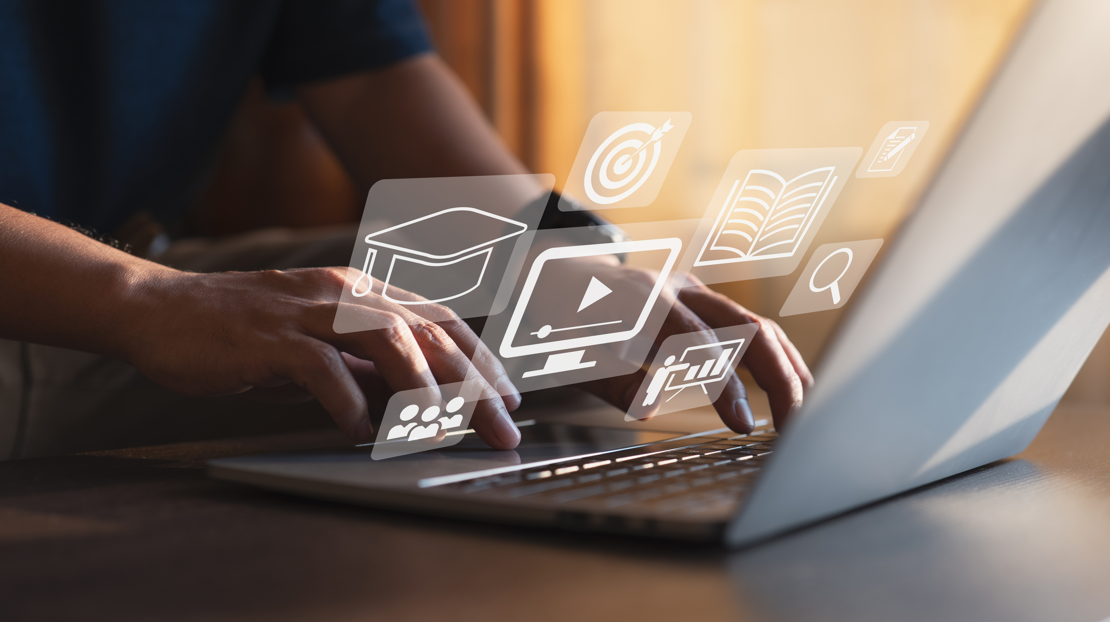

Digital Content Direction
Prepared by Dr. Sherihan Mohamed
DGM 733
Lecture 1

Slide 2
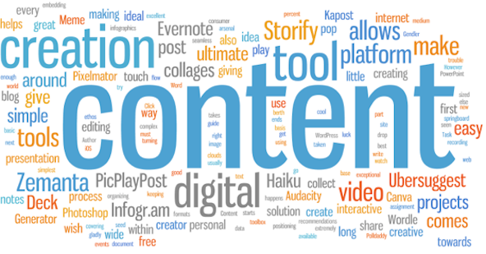
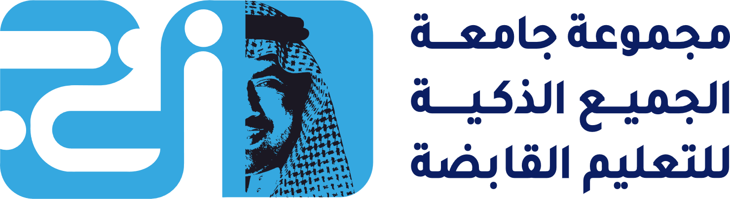

Digital Content: Purpose and Goals
Lecture 1

Slide 3

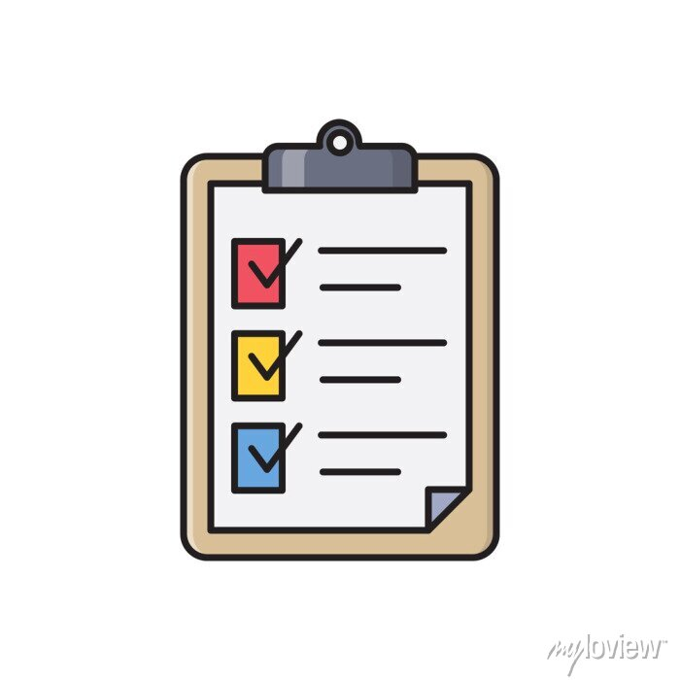
Lecture 1
Lecture Outlines:
* Digital Content: A Closer Look
* Who Creates Digital Content?
* Content Creators
* Web 2.0 and Convergence Culture
* Conclusion
* References

Slide 4

Lecture 1
Digital Content Direction
Digital Content: A Closer Look

Slide 5
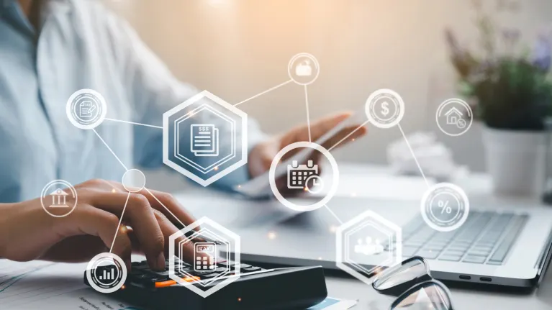
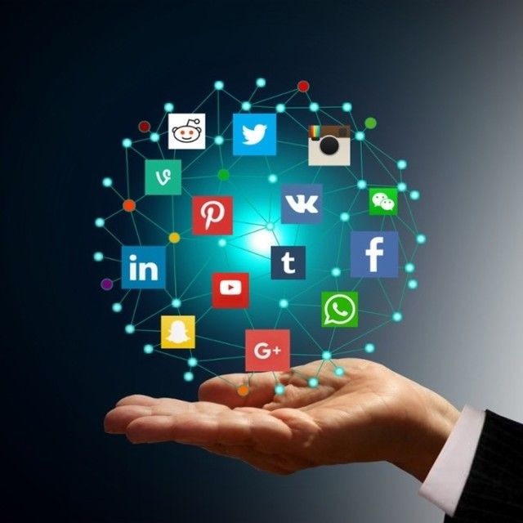
Digital Content: A Closer Look
Digital media content means any data or information that is produced in digital form, including data or information created in analogue form but reformatted in digital form, text, graphics, photographs, animation, sound, and video content.

Slide 6
”Digital media content“ Does not mean content offerings generated by the end user (including postings on electronic bulletin boards and chat rooms); content offerings comprised primarily of local news, events, weather, or local market reports; public service content; electronic commerce platforms (such as retail and wholesale websites);

Slide 7
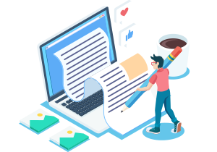
Websites or content that are produced or maintained primarily for private, industrial, corporate, or institutional purposes; or digital media content acquired or licensed by the taxpayer for distribution or incorporation into the taxpayer's digital media content.

Slide 8

Typically, digital content refers to information available for download or distribution on electronic media such as an ebook, iTunes song, blog content, or even social media post.

Slide 9
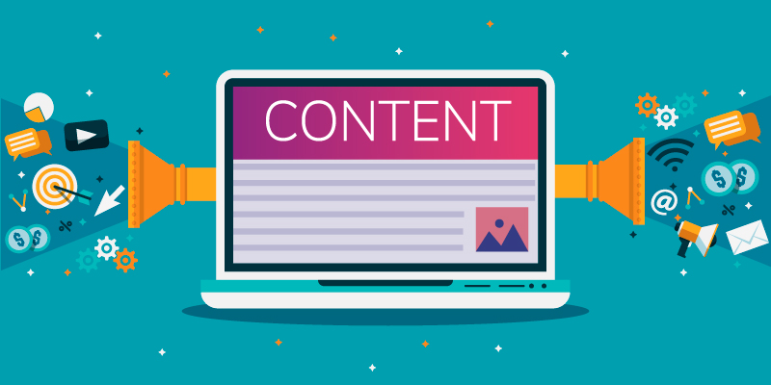
But many in the content industry argue that digital content is anything that can be published.
Following this line of thinking, it is safe to say that if you are on the internet, most likely you are looking at, watching, or listening to a piece of digital content.

Slide 10
Lecture 1
Digital Content Direction
Who Creates Digital Content?

Slide 11
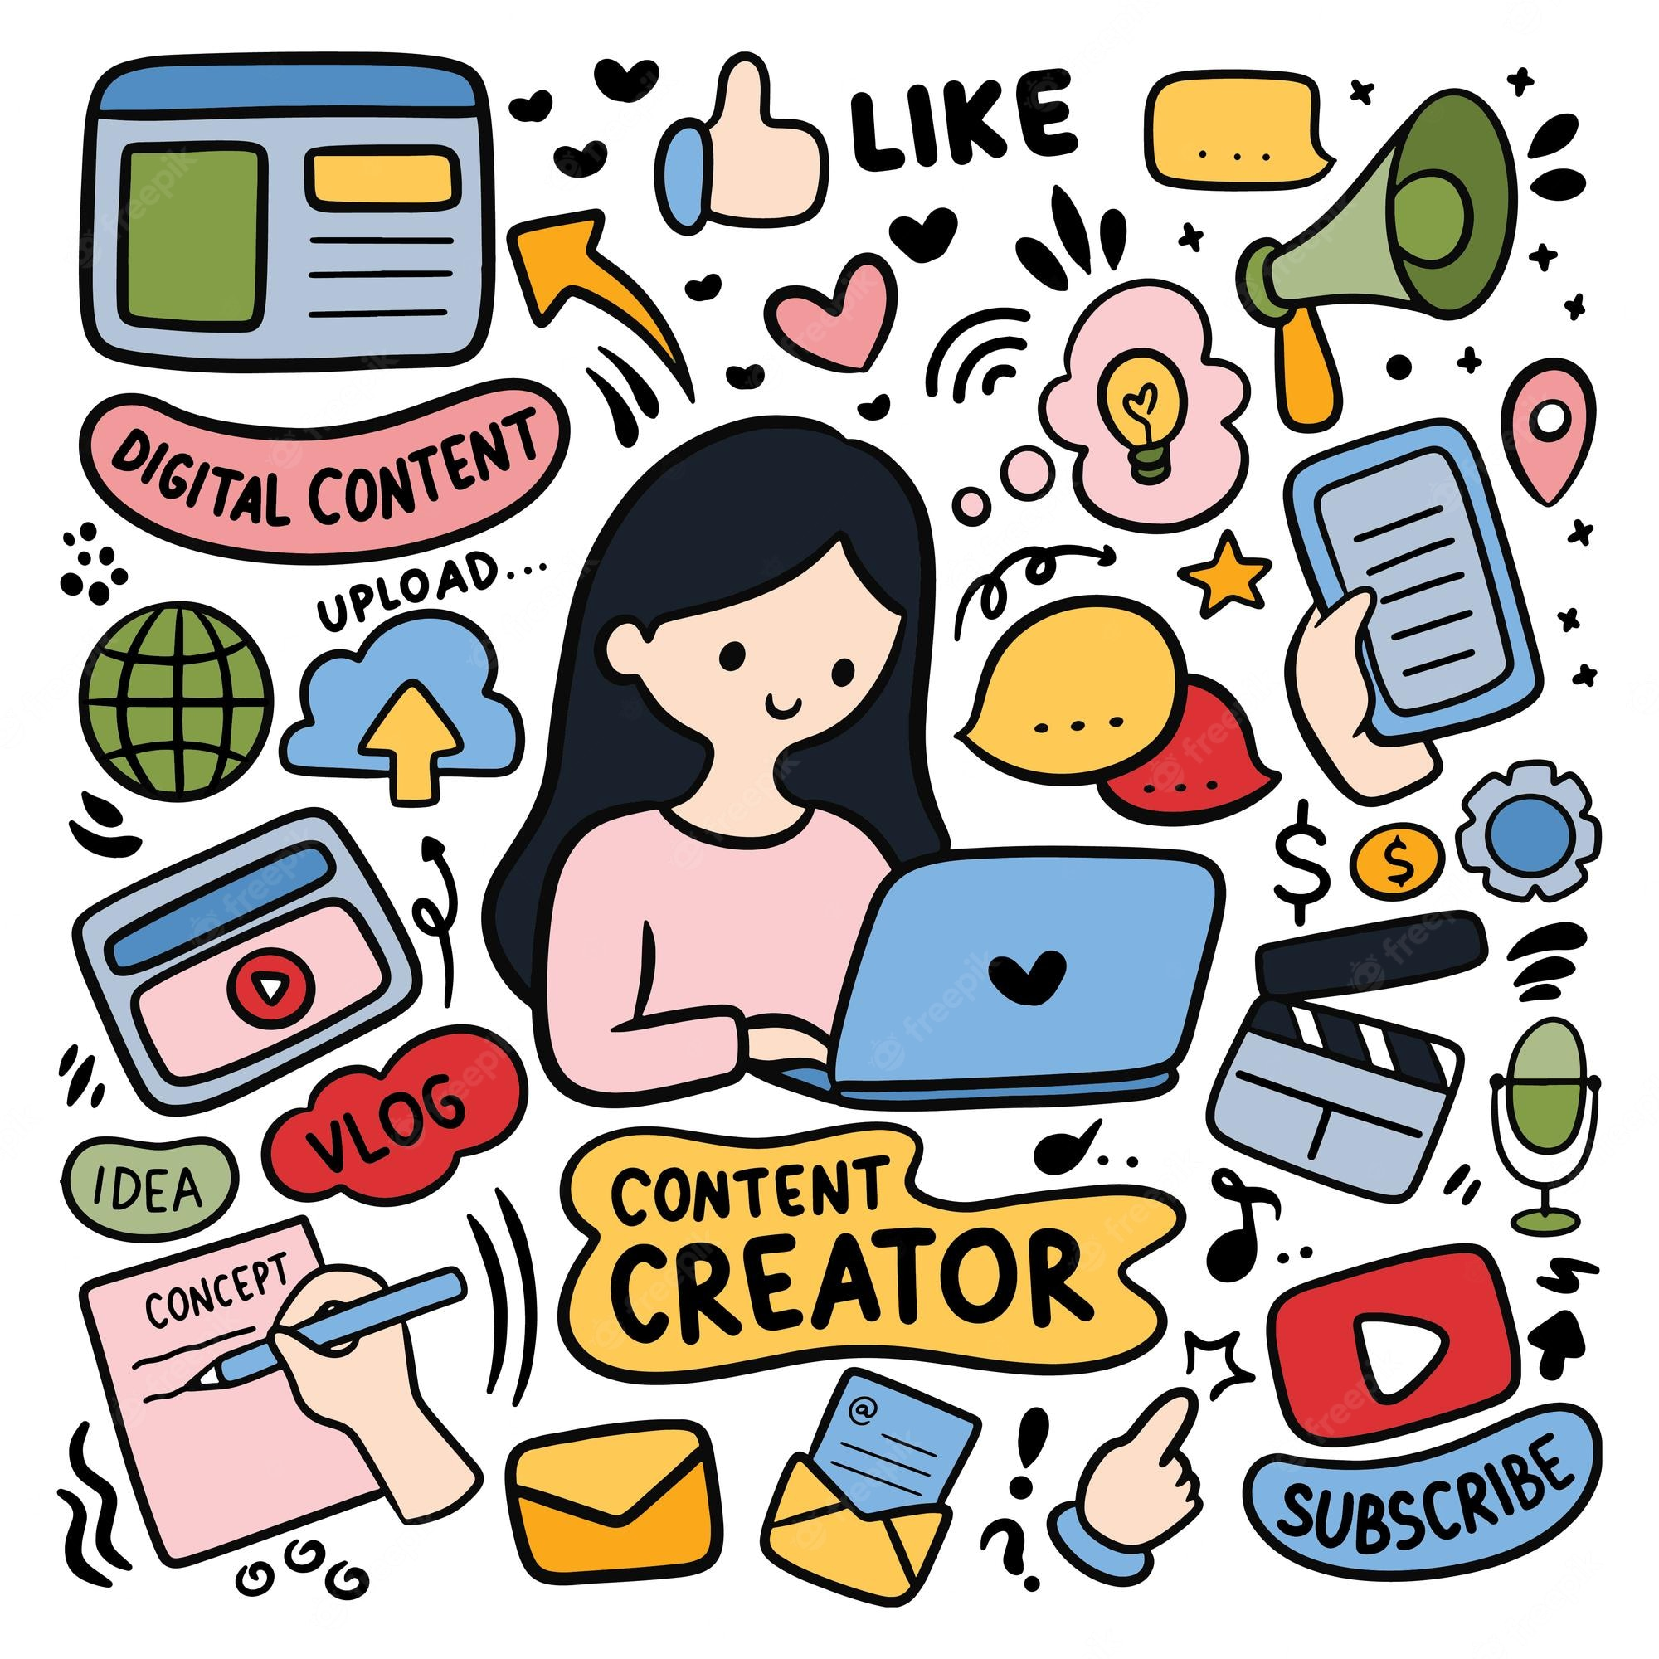
A digital content creator is somebody in charge of creating visually appealing and engaging content for an audience. This content is typically developed to educate, amuse, and delight a linked, digital audience.

Slide 12
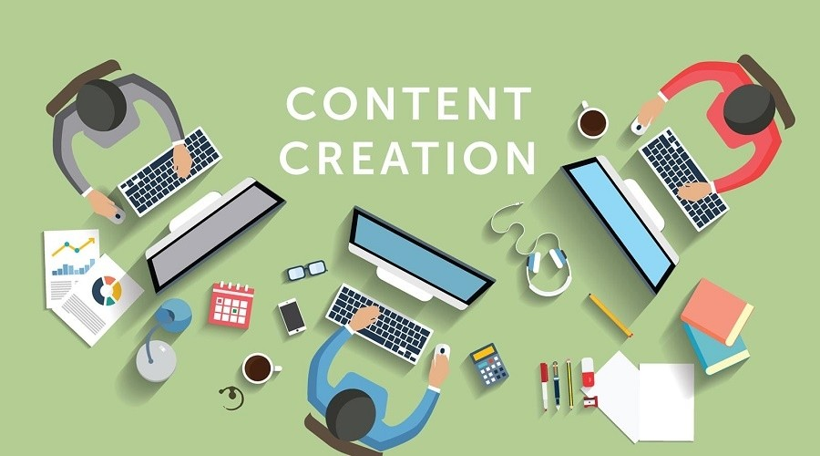
The primary goal is to build a following of people engaged in the content producer and the institution they represent. This entity could be the creator’s identity, a brand, or a business for which they work..

Slide 13
Blogs, marketing copy, online posts, podcasts, videos, graphic designs, and product and technology reviews are all examples of digital content. Many firms use digital material to create and grow their businesses on the internet. Using specialized services to develop compelling content for their consumers might assist companies in growing their brands more quickly.

Slide 14

Travel firms, for example, will typically hire writers, illustrators, and graphic designers to develop content for their websites, social media, and marketing materials.

Slide 15
A digital content maker, as the name suggests, creates material. This information could be in the video, audio, photos, or even text in blog articles.
They develop unique (mainly) content that elicits a specific reaction from their audience and piques their interest in the featured entity.

Slide 16
Creating Content For Third-Party Distribution:
Writers, for example, develop written products for third parties such as publications, marketing collateral, and website content.
Similarly, graphic designers, videographers, and other content creators do business by providing services to third parties. As a result, they command various fees based on their level of talent and experience.

Slide 17
With so many different types of content available, the question plaguing information experts today isn’t what kind of content to create, but how to deliver it.
With the continued popularity of smartphones, tablets, and eReaders, the average consumer now has a variety of options to turn to besides their computer to get the latest piece of digital content.

Slide 18
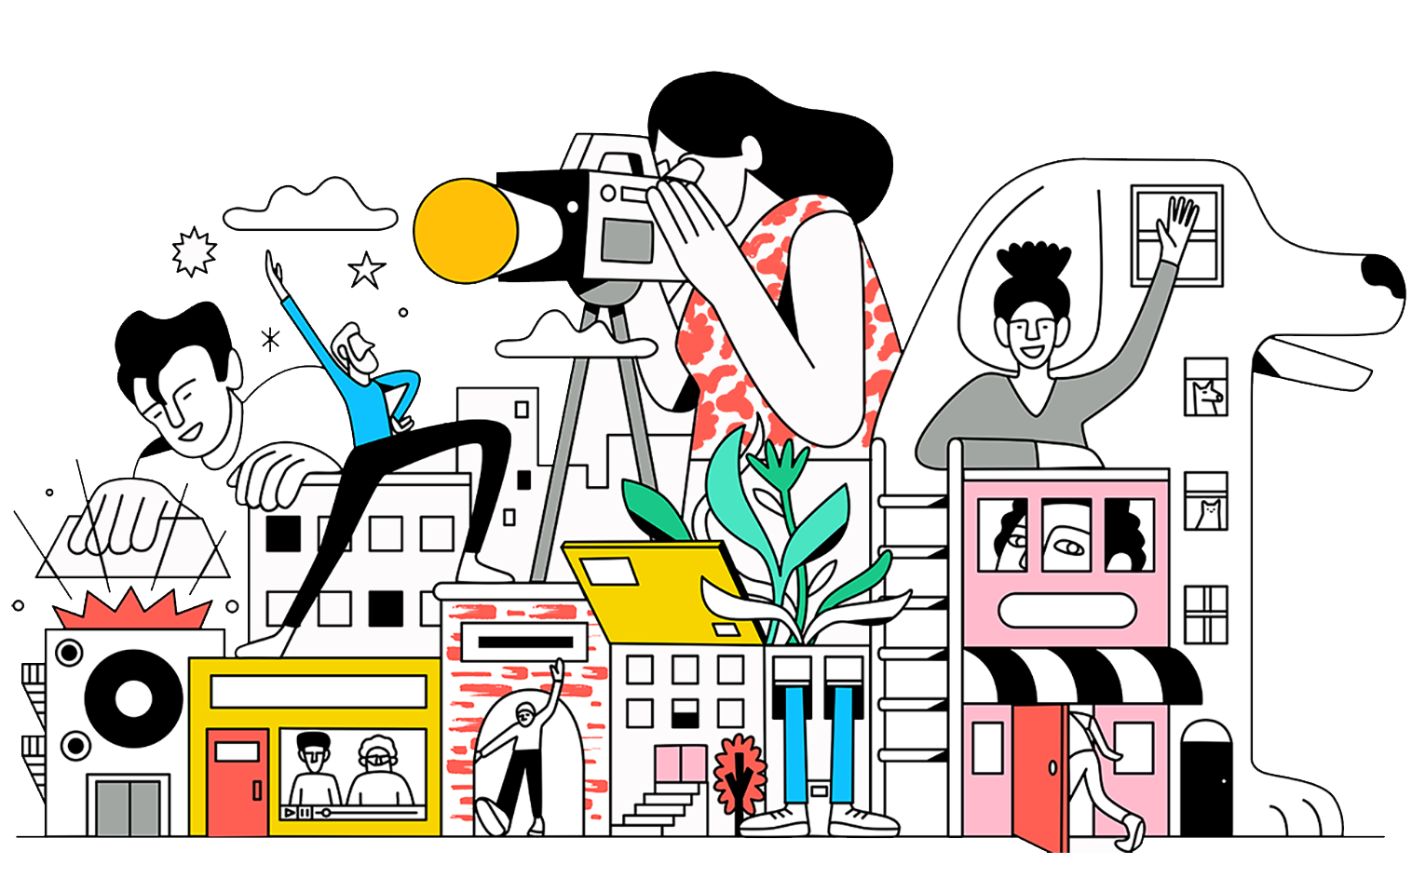
Therefore, to be successful in the digital content realm, content creators must determine the best way to present their digital content to consumers. Maybe it is an ebook. Maybe it is an app. Maybe it’s an email newsletter (like The Tilt).

Slide 19
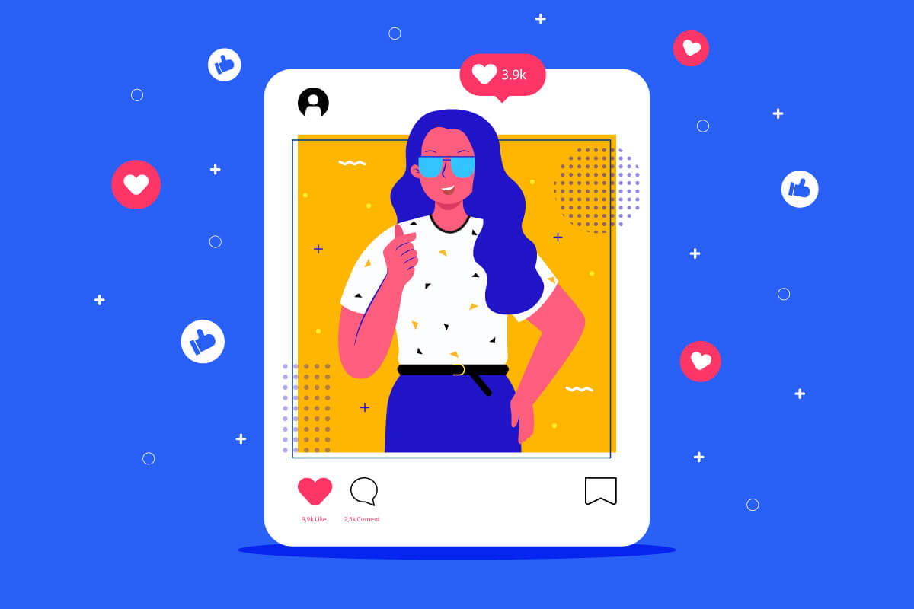
The right choice depends on the needs of the audience and how much control you want or need over the content (for example, email gives the publisher more control, while social media gives the publisher less control).

Slide 20
Lecture 1
Digital Content Direction
Content Creators

Slide 21
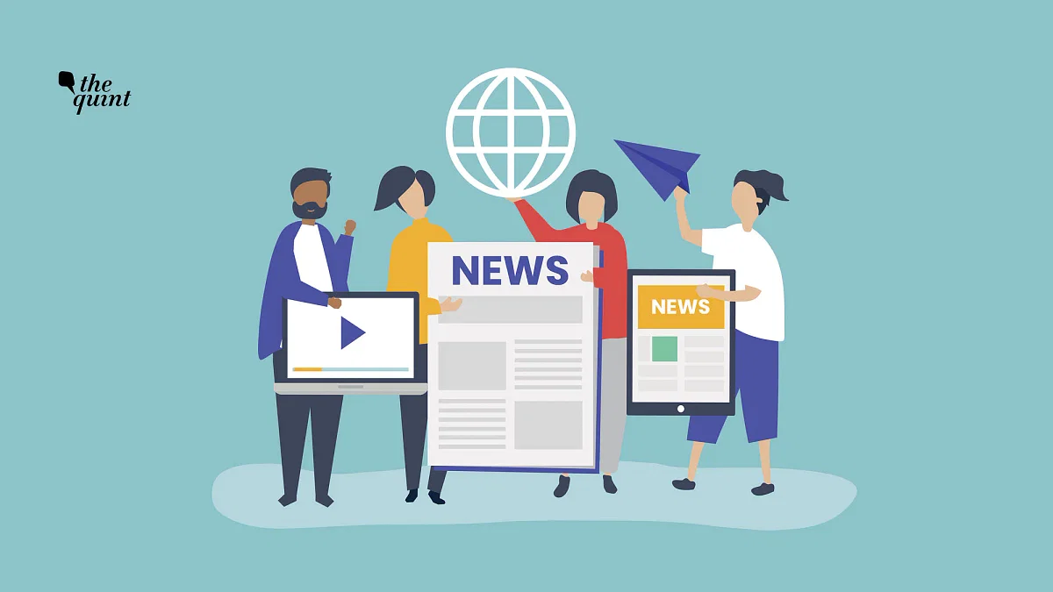
News organizations:
News organizations, especially those with a large and global reach like The New York Times, NPR, and CNN, consistently create some of the most shared content on the Web, especially in relation to current events.

Slide 22
In the words of a 2011 report from the Oxford School for the Study of Journalism and the Reuters Institute for the Study of Journalism, "Mainstream media is the lifeblood of topical social media conversations in the UK.“
While the rise of digital media has disrupted traditional news outlets, many have adapted and have begun to produce content that is designed to function on the web and be shared on social media.

Slide 23
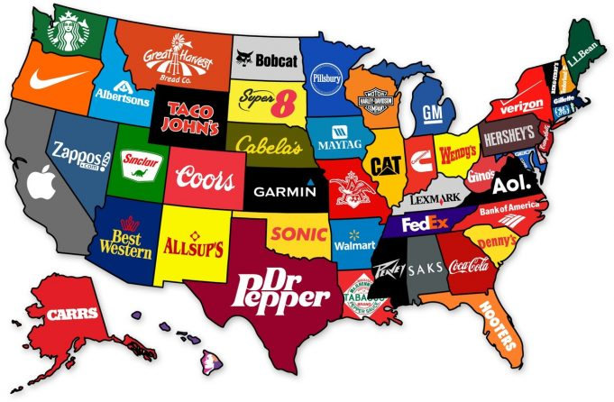
Companies:
Corporate content includes advertising and public relations content, as well as other types of content produced for profit, including white papers and sponsored research.

Slide 24
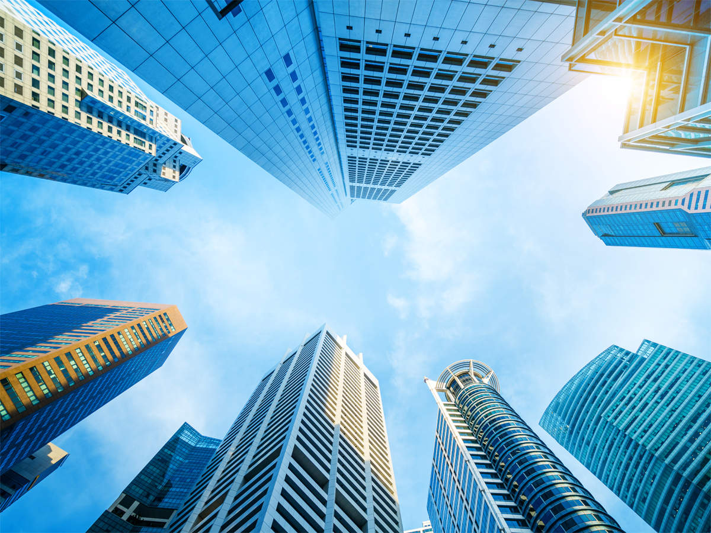
Advertising can also include auto-generated content, with blocks of content generated by programs or bots for search engine optimization.

Slide 25
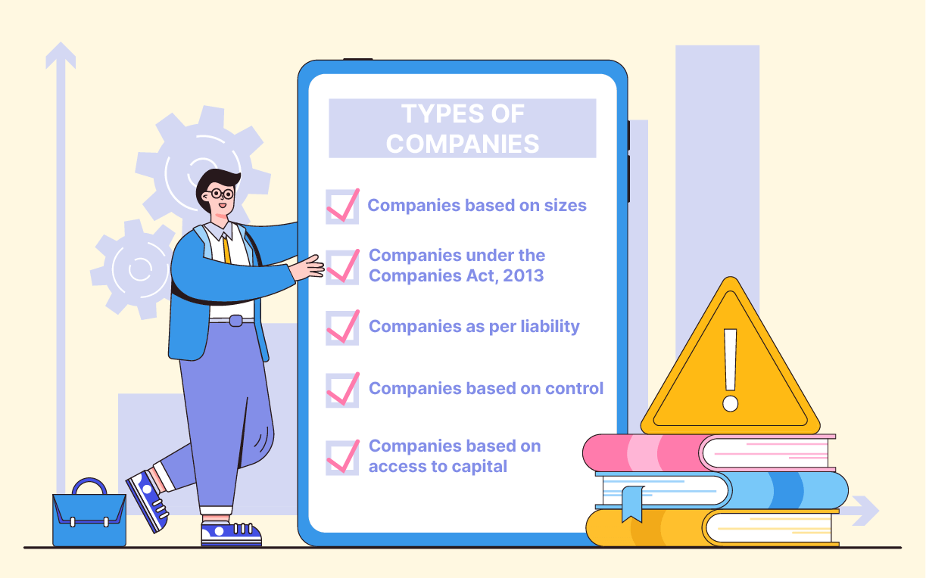
Companies also create annual reports which are part of their company's workings and a detailed review of their financial year.
This gives the stakeholders of the company insight into the company's current and future prospects and direction.

Slide 26
Artists and writers:
Cultural works, like music, movies, literature, and art, are also major forms of content. Examples include traditionally published books and e-books as well as self-published books, digital art, fanfiction, and fan art.
Independent artists, including authors and musicians, have found commercial success by making their work available on the Internet.

Slide 27
Government:
Through digitization, sunshine laws, open records laws and data collection, governments may make statistical, legal or regulatory information available on the Internet.
National libraries and state archives turn historical documents, public records, and unique relics into online databases and exhibits. This has raised significant privacy issues.

Slide 28
In 2012, The Journal News, a New York state paper, sparked outcry when it published an interactive map of the state's gun owner locations using legally obtained public records.
Governments also create online or digital propaganda to support domestic and international goals. This can include astroturfing, or using media to create a false impression of mainstream belief or opinion.

Slide 29
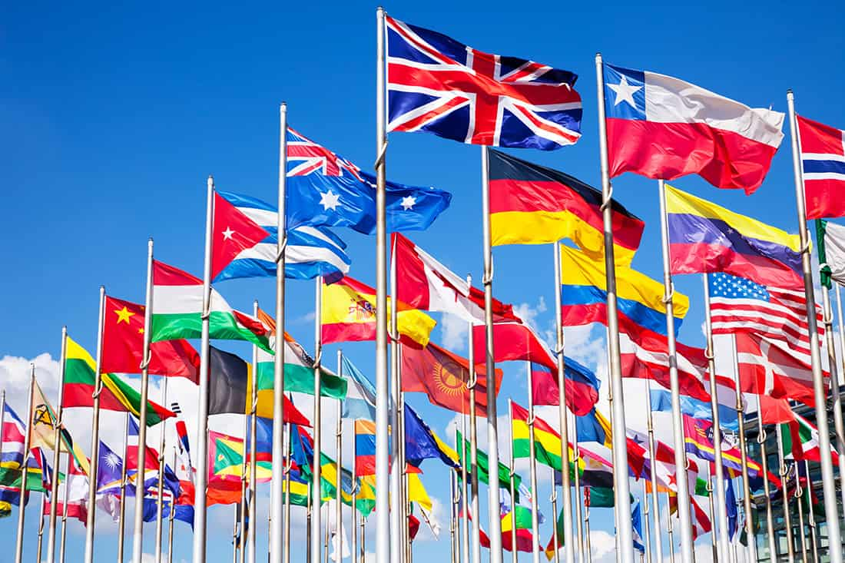
Governments can also use open content, such as public records and open data, in service of public health, educational and scientific goals, such as crowdsourcing solutions to complex policy problems.

Slide 30
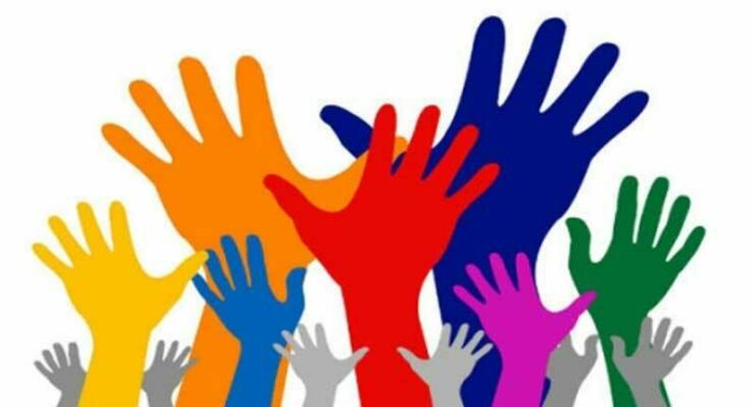
In addition to making governments more participatory, open records and open data have the potential to make governments more transparent and less corrupt.

Slide 31
Users:
The introduction of Web 2.0 made it possible for content consumers to be more involved in the generation and sharing of content.
With the advent of digital media, the amount of user generated content, as well as the age and class range of users, has increased.

Slide 32
Worldwide, about one in four Internet users are significant content creators, and users in emerging markets lead the world in engagement. Research has also found that young adults of a higher socioeconomic background tend to create more content than those from lower socioeconomic backgrounds. 69% of American and European internet users are "spectators," who consume —but don't create— online and digital media.

Slide 33
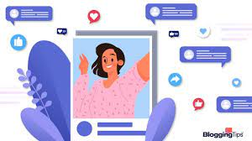
The ratio of content creators to the amount of content they generate is sometimes referred to as the 1% rule, a rule of thumb that suggests that only 1% of a forum's users create nearly all of its content.

Slide 34
Motivations for creating new content may include the desire to gain new knowledge, the possibility of publicity, or simple altruism.
Users may also create new content in order to bring about social reforms. However, researchers caution that in order to be effective, context must be considered, a diverse array of people must be included, and all users must participate throughout the process.

Slide 35
According to a 2011 study, minorities create content in order to connect with their communities online. African-American users have been found to create content as a means of self-expression that was not previously available.
Media portrayals of minorities are sometimes inaccurate and stereotypical which affects the general perception of these minorities.

Slide 36
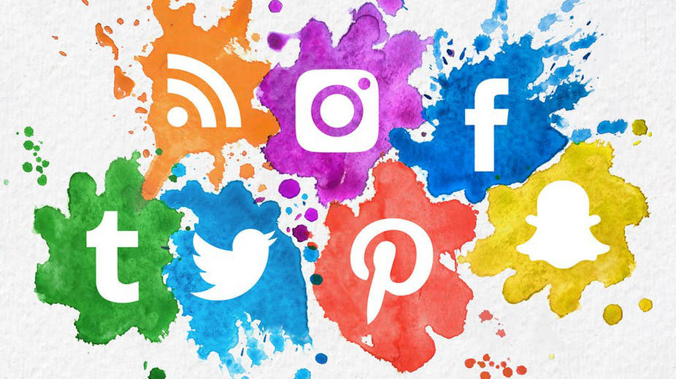
African-Americans respond to their portrayals digitally through the use of social media such as Twitter and Tumblr. The creation of Black Twitter has allowed a community to share their problems and ideas.

Slide 37
Lecture 1
Digital Content Direction
Web 2.0 & Convergence Culture

Slide 38
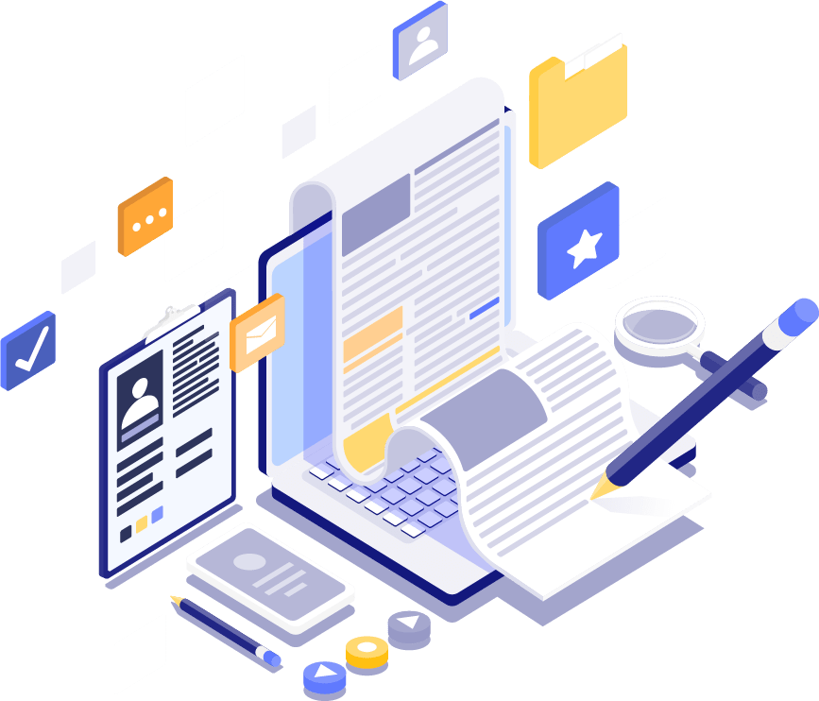
The very concept of ‘Content Production’ is a product of what is widely known as Web 2.0. Tim O’Reilly defines the term ‘Web 2.0’ as spanning all connected devices; Web 2.0 applications are those that make the most of the intrinsic advantages of that platform:

Slide 39
* Delivering software as a continually-updated service that gets better the more people use it, * Consuming and remixing data from multiple sources, including individual users, while providing their own data and services in a form that allows remixing by others, * Creating network effects through an “architecture of participation”, and going beyond the page metaphor of Web 1.0 to deliver rich user experiences.

Slide 40
The term ‘Web 2.0’ describes a break from the internet of the 1990s and early 2000s, the so-called Web 1.0, which comprised ‘a network of pages tied together by hyperlinks, interconnected in a self-referencing mesh’. That was an internet where interactivity, where networking with others was difficult—certainly more so than the current era.

Slide 41
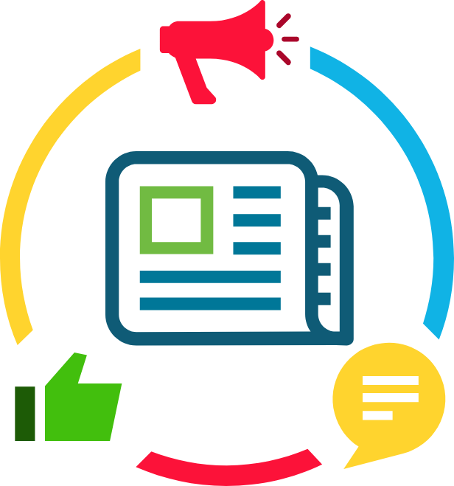
Specifically, the concept of content production reflects a specific facet of Web 2.0, and this is what is commonly known as ‘Convergence Culture’. The term ‘convergence culture’ is indebted to the media scholar Henry Jenkins, who uses it to describe the current situation.

Slide 42

Secondly, ‘convergence culture’ refers to a media culture that actively encourages media consumers to be producers.
The label ‘produsage’ has been coined to describe what happens when a media user produces the content that they and others end up consuming.

Slide 43
Thirdly, convergence culture is one that encourages participation. A key tenet of media and communications scholarship has long been that the media consumer is not a passive dupe to unseen, omnipotent forces; they/we make different meanings of the material we consume, meanings that can exceed and sometimes be completely oppositional to the aims and intent of the producer.

Slide 44

This argument is especially salient in convergence culture, where media consumers are encouraged to tweet about current affairs and actively involved in commenting on life updates using all available means, which is of course one of the most important gains of the web 2.0.

Slide 45
Lecture 1
Lecture Conclusion:
* Digital Content: A Closer Look
* Who Creates Digital Content?
* Content Creators.
* Web 2.0 and Convergence Culture

Slide 46


Lecture 1
Lecture References:
* Jenkins, H., Ford, S., & Green, J. (2013), Spreadable media: Creating value and meaning in a networked culture, New York University Press.
* Jay Daniel Thompson & John Weldon (2022), Content Production for Digital Media: An Introduction, Springer Nature Singapore.

Slide 47


Thank You

Slide 48

Digital Content
Direction
Lecture 1
DGM 733
Prepared by:
Dr. Sherihan Mohamed

