Slide 1



Information Systems
Prepared by Dr. Amjad Qtaish
IT372
Information Systems
Lecture 03

Slide 2




Module 2: Information Technology Infrastructure
Information Systems
Dr. Amjad Qtaish
Faculty of Informatics
Midocean University
Chapter 5: Databases and Information Management
Information Systems (IT372)

Slide 3

Chapter
Outline
05
    An Information Technology Infrastructure :
Data Management
Data Modeling
Relational Database Model
Database Management Systems (DBMS)
Database Administration
Database Applications
Database and Web
Managing Data Resources
Case Study
Summary
Information Systems, Dr. Amjad Qtaish
3

Slide 4
Chapter
Learning Objectives
05
    An Information Technology Infrastructure :
Define general data management concepts and terms
Identify the advantages of database approach and describe relational database model
Identify the role and functions of DBMS
Identify current database applications
Identify the role of Business Intelligence
Information Systems, Dr. Amjad Qtaish
4

Slide 5
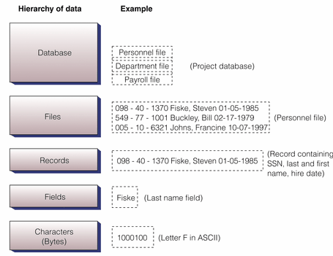
Chapter
Data Management
05
Hierarchy of data
Information Systems, Dr. Amjad Qtaish
5

Slide 6
Chapter
Data Management
05
Building blocks of hierarchy
bit (the smallest unit of data) has only two values - 1 or 0
bytes - 8 bits make up one byte, which represents one character like the letter A
field (or in a database attribute), represents a combination of bytes that make up one aspect of a business object (i.e. last name, invoice number, age)
record - a collection of related data fields (i.e. name/address/phone information for one student)
file (or in a database an entity) - a collection of related records (all students in MIS213)
database - a group of similar items (all students and faculty in Cameron School of Business)
Information Systems, Dr. Amjad Qtaish
6

Slide 7
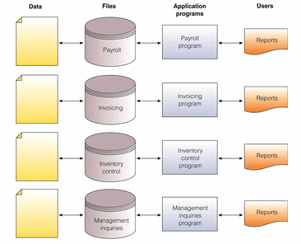
Chapter
Data Management
05
TRADITIONAL (File Based )approach to data management
Information Systems, Dr. Amjad Qtaish
7

Slide 8
Chapter
Data Management
05
PROBLEMS
  Data Redundancy
    Duplication of data, same data is stored in multiple locations
    Data inconsistency, same attributed have different names or values
    Updating problems
  Program Data Dependence
    Changes in program require changes in data
  Lack of Flexibility
    difficult and expensive process to retrieve ad-hoc reports
  Lack of Sharing
    Because data is located in different files and different departments, difficult to be shared and accessed in timely manner
Information Systems, Dr. Amjad Qtaish
8

Slide 9
Chapter
Data Management
05
DATABASE Approach
Database
  Organized collection of data, or a collection of related files containing records
Entity
  Generalized class of people, places or things (objects) for which data is collected, stored and maintained
  E.g. SUPPLIER, PRODUCT
Attribute
  Specific characteristics of each entity
  E.g. SUPPLIER: Name, address
  PRODUCT: Product ID, Product Price
Database Management System (DBMS)
Information Systems, Dr. Amjad Qtaish
9

Slide 10
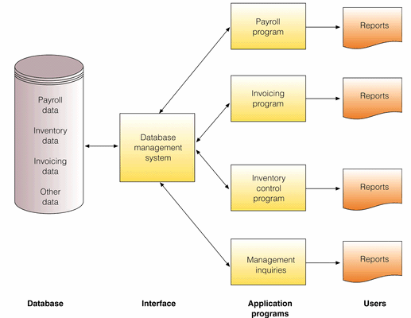
Chapter
Data Management
05
DATABASE Approach
Information Systems, Dr. Amjad Qtaish
10

Slide 11
Chapter
Data Management
05
Advantages of Database Approach
1. Reduced data redundancy | Data about a person / invoice / product is stored only one time
2. Improved data integrity | Since data is stored only once for each entity, we don't need to worry about updating multiple records for the same entity (i.e. storing home address several times for the same person)
3. Easier updating of data | Again the advantage of one storage location
4. Data and program independence | The data files are separate from the applications (HR, payroll, invoicing) and thus can be used by many applications
5. Improved strategic use of data | Accurate, complete, up-to-date data is used by decision makers
6. Improved security | Backups and access can be better controlled by passwords, ensuring privacy
Information Systems, Dr. Amjad Qtaish
11

Slide 12
Chapter
Data Management
05
Some more advantages of Database Approach
  Standardization of data access
  Shared data and information resources
Disadvantages
  More complex
    DBMS could be difficult to set up and operate
  More expensive
    More expensive to purchase, additional personnel and additional hardware required
  Difficult to recover from failure
    Failure in DBMS shuts down entire database
Information Systems, Dr. Amjad Qtaish
12

Slide 13
Chapter
Data Modeling
05
When building a database, following must be considered
  Content: What data should be collected and at what cost?
  Access: What data should be provided to which users and when?
  Logical Structure: How should data be arranged?
  Physical Organization: Where should data be physically located?
Logical Design
  Abstract model of how data should be structured and arranged
  Data Model : diagram of entities and their relationships
Physical Design
  Fine tunes logical design for performance and cost (improved response time, reduce storage space)
Information Systems, Dr. Amjad Qtaish
13

Slide 14
Chapter
Data Modeling
05
Entity Relationship Diagram
  Use basic graphical symbols to show the organization and relation between data
  One to one
  One to many
  Many to many
Information Systems, Dr. Amjad Qtaish
14

Slide 15
Chapter
Relational Database Model
05
The Relational Database Model
Relational Database
  Organize data into two-dimensional tables (relations) with columns and rows
  One table for each entity
  Fields (columns) store data representing an attribute
  Rows store data for separate records
  Key field: identifies a record
  Primary Key: A field that uniquely identifies a set of records, cannot be duplicated and distinguishes records
  Domain is the allowable values for these attributes. E.g. attribute for pay does not include negative numbers
Information Systems, Dr. Amjad Qtaish
15

Slide 16
Chapter
Relational Database Model
05
Manipulating Data
  For inquiries and analyzing data
  Selecting: eliminating rows according to certain criteria
  Projecting: eliminating columns in a table
  Joining; combining two or more tables
  As long as tables share at least one common attribute, tables in a relational database can be linked to provide useful information and reports
Information Systems, Dr. Amjad Qtaish
16

Slide 17
Chapter
Relational Database Model
05
Dept. No. | Dept. Name | SSN
001 | Accounting | 10-10
002 | Manufacturing | 23-25
003 | Marketing | 10-45
Project | Description | Dept. No.
155 | Payroll | 001
498 | Widgets | 002
226 | Sales Manual | 003
Project
Department
SSN | Name | Hire Date | Dept. No.
10-10 | Rasheed Khan | 10-07-1997 | 001
23-25 | Haider Ali | 02-17- 1998 | 002
10-45 | Safdar Ahmed | 01-05-1985 | 003
Manager
Information Systems, Dr. Amjad Qtaish
17

Slide 18
Chapter
Relational Database Model
05
Data Cleanup
  Valuable information: accurate, complete, reliable, economical, flexible, relevant, simple, timely, verifiable, accessible, secure
  Data cleanup is to develop data with these characteristics
Information Systems, Dr. Amjad Qtaish
18

Slide 19
Chapter
Database Management Systems (DBMS)
05
Group of programs used as an interface between a database and application programs/users, used to create, implement, use and update a database.
  Makes physical database available for different logical views required by users
Single User DBMS
  Databases for personal computer are meant for single users
  Access, FileMaker Pro, Microsoft InfoPath
Multiuser DBMS
  Used by large mainframe computers
  Powerful, expensive, allow hundreds of people to access
  Oracle, Sybase, DB2 by IBM, Teradata database
Information Systems, Dr. Amjad Qtaish
19

Slide 20
Chapter
Database Management Systems (DBMS)
05
Provides capabilities and tools for organizing, managing and accessing the data in the database
Data Definition language (DDL)
  Collection of instructions and commands used to define and describe data and relations in a specific database
  Basically used to define schema (description)
  Describes logical access paths and logical records in the database
  SQL: CREATE, DROP, ALTER
CREATE TABLE employees (
id INTEGER PRIMARY KEY,
first_name VARCHAR(50) NULL,
last_name VARCHAR(75) NOT NULL,
dateofbirth DATE NULL
);
Information Systems, Dr. Amjad Qtaish
20

Slide 21
Chapter
Database Management Systems (DBMS)
05
Data Dictionary
  Detailed description of all data used in the database
  Name of data item, range of values used, type of data, amount of storage needed, notation of person who updated it, users who can access it, list of reports that use data item
NORTHWEATERN MANUFACTURING
PREPARED BY: BORDWELL
DATE: 04 AUGUST 2007
APPROVED BY: EDWARDS
VERSION: 3.1
PAGE: 1 OF 1
DATA ELEMENT NAME: PARTNO
DESCRIPTION: INVENTRY PART NUMBER
OTHER NAMES: PTNO
VALUE RANGE: 100 TO 5000
DATA TYPE: NUMERIC
POSITION: 4 POSITIONS OR COLUMNS
Information Systems, Dr. Amjad Qtaish
21

Slide 22
Chapter
Database Management Systems (DBMS)
05
Data Manipulation Language
  Specific language used to access, modify, and make queries(request for specific data)
  Storing, Retrieving, Manipulating data and Generating reports
  Query By Example (QBE)
    Visual approach to developing database queries
    GUI to retrieve data
    MS Access
  Structured Query Language (SQL)
    Integral part of relational databases
    Consists of special keywords and rules
    Also includes built-in functions AVG, MAX, MIN
Information Systems, Dr. Amjad Qtaish
22

Slide 23
Chapter
Database Management Systems (DBMS)
05
Data Manipulation Language
SQL Command | Description
SELECT ClientName, Debt FROM Client WHERE Debt>1000 SELECT ClientName, ClientNum, OrderNum FROM Client, Order WHERE Client.ClientNum=Order.ClientNum GRANT INSERT ON Client to Guthrie | Query displays all clients and amount they owe to the company rom database table Client, or client who owe more than $1000 Join command that combines data rom 2 tables: Client and Order. New table will be created with client name, client number and order number. Security command, that allows Guthrie to enter values or rows in Client table
Information Systems, Dr. Amjad Qtaish
23

Slide 24
Chapter
Database Administration
05
Require a skilled DBA
  Expected to have clear understanding of the fundamental business of organizations
  Proficient in the use of selected DBMS
  Stay ahead of emerging technologies and new design approaches
  Role: plan, design, create, operate, secure, monitor, and maintain
  Works with users and programmers
  Database administrator: responsible for defining and implementing consistent principles for a variety of data issues
Information Systems, Dr. Amjad Qtaish
24

Slide 25
Chapter
Database Applications
05
Manipulate content of a database to produce useful information
  Searching, filtering, synthesizing, and assimilating the data contained in database
Businesses use databases, not only for keeping track of employee and customer records, but also to make better decisions and run operations effectively
  Data warehouse
  Data mining
  Business intelligence
  Web mining and text mining
Information Systems, Dr. Amjad Qtaish
25

Slide 26
Chapter
Database Applications
05
Data Warehouse
  Database that stores current and historical data of potential interest to decision makers throughout the company
  The data is gathered from various operational transaction system, including website transactions
  Consolidates the information from different locations and makes them available for analysis and decisions
  Provides range of standardized query tools, analytical tools and graphical reporting facilities
  Advantage: ability to relate data in innovative ways
Information Systems, Dr. Amjad Qtaish
26

Slide 27
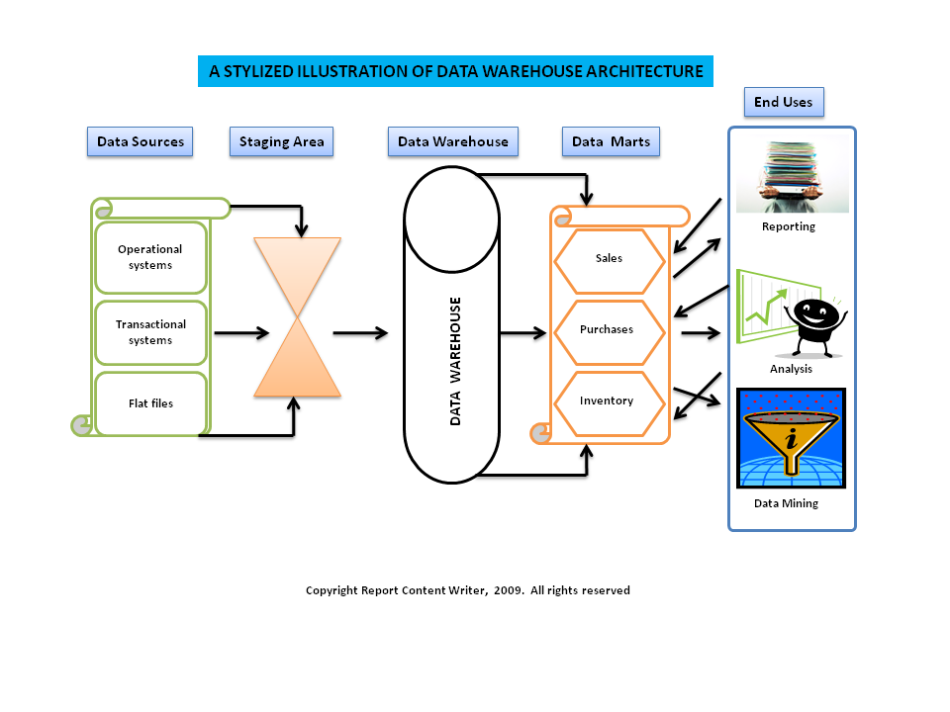
Chapter
Database Applications
05
Information Systems, Dr. Amjad Qtaish
27

Slide 28
Chapter
Database Applications
05
Data Mart
  Subset of data warehouse
  Contains summarized or highly focused portion of data about a specific area
  E.g. marketing/sales data to deal with customer information
  Useful for smaller groups who want to access detailed data
  Constructed more rapidly, requires less powerful hardware, lower cost
Information Systems, Dr. Amjad Qtaish
28

Slide 29
Chapter
Database Applications
05
Business Intelligence
  Involves gathering enough of the right information in a timely manner and usable form and analyzing it so that it can have a positive effect on business strategy, tactics or operations.
  Competitive intelligence; information about competitors and the ways that knowledge effects strategy, tactics and operations
    Beneficial for responding to changing marketplace
  Tools
    Software for database querying and reporting
    Multidimensional data analysis (OLAP)
    data mining
Information Systems, Dr. Amjad Qtaish
29

Slide 30
Chapter
Database Applications
05
Data Mining
  Provides insight into corporate data that cannot be obtained with OLAP
  Hidden patterns and relationships are found in large databases by inferring rules
  Type of information retrieved is: association, sequences, classifications, clusters, forecasts
  Extensive use in marketing to improve customer retention, cross-selling opportunities, campaign management, one-to-one marketing
  Predictive Analysis: combines historic data with assumptions about future conditions to predict outcome of events such as future product sales or such probabilities
    Find new market segments that could be profitable
  Oracle, Sybase etc. incorporate data mining functionality
Information Systems, Dr. Amjad Qtaish
30

Slide 31
Chapter
Database Applications
05
Online Analytical Processing (OLAP)
  To answer question such as: how many washers sold in each of your sales regions and compare actual results with projected sales?
  Supports multidimensional data analysis, so users can use same data in different ways/dimensions (product, pricing, region, time period)
  Enables users to obtain online answers to ad-hoc questions
OLAP | Data Mining
Used for data analysis and decision making | Used for data analysis and decision making
Top-down, query driven analysis | Bottom up, discovery driven analysis
Users must be knowledgeable of data and its business context | Users trust in data mining tools to To uncover valid hypotheses
Information Systems, Dr. Amjad Qtaish
31

Slide 32
Chapter
Database Applications
05
Text Mining and Web Mining
  Unstructured data is also part of firms useful information
    E-mails, memos, survey responses, legal cases, service reports are also valuable
  Text Mining tools help businesses analyze this data
    Extract key elements from unstructured data set
    Discover patterns and relationships
    Summarize the information
  Web Mining: Discovery and analysis of useful patterns and info from WWW
    Understanding customer behaviour
    Evaluating effectiveness of customer website
    Quantify success of marketing campaign
    Content Mining, Structure Mining, Usage MIning
Information Systems, Dr. Amjad Qtaish
32

Slide 33
Chapter
Database and Web
05
Firms use the web to make information from their internal databases available to customers and partners
Middleware and other software make this possible
  Web server
  Application server or CGI
  Database Server
Advantages
  Web browser software easier to use than query tools
  Web interfaces require few or no change to internal databases
  Less costly
Information Systems, Dr. Amjad Qtaish
33

Slide 34
Chapter
Managing Data Resources
05
Establishing Information Policy
  Organizations rules for sharing, disseminating, acquiring, standardizing, classifying and inventorying information
  Which units share info, where info can be distributed, who can maintain and update it
  Data administration in large organizations is responsible for defining policies and procedures for managing organizational resources
  Database administration: design and management group performs the following functions:
    Establishing physical database
    Logical relations among elements
    Access rules and security procedures
Information Systems, Dr. Amjad Qtaish
34

Slide 35
Chapter
Managing Data Resources
05
Ensuring Data Quality
  Poor data quality is major obstacle to successful customer relationship management
  Data Quality problems
    Redundant and inconsistent data produced by multiple systems
    Data input errors
  Data Quality Audit: structured survey of accuracy and completeness of data
  Data cleansing: detects and corrects incorrect, incomplete, improperly formatted and redundant data
Information Systems, Dr. Amjad Qtaish
35

Slide 36
Chapter
Case Study
05
What can businesses learn from Text Mining?
Text Mining
  Discovery of patterns and relationships from large sets of unstructured data
  Mobile digital platform has amplified the explosion in digital info
  Consumer collaboration and sharing offers insights into customer behaviour and attitudes
Problem with JetBlue
  Receiving large volume of e-mails, no simple way to read everything
  Used text analysis tools to identify facts, opinions, requests from text of survey responses, e-mails, blog entries, news article etc.
  Used it with another tool: classifying customers into groups
Clarabridge text analytics solution
  Delivered as software service
Information Systems, Dr. Amjad Qtaish
36

Slide 37
Chapter
Case Study
05
Challenges of unstructured data
  Lots of digital information generated that has no distinct form
  Difficult to analyze if there are loads of e-mails (with customer sentiments, preferences, requests etc.)
  Analyzing customer surveys takes weeks
  Use slow manual approaches
Improving decision making
  Spot and address problems quickly
  Identify facts, opinions, trends etc. to act quickly on customer demands
  Categorizing comments to reveal less obvious insights
  Also used to make building improvements
Information Systems, Dr. Amjad Qtaish
37

Slide 38
Chapter
Case Study
05
Kind of Businesses
  Airlines
  Hotel chains
  Restaurants
  Also used by location managers
Information Systems, Dr. Amjad Qtaish
38

Slide 39
Chapter
Summary
05
Data Management and Data Modeling are key aspects of organizing data and information
Relational model reduce my problems of data inconsistency, easier to control, more flexible
DBMS produce wide variety of documents, reports, useful for orgs
Data quality is important to be maintained
Business Intelligence tools have positive effects on business strategy
Information Systems, Dr. Amjad Qtaish
39

Slide 40



Thank You

