Slide 1

Probability and Statistics
Prepared by Dr.Israa Lewaa
Lecture 6
STA 201
Confidence Intervals

Slide 2

Chapter
06
Confidence Intervals
6.1 Confidence Intervals for the mean ( Large Samples)
6.2 Confidence Intervals for the mean ( Small Samples)
6.3 Confidence Interval for the population Proportion
6.4 Confidence Intervals for Variance and Standard Deviation

Slide 3
Chapter
06
Confidence Intervals for the Mean
(large samples)
Estimating Population Parameters
Finding a Point Estimate
Finding the Margin of Error
Confidence Interval for the population mean
Sample Size

Slide 4
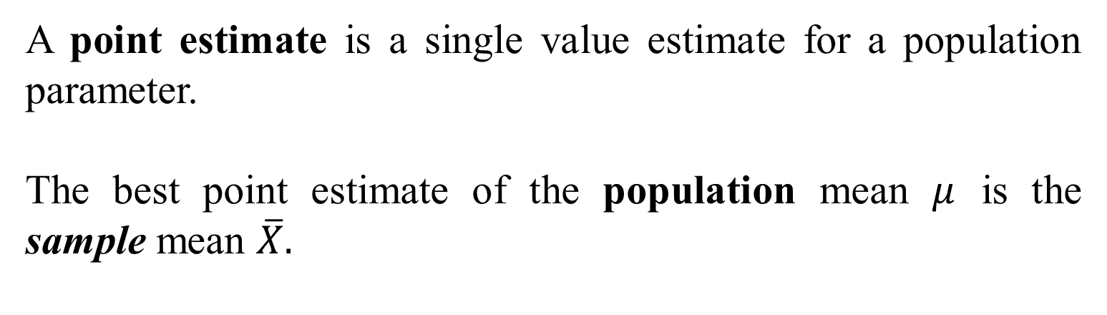
Chapter
06
Point Estimate
A point estimate is a single value estimate for a population parameter.
The best point estimate of the population mean $μ$ is the sample mean $\overline{X}.$

Slide 5
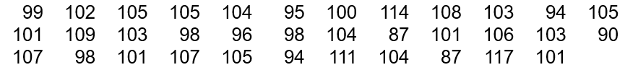
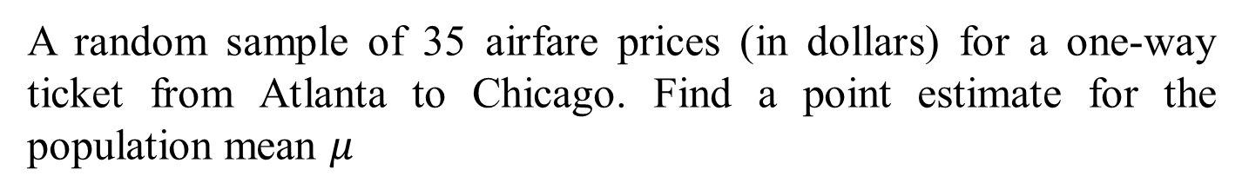
Chapter
06
Example: Point Estimate
A random sample of 35 airfare prices (in dollars) for a one-way ticket from Atlanta to Chicago. Find a point estimate for the population mean $μ$

Slide 6

Chapter
06
Solution: Point Estimate
The sample mean is
The point estimate for the price of all one way tickets from Atlanta to Chicago is $101.77.

Slide 7
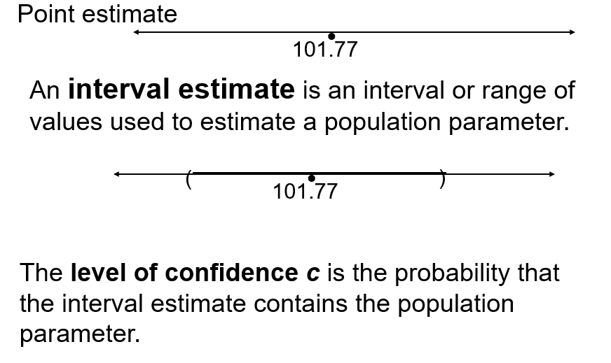
Chapter
06
Interval Estimate

Slide 8
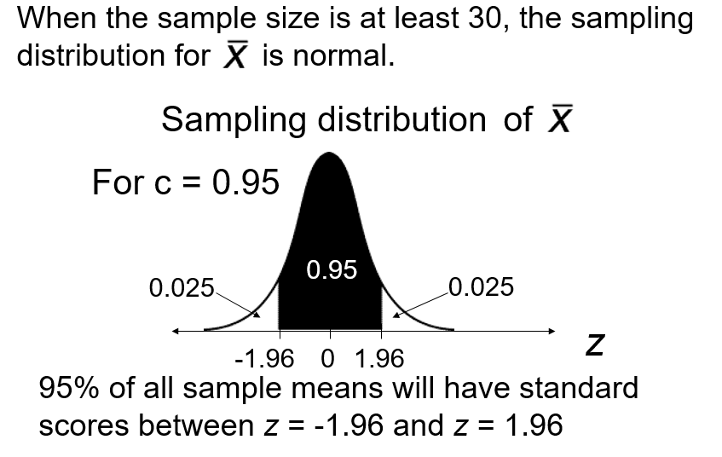
Chapter
06
Distribution of Sample Means

Slide 9
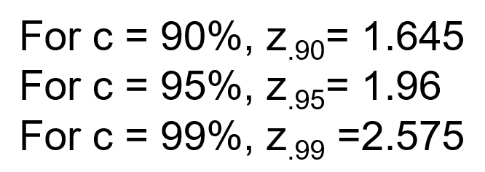
Chapter
06
Distribution of Sample Means

Slide 10
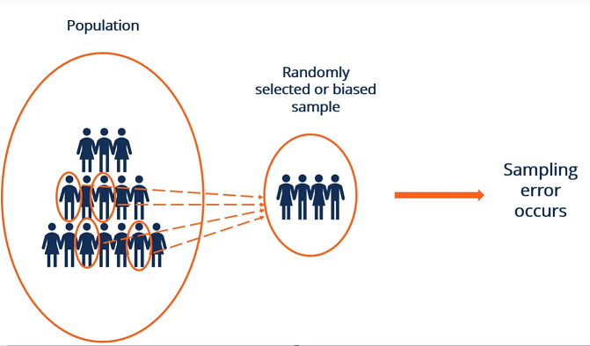
Chapter
06
Sampling Error
The difference between the point estimate and the actual parameter mean value is called the sampling error.

Slide 11

Chapter
06
Maximum Error of Estimate
The margin of error E is the greatest possible distance between the point estimate and the value of the parameter it is estimating for a given level of confidence c.
When n > 30, the sample standard deviation s can be used in place of σ

Slide 12
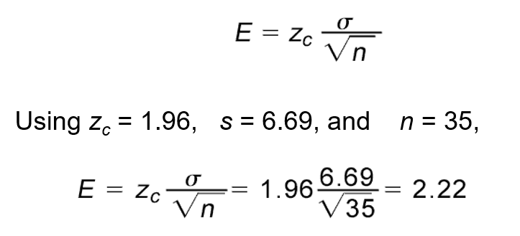
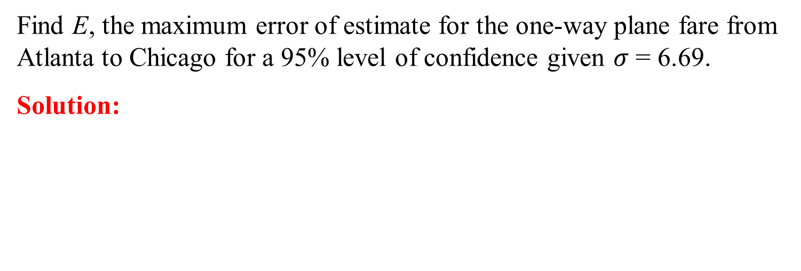
Chapter
06
Example: Maximum Error of Estimate
Find E, the maximum error of estimate for the one-way plane fare from Atlanta to Chicago for a 95% level of confidence given $σ$ = 6.69.
Solution:
You are 95% confident that the maximum error of estimate is $2.22.

Slide 13
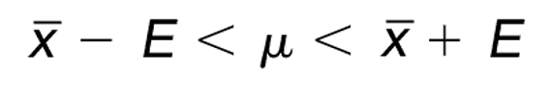

Chapter
06
Confidence Intervals for $μ$
A confidence interval for the population mean is
Find the 95% confidence interval for the one-way plane fare from Atlanta to Chicago.

Slide 14
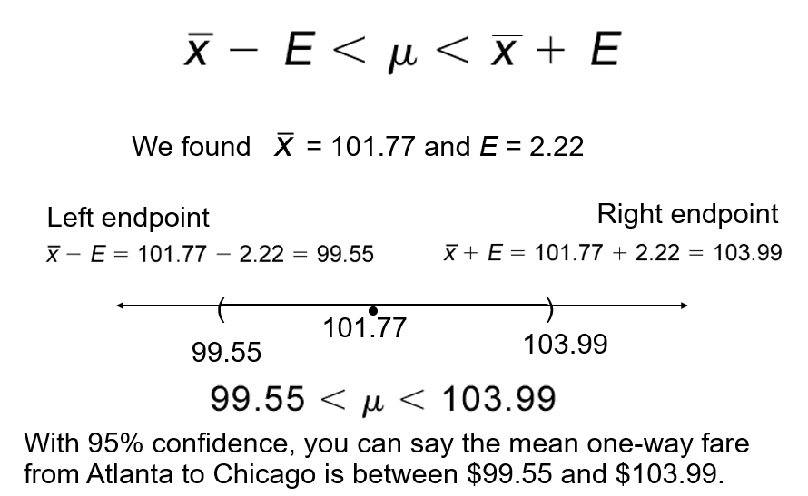
Chapter
06
Confidence Intervals for $μ$

Slide 15
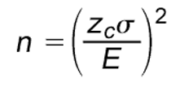
Chapter
06
Sample Size
Given a confidence level and a margin of error, the minimum sample size n needed to estimate the population mean is

Slide 16

Chapter
06
Example: Sample Size
You want to estimate the mean one-way fare from Atlanta to Chicago. How many fares must be included in your sample if you want to be 95% confident that the sample mean is within $2 of the population mean?
You should include at least 43 fares in your sample. Since you already have 35, you need 8 more.

Slide 17
Chapter
06
Confidence Intervals for the Mean
(Small samples)
Small sample size and large sample size
The t distribution
Critical value from t distribution
Confidence interval using t distribution

Slide 18
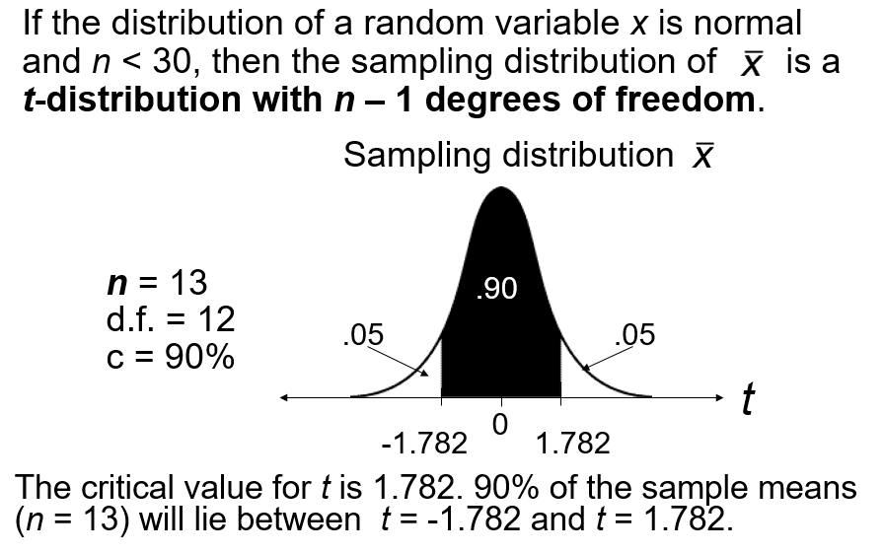
Chapter
06
The T Distribution

Slide 19
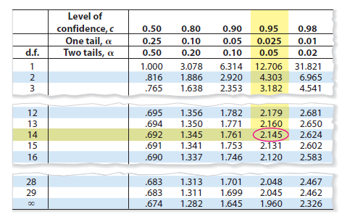
Chapter
06
Example: t-distribution
Finding Critical Values of t
Find the critical value for a 95% confidence level when the sample size is 15.
Solution:
Because n = 15, the degrees of freedom are n-1 = 15-1 = 14
portion of t table 5 is shown. Using d.f. = 14 and c= 0.95, you can find the critical value as shown by the highlighted areas in the table, which equal to 2.145

Slide 20

Chapter
06
T- distribution table

Slide 21
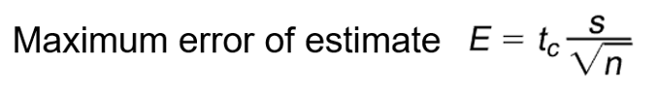
Chapter
06
Maximum error of Estimate -- Small Samples
Where;
S is the Sample standard deviation
tc is the value obtained from t table
n is the sample size

Slide 22
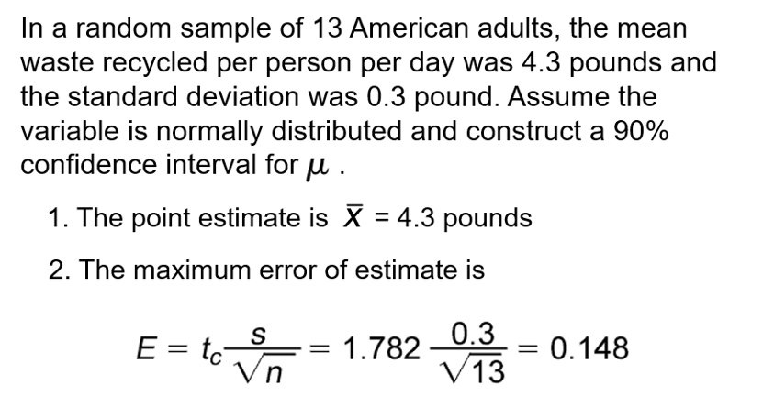
Chapter
06
Example: Maximum error of Estimate

Slide 23


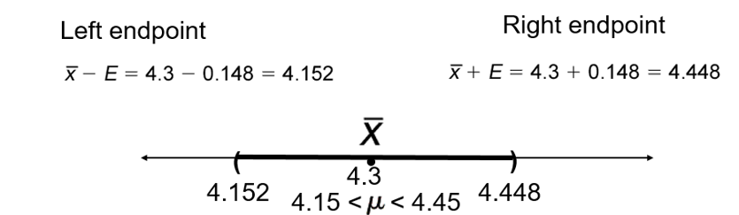
Chapter
06
Confidence Interval – Small Sample
2. Confidence Interval:

Slide 24
Chapter
06
6.3 Confidence Intervals for Population Proportions
Point Estimate for Proportion Proportions
Confidence interval for Proportion Proportions
Finding the minimum Sample Size

Slide 25
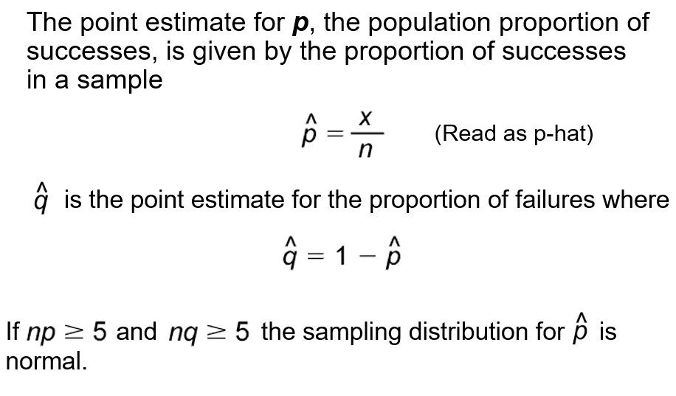
Chapter
06
Confidence Intervals for Population Proportions

Slide 26
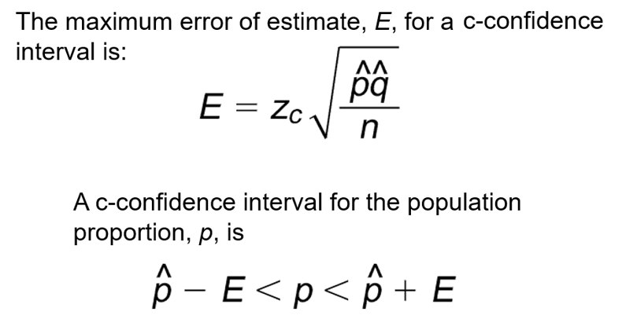
Chapter
06
Confidence Intervals for Population Proportions

Slide 27
Chapter
06
Example: Confidence Intervals for Population Proportions
In a study of 1907 fatal traffic accidents, 449 were alcohol related. Construct a 99% confidence interval for the proportion of fatal traffic accidents that are alcohol related.

Slide 28
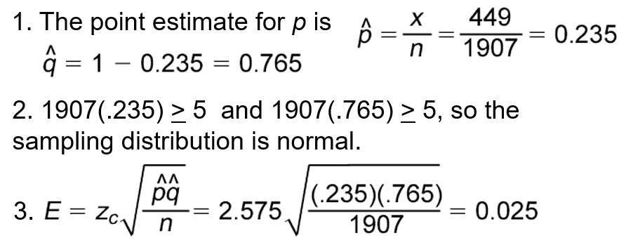
Chapter
06
Solution : Confidence Intervals for
Population Proportions

Slide 29
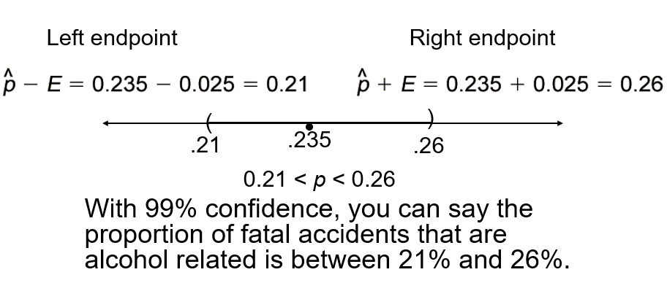
Chapter
06
Solution : Confidence Intervals for
Population Proportions

Slide 30
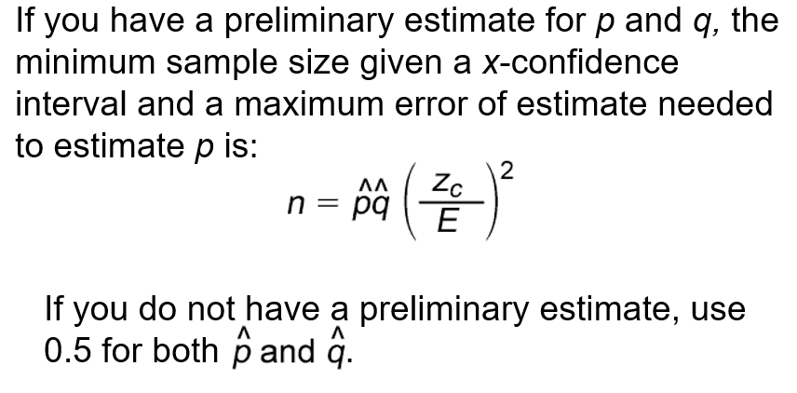
Chapter
06
Minimum Sample Size

Slide 31
Chapter
06
Example: Minimum Sample Size
You wish to estimate the proportion of fatal accidents that are alcohol related at a 99% level of confidence. Find the minimum sample size needed to be accurate to within 2% of the population proportion

Slide 32
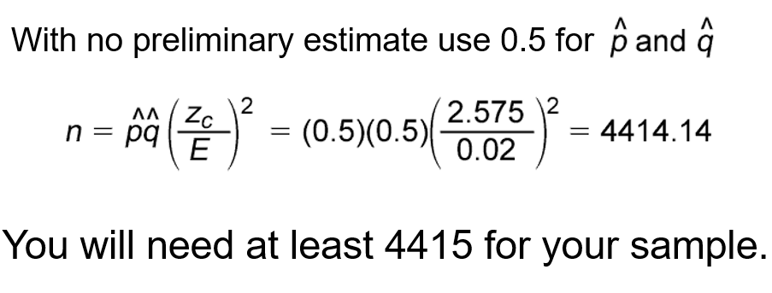
Chapter
06
Solution: Minimum Sample Size
4144.14
4145

Slide 33

Chapter
06
Example: Minimum Sample Size
You wish to estimate the proportion of fatal accidents that are alcohol related at a 99% level of confidence. Find the minimum sample size needed to be be accurate to within 2% of the population proportion. Use a preliminary estimate of p = 0.235.

Slide 34
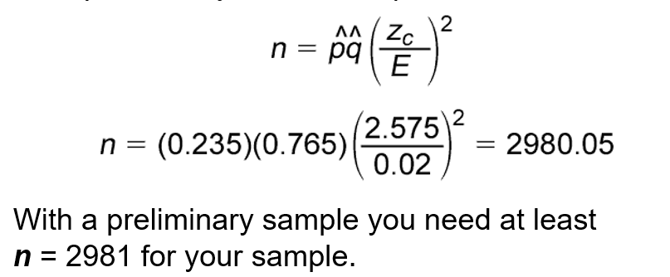
Chapter
06
Solution: Minimum Sample Size

Slide 35
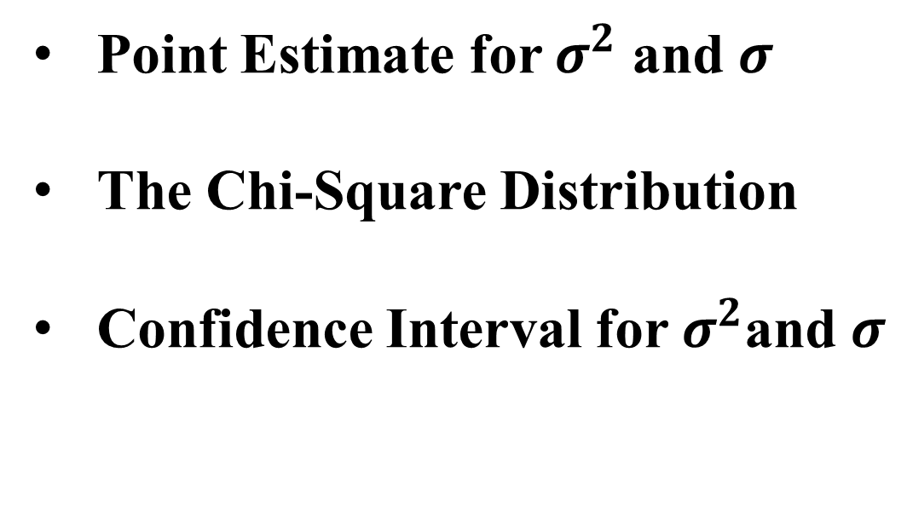
Chapter
06
6.4 Confidence Intervals for Variance and Standard Deviation
Point Estimate for $σ^{2}$ and $σ$
The Chi-Square Distribution
Confidence Interval for $σ^{2}$and $σ$

Slide 36
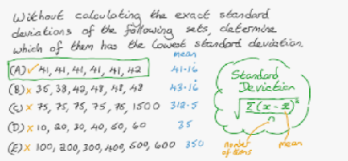
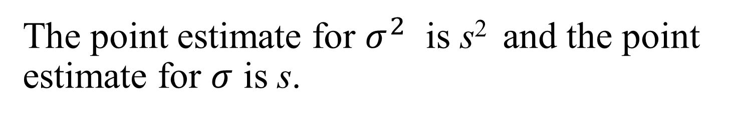

Chapter
06
Point Estimate for $σ^{2}$ and $σ$
The point estimate for $σ^{2}$ is s² and the point estimate for $σ$ is s.

Slide 37
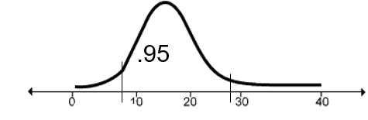
Chapter
06
The Chi-Square Distribution
If the sample size is n, use a chi-square x² distribution with n – 1 degrees of freedom to form a c-confidence interval.

Slide 38
Chapter
06
Example: The Chi-Square Distribution
Find x_{R}² the right-tail critical value and x_{L}² the left-tail
critical value for c = 95% and n = 17.
Solution:
When the sample size is 17, the degrees of freedom = n-1 = 17-1 = 16
Area to the right of x_{R}² is (1 – 0.95)/2 = 0.025
Area to the right of x_{L}² is (1 + 0.95)/2 = 0.975

Slide 39
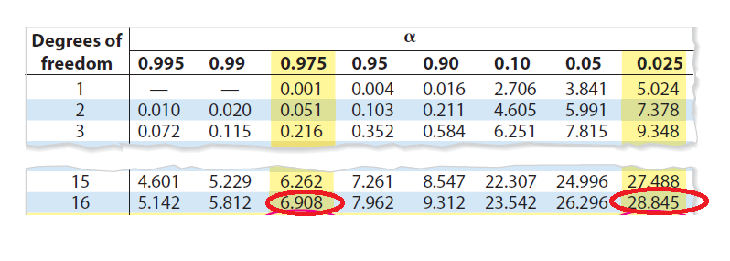



Chapter
06
Example: The Chi-Square Distribution

Slide 40
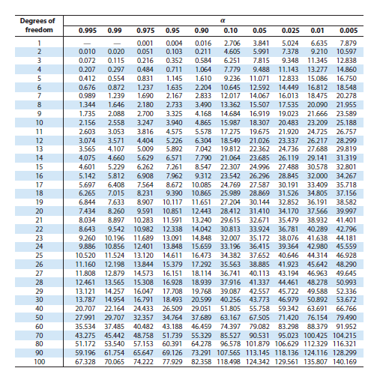
Chapter
06
The Chi-Square Table

Slide 41
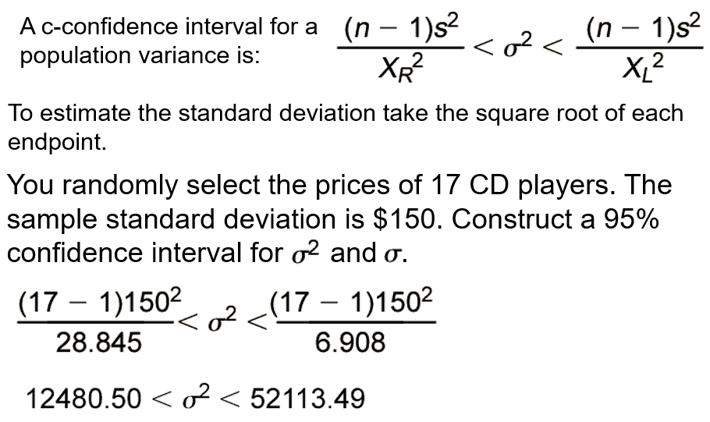

Chapter
06
Confidence Interval for $σ^{2}$and $σ$

Slide 42
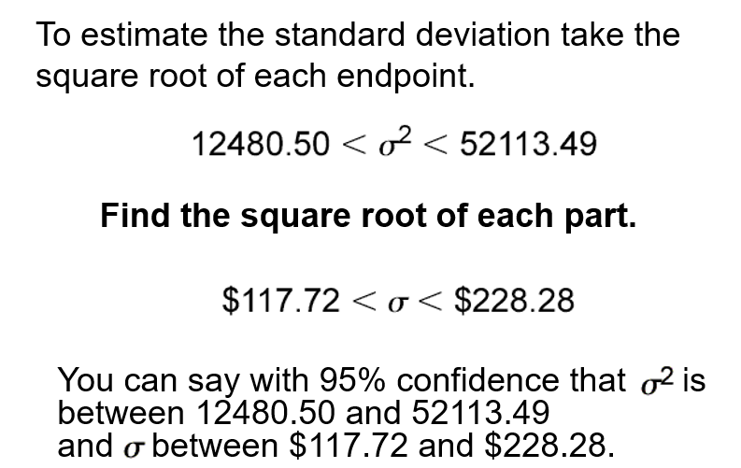

Chapter
06
Confidence Interval for $σ^{2}$and $σ$

Slide 43
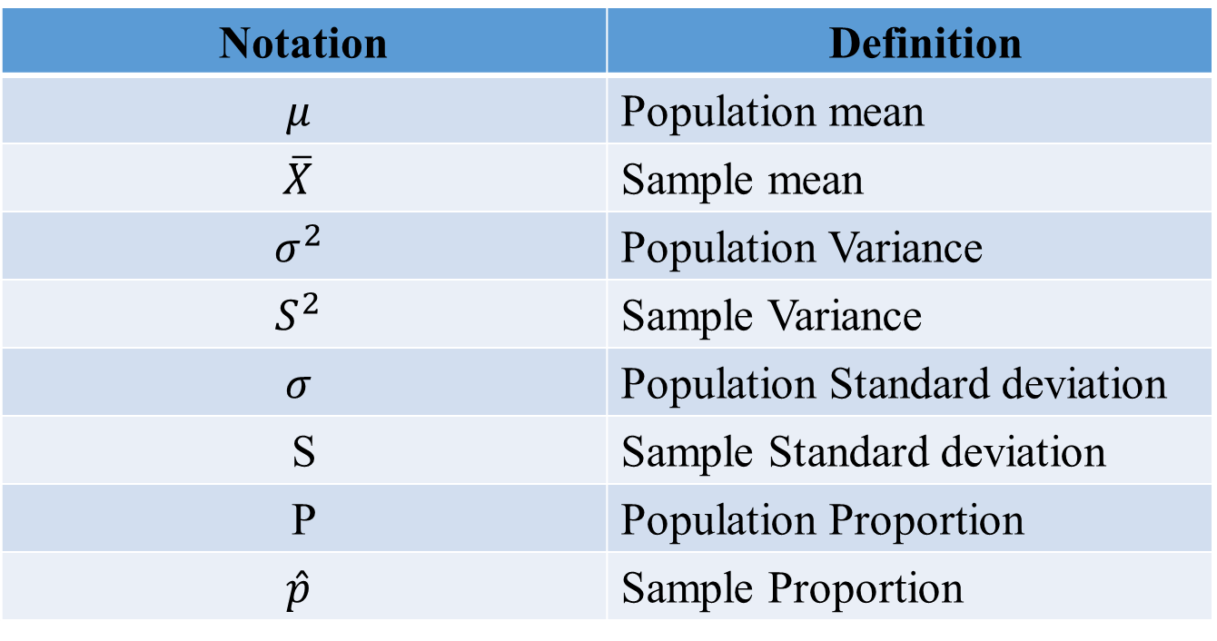
Chapter
06
Notation Summary
Notation | Definition
$$μ$$ | Population mean
$$\overline{X}$$ | Sample mean
$$σ^{2}$$ | Population Variance
$$S^{2}$$ | Sample Variance
$$σ$$ | Population Standard deviation
S | Sample Standard deviation
P | Population Proportion
$$\hat{p}$$ | Sample Proportion

Slide 44


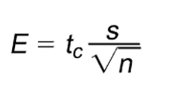
Chapter
06
Chapter Summary
Confidence Intervals for the mean ( Large Samples)
Confidence Intervals for the mean ( Small Samples)

Slide 45

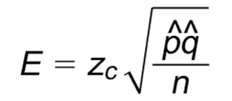
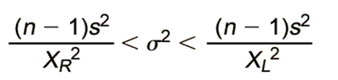
Chapter
06
Chapter Summary
Confidence Interval for the population Proportion
Confidence Intervals for Variance and Standard Deviation

Slide 46
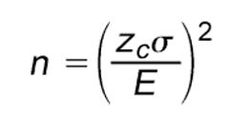
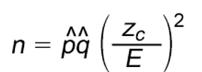
Chapter
06
Chapter Summary
Sample Size
Estimate Mean:
Estimate Proportion:

