Slide 1

Mathematics
Prepared by Dr. Israa Lewaa
Lecture 7
MAT 122
System of Linear Equations

Slide 2

Lecture
07
Lecture Outline
Solving System of Linear Equations
Cremer’s Method Definition
Cremer’s Method 2*2 matrix
Cremer’s Method 3*3 matrix
Gaussian Elimination Method
Extra Practice

Slide 3
Lecture
07
Cremer’s Method
The need to solve systems of linear equations arises frequently in engineering. The analysis of electric circuits and the control of systems are two examples.
Cramer’s rule for solving such systems involves the calculation of determinants and their ratio. It is a useful solution for systems containing only a few equations.

Slide 4
Lecture
07
Cramer’s Rule
In linear algebra, Cramer’s rule is a specific formula used for solving a system of linear equations containing as many equations as unknowns, efficient whenever the system of equations has a unique solution. This rule is named after Gabriel Cramer (1704–1752), who published the rule for an arbitrary number of unknowns in 1750.

Slide 5
Lecture
07
Cramer’s Rule
This is the most commonly used formula for getting the solution for the given system of equations formed through matrices. The solution obtained using Cramer’s rule will be in terms of the determinants of the coefficient matrix and matrices obtained from it by replacing one column with the column vector of the right-hand sides of the equations.

Slide 6
Lecture
07
Cramer’s Rule
Cramer’s rule is one of the important methods applied to solve a system of equations. In this method, the values of the variables in the system are to be calculated using the determinants of matrices. Thus, Cramer’s rule is also known as the determinant method.

Slide 7
Lecture
07
Cramer’s Rule Formula
Cramer’s Rule Formula
Consider a system of linear equations with n variables x₁, x₂, x₃, …, xₙ written in the matrix form AX = B.
Here,
A = Coefficient matrix (must be a square matrix)
X = Column matrix with variables
B = Column matrix with the constants (which are on the right side of the equations)

Slide 8
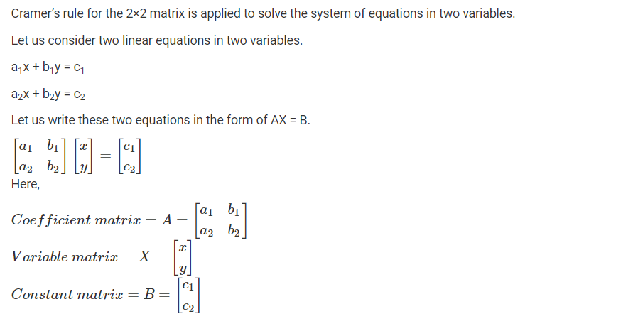
Lecture
07
Cramer’s Rule – 2×2

Slide 9
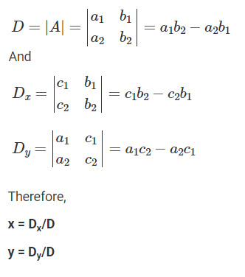
Lecture
07
Cramer’s Rule – 2×2

Slide 10
Lecture
07
Cramer’s Rule Example – 2×2
Solve the following system of equations using Cramer’s rule:
2x – y = 5
x + y = 4

Slide 11
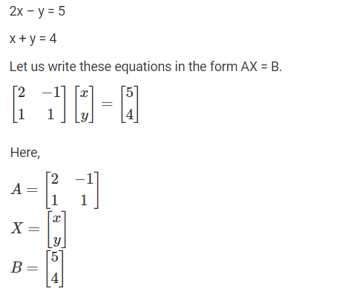
Lecture
07
Solution of Cramer’s Rule Example – 2×2

Slide 12
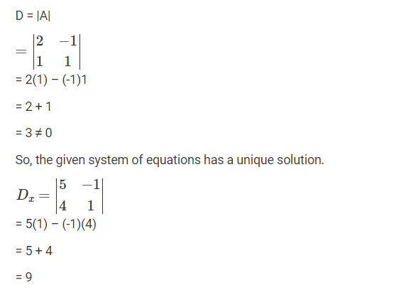
Lecture
07
Solution of Cramer’s Rule Example – 2×2

Slide 13
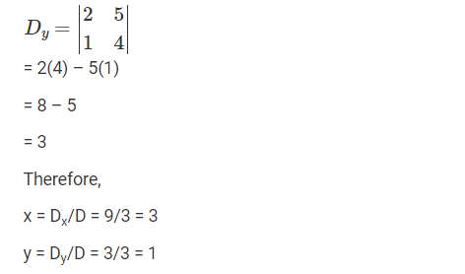
Lecture
07
Solution of Cramer’s Rule Example – 2×2

Slide 14
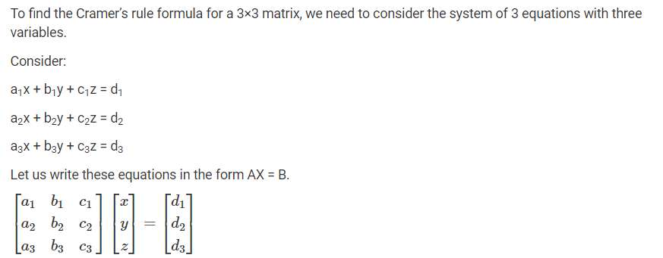
Lecture
07
Cramer’s Rule – 3×3

Slide 15
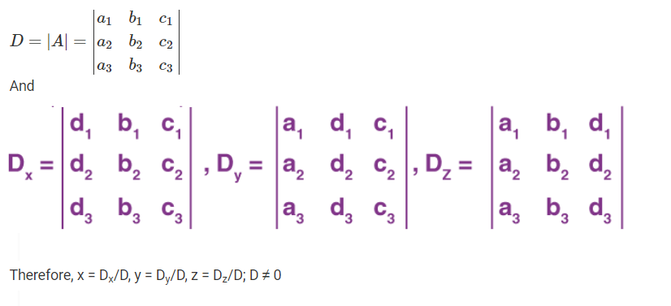
Lecture
07
Cramer’s Rule – 3×3

Slide 16
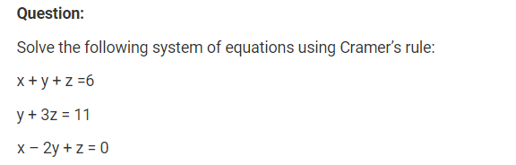
Lecture
07
Cramer’s Rule Example – 3×3

Slide 17
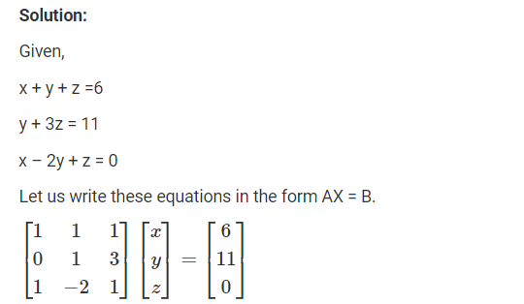
Lecture
07
Solution of Cramer’s Rule Example – 3×3

Slide 18
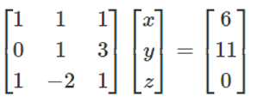
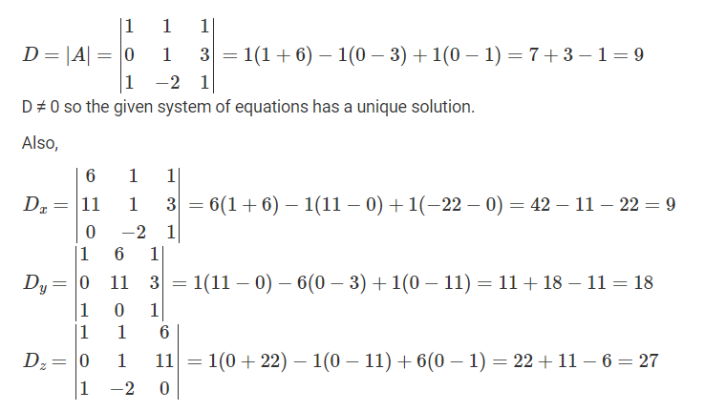
Lecture
07
Solution of Cramer’s Rule Example – 3×3

Slide 19
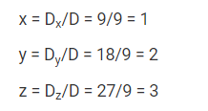
Lecture
07
Solution of Cramer’s Rule Example – 3×3

Slide 20
Lecture
07
Gaussian Elimination Method
Gaussian Elimination Method

Slide 21
Lecture
07
Gaussian Elimination Method
In mathematics, Gaussian elimination, also known as row reduction, is an algorithm for solving systems of linear equations. It consists of a sequence of operations performed on the corresponding matrix of coefficients. This method can also be used to compute the rank of a matrix, the determinant of a square matrix, and the inverse of an invertible matrix.

Slide 22
Lecture
07
Gaussian Elimination Method
In mathematics, the Gaussian elimination method is known as the row reduction algorithm for solving linear equations systems. It consists of a sequence of operations performed on the corresponding matrix of coefficients.
We can also use this method to estimate either of the following:
The rank of the given matrix
The determinant of a square matrix
The inverse of an invertible matrix

Slide 23
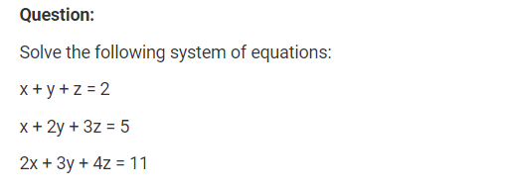
Lecture
07
Gaussian Elimination Method Example

Slide 24
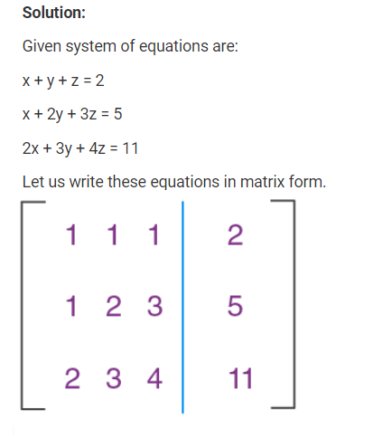
Lecture
07
Gaussian Elimination Method Solution

Slide 25
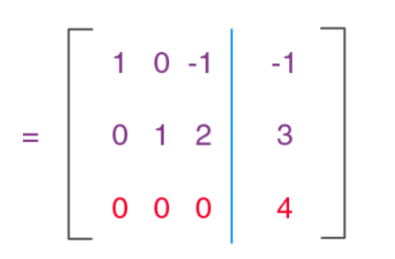
Lecture
07
Gaussian Elimination Method Solution
No Solution !!!!!

Slide 26
Lecture
07
Extra Practice
Let’s Practice

Slide 27
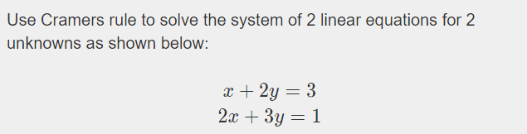
Lecture
07
Example 1

Slide 28
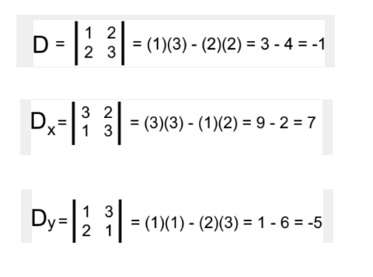
Lecture
07
Example 1 Solution

Slide 29
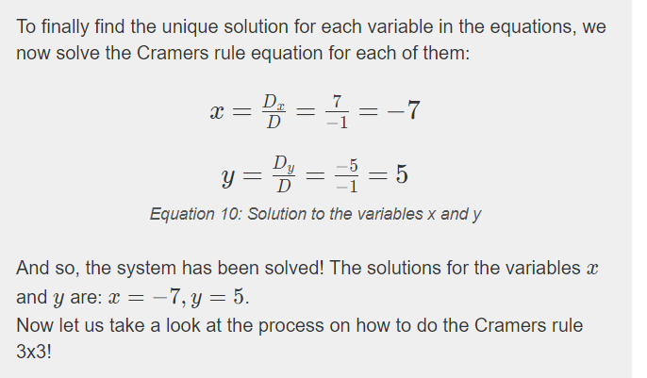
Lecture
07
Example 1 Solution

Slide 30
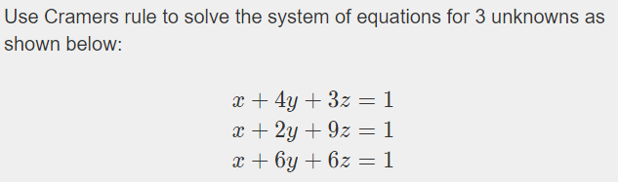
Lecture
07
Example 2

Slide 31
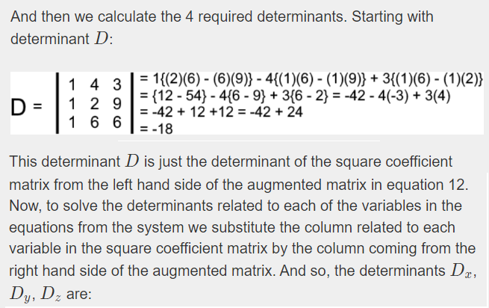
Lecture
07
Solution on Example 2

Slide 32
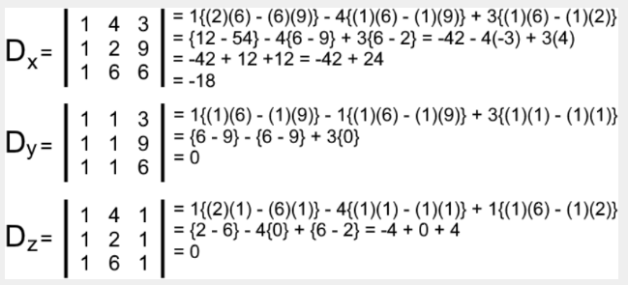
Lecture
07
Solution on Example 2

Slide 33
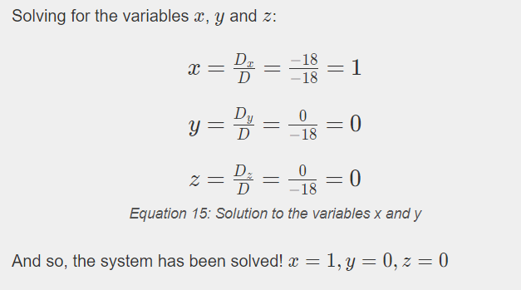
Lecture
07
Solution on Example 2

Slide 34
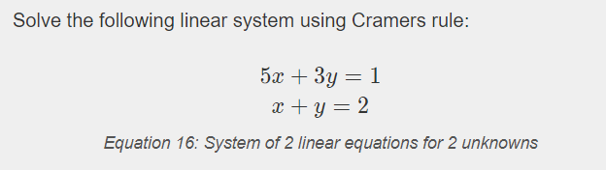
Lecture
07
Example 3

Slide 35
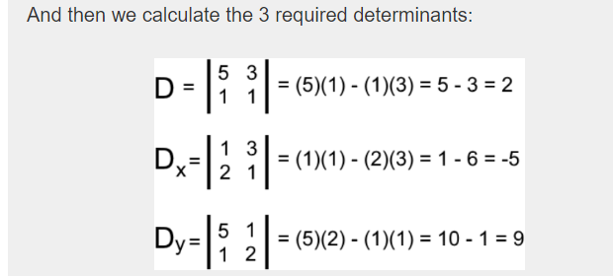
Lecture
07
Solution of Example 3

Slide 36
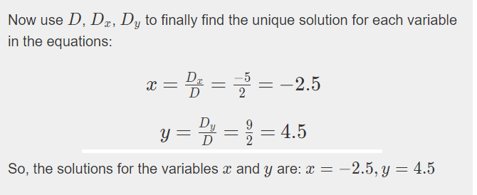
Lecture
07
** EXTRA PRACTISE

Slide 37
Lecture
07
Lecture Summary
Solving System of Linear Equations
Cremer’s Method Definition
Cremer’s Method 2*2 matrix
Cremer’s Method 3*3 matrix
Gaussian Elimination Method
Extra Practice

