Slide 1


Human Resources
Analytics
Prepared by Dr. Samah Abdelfatah
HRM 623
Lecture 02

Slide 2



Toward Analytics
and Prediction
Chapter
02
Lecture 02
HRM 623
Prepared by
Dr. Samah Abdelfatah
www.midocean.ae

Slide 3

Chapter
MAIN TOPICS
02
Descriptive , Predictive & Prescriptive Analytics—The Model for Predictive Management— Why Analytics Is Important —Measuring What Is Important— Strategic Measures Related To HCM
www.midocean.ae

Slide 4
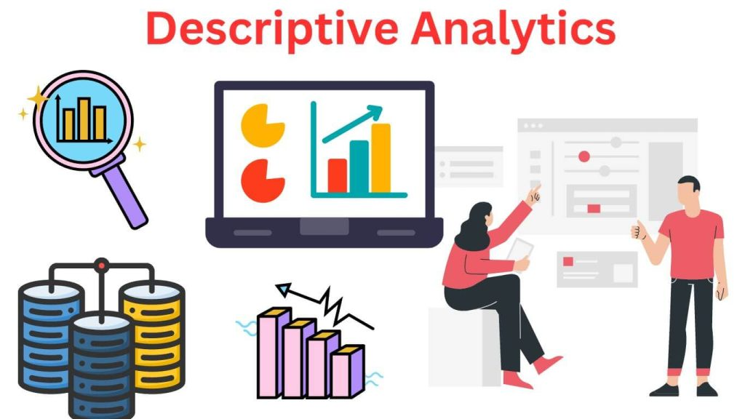
DESCRIPTIVE ANALYTICS
This type of analytics reveals and describes relationships and differences between the groups.
It can also show past and current behaviors or interests among the groups, but it is limited to exploration rather than prescription.
Chapter
02
www.midocean.ae

Slide 5
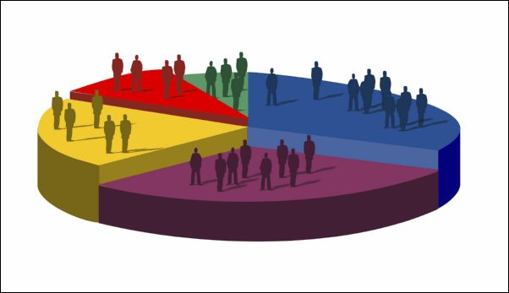
DESCRIPTIVE ANALYTICS
There are many ways to use descriptive models to understand the workforce in detail.
Any group of characteristics can be considered all that is required are the variables that make up
the characteristics (age, education, family status, benefits selections, skills, interests, potential ratings, etc.)
Chapter
02
www.midocean.ae

Slide 6
Chapter
DESCRIPTIVE ANALYTICS
02
As an example, when dealing with capability planning,
We segment the workforce into four groups for investment purposes. These groups are:
Mission-critical
the small group that has the largest effect on performance and revenues
Differentiators
the group with unique skill sets that help to generate competitive advantage
Important
Movable
the operatives who keep the organization functioning day to day
those with capabilities that can be outsourced,retrained, transferred, or terminated
www.midocean.ae

Slide 7

Chapter
DESCRIPTIVE ANALYTICS
02
From the previous categorization, we can make cost-effective investment decisions regarding development, retention, and recognition.
By this segmentation, the organization optimizes its resources that are committed to the workforce.
www.midocean.ae

Slide 8
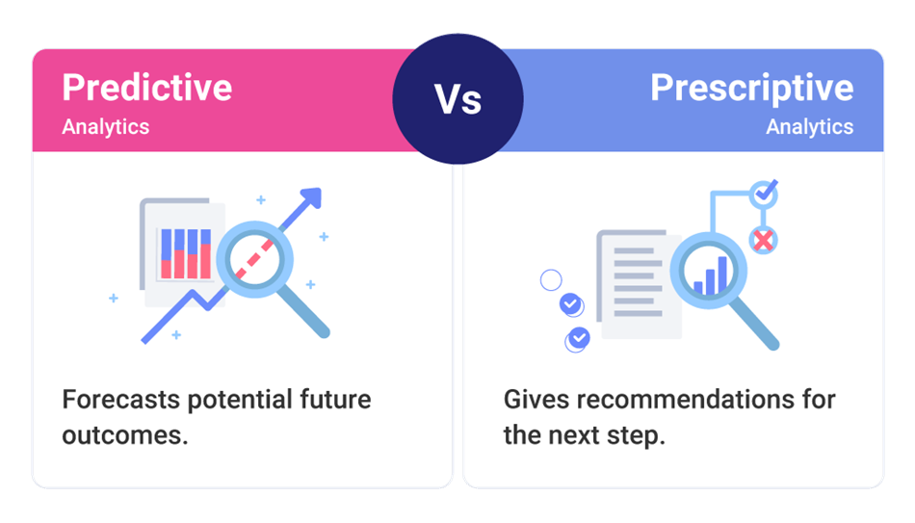
Chapter
PREDICTIVE ANALYTICS
02
Predictive analytics gives meaning to those patterns for the future.
Predictive analytics expresses the future in terms of probabilities.
www.midocean.ae

Slide 9
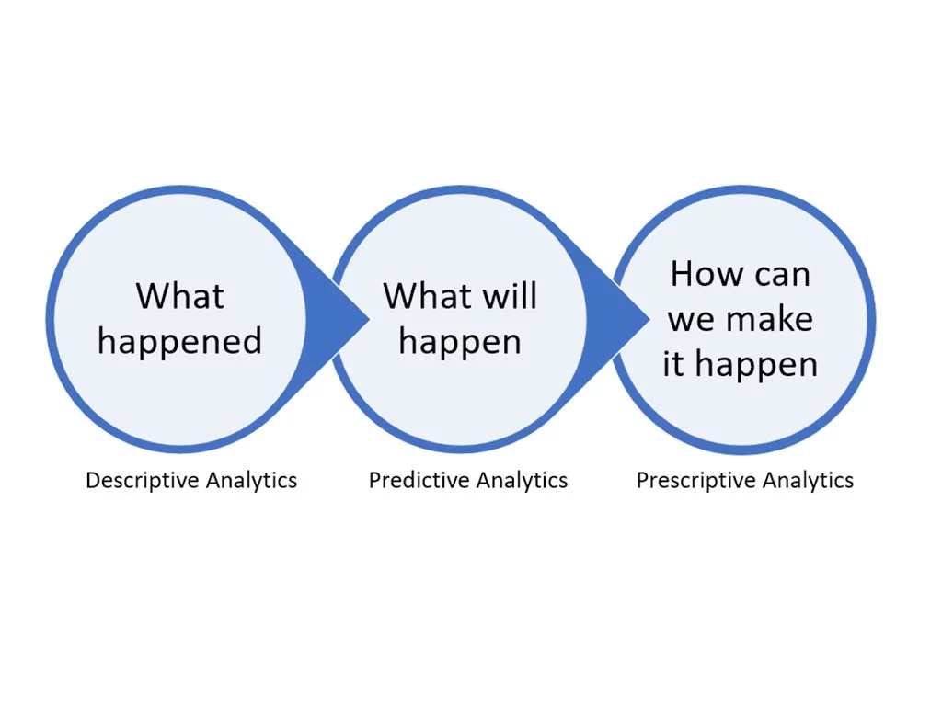
Chapter
PRESCRIPTIVE ANALYTICS
02
This form of analysis relates what we know currently to what we want to know about the future. Whereas descriptive analytics reveals current data patterns,
www.midocean.ae

Slide 10
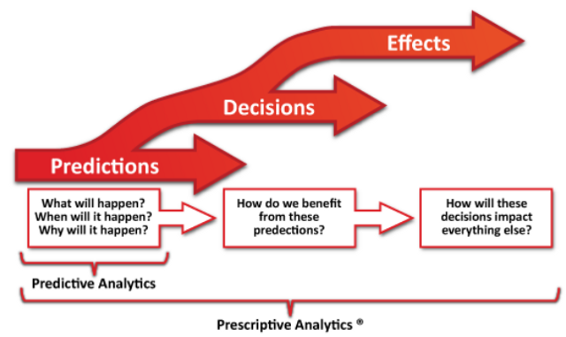
Chapter
PRESCRIPTIVE ANALYTICS
02
It helps management make decisions that minimize risks and increase ROIs.
No analytic application can predict the future with absolute certainty; but, when properly applied it will substantially reduce variability
www.midocean.ae

Slide 11
Chapter
CAUSATION
02
It is the combination of descriptive and prescriptive analytics that we call causal analysis sometimes called causal modeling.
With causal modeling we can find the hidden root cause of a problem or make a business proposition for a human capital investment.
www.midocean.ae

Slide 12
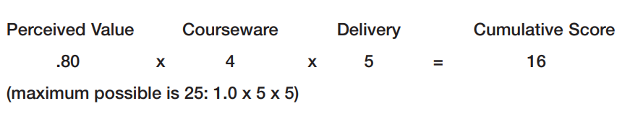
For e.g. to find and express training’s business value is to survey the trainees, asking them to score their perceived value on a scale of 1 to100 percent; the courseware, from 1 to 5 points; and the delivery, 1 to5 points. Then you put these factors into an equation such as the
www.midocean.ae

Slide 13
Chapter
THE POWER OF ANALYTICS
02
High-risk decisions have to be made under circumstances that are seldom completely clear.
For example, what actions are necessary to retain mission-critical talent under certain market conditions?
Would we select incentive compensation, challenging assignments, work-life balance, or rapid promotions?
What data do we have to support such a critical future decision?
If the mission-critical population is large, geographically dispersed, and its technology or customers are changing, who can say which action will have the highest success rate?
www.midocean.ae

Slide 14
Chapter
THE POWER OF ANALYTICS
02
Being able to foretell what is likely to happen with a high degree of probability depends on four things
1. Comprehension of past and current events
2. Understanding not only trends but also the drivers behind them
3. Being able to see patterns of consistency as well as change
4. Having tools to describe the probability of something in the
future
www.midocean.ae

Slide 15
Chapter
HUMAN RESOURCES ANALYTICS
02
HRA turns human resources metrics toward the future. It takes past and current strategic and operational data and adds leading indicators.
Data on retention, readiness, leadership, and engagement speak to what is likely to come tomorrow.
www.midocean.ae

Slide 16
Chapter
THE MODEL FOR PREDICTIVE MANAGEMENT
02
HCM:21 is the broad strategy that provides the framework for analyzing an organization’s data. It takes brainstorming lists, interview and survey data, and market research and organizes these elements around human, structural, and relational capital phenomena.
By applying HRA tools, predictive management uncovers the connections and interdependencies among organizational activities.
www.midocean.ae

Slide 17
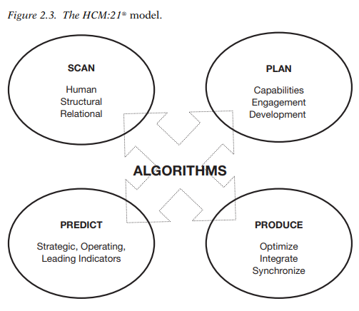
www.midocean.ae

Slide 18
Chapter
THE CRISES IN MEASURING SYSTEMS
02
The Excess Indicator Crisis(too many measures make confusion)
The Crisis in Understanding What Measurements and Parameters Mean (In many organizations, there is an assumption, one, that cost reduction is good, or else that increasing productivity levels is good. The problem is that these two assumptions are not always true in every case.
www.midocean.ae

Slide 19
Chapter
THE CRISES IN MEASURING SYSTEMS
02
The Crisis of Extremes (Benchmarking to prevent the ‘‘self-centeredness disease’’ )
The Crisis of Putting Process Measurement Ahead of Results Measurement (In many organizations, the administrative cost of paying salaries is a clearer indicator than staff performance levels and how much the cost of salary administration affects the company’s overall profitability.)
www.midocean.ae

Slide 20
Chapter
THE CRISES IN MEASURING SYSTEMS
02
The Crisis in Thinking That Everything Measured Equals Everything Existing and That Everything That Is Measured Can Be Managed(Employee satisfaction , interpersonal relationships,)
The Crisis of Rearview-Mirror Vision(Most measurements are based on the past—an unchanged past. Information about the past is important as long as it helps us understand the present and enables us to make decisions about the future)
www.midocean.ae

Slide 21
Chapter
MEASURING WHAT IS IMPORTANT
02
That which is measured should
    Possess obvious consistency (two or more people should be able to interpret the information provided by the measurement in the same way)
    be important and should provide added value. For example, measuring staff satisfaction is important and valuable.
    be limited to a few, which allows focusing, and should be associated with the company’s strategic concerns
www.midocean.ae

Slide 22
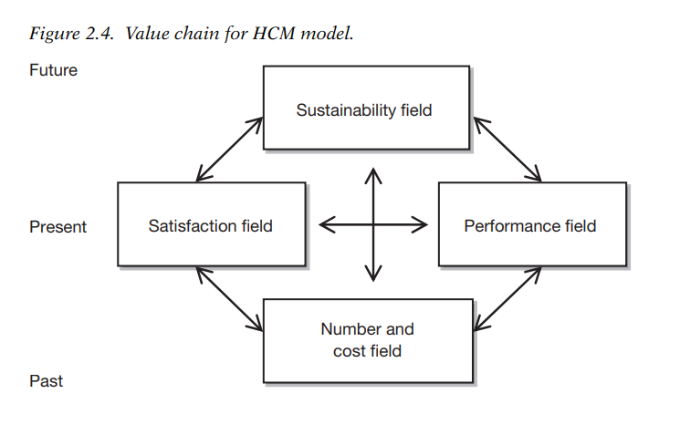
Chapter
A VALUE CHAIN
02
This value chain has three stages.
The basement, or ‘‘Past,’’ represents the consequences of previous actions or decisions like the financial information you can get from a balance sheet.
The ground floor, or ‘‘Present,’’ represents the current reality.
The first floor, or ‘‘Future,’’ represents the levers that build the next times. The figure illustrates what the important fields
www.midocean.ae

Slide 23
Chapter
A VALUE CHAIN
02
First, there is a number and cost field.
The company’s staff and working costs are figures that generally refer to the past.
HRM generates the impacts that can be seen in this field.
This chart’s specificity depends on the nature of the business, on the strategic concerns, or on the form that added value takes.
www.midocean.ae

Slide 24
Chapter
A VALUE CHAIN
02
Second, is the performance field.
It shows what is currently being achieved and how it is being achieved.
HRM actions and initiatives should be aimed at improving performance.
HRM works, so that every person, every group, and the organization as a whole can reach the objectives that have been set.
www.midocean.ae

Slide 25
Chapter
A VALUE CHAIN
02
Third element, which also belongs to the present, is the satisfaction field
  Relationship between performance and satisfaction,
  People who work well are satisfied, and when they are satisfied, they work better.
  To achieve this satisfaction, people’s ‘‘engagement,’’ or commitment, should be developed.
www.midocean.ae

Slide 26
Chapter
A VALUE CHAIN
02
Fourth field, which is related to the future, the sustainability field.
  Two elements and two concepts are used for its analysis.
  The elements are talent and organizational knowledge.
  For instance, talent could be the percentage of key positions that have an identified successor, or the percentage of promotions granted,
  Similarly, the number of patents, technical documents, papers, databases, or manuals produced by a company increases its intellectual capital.
www.midocean.ae

Slide 27
Chapter
STRATEGIC MEASURES RELATED TO HCM
02
Human Resources KPIs:
Employee satisfaction: Level of employee happiness and engagement.
Time to hire: Average time it takes to fill a vacant position.
Employee turnover rate: Percentage of employees who leave the company over a given period.
Training completion rate: Percentage of employees who complete mandatory or optional training.
Diversity and inclusion metrics: Representation of different groups of people within the workforce.
KPIs
Also referred to as key success indicators (KSIs), KPIs vary between companies and between industries, depending on performance criteria.
Human Resources KPIs:
Employee satisfaction: Level of employee happiness and engagement.
Time to hire: Average time it takes to fill a vacant position.
Employee turnover rate: Percentage of employees who leave the company over a given period.
Training completion rate: Percentage of employees who complete mandatory or optional training.
Diversity and inclusion metrics: Representation of different groups of people within the workforce.
www.midocean.ae

Slide 28
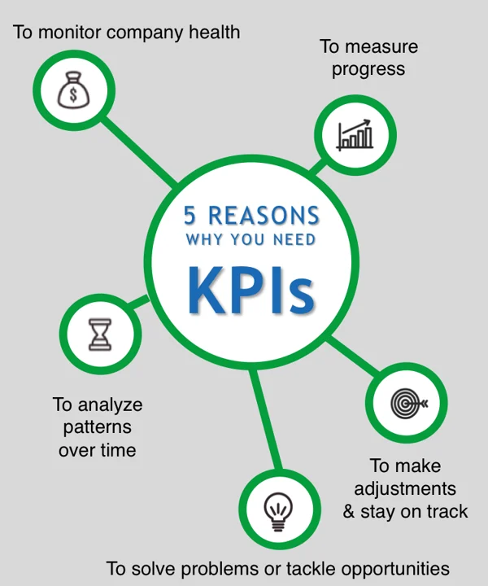

Slide 29
Chapter
02
STRATEGIC MEASURES RELATED TO HCM
KPIs
KPIs to Monitor Company Health
Use few KPIs in each of the 4 categories: Employees, Customers, Processes, and Revenue. These fall under the disciplines of human resources, customer satisfaction, business processes, and business strategy.
KPIs to Measure Progress Over Time
A key performance indicator (KPI) is any measurable result that indicates whether an organization is meeting its objectives.
It could be revenue, gross margin, number of locations, number of employees, customer satisfaction, product quality, employee productivity,
www.midocean.ae

Slide 30
Chapter
02
STRATEGIC MEASURES RELATED TO HCM
KPIs
KPIs to Make Adjustments and Stay on Track
you should also monitor your leading indicator KPIs to see how close you are to achieving your goals.
KPIs to Solve Problems or Tackle Opportunities
KPIs to Analyze Patterns Over Time
If you measure the same KPIs quarter over quarter, you can begin to detect patterns in your numbers. There are countless ways these patterns can help you in your business. Maybe you can predict when your slowest quarter will be and use that time to do a system update or company-wide training initiative.
www.midocean.ae

Slide 31
Chapter
STRATEGIC MEASURES RELATED TO HCM
02
The Balanced Scorecards
Balanced scorecards is a comprehensive measurement control system that balances financial measures with operational ones .(critical success factors .)
The main four areas are
Financial performance---- short & long term performance
Customer services----retention & satisfaction
Internal business process ----order fulfillment &cost per order .
learning and growth----- process improvement& new products
www.midocean.ae

Slide 32
Chapter
STRATEGIC MEASURES RELATED TO HCM
02
The Balanced Scorecards
The scorecards components are designed in an integrative manner so they complements and reinforce one another short terms actions with long term strategic goals.
Managers can use it for setting goals ,allocate resources ,plan budgets, set rewards ,set of new targets.
Use it as management control system, feedback control model, agenda for evaluate performance, get more data for information reports
www.midocean.ae

Slide 33
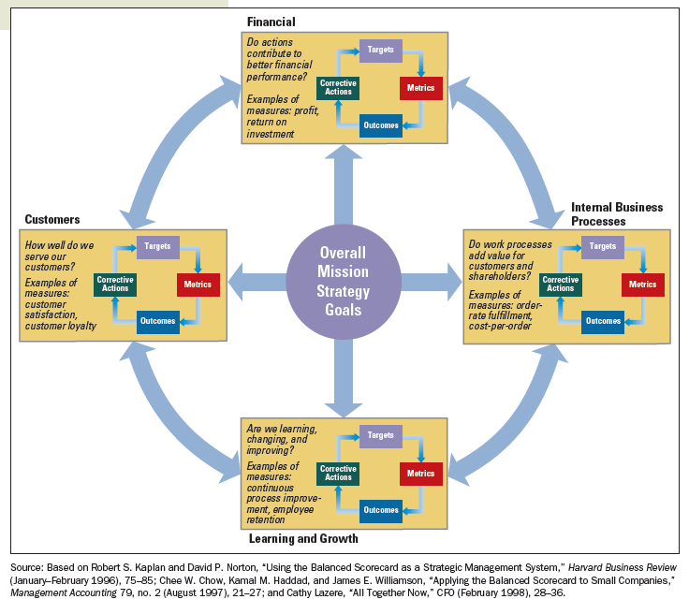
MAJOR PERSPECTIVES OF THE
BALANCED SCORECARD
www.midocean.ae

Slide 34
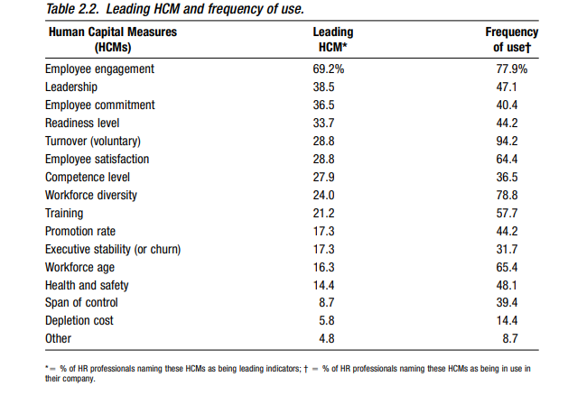
www.midocean.ae

Slide 35
Chapter
EIGHT PREDICTIVE HCMS
02
Eight predictive HCMs have wide validity in a large number of circumstances:
Professional/Managerial Ratio: The number of professionals and managers expressed as a percentage of the total number of full-time equivalents in the workforce.
In general, the higher the ratio, the greater the prospect for future growth and profitability.
www.midocean.ae

Slide 36
Chapter
EIGHT PREDICTIVE HCMS
02
2. Readiness Ratio: The percentage of key jobs with at least one person ready to take over. This measure suggests the resilience of the organization against disruption.
The closer to 1, the better
3. Commitment Ratio: The percentage of staff committed to the company’s vision. Measured by employee survey, the higher, the better.
4. Leadership Rating: Performance rating of current leaders, as measured by the staff, again through a survey
www.midocean.ae

Slide 37
Chapter
EIGHT PREDICTIVE HCMS
02
5. Climate-Culture Rating: The percentage of staff giving top scores about whether the company is a good place to work. Measured by survey, this is predictive of the employee retention rates, and therefore retained knowledge.
6. Training Rating: Scores from current programs. But what’s important is developing skills to get the job done now, not necessarily those needed for prospective future requirements. Having skills you don’t use and don’t need subtracts from corporate value, rather than adding to it.
www.midocean.ae

Slide 38
Chapter
EIGHT PREDICTIVE HCMS
02
7. Accession Ratio: The ratio of new and replacement hires as the percentage of total employment. In most organizations a high number indicates hidden costs and delays, which damage productivity.
8. Depletion Ratio: Annual percentage of top talent lost. This is a negative indicator. The higher the number, the worse your future prospects
www.midocean.ae

Slide 39
Chapter
OTHER PREDICTIVE RATIOS
02
1. Executive Stability Ratio and Separation Rate: Corporations with
executives having more than three years’ executive experience
lowers voluntary turnover.
2. Management Ratio and Promotion Rate: The number of employees that each manager supports impacts the number of promotions. Span of control is important in developing employees
professionally: A manager supervising fewer employees has a
lower number of promotions available.
3. Training Investment Factor and Promotion Rate: More dollars
allocated to training will increase professional employee development.
www.midocean.ae

Slide 40



Thank You

