Slide 1


Financial Management
Prepared by
Dr. Mohamed Hussein
Assistant Professor of Accounting
MGM424
Lecture 9

Slide 2



Financial Management
Lecture 9
MGM424 Capital Structure and Leverage
Prepared by
Dr. Mohamed Hussein

Slide 3

Chapter
09
Capital Structure and Leverage

Slide 4

Chapter
09
Capital Structure and Leverage
Determining the Optimal Capital Structure
Theories of Capital Structure (Tax Effects, Trade-Off, Signaling, Pecking Order)
Dividend Policy: Dividends vs. Capital Gains
Dividend Policy Influences
Stock Dividends, Repurchases

Slide 5
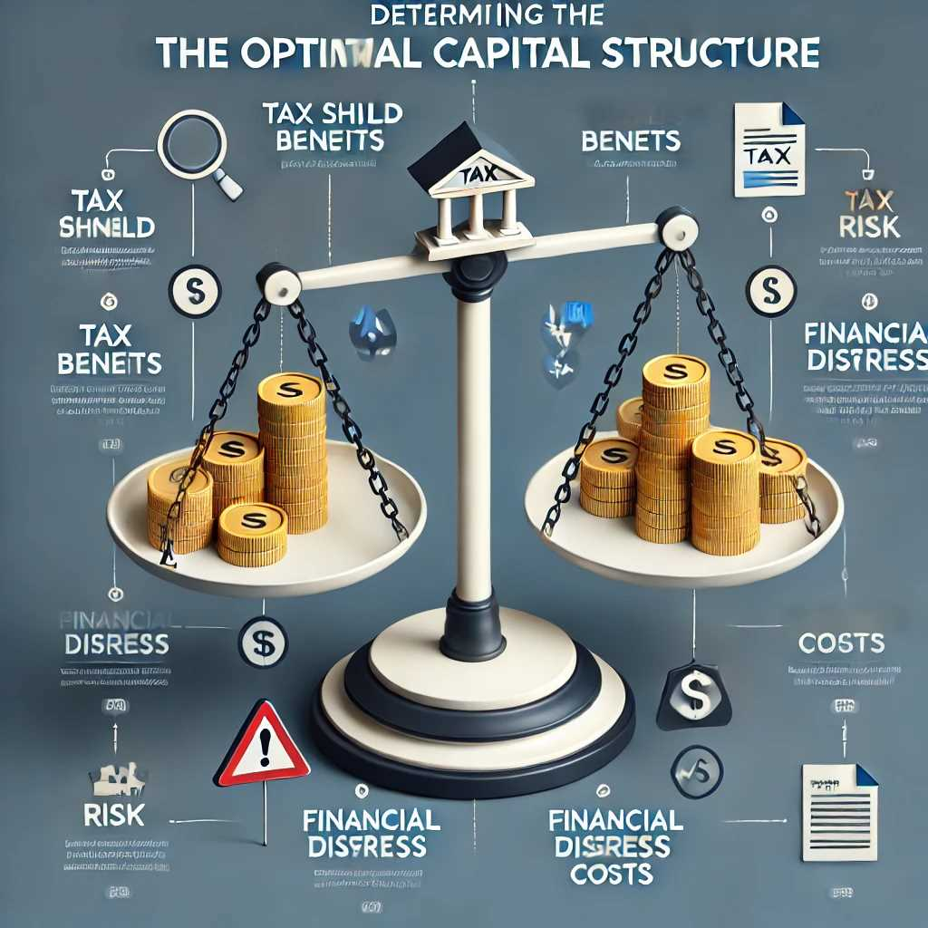
Chapter
09
Determining the Optimal Capital Structure
Balancing Return and Risk
Trade-Off: Tax Shield Benefits vs. Financial Distress Costs
  Tax Shield: By using debt, a firm can deduct interest payments from its taxable income, effectively reducing its tax burden. This tax advantage can lower the overall cost of capital.
  Financial Distress & Bankruptcy Costs: As debt levels increase, so does the likelihood (and potential severity) of financial trouble. These costs include legal fees, disruptions to operations, and damage to the firm’s reputation.
  Balancing Act: The optimal capital structure strikes a balance wherein the marginal tax benefits of adding more debt are just offset by the increase in marginal distress costs.

Slide 6
Chapter
09
Determining the Optimal Capital Structure
Balancing Return and Risk
2.Empirical Approach to Finding the Optimal Mix
  Practical vs. Theoretical: While finance theory gives insight into tax benefits and costs of distress, in practice, firms often adopt a trial-and-error or empirical approach.
  What They Monitor:
    Stock Price Performance: If a leveraged buyback or other restructuring leads to a sustained rise in stock price, it may suggest that the new structure is favorable.
    Credit Ratings: A drop in credit rating implies higher future interest costs and signals that debt usage may be too high.
    Capital Market Reactions: Investor and analyst feedback can guide management on whether their leverage policy is perceived as too risky or too conservative.

Slide 7
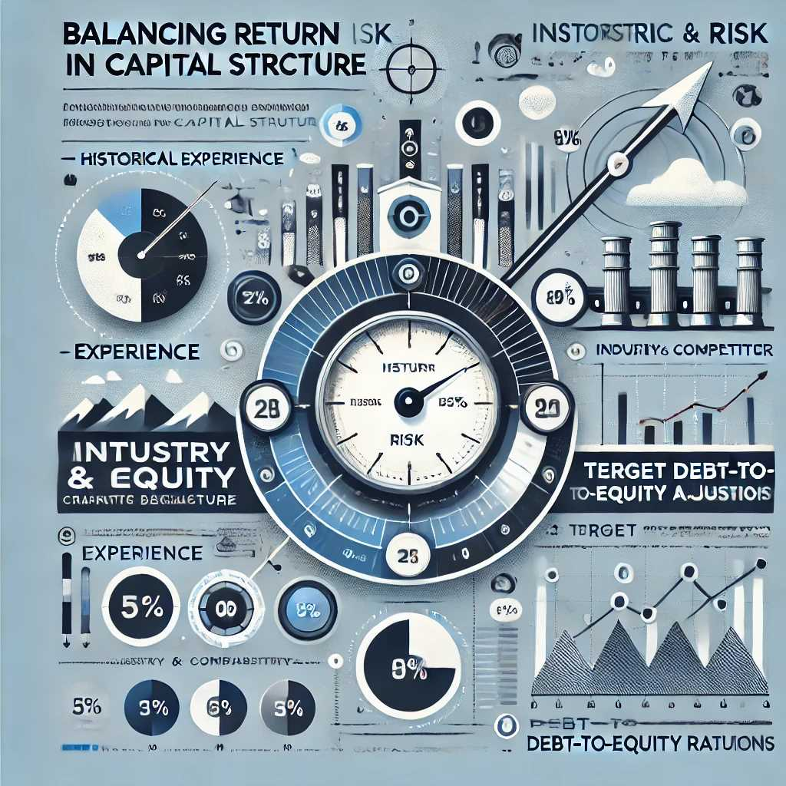
Chapter
Determining the Optimal Capital Structure
09
Balancing Return and Risk
3.Target Ratio Influenced by History and Benchmarks
  Historical Experience: Each firm has its own track record of how well it managed debt during economic cycles, which informs current decisions.
  Industry and Competitor Benchmarks: Observing how peers in the same sector structure their financing can help set “norms” or target ranges for the debt-to-equity ratio.
  Dynamic Nature: This target often adjusts over time with changes in market conditions, internal strategy, and industry outlook.

Slide 8
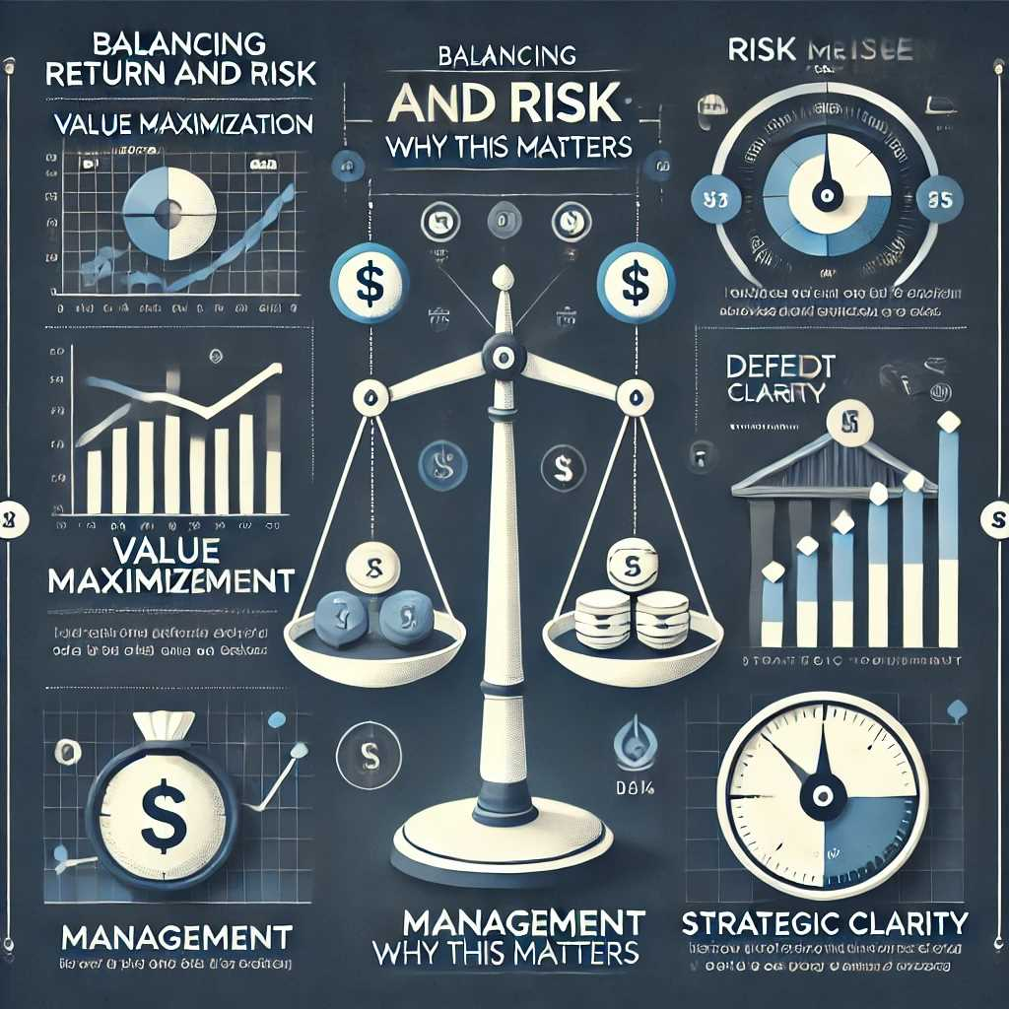
Chapter
Determining the Optimal Capital Structure
09
Balancing Return and Risk
Why This Matters
Value Maximization: Finding the right debt-equity mix can lower the firm’s cost of capital, boosting the firm’s valuation.
Risk Management: Over-leveraging can push a company toward default in downturns, while under-leveraging may miss out on the tax advantages and lower-cost financing of debt.
Strategic Clarity: A well-defined target ratio helps managers make consistent financing decisions aligned with long-term shareholder interests.

Slide 9

Chapter
Capital Structure Theories
09
Theoretical Foundations
Tax-Based Models
  Basic Idea: Stemming from the work of Modigliani and Miller (M&M) with corporate taxes, these models suggest that debt can create value for the firm because interest payments are tax-deductible. This “tax shield” lowers the firm’s overall cost of capital.
  Real-World Extension: In practice, the pure M&M model is modified to include personal taxes, the possibility of bankruptcy, and other market frictions.

Slide 10
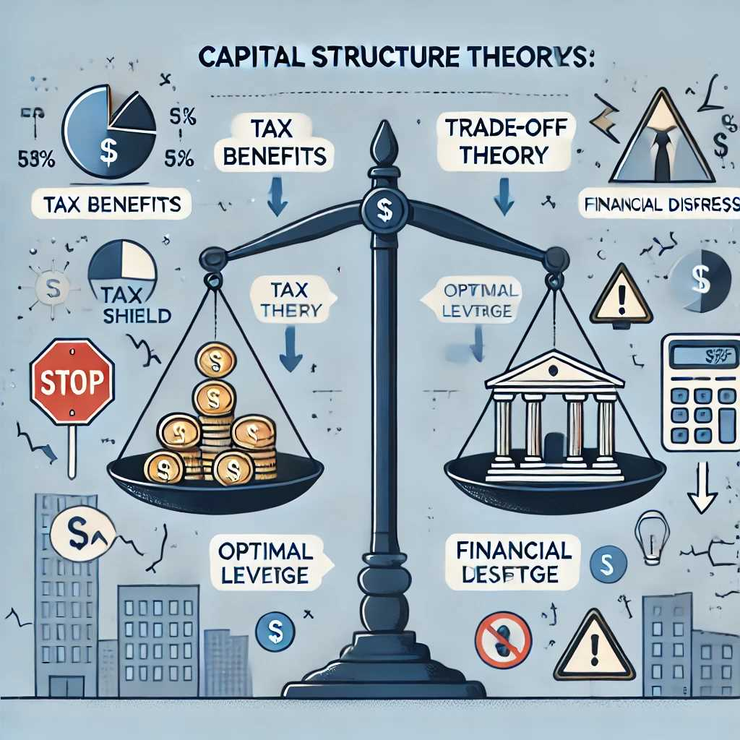
Chapter
Capital Structure Theories
09
Theoretical Foundations
2.Trade-Off Theory
  Key Insight: Firms balance the tax benefits of additional debt against the potential costs of financial distress.
  Optimal Leverage: The firm’s goal is to choose a debt level such that the incremental tax benefit from one more dollar of debt equals the incremental expected cost of distress.

Slide 11
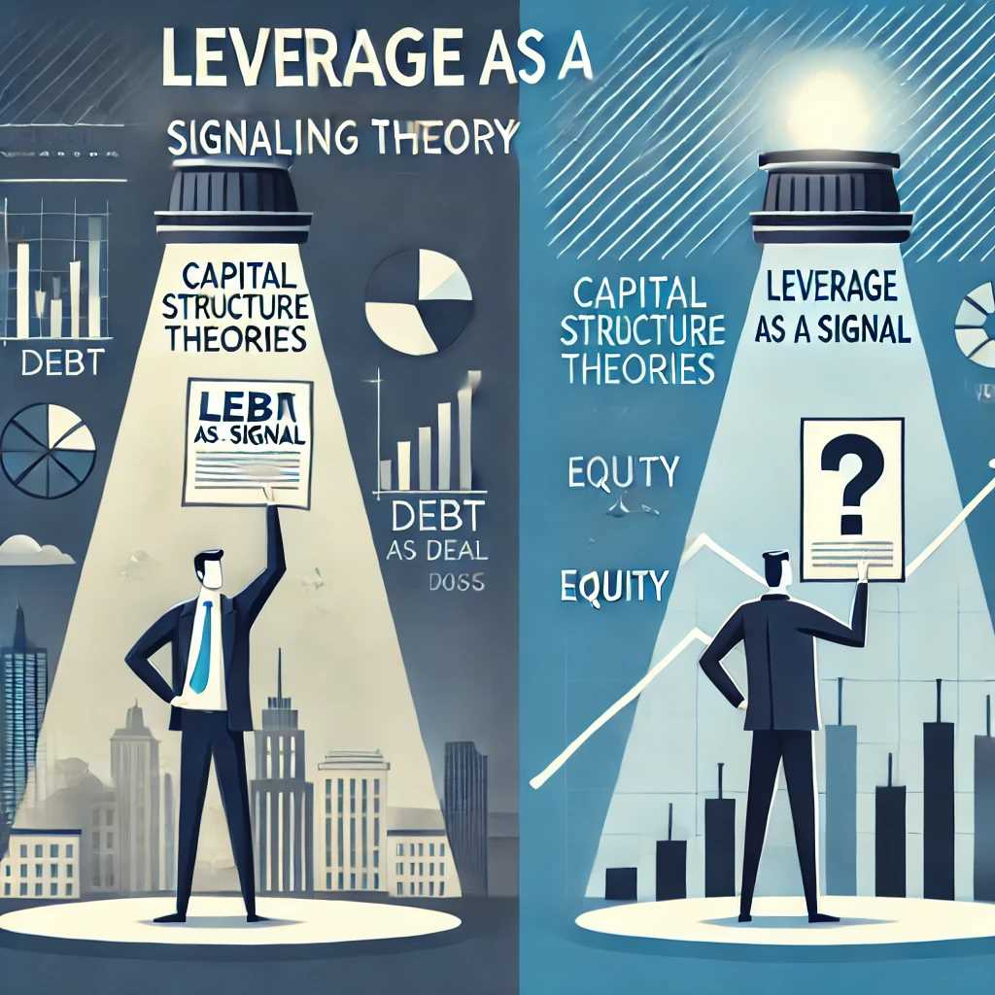
Chapter
Capital Structure Theories
09
Theoretical Foundations
3.Signaling Theory
  Information Asymmetry: Managers typically know more about a firm’s prospects than outside investors.
  Leverage as a Signal: By taking on debt, management may signal confidence in future cash flows (they expect to handle interest payments). Conversely, avoiding debt or issuing new equity could imply uncertainty about future earnings.

Slide 12
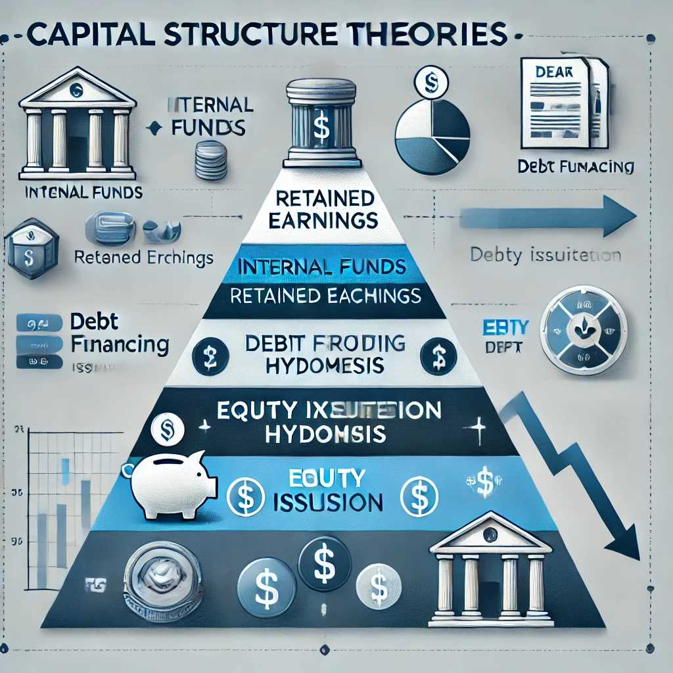
Chapter
Capital Structure Theories
09
Theoretical Foundations
4.Pecking Order Hypothesis
  Preference Hierarchy: Firms prefer to use internal funds (retained earnings) first, then debt, and issue equity as a last resort.
  Reasoning: Issuing equity can be viewed negatively by the market—investors may interpret an equity issue as a sign the firm’s stock is overvalued or that its outlook is riskier.

Slide 13
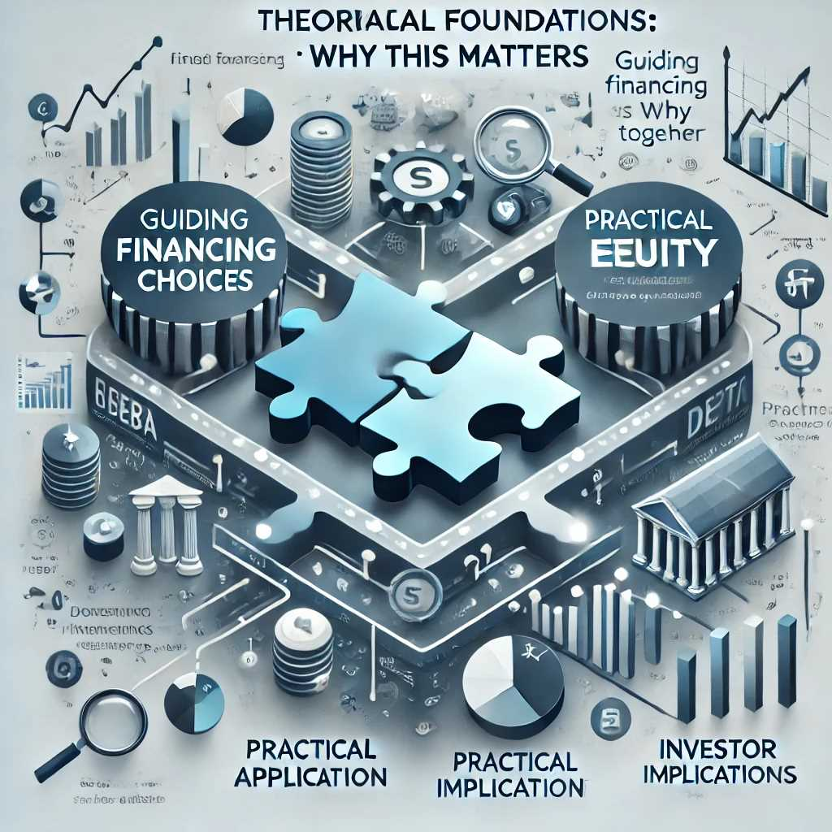
Chapter
Capital Structure Theories
09
Theoretical Foundations
Why This Matters
Guiding Financing Choices: These theories offer different lenses for understanding how and why companies select their mix of debt and equity.
Practical Application: Real-world firms often use a blend of these theories—balancing tax advantages, signaling effects, industry norms, and management’s desire to avoid financial distress.
Investor Implications: By examining a firm’s leverage policy through these frameworks, investors can gain insights into management’s view of the company’s risk and growth prospects.

Slide 14
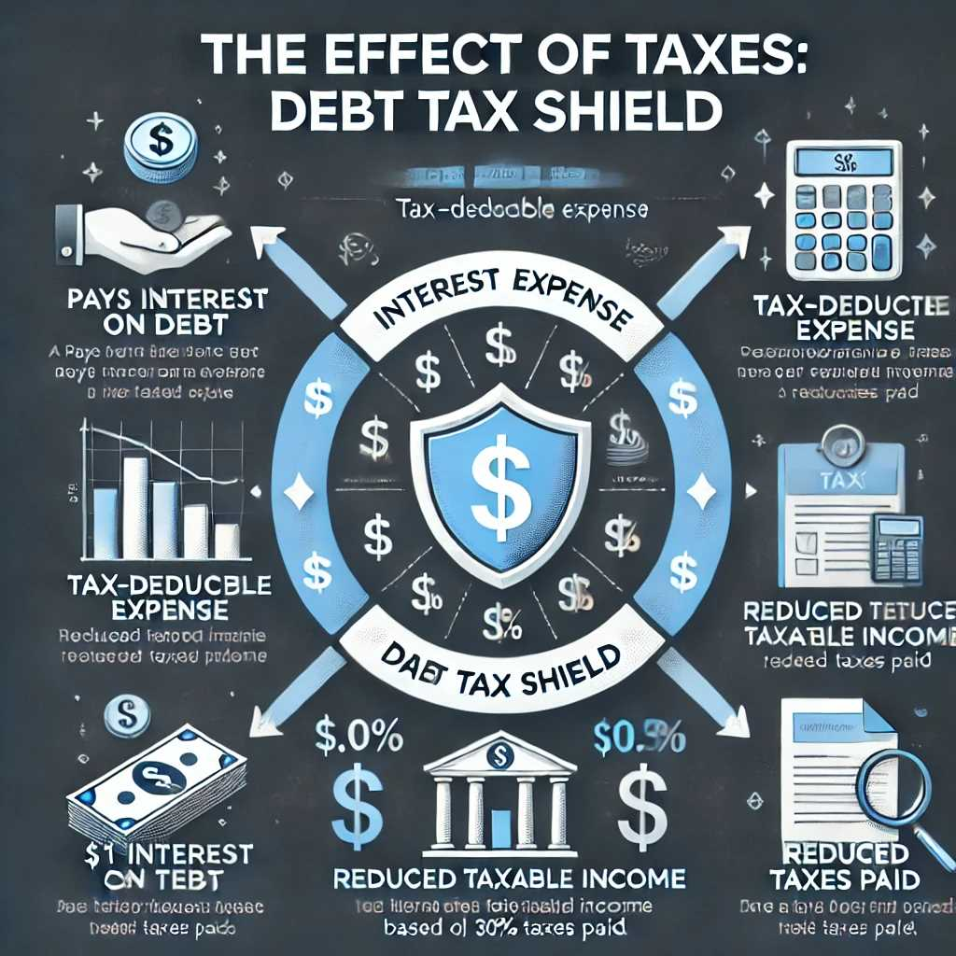
Chapter
09
The Effect of Taxes
Debt Tax Shield
Interest Expense and the Tax Benefit
  Mechanism: When a firm pays interest on debt, that interest payment is generally tax-deductible, lowering the firm’s taxable income.
  Practical Effect: If a company’s profit is taxed at, say, 30%, then every dollar of deductible interest effectively provides a 30-cent reduction in taxes (assuming there’s sufficient taxable income to offset).
  Implication: This “tax shield” can make debt a more cost-effective way to raise capital compared to equity, which does not produce a similar tax deduction.

Slide 15
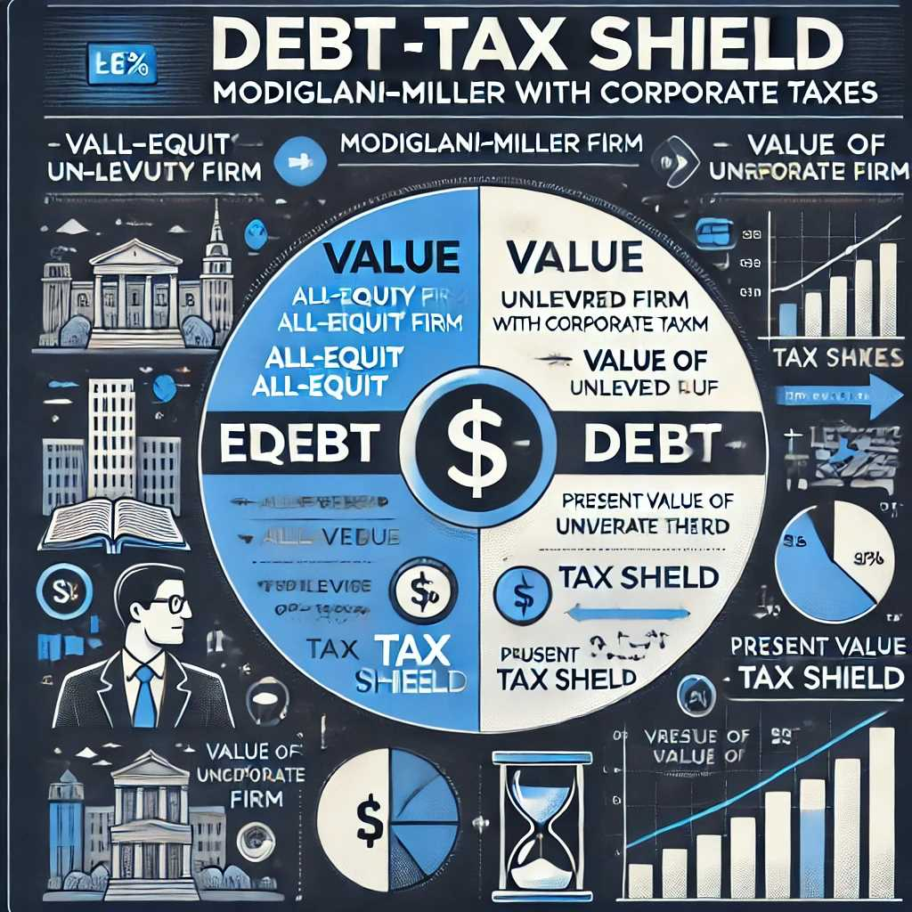
Chapter
09
The Effect of Taxes
Debt Tax Shield
2.Modigliani–Miller (M&M) with Corporate Taxes
  Original M&M Proposition (without taxes) posited that capital structure is irrelevant in a perfect market; however, once corporate taxes are considered, debt financing can increase firm value because of the interest deduction.
  Value Enhancement: The value of a levered firm can be thought of as the value of an all-equity firm plus the present value of the tax shield on debt.
  Real-World Significance: Although actual companies face other costs and market imperfections, the tax advantage of debt remains a central reason why many firms choose to have some leverage.

Slide 16
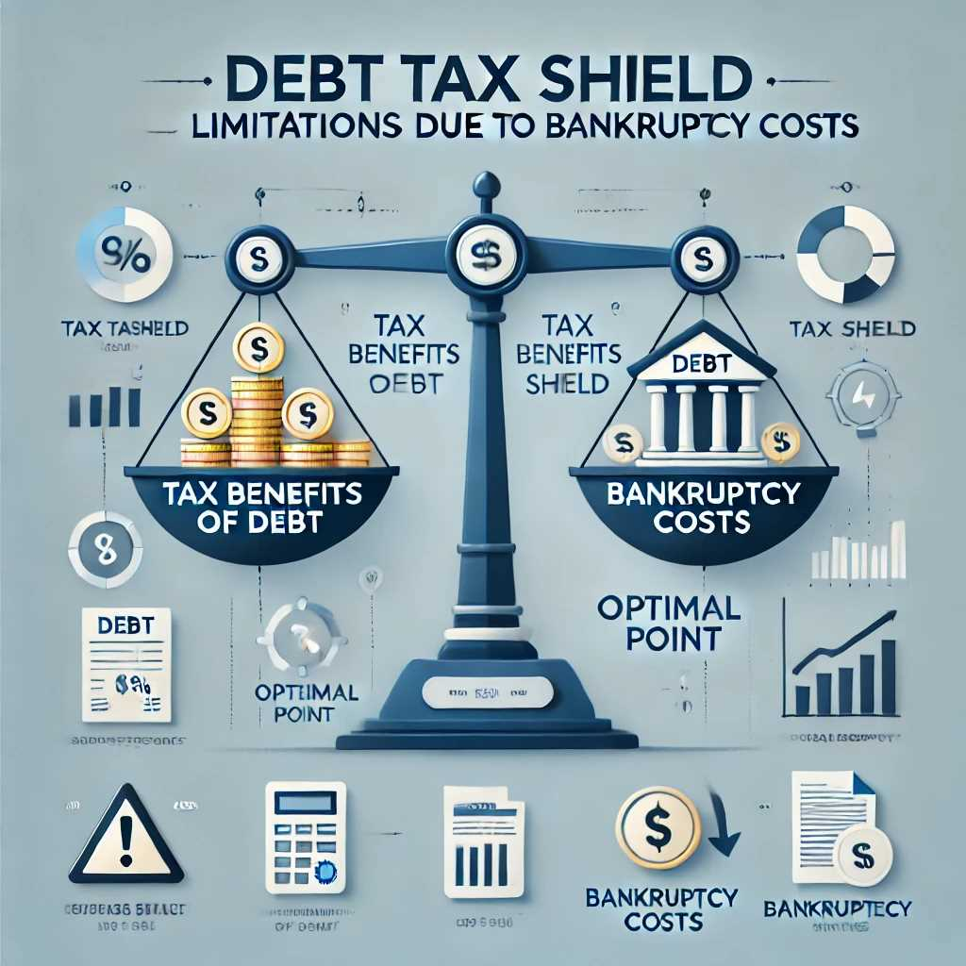
Chapter
09
The Effect of Taxes
Debt Tax Shield
3.Limitation: Bankruptcy Costs and Financial Distress
  Excessive Debt: If a firm becomes over-leveraged, the probability and cost of financial distress (including potential bankruptcy) grow, which can more than negate the tax benefits of debt.
  Offsetting Costs: These might include legal fees, business disruptions, restricted access to capital markets, and damage to the firm’s reputation.
  Balancing Act: An optimal capital structure usually involves some debt to capture the tax shield but not so much that the firm’s risk of default becomes prohibitively high.

Slide 17
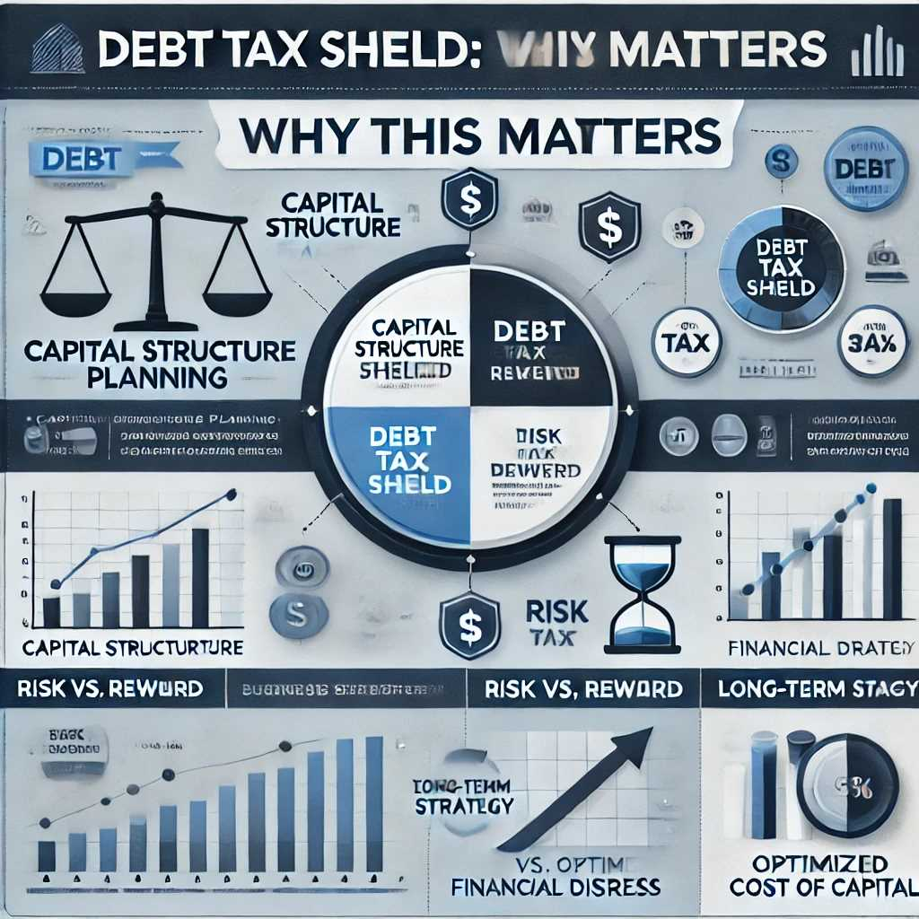
Chapter
The Effect of Taxes
09
Debt Tax Shield
Why This Matters
Capital Structure Planning: The tax benefit of debt is a major incentive for firms to incorporate a certain level of leverage.
Risk vs. Reward: While the tax shield can enhance firm value, management must weigh the increased likelihood of distress when deciding how much debt to take on.
Long-Term Strategy: Successful firms often maintain a target debt ratio that balances tax advantages against potential financial instability, optimizing their overall cost of capital.

Slide 18
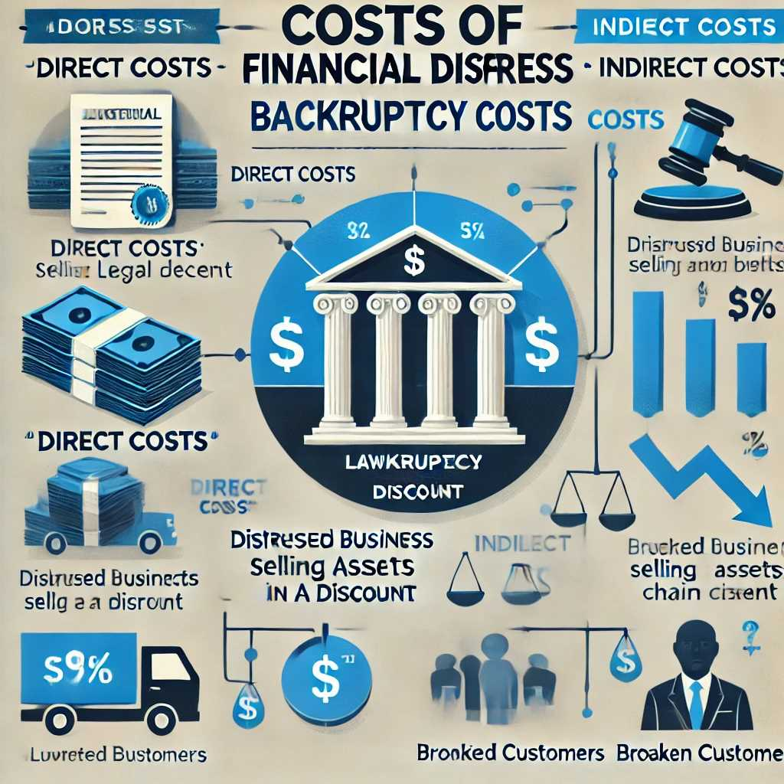
Chapter
The Effect of Potential Bankruptcy
09
Costs of Financial Distress
Bankruptcy Costs
  Direct Costs: When a firm faces severe financial trouble, potential legal and court expenses skyrocket. If the firm ends up declaring bankruptcy, it incurs substantial legal fees, administrative costs, and possibly liquidation fees.
  Indirect Costs: Even before formal bankruptcy, the firm may need to sell assets at fire-sale prices (well below their true market value) to generate cash. In addition, customers and suppliers often lose confidence, which can drive away business and disrupt supply chains.

Slide 19
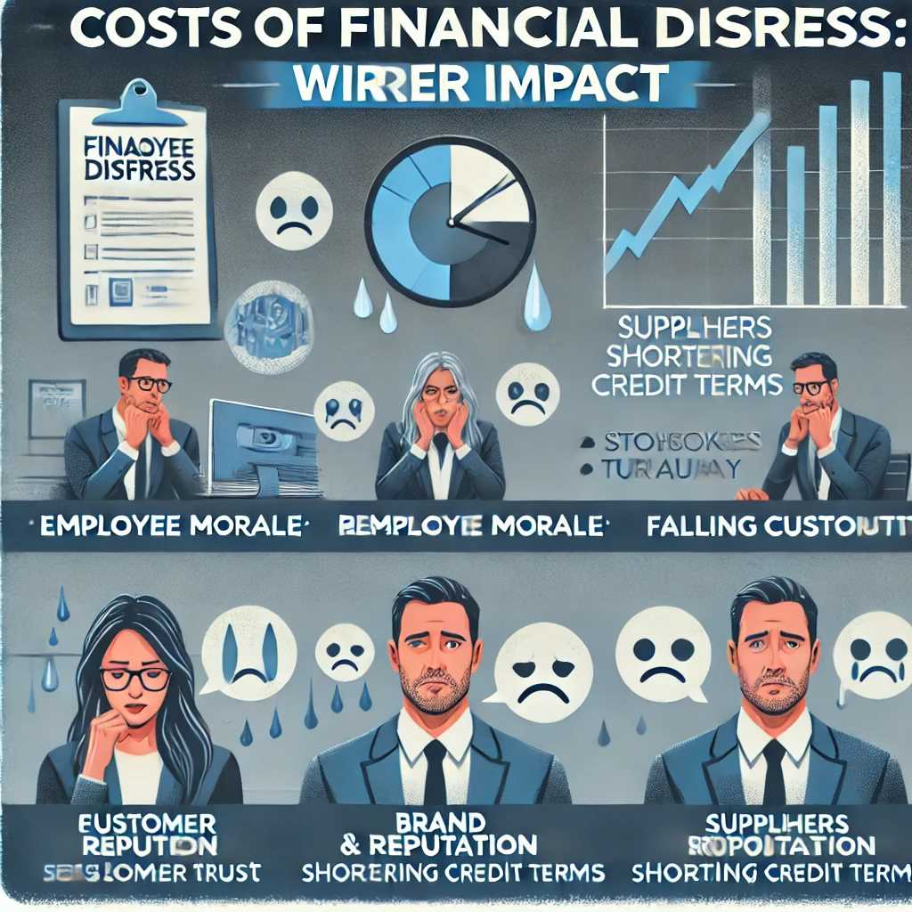
Chapter
The Effect of Potential Bankruptcy
09
Costs of Financial Distress
2.Financial Distress and Its Wider Impact
  Employee Morale: When bankruptcy rumors surface, employee anxiety can lead to higher turnover, lower productivity, and difficulties in attracting new talent.
  Brand and Reputation: Public knowledge of a firm’s financial distress can erode customer trust, reduce credit terms offered by suppliers, and harm relationships with key stakeholders. Long after a firm recovers financially, reputational damage can linger.

Slide 20
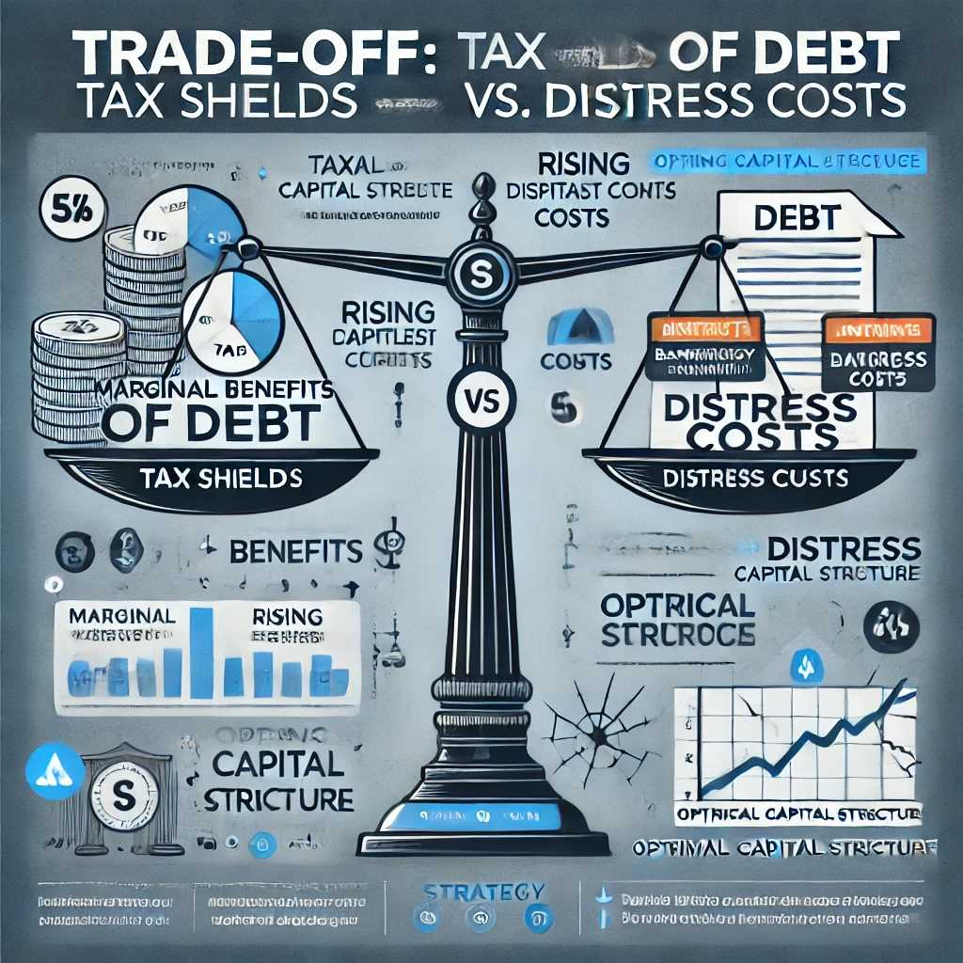
Chapter
09
The Effect of Potential Bankruptcy
Costs of Financial Distress
2.Trade-Off: Tax Shields vs. Distress Costs
  Marginal Benefits of Debt: Up to a point, taking on additional debt provides a tax advantage (the tax shield on interest).
  Rising Marginal Costs: Beyond that point, the likelihood and potential severity of bankruptcy can escalate, and these distress costs begin to outweigh the benefits of further leverage.
  Implication: An optimal capital structure seeks to balance the benefit of debt’s tax shield with the risks and costs of financial distress, rather than simply maximizing debt for the sake of a larger tax deduction.

Slide 21
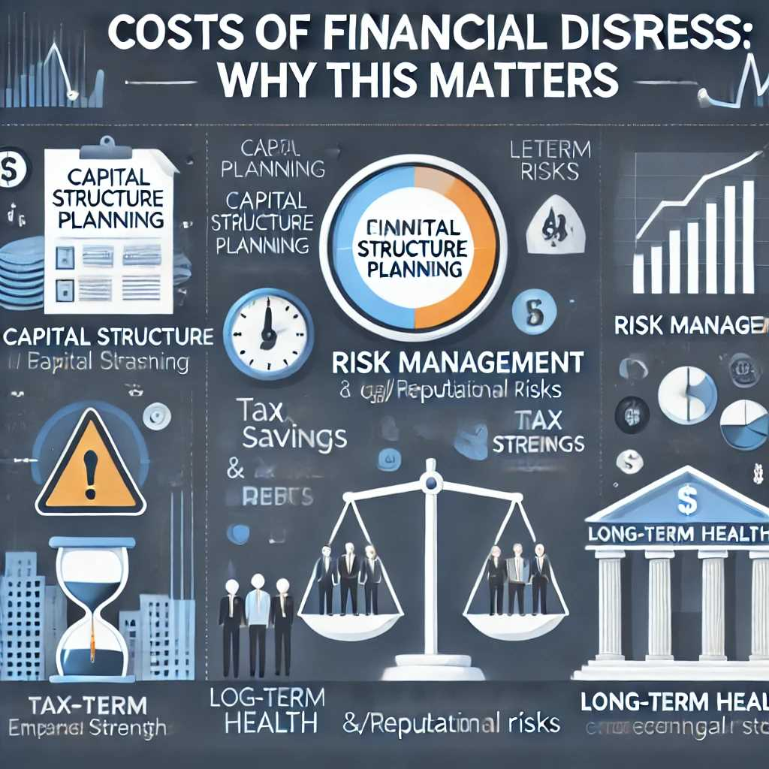
Chapter
The Effect of Potential Bankruptcy
09
Costs of Financial Distress
Why This Matters
Capital Structure Planning: Awareness of how quickly bankruptcy-related costs can escalate underscores the dangers of over-leveraging.
Risk Management: Firms must evaluate both the tax savings of debt and the potential for legal, operational, and reputational fallout if they approach default.
Long-Term Health: By keeping debt levels at a prudent level, companies can safeguard their brand, retain employee confidence, and remain resilient in economic downturns.

Slide 22
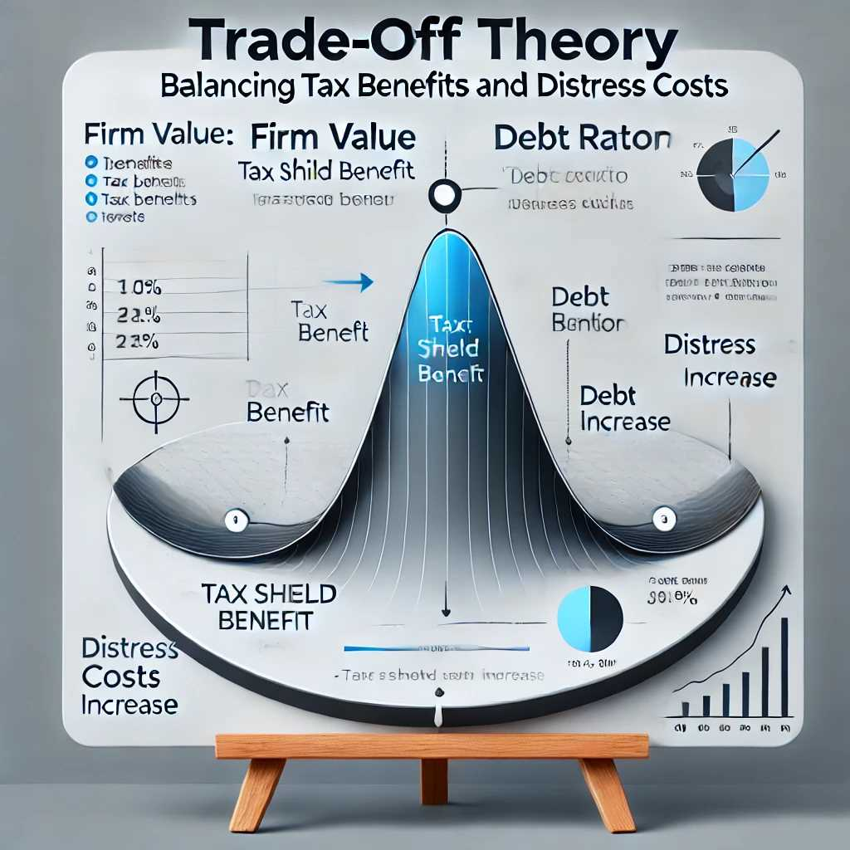
Chapter
Trade-Off Theory
09
Balancing Tax Benefits and Distress Costs
Core Idea: There is an optimal debt level where the tax shield benefit is balanced by expected distress costs.
Past that point, each additional dollar of debt reduces overall firm value.
Graphical Analogy: A concave curve showing firm value vs. debt ratio, with an apex at the optimal point.

Slide 23
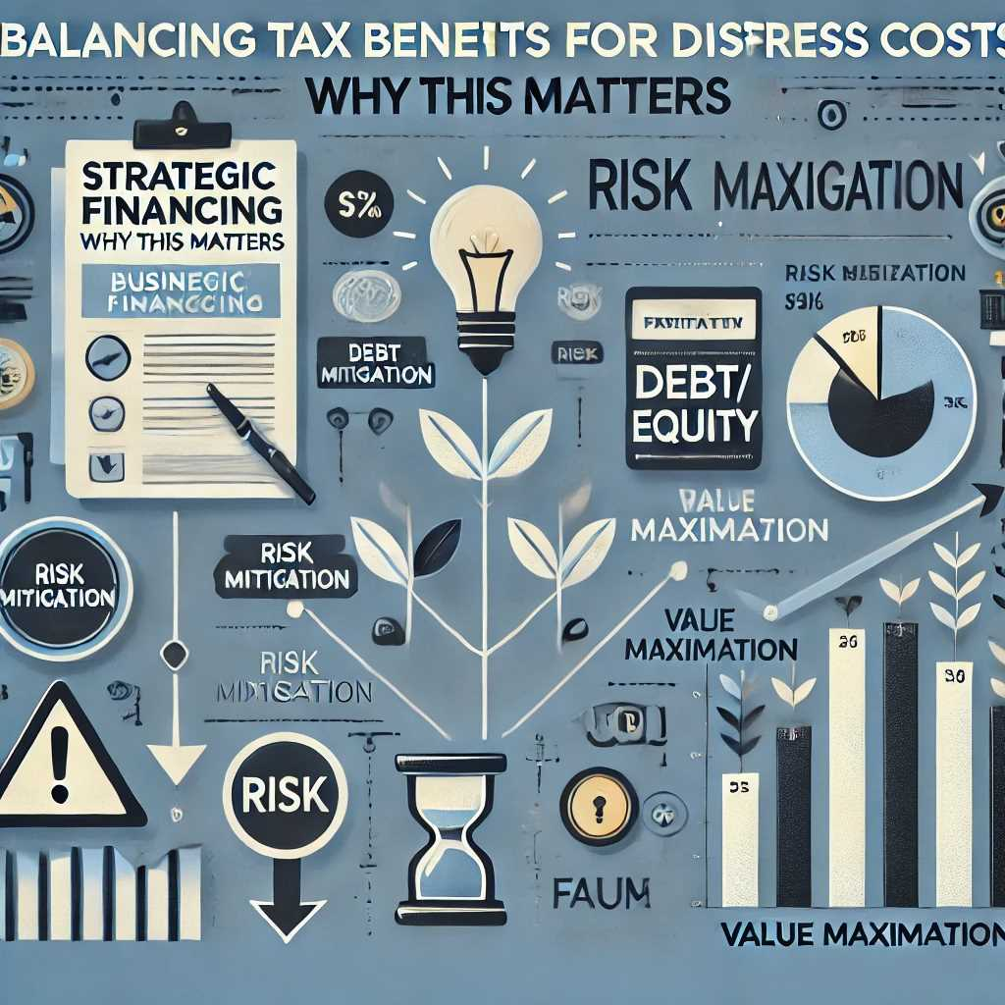
Chapter
Trade-Off Theory
09
Balancing Tax Benefits and Distress Costs
Why This Matters
Strategic Financing: Understanding the trade-off helps management and financial analysts pinpoint a range of acceptable leverage rather than blindly maximizing debt for tax reasons.
Risk Mitigation: Firms that ignore distress costs risk over-leveraging, leading to financial instability or even bankruptcy.
Value Maximization: Finding and maintaining an optimal leverage level can maximize firm value and help ensure sustainable long-term growth.

Slide 24
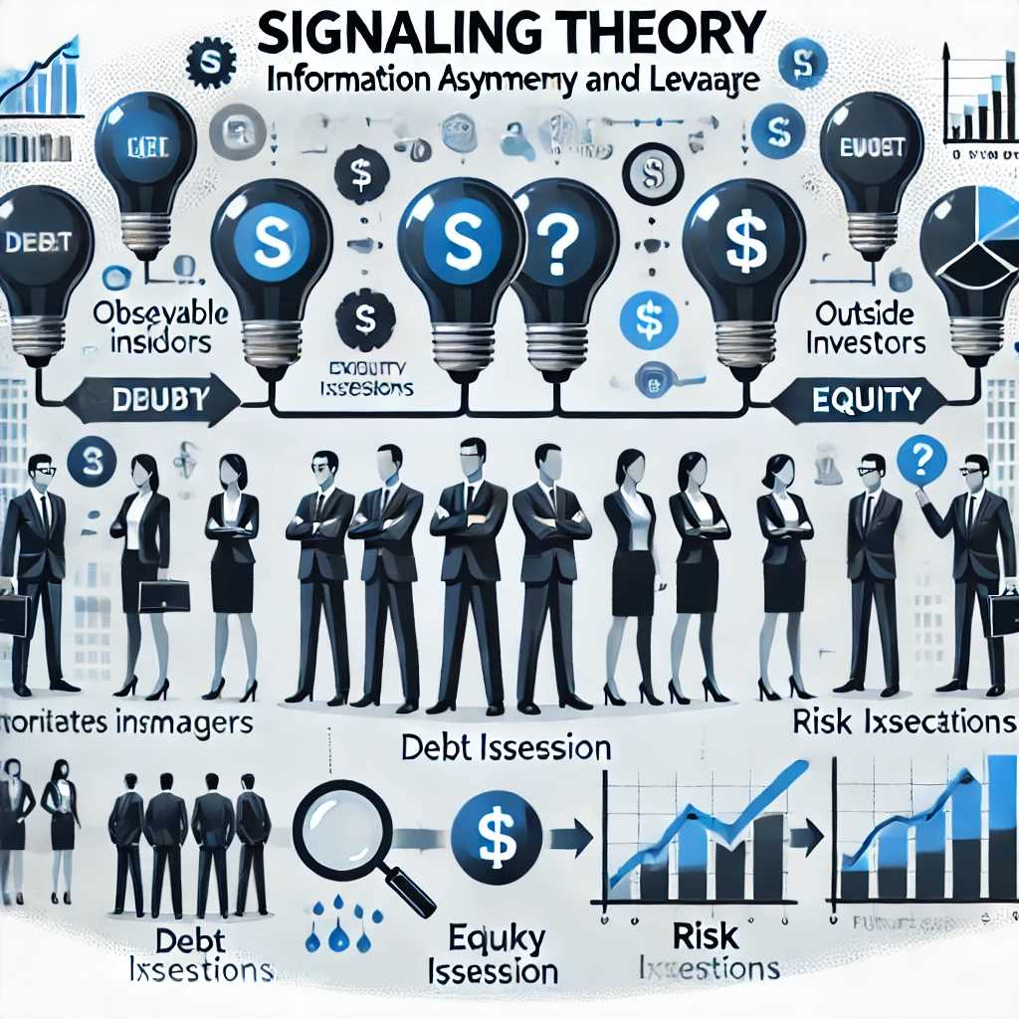
Chapter
Signaling Theory
09
Information Asymmetry and Leverage
Concept: Information Asymmetry
  Definition: Information asymmetry arises when corporate insiders (managers) possess more detailed or accurate knowledge about a firm’s current operations, prospects, and risks than outside investors do.
  Consequences: Because outsiders cannot fully observe the firm’s internal outlook, they rely on observable actions—such as financing choices—to infer management’s private beliefs about the firm’s future.

Slide 25
Chapter
Signaling Theory
09
2.Signal: Leverage as a Sign of Confidence
  Using Debt: When managers believe the firm’s future cash flows will be strong and reliable, they may be more willing to take on debt, confident in their ability to meet interest and principal payments.
  Positive Message: This choice “signals” to investors that management expects stable or growing earnings, potentially leading to favorable market reactions (e.g., a rising stock price).
  Contrast with Equity Issuance: Issuing new equity, especially if the stock may be undervalued, can send a negative signal—investors might suspect that managers believe the stock is overpriced or that the firm’s prospects are weaker.

Slide 26
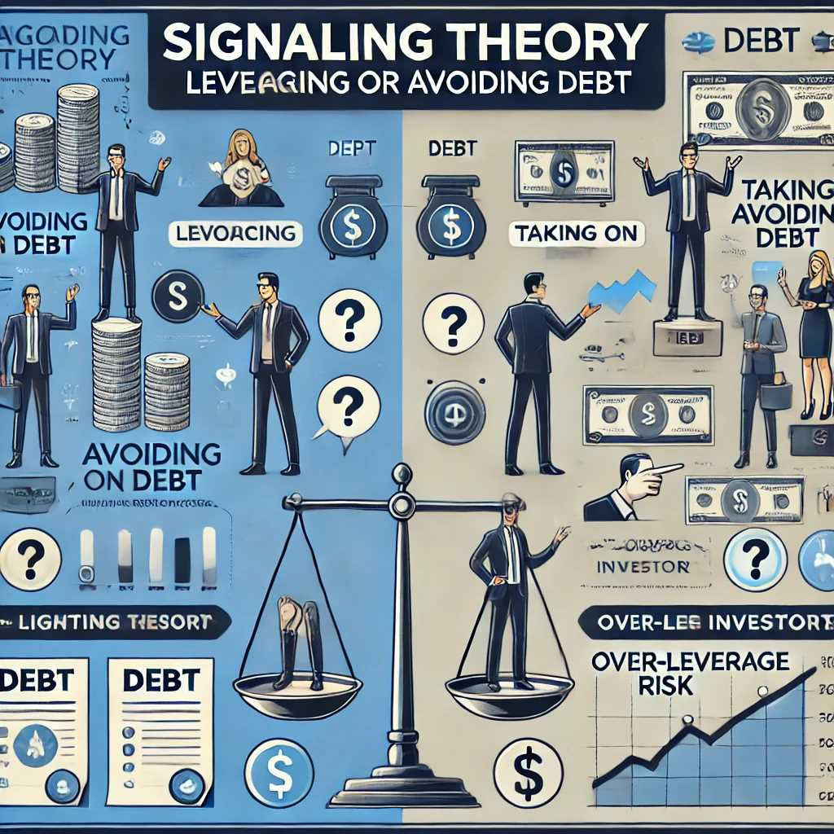
Chapter
Signaling Theory
09
3.Implication: Leveraging or Avoiding Debt
  Avoiding Debt: If managers habitually avoid borrowing, investors might interpret that as lack of confidence in future earnings or as an attempt to sidestep heightened scrutiny from lenders.
  Taking on Debt: Conversely, a deliberate increase in leverage can be a public affirmation that the firm is robust enough to handle repayment, thereby aligning with strong managerial confidence.
  Limitations: While signaling can influence investor perceptions, over-leveraging can still push the firm into higher financial risk. Thus, a balance must be struck between sending a positive signal and maintaining financial stability.

Slide 27
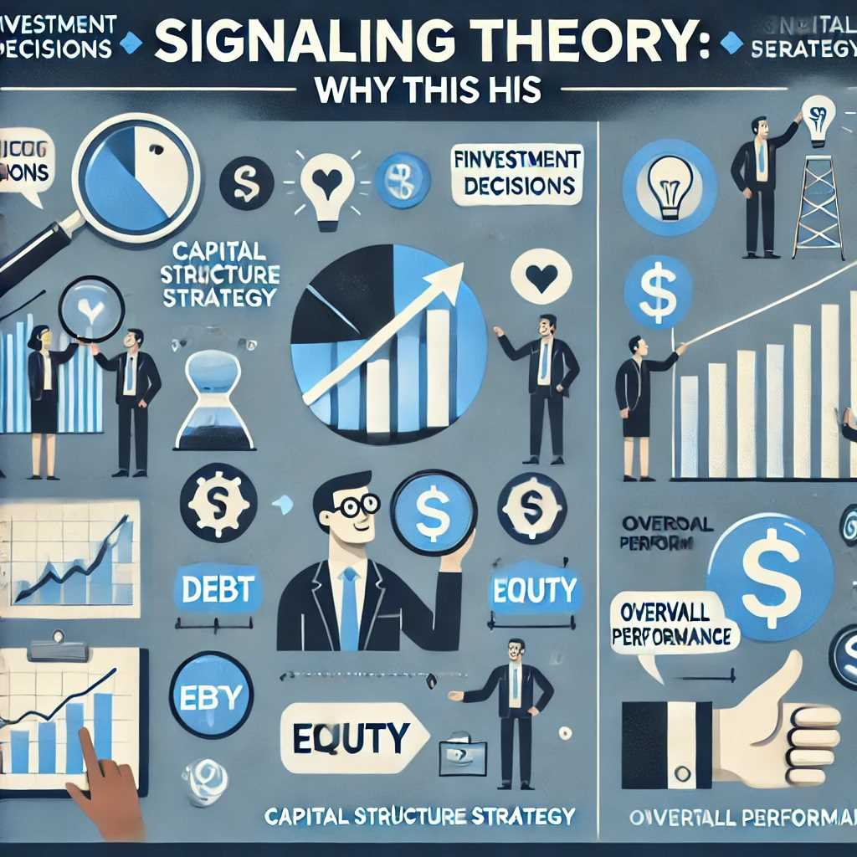
Chapter
Signaling Theory
09
Why This Matters
Investment Decisions: Investors pay attention to a firm’s financing decisions to gauge whether managers have a favorable outlook.
Capital Structure Strategy: Firms can use leverage as a tool to communicate confidence but risk sending negative signals if they either heavily dilute equity or avoid debt altogether.
Overall Performance: Signaling theory reminds us that actions (like borrowing more or issuing shares) can shape investor sentiment and thus impact the firm’s market valuation.

Slide 28
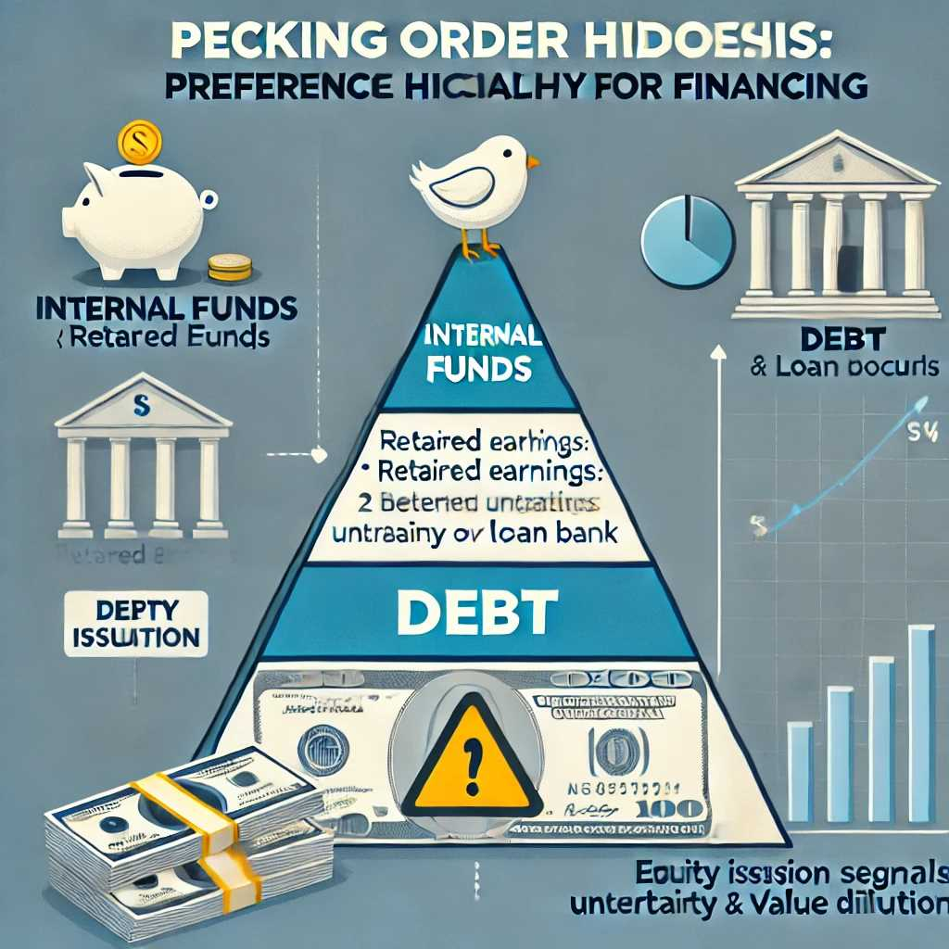
Chapter
Pecking Order Hypothesis
09
Preference Hierarchy in Financing
Firms prioritize funding from:
  Internal funds (retained earnings)
  Debt
  Equity (last resort)
Reason: Issuing new equity often signals negative information (potentially diluting value), so managers prefer debt over equity when external funds are needed.

Slide 29
Chapter
09
Pecking Order Hypothesis
3.Pecking Order Theory: The Hierarchy
  Foundational Concept: The Pecking Order Hypothesis suggests that firms have a natural order in which they prefer to raise capital, driven by concerns about cost and investor perceptions.
  Internal Funds: Retained earnings are the first choice, as using cash already on hand avoids transaction costs and does not signal any negative information to the market.
  Debt: If more funds are needed beyond what is internally available, managers typically turn to debt next, because interest payments are tax-deductible and issuing debt doesn’t typically have the same “negative signal” as issuing equity.
  Equity (Last Resort): Selling new shares can dilute existing shareholders’ stakes and often raises suspicion among investors—"If management is issuing shares, do they believe the stock is overvalued, or are they expecting weaker future performance?”

Slide 30
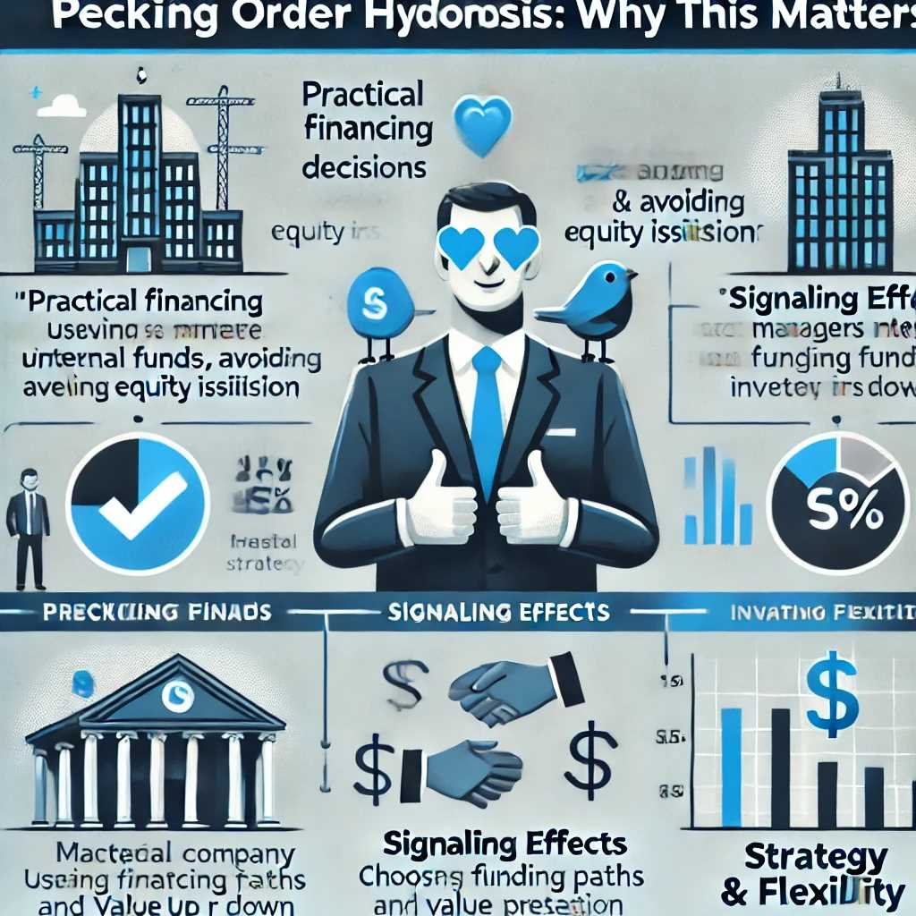
Chapter
Pecking Order Hypothesis
09
Why This Matters
Practical Financing Decisions: The Pecking Order Hypothesis helps explain why profitable, mature firms often avoid issuing new shares—relying on internal cash flows and moderate levels of debt.
Signaling Effects: Managers’ choices in financing can send strong signals to the market about the firm’s perceived valuation and risk profile.
Strategy & Flexibility: Understanding this hierarchy guides managers in structuring capital-raising strategies that minimize negative market reactions and preserve shareholder value.

Slide 31

Chapter
Checklist for Capital Structure Decisions
09
Managerial Guidelines
Evaluate Business Risk and Stability of Cash Flows
  Definition: Business risk refers to the unpredictability of a firm’s earnings due to fluctuations in demand, sales prices, and cost structures.
  Implication: A firm with more stable and predictable cash flows can generally handle higher leverage because it’s more likely to meet interest and principal payments. Conversely, volatile revenue streams necessitate caution when adding debt.

Slide 32
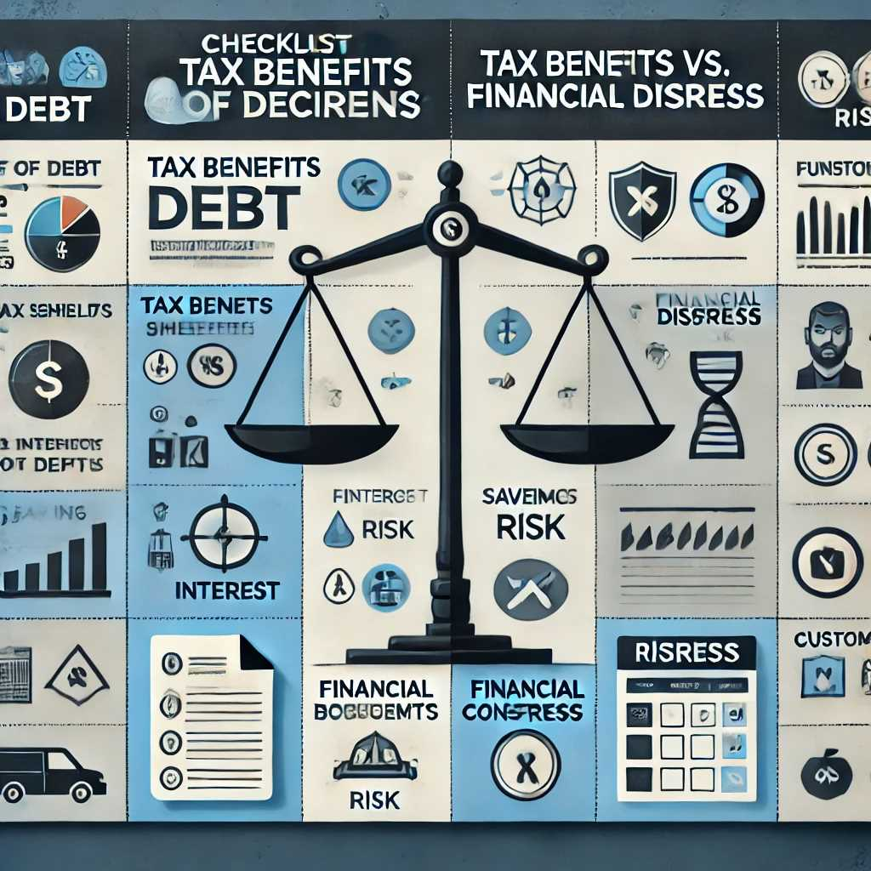
Chapter
Checklist for Capital Structure Decisions
09
Managerial Guidelines
2.Consider Tax Benefits of Debt vs. Potential Financial Distress
  Tax Benefits: Interest expense on debt is usually tax-deductible, which can lower a firm’s overall cost of capital.
  Financial Distress: Too much debt heightens default risk, which can lead to bankruptcy costs, loss of customer confidence, and reputational damage.
  Balancing Act: Management must determine how much debt is beneficial (for the tax shield) without unduly risking financial stability.

Slide 33
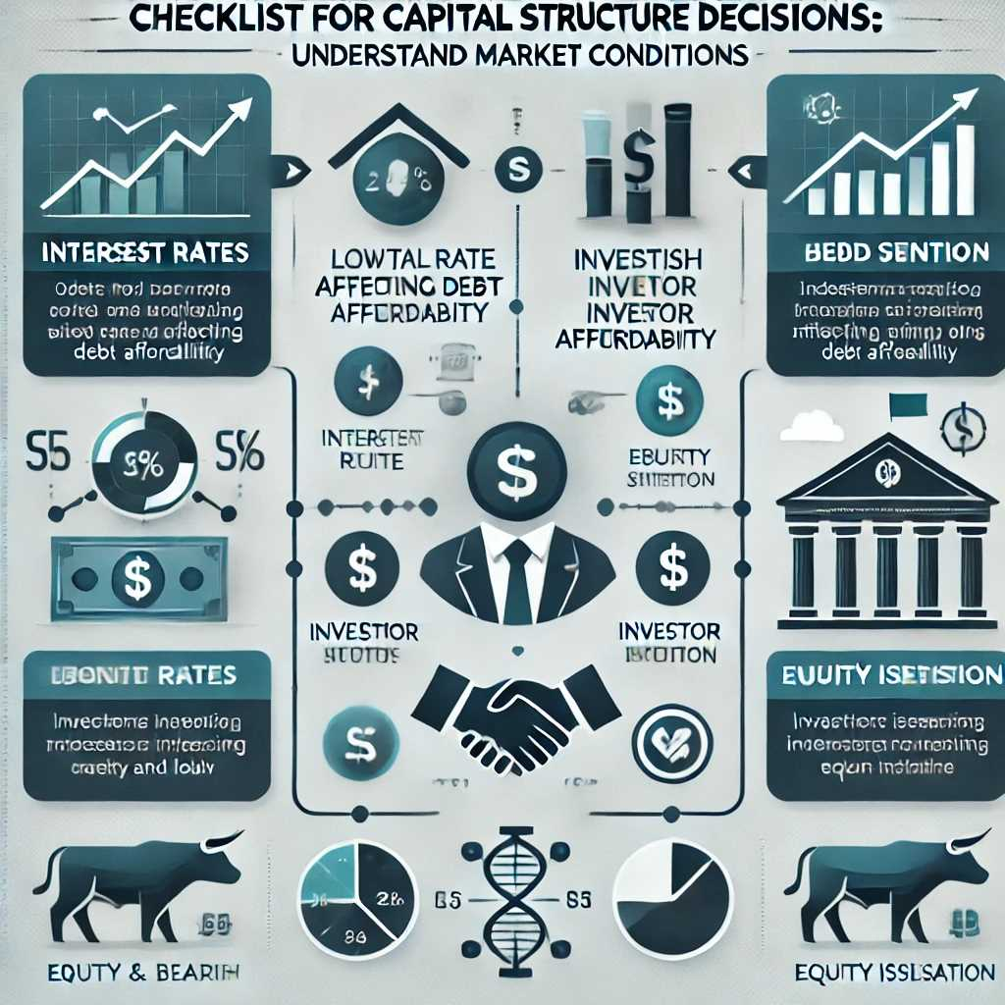
Chapter
Checklist for Capital Structure Decisions
09
Managerial Guidelines
3.Understand Market Conditions (Interest Rates, Investor Sentiment)
  Interest Rates: In a low-rate environment, debt financing becomes cheaper, making leverage more attractive. When rates rise, the cost of servicing debt increases.
  Investor Sentiment: Positive market sentiment can make it easier (and cheaper) to issue equity or secure favorable loan terms. Negative sentiment may increase interest spreads and reduce equity demand.

Slide 34
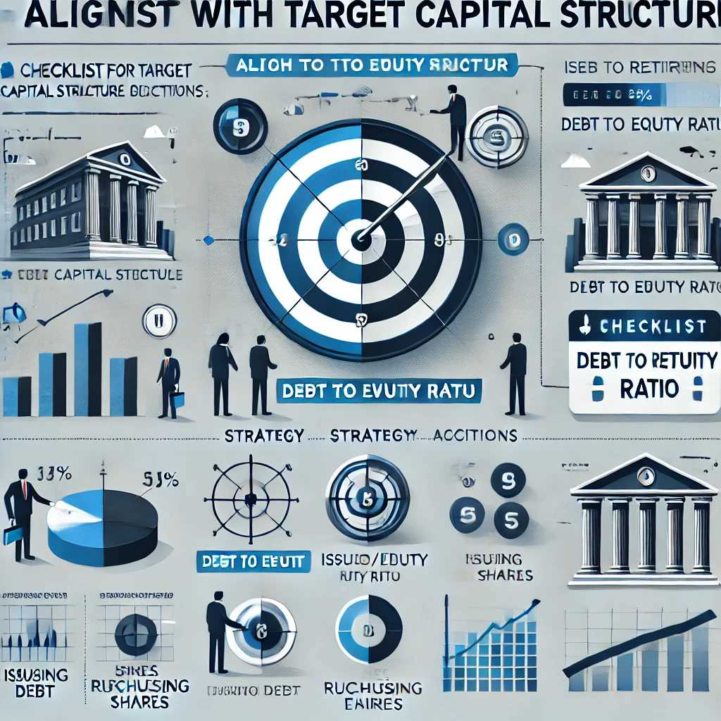
Chapter
Checklist for Capital Structure Decisions
09
Managerial Guidelines
4.Align with Target Capital Structure or Adjust Strategy if Needed
  Target Ratio: Many firms set a desired ratio of debt to equity based on industry norms, historical experience, and corporate strategy.
  Adjust as Necessary: If market forces or earnings fluctuations push the firm away from its target, management may issue or retire debt/equity, repurchase shares, or reinvest earnings to realign with the strategic goal.

Slide 35
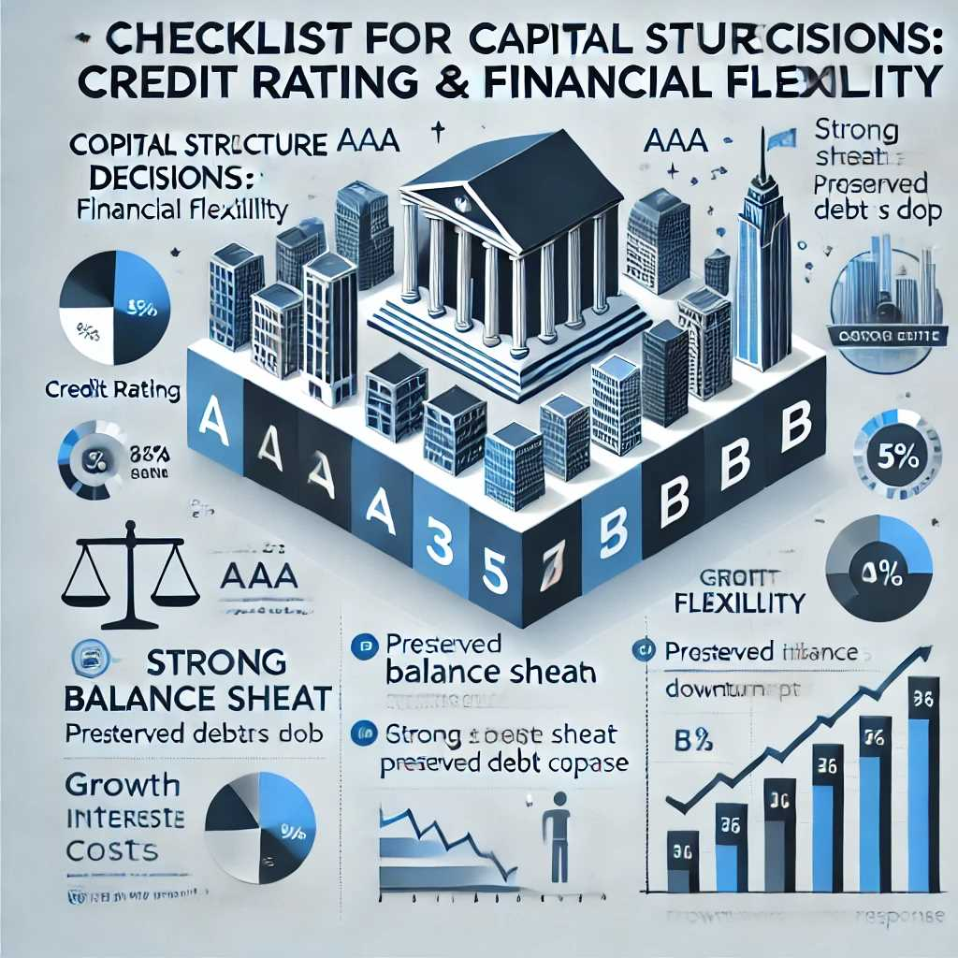
Chapter
Checklist for Capital Structure Decisions
09
Managerial Guidelines
5.Track Credit Rating Implications and Financial Flexibility
  Credit Rating: Bond rating agencies (e.g., Moody’s, S&P) assess the firm’s leverage and financial metrics. A lower rating increases borrowing costs and signals higher risk.
  Financial Flexibility: Maintaining a healthy balance sheet and preserving borrowing capacity can be crucial for seizing growth opportunities or weathering downturns. Over-leveraging may limit a firm’s ability to respond to unexpected needs for capital.

Slide 36
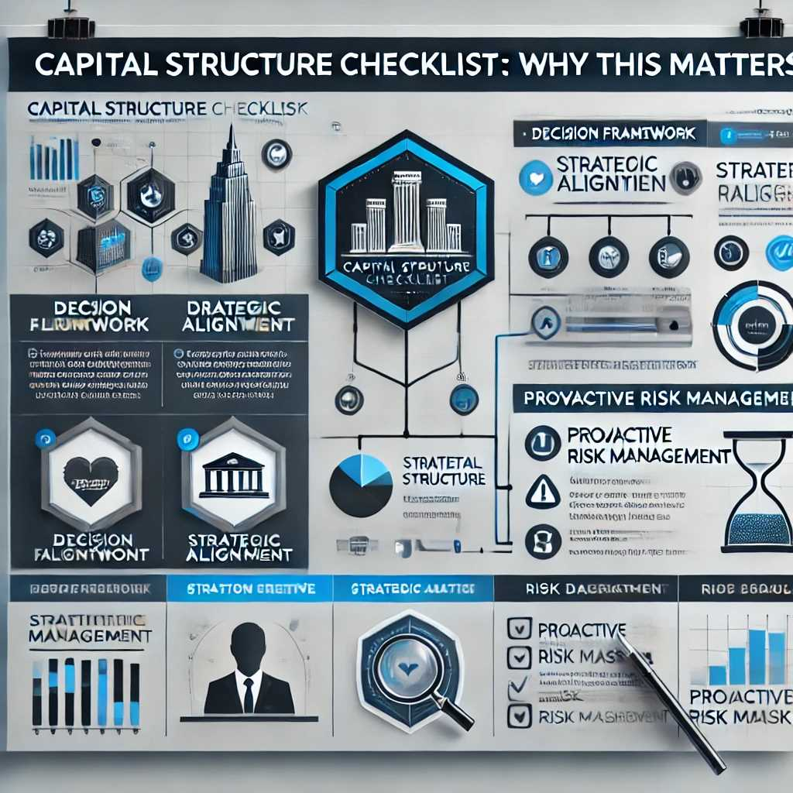
Chapter
Checklist for Capital Structure Decisions
09
Managerial Guidelines
Why This Matters
Decision Framework: This checklist provides a structured approach for managers to make informed financing choices that balance risk and reward.
Strategic Alignment: Ensuring that day-to-day financing decisions reflect the firm’s long-term strategy helps sustain corporate health and shareholder value.
Proactive Risk Management: By routinely monitoring business risk, tax benefits, and market signals, firms can adapt their capital structure to changing conditions and avoid distress.

Slide 37
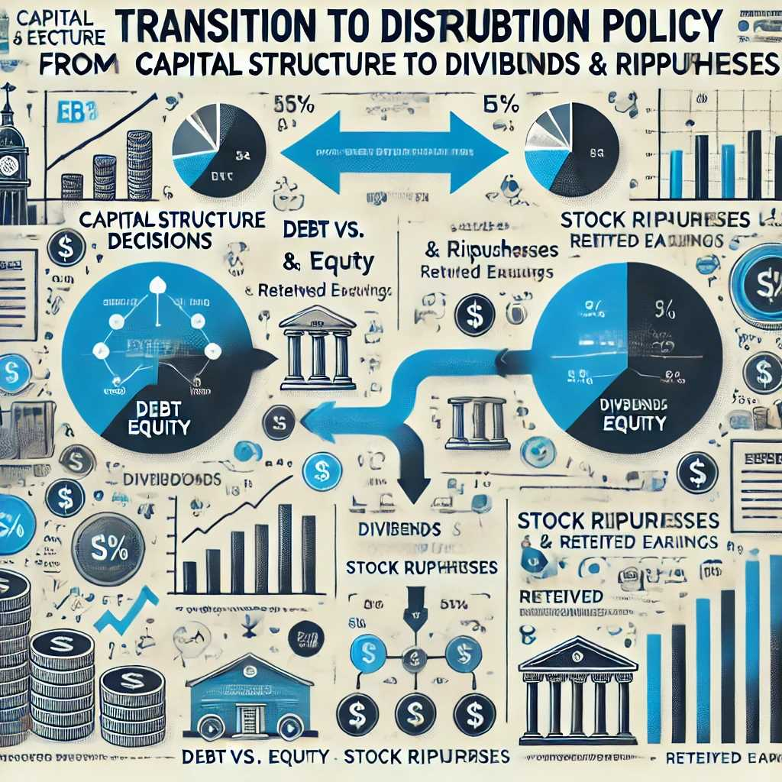
Chapter
Transition to Distribution Policy
09
From Capital Structure to Dividends & Repurchases
Connecting Financing Decisions to Distribution Policy
  Up to this point, the focus has been on capital structure—how a firm raises long-term funds (debt vs. equity).
  Once a company generates profits, it faces another set of decisions on how to distribute some portion of those profits to shareholders—or whether to retain them for future investment.
  This transition highlights that capital structure (how the firm is financed) and distribution choices (how excess capital flows out to shareholders) are closely linked.

Slide 38
Chapter
Transition to Distribution Policy
09
From Capital Structure to Dividends & Repurchases
2.Dividends vs. Share Repurchases
  Dividends: Direct cash payments to shareholders, typically on a periodic basis. Dividends, once “set,” tend to be “sticky” in the short run, as firms often hesitate to reduce them for fear of sending negative signals.
  Share Repurchases: Using corporate funds to buy back a portion of the company’s own shares, thus reducing the number of shares outstanding. Repurchases can be more flexible, as companies can adjust them from year to year without sending the same negative signals a dividend cut would.
  Both methods can shift a firm’s capital structure by altering the equity portion. For instance, a share repurchase reduces total equity in the market, potentially increasing leverage if total debt remains unchanged.

Slide 39
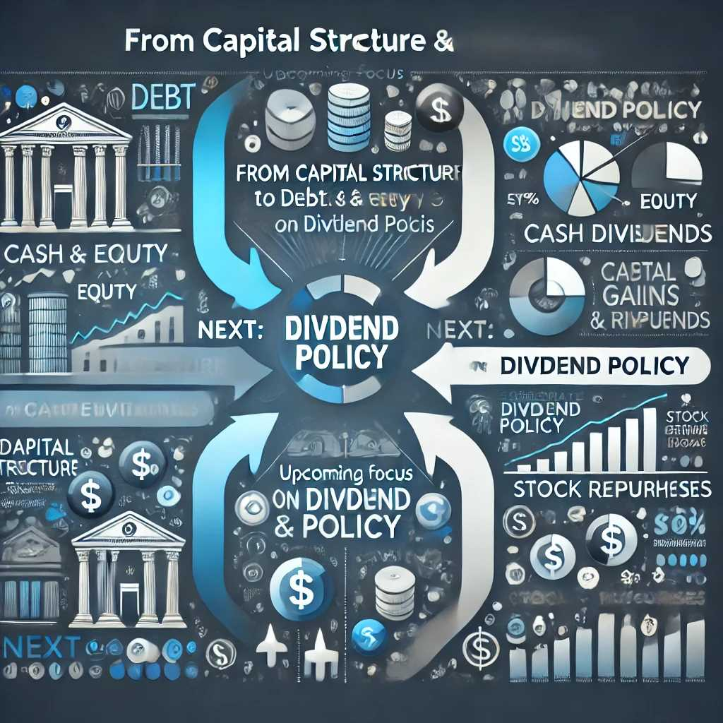
Chapter
Transition to Distribution Policy
09
From Capital Structure to Dividends & Repurchases
3.Upcoming Focus: Dividend Policy
  The subsequent slides will delve into how dividend policy is set, the signaling effects of dividends, various theories about dividends versus capital gains, and how real-world companies manage these distribution choices.
  This understanding completes the picture of corporate finance—from how firms obtain capital to how they deploy profits and reward investors, all within the framework of maximizing shareholder wealth.

Slide 40
Chapter
Transition to Distribution Policy
09
From Capital Structure to Dividends & Repurchases
Why This Matters
Comprehensive Financial Strategy: Learning about both how firms raise capital and how they distribute it to shareholders gives a full view of corporate financial management.
Shareholder Value: Distribution decisions can affect stock price, investor expectations, and the firm’s risk profile, since distributing cash reduces internal funds for reinvestment and may change the capital structure.
Practical Context: This transition sets the stage for exploring the mechanics and rationale behind dividends and share repurchases, which are key to investor returns.

Slide 41
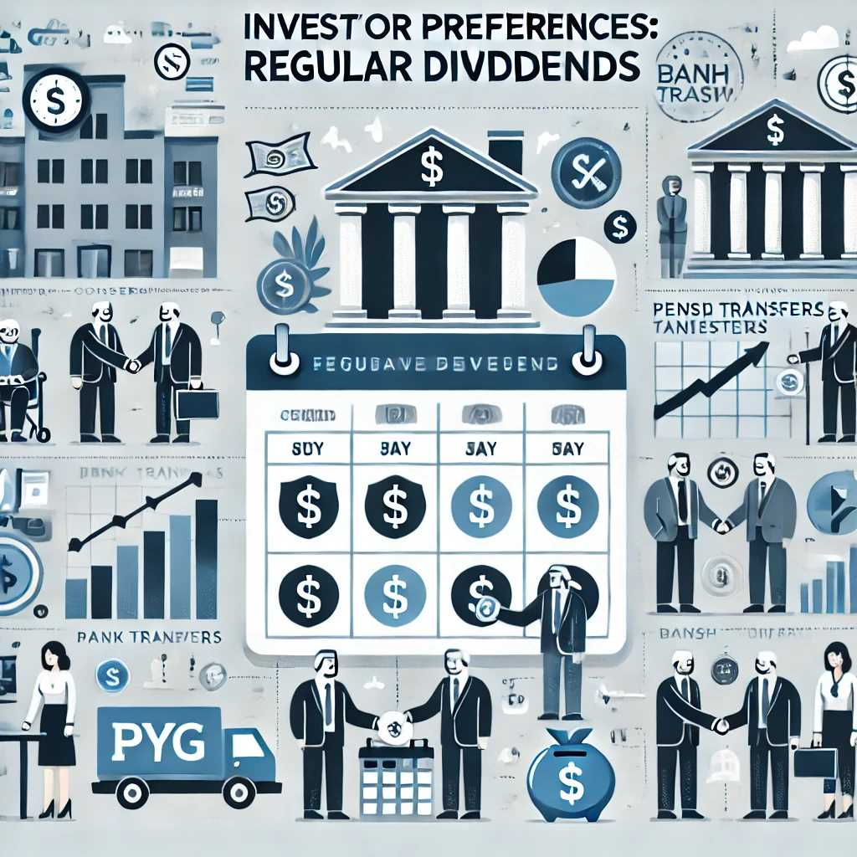
Chapter
Dividends vs. Capital Gains
09
investor Preferences
Investors Who Prefer Regular Dividends
  Income Focus: Certain investor groups—such as retirees, pension funds, or conservative income-oriented funds—often rely on regular dividend payouts to meet their cash flow needs.
  Perceived Stability: These investors may view companies that pay consistent dividends as less risky or more stable. Dividends can serve as a signal of corporate strength and reliable earnings.

Slide 42
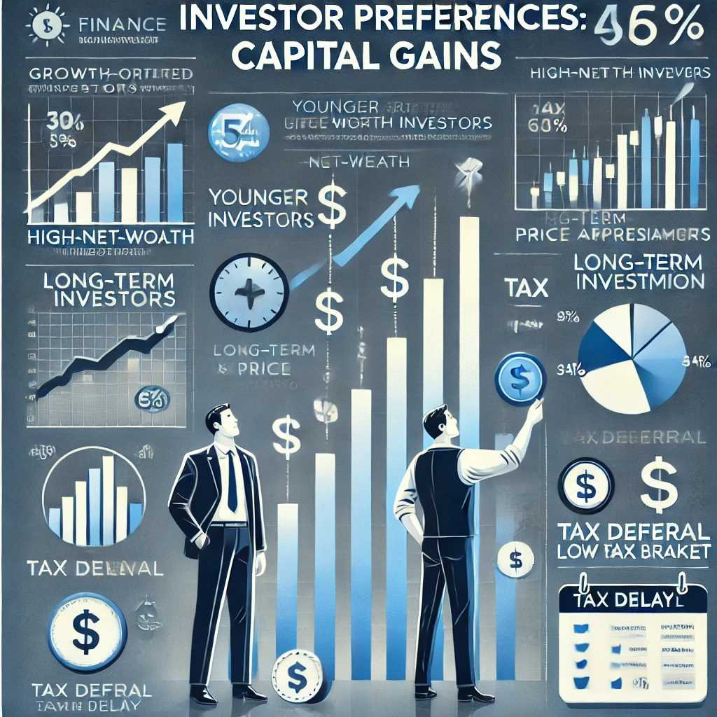
Chapter
Dividends vs. Capital Gains
09
investor Preferences
2.Investors Who Prefer Capital Gains
  Tax Deferral: Capital gains taxes are generally incurred only when shares are sold; in some jurisdictions, long-term capital gains may even enjoy lower tax rates than dividends.
  Growth Potential: Investors focused on wealth accumulation might choose firms that reinvest earnings for expansion rather than paying them out. They expect the stock price to appreciate over time, leading to capital gains.

Slide 43
Chapter
Dividends vs. Capital Gains
09
investor Preferences
3.Investor Demographics and the Clientele Effect
  Clientele Effect: Different investors are naturally drawn to companies whose distribution policy aligns with their preferences.
  Matching Policy to Market Segments: A high-dividend-paying firm may attract income-seeking investors, whereas a low‑dividend or zero‑dividend firm might appeal to growth-oriented or tax-sensitive shareholders.
  Policy Implications: If a company changes its dividend policy significantly (e.g., cuts or eliminates a long-established dividend), it risks losing its existing “clientele,” which can cause share price volatility.

Slide 44
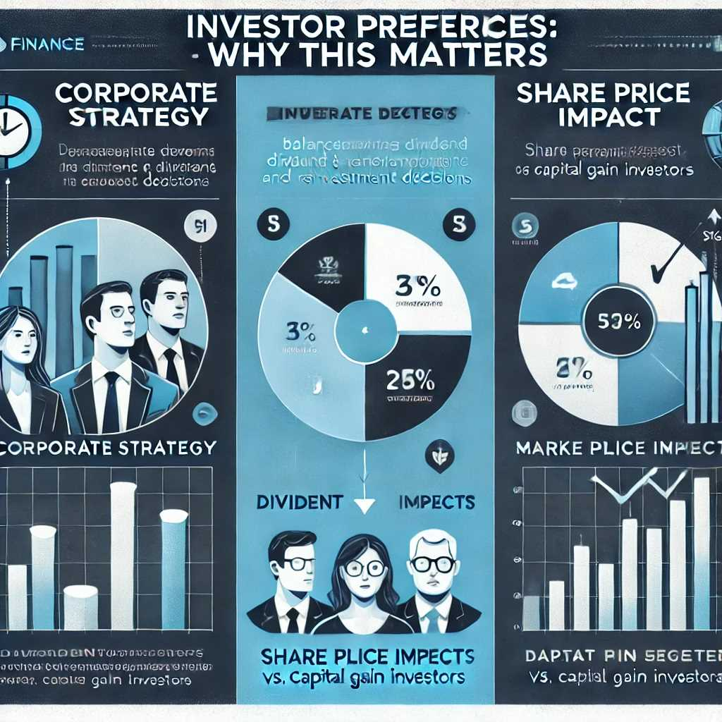
Chapter
Dividends vs. Capital Gains
09
investor Preferences
Why This Matters
Corporate Strategy: Managers must balance investor preferences, the firm’s investment opportunities, and tax considerations to set an optimal dividend policy.
Share Price Impact: Aligning dividend policy with the expectations of the company’s investor base can help maintain or enhance shareholder value.
Market Segmentation: Recognizing that no single dividend policy can satisfy all investors underscores the trade-offs between dividend payouts and reinvestment for growth.

Slide 45



Thank You

