Slide 1


Attitudes and Job Satisfaction
Organizational Behavior
and Projects
Lecture 4
Motivation Theories
Prepared by
Dr. Mohammed Mustafa
www.midocean.ae

Slide 2

Lecture
Learning Objectives
04
Understand the differences between the context-based theories of motivation: reinforcement theory and social learning theory.
Compare the process-based theories of motivation: expectancy theory, goal-setting theory, and self-efficacy theory.
Describe the forms of organizational justice, including distributive justice, procedural justice, informational jus tice, and interactional justice.
Describe how the contemporary theories of motivation complement one another.
www.midocean.ae

Slide 3
Lecture
Learning Outcomes
04
Process Theories of Motivation
Recent Research on Motivation Theories
www.midocean.ae

Slide 4


Contemporary Theories of Motivation: Context-Based
The contemporary content theories of motivation are similar to the classical theories discussed earlier as they primarily concern the fundamental, universal “truths” of motivation that exist across people.
They cover content like psycho logical needs and individual differences in people’s motivation.
However, they are far from the only noteworthy OB theories on the subject.
For instance, a number of other classic theories that emphasize the role of the context or environment on motivation are still used and supported to this day.
.
www.midocean.ae

Slide 5
Reinforcement Theory
Reinforcement theory argues that reinforcement conditions behavior.
Reinforcement theory is behaviorist, meaning that it portrays behavior as caused by the context or environment.
You need not be concerned, behaviorists would argue, with internal cognitive events (such as the psychological aspects of autonomy, regulatory focus, or job engagement or the process-based theories to come).
Instead, what controls behavior are reinforcers—any consequences that, when they immediately follow responses, increase the probability that the behavior will be repeated.
For example, when you are given a compliment for doing something at work, you might be more likely to do it again.
.
www.midocean.ae

Slide 6
Reinforcement Theory – Cont.
Reinforcement theory ignores the inner state of the individual and concentrates solely on what happens when the individual acts.
Although it is not strictly a motivation theory, it does provide a powerful means of analyzing what controls behavior, and therefore we typically do consider reinforcement when we think about motivation in OB.
It is also important to note that strict adherence to reinforcement and behaviorism is not recommended because, clearly, people have rich psychological worlds that impact their motivations and behavior.
However, there is a great deal of truth to be found in behaviorist approaches concerning the roles of reinforcement and conditioning on human behavior.
.
www.midocean.ae

Slide 7
Reinforcement Theory – Cont.
Operant Conditioning/Behaviorism and Reinforcement Operant conditioning suggests that people learn to behave in a certain way to either get something they want or avoid something they do not want.
Reinforcement strengthens a behavior and increases the likelihood it will be repeated.
Operant conditioning was part of B. F. Skinner’s broader concept of behaviorism, which argues that behavior follows stimuli in a relatively unthinking manner.
Skinner’s form of radical behaviorism rejects feelings, thoughts, and other states of mind as causes of behavior.
.
www.midocean.ae

Slide 8
Reinforcement Theory – Cont.
In short, people learn to associate stimulus and response, but their conscious awareness of this association is irrelevant.
For instance, a commissioned salesperson wanting to earn a sizable income finds doing so is contingent on generating high sales, so the salesperson sells as much as possible.
Skinner demonstrated that people will likely engage in desired behaviors if they are positively reinforced for doing so; rewards are most effective if they immediately follow the desired response; and behavior that is not rewarded or is punished is less likely to be repeated.
.
www.midocean.ae

Slide 9
Social Learning Theory
Individuals can learn by being told or by observing what happens to other people as well as through direct experience.
Much of what we have learned comes from watching models—coworkers, supervisors, customers, and so forth.
The view that we can learn through both observation and direct experience is called social learning theory.
Social learning theory, like reinforcement theory, assumes behavior is a function of consequences—but it also clarifies the effects of observation and perception in motivation.
.
www.midocean.ae

Slide 10
Social Learning Theory – Cont.
People respond to the way they perceive and define consequences, not to the objective consequences themselves.
As an essential component of social learning theory, people learn from and “model” their behavior from other people.
More specifically, they pay attention to what others are doing, commit and retain what they do to memory, and reproduce the behaviors from memory.
Moreover, we are more likely to repeat behaviors in the future if they are also reinforced by the model (e.g., positive feedback from a coach or trainer).
.
www.midocean.ae

Slide 11
Contemporary Theories of Motivation: Process-Based : (1) Expectancy Theory
One of the most widely accepted explanations of motivation is Victor Vroom’s expectancy theory.
Although it has critics, most evidence supports the theory.
Expectancy theory argues that the strength of our tendency to act a certain way depends on the strength of our expectation of a given outcome and its attractiveness.
www.midocean.ae

Slide 12
Expectancy Theory
In practical terms, employees will be motivated to exert a high level of effort when they believe that it will lead to a good performance appraisal, that a good appraisal will lead to organizational rewards such as salary increases and/or intrinsic rewards, and that these rewards will satisfy their personal goals.
Therefore, the theory focuses on three relationships that, in many ways, establish a common language to describe the motivational process:
www.midocean.ae

Slide 13
Expectancy Theory – Cont.
Expectancy: the effort–performance relationship. The degree to which the individual believes exerting a given amount of effort will lead to performance.
Instrumentality: the performance–reward relationship. The degree to which the individual believes performing at a particular level will lead to the attainment of a desired outcome.
Valence: the rewards–personal goals relationship. The degree to which organizational rewards satisfy an individual’s personal goals or needs and the attractiveness of those potential rewards for the individual.
www.midocean.ae

Slide 14
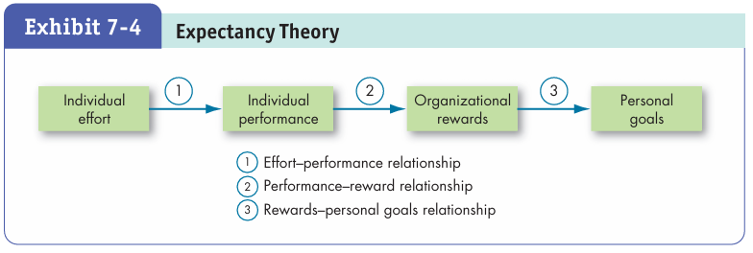
Expectancy Theory – Cont.
Expectancy theory helps explain why a lot of workers are not motivated on their jobs and do only the minimum necessary to get by.
It can also explain employees’ efforts toward goal accomplishment.
www.midocean.ae

Slide 15
Goal-Setting Theory
Goal-setting theory proposed by Edwin Locke and Gary Latham, reveals the impressive effects of goals on performance.
Under this theory, intentions to work toward a goal are considered a major source of work motivation.
How do goals affect performance? According to the theory and decades of evidence supporting it, goals do four things:
(1) They direct attention,
(2) they mobilize effort,
(3) they encourage persistence, and
(4) they facilitate the development of strategy.
www.midocean.ae

Slide 16
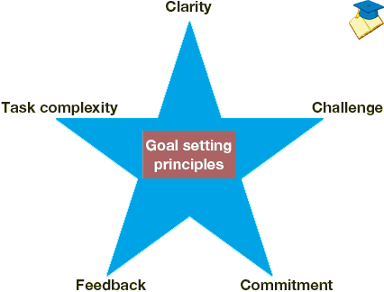
Goal-Setting Theory – Cont.
goal-setting theory A theory that intentions to work toward a goal are considered a major source of work motivation and lead to higher performance.
www.midocean.ae

Slide 17
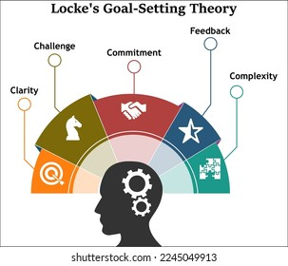
Goal-Setting Theory – Cont.
Factors That Help or Hurt Goal Setting;
Although goal setting has a direct impact on performance in organizations, a number of factors can either help or hurt goal-setting efforts.
These include (1) goal commitment,
(2) task characteristics,
(3) feedback,
(4) goal orientation, and
(5) goal conflict.
www.midocean.ae

Slide 18
Goal-Setting and Ethics
The relationship between goal setting and ethics is quite complex:
If we emphasize the attainment of goals, what is the cost?
The answer is probably found in the standards we set for goal achievement.
For example, when money is tied to goal attainment, we may focus on getting the money, become willing to compromise ourselves ethically, and disengage from the ethical aspects of the situation (e.g., justify what we are doing even though it is unethical).
www.midocean.ae

Slide 19
Goal-Setting and Ethics – Cont.
The context also matters. Time pressure often increases as we are nearing a goal, which can tempt us to act unethically to achieve it.
Goal setting can also lead to unethical behavior through depletion.
For example, if the kitchen staff is exhausted and overloaded, they might be more prone to take shortcuts in food preparation and cleaning that put food safety in danger.
Even personal characteristics matter. For instance, our goal orientation can have an influence—if we are focused more on proving our worth or avoiding failure rather than mastering the process, we may be more likely to engage in unethical behavior.
www.midocean.ae

Slide 20
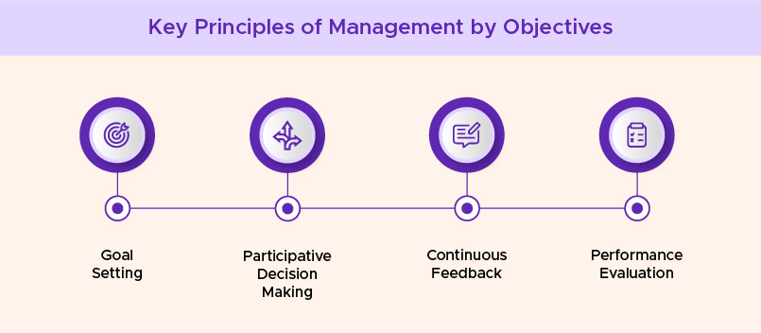
Implementing Goal Setting Theory
Management by objectives (MBO):
A program that encompasses specific goals, participatively set, for an explicit time period, with feedback on goal progress.
www.midocean.ae

Slide 21
Self-Efficacy Theory
Self-efficacy refers to an individual’s belief of being capable of performing a task.
The higher your self-efficacy, the more confidence you have in your ability to succeed.
For example, if you feel like your college education equipped you with the employability skills to establish a rewarding career, you may feel more capable of succeeding in your job search and more motivated to apply for jobs post-graduation.
www.midocean.ae

Slide 22
Self-Efficacy Theory – Cont.
In contrast, in difficult situations, people with low self-efficacy are more likely to lessen their effort or give up altogether,
while those with high self-efficacy will try harder to master the challenge.
Intelligence and personality are linked to higher self-efficacy.
People who are intelligent, conscientious, and emotionally stable are so much more likely to have high self-efficacy that some researchers argue self-efficacy is more important than prior research suggested.
www.midocean.ae

Slide 23
Self-Efficacy Theory – Cont.
Increasing Self-Efficacy How can employees achieve high levels of self-efficacy? By bringing goal-setting theory and self-efficacy theory together.
Supportive managers who set difficult goals for their employees may lead them to have a higher level of self-efficacy and set higher goals for their own performance.
www.midocean.ae

Slide 24
Self-Efficacy Theory – Cont.
Research also suggests that there are four ways of increasing self-efficacy:
(1) Give employees relevant experiences with the task (i.e., enactive mastery),
(2) enable them to watch someone else do the task (i.e., vicarious modeling),
(3) reassure the employees, letting them know that they have “what it takes” to do the task (i.e., verbal persuasion), and
(4) tell them to “get psyched up” (i.e., arousal)—getting energized will enable the employees to approach the task more positively (although this last step is probably not a good idea if the task is “low-key,” like writing a sales report).
www.midocean.ae

Slide 25
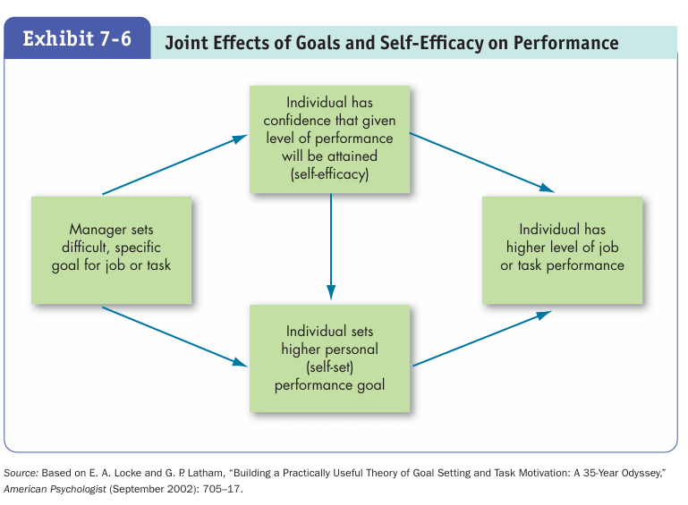
Self-Efficacy Theory – Cont.
www.midocean.ae

Slide 26
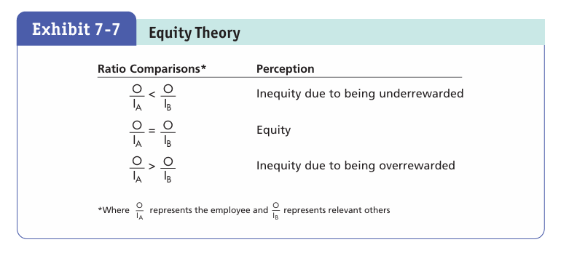
Equity Theory
A theory stating that individuals compare their job inputs and outcomes with those of others and then respond to eliminate any inequities.
www.midocean.ae

Slide 27
Organizational Justice
Organizational justice: An overall perception of what is fair in the workplace, composed of distributive, procedural, informational, and interpersonal justice.
Distributive justice: Perceived fairness of the amount and allocation of rewards among individuals.
Procedural justice: The perceived fairness of the process used to determine the distribution of rewards.
Informational justice: The degree to which employees are provided truthful explanations for decisions.
Interpersonal justice: The degree to which employees are treated with dignity and respect.
www.midocean.ae

Slide 28
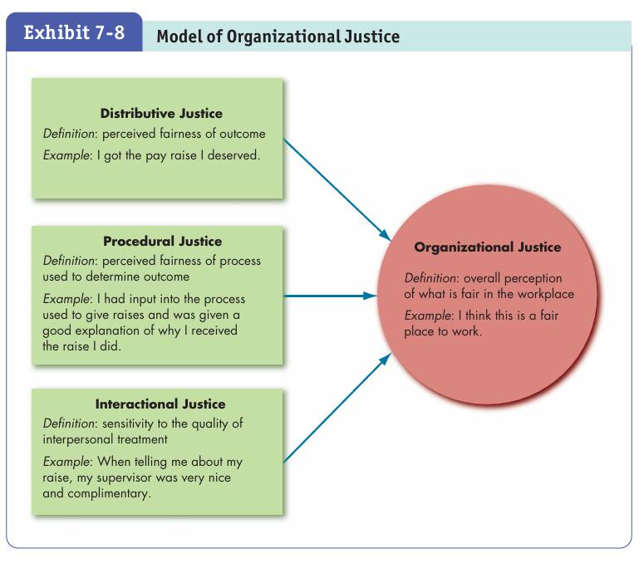
Organizational Justice Model
www.midocean.ae

Slide 29
Implications for Managers
Classic theories paint an incomplete picture of motivation. Consider con temporary theories when assessing motivation in your organization.
People will be motivated if they feel like their actions are feely chosen and in alignment with their interests and values. Try to foster this autonomy instead of treating motivation as completely “controllable” through pressure, direction, or reward.
Despite the power of autonomy, rewards and reinforcement can still be a powerful force in promoting desired behaviors in organizations—but do not underestimate the psychological aspects of motivation. Rewards alone cannot fix organizational problems.
www.midocean.ae

Slide 30
Implications for Managers
Depending on which behaviors are desirable given the task, try to adopt or lead others toward a promotion focus (e.g., for innovation goals) or prevention focus (e.g., for safety goals).
Job engagement is still a management “buzzword,” and there is confusion regarding what job engagement actually represents. However, it can help put motivation into practice.
Apply other contemporary motivation theories to understand how employees and managers can become (and stay) engaged in the workplace.
www.midocean.ae

Slide 31
Implications for Managers
Lead by example: Model and encourage others to model the types of behaviors you would like to see performed by employees.
Thinking of motivation in terms of expectancy, instrumentality, and valence can help you break down many common motivation problems in organizations into their parts.
Ask yourself whether effort leads to performance, whether performance leads to the desired outcome, and whether those involved actually care about it.
www.midocean.ae

Slide 32
Implications for Managers
Harness the power of goal setting: Set specific, difficult goals. Consider the factors that may affect goal setting. Determine whether a management by objectives program would be suitable for your organization.
Self-efficacy can affect motivation and behavior throughout the motivation process and is sometimes helpful and sometimes even harmful.
Consider how self-efficacy changes throughout the goal-setting process and adapt accordingly.
www.midocean.ae

Slide 33
Implications for Managers
When making decisions regarding resources in your organization, make sure to consider how the resources are being distributed (and who is affected), the fairness of the decision, and whether your actions demonstrate that you respect those involved.
www.midocean.ae

Slide 34

www.midocean.ae

Slide 35



Thank You

