Slide 1
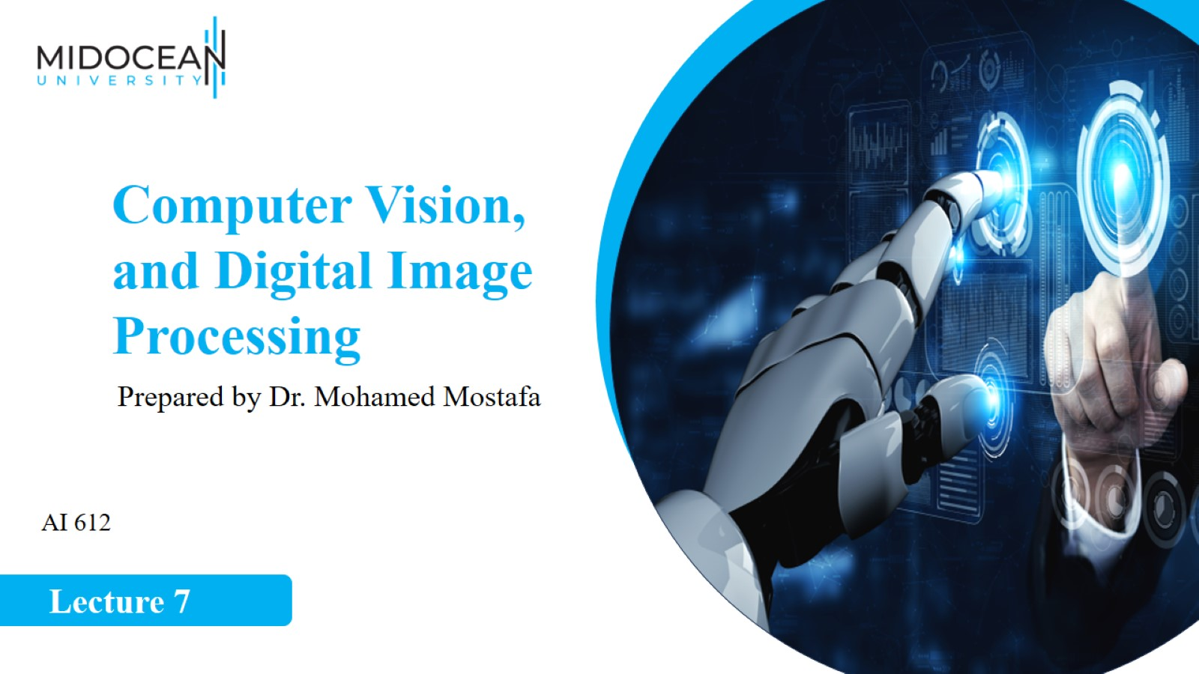

Slide 2
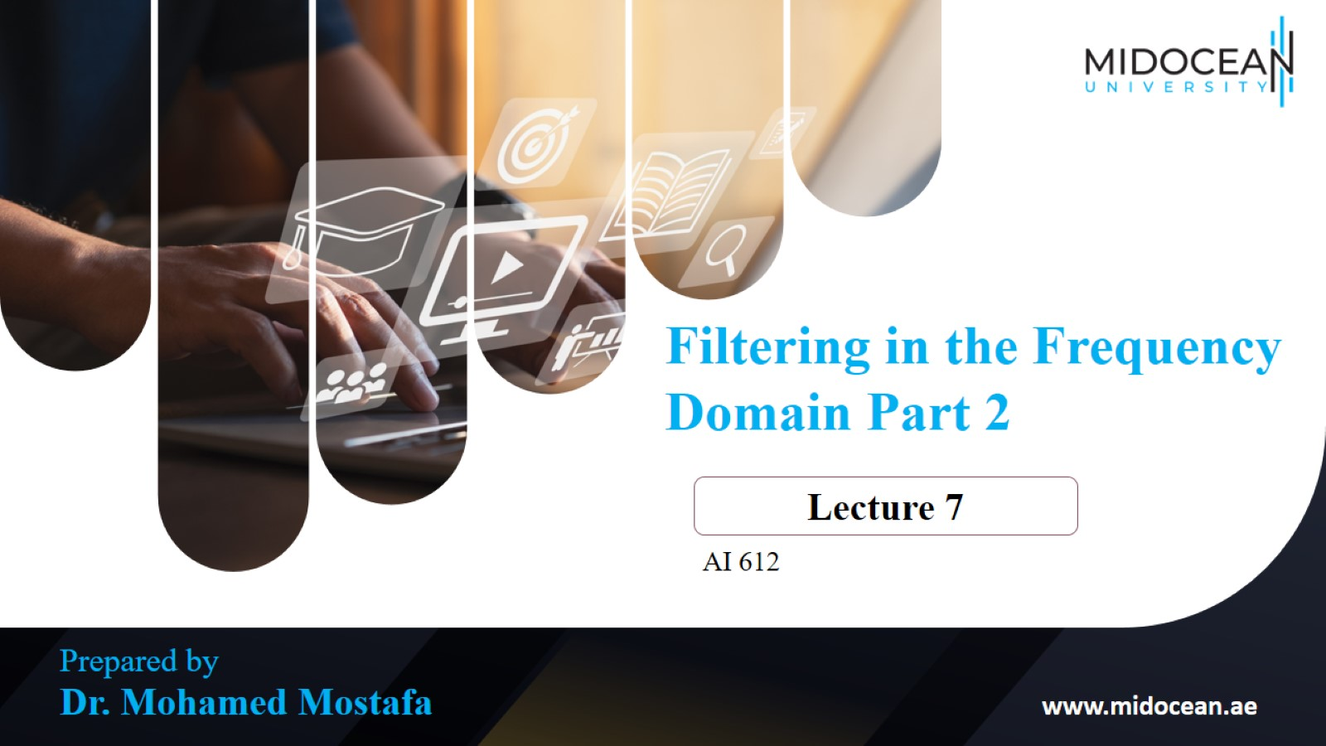

Slide 3
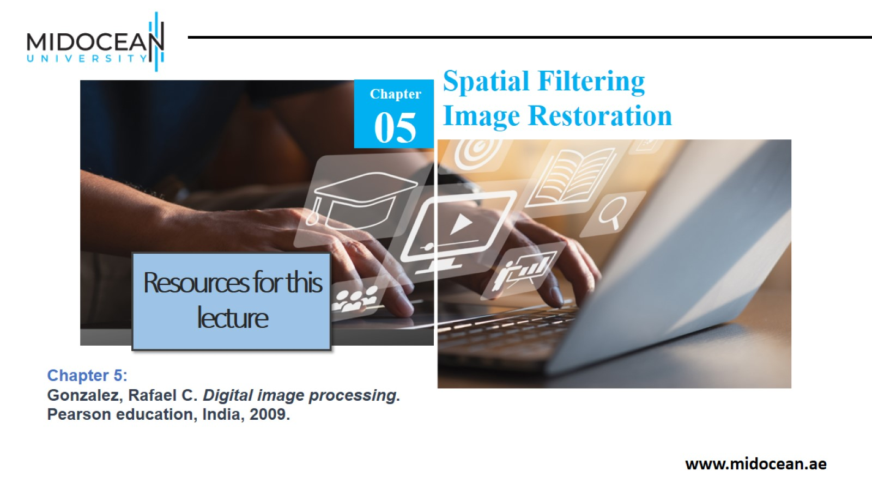

Slide 4
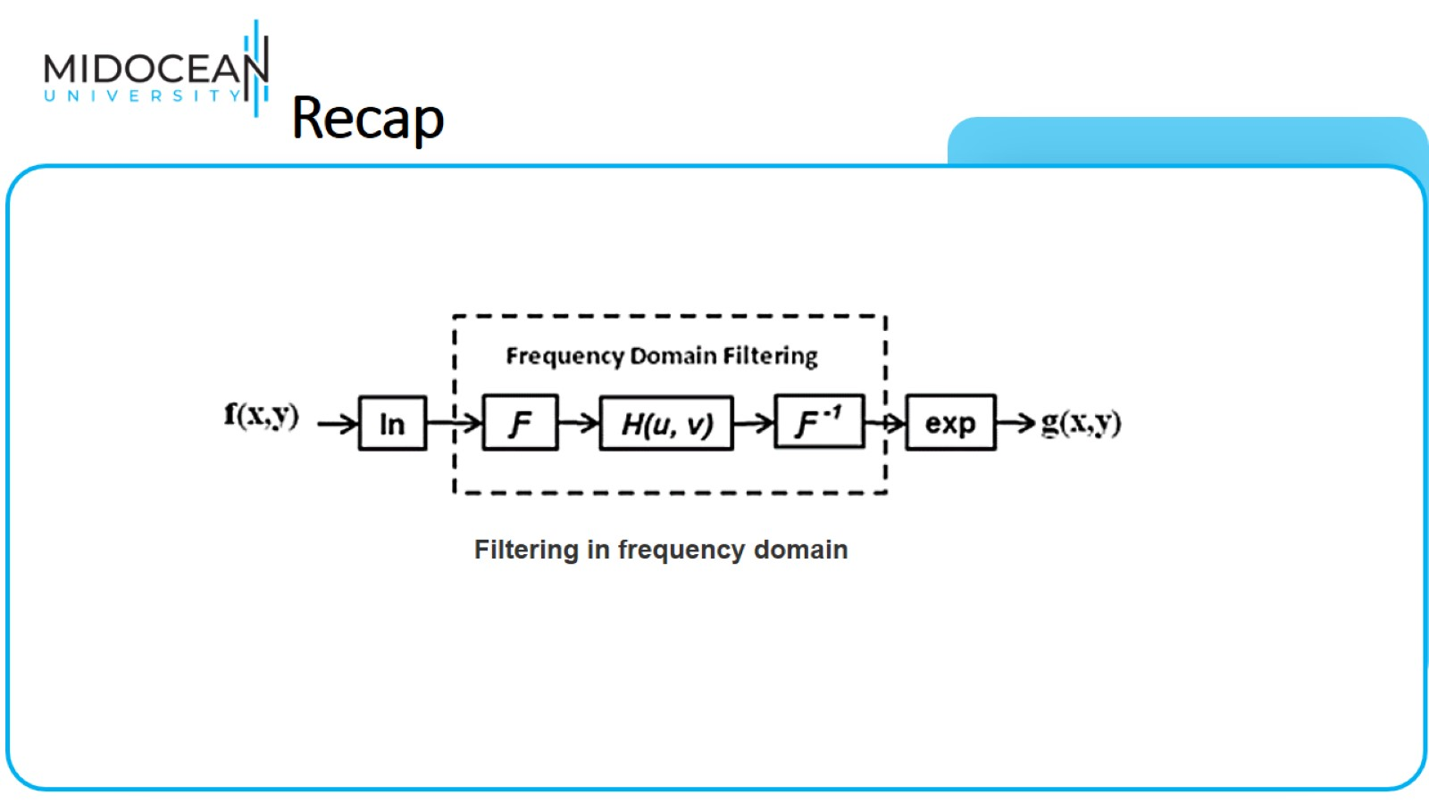
Recap

Slide 5
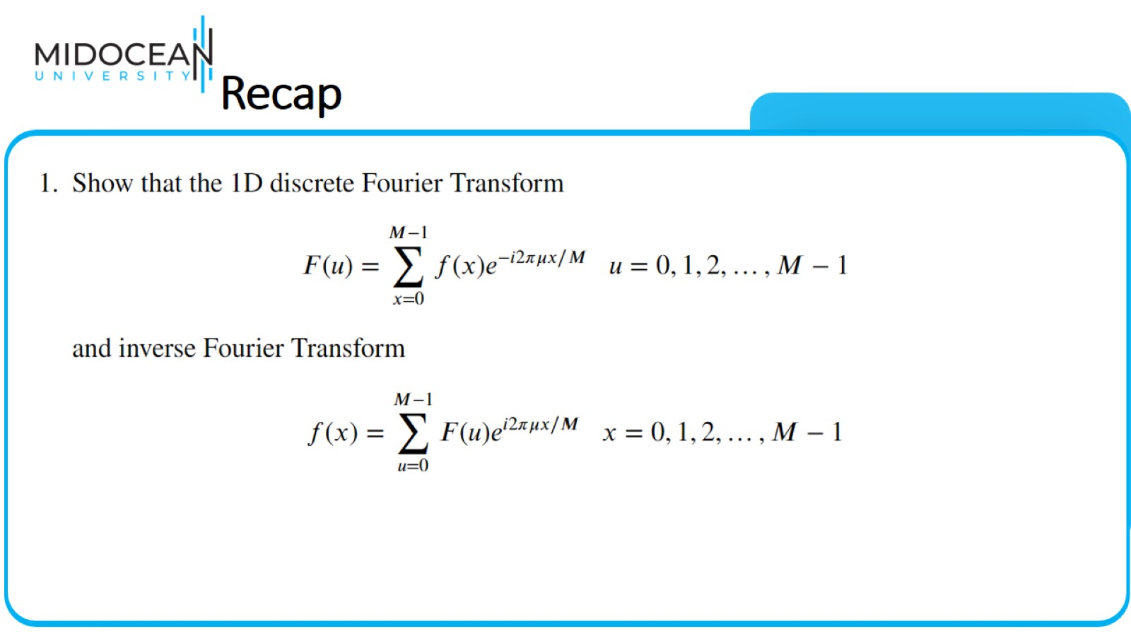
Recap

Slide 6
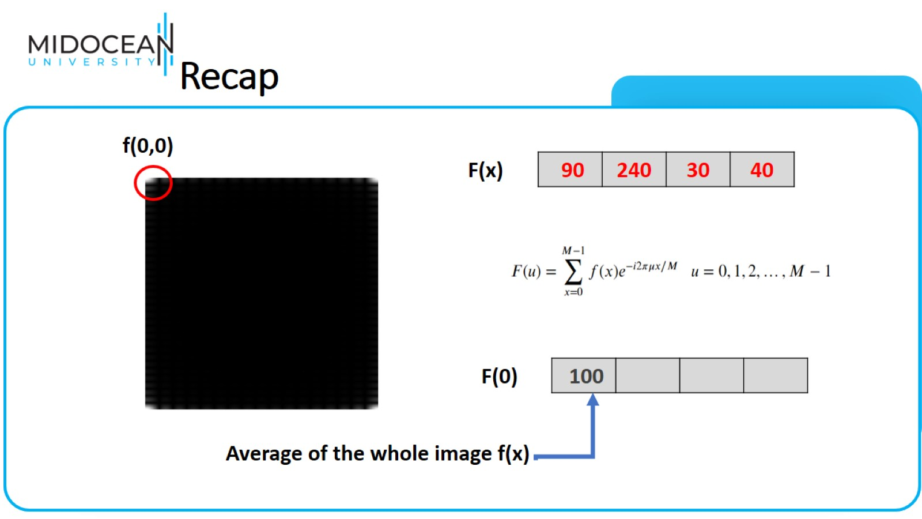
Recap

Slide 7
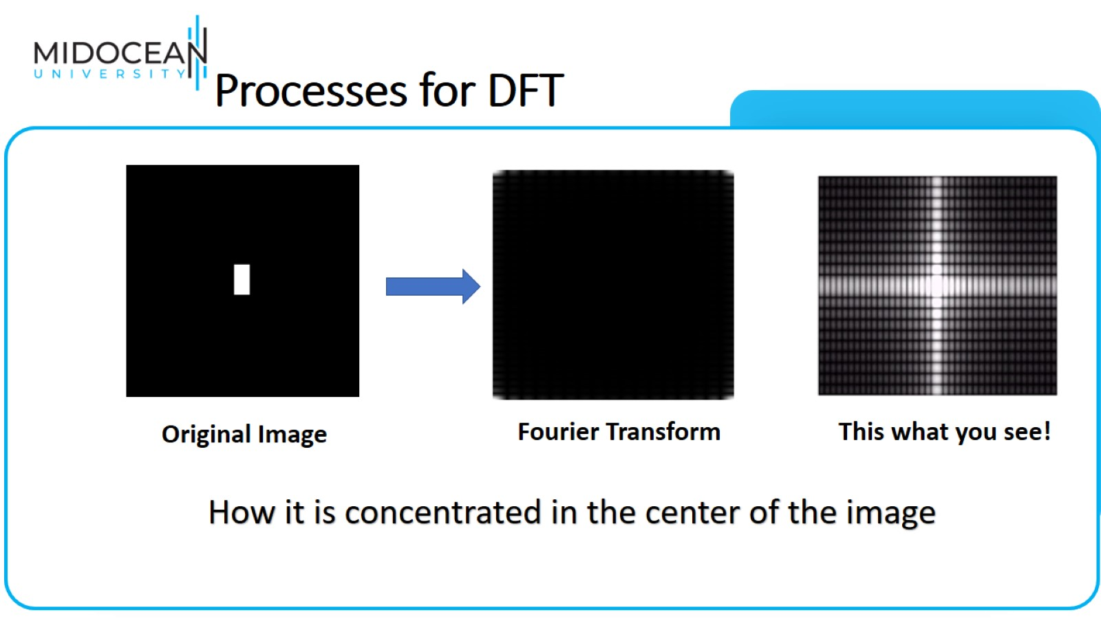
Processes for DFT

Slide 8
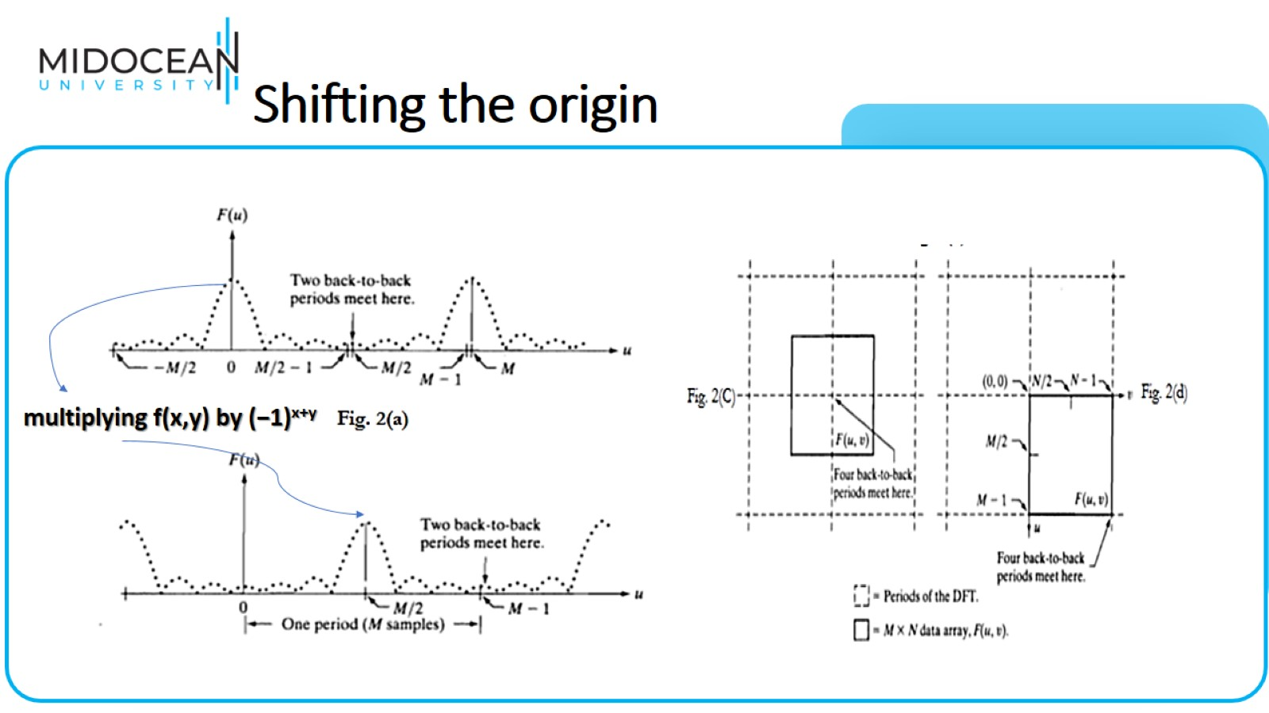
Shifting the origin

Slide 9
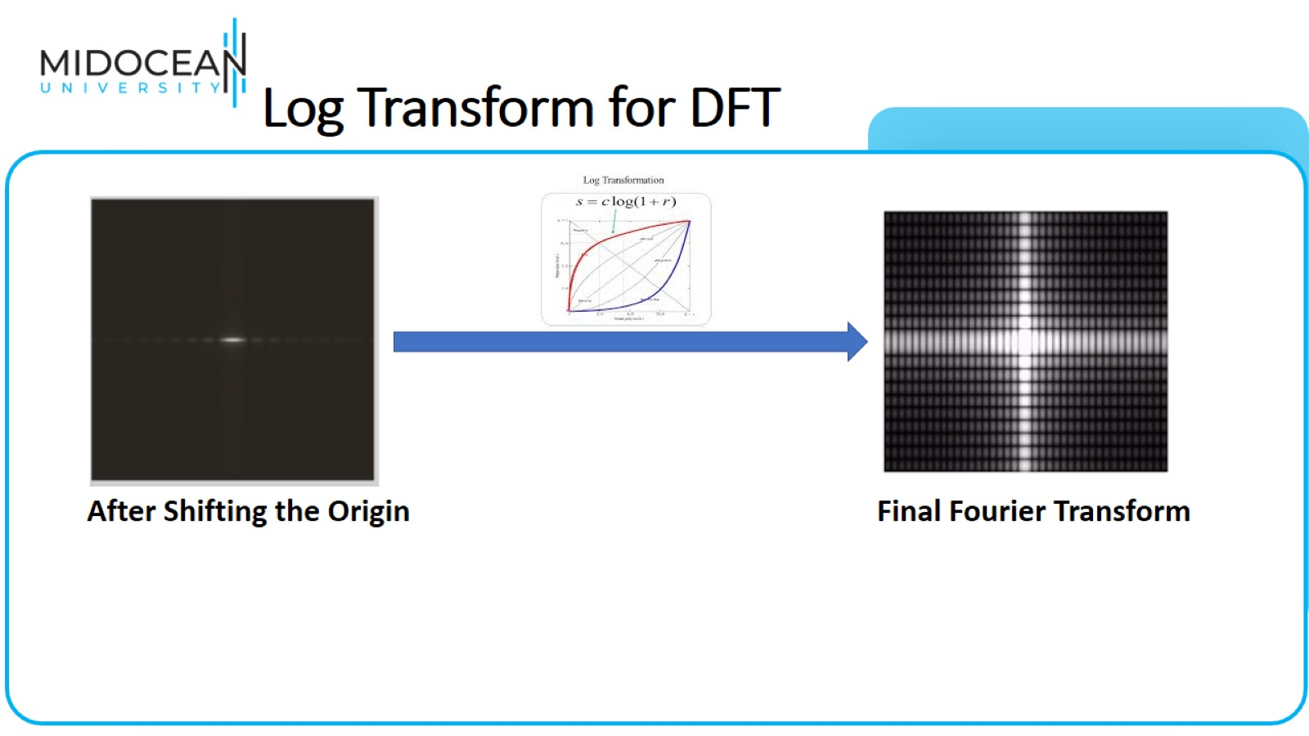
Log Transform for DFT

Slide 10
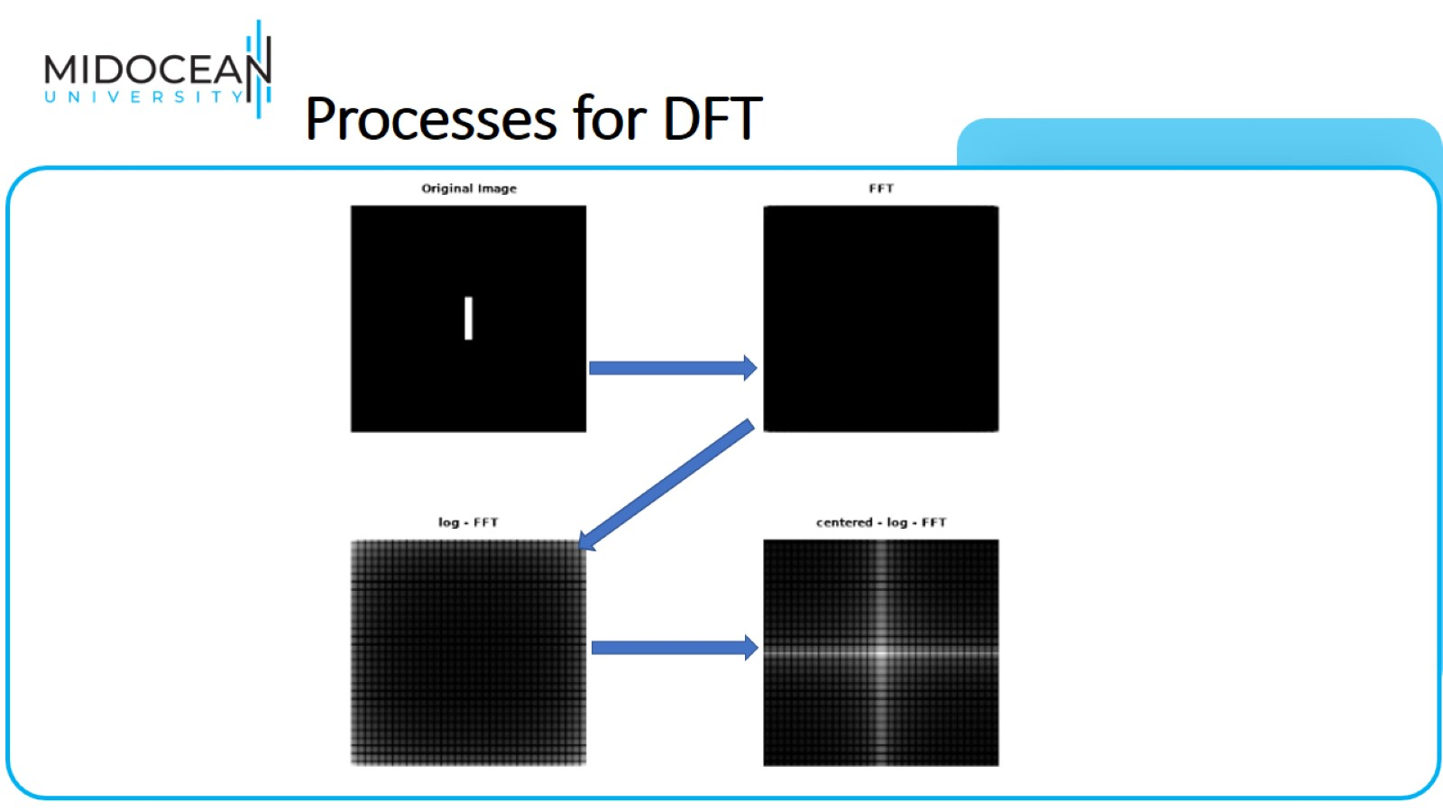
Processes for DFT

Slide 11
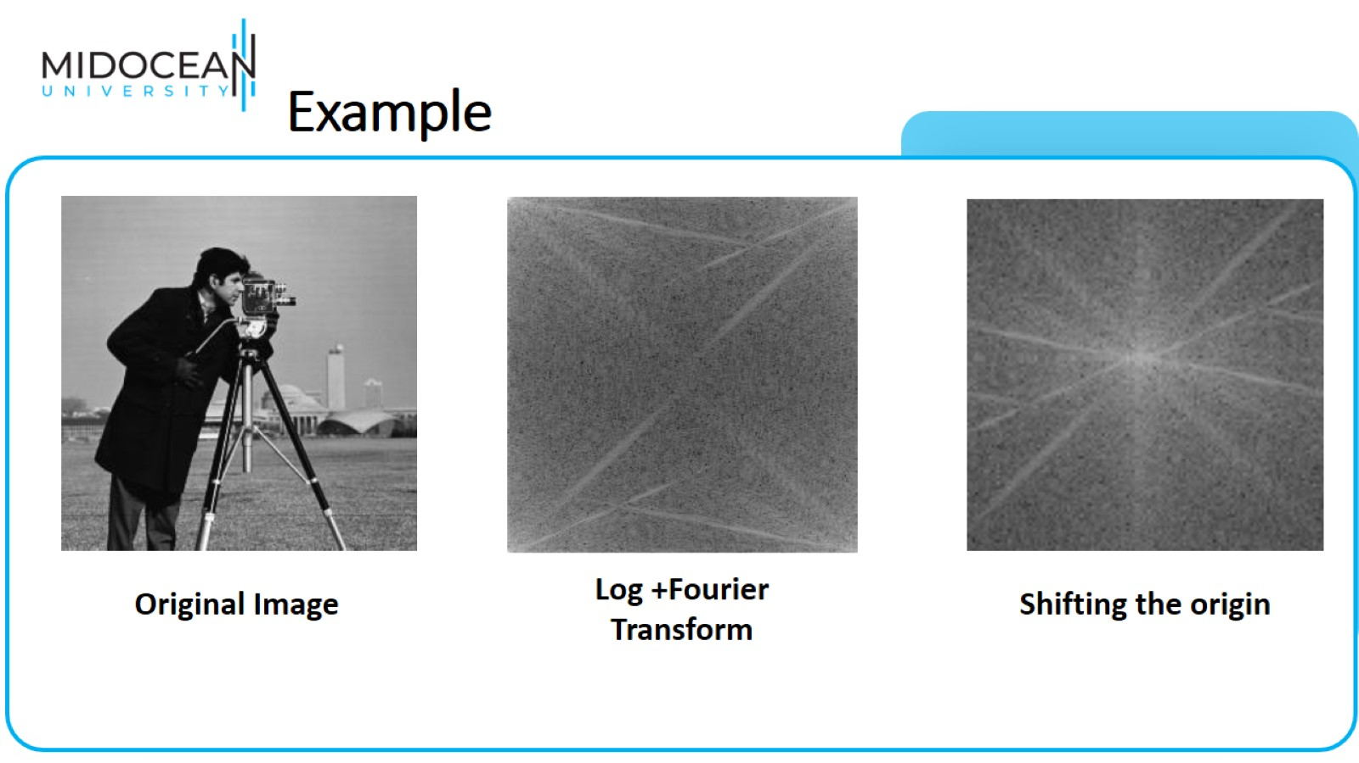
Example

Slide 12
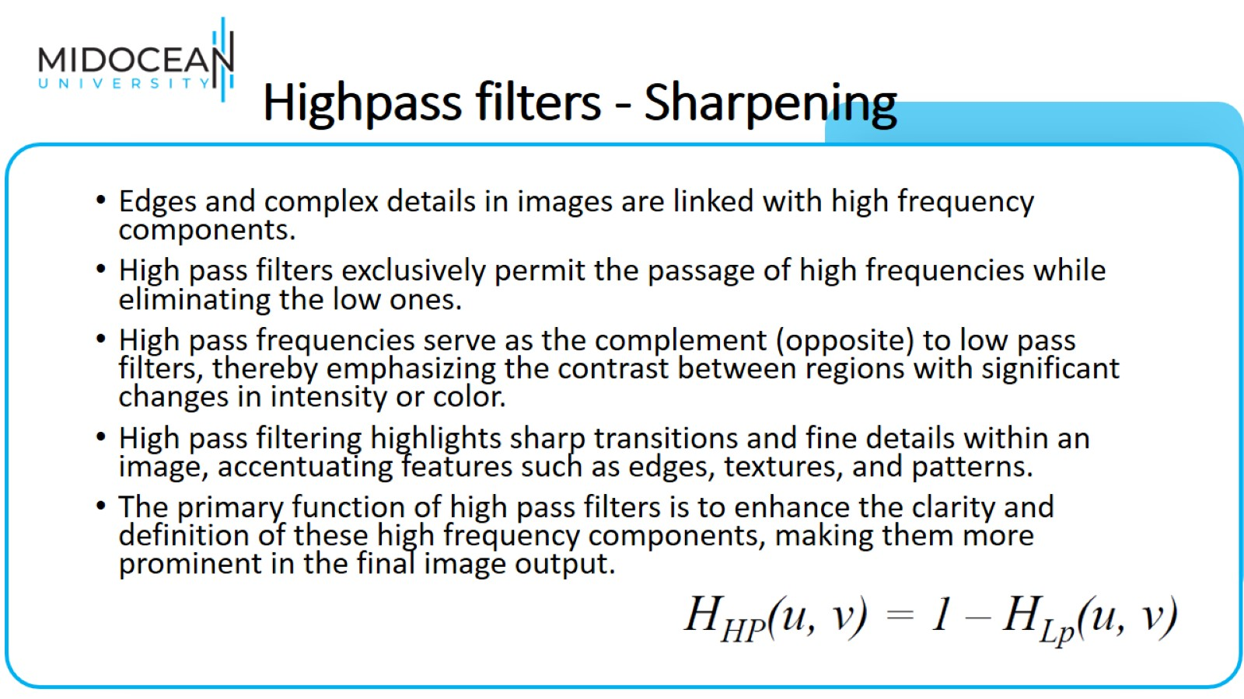
Highpass filters - Sharpening

Slide 13
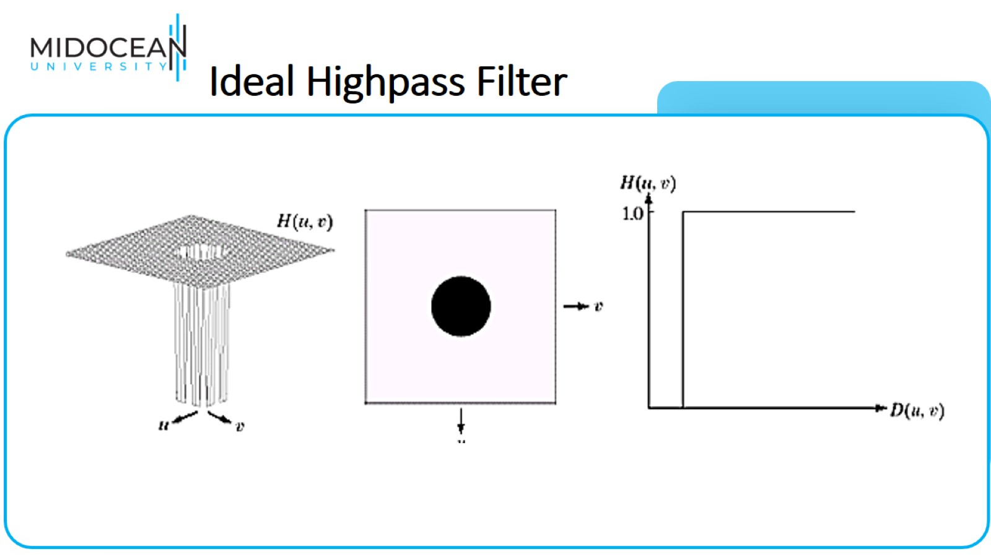
Ideal Highpass Filter

Slide 14
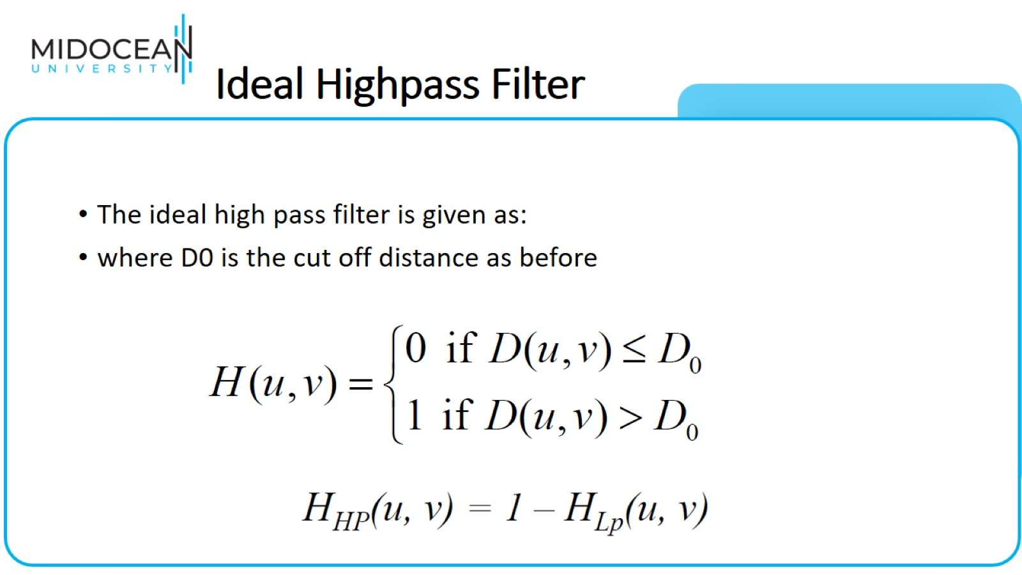
Ideal Highpass Filter

Slide 15
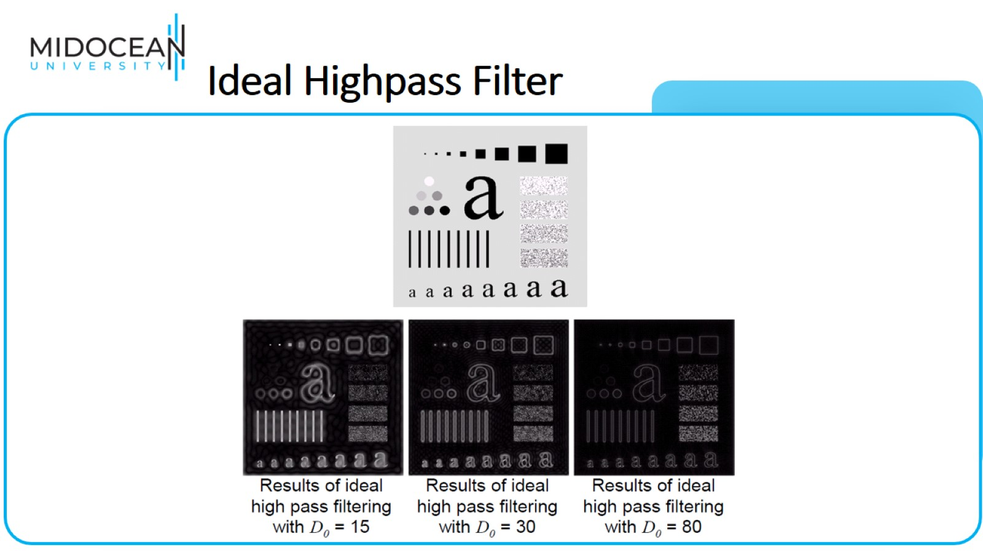
Ideal Highpass Filter

Slide 16
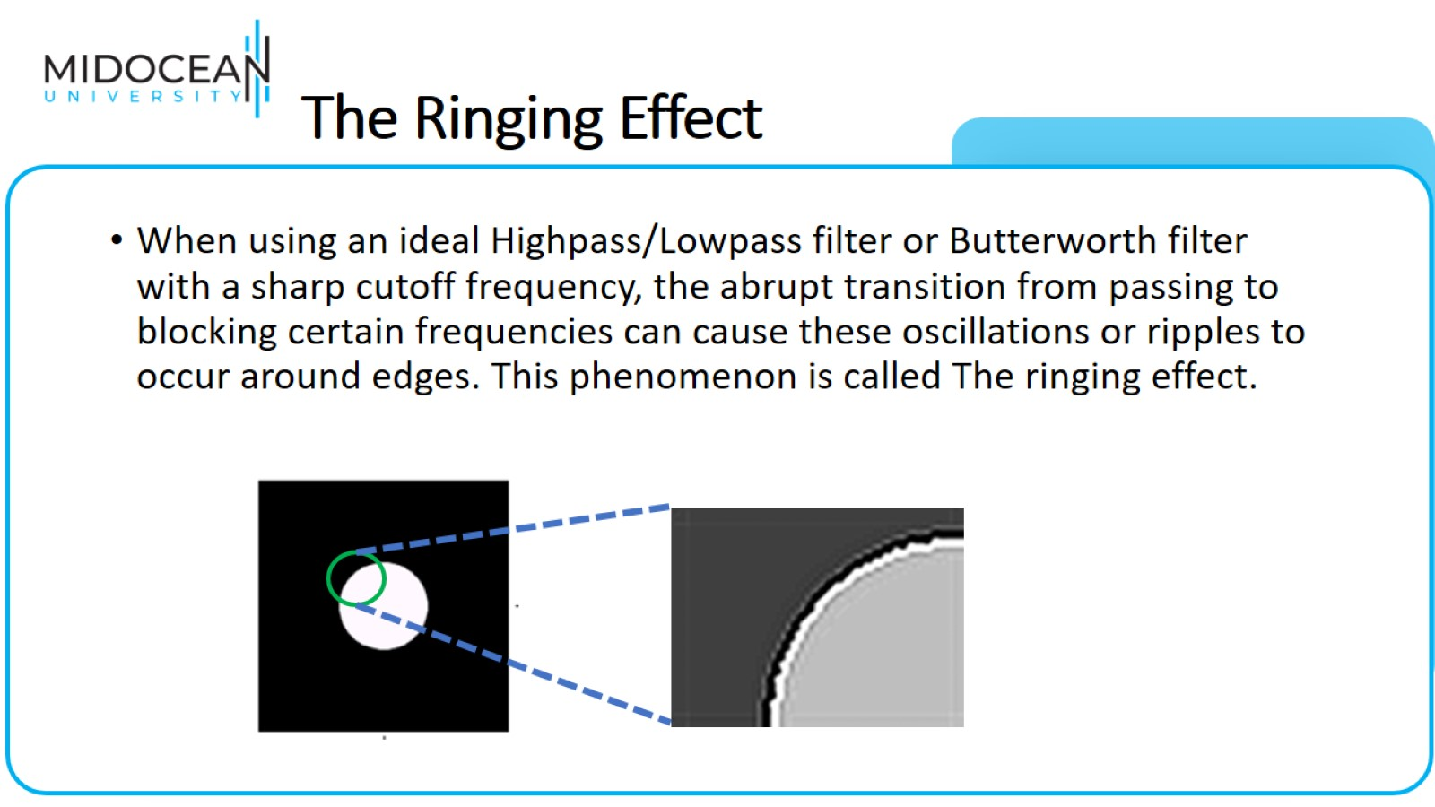
The Ringing Effect

Slide 17
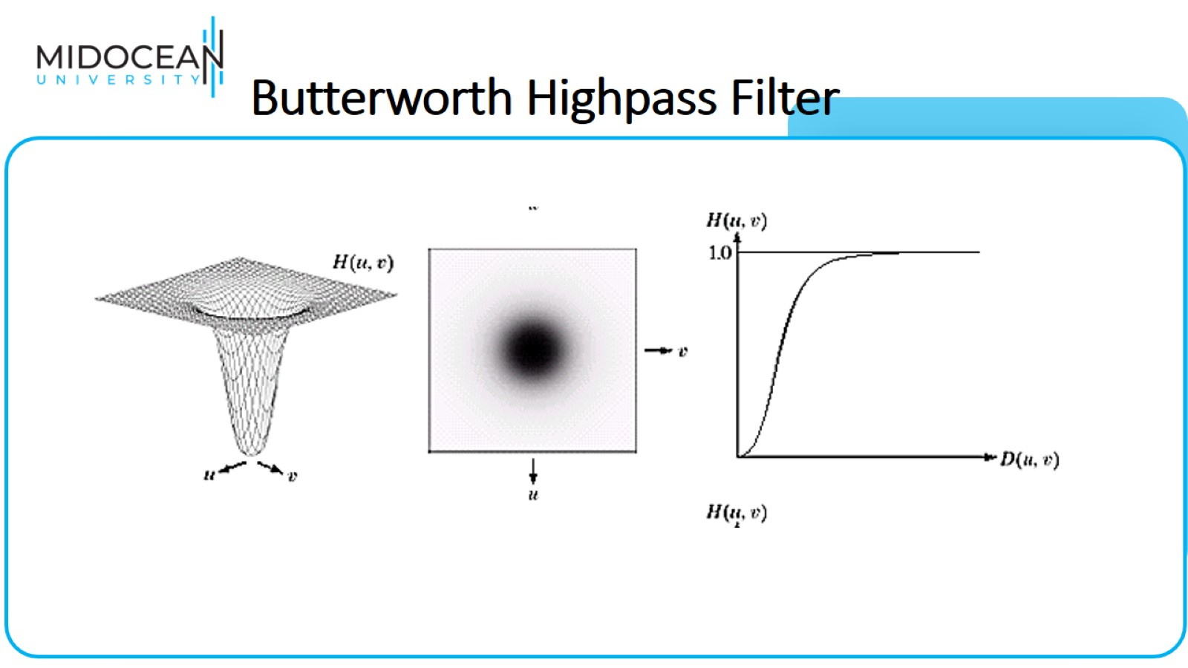
Butterworth Highpass Filter

Slide 18
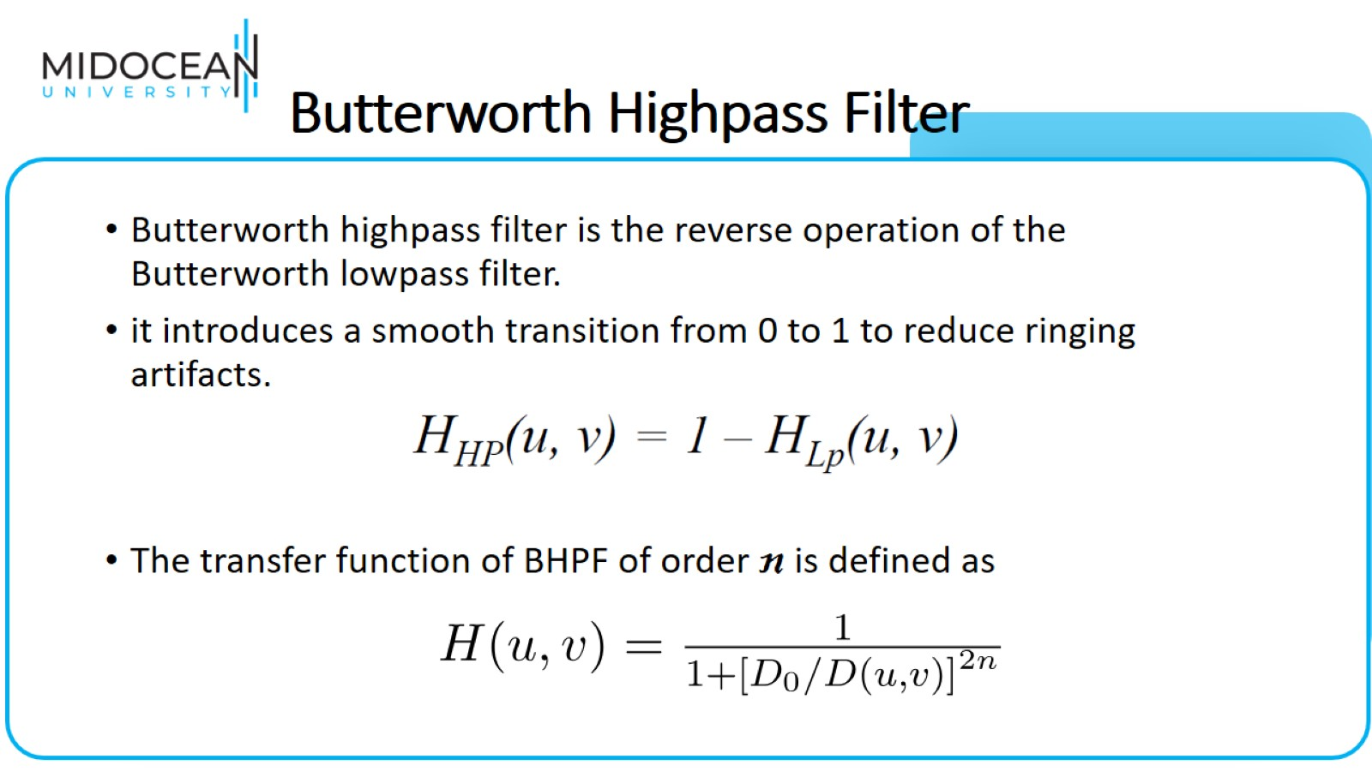
Butterworth Highpass Filter

Slide 19
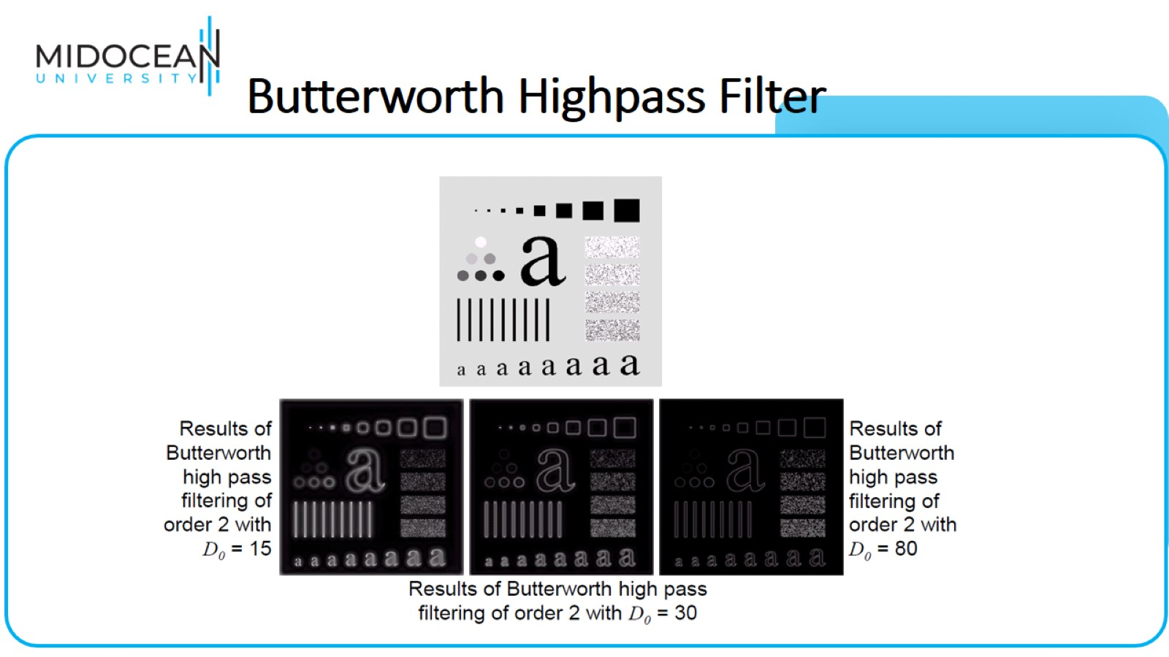
Butterworth Highpass Filter

Slide 20
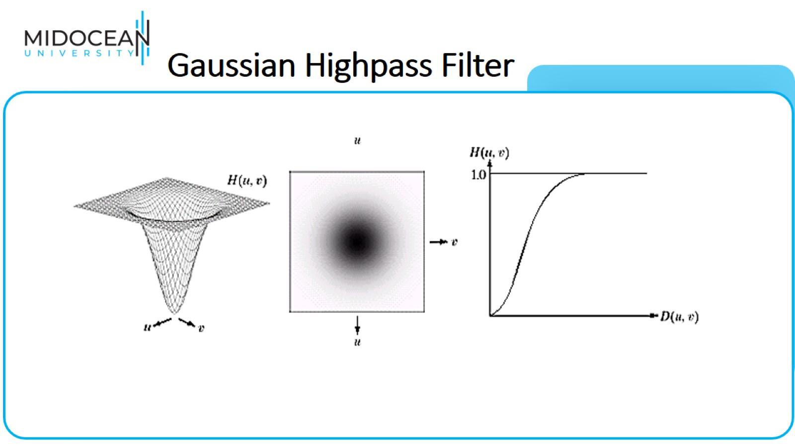
Gaussian Highpass Filter

Slide 21
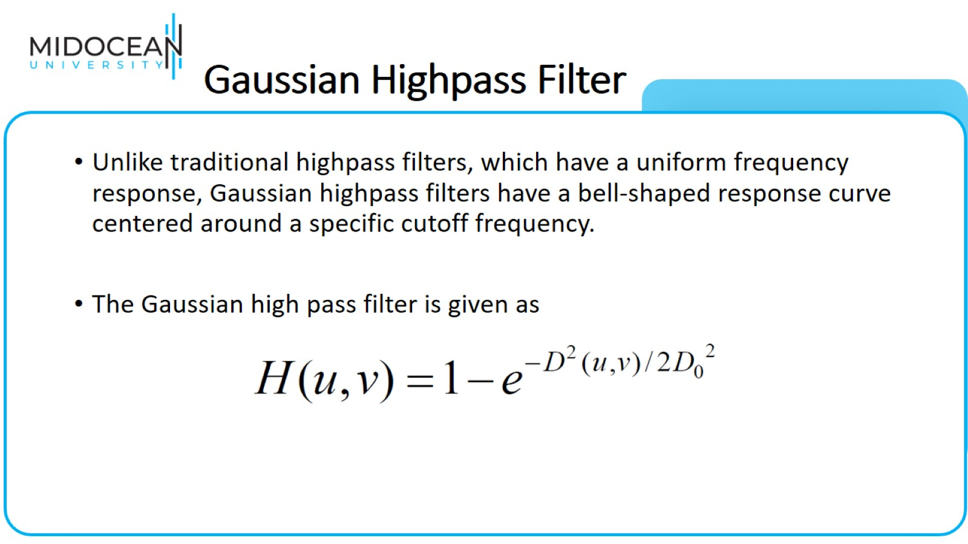
Gaussian Highpass Filter

Slide 22
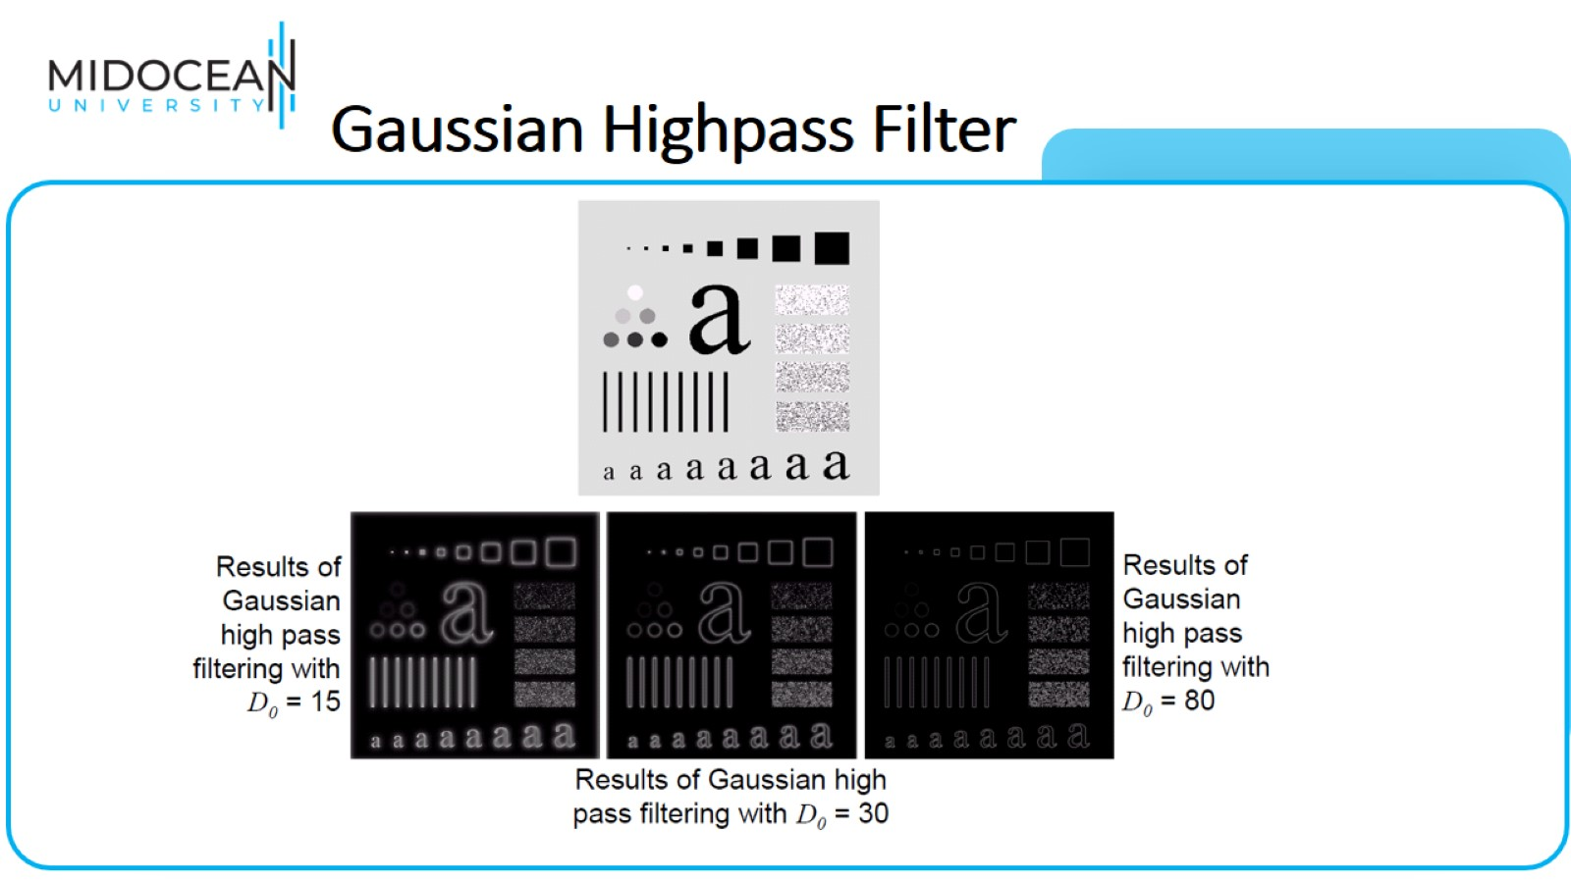
Gaussian Highpass Filter

Slide 23
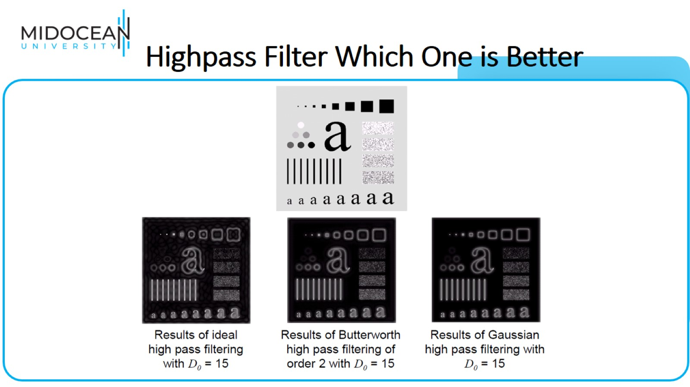
Highpass Filter Which One is Better

Slide 24
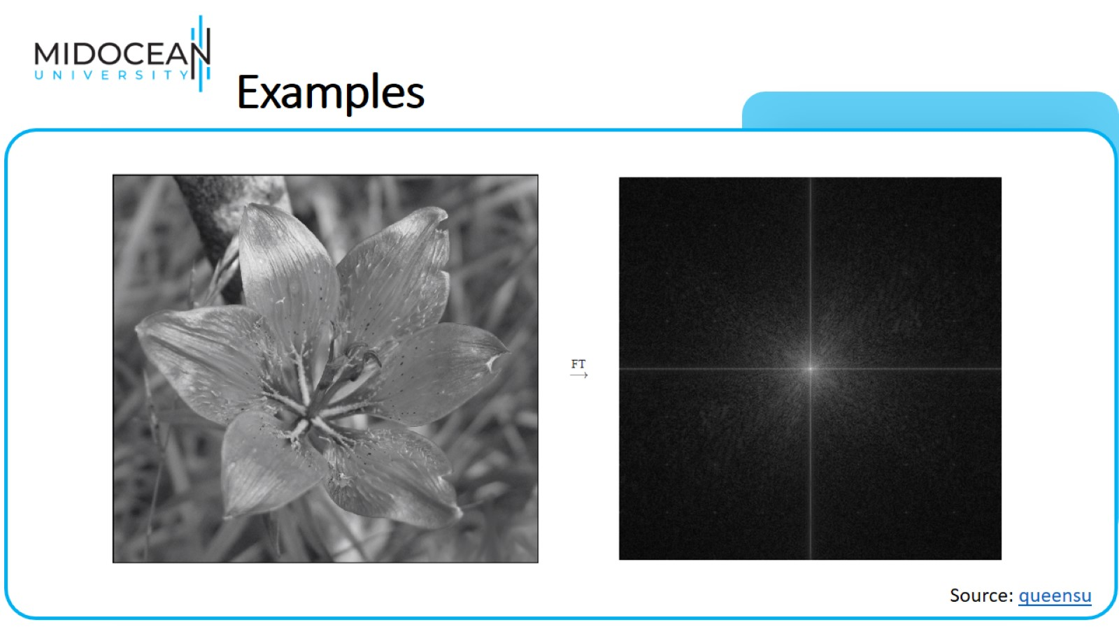
Examples

Slide 25
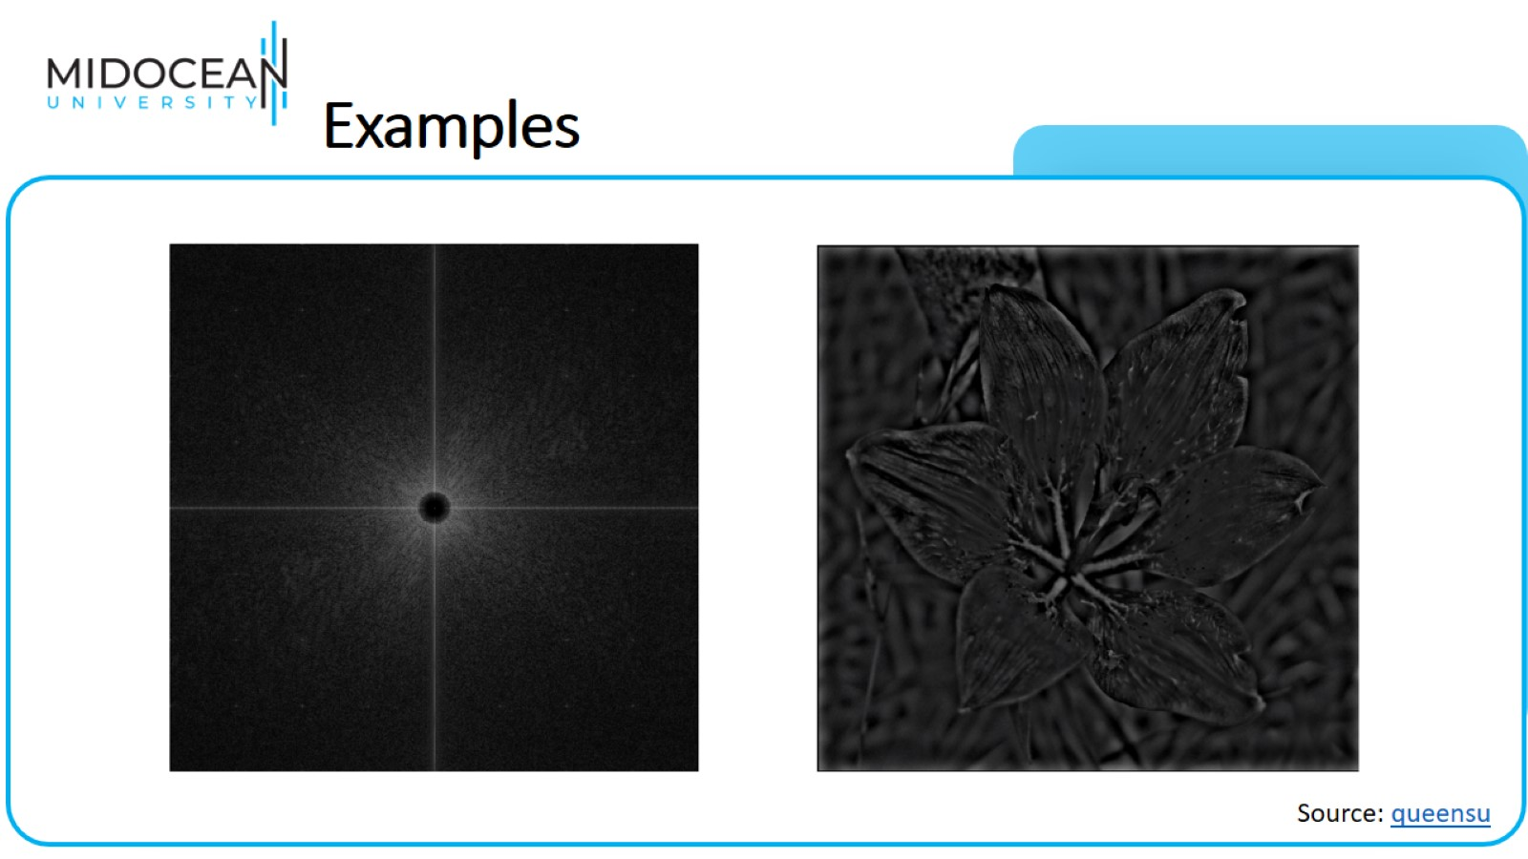
Examples

Slide 26

Image Restoration and Reconstruction

Slide 27
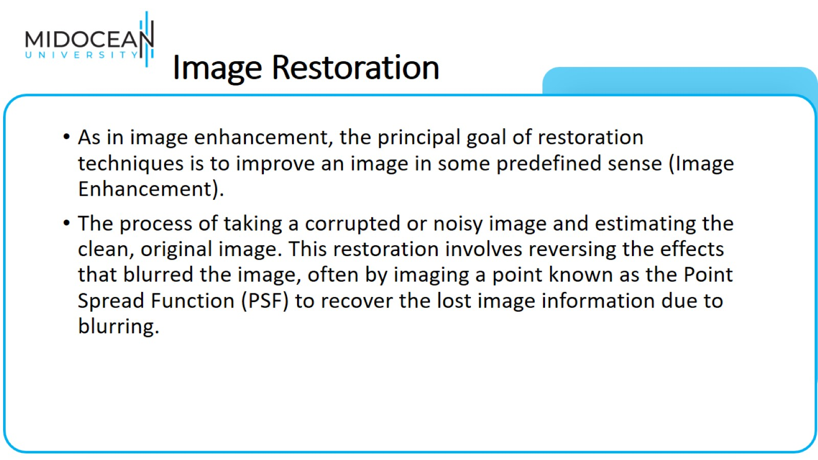
Image Restoration

Slide 28
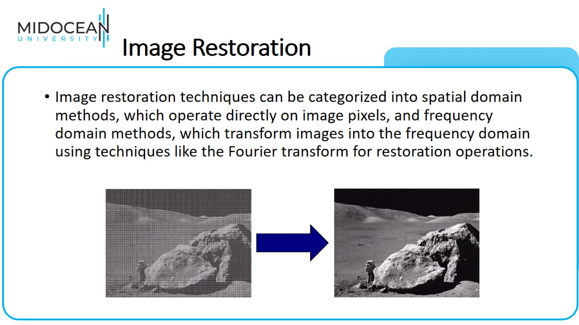
Image Restoration

Slide 29
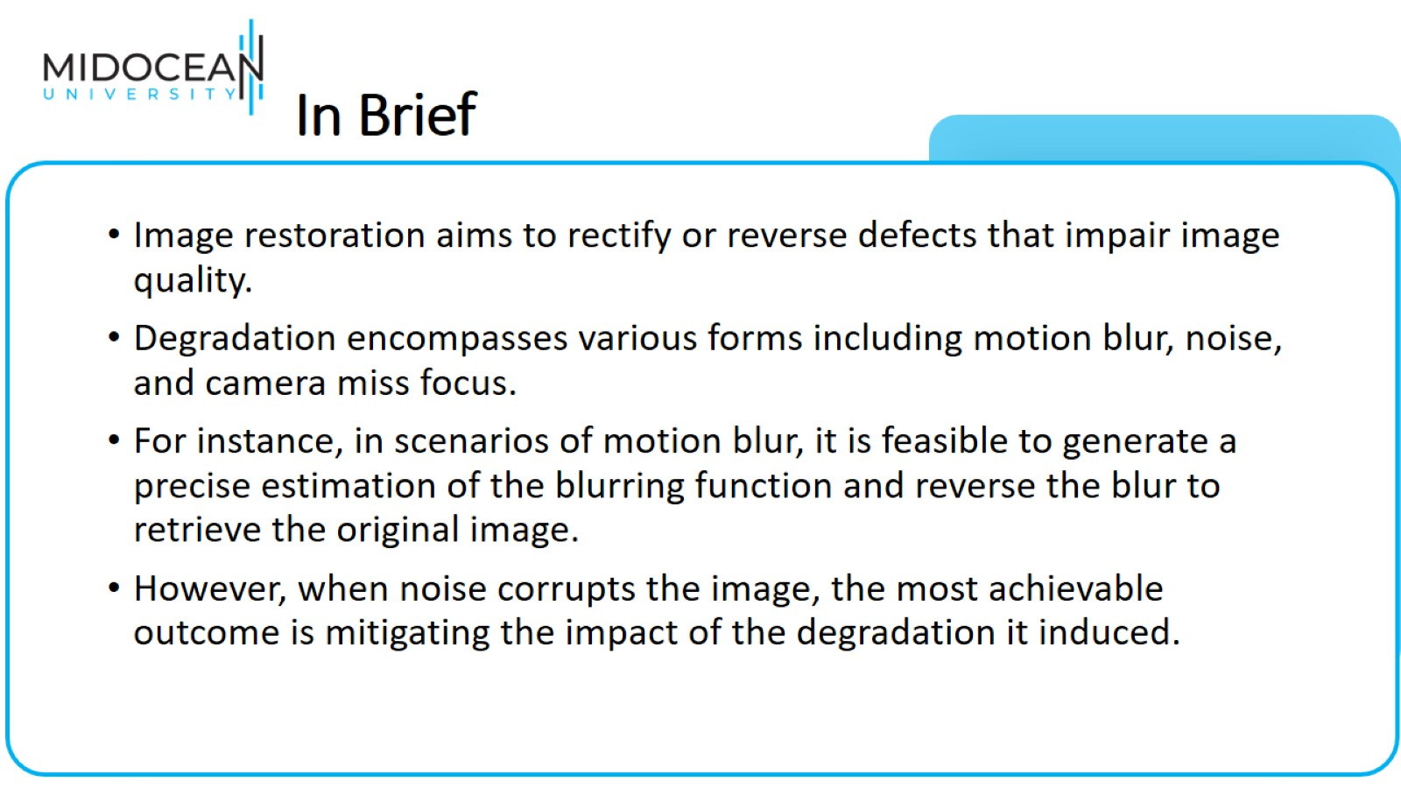
In Brief

Slide 30
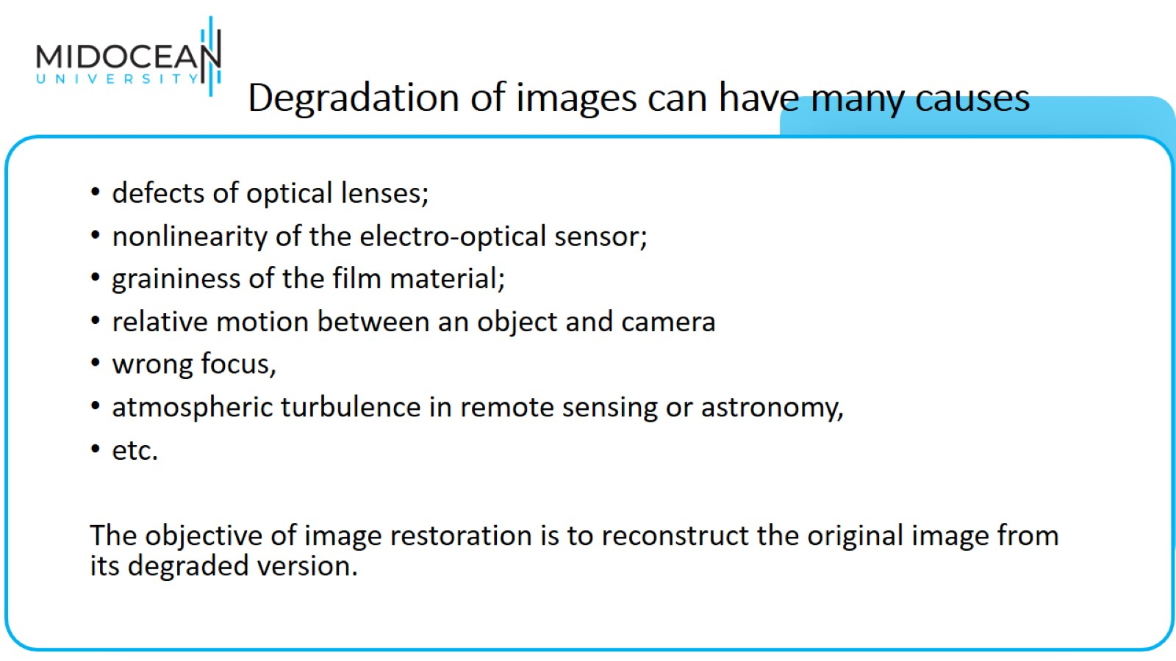
Degradation of images can have many causes

Slide 31
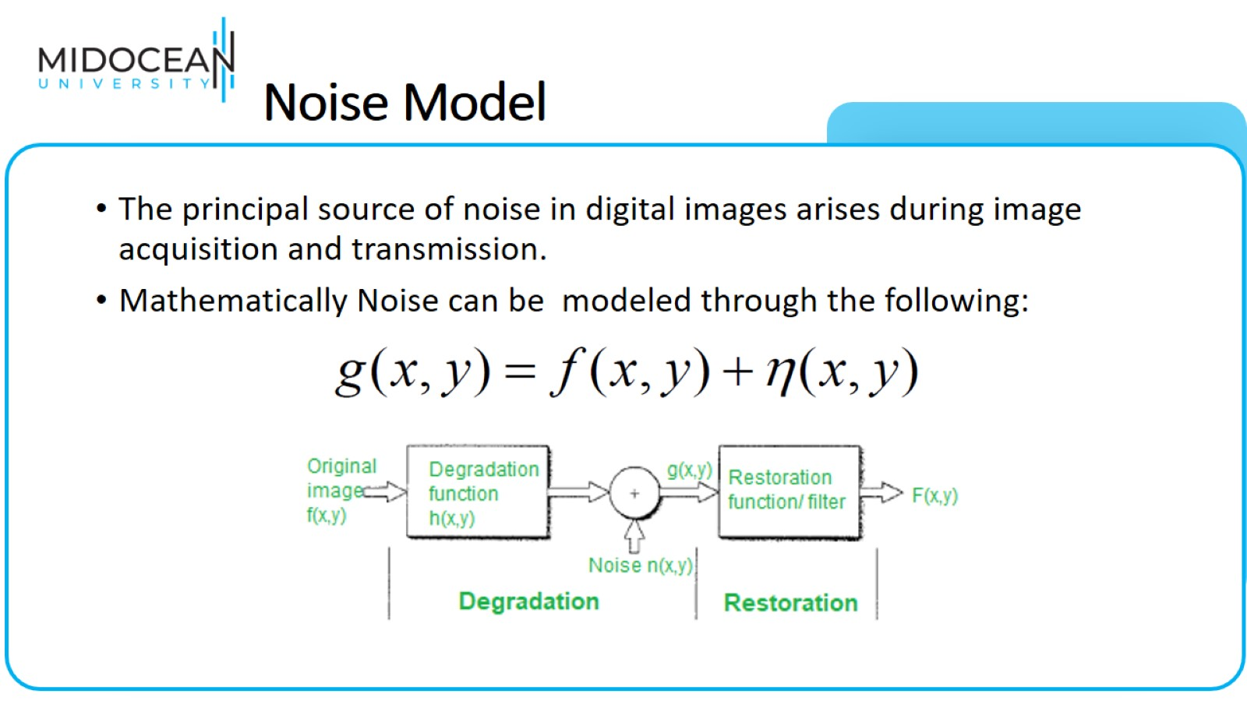
Noise Model

Slide 32
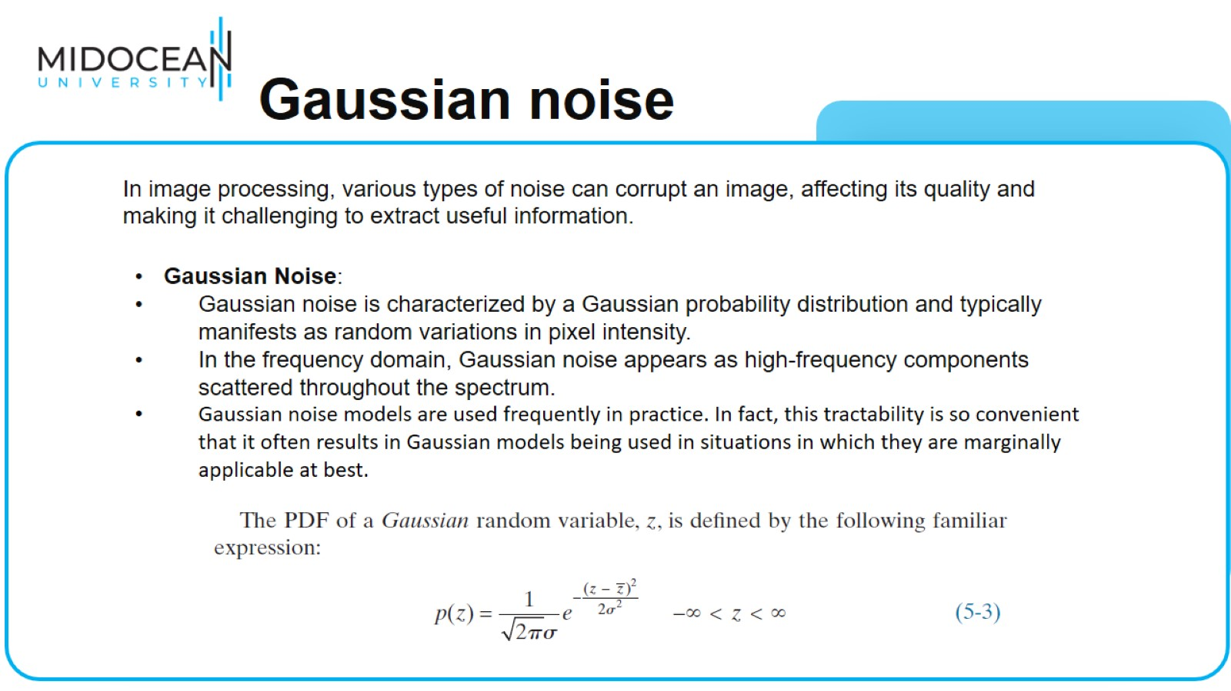
Gaussian noise

Slide 33
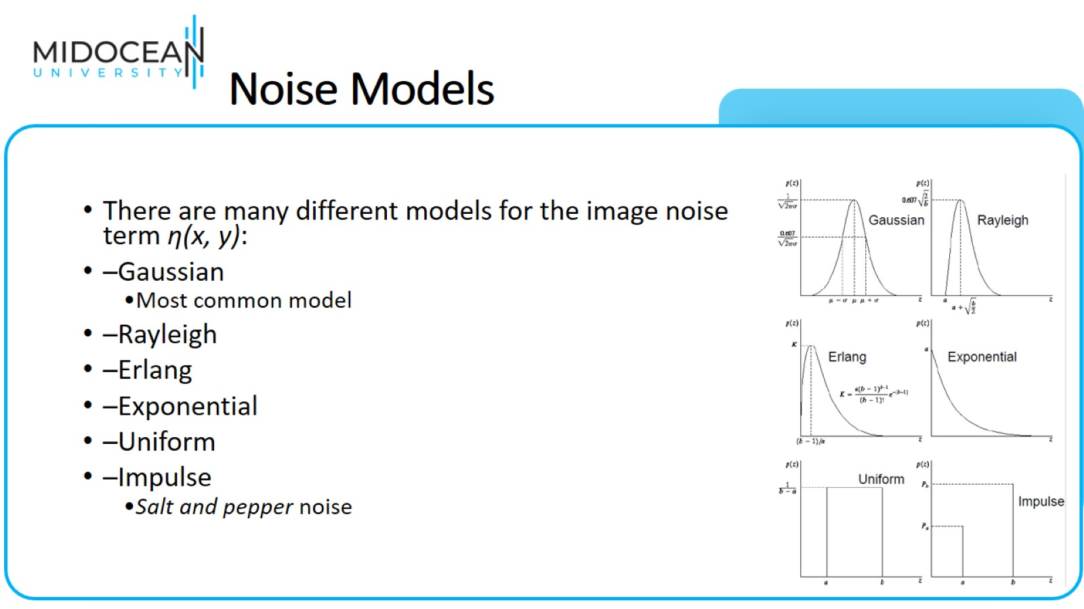
Noise Models

Slide 34
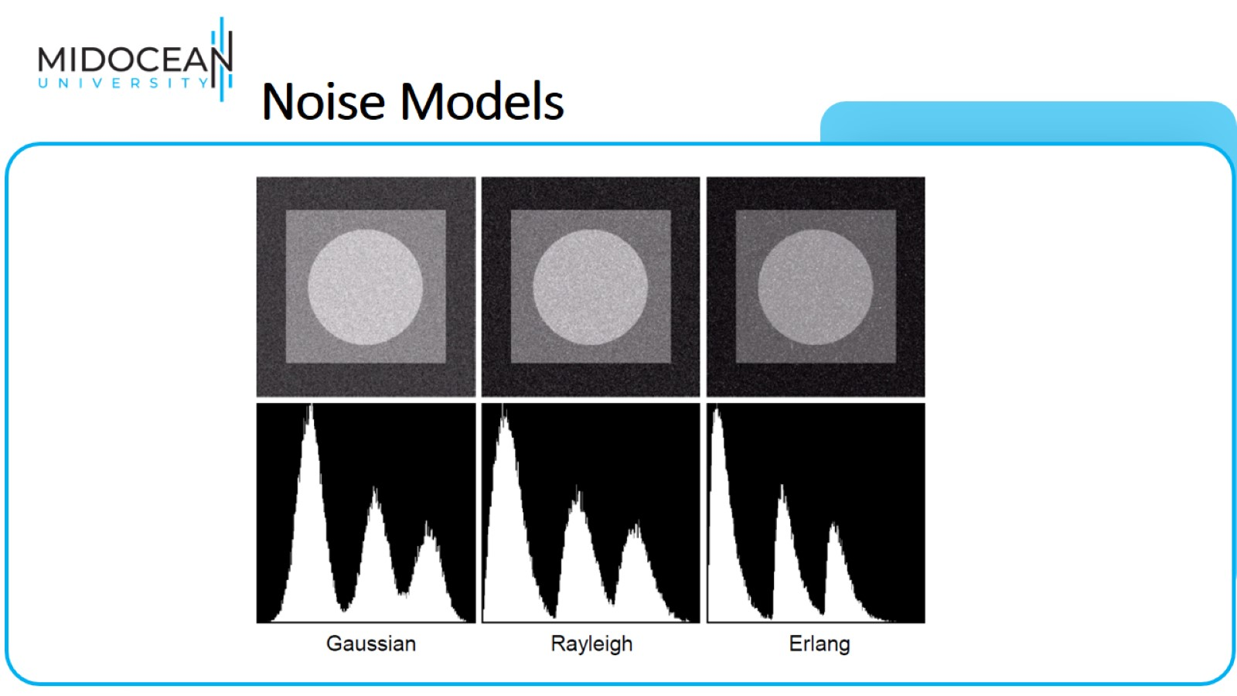
Noise Models

Slide 35
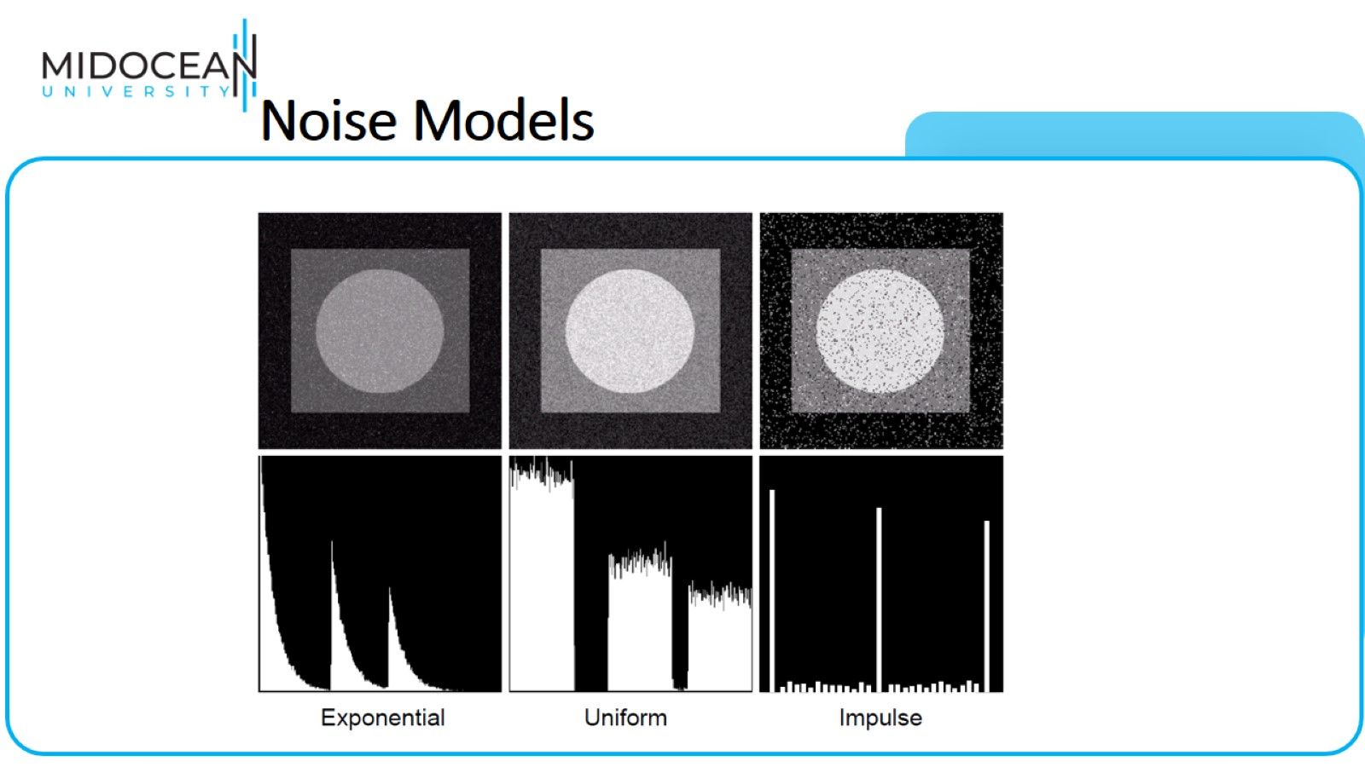
Noise Models

Slide 36
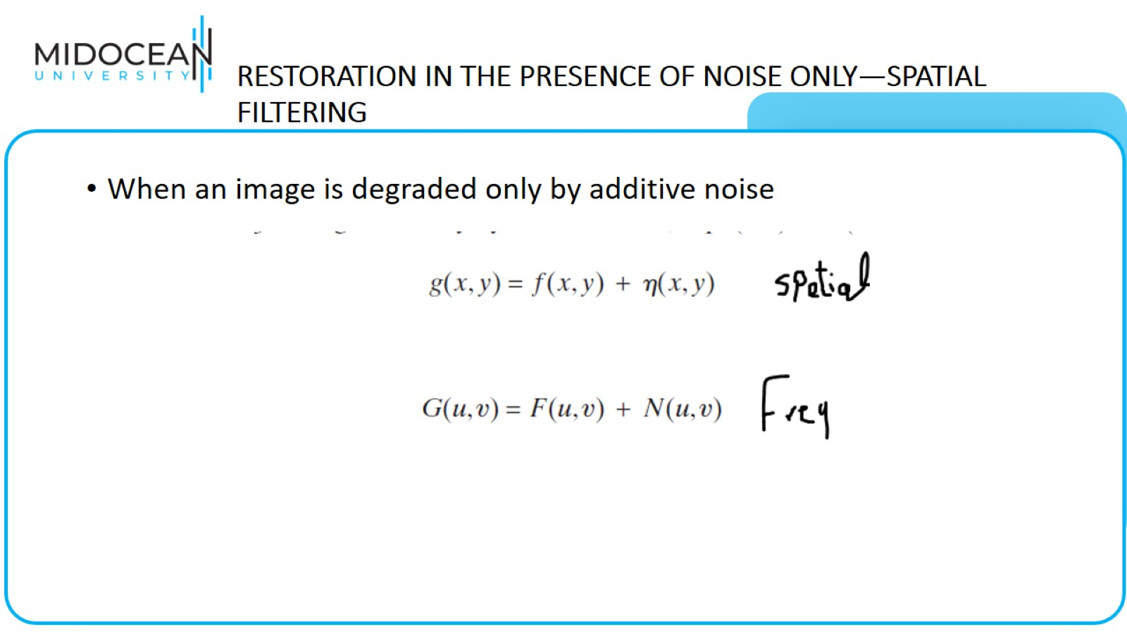
RESTORATION IN THE PRESENCE OF NOISE ONLY—SPATIAL
FILTERING

Slide 37
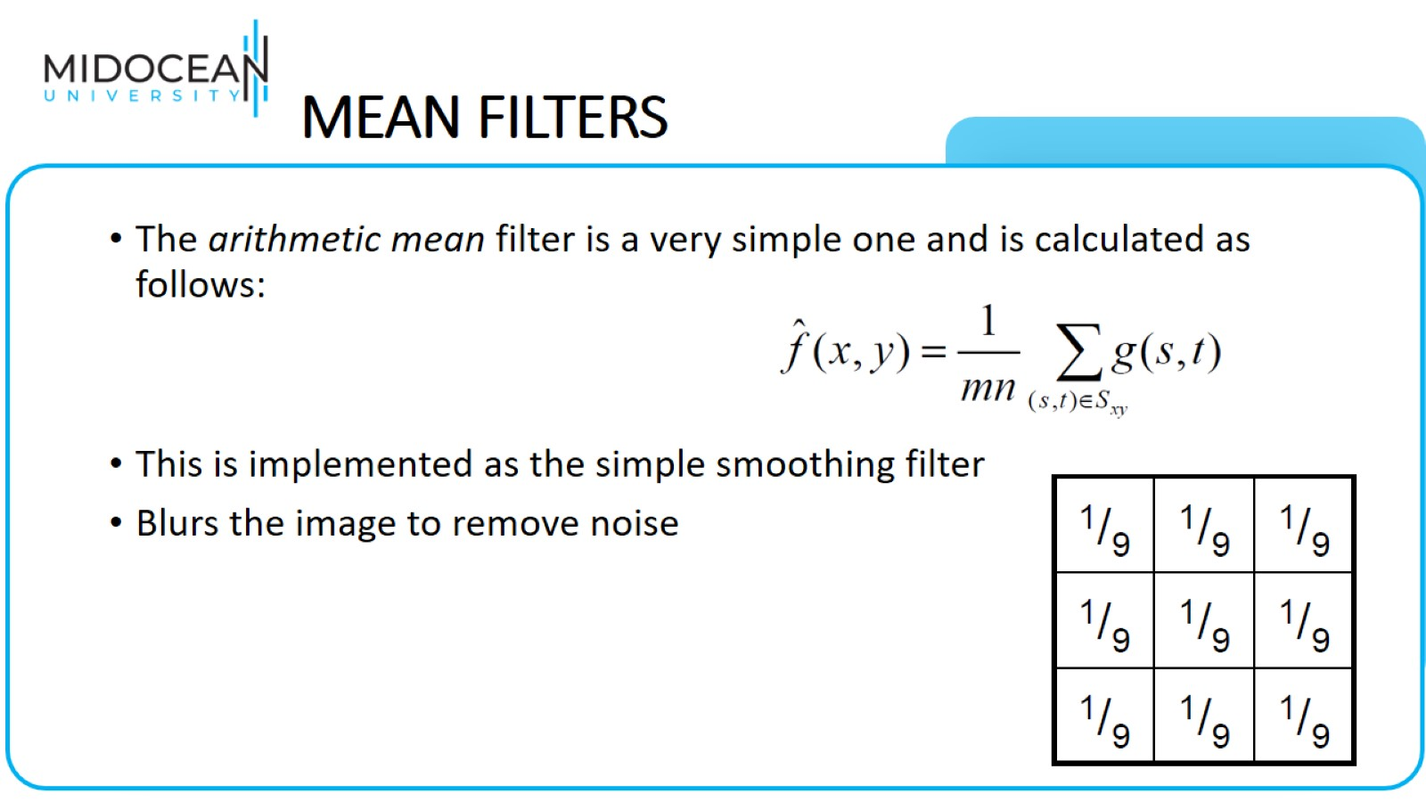
MEAN FILTERS

Slide 38
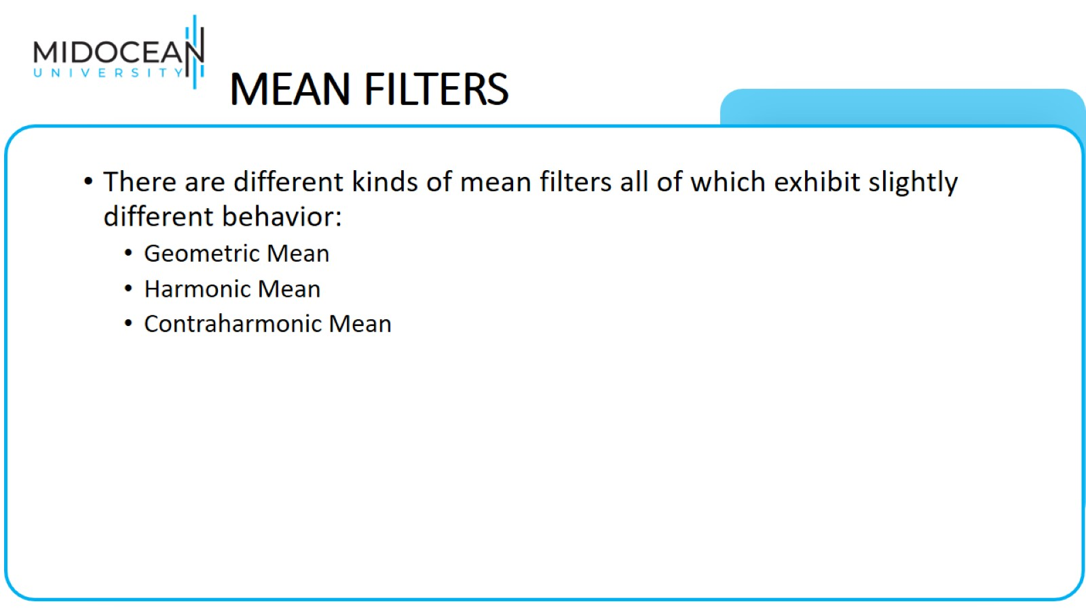
MEAN FILTERS

Slide 39
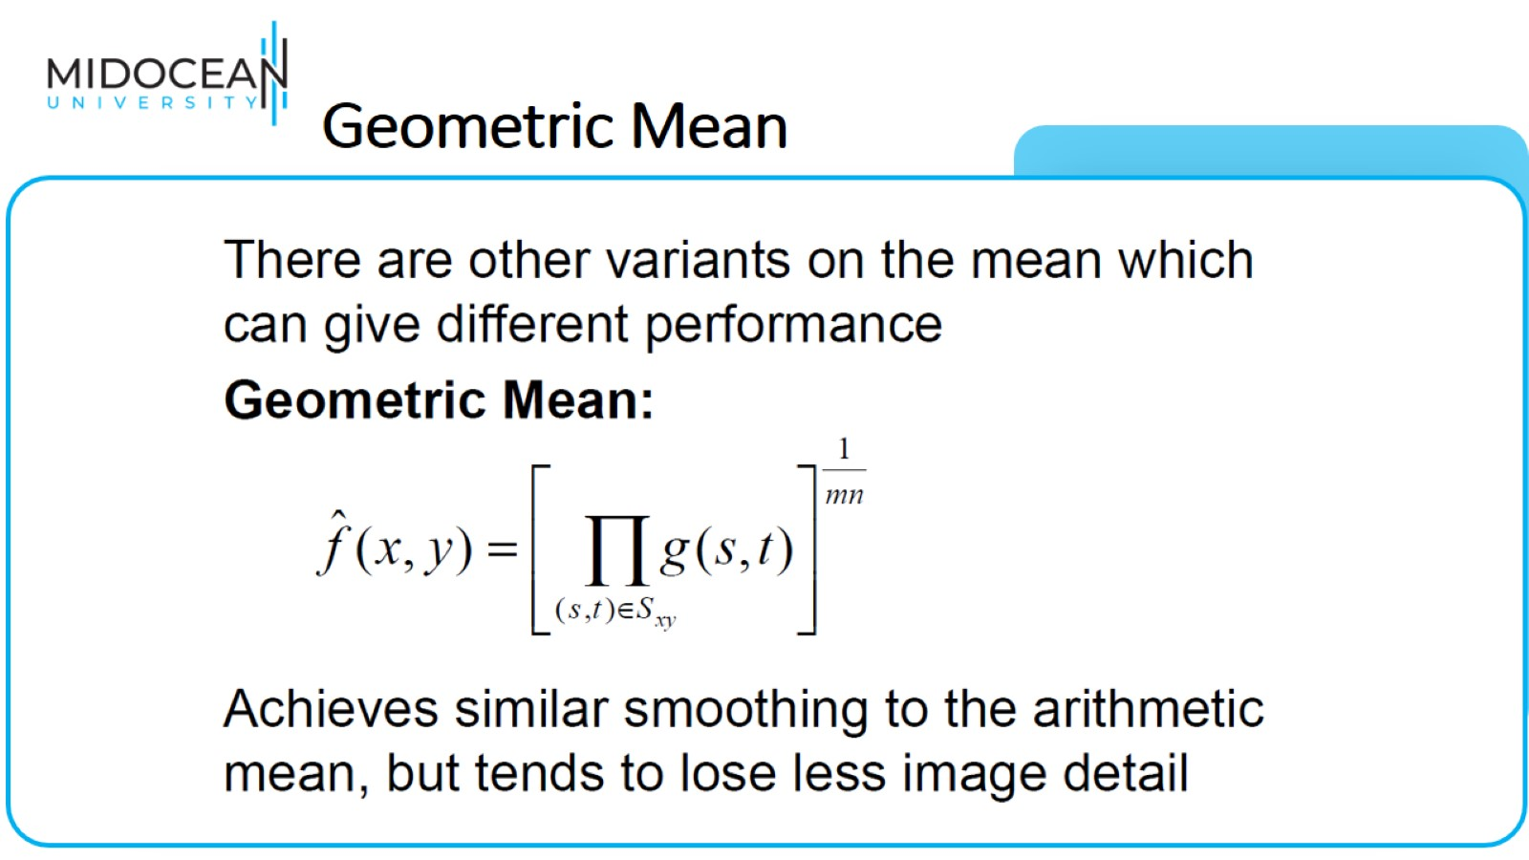
Geometric Mean

Slide 40
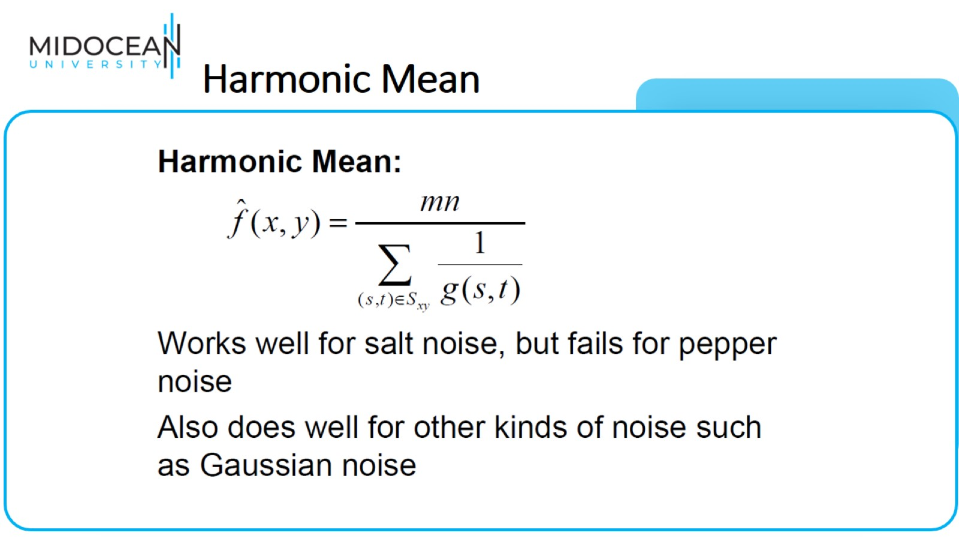
Harmonic Mean

Slide 41
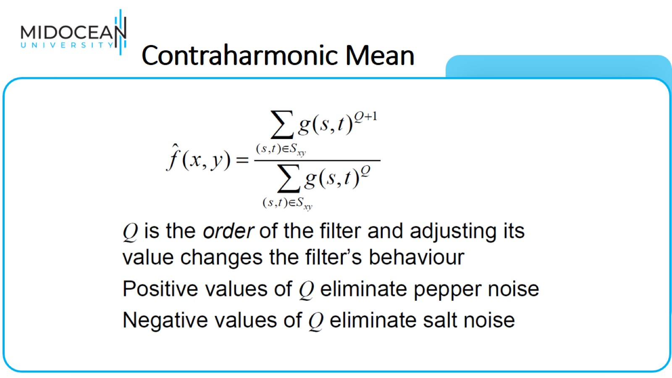
Contraharmonic Mean

Slide 42
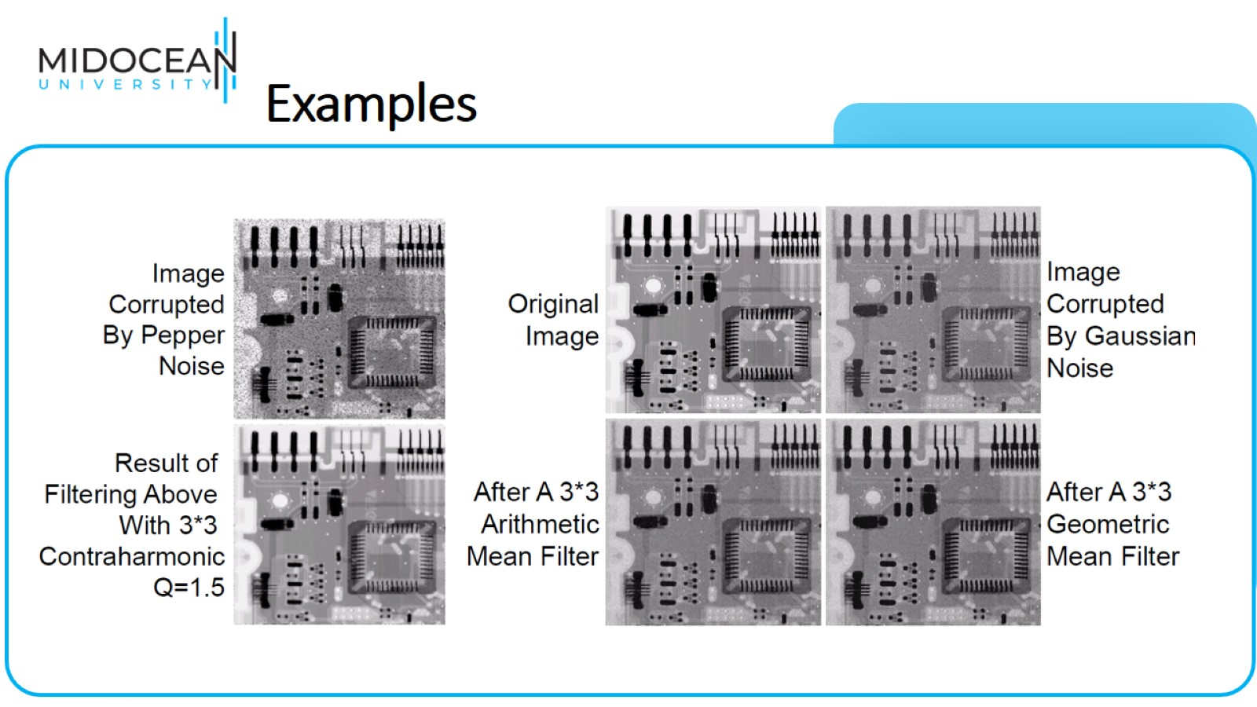
Examples

Slide 43
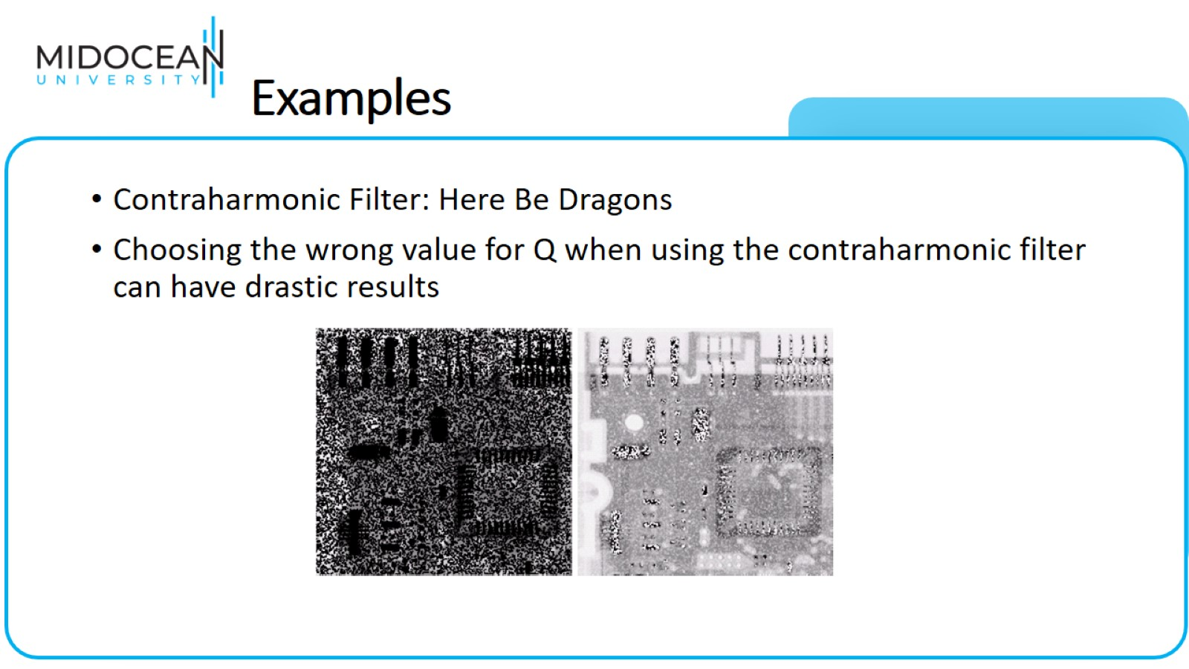
Examples

Slide 44
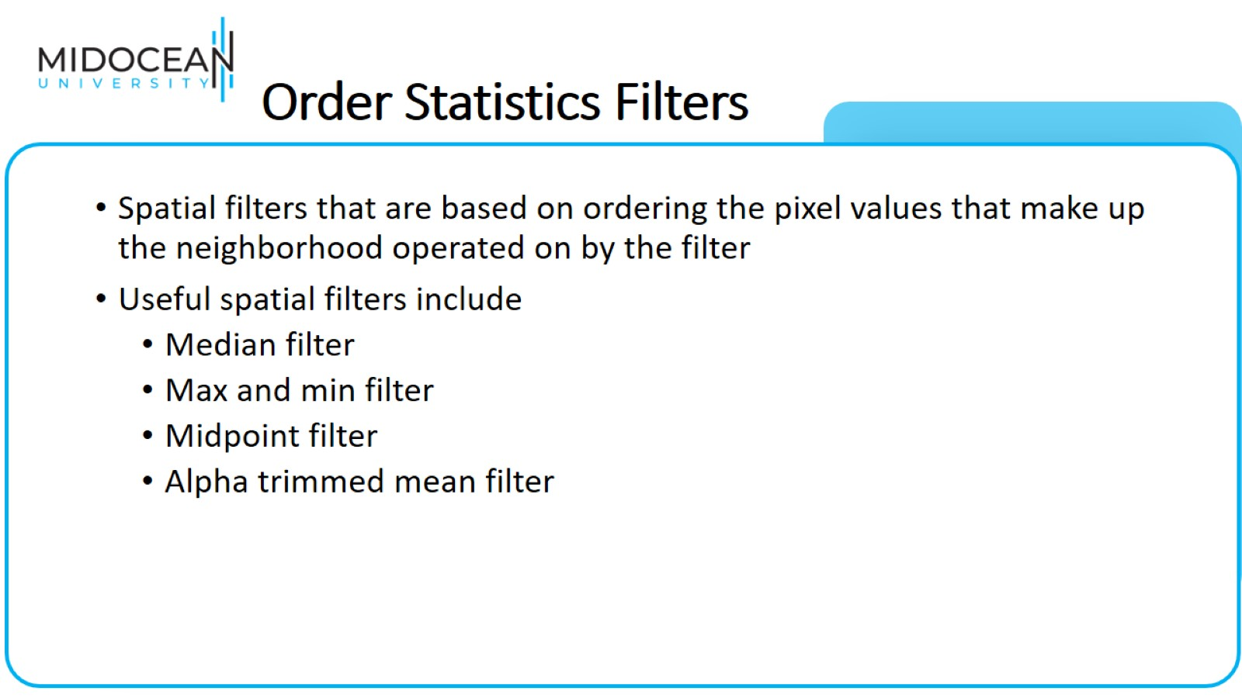
Order Statistics Filters

Slide 45
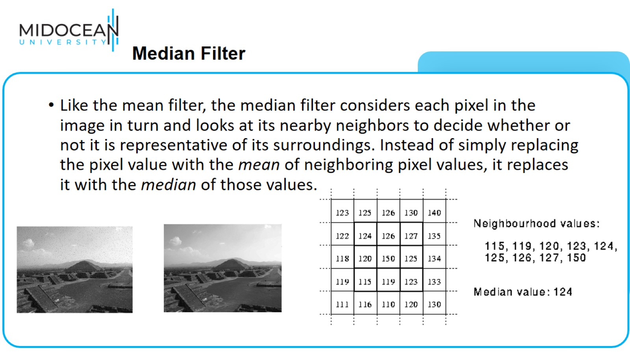
  Median Filter

Slide 46
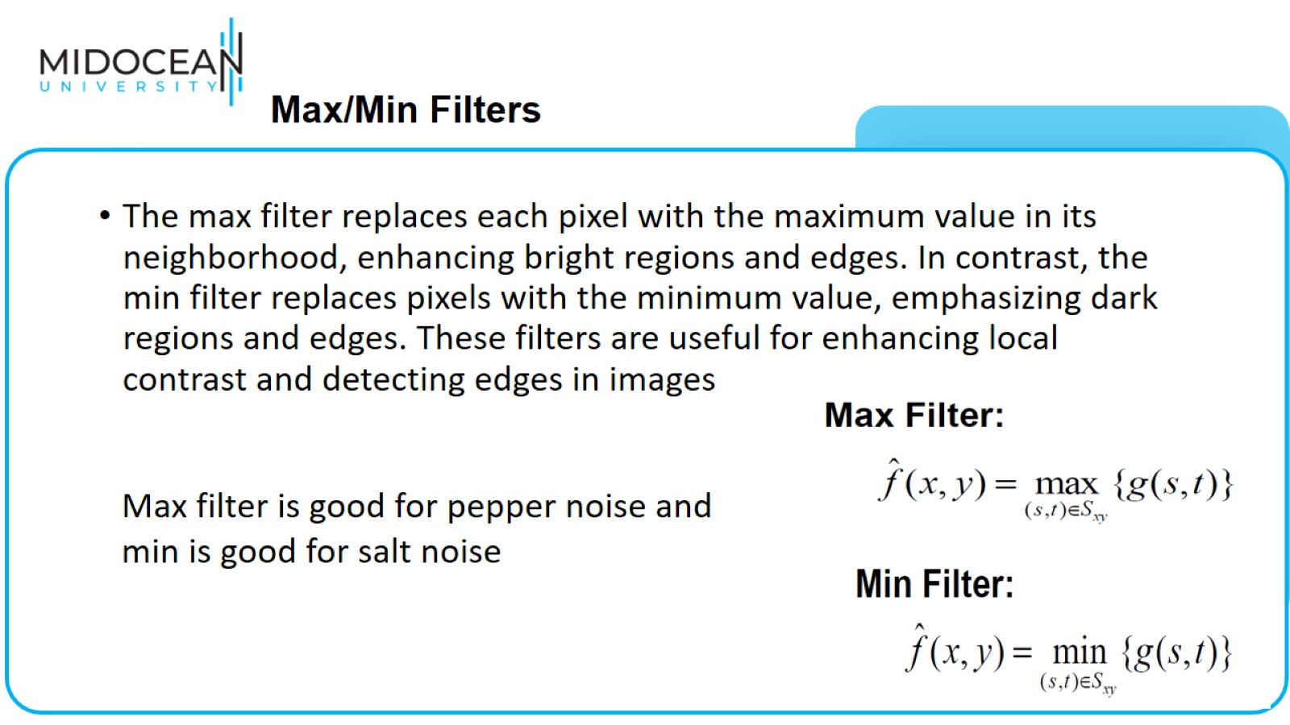
  Max/Min Filters

Slide 47
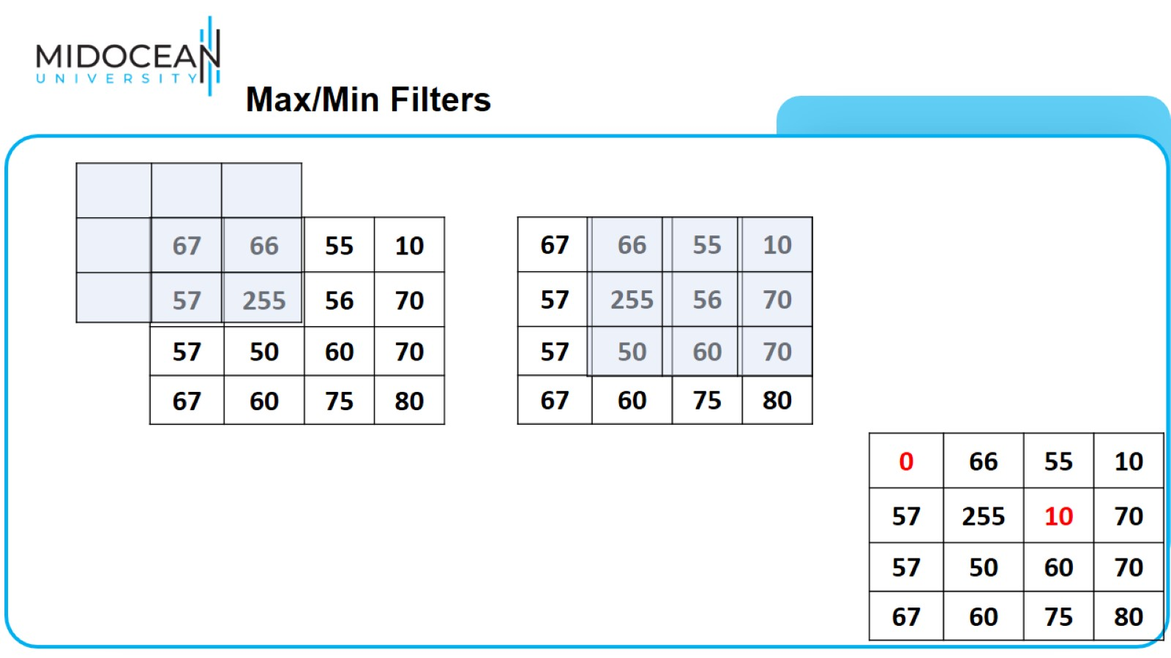
  Max/Min Filters

Slide 48
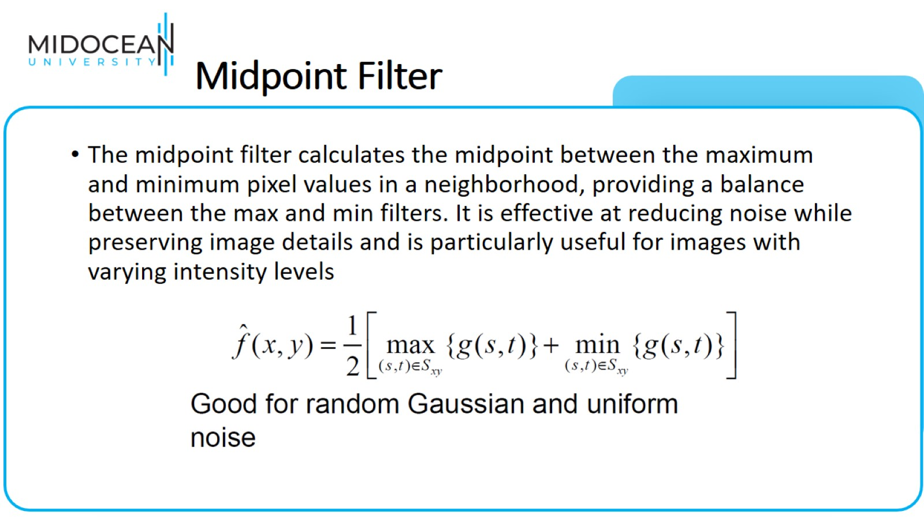
Midpoint Filter

Slide 49
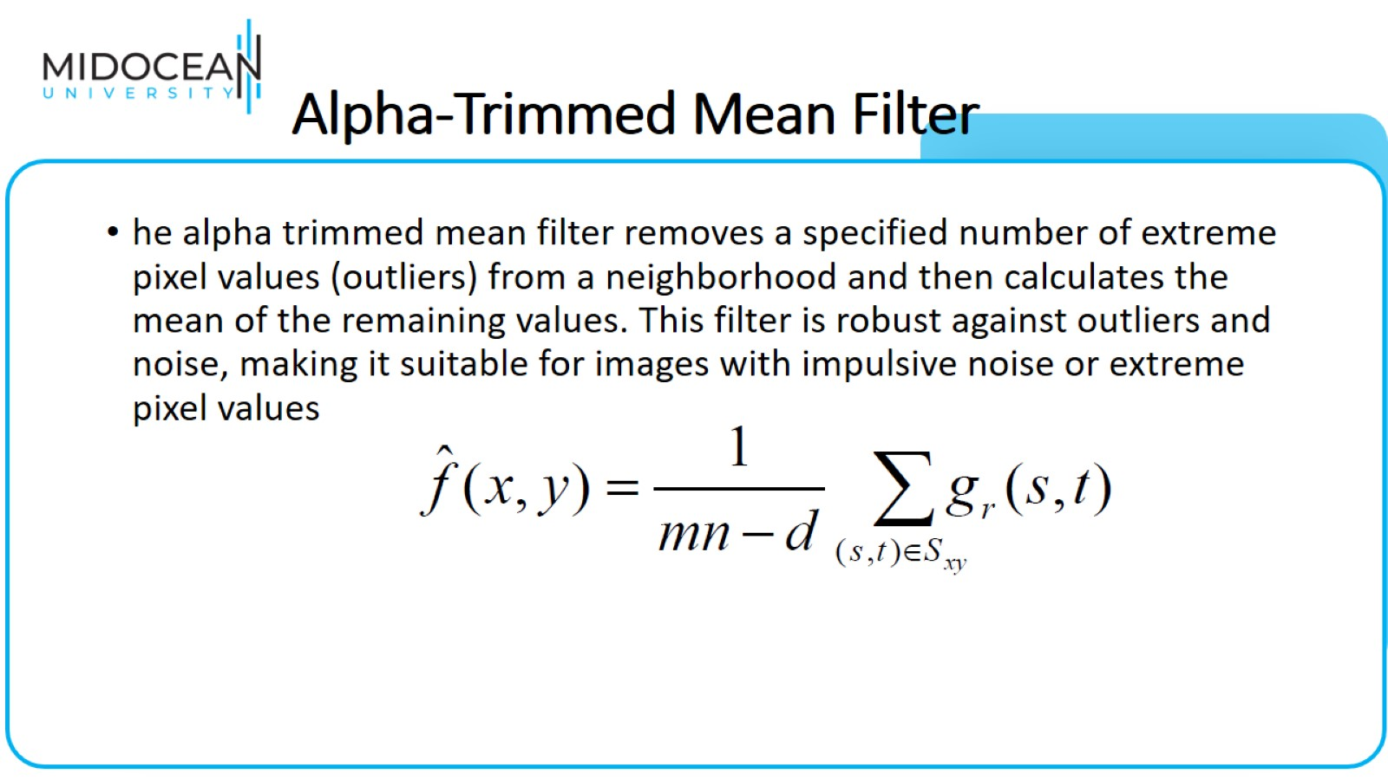
Alpha-Trimmed Mean Filter

Slide 50
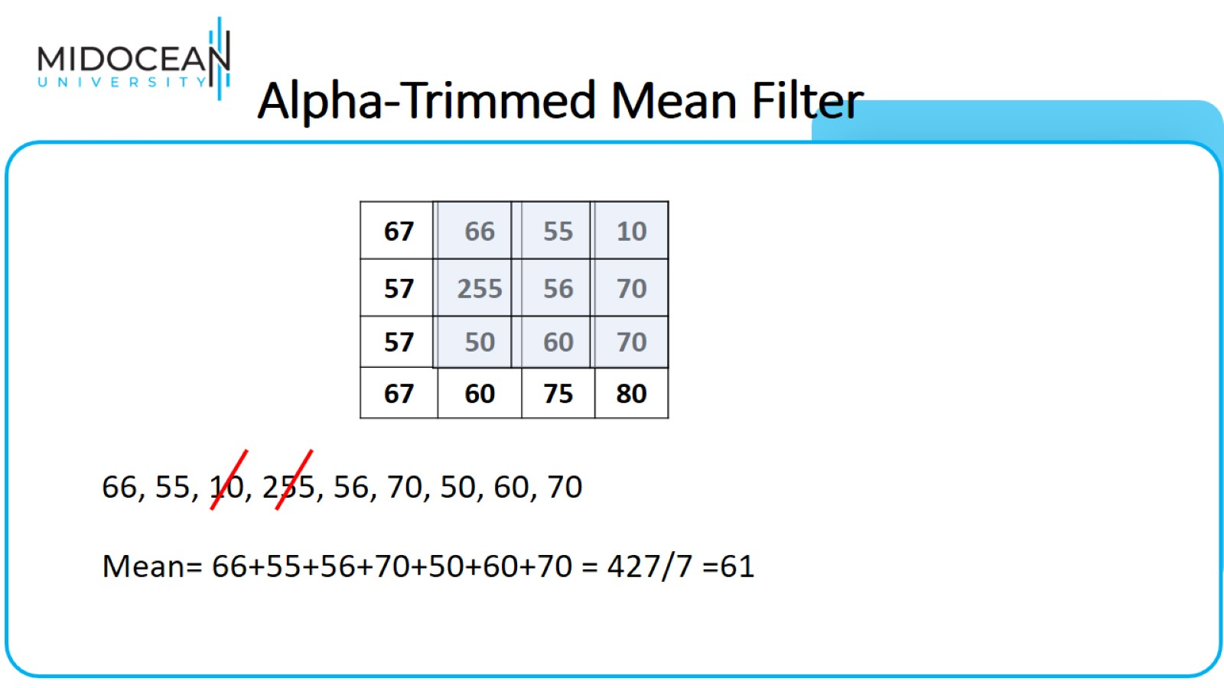
Alpha-Trimmed Mean Filter

Slide 51


