Slide 1

Presenting Quantitative Thesis
School of Social Sciences
PhD Program in Business Administration
By Mohammed A. Al Jarousha
Instructor: Doç. Dr. Evrim İldem DEVELİ
Course Name: SBE608– Seminar

Slide 2
Research information
Title of dissertation
"Role of R&D and Innovation Policies in the Development of R&D and Innovation Approaches and Skills of SME’s: Malatya First and Second Organized Industrial Zones and Malatya Technocity“.
Researcher: Taha Yasin ÖLMEZTOPRAK
Supervisor: Prof. Dr. Nilay ALUFTEKİN SAKARYA
Citation : Ölmeztoprak, T. (2023). Role of R&D and Innovation Policies In The Development of R&D And Innovation Approaches And Skills Of Sme's: Maltya First And Second Organized Industrial Zones And Malatya Technocity, Doctoral dissertation, Ankara Yildirim Beyazit University.

Slide 3
Article Abstract
The main aim of this research is to analyze the effect of state supports on product and process innovation capabilities of SMEs and the moderator role of R&D capacities of companies.
The data was collected by online and face to face survey methods to SMEs operating in First and Second Organized Industry Zones of Malatya and Malatya Technocity. For this purpose, 90 surveys have been carried out to companies and the results have been analyzed.
According to the hypotheses test results, it is seen that state supports have significant effect on innovation, but R&D does not have a moderator role in this relationship.

Slide 4
Study variables:
Independent variable
  The Support of the State
    Having Knowledge
    Following the Developments
    Specialist employment
    Getting Help
Dependent variable
  Innovation
    Product Innovation
    Process Innovation
Moderating variable
  Research and Development (R&D) Capacity

Slide 5
Study Model:

Slide 6
Study Hypothesis:
H1a: There is a positive and meaningful relationship between the company’s having knowledge status and product innovation.
H1b: There is a positive and meaningful relationship between the company’s having knowledge status and process innovation.
H2a: There is a positive and meaningful relationship between the company’s following the development status and product innovation.
H2b: There is a positive and meaningful relationship between the company’s following the development status and process innovation.
H3a: There is a positive and meaningful relationship between the company’s getting help status and product innovation.
H3b: There is a positive and meaningful relationship between the company’s getting help status and process innovation.

Slide 7
Study Hypothesis cont.
H4a: There is a positive and meaningful relationship between the company’s specialist employment status and product innovation.
H4b: There is a positive and meaningful relationship between the company’s specialist employment status and process innovation.
H5a: There is a positive and meaningful relationship between the company’s R&D capacity and product innovation.
H5b: There is a positive and meaningful relationship between the company’s R&D capacity and process innovation.
H6: If the R&D capacity of a company increases, the relationship between the following developments and innovation becomes stronger.
H7: If the R&D capacity of a company increases, the relationship between having knowledge and innovation becomes stronger.
H8: If the R&D capacity of a company increases, the relationship between getting help and innovation becomes stronger.
H9: If the R&D capacity of a company increases, the relationship between the specialist employment and innovation becomes stronger

Slide 8
Research population:
According to the data taken from the managements of Malatya Organized Industry Zones First and the Second and Technopark of Malatya in total 352 SMEs in total, 90 of these companies replied to survey.

Slide 9
Research Tool:
An online questionnaire with 5-point Likert system used to collect primary data. The surveys used in this research consists of four parts.
The five-point Likert scale, includes answers; 1: I strongly disagree, 2: I disagree, 3: Neutral/Undecided, 4: Agree, 5: Strongly Agree.
In the first part of the study, the questions are related to the company and the owners of the company, such that; the sector, legal status of the company, number of employees, education level of the owner, etc.

Slide 10
Scales used to measured the variables:
R&D Scale
The R&D scale consists of two parts, in the first part there are 9 questions about the company information such as annual turnover, gender of company owner, net export and import values in years, etc.
The second part of R&D scale consists of 15 questions about the R&D capacities of the companies obtained from Özkan (2020).

Slide 11
Scales used to measured the variables:
Innovation Scale
Innovation scale consists of 5 items to measure product innovation and 9 items to measure the process innovation obtained from Oslo Manual (2020).
Support of the State Scale
Support of the State scale consists of 25 items obtained from Ceylan (2019).

Slide 12
Reliability and Validly tests
The data gathered in the research were analyzed using SPSS (Statistical Package for Social Sciences) 25.0 for Windows and AMOS (Analysis of Moment Structures) 23.0 software.
"Reliability Analysis" was used to test the reliability of the scales, and "Confirmatory Factor Analysis (CFA)" was used to test construct validity using the Amos program. Path analysis, mediator role and moderator effect were analyzed in line with the model, and the moderator effect has been tested with the process macro.

Slide 13
Reliability and Validly tests
When the reliability of the scale was evaluated, the reliability coefficient was found to be 0.902 for the overall scale and it was found to have a good degree of reliability. A Cronbach Alpha value greater than 0.60 indicates that the scales used are reliable, so this shows that the internal consistency of the scale used in the study is good.

Slide 14
Reliability and Validly tests
When the reliability of the scale was evaluated, the reliability coefficient was found to be 0.902 for the overall scale and it was found to have a good degree of reliability. A Cronbach Alpha value greater than 0.60 indicates that the scales used are reliable, so this shows that the internal consistency of the scale used in the study is good.

Slide 15
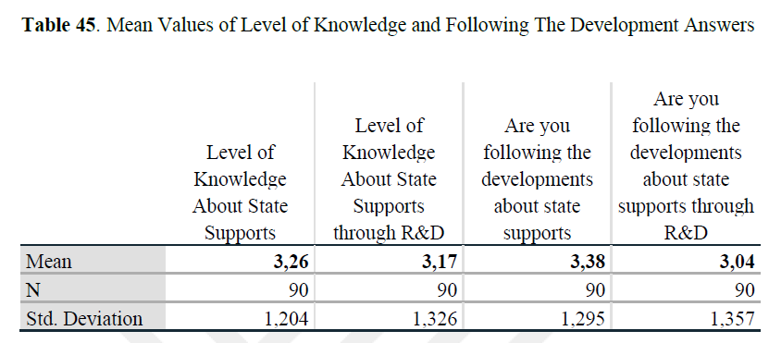
Mean Values of Level of Knowledge and Following the Development Answers

Slide 16
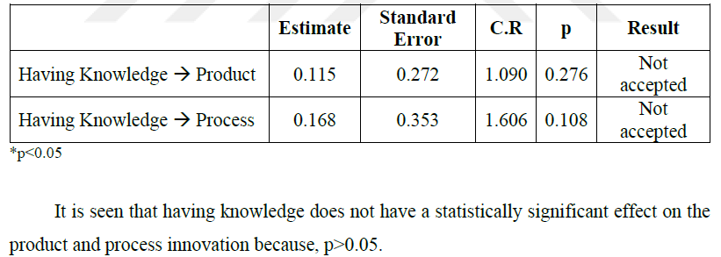
Hypothesis testing

Slide 17
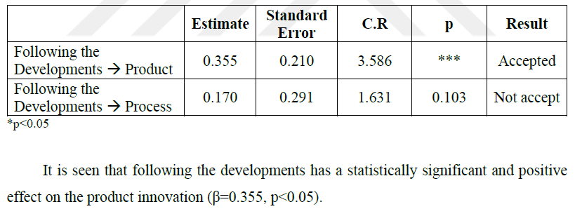
Hypothesis testing

Slide 18
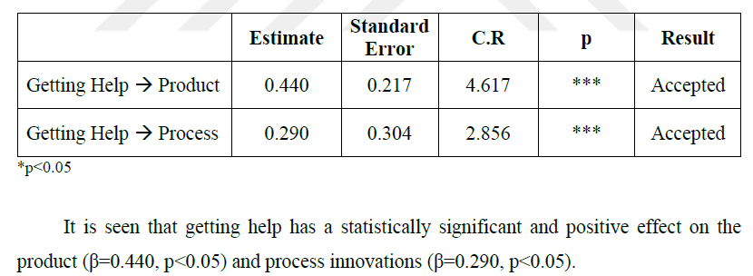
Hypothesis testing

Slide 19
Hypothesis testing
HYPOTHESIS | ACCEPTED / REJECTED
H1a: There is a positive and meaningful relationship between the company’s having knowledge status and product innovation. | Rejected
H1b: There is a positive and meaningful relationship between the company’s having knowledge status and process innovation. | Rejected
H2a: There is a positive and meaningful relationship between the company’s following the development status and product innovation. | Accepted
H2b: There is a positive and meaningful relationship between the company’s following the development status and process innovation. | Rejected
H3a: There is a positive and meaningful relationship between the company’s getting help status and product innovation. | Accepted
H3b There is a positive and meaningful relationship between the company’s getting help status and process innovation. | Accepted
H4a There is a positive and meaningful relationship between the company’s specialist employment status and product innovation. | Rejected
H4b There is a positive and meaningful relationship between the company’s specialist employment status and process innovation. | Rejected
H5a There is a positive and meaningful relationship between the company’s R&D capacity and product innovation. | Rejected
H5b There is a positive and meaningful relationship between the company’s R&D capacity and product innovation. | Rejected
H6 If the R&D capacity of a company increases, the relationship between the following developments and innovation becomes stronger. | Rejected
H7 If the R&D capacity of a company increases, the relationship between having knowledge and innovation becomes stronger. | Rejected
H8 If the R&D capacity of a company increases, the relationship between getting help and innovation becomes stronger. | Rejected
H9 If the R&D capacity of a company increases, the relationship between the specialist employment and innovation becomes stronger. | Accepted

Slide 20


Mohammed A. Al Jarousha

