Slide 1


Prepared by Dr. Wesam Ahmed
IT393‎
Business Intelligence
Lecture 10

Slide 2



Prescriptive Analytics and Big Data Concepts and Tools
Lecture 10
IT393‎
Business Intelligence
Prepared by
Dr. Wesam Ahmed

Slide 3

01
Learning Objectives:
1.1 Understand the applications of prescriptive analytics techniques
1.2 Understand the basic concepts of analytical decision modeling
1.3 Learn what Big Data is and how it is changing the world of analytics
1.4 Understand the motivation for Big Data analytics
1.5 The wide range of enabling technologies for Big Data analytics
1.6 Case study about data mining

Slide 4
02
Prescriptive analytics
FIGURE 2.2 A Simple Taxonomy of Data.
Prescriptive analytics is the process of using data to determine an optimal course of action. By considering all relevant factors, this type of analysis yields recommendations for next steps. Because of this, prescriptive analytics is a valuable tool for data-driven decision-making.
Most organizations face the problem of making decisions where one has to select from multiple options. Each option has a cost and capability associated with it. The goal of such models is to select the combination of options that meet all the requirements and yet optimizes the costs. Prescriptive analytics particularly apply to the problem of such decisions. And tools such as built-in or Premium Solver for Excel make it easy to apply such techniques.

Slide 5
03
Prescriptive analytics
FIGURE 2.2 A Simple Taxonomy of Data.
Prescriptive Analytics Model Examples: Modeling is a key element for prescriptive analytics. In the examples, one has to employ a mathematical model to be able to recommend a decision for any realistic problem. For example, deciding which customers (among potentially millions) will receive what offer so as to maximize the overall response value but staying within a budget is not something you can do manually. Building a probability-based response maximization model with the budget as a constraint would give us the information we are seeking. Depending on the problem we are addressing, there are many classes of models, and there are often many specialized techniques for solving each one.

Slide 6
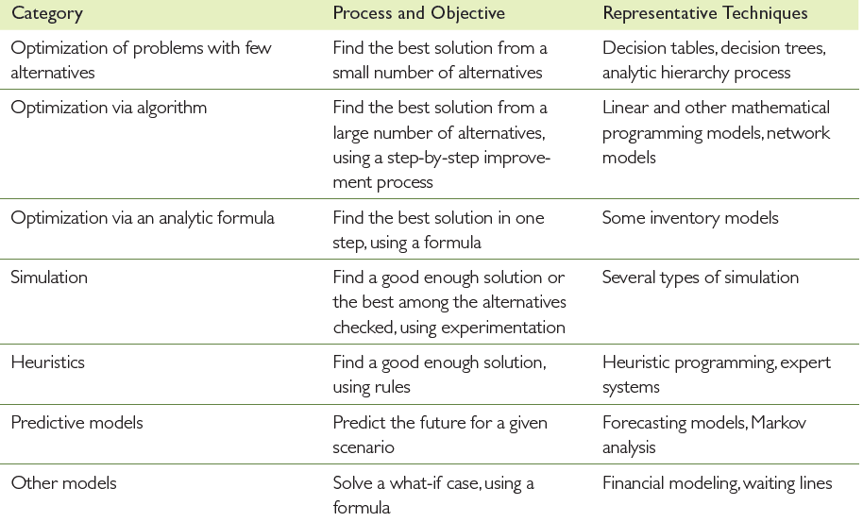
04
Prescriptive analytics
FIGURE 2.2 A Simple Taxonomy of Data.
TABLE 10.1: Categories of Models

Slide 7
05
Prescriptive analytics
How Prescriptive Analytics Works :
Prescriptive analytics tries to answer the question “How do we get to this point?” It relies on artificial intelligence (AI) techniques, such as machine learning (the ability of a computer program without additional human input), to understand and advance from the data it acquires, adapting all the while.
Machine learning makes it possible to process a tremendous amount of data available today. As new or additional data becomes available, computer programs adjust automatically to make use of it, in a process that is much faster and more comprehensive than human capabilities could manage.
Prescriptive analytics works with another type of data analytics: predictive analytics, which involves the use of statistics and modeling to determine future performance, based on current and historical data.
FIGURE 2.2 A Simple Taxonomy of Data.

Slide 8
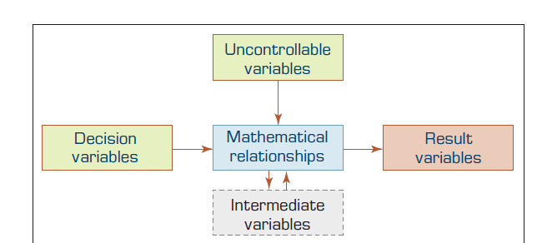
06
Prescriptive analytics
FIGURE 2.2 A Simple Taxonomy of Data.
Structure of Mathematical Models for Decision Support:
Figure 10.1 The General Structure of a Quantitative Model.

Slide 9
07
Prescriptive analytics
FIGURE 5.11 A Simple Taxonomy of Web Mining
A quantitative decision support model typically has four basic components that are connected through mathematical relationships:
Result (Outcome) Variables
Decision Variables
Uncontrollable Variables (Parameters)
Intermediate Result Variables
The model’s purpose is to determine how decisions and external factors influence outcomes.

Slide 10
08
Prescriptive analytics
FIGURE 5.11 A Simple Taxonomy of Web Mining
Result (Outcome) Variables (Outputs / Dependent Variables)
  Show how well the system meets its goals (effectiveness).
  Dependent on decision variables and uncontrollable variables.
  Example: Total profit, customer satisfaction, production output.
Decision Variables (Controllable Inputs)
  Chosen by the decision maker; represent possible courses of action.
  Example: Investment amount, scheduling choices, pricing.

Slide 11
09
Prescriptive analytics
FIGURE 5.11 A Simple Taxonomy of Web Mining
Uncontrollable Variables (Parameters) (External Constraints)
  Factors outside the decision maker’s control that affect results.
  May be fixed (parameters) or variable.
  Example: Interest rates, tax regulations, building codes.
Intermediate Result Variables (Linking Variables)
  Represent intermediate outcomes that influence final results.
  Example: Employee salaries → affect satisfaction → affect productivity.

Slide 12
10
Prescriptive analytics
FIGURE 2.2 A Simple Taxonomy of Data.
The Structure of Mathematical Models : The components of a quantitative model are linked by mathematical (algebraic) expressions—equations or inequalities. A very simple financial model is
P = R - C
where P = profit, R = revenue, and C = cost. This equation describes the relationship among the variables. Another well-known financial model is the simple present-value cash flow model, where P = present value, F = a future single payment in dollars, i = interest rate (percentage), and n = number of years. With this model, it is possible to determine the present value of a payment of $100,000 to be made 5 years from today, at a 10% (0.1) interest rate, as follows:
P = 100,000/ (1 + 0.1)5 = 62,092

Slide 13
11
Prescriptive analytics
FIGURE 2.2 A Simple Taxonomy of Data.
Examples of Prescriptive Analytics
Numerous data-intensive businesses and government agencies can benefit from using prescriptive analytics. This includes companies in the financial services and healthcare sectors, where the cost of human error is high. For instance, prescriptive analytics could be used to:
Predict whether an article on a particular topic will be popular with readers based on data about searches and social shares for related topics
Adjust a worker training program in real time based on how the worker is responding to each lesson.

Slide 14
12
Prescriptive analytics
FIGURE 2.2 A Simple Taxonomy of Data.
Banking: Fraud Detection : The use of prescriptive analytics is the detection and flagging of bank fraud. With the sheer volume of data stored in a bank’s system, it would be nearly impossible for a person to manually detect any suspicious activity in a single account. An algorithm—trained using customers’ historical transaction data—analyzes and scans new transactional data for anomalies. For instance, perhaps you typically spend $3,000 per month, but this month, there’s a $30,000 charge on your credit card.
The algorithm analyzes patterns in your transactional data, alerts the bank, and provides a recommended course of action. In this example, the course of action may be to cancel the credit card, as it could have been stolen.

Slide 15
13
Prescriptive analytics
FIGURE 2.2 A Simple Taxonomy of Data.
Product Management: Development and Improvement : Prescriptive analytics can also inform product development and improvements. Product managers can gather user data by surveying customers, running tests with a product’s beta versions, conducting market research with people who aren’t current product users, and collecting behavioral data as current users interact. All this data can be analyzed—either manually or algorithmically—to identify trends, discover the reasons for those trends, and predict whether the trends are predicted to recur.
Prescriptive analytics can help determine which features to include or leave out of a product and what needs to change to ensure an optimal user experience.

Slide 16
14
Prescriptive analytics
FIGURE 2.2 A Simple Taxonomy of Data.
Leveraging Prescriptive Analytics at Your Organization: If your organization is new to prescriptive analytics, there’s no better time to see how it impacts your decision-making processes. Start small with one question you need answered or one process you’d like to optimize. Gather data surrounding that question or process and move through each type of analytics to paint the full picture. Descriptive: What trends does the data show?
Diagnostic: What factors contribute to those trends? Why are those trends occurring?
Prescriptive: If applicable, determine whether a trend is one you can expect to continue or recur.
Prescriptive: Finally, dive into prescriptive analytics. If you have a proprietary algorithm or third-party analytics tool, run it using your company’s data. Alternatively, conduct manual analysis of possible next steps based on what you’ve discovered about your question or process. How will each option impact the situation’s outcome and, thus, your goal?

Slide 17
15
Big data
FIGURE 2.2 A Simple Taxonomy of Data.
Big Data, which means many things to many people, is not a new technological fad. It has become a business priority that has the potential to profoundly change the competitive landscape in today’s globally integrated economy. In addition to providing innovative solutions to enduring business challenges, Big Data and analytics instigate new ways to transform processes, organizations, entire industries, and even society altogether.
Using data to understand customers/clients and business operations to sustain growth and profitability is an increasingly challenging task for today’s enterprises. As more and more data becomes available in various forms and fashions, timely processing of the data with traditional means becomes impractical. Nowadays, this phenomenon called Big Data, which is receiving substantial press coverage and drawing increasing interest from both business users and IT professionals. The result is that Big Data is becoming an overhyped and overused marketing buzzword.

Slide 18
16
Big data
FIGURE 2.2 A Simple Taxonomy of Data.
the term Big Data has been used to describe the massive volumes of data analyzed by huge organizations like Google or research science projects at NASA. But for most businesses, it’s a relative term: “Big” depends on an organization’s size. Big Data exceeds the reach of commonly used hardware environments and/or capabilities of software tools to capture, manage, and process it within a tolerable time span for its user population.
Big Data has become a popular term to describe the exponential growth, availability, and use of information, both structured and unstructured. Because of the technology challenges in managing the large volume of data coming from multiple sources, sometimes at a rapid speed, additional new technologies have been developed to overcome the technology challenges. Use of the term Big Data is usually associated with such technologies. Because a prime use of storing such data is generating insights through analytics, sometimes the term Big Data is expanded as Big Data analytics.

Slide 19
17
Big data
FIGURE 2.2 A Simple Taxonomy of Data.
Big Data may come from Web logs, radio-frequency identification (RFID), global positioning systems (GPS), sensor networks, social networks, Internet-based text documents, Internet search indexes, detail call records, astronomy, atmospheric science, biology, genomics, nuclear physics, biochemical experiments, medical records, scientific research, military surveillance, photography archives, video archives, and large-scale e-commerce practices. Big Data is typically defined by five “V”s:.
Velocity is the speed at which the data is created and how fast it moves.
Volume is the amount of data qualifying as big data.
Value is the value the data provides.
Variety is the diversity that exists in the types of data.
Veracity is the data's quality and accuracy.

Slide 20
18
Big data
FIGURE 2.2 A Simple Taxonomy of Data.
Velocity: refers to how quickly data is generated and how fast it moves. This is an important aspect for organizations that need their data to flow quickly, so it's available at the right times to make the best business decisions possible. An organization that uses big data will have a large and continuous flow of data that's being created and sent to its end destination. Data could flow from sources such as machines, networks, smartphones or social media. Velocity applies to the speed at which this information arrives.
For example, in healthcare, many medical devices today are designed to monitor patients and collect data. From in-hospital medical equipment to wearable devices, collected data needs to be sent to its destination and analyzed quickly.

Slide 21
19
Big data
FIGURE 2.2 A Simple Taxonomy of Data.
Volume refers to the amount of data that exists. Volume is like the base of big data, as it's the initial size and amount of data that's collected. If the volume of data is large enough, it can be considered big data. However, what's considered to be big data is relative and will change depending on the available computing power that's on the market.
For example, a company that operates hundreds of stores across several states generates millions of transactions per day. This qualifies as big data, and the average number of total transactions per day across stores represents its volume.

Slide 22
20
Big data
FIGURE 2.2 A Simple Taxonomy of Data.
Value refers to the benefits that big data can provide, and it relates directly to what organizations can do with that collected data. Being able to pull value from big data is a requirement, as the value of big data increases significantly depending on the insights that can be gained from it.
Organizations can use big data tools to gather and analyze the data, but how they derive value from that data should be unique to them. Tools like Apache Hadoop can help organizations store, clean and rapidly process this massive amount of data.
A great example of big data value can be found in the gathering of individual customer data. When a company can profile its customers, it can personalize their experience in marketing and sales, improving the efficiency of contacts and garnering greater customer satisfaction.

Slide 23
21
Big data
FIGURE 2.2 A Simple Taxonomy of Data.
Variety refers to the diversity of data types. An organization might obtain data from several data sources, which might vary in value. Data can come from sources in and outside an enterprise as well. The challenge in variety concerns the standardization and distribution of all data being collected. Collected data can be unstructured, semi-structured or structured.
Raw data also qualifies as a data type. While raw data can fall into other categories -- structured, semi-structured or unstructured -- it's considered raw if it has received no processing at all. Most often, raw applies to data imported from other organizations or submitted or entered by users. Social media data often falls into this category.
A more specific example could be found in a company that gathers a variety of data about its customers. This can include structured data culled from transactions or unstructured social media posts and call center text. Much of this might arrive in the form of raw data, requiring cleaning before processing.

Slide 24
22
Big data
FIGURE 2.2 A Simple Taxonomy of Data.
Veracity refers to the quality, accuracy, integrity and credibility of data. Gathered data could have missing pieces, might be inaccurate or might not be able to provide real, valuable insight. Veracity, overall, refers to the level of trust there is in the collected data. Data can sometimes become messy and difficult to use. A large amount of data can cause more confusion than insights if it's incomplete. For example, in the medical field, if data about what drugs a patient is taking is incomplete, the patient's life could be endangered. Both value and veracity help define the quality and insights gathered from data.
Variability refers to inconsistencies in either the usage or the flow of big data. Minimizing variability in big data requires carefully constructing data flows as data moves through the organization's systems, from the transactional to the analytical and everything in between. The biggest benefit is big data veracity, as consistency in data usage yields more stable reporting and analytics and therefore higher confidence.

Slide 25
23
Big data
FIGURE 2.2 A Simple Taxonomy of Data.
Business Problems Addressed by Big Data Analytics
The top business problems addressed by Big Data overall are process efficiency and cost reduction, as well as enhancing customer experience, but different priorities emerge when it is looked at by industry. Process efficiency and cost reduction are perhaps among the top-ranked problems that can be addressed with Big Data analytics for the manufacturing, government, energy and utilities, communications and media, transport, and healthcare sectors. Enhanced customer experience may be at the top of the list of problems addressed by insurance companies and retailers. Here is a partial list of problems that can be addressed using Big Data analytics:

Slide 26
24
Big data
FIGURE 2.2 A Simple Taxonomy of Data.
List of Problems Big Data Can Address:
Process efficiency and cost reduction
  Streamlining operations, reducing waste, cutting costs.
Brand management
  Monitoring brand reputation through social media and customer sentiment.
Revenue maximization, cross-selling, and up-selling
  Using data to find ways to increase sales to existing customers.
Enhanced customer experience
  Personalizing services, improving product recommendations.

Slide 27
25
Big data
FIGURE 2.2 A Simple Taxonomy of Data.
Identifying new products and market opportunities
  Detecting gaps in the market before competitors do.
Risk management
  Predicting and mitigating risks (fraud detection, investment risks, etc.).
Regulatory compliance
  Using data to ensure laws and rules are followed.
Enhanced security capabilities
  Detecting cyberattacks or security breaches in real time.
Churn identification & customer recruiting :Spotting customers likely to leave, and attracting new ones.
Improved customer service : Predicting issues and responding quickly.

Slide 28
26
Big data
FIGURE 2.2 A Simple Taxonomy of Data.
Big Data Technologies:
There are a number of technologies for processing and analyzing Big Data, but most have some common characteristics . Namely, they take advantage of commodity hardware to enable scale-out and parallel-processing techniques; employ nonrelational data storage capabilities to process unstructured and semistructured data; and apply advanced analytics and data visualization technology to Big Data to convey insights to end users. The three Big Data technologies that stand out that most believe will transform the business analytics and data management markets are MapReduce, and Hadoop.
MapReduce is a technique popularized by Google that distributes the processing of very large multistructured data files across a large cluster of machines. High performance is achieved by breaking the processing into small units of work that can be run in parallel across the hundreds, potentially thousands, of nodes in the cluster.
,

Slide 29
27
Big data
FIGURE 2.2 A Simple Taxonomy of Data.
MapReduce is a programming model and an associated implementation for processing and generating large data sets. Programs written in this functional style are automatically parallelized and executed on a large cluster of commodity machines. This allows programmers without any experience with parallel and distributed systems to easily utilize the resources of a large distributed system.
Hadoop is an open source framework for processing, storing, and analyzing massive amounts of distributed, unstructured data. Originally created by Doug Cutting at Yahoo!, Hadoop was inspired by MapReduce, a user-defined function developed by Google in the early 2000s for indexing the Web. It was designed to handle petabytes and exabytes of data distributed over multiple nodes in parallel. Hadoop breaks up Big Data into multiple parts so each part can be processed and analyzed at the same time.

Slide 30
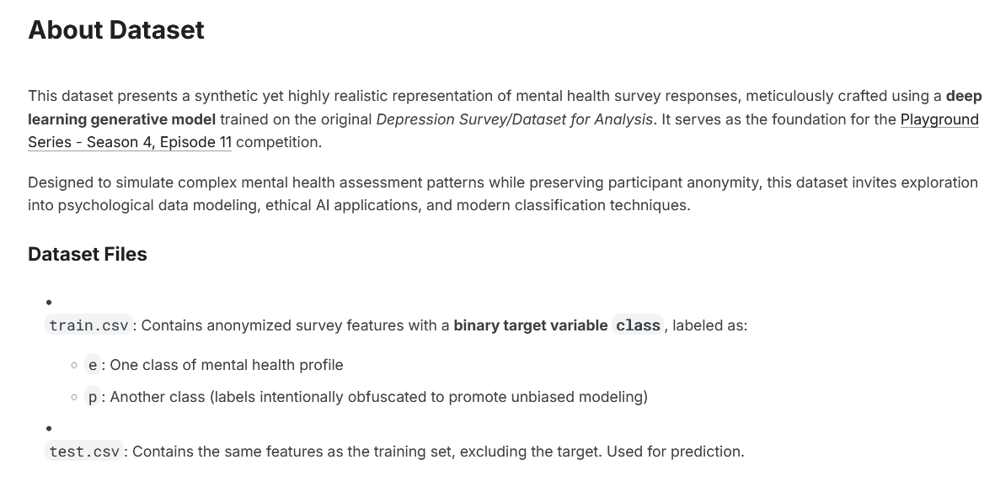
28
Case study of data mining
FIGURE 2.2 A Simple Taxonomy of Data.
https://www.kaggle.com/datasets/adilshamim8/exploring-mental-health-data/data

Slide 31
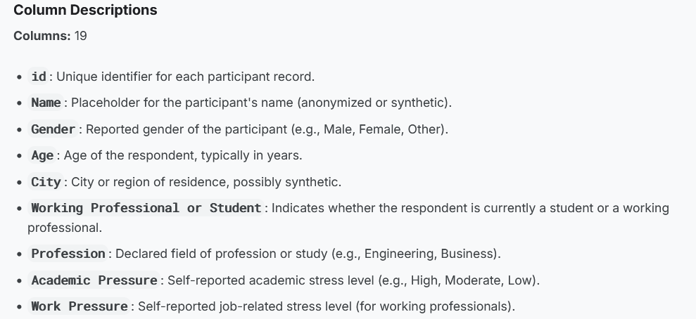
29
Case study of data mining
FIGURE 2.2 A Simple Taxonomy of Data.

Slide 32
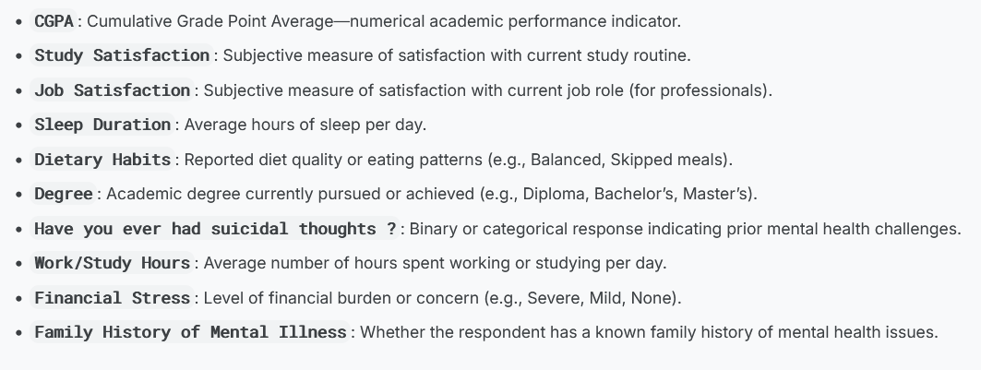
30
Case study of data mining
FIGURE 2.2 A Simple Taxonomy of Data.

Slide 33
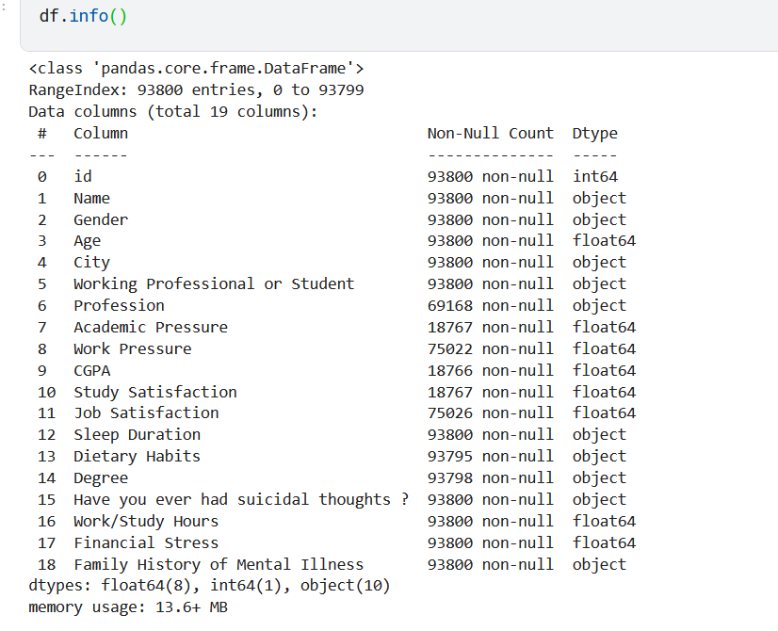
31
Case study of data mining
FIGURE 2.2 A Simple Taxonomy of Data.

Slide 34
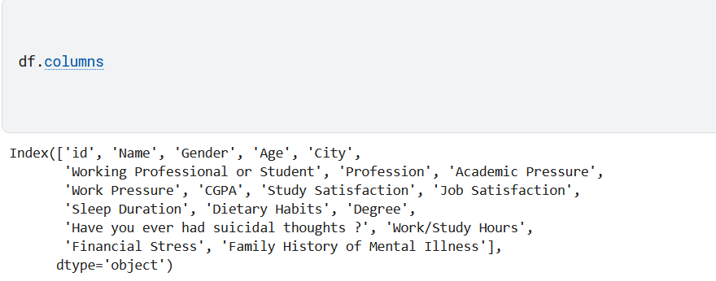
32
Case study of data mining
FIGURE 2.2 A Simple Taxonomy of Data.

Slide 35

32
Case study of data mining
FIGURE 2.2 A Simple Taxonomy of Data.

Slide 36
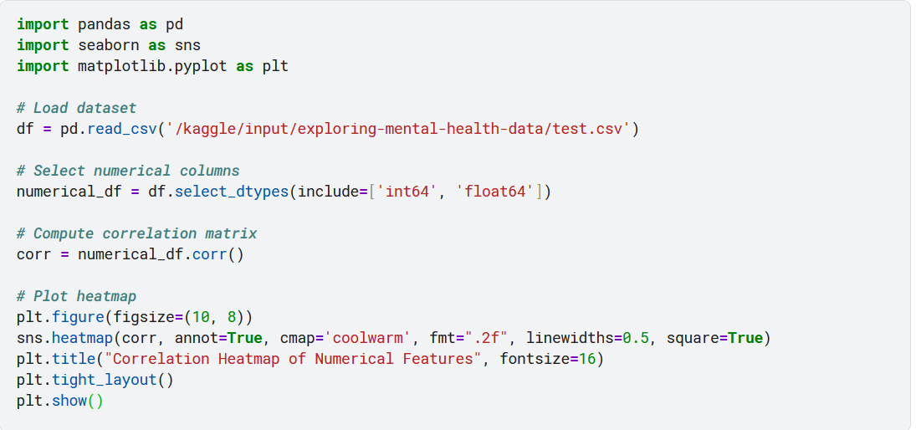
33
Case study of data mining
FIGURE 2.2 A Simple Taxonomy of Data.

Slide 37
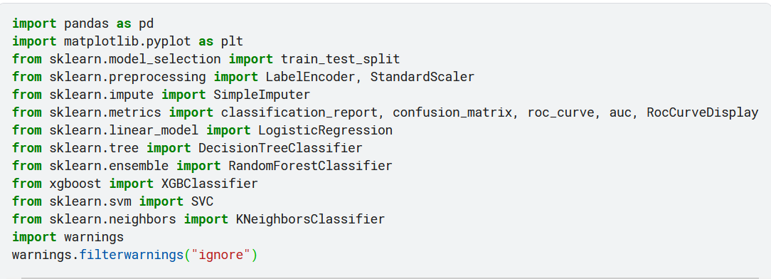
34
Case study of data mining
FIGURE 2.2 A Simple Taxonomy of Data.

Slide 38
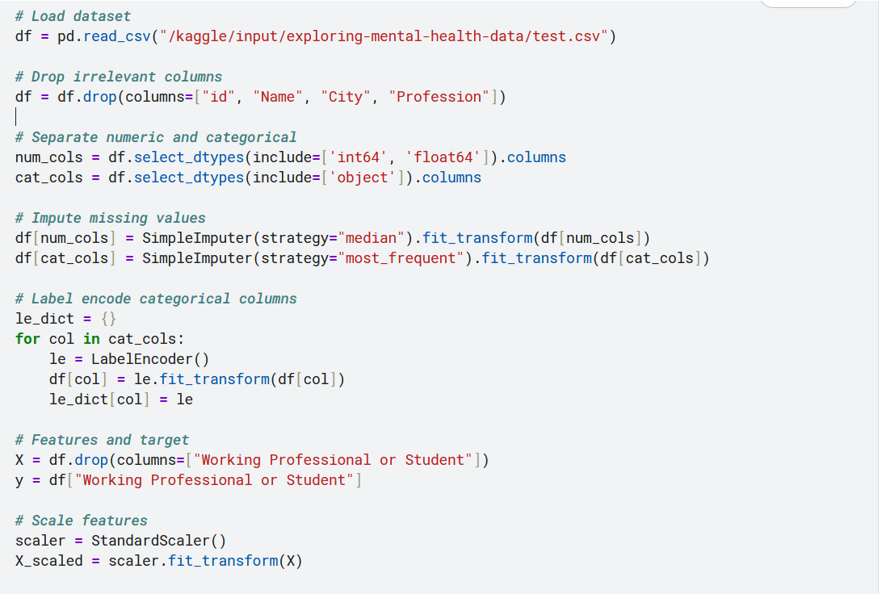
35
Case study of data mining
FIGURE 2.2 A Simple Taxonomy of Data.

Slide 39
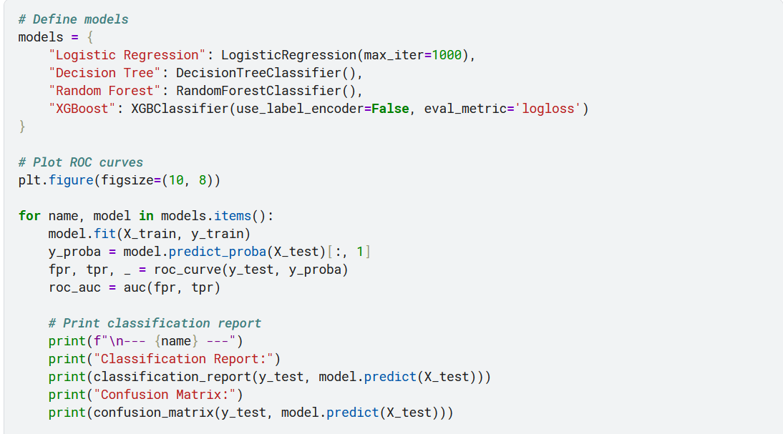
36
Case study of data mining
FIGURE 2.2 A Simple Taxonomy of Data.

Slide 40
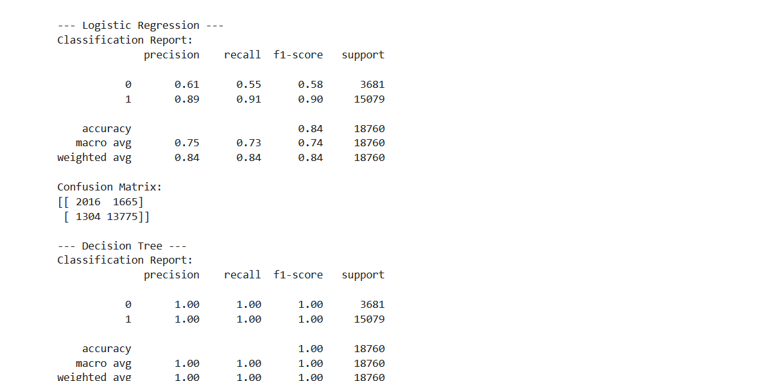
37
Case study of data mining
FIGURE 2.2 A Simple Taxonomy of Data.

Slide 41
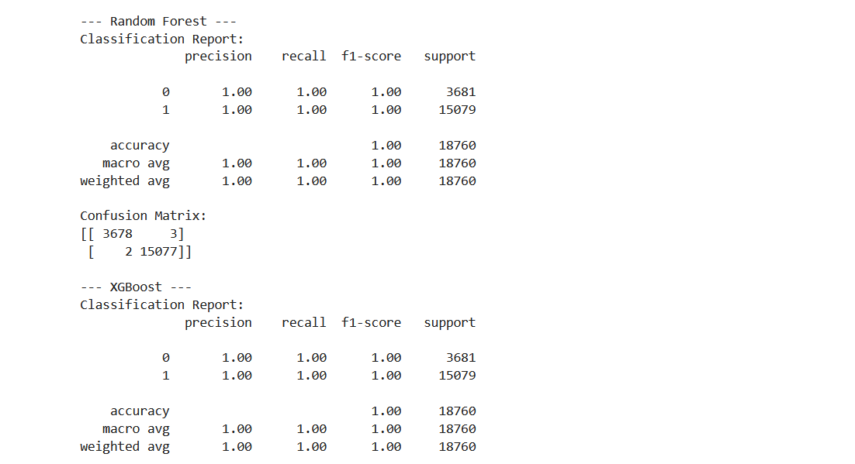
38
Case study of data mining
FIGURE 2.2 A Simple Taxonomy of Data.

Slide 42
39
Summary
Prescriptive analytics.
Big data.
Case study of data mining

Slide 43


Thank You

