Slide 1




Project Leadership
Lecture 6
PMG 511
Ch6 - Team Structure and Development
Prepared by
Dr Hakem Sharari
www.midocean.ae

Slide 2
Chapter
Learning Outcomes
06
Why teamwork?
Leadership and team building.
What Makes a Team Successful?
Team Structure.
Common Team Roles.
Team Development.
Needs and the Team.
Summary and Conclusion.
Self-assessment.
www.midocean.ae

Slide 3
Chapter
Why Teamwork?
06
www.midocean.ae

Slide 4

Chapter
Why Teamwork?
06
www.midocean.ae

Slide 5
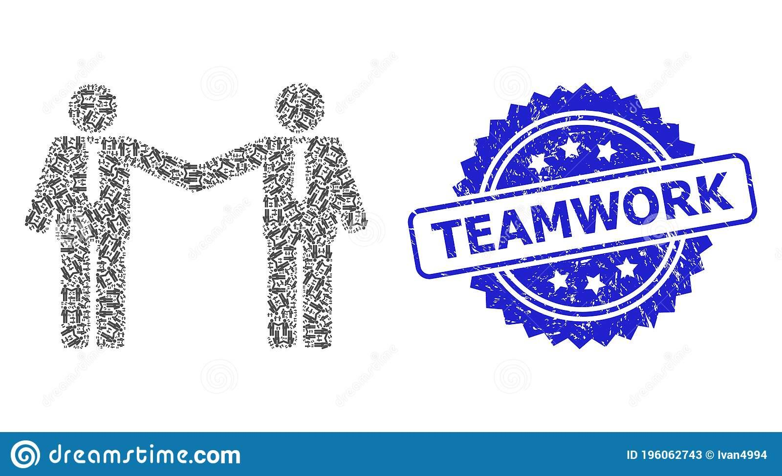
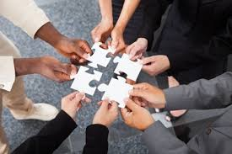

Chapter
Why Teamwork?
06
Teamwork is like photomosaic
www.midocean.ae

Slide 6

Chapter
06
www.midocean.ae

Slide 7

Chapter
06
www.midocean.ae

Slide 8
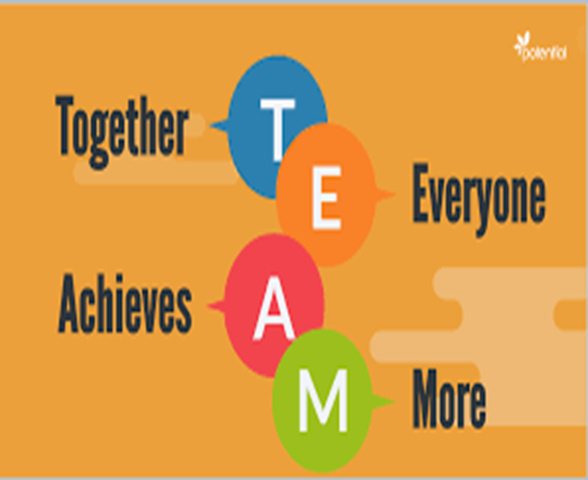
Chapter
What is a Team?
06
A team is an organized group of people who work together to achieve a common goal, they are committed to work together to complete a well defined work.
www.midocean.ae

Slide 9
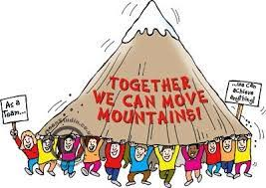
Chapter
Types of Teams
06
Formal - structured to perform specific tasks.
Informal - emerge naturally in response to organizational or member interests.
www.midocean.ae

Slide 10
Chapter
What is Teamwork?
06
The Process of Working Collaboratively With A Group Of People In Order To Achieve A Goal.
Teamwork represents a set of values :
Encourages behaviors such as listening & responding to view points of others, giving benefit of doubt to others.
Providing support to those who need it.
Recognizing the interests & achievements of others.
Also promote performance as individuals and the performance of the entire organization.
www.midocean.ae

Slide 11
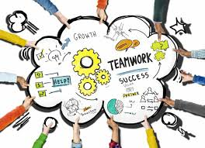
Chapter
Why To Build a Successful Team?
06
The ability to build teams is a valuable leadership quality.
^{Problem solving.}
^{Data gathering.}
^{Diagnosis.}
^{Decision-making.}
^{Planning.}
To set team goals and priorities.
To analyze or allocate the work performed.
^{Combined strengths.}
^{Evaluation.}
www.midocean.ae

Slide 12
Chapter
Leadership and Team Building
06
www.midocean.ae

Slide 13
Why Leaders Need to Encourage and Prioritize Team Building?
Chapter
06
Leaders need to be working towards developing great teams, the ability to build teams is a valuable leadership quality.
When group interaction is necessary to job performance, team building can be used to foster team spirit, cooperation and commitment to group success.
www.midocean.ae

Slide 14
Chapter
Leadership and Team Building
06
Leadership focuses on “people” aspect of management and is based on the assumption that organizational effectiveness significantly depends on their motivation, effort and abilities.
The human relations movement, the important role of employee motivation and group norms is the key of organizational success.
This led to the recognition of leadership effectiveness as an important determinant of organizational effectiveness.
It is the manager in his leadership role who has to stimulate and inspire the employees to contribute willingly and cooperatively to the optimum achievement of organizational goals.
www.midocean.ae

Slide 15
Chapter
Leadership and Team Building
06
In this context, team members support one another.
They offer suggestions and give feedback to other members.
They may disagree but work to resolve differences and reach consensus. Each and every member of the team trust and support other members.
Anyone who acts as a model to others is often called a “leader”.
Leadership is an attribute of that person who is an ideal for the other members of the group.
www.midocean.ae

Slide 16
Chapter
What Makes a Team Successful?
06
www.midocean.ae

Slide 17
Chapter
What Makes a Team Successful?
06
Successful teams include one or more ‘ingredients’:
Complimentary skillsets
  Some overlap, but intentional, effective diversity of skills.
Common purpose and goals
  All team members are aware of why their project is important.
Good planning
  Plans are laid-out ahead of time, and all team members can rely on each other to follow them.
Effective leadership
  Strong leaders that match the culture of the team and project.
Appropriate motivators
  Motivators that match the culture of the team as well as the individuals on it.
‘Chemistry’
  Chemistry is hard to define, but you’ll know it when you see it.
www.midocean.ae

Slide 18
Chapter
Team Structures
06
www.midocean.ae

Slide 19
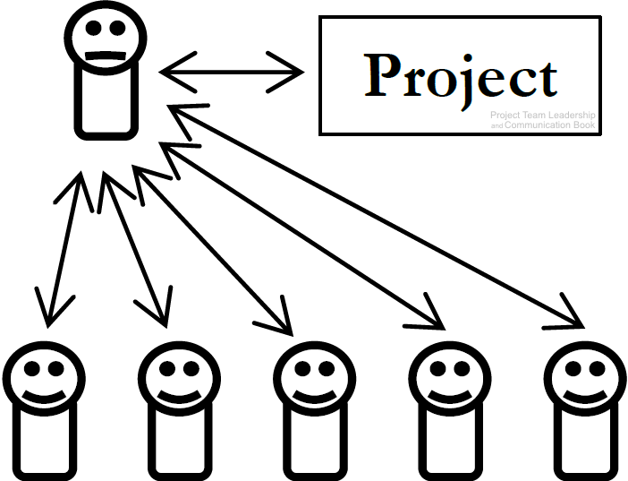
Chapter
Common Team Structures
06
Why this structure?
Inexperienced team, extremely tight deadline, or organizational/ external pressures.
1-Top-Down Teams
‘Classic’ team structure.
Team members’ attachment is to the ‘boss’, who is primarily responsible for the success of the project (and can be singularly responsible for its failure).
Not necessarily an authoritarian style of leadership.
www.midocean.ae

Slide 20
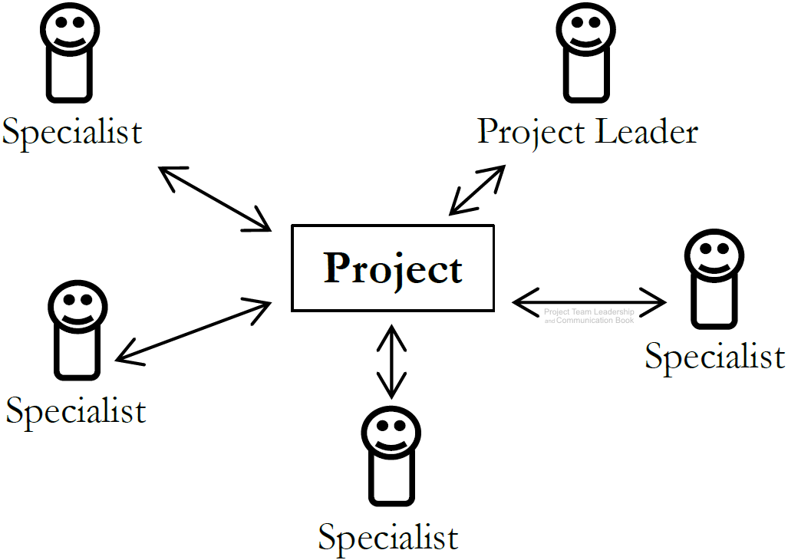
Chapter
Common Team Structures
06
2- Interdisciplinary Teams
Characterized by equal status of each team member, who are each concerned with the success of the project.
Each team member has one or more specialties/skillsets.
Decisions are often made at the group level.
Leader is an equal with organizational/communication skillsets. “equality of members”.
www.midocean.ae

Slide 21
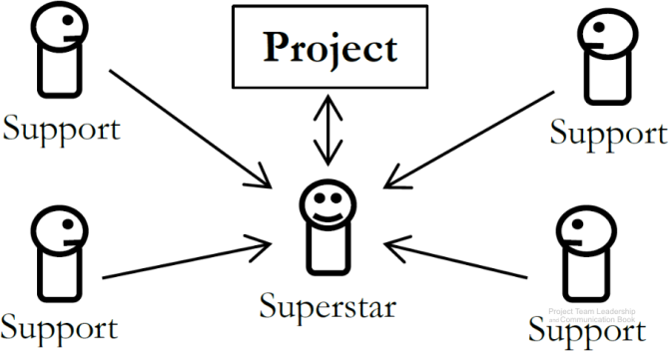
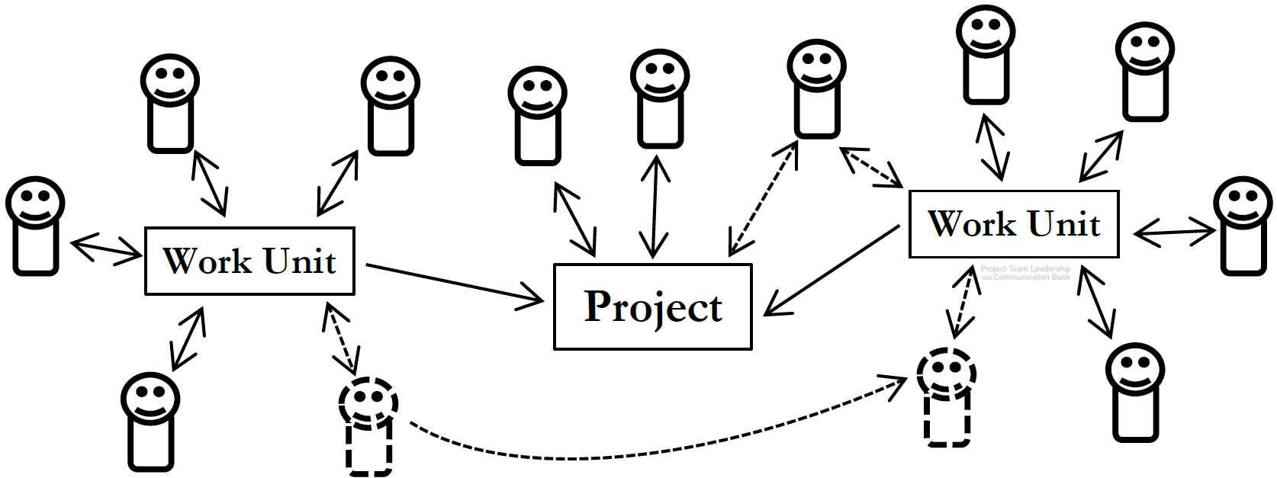
Chapter
Common Team Structures
06
3- Superstar-Support Teams
Like a surgical team: one member performs the most prominent work.
Other team members perform supportive functions.
‘Superstar’ must acknowledge importance of other team members
4- Large and Variable-Structure Teams
Teams can vary in size, structure, and stability.
Difficult to organize and track efficiently.
Moving or adding team members efficiently is also difficult.
www.midocean.ae

Slide 22
Chapter
Common Team Roles
06
www.midocean.ae

Slide 23
Chapter
Common Team Roles
06
Leader – guides the team towards the goal
  Primary competencies: leadership, prioritization, and communication
Information Manager – takes ownership of the documentation and data
  Primary competencies: elicitation, organization, and reporting
Externally-Facing – intermediary between project team and external stakeholders
  Primary competencies: perception, communication, and negotiation
Problem-Solver – finds and works through difficult problems
  Primary competencies: evaluation, research, and implementation
Specialist – a ‘subject matter expert’ “SME’s” “technical specialist” In one or more subject areas
  Primary competencies: evaluation, anticipation, and articulation
www.midocean.ae

Slide 24
Chapter
Team Development Stages
06
www.midocean.ae

Slide 25
Chapter
Team Development Stages
06
Dr. Bruce Tuckman articulates 4 stages which teams must
pass as they develop:
Forming – the team comes together, and the project gains
little benefit from the ‘team’ - productivity is similar to each
working independently
Storming – clashes and disagreements begin as the team tries to determine leadership and ‘rules’ for how they will work together. Productivity may drop
Norming – ‘storming’ is lessening and the ‘rules,’ or ‘norms’ for the group are rapidly developing. Productivity begins to increase, the group starts to identify as a team
Performing – The team reaches increasing efficiency, gaining the efficiencies of working together rather than separate. The team now focuses externally on the work at hand
www.midocean.ae

Slide 26
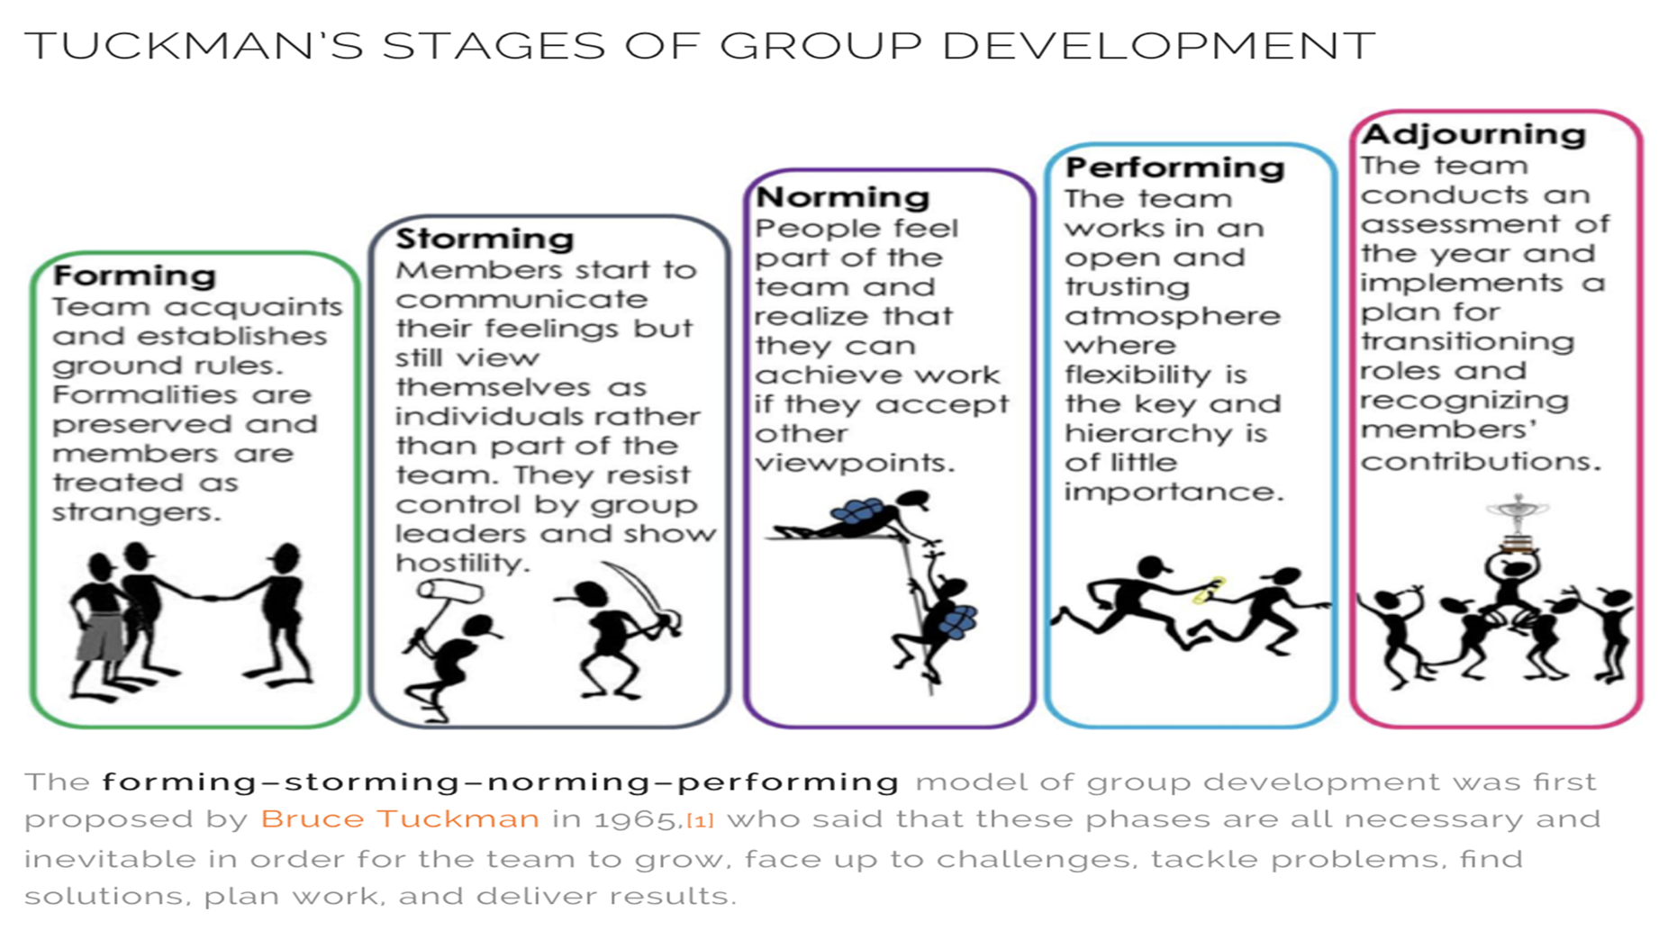
Chapter
06
www.midocean.ae

Slide 27
Chapter
Team Needs
06
www.midocean.ae

Slide 28
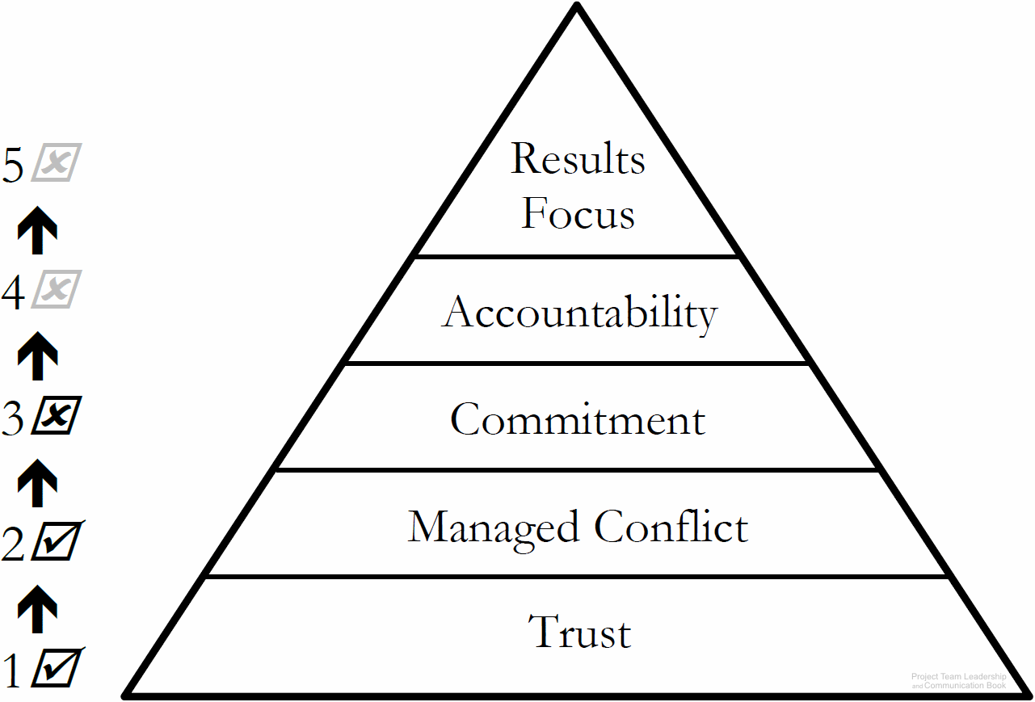
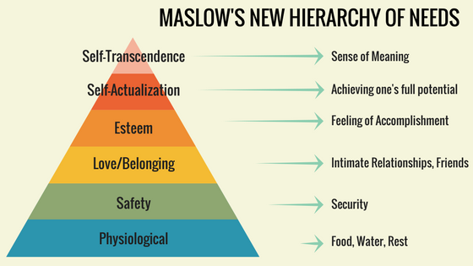
Chapter
Team Needs
06
Similar to Maslow’s hierarchy of needs, teams have basic needs
  Needs at the bottom (such as trust) must be satisfied before those higher-up can be addressed
www.midocean.ae

Slide 29

Chapter
Building Trust
06
The foundation, the most vital to operate as a team.
It takes time, requiring consistently positive interactions.
Deeper trust requires vulnerability (difficult for many).
Needs to be maintained, rebuilt after damage.
Leader must create and protect the ‘environment of trust’.
  Take the lead in expressing trust-building vulnerability.
  Seek and prevent trust-breaking actions such as bullying.
Team-based personality tests and team-building activities are designed to build trust.
www.midocean.ae

Slide 30
Chapter
06
Managing Conflict
Conflict isn’t bad – healthy debate means engaged, passionate team members and better decisions.
Appropriate conflict requires rules, or norms to be clear to all involved. Examples:
  Focus on the primary decision to be made (not secondary debates)
  Avoid rhetoric, name-calling, or non-contributing statements, which erode trust
  Agree to reach consensus, with all parties pledging to support the outcome
Trust is the foundation of healthy conflict and debate.
There are numerous conflict resolution tools and techniques.
www.midocean.ae

Slide 31

Chapter
Managing Conflict
06
  A- Confronting / Problem Solving
  B-Compromising
  C-Withdrawal / Avoidance
  D- Smoothing / Accommodating
  E- Collaborating
  F- Forcing
www.midocean.ae

Slide 32

Chapter
Achieving Commitment
06
Commitment requires clarity – to commit to something, it must be clear exactly what you’re committing to.
Each party or entity must commit to multiple others
  Leader 🡪 Team Team 🡪 Leader Individual 🡪 The Work They’re Assigned
  Leader 🡪 Project Team 🡪 Project Individual 🡪 Team
  Team 🡪 Being a Good Team
Leaders set the example, so an uncommitted leader can destroy a project / team.
Teams must have a good structure, trust each other, and manage conflict properly.
Individuals can fail to commit for multiple reasons (not motivated, personal issues, etc.)
www.midocean.ae

Slide 33
Chapter
Achieving Commitment
06
Commitment requires:
Leadership by example: the leader must show commitment to the project and team first
Trust and conflict management
Clear prioritization of multiple commitments
A healthy team and project; commitment requires fundamental issues to be solved
Good team structure
Strategies to gain commitment include:
Communicating expectations clearly
Seeking factors affecting noncommittal parties.
Assigning leadership or ownership
Recognizing achievement (a primary motivator)
Engaging the creativity of individuals (another motivator)
www.midocean.ae

Slide 34
Chapter
Embracing Accountability
06
Accountability is a readiness to accept responsibility for work or results.
Each team member is accountable to:
  The leader – the most common and natural type of accountability.
  Themselves – also known as self-discipline.
  Their fellow team members – often the strongest with the most ‘paths’ of accountability.
Accountability requires the ability to commit, as well as other’s ability to trust their word and actions.
A great tool is the ‘RASCI” accountability matrix.
www.midocean.ae

Slide 35
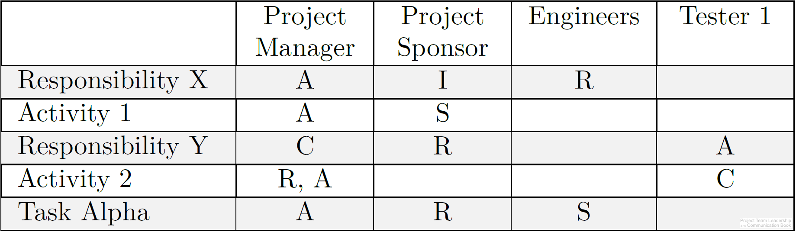
Chapter
The ‘RASCI’ Accountability Matrix
06
An accountability matrix is a tool for effectively assigning and communicating levels of accountability for project tasks of functions
Each task or function must have at least
one “A” as well as other letters:
  “R” – Responsible. The party who is to
  complete the task or action.
  “A” – Accountable. This party is ultimately
  answerable for the task or action’s completion.
  “S” – Support. Similar to “R” but a secondary resource who may be called in if needed.
  “C” – Consulted. A specialist or expert who may be called upon to provide vital input.
  “I” – Informed. This party must be informed if the task/function is completed, behind schedule. Often the party who completes dependent tasks later in the timeline.
www.midocean.ae

Slide 36
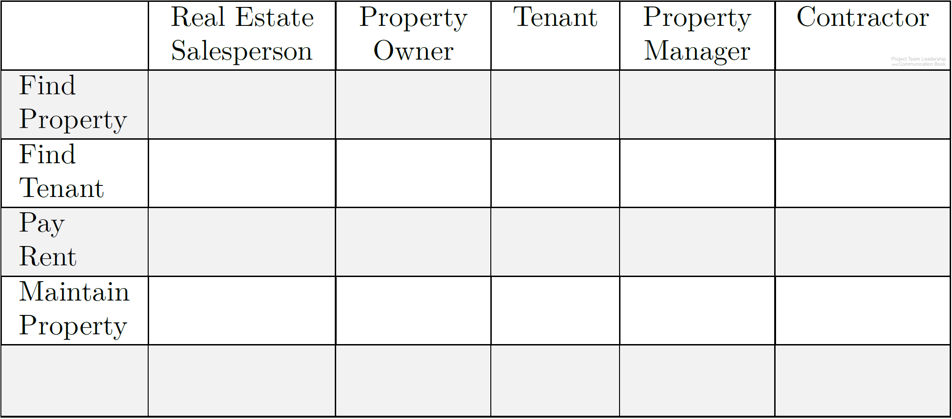
Activity – Building a ‘RASCI’ Accountability Matrix
Chapter
06
Using the grid below, add the letters “R,” “A,” “S,” “C,” or “I” to denote the typical level of accountability each person has to each task.
Add at least two new tasks and add the letters as appropriate.
www.midocean.ae

Slide 37
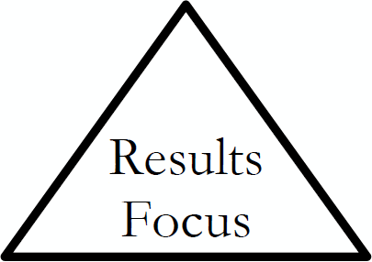
Chapter
Focusing on Results
06
A results-focused team has solved issues related to trust, conflict, and commitment – it’s ready and willing to focus on the work at hand
Leadership and the team have new focuses:
  Clarity and priority – because the team working so well, it’s important that each team member knows what they’re working towards.
  Visibility – understanding the bigger picture is more valuable for a team that is making decisions quickly and effectively
  Process – creating and documenting process can make the team even more efficient
www.midocean.ae

Slide 38
Chapter
Summary and Conclusions
06
www.midocean.ae

Slide 39
Chapter
Summary and Conclusions
06
Team success comes from many factors, such as effective leadership, good planning, and established goals
The structure and roles of a team are affected both by their work and the organization to which they belong. Additionally, structures and roles affect how teams complete their work
As teams mature, they progress through ‘forming,’ ‘storming,’ ‘norming,’ and ‘performing’ stages
Teams must meet core needs such as building trust and effectively managing conflict before they can commit, become accountable, and achieve results effectively.
Various tools and techniques are available for teams, such as various conflict management techniques (compromise, forcing, etc.) and the ‘RASCI’ accountability matrix.
www.midocean.ae

Slide 40
Chapter
Self-assessment
06
www.midocean.ae

Slide 41

Chapter
Self-assessment
06
1- Classify features of basic team structures?
2- Differentiate stages of team development by examining team actions?
3- Propose strategies for building trust and commitment in a project team environment?
www.midocean.ae

Slide 42
Self-assessment
Activity – Trust and Commitment
Chapter
06
Consider each of the following commitment relationships:
Leader ↔ Team Leader ↔ Individual
Team ↔ Individual
What could each party do to build trust with the other?
What could they do to reduce or break trust?
For a successful project, what commitments must each party make?
What factors are important in those commitments?
www.midocean.ae

Slide 43
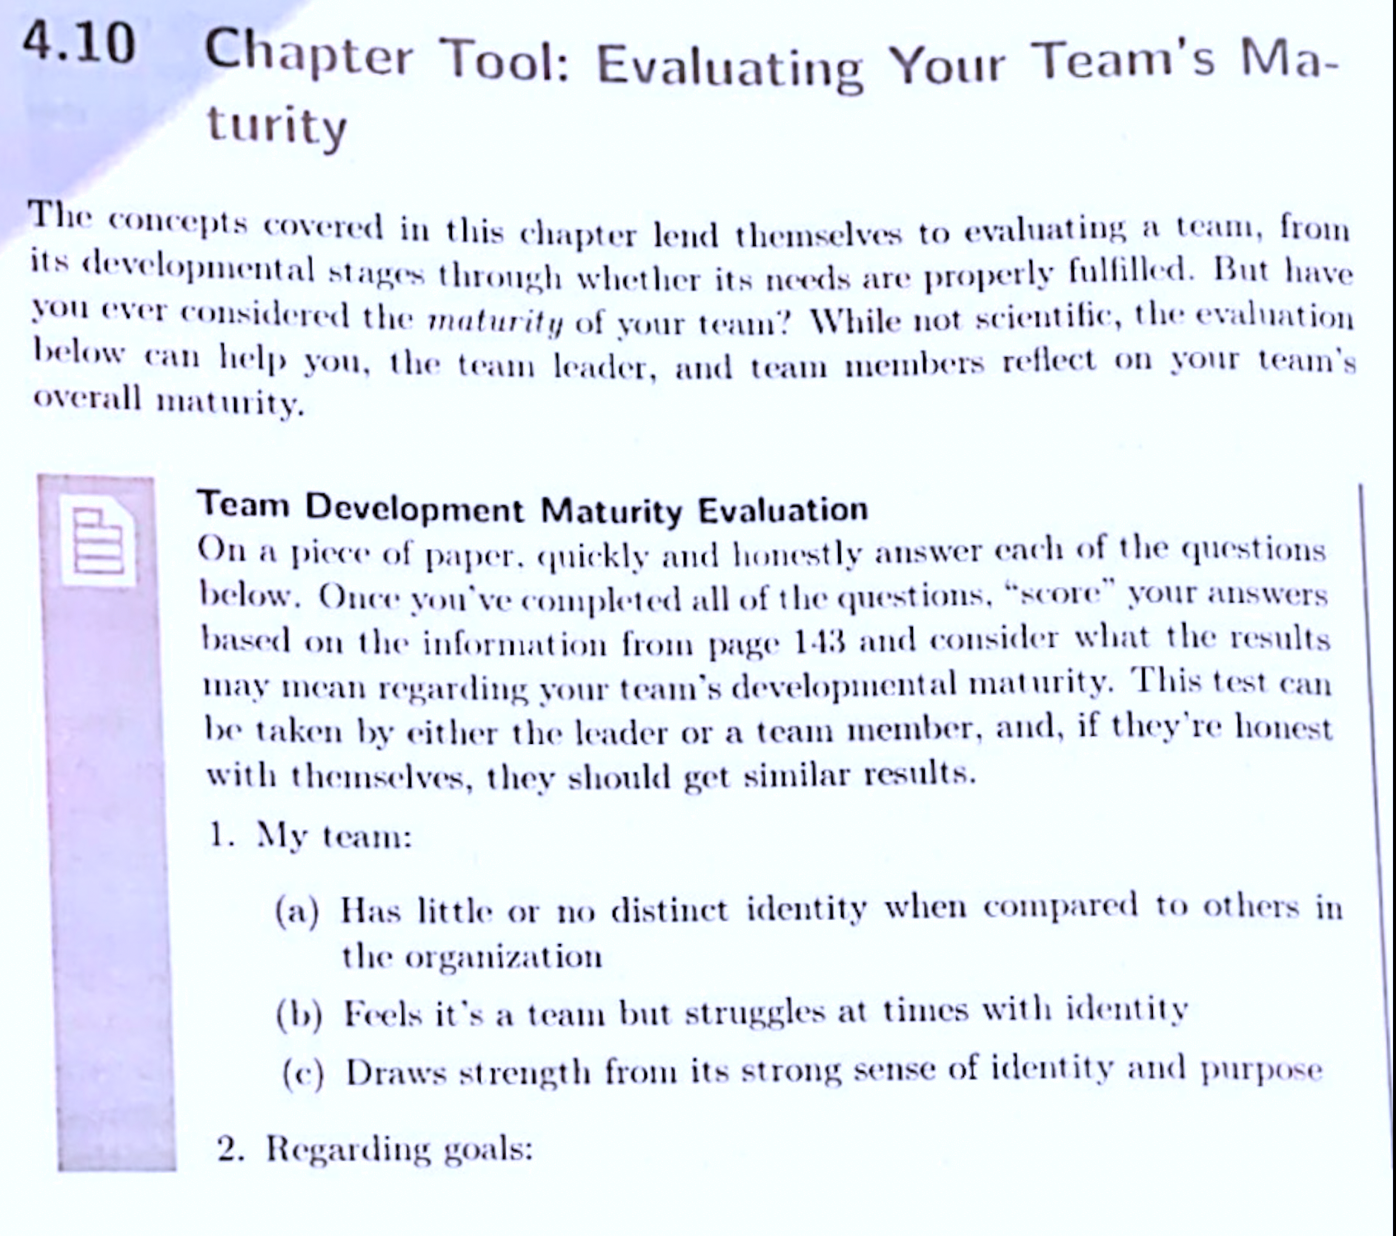
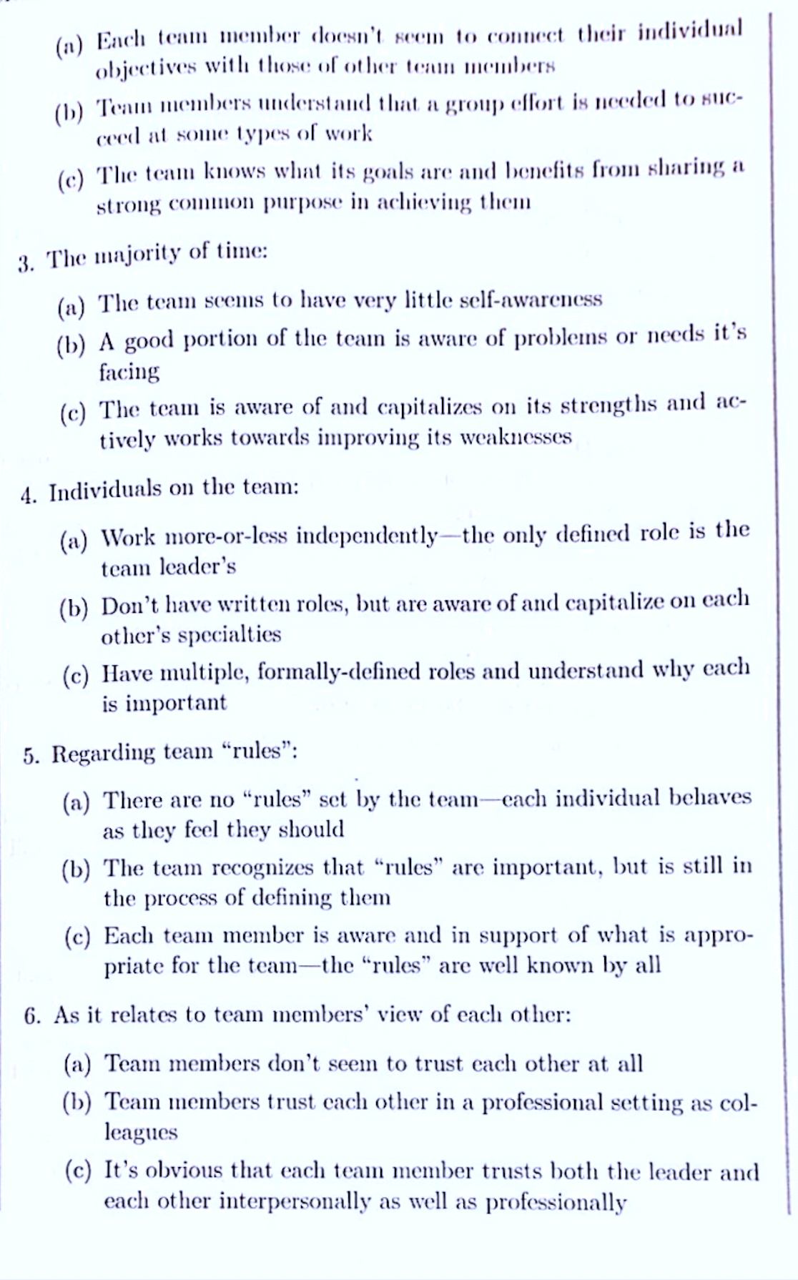
06
www.midocean.ae

Slide 44
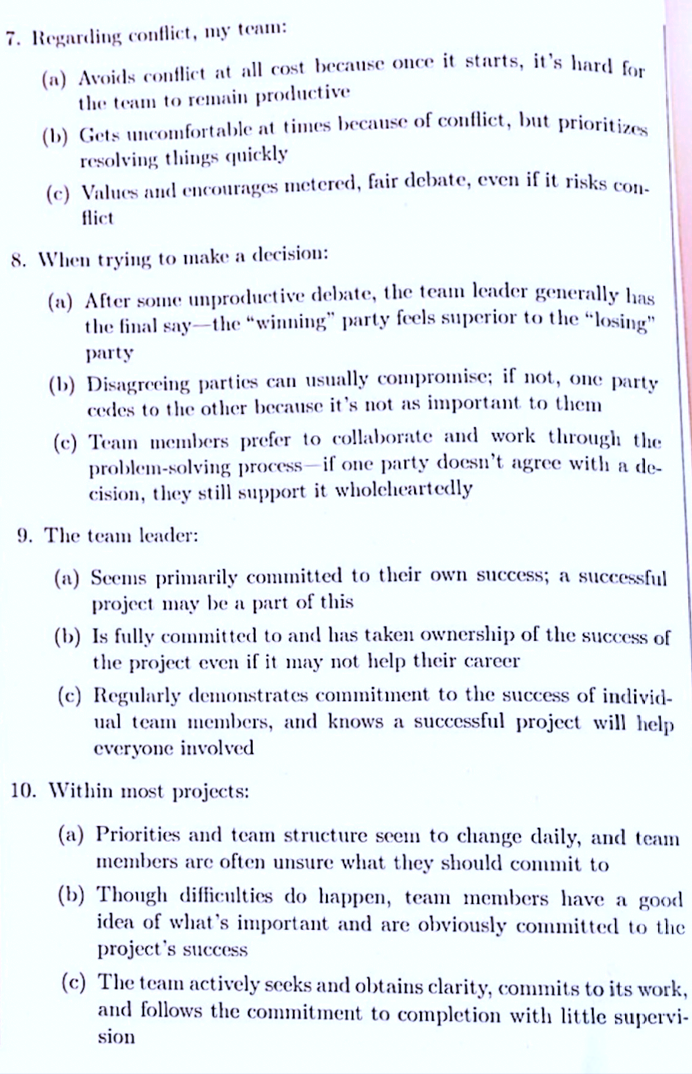
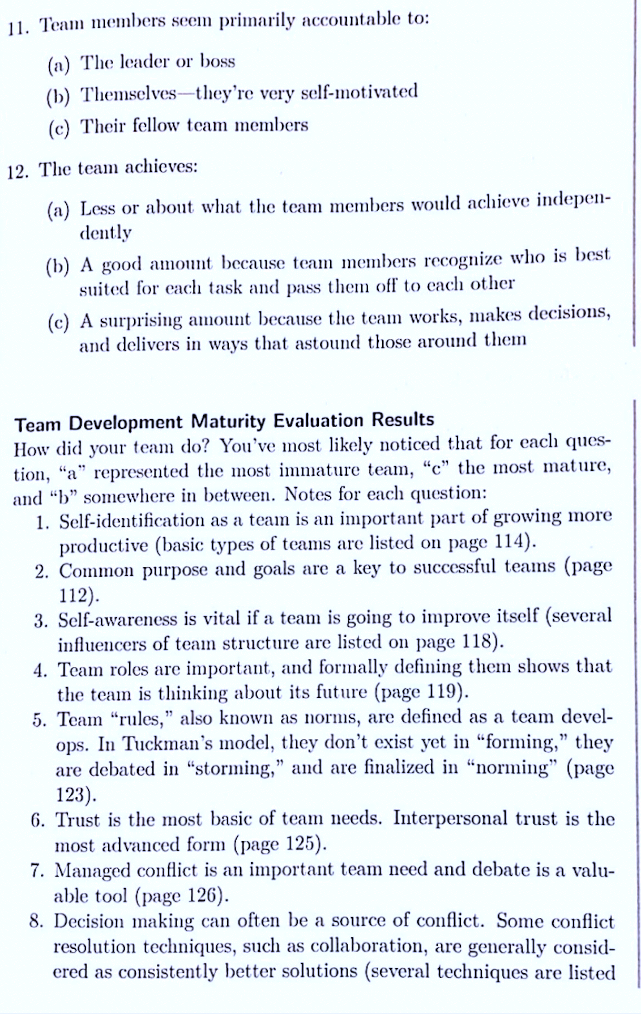
06
www.midocean.ae

Slide 45
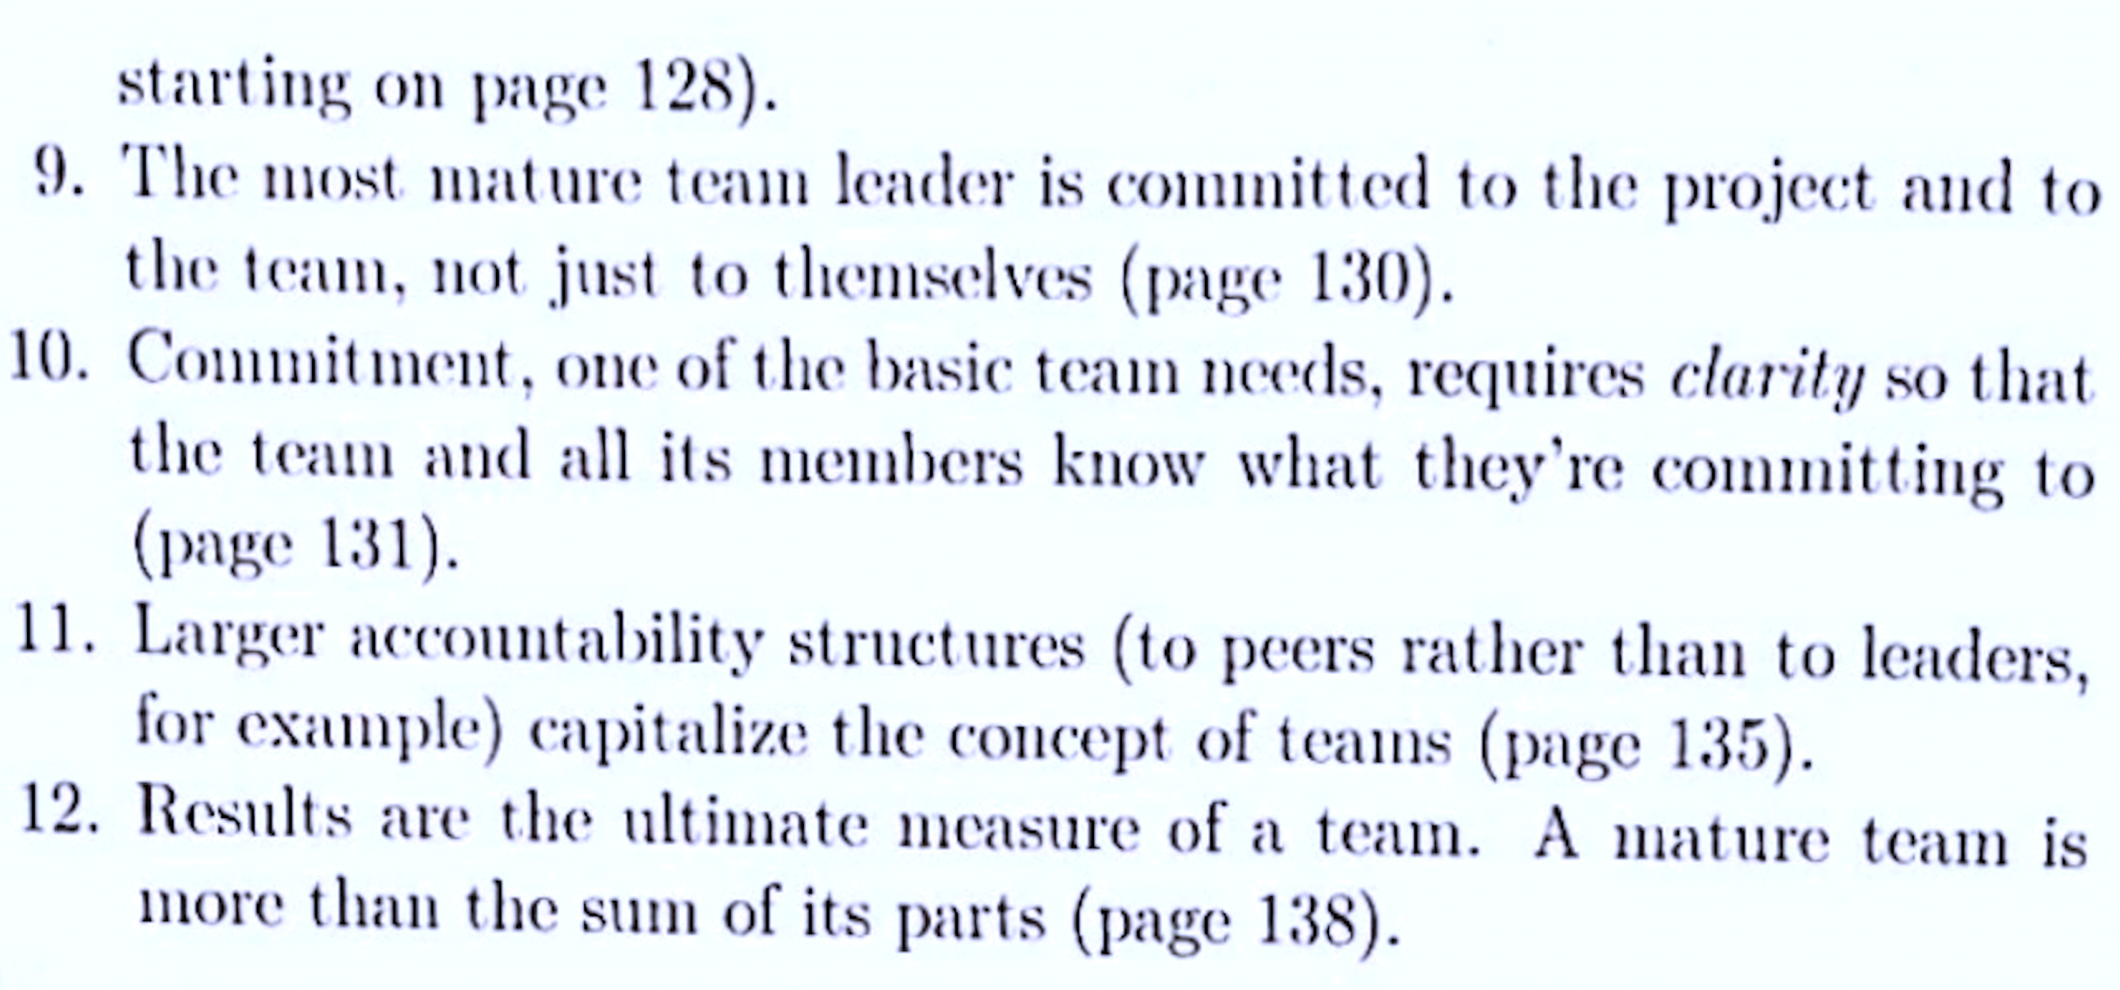
06
www.midocean.ae

Slide 46
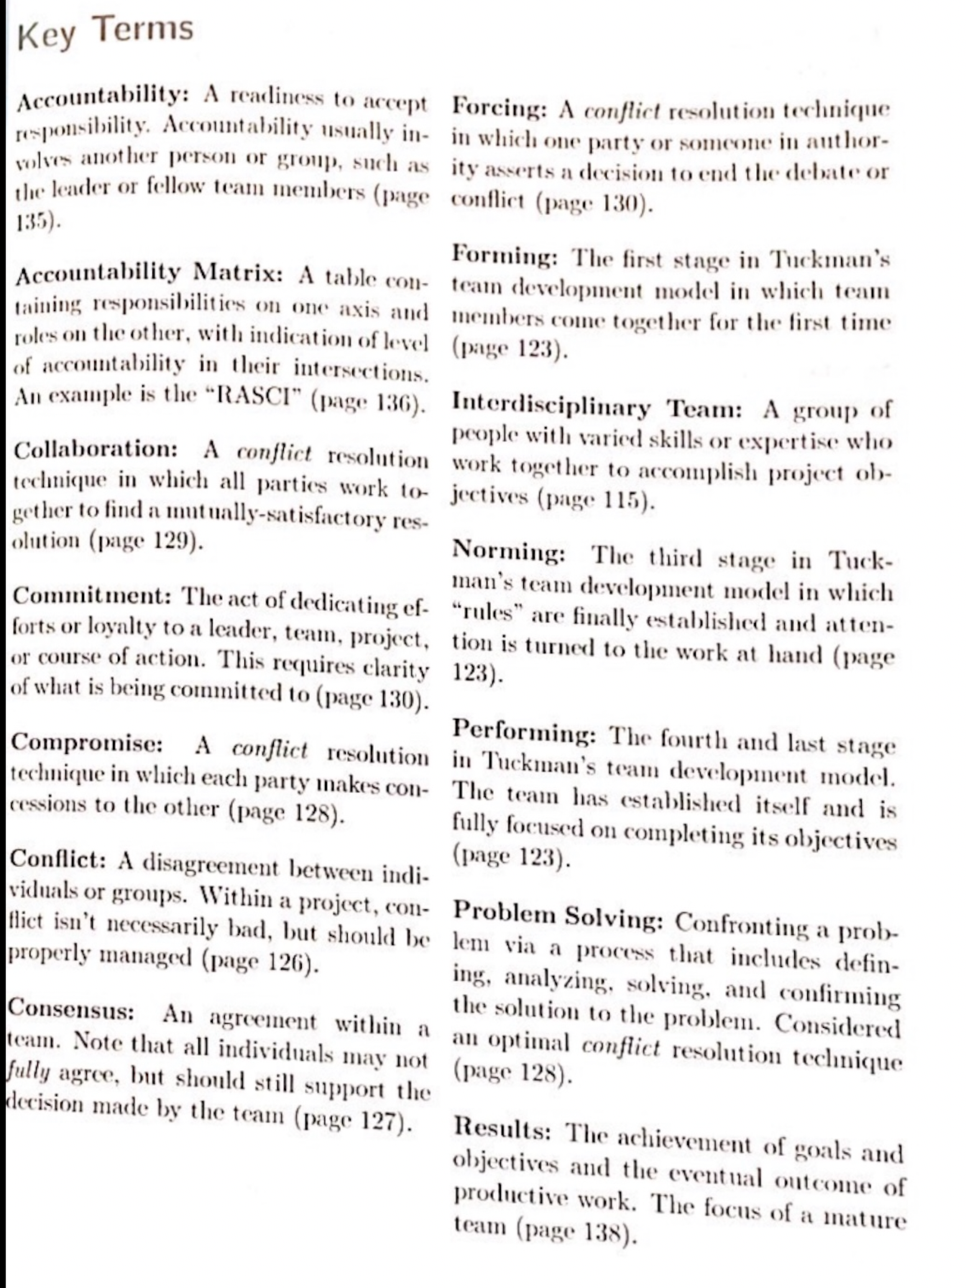
06
www.midocean.ae

Slide 47
Chapter
Resources
06
Project Team Leadership and Communication by Samuel Malachowsky, 2018.
Leadership: Theory and Practice, 7th Edition.
www.midocean.ae

Slide 48

Chapter
Reference
06
www.midocean.ae

Slide 49


Thank You

