Slide 1



Strategic Management
Prepared by Dr. Amira Elfekky
Lecture 6
MGM414

Slide 2

Content
Part One / Analysis
Chapter 1 What Is Strategy?
Chapter 2 Strategic Leadership: Managing the Strategy Process
Chapter 3 External Analysis: Industry Structure, Competitive Forces, and Strategic Groups
Chapter 4 Internal Analysis: Resources, Capabilities, and Core Competencies
Chapter 5 Competitive Advantage, Firm Performance, and Business Models

Slide 3
Content
Part Two/ Formulation
Chapter 6 Business Strategy: Differentiation, Cost Leadership, and Blue Oceans
Chapter 7 Business Strategy: Innovation, Entrepreneurship, and Platforms
Chapter 8 Corporate Strategy: Strategic Alliances, Mergers, and Acquisitions
Chapter 9 Global Strategy: Competing Around the World
Part Three/ Implementation
Chapter 10 Organizational Design: Structure, Culture, and Control

Slide 4


Strategic Management
Strategic management involves developing and implementing plans to help an organization achieve its goals and objectives. This process can include formulating strategy, planning organizational structure and resource allocation, leading change initiatives, and controlling processes and resources.

Slide 5
Agenda Business Strategy: Differentiation, Cost Leadership, and Blue Oceans
6.1 Business-Level Strategy: How to Compete
Generic Business Strategies
6.2 Differentiation Strategy: Understanding Value Drivers
Product Features
Customer Service
Complements
6.3 Cost-Leadership Strategy: Understanding Cost Drivers
Cost of Input Factors
Economies of Scale
Learning Curve
Experience Curve
6.4 Business-Level Strategy and the Five Forces:
Benefits and Risks
Differentiation Strategy: Benefits and Risks
Cost-Leadership Strategy: Benefits and Risks
6.5 Blue Ocean Strategy: Combining Differentiation and Cost Leadership
Value Innovation
Blue Ocean Strategy Gone Bad: “Stuck in the Middle”

Slide 6
Agenda Business Strategy: Differentiation, Cost Leadership, and Blue Oceans
6.1 Business-Level Strategy: How to Compete
Generic Business Strategies
6.2 Differentiation Strategy: Understanding Value Drivers
Product Features
Customer Service
Complements
6.3 Cost-Leadership Strategy: Understanding Cost Drivers
Cost of Input Factors
Economies of Scale
Learning Curve
Experience Curve
6.4 Business-Level Strategy and the Five Forces:
Benefits and Risks
Differentiation Strategy: Benefits and Risks
Cost-Leadership Strategy: Benefits and Risks
6.5 Blue Ocean Strategy: Combining Differentiation and Cost Leadership
Value Innovation
Blue Ocean Strategy Gone Bad: “Stuck in the Middle”

Slide 7

Business-Level Strategy
Business-level strategy details the goal-directed actions managers take in their quest for competitive advantage when competing in a single product market. It may involve a single product or a group of similar products that use the same distribution channel.

Slide 8
Generic business strategy
The two fundamentally different generic business strategies can be used by any organization—manufacturing or service, large or small, for-profit or nonprofit, public or private —in the quest for competitive advantage, independent of industry context.
There are as the following;
1- Differentiation
2- Cost leadership

Slide 9


Chapter
Generic business strategy
6
Cost
Advantage
Similar Product
At Lower Cost
Competitive
Advantage
Differentiation
Advantage
Price Premium
From Unique Product
6–9

Slide 10
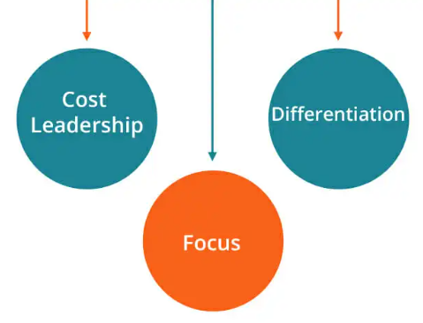
Chapter
Generic business strategy
6
A differentiation strategy:
It seeks to create higher value for customers than the value that competitors create, by delivering products or services with unique features while keeping costs at the same or similar levels, allowing the firm to charge higher prices to its customers.

Slide 11

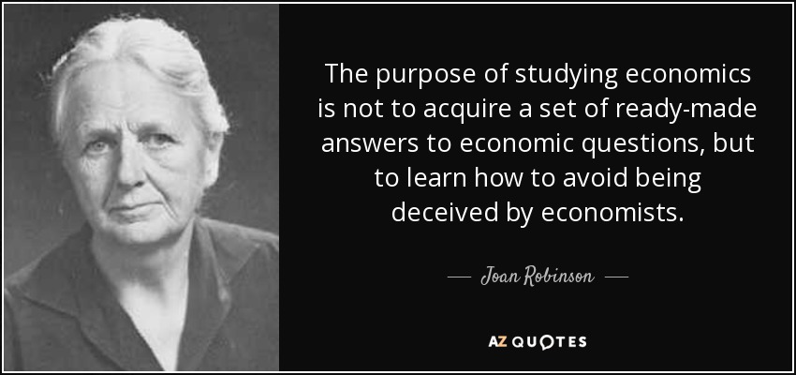
Differentiation Advantage
Chapter
Generic business strategy
6
Differentiation Advantage: a concept developed by economist Joan Robinson, occurs when a firm is able to obtain from its differentiation a price premium in the market which exceeds the cost of providing differentiation.
6–11

Slide 12
Chapter
Generic business strategy
6
2- A cost-leadership strategy:
It seeks to create the same or similar value for customers by delivering products or services at a lower cost than competitors, enabling the firm to offer lower prices to its customers.

Slide 13
Agenda Business Strategy: Differentiation, Cost Leadership, and Blue Oceans
6.1 Business-Level Strategy: How to Compete
Generic Business Strategies
6.2 Differentiation Strategy: Understanding Value Drivers
Product Features
Customer Service
Complements
6.3 Cost-Leadership Strategy: Understanding Cost Drivers
Cost of Input Factors
Economies of Scale
Learning Curve
Experience Curve
6.4 Business-Level Strategy and the Five Forces:
Benefits and Risks
Differentiation Strategy: Benefits and Risks
Cost-Leadership Strategy: Benefits and Risks
6.5 Blue Ocean Strategy: Combining Differentiation and Cost Leadership
Value Innovation
Blue Ocean Strategy Gone Bad: “Stuck in the Middle”

Slide 14
Differentiation Strategy:
Understanding Value Drivers
The goal of a differentiation strategy is to add unique features that will increase the perceived value of goods and services in the minds of consumers so they are willing to pay a higher price. The focus of competition in a differentiation strategy tends to be on unique product features, services, and new product launches, or on marketing and promotion rather than price.

Slide 15
Differentiation Strategy:
Understanding Value Drivers
Managers can adjust a number of different levers to improve a firm’s strategic position. These levers either increase perceived value or decrease costs. Here, we will study the most salient value drivers that managers have at their disposal (we look at cost drivers in the next section).
They are:
Product features
Customer service
Complements

Slide 16
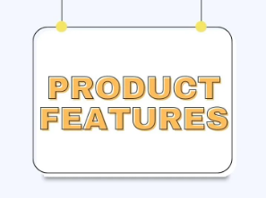
Differentiation Strategy:
Understanding Value Drivers
Chapter
6
1- PRODUCT FEATURES
One of the obvious but most important levers that strategic leaders can adjust is product features, thereby increasing the perceived value of the product or service offering. Adding unique product attributes allows firms to turn commodity products into differentiated products commanding a premium price. Strong R&D capabilities are often needed to create superior product features.

Slide 17

Differentiation Strategy:
Understanding Value Drivers
Chapter
6
2- CUSTOMER SERVICE
Managers can increase the perceived value of their firms’ product or service offerings by focusing on customer service. For example, the online retailer Zappos earned a reputation for superior customer service by offering free shipping both ways: to the customer and for returns. Zappos’s strategic leaders didn’t view this as an additional expense but rather as part of their marketing budget. Competitors took notice, too; Amazon bought Zappos for over $1 billion.

Slide 18

Differentiation Strategy:
Understanding Value Drivers
Chapter
6
3- COMPLEMENTS
Complements add value to a product or service when they are consumed in tandem. Finding complements, therefore, is an important task for managers in their quest to enhance the value of their offerings. A prime example of complements is smartphones and cellular services. For instance, service for the iPhone was exclusively offered by AT&T. Thus, if you wanted an iPhone, you had to sign up for a two-year service contract with AT&T.

Slide 19
Agenda Business Strategy: Differentiation, Cost Leadership, and Blue Oceans
6.1 Business-Level Strategy: How to Compete
Generic Business Strategies
6.2 Differentiation Strategy: Understanding Value Drivers
Product Features
Customer Service
Complements
6.3 Cost-Leadership Strategy: Understanding Cost Drivers
Cost of Input Factors
Economies of Scale
Learning Curve
Experience Curve
6.4 Business-Level Strategy and the Five Forces:
Benefits and Risks
Differentiation Strategy: Benefits and Risks
Cost-Leadership Strategy: Benefits and Risks
6.5 Blue Ocean Strategy: Combining Differentiation and Cost Leadership
Value Innovation
Blue Ocean Strategy Gone Bad: “Stuck in the Middle”

Slide 20
Cost-Leadership Strategy:
Understanding Cost Drivers
The goal of a cost-leadership strategy is to reduce the firm’s cost below that of its competitors while offering adequate value. The cost leader, as the name implies, focuses its attention and resources on reducing the cost to manufacture a product or on lowering the operating cost to deliver a service in order to offer lower prices to its customers.

Slide 21
Cost-Leadership Strategy:
Understanding Cost Drivers
The most important cost drivers that managers can manipulate to keep their costs low are:
Cost of input factors.
Economies of scale.
Learning-curve effects.
Experience-curve effects.

Slide 22

Cost-Leadership Strategy:
Understanding Cost Drivers
Chapter
6
1- Cost of input factors.
One of the most basic advantages a firm can have over its rivals is access to lower-cost input factors such as raw materials, capital, labour, and IT services. To benefit from lower-cost IT services, the Gulf carriers also outsource some value chain activities such as booking and online customer service to India.

Slide 23
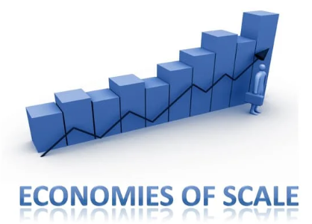
Cost-Leadership Strategy:
Understanding Cost Drivers
Chapter
6
2- Economies of scale.
Firms with greater market share might be in a position to reap economies of scale and decreases in cost per unit as output increases.
What causes per-unit cost to drop as output increases Economies of
scale allow firms to:
Spread their fixed costs over a larger output.
Employ specialized systems and equipment.
Take advantage of certain physical properties.

Slide 24
Cost-Leadership Strategy:
Understanding Cost Drivers
Chapter
6
2- Economies of scale.
A. Spread their fixed costs over a larger output.
Larger output allows firms to spread their fixed costs over more units. That is why gains in market share are often critical to drive down per-unit cost. This relationship is even more pronounced in many high-tech industries because most of the cost occurs before a single product or service is sold.

Slide 25
Cost-Leadership Strategy:
Understanding Cost Drivers
Chapter
6
2- Economies of scale.
B. Employ specialized systems and equipment.
Larger output also allows firms to invest in more specialized systems and equipment, such as enterprise resource planning (ERP) software or manufacturing robots. Tesla’s strong demand for its new Model 3 sedan allows it to employ cutting-edge robotics in its Fremont, California, manufacturing plant to produce cars of the highest quality at large scale and thus driving down costs.

Slide 26
Cost-Leadership Strategy:
Understanding Cost Drivers
Chapter
6
2- Economies of scale.
B. Take advantage of certain physical properties.
Ex: Big box stores can stock more merchandise and handle inventory efficiently

Slide 27
Cost-Leadership Strategy:
Understanding Cost Drivers
Chapter
6
3- Learning-curve effects.
Do learning curves go up or down? Looking at the challenge of learning, many people tend to see it as an uphill battle and assume the learning curve goes up. But if we consider our productivity, learning curves go down, as it takes less and less time to produce the same output as we learn how to be more efficient—learning by doing drives down cost.

Slide 28
Cost-Leadership Strategy:
Understanding Cost Drivers
Chapter
6
4- Experience-curve effects.
In the learning curve just discussed, we assumed the underlying technology remained constant, while only cumulative output increased. In the experience curve, in contrast, we now change the underlying technology while holding cumulative output constant.

Slide 29
Agenda Business Strategy: Differentiation, Cost Leadership, and Blue Oceans
6.1 Business-Level Strategy: How to Compete
Generic Business Strategies
6.2 Differentiation Strategy: Understanding Value Drivers
Product Features
Customer Service
Complements
6.3 Cost-Leadership Strategy: Understanding Cost Drivers
Cost of Input Factors
Economies of Scale
Learning Curve
Experience Curve
6.4 Business-Level Strategy and the Five Forces:
Benefits and Risks
Differentiation Strategy: Benefits and Risks
Cost-Leadership Strategy: Benefits and Risks
6.5 Blue Ocean Strategy: Combining Differentiation and Cost Leadership
Value Innovation
Blue Ocean Strategy Gone Bad: “Stuck in the Middle”

Slide 30
Business-Level Strategy and the Five Forces:
Benefits and Risks
The business-level strategies introduced in this chapter allow firms to carve out strong strategic positions that enhance the likelihood of gaining and sustaining competitive advantage.

Slide 31
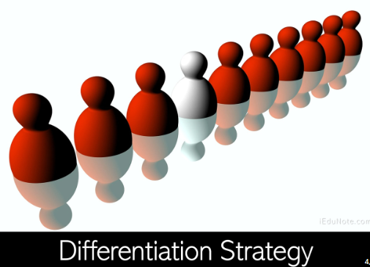
Chapter
Differentiation Strategy: Benefits and Risks
6
A differentiation strategy is defined as establishing a strategic position that creates higher perceived value while controlling costs. The successful differentiator stakes out a unique strategic position, where it can benefit from imperfect competition and command a premium price. A well-executed differentiation strategy reduces rivalry among competitors.

Slide 32

COST-LEADERSHIP STRATEGY: BENEFITS AND RISKS
Chapter
6
A cost-leadership strategy is defined as obtaining the lowest-cost position in the industry while offering acceptable value. The cost leader, therefore, is protected from other competitors because of having the lowest cost. If a price war ensues, the low-cost leader will be the last firm standing; all other firms will be driven out as margins evaporate.

Slide 33
Chapter
Differentiation Strategy: Benefits and Risks
6
Competitive Force
Threat of entry
Differentiation
Benefits
• Protection against entry due to intangible resources such as a reputation for innovation, quality, or customer service
Risks
• Erosion of margins
• Replacement

Slide 34
Chapter
Differentiation Strategy: Benefits and Risks
6
Competitive Force
Threat of entry
Cost Leadership
Benefits
• Protection against entry due to economies of scale
Risks
• Erosion of margins
• Replacement

Slide 35
Chapter
Differentiation Strategy: Benefits and Risks
6
Competitive Force
Power of suppliers
Differentiation
Benefits
Protection against increase in input prices, which can be passed on to customers
Risks
• Erosion of margins

Slide 36
Chapter
Differentiation Strategy: Benefits and Risks
6
Competitive Force
Power of suppliers
Cost Leadership
Benefits
• Protection against increase in input prices, which can be absorbed استيعاب
Risks
• Erosion of margins

Slide 37
Chapter
Differentiation Strategy: Benefits and Risks
6
Competitive Force
Power of buyers
Differentiation
Benefits
• Protection against decrease in sales prices, because well differentiated Products or services are not perfect imitations المقلدة
Risks
• Erosion of margins

Slide 38
Chapter
Differentiation Strategy: Benefits and Risks
6
Competitive Force
Power of buyers
Cost Leadership
Benefits
• Protection against increase in input prices, which can be absorbed
Risks
• Erosion of margins

Slide 39
Agenda Business Strategy: Differentiation, Cost Leadership, and Blue Oceans
6.1 Business-Level Strategy: How to Compete
Generic Business Strategies
6.2 Differentiation Strategy: Understanding Value Drivers
Product Features
Customer Service
Complements
6.3 Cost-Leadership Strategy: Understanding Cost Drivers
Cost of Input Factors
Economies of Scale
Learning Curve
Experience Curve
6.4 Business-Level Strategy and the Five Forces:
Benefits and Risks
Differentiation Strategy: Benefits and Risks
Cost-Leadership Strategy: Benefits and Risks
6.5 Blue Ocean Strategy: Combining Differentiation and Cost Leadership
Value Innovation
Blue Ocean Strategy Gone Bad: “Stuck in the Middle”

Slide 40
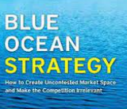
6.5 Blue Ocean Strategy: Combining Differentiation and Cost Leadership
Blue ocean strategy is a business-level strategy that successfully combines differentiation and cost-leadership activities using value innovation to reconcile the inherent trade-offs in those two distinct strategic positions. They use the metaphor of an ocean to denote market spaces. Blue oceans represent untapped market space, the creation of additional demand, and the resulting opportunities for highly profitable growth.

Slide 41
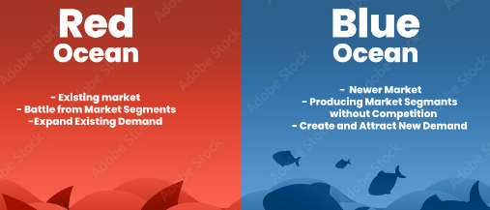
6.5 Blue Ocean Strategy: Combining Differentiation and Cost Leadership
In contrast, red oceans are the known market space of existing industries. In red oceans the rivalry among existing firms is cut-throat because the market space is crowded and competition is a zero-sum game.

Slide 42
Blue Ocean Strategy: Combining Differentiation and Cost Leadership
Chapter
6
VALUE INNOVATION
Instead of attempting to out-compete your rivals by offering better features or lower costs, successful value innovation makes competition irrelevant by providing a leap in value creation, thereby opening new and uncontested market spaces. Successful value innovation requires that a firm’s strategic moves lower its costs and also increase the perceived value for buyers. Lowering a firm’s costs is primarily achieved by eliminating and reducing the taken-for-granted factors that the firm’s industry rivals compete on.

Slide 43
Blue Ocean Strategy: Combining Differentiation and Cost Leadership
Chapter
6
VALUE INNOVATION
Value Innovation—Lower Costs
1. Eliminate. Which of the factors that the Industry takes for granted should be eliminated?
2. Reduce. Which of the factors should be reduced well below the industry’s standard?

Slide 44
Blue Ocean Strategy: Combining Differentiation and Cost Leadership
Chapter
6
VALUE INNOVATION
Value Innovation—Increase Perceived Consumer Benefits
3. Raise. Which of the factors should be raised well above the industry’s standard?
4. Create. Which factors should be created that the industry has never offered?

Slide 45
Blue Ocean Strategy: Combining Differentiation and Cost Leadership
Chapter
6
VALUE INNOVATION
The international furniture retailer IKEA, for example, has used value innovation based on the eliminate-reduce-raise-create framework to initiate its own blue ocean and to achieve sustainable competitive advantage.

Slide 46
Blue Ocean Strategy: Combining Differentiation and Cost Leadership
Chapter
6
VALUE INNOVATION
ELIMINATE
IKEA eliminated several taken-for-granted competitive elements: salespeople, expensive but small retail outlets in prime urban locations and shopping malls, long wait after ordering furniture, after-sales service, and other factors. In contrast, IKEA displays its products in a warehouse-like setting, thus reducing inventory cost. Customers serve themselves and then transport the furniture to their homes in IKEA’s signature flatpacks for assembly.

Slide 47
Blue Ocean Strategy: Combining Differentiation and Cost Leadership
Chapter
6
VALUE INNOVATION
REDUCE
Because of its do-it-yourself business model regarding furniture selection, delivery, and assembly, IKEA drastically reduced the need for staff in its mega-stores. Strolling through an IKEA store, you encounter few employees. IKEA also reduced several other taken-for-granted competitive elements: 25-year warranties on high-end custom furniture, high degree of customization in selection of options such as different fabrics and patterns, and use of expensive materials such as leather or hardwoods, among other elements.

Slide 48
Blue Ocean Strategy: Combining Differentiation and Cost Leadership
Chapter
6
VALUE INNOVATION
RAISE
IKEA raised several competitive elements: It offers tens of thousands of home furnishing items in each of its big-box stores (some 300,000 square feet, roughly five football fields), versus a few hundred at best in traditional furniture stores; it also offers more than furniture, including a range of accessories such as place mats, laptop stands, and much more; each store has hundreds of rooms fully decorated with all sorts of IKEA items, each with a detailed tag explaining the item.

Slide 49
Blue Ocean Strategy: Combining Differentiation and Cost Leadership
Chapter
6
VALUE INNOVATION
CREATE
IKEA created a new way for people to shop for furniture. Customers stroll along a predetermined path winding through the fully furnished showrooms. They can compare, test, and touch all the things in the showroom. The price tag on each item contains other important information: type of material, weight, and so on. Once an item is selected, the customer notes the item number.

Slide 50
Thank You

