Slide 1
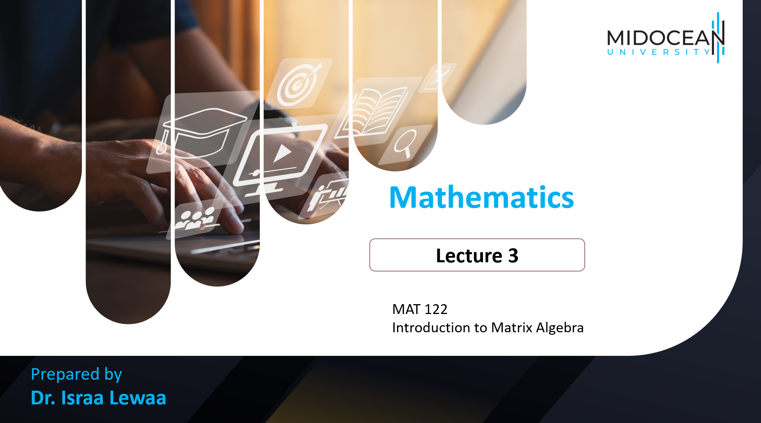

Mathematics
Prepared by Dr. Israa Lewaa
Lecture 3
MAT 122
Introduction to Matrix Algebra

Slide 2

Lecture
03
Lecture Outline
Concept of a matrix.
Order and size of a matrix.
Special Definitions in Matrices.
Special types of matrices.
Extra Practice.
Lecture 3 Dr. Israa Lewaa Mathematics 2

Slide 3
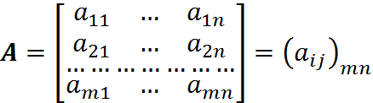
Lecture
03
Matrix
A matrix is an ordered rectangular array of numbers, arranged in rows and columns.
Lecture 3 Dr. Israa Lewaa Mathematics 2

Slide 4
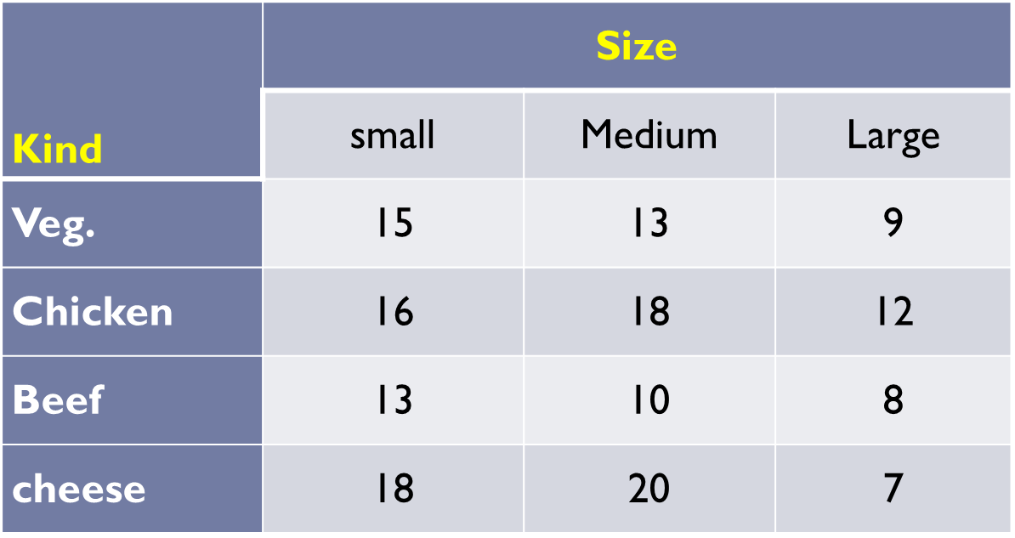
Lecture
03
Example for A Matrix
A restaurant offers 4 kinds of pizza (vegetables, cheese, beef and chicken) with 3 sizes.

Slide 5
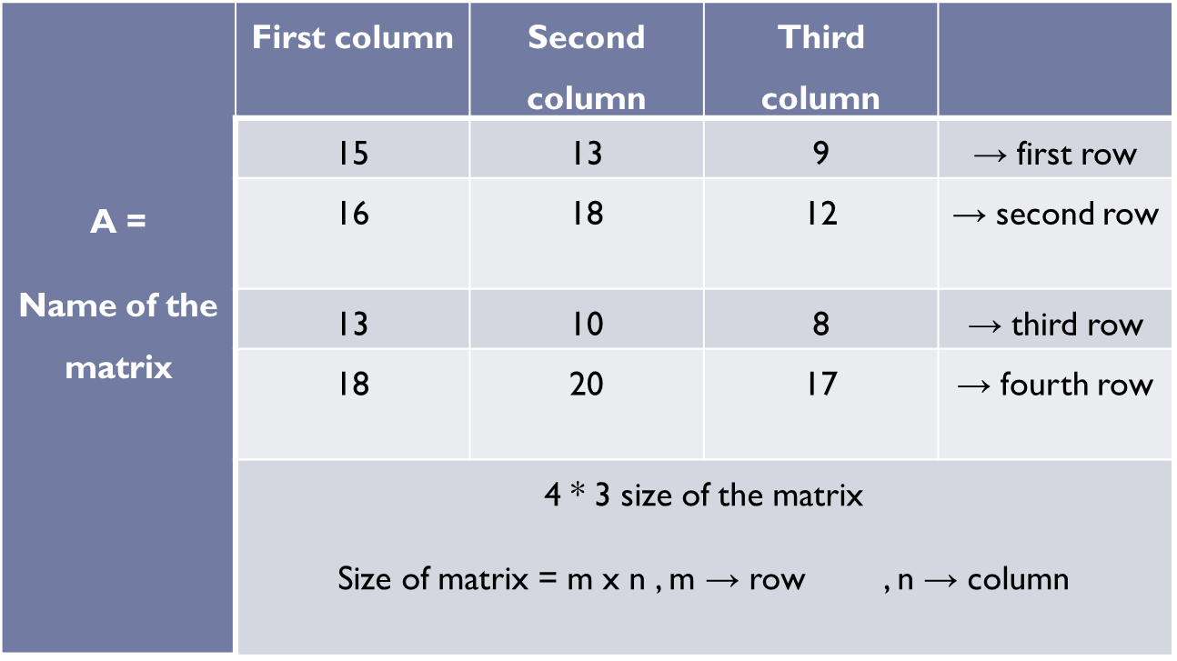
Lecture
03
Example for A Matrix
If we want to write it in a form of matrix :

Slide 6
Lecture
03
Size of the matrix
The size or order of a matrix is described by its number of rows and the number of columns.
If a matrix, A, has m rows and n columns
then A is described as an mxn matrix.
Lecture 3 Dr. Israa Lewaa Mathematics 2

Slide 7
Lecture
03
Size of the matrix
A matrix consisting of m horizontal rows and n vertical columns is called an m×n matrix or a matrix of size m×n.
For the entry a_{ij}, we call i the row subscript and j the column subscript.
Lecture 3 Dr. Israa Lewaa Mathematics 2

Slide 8
Lecture
03
Example
Find the size for the following matrices:
A-
B-
C-
D-

Slide 9
Lecture
03
Solution
Find the size for the following matrices:
The matrix has size .
b. The matrix has size
.
Lecture 3 Dr. Israa Lewaa Mathematics 2

Slide 10
Lecture
03
Solution
Find the size for the following matrices:
C- The matrix has size .
d. The matrix has size
.
Lecture 3 Dr. Israa Lewaa Mathematics 2

Slide 11
Lecture
03
Some important Definitions
Elements of a matrix
Row Matrix
Column Matrix
Matrices of the same order
Equal Matrices
Lecture 3 Dr. Israa Lewaa Mathematics 2

Slide 12


Lecture
03
1- Elements of a matrix
The numbers in a matrix are called its elements. The element in the i^{th} row and j^{th} column of a matrix is generally denoted by a^{ij}. A matrix with m rows and n columns is written or .
Lecture 3 Dr. Israa Lewaa Mathematics 2

Slide 13
Lecture
03
2- Row Matrix
A matrix with just one row is called a row matrix (or row vector).
(1 x n)
Lecture 3 Dr. Israa Lewaa Mathematics 2

Slide 14
Lecture
03
3- Column Matrix
A matrix with just one column is called a column matrix.
(m x 1)
Lecture 3 Dr. Israa Lewaa Mathematics 2

Slide 15
Lecture
03
4- Matrices of the same order
Two matrices which have the Same number of rows and columns are said to be matrices of the same order.
Lecture 3 Dr. Israa Lewaa Mathematics 2

Slide 16
Lecture
03
5- Equal Matrices
Two matrices A and B are said to be equal if, and only if, each element a_{ij} of A is equal to the corresponding element b_{ij} of B.
Lecture 3 Dr. Israa Lewaa Mathematics 2

Slide 17
Lecture
03
5- Equal Matrices
Two matrices A = (a_{ij}) and B = (b_{ij}) are said to be equal if, and only if, each element a_{ij} of A is equal to the corresponding element b_{ij} of B.
In symbolic form this reads:
From this it follows that equal matrices are of the same order but matrices of the same order are not necessarily equal.
A=B ⬄ a_{ij} = b_{ij} for all i and j
Lecture 3 Dr. Israa Lewaa Mathematics 2

Slide 18
Lecture
03
Types of Matrices
Null Matrix
Identity Matrix
Square Matrix
Transpose Matrix
Lecture 3 Dr. Israa Lewaa Mathematics 2

Slide 19
Lecture
03
1- The Null Matrix
Any matrix all of whose elements are zero is called a null or zero matrix
Lecture 3 Dr. Israa Lewaa Mathematics 2

Slide 20
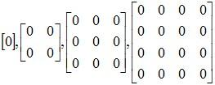
Lecture
03
1- Null Matrix
Any matrix, all of whose elements are zero, is called a null or zero matrix and is denoted by O.
Lecture 3 Dr. Israa Lewaa Mathematics 2

Slide 21
Lecture
03
2- Identity Matrix
Square matrix with ones on the diagonal and zeros elsewhere.
Lecture 3 Dr. Israa Lewaa Mathematics 2

Slide 22
Lecture
03
3- Square Matrix
Same number of rows and columns
Lecture 3 Dr. Israa Lewaa Mathematics 2

Slide 23
Lecture
03
4- Transpose Matrix
Rows become columns and columns become rows
A^{T}
Lecture 3 Dr. Israa Lewaa Mathematics 2

Slide 24
Lecture
03
4- Transpose Matrix
The transpose of an m x n matrix A, donated A^{T}, is the n x m matrix.
Lecture 3 Dr. Israa Lewaa Mathematics 2

Slide 25
Lecture
03
Practice
Let’s Practice
Lecture 3 Dr. Israa Lewaa Mathematics 2

Slide 26
Lecture
03
Example 1
If
Find .
Lecture 3 Dr. Israa Lewaa Mathematics 2

Slide 27
Lecture
03
Solution of Example 1
Transpose of matrix A
Lecture 3 Dr. Israa Lewaa Mathematics 2

Slide 28
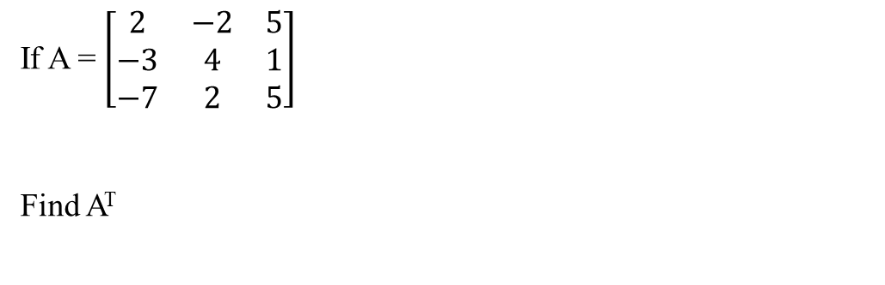
Lecture
03
Example 2
If A = $\left[\begin{matrix}2 & −2 & 5 \\ −3 & 4 & 1 \\ −7 & 2 & 5\end{matrix}\right]$
Find A^{T}
Lecture 3 Dr. Israa Lewaa Mathematics 2

Slide 29
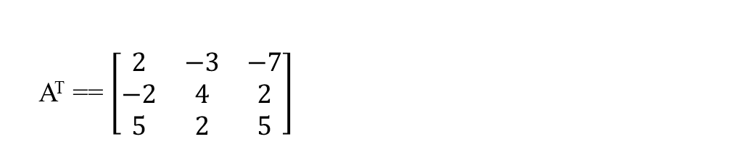
Lecture
03
Solution of Example 2
A^{T} == $\left[\begin{matrix}2 & −3 & −7 \\ −2 & 4 & 2 \\ 5 & 2 & 5\end{matrix}\right]$
Lecture 3 Dr. Israa Lewaa Mathematics 2

Slide 30
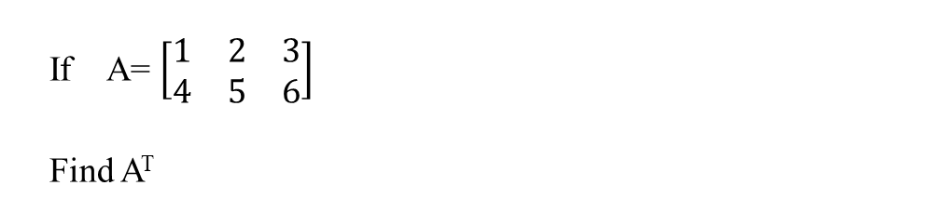
Lecture
03
Example 3
If A= $\left[\begin{matrix}1 & 2 & 3 \\ 4 & 5 & 6\end{matrix}\right]$
Find A^{T}
Lecture 3 Dr. Israa Lewaa Mathematics 2

Slide 31
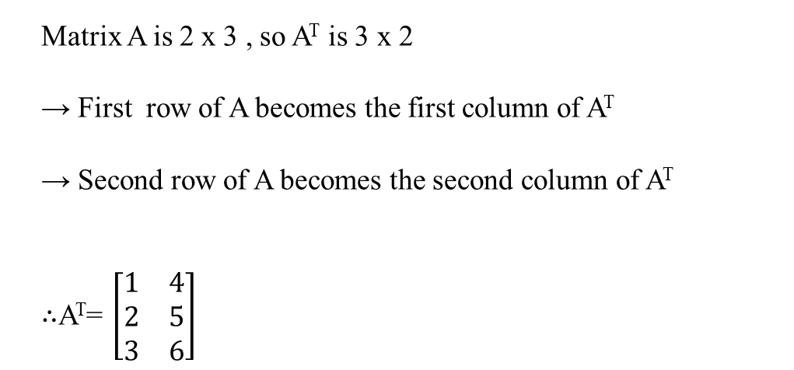
Lecture
03
Solution of Example 3
Matrix A is 2 x 3 , so A^{T} is 3 x 2
→ First row of A becomes the first column of A^{T}
→ Second row of A becomes the second column of A^{T}
$∴$A^{T}= $\left[\begin{matrix}1 & 4 \\ 2 & 5 \\ 3 & 6\end{matrix}\right]$
Lecture 3 Dr. Israa Lewaa Mathematics 2

Slide 32
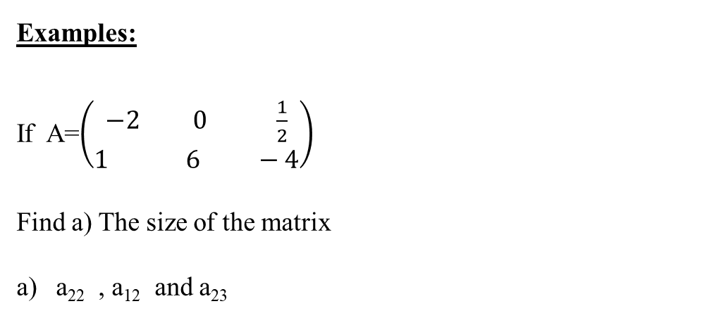
Lecture
03
Example 4
Examples:
If A=$\left(\begin{aligned}−2 0 \frac{1}{2} \\ 1 6 −4\end{aligned}\right)$
Find a) The size of the matrix
a₂₂ , a₁₂ and a₂₃
Lecture 3 Dr. Israa Lewaa Mathematics 2

Slide 33
Lecture
03
Solution of Example 4
Solution
size = 2 x 3
a₂₂ = 6 , a¹² = 0 a₂₃= - 4
Lecture 3 Dr. Israa Lewaa Mathematics 2

Slide 34
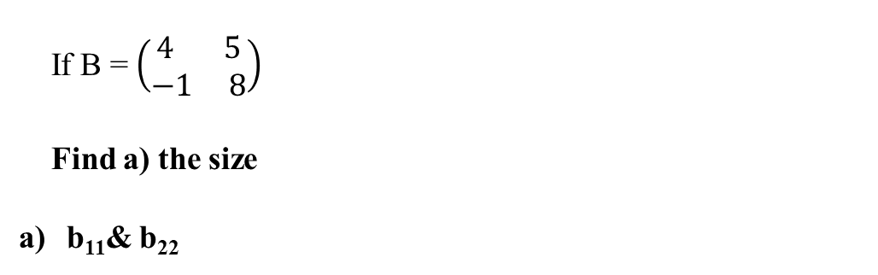
Lecture
03
Example 5
If B = $\left(\begin{aligned}4 5 \\ −1 8\end{aligned}\right)$
Find a) the size
b₁₁& b₂₂
Lecture 3 Dr. Israa Lewaa Mathematics 2

Slide 35
Lecture
03
Solution of Example 5
Solution
the size = 2 x 2
b_{n} = 4 b₂₂ = 8
Lecture 3 Dr. Israa Lewaa Mathematics 2

Slide 36
Lecture
03
Example 6
Lecture 3 Dr. Israa Lewaa Mathematics 2

Slide 37
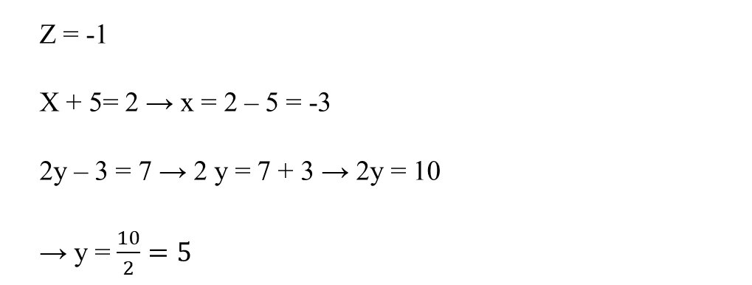
Lecture
03
Solution of Example 6
Z = -1
X + 5= 2 → x = 2 – 5 = -3
2y – 3 = 7 → 2 y = 7 + 3 → 2y = 10
→ y = $\frac{10}{2}=5$
Lecture 3 Dr. Israa Lewaa Mathematics 2

Slide 38
Lecture
03
Lecture Summary
Concept of a matrix.
Order and size of a matrix.
Special Definitions in Matrices.
Special types of matrices.
Lecture 3 Dr. Israa Lewaa Mathematics 2

