Slide 1






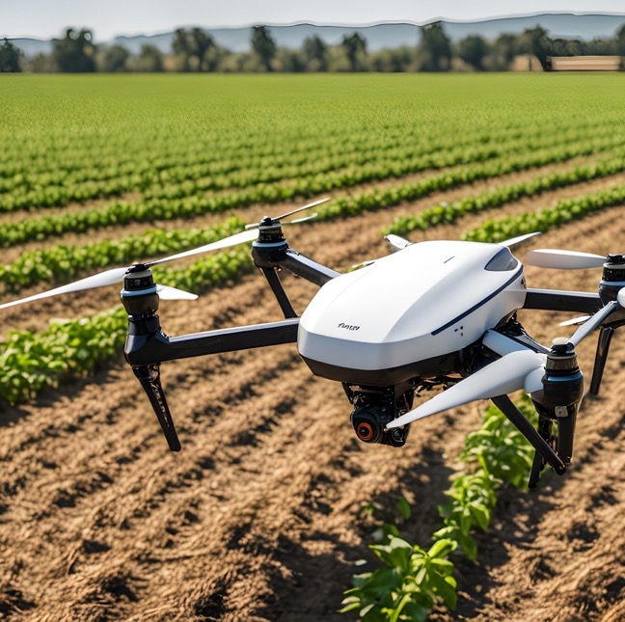
Leveraging AI to study the impact of climate change on the spread and severity of plant diseases
Fatima Alkaff
Master’s Student, Department of Artificial Intelligence
Midocean University
Lecturer: Dr. Hager Saleh

Slide 2




Presentation Roadmap
  Introduction
  Problem Statement
  Objectives
  Related Works
  Dataset
  Data Preprocessing
  Evaluation Metrics
  Results
  Conclusion
  Future Work

Slide 3




AI and the impact of climate change on plant diseases
Introduction
Problem
Objectives
Related Work
Dataset
Preprocessing
Evaluation
Results
Conclusion
Future Work
The worst problem confronting agriculture at present is global climate change, including changes in temperature, humidity, and altered precipitation, which is inducing increasing plant disease and insect transmission.
This proposal aims to develop an artificial intelligence system for predicting the intensity of climate change-induced plant diseases. Other than using historical climate data and crop infection disease, research shows that developing an early warning crop plan forecast program would reduce crop loss, help farmers decide, and be part of a larger world climate change-induced sustainable agriculture.
Introduction

Slide 4
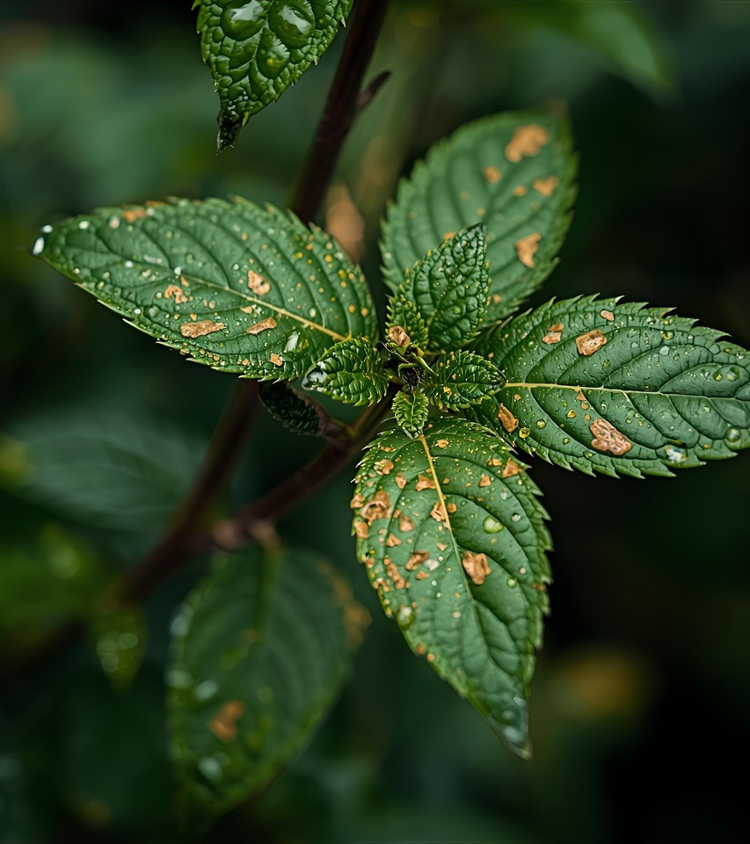
AI and the impact of climate change on plant diseases
Introduction
Problem
Objectives
Related Work
Dataset
Preprocessing
Evaluation
Results
Conclusion
Future Work
Problem Statement
Although more awareness of the role played by climate change in plant disease is present, current forecasting methods fall short. There is an evident requirement for intelligent and adaptive models that will convert multi-source climatic and biological data into a format in which they will be capable of predicting outbreaks of disease in a constantly changing climate.
The project realizes the requirement by offering a solution to the issue of bringing deep learning algorithms to the model development for predicting the timing, location, and magnitude of plant disease outbreaks in terms of climatic trends.

Slide 5
AI and the impact of climate change on plant diseases
Introduction
Problem
Objectives
Related Work
Dataset
Preprocessing
Evaluation
Results
Conclusion
Future Work
OBJECTIVES
Develop
a multimodal deep learning framework for plant leaf disease classification
Preprocess and integrate
image data with environmental and soil variables
Evaluate
the performance of image-only CNN models and structured-data-based models
Design
an intermediate fusion model combining CNN features with an MLP
Analyze
whether environmental variables improve disease classification accuracy

Slide 6


AI and the impact of climate change on plant diseases
Introduction
Problem
Objectives
Related Work
Dataset
Preprocessing
Evaluation
Results
Conclusion
Future Work
Related Works

Slide 7

AI and the impact of climate change on plant diseases
Introduction
Problem
Objectives
Related Work
Dataset
Preprocessing
Evaluation
Results
Conclusion
Future Work
1.Plant Disease Detection Using Deep Learning Techniques
1
Applied Convolutional Neural Network (CNN) models: ResNet152, VGG19, DenseNet169, and MobileNetv3 to detect plant diseases using the highly regarded PlantVillage dataset. In addition, image augmentation Keras' Image Data Generator was used to extend the training set. The results showed that MobileNetv3 had the best testing accuracy.
5
4
2
3

Slide 8
AI and the impact of climate change on plant diseases
Introduction
Problem
Objectives
Related Work
Dataset
Preprocessing
Evaluation
Results
Conclusion
Future Work
2. Tomato Leaf Disease Detection using Convolution Neural Network
1
Applied CNN: VGG16, InceptionV3, and MobileNet for disease detection and classification. Images of Tomato disease have been taken from the PlantVillage dataset, which includes over 50,000 images of 14 crops. Experimentally, they observed testing accuracy ranging from 76% to 99% for the classification for the 9 diseases and 1 healthy class.
5
4
2
3

Slide 9
AI and the impact of climate change on plant diseases
Introduction
Problem
Objectives
Related Work
Dataset
Preprocessing
Evaluation
Results
Conclusion
Future Work
3. Automatic Image-Based Plant Disease Severity Estimation Using Deep Learning
1
5
used apple black rot images in the PlantVillage dataset, a series of CNN: VGG16, VGG19, Inception‑v3, and ResNet50 were trained to diagnose the severity of the disease. Results show that the best model is the deep VGG16 model trained with transfer learning.
4
2
3

Slide 10
AI and the impact of climate change on plant diseases
Introduction
Problem
Objectives
Related Work
Dataset
Preprocessing
Evaluation
Results
Conclusion
Future Work
4. Plant leaf disease classification using EfficientNet deep learning model
1
5
proposed EfficientNet B5 and B4 models of DL architecture in plant leaf disease classification. All models were trained with the original and augmented PlantVillage datasets, having 55,448 and 61,486 images. They compared performance with other state-of-the-art DL models. The results showed that B5 and B4 models of EfficientNet architecture achieved the highest values compared to other DL models for accuracy.
4
2
3

Slide 11
AI and the impact of climate change on plant diseases
Introduction
Problem
Objectives
Related Work
Dataset
Preprocessing
Evaluation
Results
Conclusion
Future Work
5. A Deep Learning-based Approach for Banana Leaf Diseases Classification
1
5
used the LeNet architecture as a CNN to classify and detect two famous banana diseases, which are banana sigatoka and banana speckle, using a real dataset of banana diseases obtained from the PlantVillage. The results was very good demonstrated with 20% training and 80% testing.
4
2
3

Slide 12

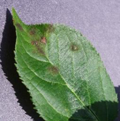
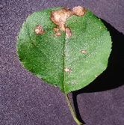
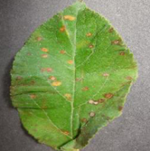
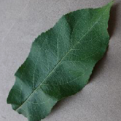
AI and the impact of climate change on plant diseases
Introduction
Problem
Objectives
Related Work
Dataset
Preprocessing
Evaluation
Results
Conclusion
Future Work
Dataset
The data utilized is a subset of images of apples taken from the Multimodal Plant Disease dataset by Shubham Divakar on Kaggle, which has 40,000 images spanning multiple plant species. The dataset consists of two main parts:
Apple Scab
Structured Climate Dataset
Image Dataset - Plant Leaf Images
Black Rot
  Balanced data 10,000 row per disease category.
features
  The actual number of available images after filtering and validating the apple images is only 3,171 usable images.
    Apple Scab: 630 images
    Apple Black Rot: 621 images
    Cedar Apple Rust: 275 images
    Apple Healthy: 1645 images
Apple Rust
The environment and soil are described with the following features:
  Nitrogen (N)
  Phosphorus (P)
  Potassium (K)
  Temperature
  Humidity
  Rainfall
  pH
Healthy

Slide 13
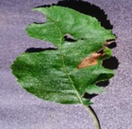
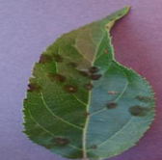
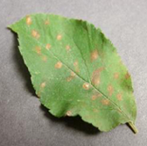
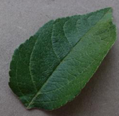
AI and the impact of climate change on plant diseases
Introduction
Problem
Objectives
Related Work
Dataset
Preprocessing
Evaluation
Results
Conclusion
Future Work
Dataset
N | P | K | temperature | humidity | ph | rainfall | Label | Image Path
71 | 54 | 16 | 22.61359953 | 63.69070564 | 5.749914421 | 87.75953857 | Apple Black rot | color\Apple___Black_rot\0090d05d-d797-4c99-abd4-3b9cb323a5fd___JR_FrgE.S 8727.JPG
90 | 42 | 43 | 20.8797437 | 82.0027442 | 6.50298529 | 202.935536 | Apple scab | color\Apple___Apple_scab\00075aa8-d81a-4184-8541-b692b78d398a___FREC_Scab 3335.JPG
40 | 72 | 77 | 17.0249846 | 16.9886117 | 7.48599607 | 88.5512314 | Cedar Apple Rust | color\Apple___Cedar_apple_rust\025b2b9a-0ec4-4132-96ac-7f2832d0db4a___FREC_C.Rust 3655.JPG
13 | 60 | 25 | 17.1369277 | 20.5954169 | 5.68597166 | 128.256862 | Apple Healthy | color\Apple___healthy\0055dd26-23a7-4415-ac61-e0b44ebfaf80___RS_HL 5672.JPG

Slide 14
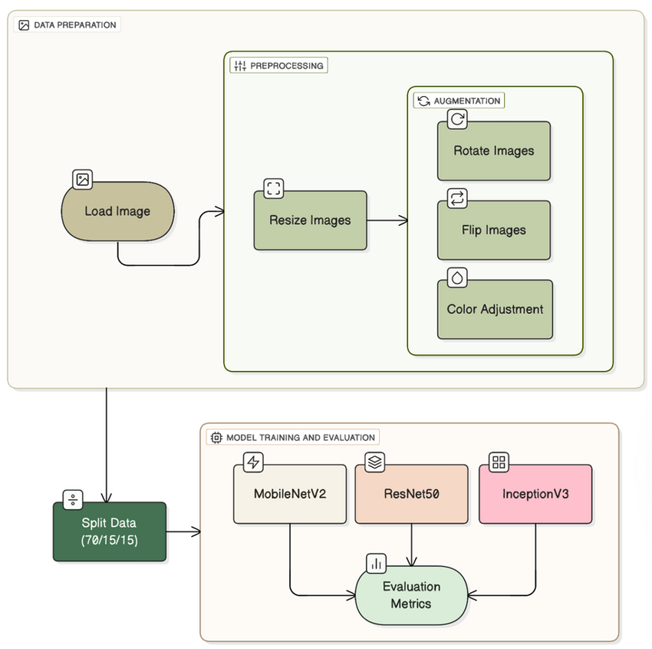
AI and the impact of climate change on plant diseases
Introduction
Problem
Objectives
Related Work
Dataset
Preprocessing
Evaluation
Results
Conclusion
Future Work
Data Preprocessing - image
Image Preprocessing
  Resizing the picture size to 224×224
  Normalization (0–1 scaling)
  Data augmentation: rotation, flipping, brightness adjustment, zoom, shifting
CNN architectures applied
  MobileNetV2
  ResNet50
  InceptionV3
Training Setup
  Optimizer: Adam
  Epochs: 10
  Batch size: 32
  Loss function: Categorical Crossentropy
  Callbacks: Early Stopping

Slide 15
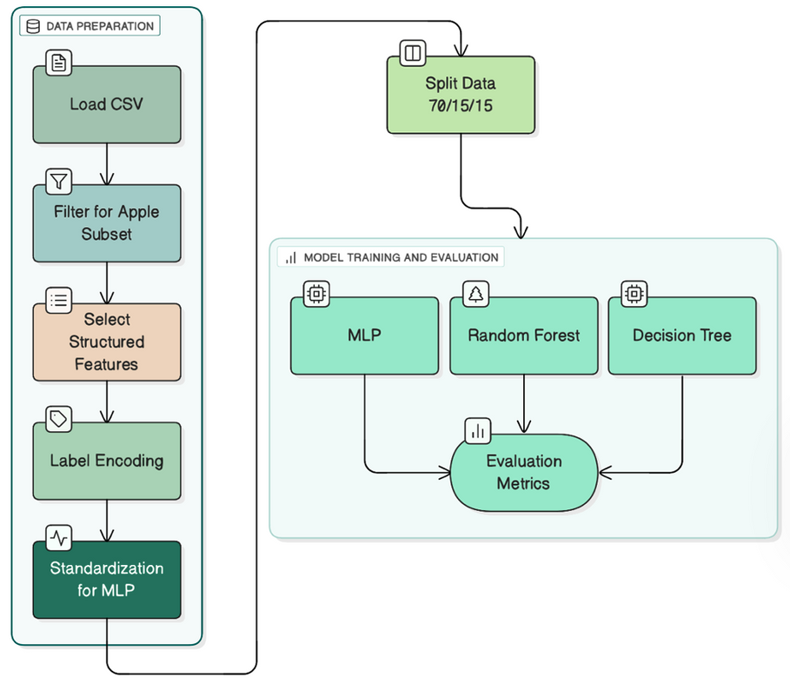
AI and the impact of climate change on plant diseases
Introduction
Problem
Objectives
Related Work
Dataset
Preprocessing
Evaluation
Results
Conclusion
Future Work
Data Preprocessing - Structured
Structured Data Preprocessing
  Standardization using StandardScaler
  Label encoding for class names
Structured-Only Models
  Decision Tree
  Random Forest
  Multi-Layer Perceptron (MLP)
Models selected because they are simple, fast, and effective for tabular data

Slide 16
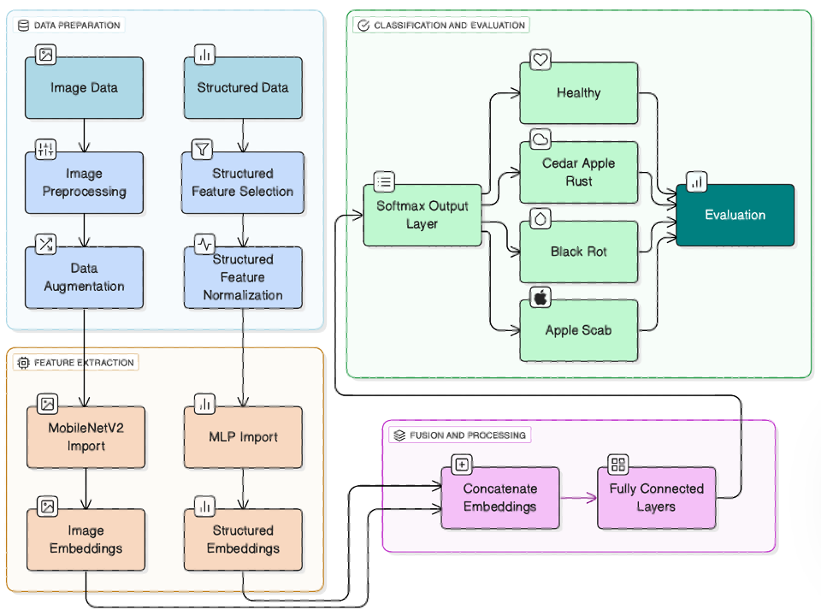
AI and the impact of climate change on plant diseases
Introduction
Problem
Objectives
Related Work
Dataset
Preprocessing
Evaluation
Results
Conclusion
Future Work
Multimodal Fusion Pipeline
Multimodal Paired Subset
  After matching images with structured data and removing duplicates
  Split into (70/15/15)
  Oversampling for minority classes
Multimodal Fusion Pipeline
  CNN branch: extracts image embeddings
  MLP branch: processes structured features
  Fusion layer: concatenation
  Final dense layers: classification output

Slide 17

AI and the impact of climate change on plant diseases
Introduction
Problem
Objectives
Related Work
Dataset
Preprocessing
Evaluation
Results
Conclusion
Future Work
Evaluation Metrics
01
02
03
04
05
Accuracy
Precision
Recall
F1-score
Confusion Matrix
correctness of positive predictions
how many actual positives were captured
balance between precision & recall
overall correctness
class-level performance

Slide 18
AI and the impact of climate change on plant diseases
Introduction
Problem
Objectives
Related Work
Dataset
Preprocessing
Evaluation
Results
Conclusion
Future Work
Results - Structured
Structured Feature Extraction Models
All models achieved 100% accuracy.
Model | Dataset | Accuracy | Precision | Recall | F1-Score
MLP | Apple Disease Dataset | 1 | 1 | 1 | 1
Random Forest | Apple Disease Dataset | 1 | 1 | 1 | 1
Decision Tree | Apple Disease Dataset | 1 | 1 | 1 | 1
Structured features are highly separable and very discriminative.
Even simple models learned the patterns perfectly → no noise or overlap in the data.
Structured data alone provides an almost deterministic prediction of the disease class.

Slide 19
AI and the impact of climate change on plant diseases
Introduction
Problem
Objectives
Related Work
Dataset
Preprocessing
Evaluation
Results
Conclusion
Future Work
Results - Image
Image Feature Extraction Models
Model | Dataset | Accuracy | Precision | Recall | F1-Score
MobileNetV2 | Apple Disease Dataset | 0.9936 | 0.997 | 0.992 | 0.9944
ResNet50 | Apple Disease Dataset | 0.9957 | 0.9947 | 0.9947 | 0.9946
InceptionV3 | Apple Disease Dataset | 0.9978 | 0.9973 | 0.9989 | 0.9981
  All three CNN models (MobileNetV2, ResNet50, InceptionV3) achieved >99% accuracy.
  MobileNetV2: lightweight and efficient, learned compact features.
  ResNet50: strong generalization even with a small dataset.
  InceptionV3: highest accuracy due to multi-scale feature extraction.
  Image data alone provides very reliable disease classification.

Slide 20
AI and the impact of climate change on plant diseases
Introduction
Problem
Objectives
Related Work
Dataset
Preprocessing
Evaluation
Results
Conclusion
Future Work
Results - Multimodal
Image Feature Extraction Models
  Adding structured + image features produced strong and stable performance.
  MobileNetV2 + MLP: achieved 100% accuracy due to clean, small, and highly separable multimodal subset.
  ResNet50 + MLP: ~98.5% — strong but needs larger multimodal data to use its depth effectively.
  InceptionV3 + MLP: ~95.6% — limited benefit from fusion because classes are visually similar and structured data adds little variation.
  MobileNetV2 showed the best compatibility with structured features, making it the most effective fusion backbone.
Model | Input Type | Accuracy | Precision | Recall | F1-Score
MobileNetV2 + MLP | Image +Climate | 1 | 1 | 1 | 1
ResNet50 + MLP | Image + Climate | 0.9852 | 0.9861 | 0.9861 | 0.9857
InceptionV3 + MLP | Image + Climate | 0.9558 | 0.9521 | 0.9529 | 0.9521

Slide 21
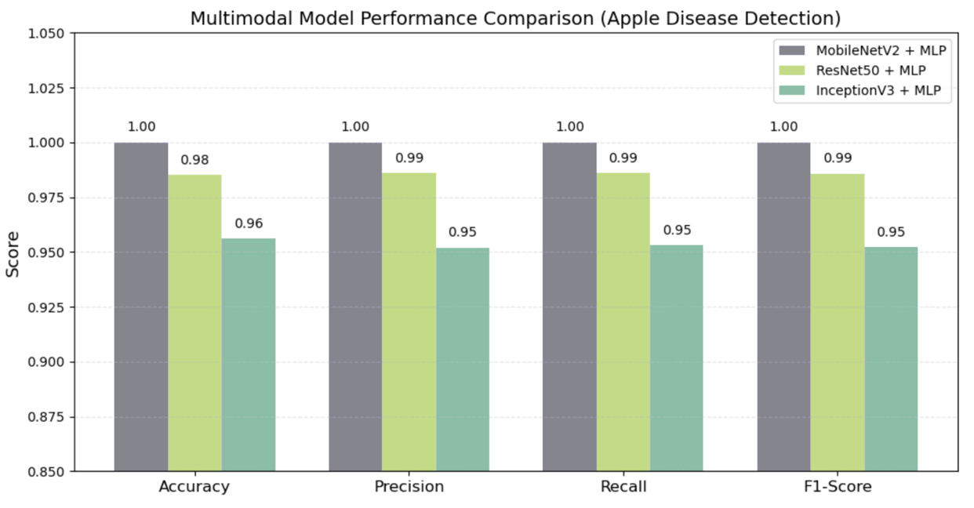
AI and the impact of climate change on plant diseases
Introduction
Problem
Objectives
Related Work
Dataset
Preprocessing
Evaluation
Results
Conclusion
Future Work
Multimodal Model Comparison
MobileNetV2 + MLP: Best performance (~100%) across all metrics → Lightweight embeddings + strong compatibility with structured features
ResNet50 + MLP: ~98.5%, strong but needs more diverse multimodal data → Deep architecture didn’t fully benefit from fusion
InceptionV3 + MLP: ~95.6%, moderate improvement → Visual similarity between classes limited its fusion benefit
Overall: Lightweight backbones gain more from multimodal fusion than deeper CNNs

Slide 22
AI and the impact of climate change on plant diseases
Introduction
Problem
Objectives
Related Work
Dataset
Preprocessing
Evaluation
Results
Conclusion
Future Work
Structured data alone achieves perfect performance → features are highly separable.
Image-only CNNs also achieve >99% → visual patterns are very clear.
Multimodal fusion improved MobileNetV2 the most due to compatibility of features.
Deep models like ResNet50 and InceptionV3 need more diverse multimodal data to benefit.
Overall, multimodal learning is promising, but effectiveness depends on dataset quality and model architecture.
Conclusion

Slide 23
AI and the impact of climate change on plant diseases
Introduction
Problem
Objectives
Related Work
Dataset
Preprocessing
Evaluation
Results
Conclusion
Future Work
Future Work
Expand multimodal dataset with more diverse samples
Test advanced fusion strategies (attention, gated fusion, transformers)
Include additional climate variables or temporal climate trends
Deploy the model as a real-time mobile/field diagnosis tool

Slide 24
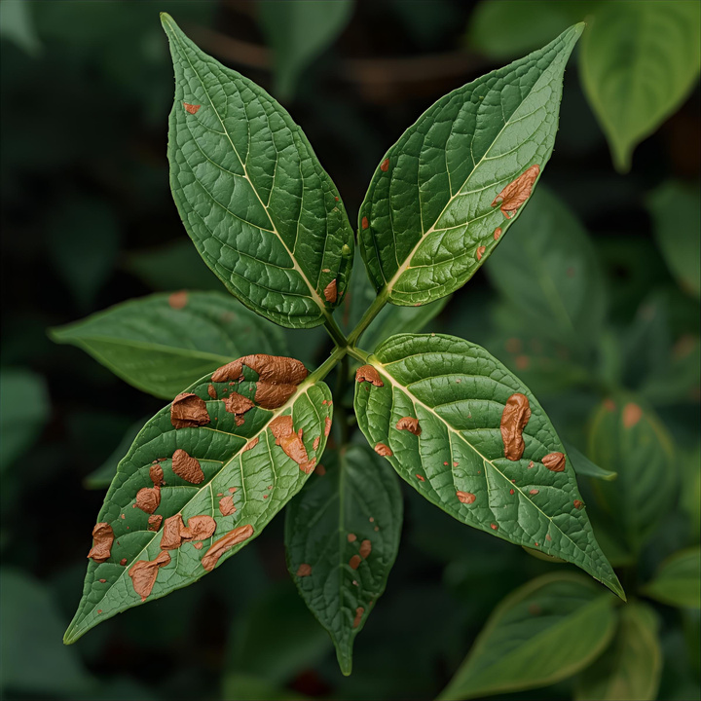
THANK YOU!
Fatima Alkaff
Master’s Student,
Department of Artificial Intelligence
Midocean University
Lecturer: Dr. Hager Saleh

