Slide 1


Chapter 1: Introduction to FinTech and the Digital Economy
Prepared by Dr. Mohamed Sleem
FNT611
Foundations of FinTech
Lecture 1

Slide 2



Chapter 1: Introduction to FinTech and the Digital Economy
Lecture 1
FNT611
Foundations of FinTech
Prepared by
Dr. Mohamed Sleem

Slide 3
Objectives
Understand the definition, characteristics, growth trends, and key drivers of the digital economy.
Explain the historical progression of industrial revolutions and their impact on digital transformation.
Discuss Moore’s Law and its significance in technological advancement.
Identify the foundational elements supporting the digital economy, including digital advertising.
Explain digital currencies and blockchain technology, including their principles and applications.
Describe artificial intelligence, big data, and FinTech innovations in the digital economy.

Slide 4
Digital Economy
Global business e-commerce sales reached about $27 trillion in 2022, based on data from 43 countries representing around three quarters of global GDP.
Retail e-commerce sales passed $6 trillion globally in 2024, representing about 20.1% of total retail sales worldwide.
Around 5.5 billion people were online in 2024, equal to 68% of the world’s population.
About 2.6 billion people remain offline, showing that the digital divide is still a major global challenge.
Worldwide digital transformation spending is forecast to reach nearly $4 trillion by 2027, driven strongly by AI, cloud, automation, and data technologies.
The number of IoT devices is projected to reach 39 billion by 2029, showing the rapid expansion of connected digital infrastructure.

Slide 5
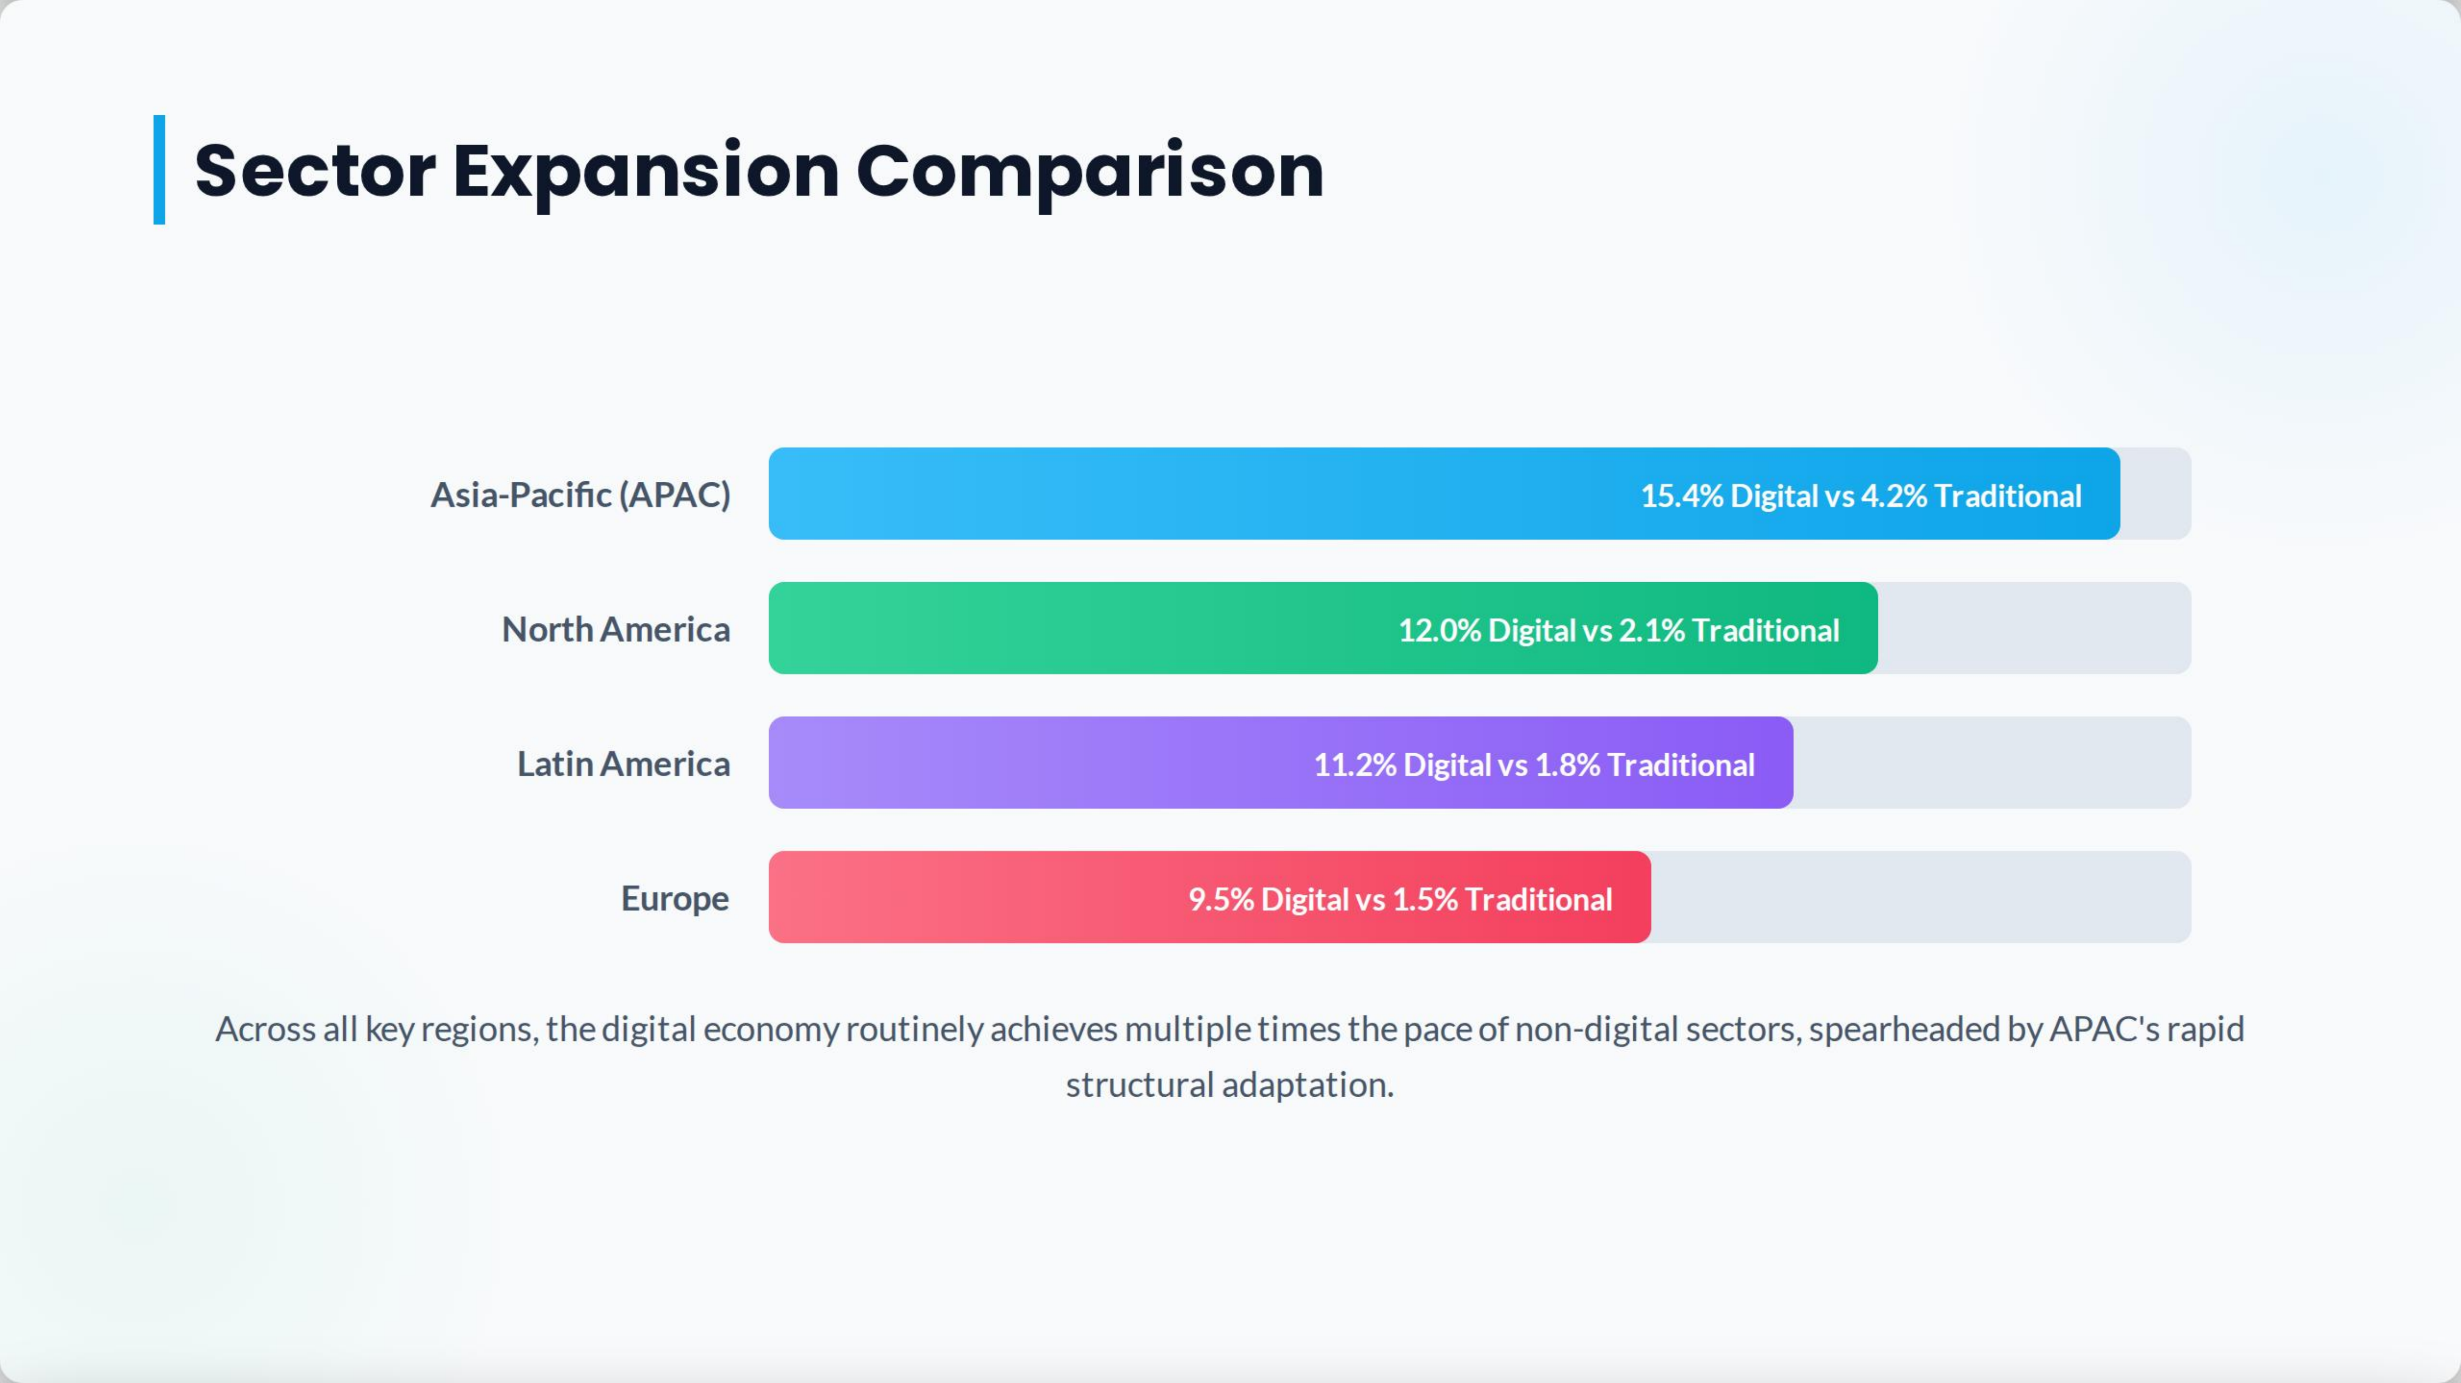

Slide 6
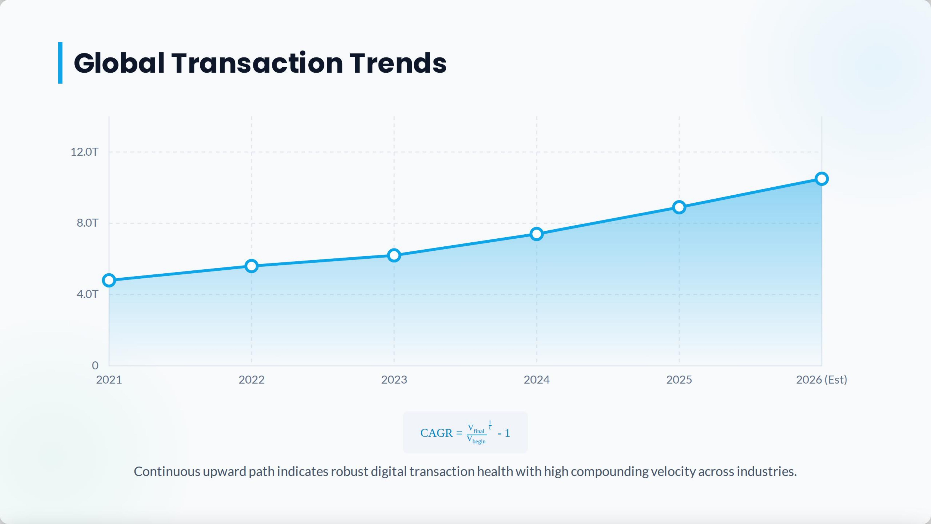

Slide 7
Digital Economy Definition
The digital economy is the part of the economy that is enabled, driven, and transformed by digital technologies, including the internet, data, software, artificial intelligence, cloud computing, and digital platforms.
It encompasses the production, distribution, exchange, and consumption of goods and services through digital means, as well as the economic activities, business models, and social interactions that rely on digital infrastructure and data-driven innovation.

Slide 8
Notable Achievements
Feature/Aspect | Uber | General Motors (GM)
Business Model | Platform-based, connects drivers to riders. | Traditional automaker; designs and sells vehicles.
Digital Integration | Entirely app-based with data analytics for optimization. | OnStar, EV tech, autonomous tech, and Maven car-sharing
Revenue Streams | Service fees from rides, Uber Eats. | Vehicle sales, leasing, financing.
Scalability | Rapid expansion via its digital model. | Capital-intensive expansion with physical infrastructure
Adaptability | Agile, quick pivots in the digital space. | Slower adaptation due to size and physical product.
Main Challenges | Regulatory issues, competition, driver status concerns. | EV shift, tech competition (e.g., Tesla), digital transformation.

Slide 9
1st, 2nd, 3rd Industrial Revolutions:
First Industrial Revolution
  In the late 18th to early 19th century, people started using machines for production, like the steam engine and spinning jenny, creating the first factories.
Second Industrial Revolution
  In the late 19th to early 20th century, electricity, steel processes, and railroads became common, leading to mass production and more industry growth.
Third Industrial Revolution
  In the late 20th century, known as the Digital Revolution, we moved from analog to digital technology, with the rise of computers and the internet.

Slide 10
Moore's Law
The founder of Intel, Gordon Moore, predicted that by making transistors smaller and smaller, one could double the number of transistors on a single silicon chip every two years.
Intel 4004 was made with 10 μm technology, that is, the size of the transistor on the 4004 chip is about 10 μm large (1 μm is one-millionth of a meter, i.e., it is the size of small bacteria).
Gordon Moore’s prediction is famously known as Moore’s Law.
Today, almost 50 years later, this prediction still holds true.

Slide 11
The 4th Industrial Revolution
The 4th Industrial Revolution (4IR) refers to the current and developing environment in which disruptive technologies and trends such as the Internet of Things (IoT), robotics, virtual reality, and artificial intelligence (AI) are changing the way we live and work.
Key Features of the 4th Industrial Revolution:
  Interconnectivity: With IoT and improved internet connectivity, devices can communicate with each other seamlessly.
  Automation: Advanced robotics and AI allow for tasks in industries to be automated, reducing the need for human intervention.
  Real-time Data: Advanced sensors and analytics provide real-time insights which can be used to optimize processes and outcomes.
  Advanced User Interfaces: Virtual and augmented reality offers new ways for humans to interact with technology.

Slide 12
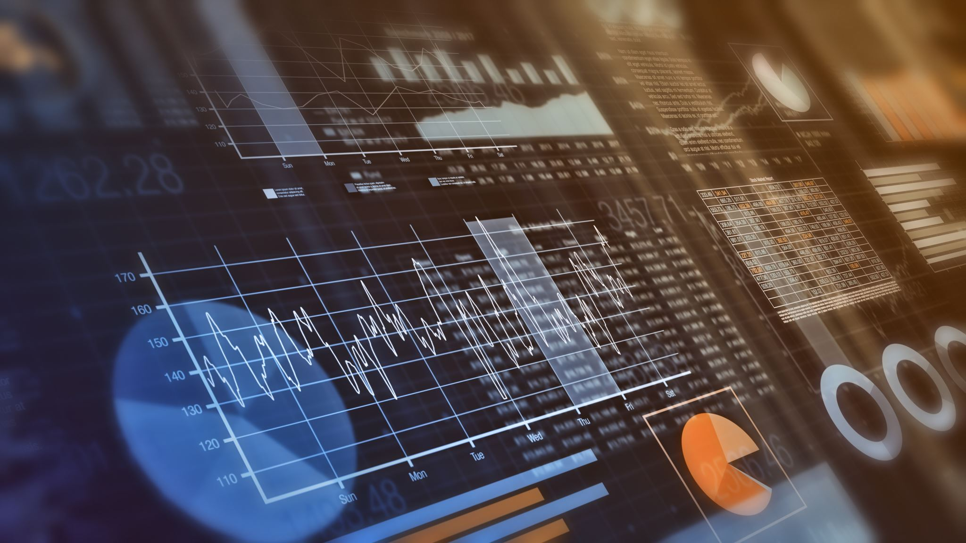
Digital Economy Foundation
Processing Information Digitally:
  This refers to the conversion of information into digital formats, where it can be efficiently stored, accessed, and analyzed using computers and digital tools. Unlike traditional methods which relied on physical records and manual computations, digital processing speeds up tasks, reduces errors, and enables complex operations that were previously unfeasible.
Importance of Data:
  Data, when collected, analyzed, and utilized properly, can provide insights, fuel innovation, personalize experiences, and drive decision-making. It's the backbone of artificial intelligence, machine learning, and many modern business strategies. The quality, accuracy, and security of this data are paramount in maximizing its potential.

Slide 13
Transformation of Advertising
Traditional Ads
  Uses things like TV, radio, and newspapers to reach many people but can't be customized or tracked well.
Digital Ads
  Uses the internet and email and can be adjusted in real-time to fit specific groups of people, with detailed tracking.
Smart Ads
  Show ads based on what users do online, so ads are more relevant and likely to get responses.

Slide 14
Blockchain Technology
A decentralized and distributed digital ledger used to record transactions across multiple computers so that the record cannot be altered retroactively without the alteration of all subsequent blocks.
Transition to Internet of Value:
Internet of Value: A concept where value, including money, assets, and even votes, can be transferred over the internet as easily as information. It moves beyond just transactional data to include value and trust.
Blockchain's Role: it provides a secure, transparent, and tamper-proof way to transfer value (like Bitcoin or other assets) across the internet. Its decentralized nature ensures that value can be transferred peer-to-peer, without intermediaries, making transactions more efficient.

Slide 15

Beyond Internet - Digital Currency
Digital or virtual currencies that use cryptography for security, operating independently of a traditional bank.
Rise of Bitcoin and Cryptocurrencies:
Bitcoin: Introduced in 2009 by an anonymous entity called Satoshi Nakamoto, it was the first decentralized cryptocurrency.
Growth: Since then, thousands of alternative cryptocurrencies have been created, such as Ethereum, Ripple, and Litecoin, reflecting a burgeoning interest and adoption in the digital currency space.

Slide 16
Introduction to Artificial Intelligence (AI)
AI refers to the simulation of human intelligence in machines that are programmed to think and learn like humans.
Role in the Digital Economy:
  Economic Catalyst: AI acts as a driving force in the digital economy, automating processes, enhancing user experiences, and creating new ways of doing business.
  Data Analysis: In the data-driven digital economy, AI provides businesses with insights by analyzing large datasets at speeds impossible for humans.
  Personalization: AI enables businesses to tailor services and products to individual preferences, driving consumer engagement and sales.

Slide 17
Integration of AI in Various Industries:
Healthcare: From diagnostic AI tools that can identify diseases to robotic surgeries, AI is revolutionizing patient care and medical research.
Retail: AI-driven recommendation systems, chatbots, and predictive inventory management enhance customer experience and operational efficiency.
Finance: Algorithms can predict market changes, detect fraudulent activities, and automate trading.
Automotive: The push towards autonomous vehicles is heavily reliant on AI systems for navigation, safety, and decision-making.
Entertainment: Content recommendation on platforms like Netflix or Spotify is powered by AI analyzing user behavior and preferences.

Slide 18
Capabilities of AI
Machine Learning
Natural Language Processing (NLP(
Computer Vision
Robotics
Predictive Analytics
Speech Recognition
Recommendation Systems

Slide 19
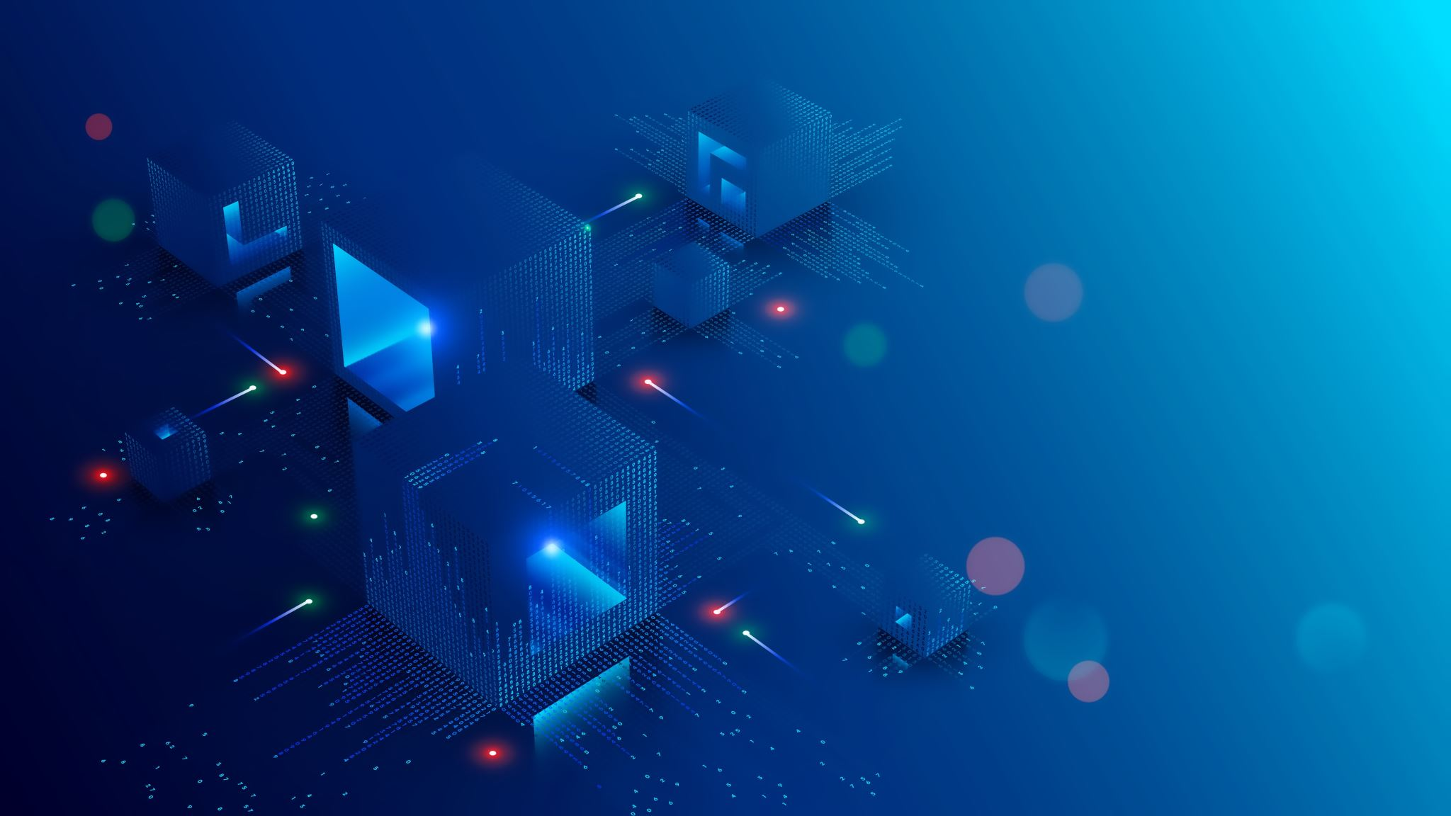
Capabilities of AI
Future Prospects:
General AI
Quantum Computing
Enhanced Personalization
Brain-Computer Interfaces
Ethical AI
Integration in Healthcare
Autonomous Vehicles

Slide 20
AI Components: 1- Hardware
  GPUs: Graphics Processing Units, crucial for the parallel processing required for many AI computations.
  ASICs: Application-Specific Integrated Circuits, like Google's Tensor Processing Unit (TPU), optimized for AI-related tasks.
  Neuromorphic Chips: Designed to mimic the human brain, facilitating more efficient learning and processing.
  Quantum Processors: Future prospect for providing exponential computational capabilities.

Slide 21
AI Components: 2- Software
Machine Learning Frameworks: Tools like TensorFlow, PyTorch, and Keras which provide libraries and functions for building AI models.
Algorithms: The underlying mathematical models that AI systems are based on. Examples include neural networks, decision trees, and clustering algorithms.
Pre-trained Models: Models like GPT-3 or BERT which can be fine-tuned for specific tasks, reducing training time and data needs.
APIs: Offer AI capabilities as services. E.g., IBM's Watson, Google Cloud AI, and Microsoft Azure AI.

Slide 22
AI Components: 3- Big Data
Structured Data: Organized in databases, spreadsheets, and can be readily and seamlessly searched.
Unstructured Data: Includes texts, images, sounds which aren't categorized and cannot be easily queried.
Real-time Data: Streaming data that is used and analyzed in real-time scenarios, often seen in IoT devices and sensors.
Training Data Sets: Specific collections of data used to train AI models.

Slide 23
Role of Big Data in AI Learning:
Training: AI gets better with a lot of good quality data from Big Data.
Validation: Separate big sets of data check and improve AI models to work well with new data.
Feature Picking: Big Data helps find important pieces of data to make models more accurate.
Learning: As more data comes, AI keeps learning and stays useful.
Diverse Learning: Data from different places makes AI fair and widely usable.
Deep Learning: Deep learning finds complex patterns in big datasets.

Slide 24
Industry 4.0
Trend of Automation: Fourth Industrial Revolution, signifies the current trend of automation and data exchange in manufacturing processes.
Involving Technologies: It uses systems that combine computer and physical processes, the Internet of Things (IoT), cloud computing, and smart computing.
New Way of Producing: It’s a more connected and complete way of creating products and running industries.

Slide 25
Digital Technologies in Manufacturing:
IoT: Devices share data through the internet, making real-time changes in making things.
Cyber-Physical Systems: Systems mix computer programs and the internet to control physical processes. They let physical processes and computations affect each other.
Cloud Computing: Helps businesses by managing and studying data on the cloud, saving money and growing easily.

Slide 26
Digital Technologies in Manufacturing:
AI & Computing: Lets machines make decisions and do tasks like humans.
Augmented Reality: Mixes digital data with the real world for training and design.
Big Data: Lets businesses study lots of data to work better and predict problems.
Digital Twins: virtual models of real things and can test how a product works under different situations.

Slide 27
Digital Technologies in Manufacturing:
Smart Factories : digital factories that use smart manufacturing to run themselves and adjust to new conditions in real-time.
Advanced Robots:"cobots," can work with humans and share data in real-time, making manufacturing fast and precise.
Adaptive Making: machines change tools and adjust themselves for different jobs, using smart sensing technology.
3D Printing: let us make parts on-site, allowing quick testing and less reliance on supply chains.
Modular Production: Automated lines can be changed quickly to meet new design or volume needs, making manufacturing flexible.

Slide 28
Data in Industry 4.0
Real-time Data Collection: With sensors and Internet of Things (IoT) devices embedded in machinery and products, industries can collect data in real-time, leading to immediate feedback and adjustments.
Interconnectedness: Devices, machines, and systems share data across a networked infrastructure, allowing seamless communication between different segments of the production process.
Predictive Analytics: By analyzing historical and real-time data, predictive models can be constructed to anticipate machine failures, maintenance needs, and production inefficiencies.
Data-driven Supply Chain Management: Data analytics can optimize supply chains by predicting demand, managing inventory, and enhancing logistics.

Slide 29
Decision-making with Data:
Insightful Operations: Analytics provide insights into production inefficiencies, bottlenecks, and operational risks, enabling timely intervention and optimization.
Customer-centric Production: By analyzing consumer data, companies can better understand customer preferences and can tailor products and services accordingly.
Strategic Planning: With a data-driven approach, businesses can make informed decisions about product launches, market expansion, and investments.
Risk Management: Predictive analytics can identify potential risks and help businesses develop strategies to mitigate them.

Slide 30
FinTech
"Financial Technology", refers to the integration of technology into financial services to improve, automate, and modernize financial activities.
It combines new technologies with financial services, making new business models and products.
It’s the future of finance, using technology to make finance open to everyone, clearer, and more efficient. It’s important for everyone, including regulators and consumers, to work together to use its benefits and reduce any risks.

Slide 31
FinTech Benefits:
Accessibility: Makes financial services more accessible, especially in underserved areas without traditional banking.
Efficiency: Streamlines operations, making them quicker and often more user-friendly.
Cost Reduction: Often results in reduced costs for both service providers and consumers.
Transparency: Many FinTech platforms offer real-time tracking, clear fee structures, and instant notifications.

Slide 32
FinTech Barriers:
Security Concerns: With digital services, there's always the risk of cyberattacks.
Regulation: As a relatively new industry, FinTech often faces regulatory challenges.
Trust: Newer FinTech companies might face challenges in gaining the trust of consumers used to traditional financial institutions.
Market Saturation: The popularity of FinTech has led to a crowded market with numerous start-ups competing in similar spaces.

Slide 33
Key Aspects of FinTech:
Banking & Payments:
  Digital Banking: Online platforms or mobile apps that offer traditional banking services without the need for physical branches.
  Mobile Payments: Using smartphones or wearable technology to make payments.
  P2P Transfers: Peer-to-peer platforms allowing individuals to send money to each other directly.

Slide 34
Key Aspects of FinTech:
Investments & Savings:
  Robo-Advisors: Automated platforms that provide investment advice based on algorithms without human intervention.
  Digital Trading Platforms: Apps or websites for trading stocks, commodities, or other financial instruments.
  Cryptocurrency & Blockchain: Digital or virtual currencies like Bitcoin that use cryptography for security, and the underlying technology known as blockchain.

Slide 35
Key Aspects of FinTech:
Lending:
  P2P Lending: Online platforms where individuals can either borrow or lend to their peers, bypassing traditional banks.
  Crowdfunding: Platforms where entrepreneurs can raise small amounts of money from a large number of people.

Slide 36
Key Aspects of FinTech:
Insurance (InsurTech):
  Telematics: Using IoT and data analytics in car insurance to charge based on actual driving patterns.
  Digital Insurance Platforms: Online platforms or apps offering insurance products and claims processing.

Slide 37
Key Aspects of FinTech:
RegTech:
  Regulatory Compliance: Technologies to help financial service providers meet financial compliance rules.
  Anti-Money Laundering (AML) & Know Your Customer (KYC) Solutions: Digital tools to prevent financial crimes.

Slide 38
Key Aspects of FinTech:
Financial Health:
  Personal Financial Management: The state of one's personal monetary affairs, and the ability to manage short-term obligations while ensuring long-term financial security. It encompasses income, spending, saving, and investment habits, as well as understanding and use of financial tools.
  Personal Financial Management (PFM): A set of tools or platforms, usually digital, designed to help individuals monitor, manage, and optimize their financial affairs.

Slide 39
Future Outlook
The continuous integration of AI, big data, and other emerging technologies suggests the FinTech sector will keep evolving.
Collaboration between traditional financial institutions and FinTech startups can lead to hybrid models, combining the best of both worlds.
In essence, FinTech represents the future of the financial industry, leveraging technology to make financial transactions more efficient, accessible, and often more affordable for the end-user.

Slide 40
Fintech in the Digital Economy
Digital Banking:
  Neobanks: These are digital-only banks without physical branches. Examples include Monzo, Revolut, and Chime.
  Banking Platforms: Traditional banks now offer comprehensive online platforms and apps, enabling users to perform almost all banking functions remotely.
Payments and Transfers:
  Mobile Wallets: Platforms like Apple Pay, Google Wallet, and Samsung Pay allow users to store card details and make contactless payments.
  Cross-border Transfers: Companies like TransferWise (now Wise) and Remitly offer international money transfers at lower fees than traditional banks.

Slide 41
Summary
Explored the core definition and growth dynamics of the digital economy.
Traced historical milestones, from industrial revolutions to modern advancements.
Delved into the pivotal role of Moore's Law in tech progression.
Examined key technologies like blockchain and AI, and their broader impacts.
Understood the evolution of sectors, notably in advertising and finance, through digital lenses.
Highlighted the crucial interplay between big data and AI learning.
Touched upon the transformative influence and potential of FinTech in our economic structure.

Slide 42
For Discussion:
Explain the difference between a narrow definition and a broad definition of the digital economy.
Explain the impact of the 4th Industrial Revolution on how we live and work, focusing on its key features.
Explain the role of Artificial Intelligence (AI) in the digital economy and how it influences business processes and user experiences.
Discuss four benefits associated with FinTech.

Slide 43


