Slide 1


Orientation show
عرض توجيهي
IT111 - Introduction to Information Technology
Bachelor of Science in Information Technology
Prof. Lamiaa Fattouh Ibrahim
Everyone Smart University
Faculty of INFORMATICS
Spring 2023

Slide 2

بسم الله الرحمن الرحيم
اللهم صلي و سلم و بارك على اشرف المرسلين سيدنا محمد و على ال و اصحابه افضل التسليم
يسعدني أن أرحب بكم ترحيبا خاصا في مستهل هذا الفصل الدراسي الجديد، الذي نتطلع فيه إلى المزيد من العمل المثمر والجاد من أجل بلوغ الأهداف التي
اجتمعنا من أجلها في هذا الصرح العلمي العظيم، راجيا من الله العلي القدير أن يوفقنا جميعا لتأدية مهامنا الأكاديمية والإدارية
والتربوية على الوجه الذي يحبه و يرضاه.
كل عام و انتم بخير

Slide 3
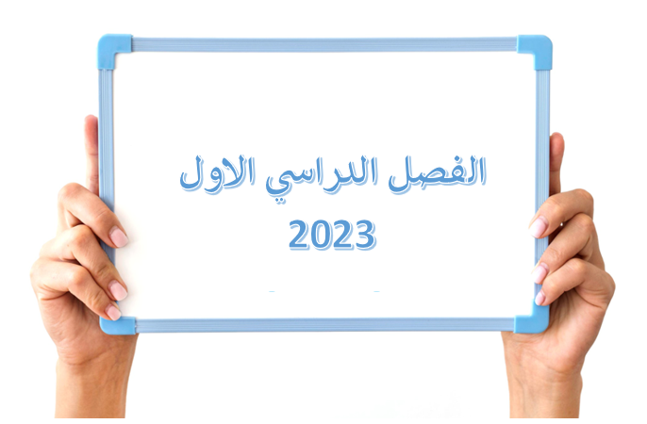


Spring 2022-2023
Introduction to Information Technology, Prof. Lamiaa Fattouh Ibrahim, Spring 2022-2023

Slide 4
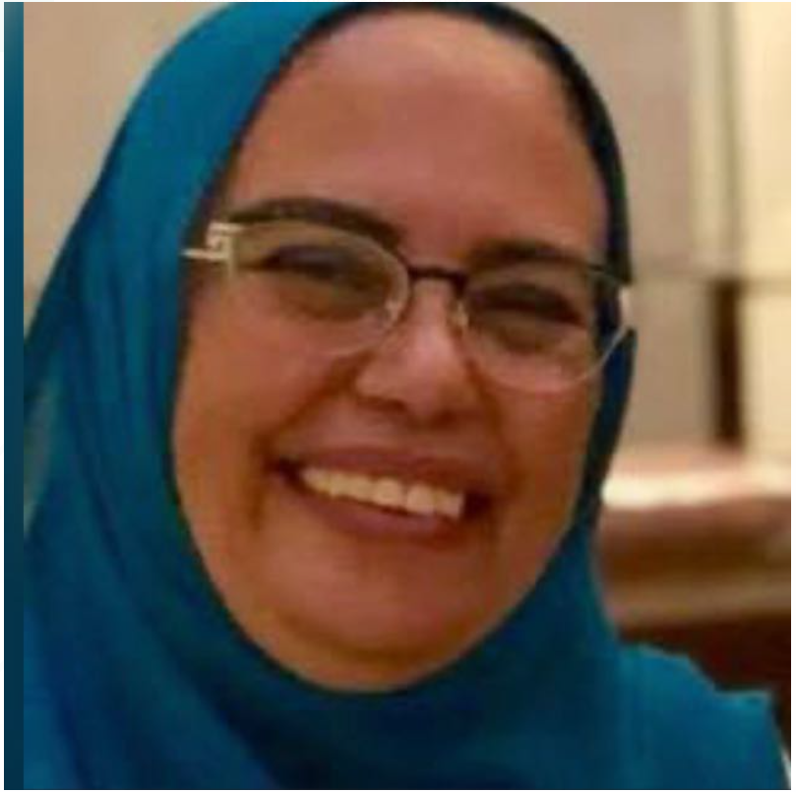
Who Am I?
Prof. Lamiaa Fattouh Ibrahim
  Professor in Artificial Intelligent
Dean of Faculty of Informatics- Everyone’s Smart University
Professor Department of Computer Science – Faculty of Graduate Studies for Statistical Research - Cairo University.
4
Operating Sysems, Prof. Lamiaa Fattouh Ibrahim, Summer 2022

Slide 5
Who Am I?
Vice Dean for Education and Student Affairs, Faculty of Information Systems and Computer Science, October 6 University.
Head of Department of Computer Science – Faculty of Graduate Studies for Statistical Research - Cairo University
Professor in the Information Technology Department, Faculty of Computing and Information Technology, King Abdulaziz University from 2004 to 2018.
Introduction to Information Technology, Prof. Lamiaa Fattouh Ibrahim, Spring 2022-2023

Slide 6
Who Am I?
  Doctor of Philosophy Ph.D. Cairo University. Faculty of Engineering. Electronics and Electrical Communications department 1999.
  Master: Ain Shams University. Faculty of Engineering. Computer & Systems Engineering department 1993.
  Master: Ecole National Superieur de Telecommunication ENST France, Paris 1987.
B.S.c: Ain Shams University. Faculty of Engineering. Electrical Engineering Department Computer & Automatic Control department
Introduction to Information Technology, Prof. Lamiaa Fattouh Ibrahim, Spring 2022-2023

Slide 7
Who Am I?
Over 37 years of experience in the fields of network design engineering and artificial intelligence, focusing on applying knowledge base and data mining techniques in wired and wireless network planning.
Published papers in many international journals and international conferences in the areas of networks, data mining, and wired and mobile network planning.

Slide 8



Contact information
  How to reach me
    By email at lamiaa@esu.ac.ae
    ( please include “Introduction to Information Technology” in subject line)
  Office hours
  Discussion Time (Wednesday at 9:00 PM) every week
https://scholar.google.com/citations?user=nT5sDzUAAAAJ&hl=en
https://www.scopus.com/authid/detail.uri?authorId=6701449773
https://orcid.org/my-orcid?orcid=0000-0001-5671-8941
Introduction to Information Technology, Prof. Lamiaa Fattouh Ibrahim, Spring 2022-2023

Slide 9

The course that will be taught
Introduction to Information Technology, Prof. Lamiaa Fattouh Ibrahim, Spring 2022-2023

Slide 10
Learning Resources:
Credit Hours: 3 credit hours.
  Required Textbook:
Foundations of Computer Science,
4th Edition
Behrouz Forouzan
Introduction to Information Technology, Prof. Lamiaa Fattouh Ibrahim, Spring 2022-2023

Slide 11
Description of the course:
This course contains an introduction to information technology and computing systems. This course is intended to introduce the discipline of computing, computer systems, number systems, data representation, basic computer organization, operating system functionality, basics of networking and Internet. This course also provides an overview of database systems, models, software engineering methodologies and programming languishes.
Introduction to Information Technology, Prof. Lamiaa Fattouh Ibrahim, Spring 2022-2023

Slide 12
Learning Outcomes
Upon successful completion of this course, students should be able to:
Identify the historical development of computer science and technologies and their applications.
Distinguish and converting between different number systems.
Describe how computer represent, manipulate different data types and how to communicate with peripheral devices.
Describe the basic structures and functional components of computer hardware.
Introduction to Information Technology, Prof. Lamiaa Fattouh Ibrahim, Spring 2022-2023

Slide 13
Learning Outcomes
Describe basic operating systems functions and how they do it.
Compare different operating systems.
Describe constructions and operation of computer networks, applications of networks, Internet.
Identify the basics of software engineering discipline and software life cycle.
Compare different software engineering methodologies.
Recognize the commonality and diversity among programming languages and their associated methodologies.
Introduction to Information Technology, Prof. Lamiaa Fattouh Ibrahim, Spring 2022-2023

Slide 14
Course Information
  Assessment Method:
Short Exam
  80% marks
    Count of short Exam 10 (Weekly)
    8 Marks for every each of short Exam.
  20% Final Examination
Introduction to Information Technology, Prof. Lamiaa Fattouh Ibrahim, Spring 2022-2023

Slide 15
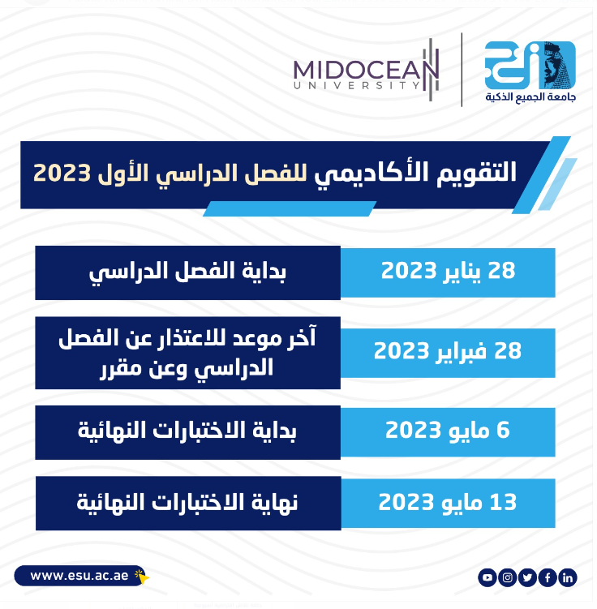
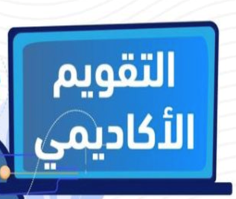
Academic Calendar
Introduction to Information Technology, Prof. Lamiaa Fattouh Ibrahim, Spring 2022-2023

Slide 16


Academic Calendar
الفترة الزمنية التعليمية في الفصل الدراسي ربيع تكون مدة ١٣أسبوع
(منهم أسبوع للاختبار النهائي)
Introduction to Information Technology, Prof. Lamiaa Fattouh Ibrahim, Spring 2022-2023

Slide 17
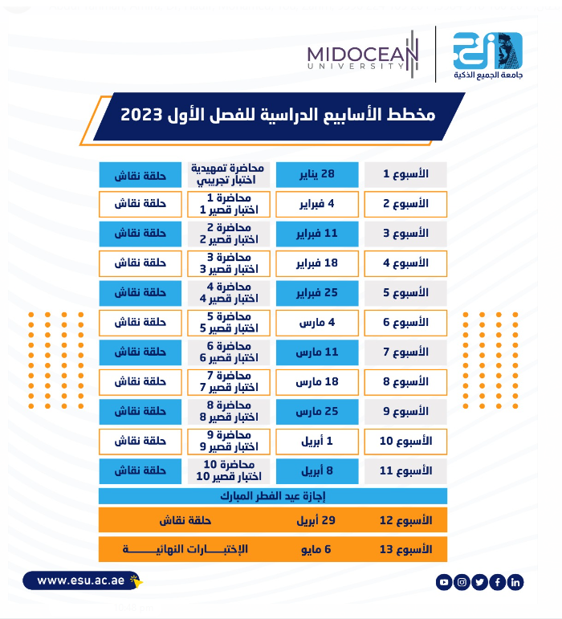
Academic Calendar
Introduction to Information Technology, Prof. Lamiaa Fattouh Ibrahim, Spring 2022-2023

Slide 18
Course Schedule Model
Week Number | Covered
1 | Orientation week
2 | Introduction (Chapter 1) Number Systems (Chapter 2)
3 | Number Systems (Chapter 2 continue)
4 | Data Storage (Chapter 3)
5 | Operations on Data (Chapter 4)
6 | Computer Organization (Chapter 5)
7 | Computer Organization (Chapter 5 continue)
8 | Computer Networks (Chapter6)
9 | Operating Systems (Chapter 7)
10 | Programming Languages (Chapter 9)
11 | Software Engineering (Chapter 10)
12 | Revision
13 | Final Exams

Slide 19
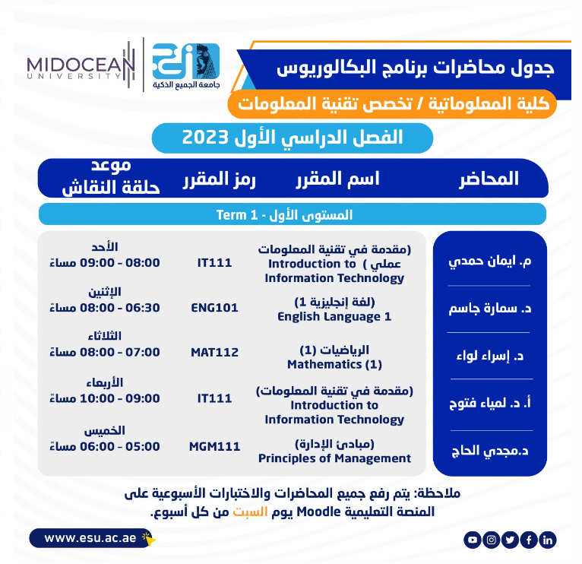
Academic Calendar
عبر برنامج ZOOM
سيتم تثبيت رابط حلقة النقاش على صفحة المقرر
Introduction to Information Technology, Prof. Lamiaa Fattouh Ibrahim, Spring 2022-2023

Slide 20

Academic Calendar
-- اللغة الأساسية في المحاضرات هي:
اللغة الإنجليزية
-- الاختبارات باللغة الإنجليزية مع وجود
ترجمة للسؤال.
Introduction to Information Technology, Prof. Lamiaa Fattouh Ibrahim, Spring 2022-2023

Slide 21

Introduction to Information Technology, Prof. Lamiaa Fattouh Ibrahim, Spring 2022-2023

