Slide 1

Advanced Project Management APM
Advanced Project Management (APM)

Slide 2
Advanced Project Management
Strategic Management and Project Selection

Slide 3

Strategic Management and Project Selection
With so many ongoing projects it becomes difficult for smaller projects to get adequate support, or even the attention of senior management. Three common problems in organizations trying to manage multiple projects are:
1- Delays in one project cause delays in other projects because of common resource needs or technological dependencies.
2- The inefficient use of corporate resources results in peaks and valleys of resource utilization. 3- Bottlenecks in resource availability or lack of required technological inputs result in project delays that depend on those scarce resources or technology.
This enforce the need for Project Management Office (PMO).
It is expected that the PMO will promote those projects that capitalize on the organization’s strengths, offer a competitive advantage, and mutually support each other, while avoiding those with resource or technology needs in areas where the organization has no desire for development.

Slide 4
Strategic Management and Project Selection
Given that the organization has an appropriate mission statement and strategy, projects must be selected that are consistent with the strategic goals of the organization.
Project selection is the process of evaluating individual projects or groups of projects and then choosing to implement some set of them so that the objectives of the parent organization will be achieved.
Because considerable uncertainty may surround one’s initial notions of precisely how most projects will be carried out, what resources will be required, and how long it will take to complete the project, we will introduce risk analysis
The project manager who does not understand what a given project is expected to contribute to the parent organization lacks critical information needed to manage the project in order to optimize its contribution to the parent organization

Slide 5
Strategic Management and Project Selection
2.1 PROJECT MANAGEMENT MATURITY
Project management maturity is a measure of the organization’s project managers mastery of the skills required to manage projects competently.
A number of consulting firms, as well as scholars, have devised formal maturity measures including:
IPMA, PMI, PM3® and others.

Slide 6
Strategic Management and Project Selection
2.2 PROJECT SELECTION AND CRITERIA OF CHOICE
Project selection is the process of evaluating proposed projects or groups of projects, and then choosing to implement some set of them so that the objectives of the parent organization will be achieved.
This systematic process can be applied to any area of the organization’s business in which choices must be made between competing alternatives.
It is critically important to the success of the PM that he or she fully understands the parent organization’s objectives in undertaking a project that the PM is expected to lead. Most of the decisions that the PM is forced to make will have an impact on the degree to which the project contributes to those objectives the parent organization expected from the project.
modeling the problem is the process of carving away the unwanted reality from the bones of a problem.
many models include graphs, analogies, diagrams, as well as flow graph and network models to help solve scheduling problems, and symbolic (mathematical) models for a number of purposes.

Slide 7
Strategic Management and Project Selection
2.2 PROJECT SELECTION AND CRITERIA OF CHOICE
If the input data for a model are not known precisely, we often use probabilistic information; that is, the model is said to be stochastic rather than deterministic.
When a firm chooses a project selection model, the following criteria are most important:
Realism The model should reflect the reality of the firm’s decision situation. It should also take into account the realities of the firm’s limitations on facilities, capital, personnel, and so forth, and include factors that reflect project technical and market risks: performance, cost, time, customer rejection, and implementation.
Capability The model should be sophisticated enough to deal with the relevant factors: multiple time periods, situations both internal and external to the project (e.g., strikes, interest rate changes), and so on.
Flexibility The model should give valid results within the range of conditions that the firm might experience. It should be easy to modify in response to changes.

Slide 8
Strategic Management and Project Selection
2.2 PROJECT SELECTION AND CRITERIA OF CHOICE
Ease of use The model should be reasonably convenient, not take a long time to execute, and be easy to use and understand. It should not require special interpretation, data that are difficult to acquire, excessive personnel, or unavailable equipment.
Cost Data-gathering and modeling costs should be low relative to the cost of the project and less than the potential benefits of the project. All costs should be considered, including the costs of data management and of running the model.
Easy computerization It should be easy and convenient to gather and store the information in a computer database, and to manipulate data in the model through use of a widely available, standard computer package such as Excel®

Slide 9
Strategic Management and Project Selection
2.3 THE NATURE OF PROJECT SELECTION MODELS
There are two basic types of project selection models, numeric and nonnumeric. Both are widely used. Many organizations use both at the same time, or they use models that are combinations of the two.
Nonnumeric models, as the name implies, do not use numbers as inputs.
Numeric models do, but the criteria being measured may be either objective or subjective.
It is important to remember that the qualities of a project may be represented by numbers, and that subjective measures are not necessarily less useful or reliable than objective measures.
Never forgetting two critically important, but often overlooked, facts:
• Models do not make decisions—people do.
• All models, however sophisticated, are only partial representations of the reality they are meant to reflect.

Slide 10
Strategic Management and Project Selection
2.4 TYPES OF PROJECT SELECTION MODELS
Nonnumeric Models:
The Sacred Cow The project is suggested by a senior and powerful official in the organization with a simple comment such as, “If you have a chance, why don’t you look into…,” The immediate result of this bland statement is the creation of a “project” to investigate whatever the boss has suggested. The project is “sacred” in the sense that it will be maintained until successfully concluded, or until the boss, personally, recognizes the idea as a failure and terminates it.
The Operating Necessity If a flood is threatening the plant, a project to build a protective dike does not require much formal evaluation, which is an example of this scenario.
If the project is required in order to keep the system operating, the primary question becomes: Is the system worth saving at the estimated cost of the project? If the answer is yes, project costs will be examined to make sure they are kept as low as is consistent with project success, but the project will be funded.

Slide 11
Strategic Management and Project Selection
2.4 TYPES OF PROJECT SELECTION MODELS
Nonnumeric Models:
The Competitive Necessity Is the company decision to go for some projects if the firm want to maintain its competitive position in the market area.
Investment in an operating necessity project takes precedence over a competitive necessity project, but both types of projects may bypass the more careful numeric analysis used for projects deemed to be less urgent or less important to the survival of the firm.
The Product Line Extension A project to develop and distribute new products would be judged on the degree to which it fits the firm’s existing product line, fills a gap, strengthens a weak link, or extends the line in a new, desirable direction. Sometimes careful calculations of profitability are not required. Decision makers can act on their beliefs about what will be the likely impact on the total system performance if the new product is added to the line.

Slide 12
Strategic Management and Project Selection
2.4 TYPES OF PROJECT SELECTION MODELS
Nonnumeric Models:
Comparative Benefit Model Senior management would like to select a subset of the projects that would most benefit the firm, but the projects do not seem to be easily comparable.
The organization has no formal method of selecting projects, but members of the Selection Committee think that some projects will benefit the firm more than others, even if they have no precise way to define or measure “benefit.”
Of the several techniques for ordering projects, the Q-Sort is one of the most straightforward. First, the projects are divided into three groups—good, fair, and poor—according to their relative merits. If any group has more than eight members, it is subdivided into two categories, such as fair-plus and fair-minus. When all categories have eight or fewer members, the projects within each category are ordered from best to worst. Again, the order is determined on the basis of relative merit. The rater may use specific criteria to rank each project, or may simply use general overall judgment.

Slide 13
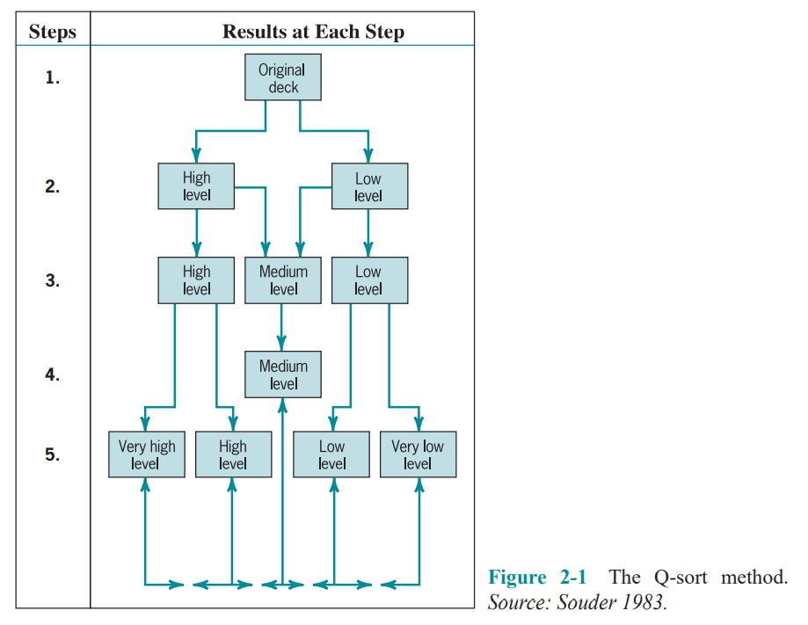
Strategic Management and Project Selection
2.4 TYPES OF PROJECT SELECTION MODELS

Slide 14
Strategic Management and Project Selection
2.4 TYPES OF PROJECT SELECTION MODELS
Numeric Models: Profit/Profitability
A large majority of all firms using project evaluation and selection models use profitability as the sole measure of acceptability.
Payback Period The payback period for a project is the initial fixed investment in the project divided by the estimated annual net cash inflows from the project. The ratio of these quantities is the number of years required for the project to repay its initial fixed investment.
For example, assume a project costs $100,000 to implement and has annual net cash inflows of $25,000. Then
Payback period = $100,000/$25,000 =4 years
This method assumes that the cash inflows will persist at least long enough to pay back the investment, and it ignores any cash inflows beyond the payback period. The method also serves as an (inadequate) proxy for risk. The faster the investment is recovered, the less the risk to which the firm is exposed.

Slide 15
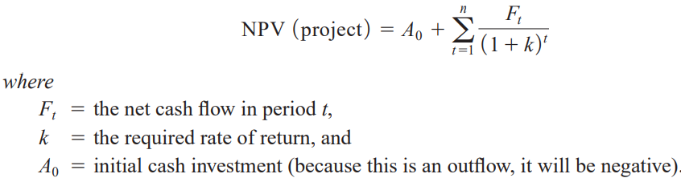
Strategic Management and Project Selection
2.4 TYPES OF PROJECT SELECTION MODELS
Numeric Models: Profit/Profitability
Discounted Cash Flow Also referred to as the net present value (NPV) method, the discounted cash flow method determines the net present value of all cash flows by discounting them by the required rate of return (also known as the hurdle rate, cut off rate, and similar terms) as follows:

Slide 16

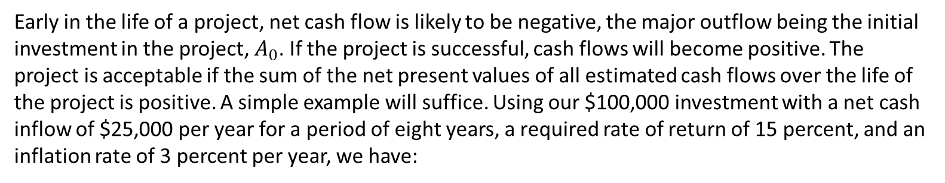
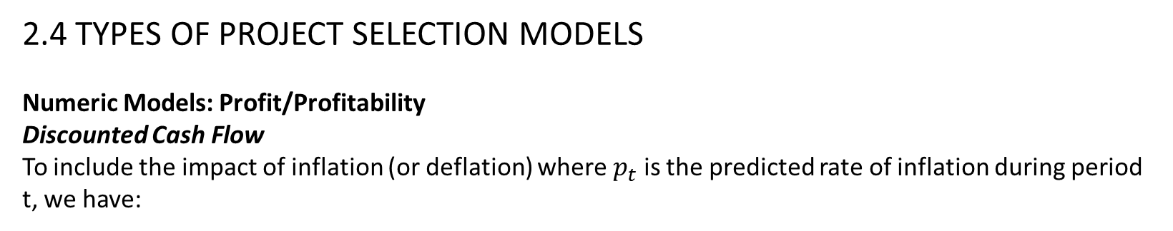
Strategic Management and Project Selection
2.4 TYPES OF PROJECT SELECTION MODELS
Numeric Models: Profit/Profitability
Discounted Cash Flow
To include the impact of inflation (or deflation) where $p_{t}$ is the predicted rate of inflation during period t, we have:
Early in the life of a project, net cash flow is likely to be negative, the major outflow being the initial investment in the project, $A_{0}$. If the project is successful, cash flows will become positive. The project is acceptable if the sum of the net present values of all estimated cash flows over the life of the project is positive. A simple example will suffice. Using our $100,000 investment with a net cash inflow of $25,000 per year for a period of eight years, a required rate of return of 15 percent, and an inflation rate of 3 percent per year, we have:

Slide 17
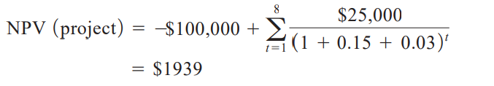
Strategic Management and Project Selection
2.4 TYPES OF PROJECT SELECTION MODELS
Numeric Models: Profit/Profitability
Discounted Cash Flow
Because the present value of the inflows is greater than the present value of the outflow i.e, the net present value is positive, the project is deemed acceptable.

Slide 18

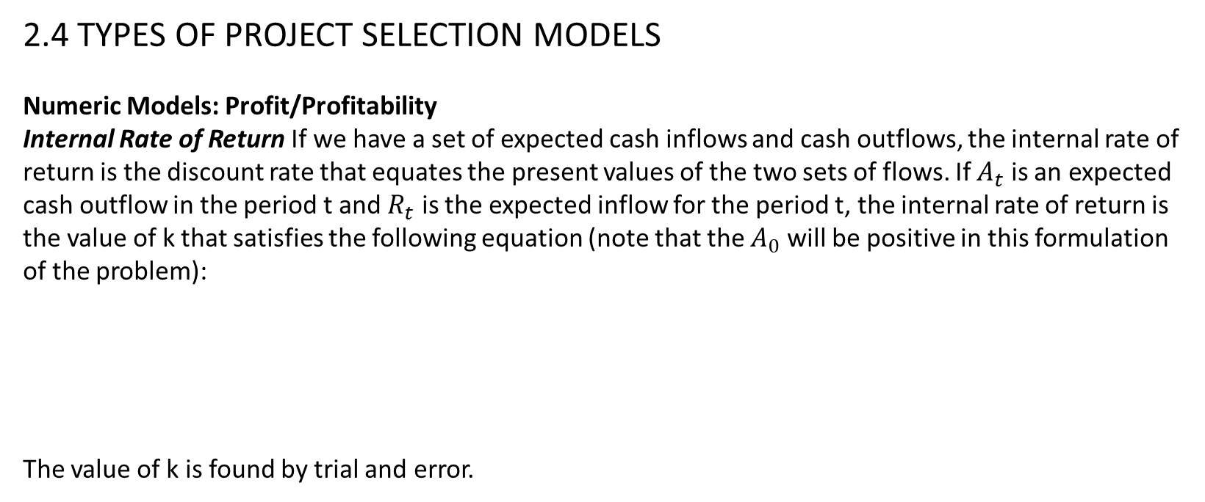
Strategic Management and Project Selection
2.4 TYPES OF PROJECT SELECTION MODELS
Numeric Models: Profit/Profitability
Internal Rate of Return If we have a set of expected cash inflows and cash outflows, the internal rate of return is the discount rate that equates the present values of the two sets of flows. If $A_{t}$ is an expected cash outflow in the period t and $R_{t}$ is the expected inflow for the period t, the internal rate of return is the value of k that satisfies the following equation (note that the $A_{0}$ will be positive in this formulation of the problem):
The value of k is found by trial and error.

Slide 19
Strategic Management and Project Selection
2.4 TYPES OF PROJECT SELECTION MODELS
Numeric Models: Profit/Profitability
Profitability Index Also known as the benefit–cost ratio, the profitability index is the net present value of all future expected cash flows divided by the initial cash investment. (Some firms do not discount the cash flows in making this calculation.) If this ratio is greater than 1.0, the project may be accepted.
Other Profitability Models There are a great many variations of the models just described. These variations fall into three general categories:
those that subdivide net cash flow into the elements that comprise the net flow.
(2) those that include specific terms to introduce risk (or uncertainty, which is treated as risk) into the evaluation.
(3) those that extend the analysis to consider effects that the project might have on other projects or activities in the organization.
Several comments are in order about all the profit-profitability numeric models.

Slide 20
Strategic Management and Project Selection
2.4 TYPES OF PROJECT SELECTION MODELS
Numeric Models: Profit/Profitability
First, let us consider their advantages:
1. The undiscounted models are simple to use and understand.
2. All use readily available accounting data to determine the cash flows.
3. Model output is in terms familiar to business decision makers.
4. With a few exceptions, model output is on an “absolute” profit/profitability scale and allows “absolute” go/no-go decisions.
5. Some profit models can be amended to account for project risk.
The disadvantages of these models are the following:
1. These models ignore all nonmonetary factors except risk.
2. Models that do not include discounting ignore the timing of the cash flows and the time value of money.
3. Models that reduce cash flows to their present value are strongly biased toward the short run.

Slide 21
Strategic Management and Project Selection
Thank you

