Slide 1




DIGITAL MARKETING STRATEGY
Prepared by
Dr. HEBA ZIAD
Lecture 7
www.midocean.ae

Slide 2
www.midocean.ae
social media strategy
TABLE OF CONTENTS
What is a social media marketing strategy
How to create a social media strategy:
Core components of social media marketing
Track meaningful social media metrics

Slide 3
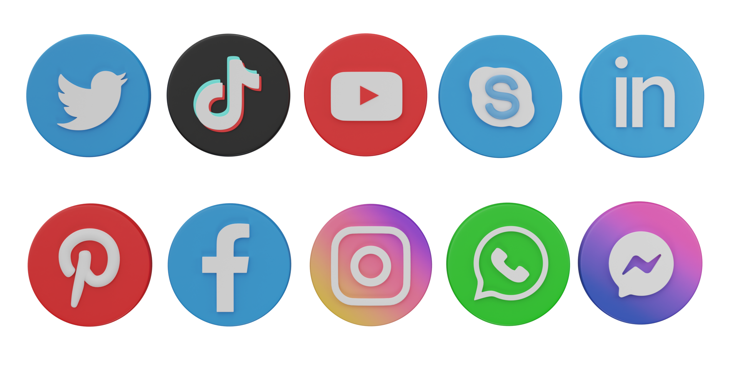
www.midocean.ae
What is social media marketing?
Social media marketing is the practice of using social media channels to sell or promote a brand, product or service.
Social media marketing helps businesses:
Increase brand awareness
Build engaged communities
Sell products and services

Slide 4

www.midocean.ae
Social media marketing helps businesses:
Measure brand sentiment
Provide social customer service
Advertise products and services to target audiences
Track performance and adjust larger marketing strategies accordingly

Slide 5

www.midocean.ae
Core components of social media marketing include:
Content creation: writing and designing social media posts to be published on social media networks
Scheduling and publishing content: using a social media management tool to keep track of when posts are published and to which networks

Slide 6

www.midocean.ae
Core components of social media marketing include:
Data analysis: tracking and reporting on performance of content through social media analytics, auditing channels quarterly
Curating content: working with influencers, followers, or customers to share user-generated content, promote your business to new audiences and/or develop sponsorship deals

Slide 7

www.midocean.ae
Core components of social media marketing include:
Social listening: tracking mentions of your business on social media to identify opportunities and stay abreast of potential crises
Community management: replying to comments and messages, hosting chats or live audio sessions with followers
Proving return-on-investment: showing how your performance on social media contributes to larger business objectives
Advertising and paid promotions: creating social media ad campaigns and/or boosting organic content with a paid budget

Slide 8

www.midocean.ae
What is a social media marketing strategy?
What is a social media marketing strategy?
A social media strategy is a document outlining your social media goals, the tactics you will use to achieve them and the metrics you will track to measure your progress.
social media marketing strategy should also list all existing and planned social media accounts along with goals specific to each platform you’re active on. These goals should align with your business’s larger digital marketing strategy.
Finally, a good social media plan should define the roles and responsibilities within your team and outline your reporting cadence.

Slide 9
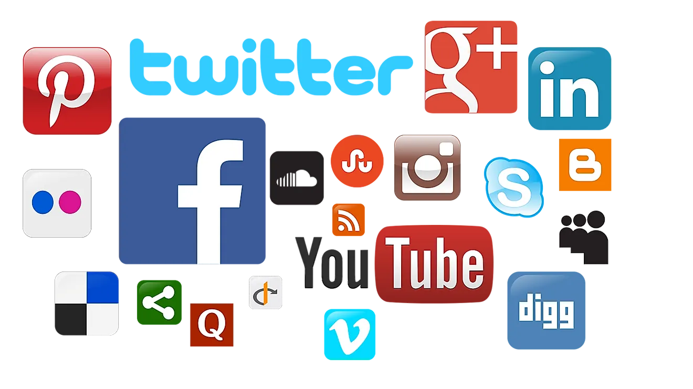
www.midocean.ae
Chapter 7
How to create a social media marketing strategy

Slide 10
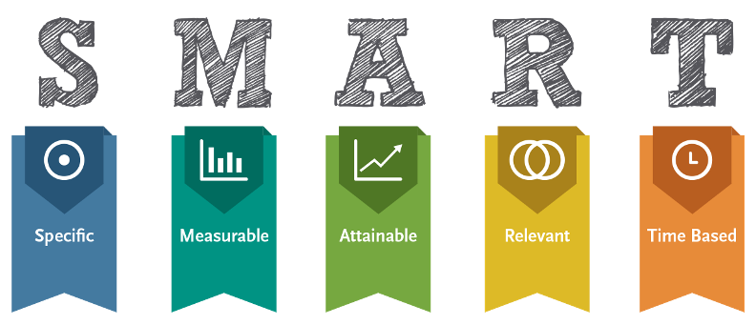
www.midocean.ae
Step 1. Choose goals that align to business objectives
Chapter 7
Set S.M.A.R.T. goals
The first step to creating a winning social media strategy is to establish clear objectives and goals. Without goals, you have no way to measure success and return on investment (ROI).
Each of your social media marketing goals should be SMART: specific, measurable, attainable, relevant and time-bound.
social media ROI means the business value returned from social media marketing and advertising.

Slide 11

www.midocean.ae
Track meaningful metrics
Vanity metrics like number of followers and likes are easy to track, but it’s hard to prove their real value. Instead, focus on things like engagement, click-through, and conversion rates.
For inspiration, take a look at these
essential social media metrics.
You may want to track different goals for different social media networks, or even different uses for each network.
Social media metrics are data points that measure how well your social media strategy is performing — and help you understand how you can improve.

Slide 12
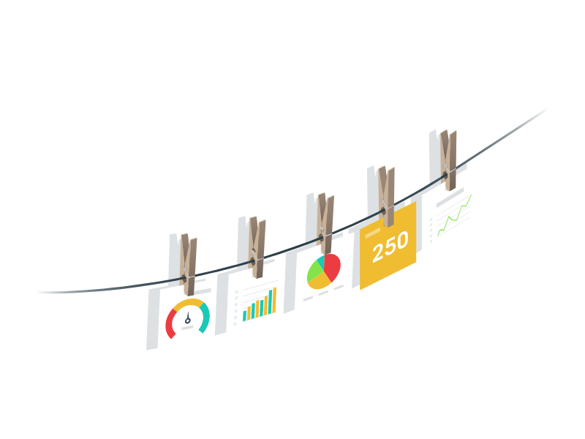
www.midocean.ae
Track meaningful metrics
Social media metrics are data points that measure how well your social media strategy is performing — and help you understand how you can improve.
and help you understand how you can improve. They are like scorecards for your online posts and interactions, showing how many people saw, liked, shared, or commented on your content. Social media metrics also reveal how much effort and money you’re spending, and how much you’re getting in return.

Slide 13
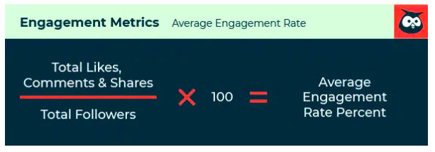
www.midocean.ae
Social media engagement metrics
1. Engagement rate
Engagement rate measures the number of engagements (reactions, comments and shares) your content gets as a percentage of your audience.
One of the most common ways is to add up your total likes, comments, shares, and saves, and divide the total by your number of followers. Then multiply by 100 to get a percentage

Slide 14
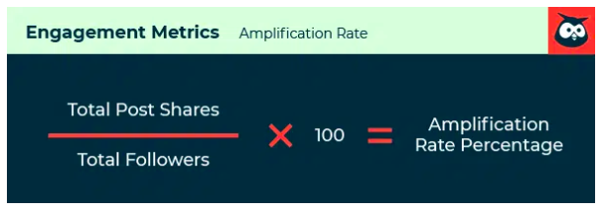
www.midocean.ae
Social media engagement metrics
2. Amplification rate
Amplification Rate is the ratio of shares per post to the number of overall followers.
amplification is “the rate at which your followers take your content and share it through their networks.”
Basically, the higher your amplification rate, the more your followers are expanding your reach for you.
To calculate amplification rate, divide a post’s total number of shares by your total number of followers. Multiply by 100 to get your amplification rate as a percentage.

Slide 15
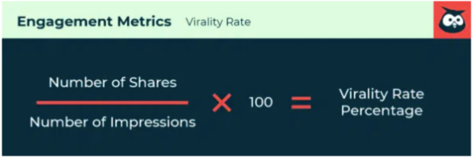
www.midocean.ae
Social media engagement metrics
3. Virality rate
Virality rate is similar to amplification rate in that it measures how much your content is shared. However, virality rate calculates shares as a percentage of impressions rather than as a percentage of followers.
Remember that every time someone shares your content, it achieves a fresh set of impressions via their audience. So virality rate measures how your content is spreading exponentially.
To calculate virality rate, divide a post’s number of shares by its impressions. Multiply by 100 to get your virality rate as a percentage.

Slide 16
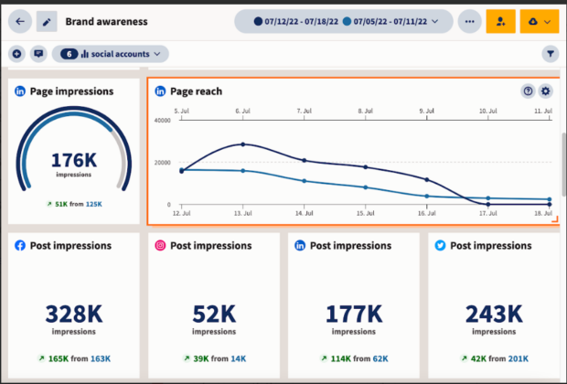
www.midocean.ae
Social media awareness metrics
Social media brand awareness metrics show how many people see your content and how much attention your brand gets on social media.

Slide 17
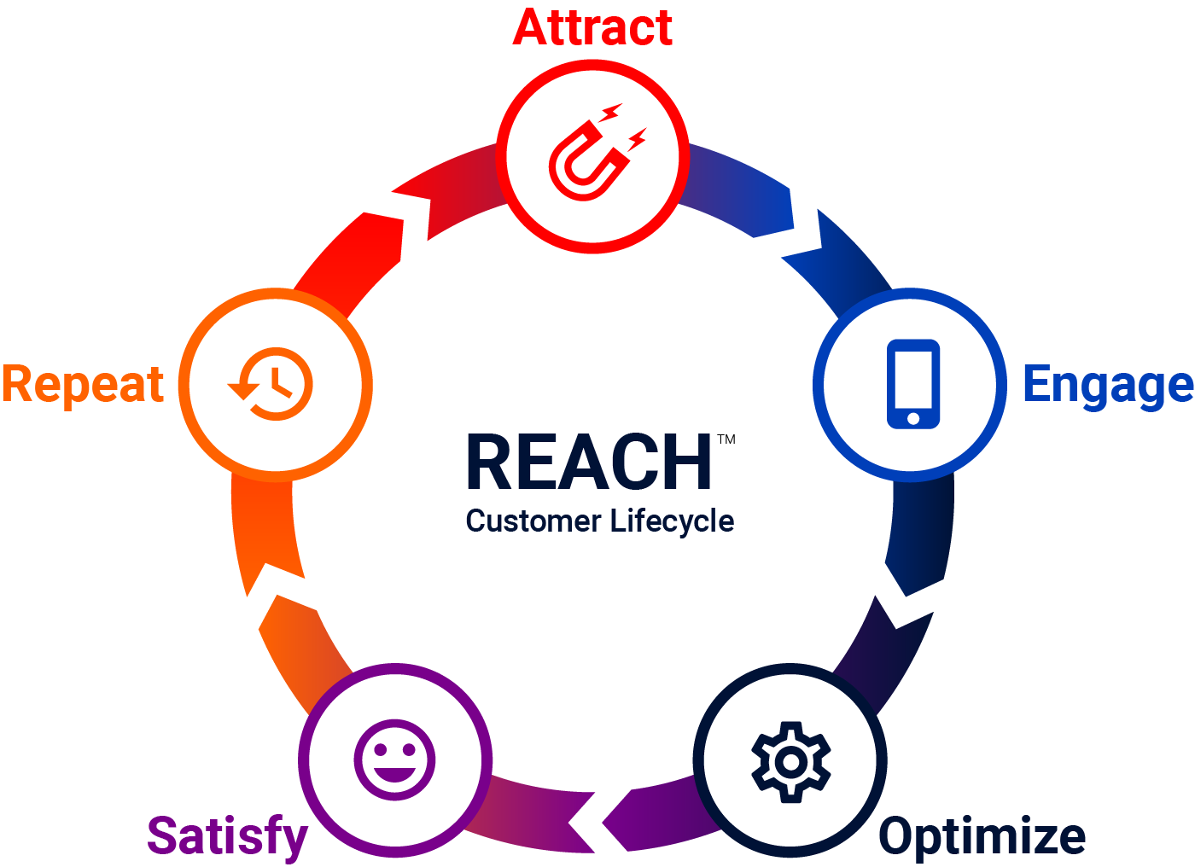
www.midocean.ae
Social media awareness metrics
4. Reach
Reach is simply the number of people who see your content. It’s a good idea to monitor your average reach, as well as the reach of each individual post, story, or video. You can also measure the reach for your page/profile overall.
A valuable subset of this metric is to look at what percentage of your reach is made up of followers vs. non-followers. If a lot of non-followers are seeing your content, that means it’s being shared or doing well in the algorithms, or both.

Slide 18

www.midocean.ae
Social media awareness metrics
5. Impressions
Impressions indicate the number of times people saw your content. You can measure impressions by post, as well as the overall number of impressions on your social media profile.
Impressions can be higher than reach because the same person might look at your content more than once.
An especially high level of impressions compared to reach means people are looking at a post multiple times. Do some digging to see if you can understand why it’s so sticky.

Slide 19
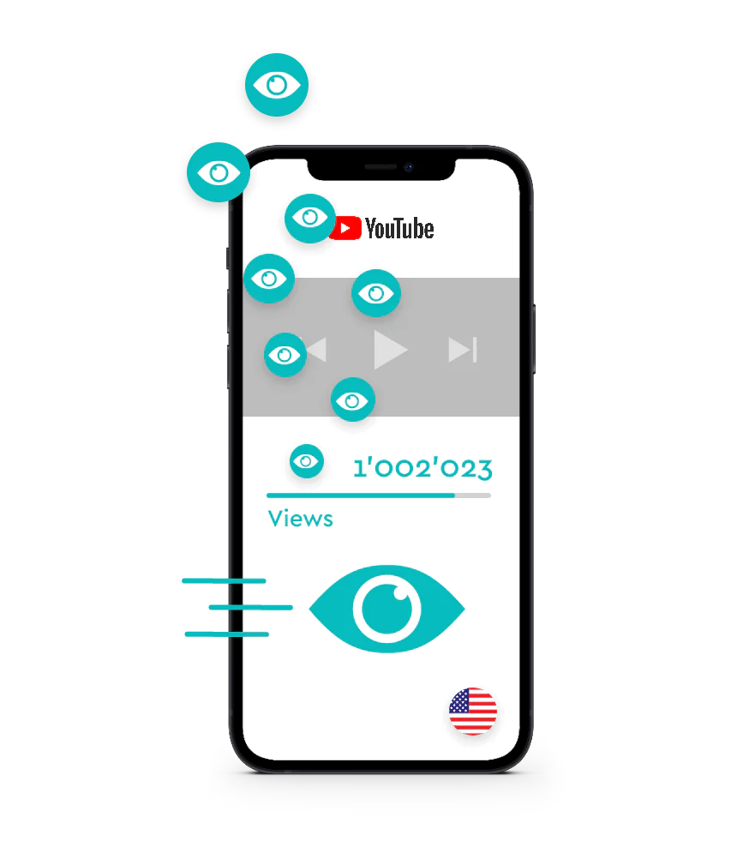
www.midocean.ae
Social media awareness metrics
6. Video views
Each social network determines what counts as a “view” a little differently, but usually, even a few seconds of watch time counts as a “view.”
So, video views is basically a good at-a-glance indicator of how many people have seen at least the start of your video.

Slide 20

www.midocean.ae
Social media awareness metrics
7. Video completion rate
Video views are great, but they only let you know that someone started to watch your video. So how often do people actually watch your videos all the way through to the end? Video completion rate is a good indicator that you’re creating quality content that connects with your audience.
Video completion rate is also a key signal to many social media algorithms, so this is a good one to focus on improving.

Slide 21
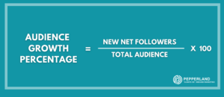
www.midocean.ae
Social media awareness metrics
8. Audience growth rate
Audience growth rate measures how many new followers your brand gets on social media within a certain amount of time.
It’s not a simple count of your new followers. Instead, it measures your new followers as a percentage of your total audience.
To calculate your audience growth rate, track your net new followers (on each social media platform) over a reporting period. Then divide that number by your total audience (on each platform) and multiply by 100 to get your audience growth rate percentage.

Slide 22
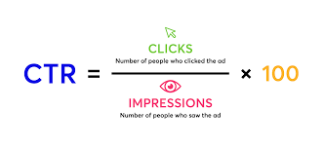
www.midocean.ae
Social media marketing metrics
9. Click-through rate (CTR)
Click-through rate, or CTR, indicates how often people click a link in one of your posts to access additional content. That could be anything from a blog post to your online store.
CTR gives you a sense of how many people saw your social content and wanted to know more. It’s a good indicator of how well different types of content promote your brand on social.
To calculate CTR, divide the total number of clicks for a post by the total number of impressions. Multiply by 100 to get your CTR as a percentage.

Slide 23
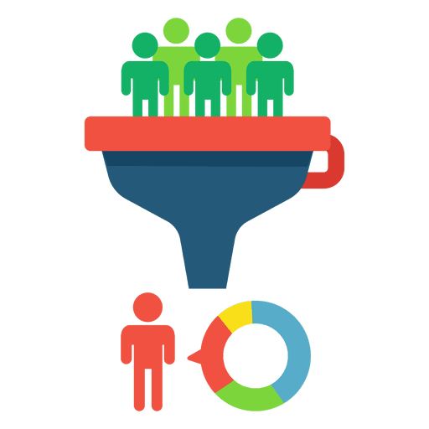
www.midocean.ae
Social media marketing metrics
10. Conversion rate
Conversion rate measures how often your social content starts the process to a conversion event like a subscription, download, or sale. This is one of the most important social media marketing metrics because it shows the value of your social media campaigns (organic and paid) as a means of feeding your funnel.
UTM parameters are the key to making your social conversions trackable. Learn all about how they work in our blog post on using UTM parameters to track social success.
Once you’ve added your UTMs, calculate conversion rate by dividing the number of conversions by the number of clicks.

Slide 24
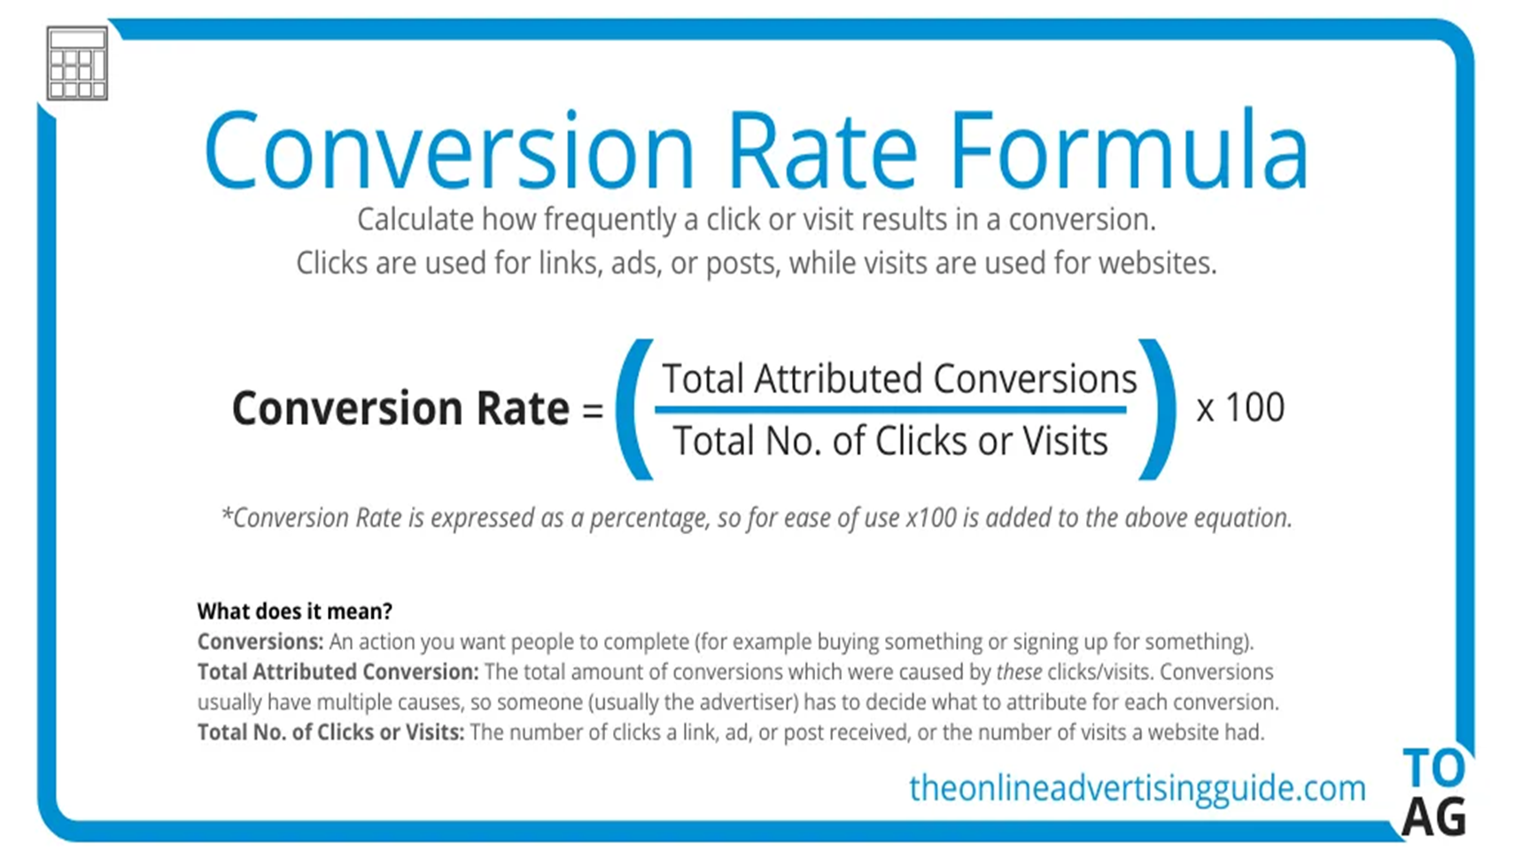
www.midocean.ae
Social media marketing metrics
10. Conversion rate
Once you’ve added your UTMs, calculate conversion rate by dividing the number of conversions by the number of clicks.

Slide 25
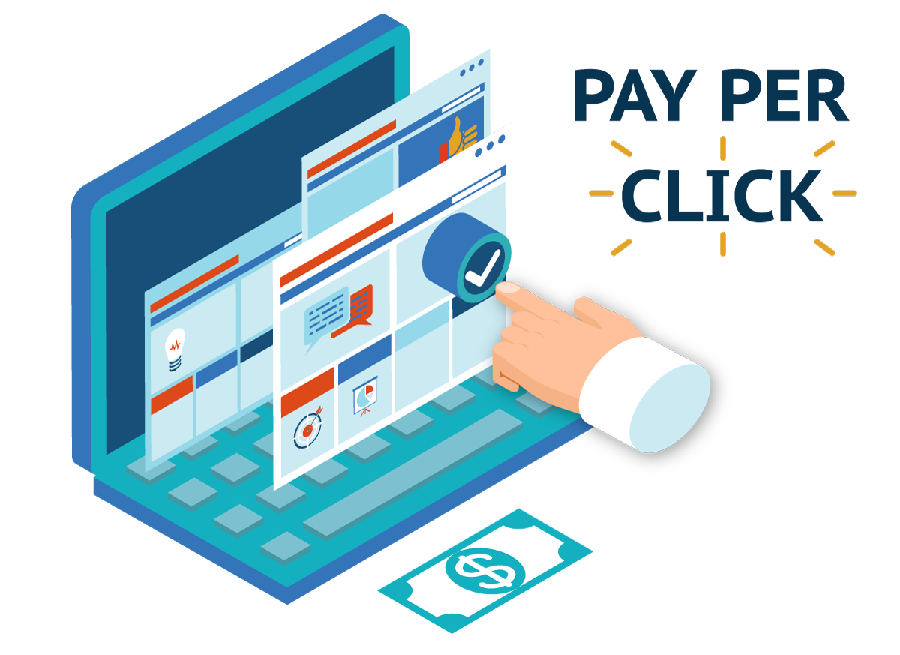
www.midocean.ae
Social media marketing metrics
11. Cost-per-click (CPC)
Cost-per-click, or CPC, is the amount you pay per individual click on a social ad.
Knowing the lifetime value of a customer for your business, or even the average order value, will help you put this number in important context.
A higher lifetime value of a customer combined with a high conversion rate means you can afford to spend more per click to get visitors to your website in the first place.
You don’t need to calculate CPC: You can find it in the analytics for the social network where you’re running your ad.

Slide 26
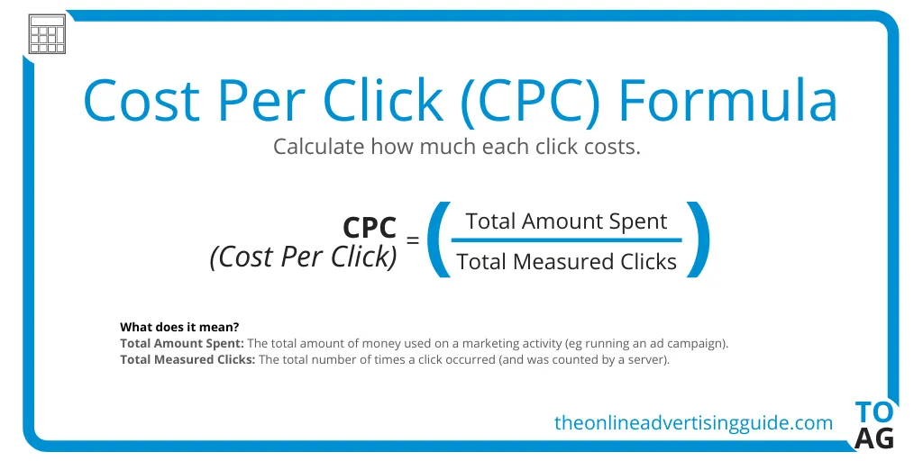
www.midocean.ae
Social media marketing metrics
11. Cost-per-click (CPC)

Slide 27

www.midocean.ae
Social media marketing metrics
12. Cost per thousand impressions (CPM)
Cost per thousand impressions, or CPM, is exactly what it sounds like. It’s the cost you pay for every thousand impressions of your social media ad.
CPM is all about views, not actions.
Again, there’s nothing to calculate here—just import the data from your social network’s analytics.

Slide 28
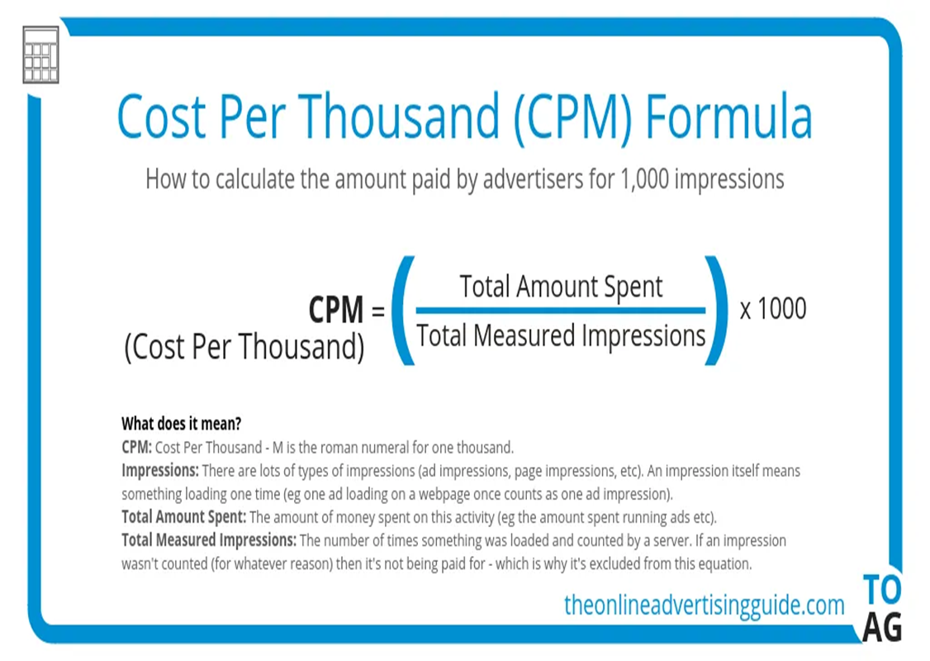
www.midocean.ae
Social media marketing metrics
12. Cost per thousand impressions (CPM)

Slide 29
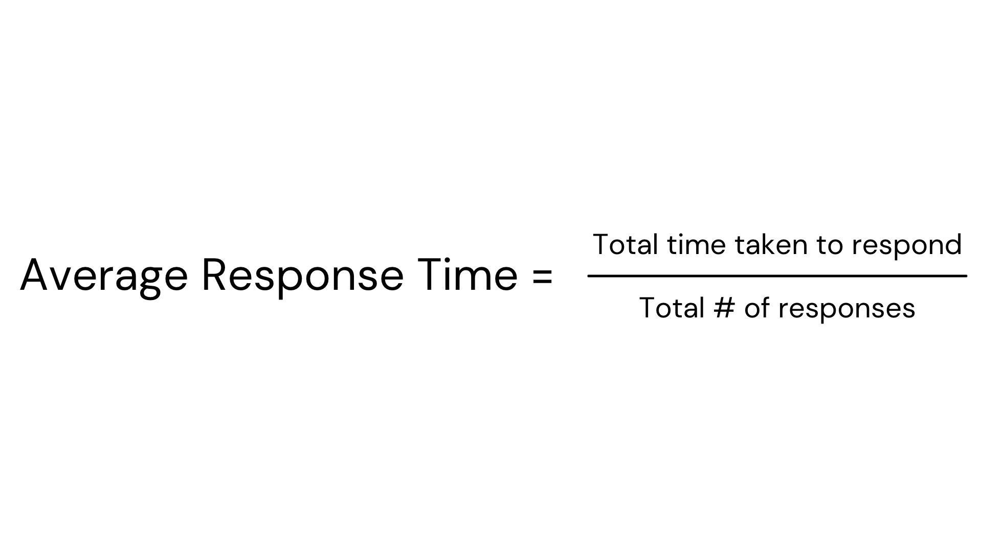
www.midocean.ae
Social customer service metrics
13. Average response time
Response time is a metric that measures how long it takes for your customer service team to respond to queries that come in through social channels. It’s the social media equivalent of time spent on hold.
Using AI customer service bots can significantly reduce response time for many simple requests.
If you’re using a social customer service tool you can add response time directly to your analytics report.
Otherwise, you can calculate it manually by adding up the total amount of time taken for an initial response to customer queries and dividing it by the number of queries.

Slide 30
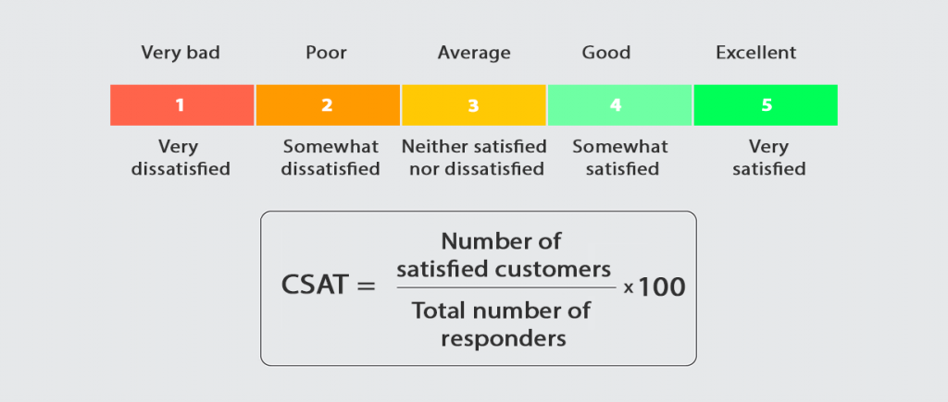
www.midocean.ae
Social media marketing metrics
14. Customer satisfaction (CSAT) score
Of course, customer service metrics are not just about response times and response rates. CSAT (customer satisfaction score), is a metric that measures how happy people are with your product or service.
Usually, the CSAT score is based on one, straightforward question: How would you rate your overall level of satisfaction? In this case, it’s used to measure the level of satisfaction with your social customer service.
It’s the reason why so many brands ask you to rate your experience with a customer service agent after it’s over. And that’s exactly how you can measure it too.

Slide 31
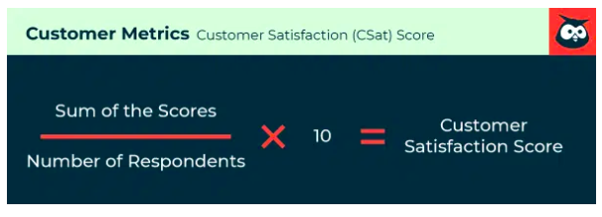
www.midocean.ae
Social media marketing metrics
Create a one-question survey asking your customers to rate their satisfaction with your customer service and send it via the same social channel used for the service interaction. This is a great use for bots.
Add up all the scores and divide the sum by the number of responses. Then multiply by 100 to get your CSAT score as a percentage.

Slide 32
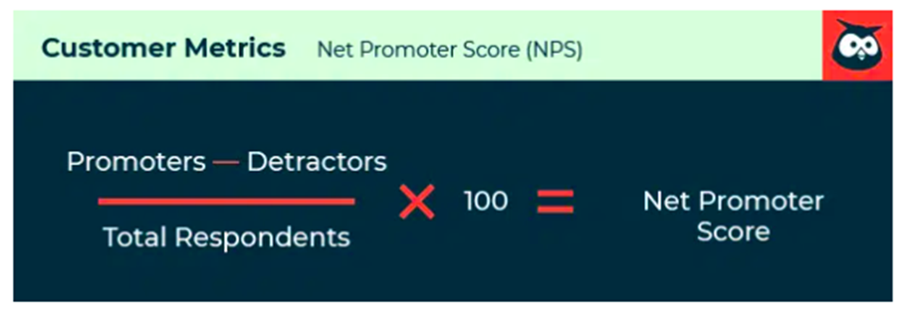
www.midocean.ae
Social media marketing metrics
15. Net promoter score (NPS)
Net promoter score, or NPS, is a metric that measures customer loyalty.
Unlike CSAT, NPS is good at predicting future customer relationships. It is based on one—and only one—specifically phrased question: How likely is it that you would recommend our [company/product/service] to a friend?
Customers are asked to answer on a scale of zero to 10. Based on their response, each customer is grouped into one of three categories:
Detractors: 0–6 score range
Passives: 7–8 score range
Promoters: 9–10 score range

Slide 33

www.midocean.ae
Social media marketing metrics
NPS is unique in that it measures customer satisfaction as well as the potential for future sales, which has made it a valuable, go-to metric for organizations of all sizes.
To calculate NPS, subtract the number of promoters from the number of detractors.
Divide the result by the total number of respondents and multiply by 100 to get your NPS.

Slide 34
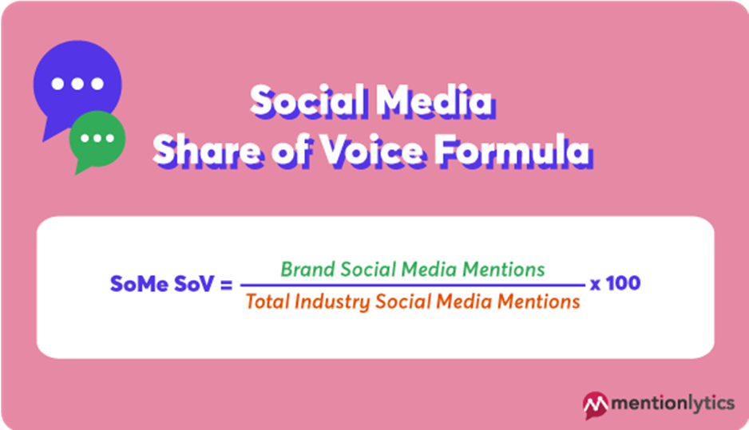
www.midocean.ae
Other important social media metrics
16. Social share of voice (SSoV)
Social share of voice measures how many people are talking about your brand on social media compared to your competitors. How much of the social conversation in your industry is all about you?
Mentions can be either:
Direct (tagged—e.g., “@Hootsuite”)
Indirect (untagged—e.g., “hootsuite”)

Slide 35

www.midocean.ae
Other important social media metrics
16. Social share of voice (SSoV)
SSoV is, essentially, competitive analysis: how visible—and, therefore, relevant—is your brand in the market?
To calculate it, add up every mention of your brand on social across all networks. Do the same for your competitors. Add both sets of mentions together to get a total number of mentions for your industry. Divide your brand mentions by the industry total, then multiply by 100 to get your SSoV as a percentage.

Slide 36
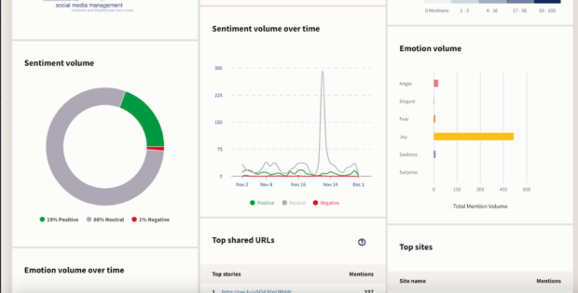
www.midocean.ae
Other important social media metrics
17. Social sentiment
Whereas SSoV tracks your share of the social conversation, social sentiment tracks the feelings and attitudes behind the conversation. When people talk about you online, are they saying positive or negative things?

Slide 37
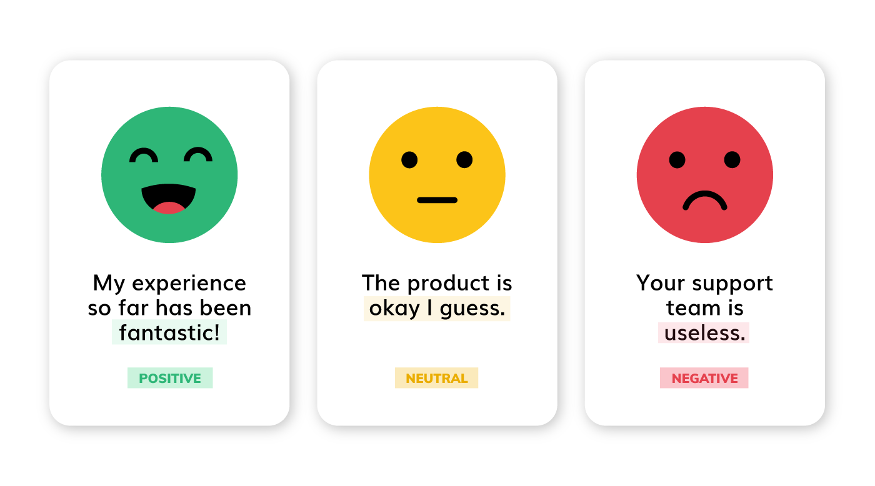
www.midocean.ae
Other important social media metrics
17. Social sentiment
Calculating social sentiment requires some help from a social media metrics tool that can process and categorize language and context.

Slide 38
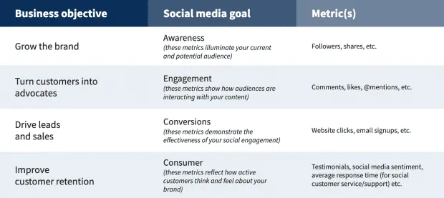
www.midocean.ae
Social media goals should align with your overall marketing objectives. This makes it easier to show the value of your work and secure buy-in from your boss.
Start developing a successful social media marketing plan by writing down at least three goals for social media.

Slide 39
www.midocean.ae
“It’s easy to get overwhelmed by deciding what to post and which metrics to track, but you need to focus on what you want to get out of social media to begin with, “Don’t just start posting and tracking everything: match your goals to your business, and your metrics to your goals.”

Slide 40

www.midocean.ae
What is a social media marketing strategy
How to create a social media strategy:
Core components of social media marketing
Track meaningful social media metrics
summery OF CONTENTS

Slide 41



Thank You

