Slide 1

Digital Media Leadership
Prepared by Dr. Doaa Rady
W5 Lecture
DGM 726
Master of Digital Media

Slide 2

Last Lecture, we leaned about
Types of Leadership
Methods of leadership
Theories of Leadership
  1. The Great Man Theory
  2. Trait Theories of Leadership
  3. Behavioral Theories of Leadership
  4.Transactional & Transformational Theories
  5.Contingency theory of leadership
  6. Neo-Charismatic Theories
  New Leaders Take Note & Traps
  Leading Effectively: The 70-20-10 Rule
  Self-Assessment Exercise 3
    Do You Have Charismatic Tendencies?
W5 Lecture outline

Slide 3
Today’s Lecture we will Know about
  Styles of Leadership
    Autocratic أوتوقراطي
    Managerial إداري
    Democraticديمقراطي
    Collaborativeالتعاوني
    How do you determine what is an appropriate style?
    How do you choose and develop a leadership style?
W5 Lecture outline

Slide 4
Introduction & Learning Outcomes
Leadership styles refer to the behavioral approach employed by leaders to influence, motivate, and direct their followers. A leadership style determines how leaders implement plans and strategies to accomplish given objectives while accounting for *stakeholder expectations and the wellbeing and soundness of their team.
Learn about the different styles of leadership,
Determine which is appropriate for your organization, and
Learn how to choose and develop a leadership style.
* investors, employees, customers, and suppliers.
W5 Lecture Objectives

Slide 5

Live
W3 Lecture

Slide 6
W5 Lecture
How do you choose and
develop a leadership style?
Some questions you might ask yourself to start:
• How great is my need to be in control?
• How willing am I to trust others to do their jobs?
• How patient am I?
• How organized am I?
• How good are my people skills?

Slide 7
W5 Lecture
How do you choose and
develop a leadership style?
Some questions you might ask yourself to start:
• How great is my need to be in control?
When you're in a car, are you uncomfortable if you're not driving, assuming the driver is competent?
Would you let someone else order for you in a restaurant?
If you were teaching a class, would it be a lecture?
Is there a right way to do most everything?
If your answers to these questions are yes, no, yes, and yes, you probably have a pretty high need to be in control of things.
Live

Slide 8
W5 Lecture
How do you choose and
develop a leadership style?
Some questions you might ask yourself to start:
• How willing am I to trust others to do their jobs?
Are you uncomfortable delegating work, so that you just try to do it yourself?
Do you tell people exactly how to do things, even when they have experience doing them?
Do you think supervisors should spend a lot of their time checking the work of those they supervise?
"Yes" answers to these questions could mean that you don't have much confidence in others.
Live

Slide 9
W5 Lecture
How do you choose and
develop a leadership style?
Some questions you might ask yourself to start:
• How patient am I?
If someone is having trouble doing something, do you just do it for him?
Do you interrupt with your comments before others are finished speaking?
Do you want the discussion to end because you want to start doing something?
If all these are the case, patience may not be your greatest virtue.
Live

Slide 10
W5 Lecture
How do you choose and
develop a leadership style?
Some questions you might ask yourself to start:
• How organized am I?
Can you almost always find whatever you need without having to search for it?
Is your desk clean?
Are your files alphabetized and orderly? Are your books alphabetized?
Do you have a place for nearly everything?
Is your appointment book readable by anyone but you?
Are you always on time, and hardly ever miss appointments?
Live

Slide 11
W5 Lecture
How do you choose and
develop a leadership style?
Some questions you might ask yourself to start:
• How good are my people skills?
Are you comfortable with other people?
Do people seem to be comfortable with you?
When you're with others, do you spend most of your time talking? Listening? About even?
Do people seek you out for help or advice?
Do you consider yourself a good judge of people, and has that been borne out by your experience?
Do you try to consider others' needs and feelings in any decision?
Live

Slide 12
W5 Lecture
How do you choose and
develop a leadership style?
These few questions are obviously just a beginning, but they should help you think about some important leadership issues.
If you have a high need for control, for instance, it doesn't mean you can't be a collaborative leader, but it does mean that you'll have to learn some new behavior, and perhaps a whole new way of looking at things.
If you're not well-organized, it doesn't mean you can't be a good manager, but you'll have to find strategies to keep you on top of everything.
Live

Slide 13

Styles of Leadership
W5 Lecture

Slide 14
W5 Lecture
Leadership styles
Leadership styles are the ways in which a leader views leaderships and performs it in order to accomplish their goals.
"Leadership is the process of persuasion or example by which an individual (or leadership team) inducesيحث/ يقنع a group to pursue objectives held by the leader or shared by the leader and his or her followers." John Gardner
If we accept that definition, then leadership style is the way in which that process is carried out.

Slide 15
W5 Lecture
Leadership styles
Leaders' styles encompass how they relate to others within and outside the organization, how they view themselves and their position, and - to a very large extent - whether or not they are successful as leaders.
If a task needs to be accomplished, how does a particular leader set out to get it done? If an emergency arises, how does a leader handle it? If the organization needs the support of the community, how does a leader go about mobilizing it? All of these depend on leadership style.

Slide 16
W5 Lecture
Leadership styles
We will focus on individual leaders, but leadership can be invested in a team, or in several teams, or in different people at different times.
Many - perhaps most - organizations have several levels of leadership, and thus many leaders.
The style of an organization's leadership is reflected in both the nature of that organization and its relationships with the community.
If a leader is suspicious and jealous of power, others in the organization are likely to behave similarly, in dealing with both colleagues and the community.
If a leader is collaborative and open, this behavior is likely to encourage the same attitudes among staff members, and to work collaboratively with other organizations.

Slide 17
W5 Lecture
Leadership styles
In many ways, the style of its leader defines an organization. If the organization is to be faithful to its philosophy and mission, its leader's style must be consistent with them.
An autocratic leader in a democratic organization can create chaos. A leader concerned only with the bottom line النتيجة النهائية in an organization built on the importance of human values may undermine the purpose of its work. For that reason, being conscious of both your own style as a leader and those of others you hire as leaders can be crucial in keeping your organization on the right track.

Slide 18
W5 Lecture
Leadership styles
Conceptions of leadership
  Styles have to do with a leader's - and organization's - ideas of what leadership is and does. Possible conceptions include:
  Exercising power ممارسة السلطة. Leadership is a matter of pursuing one's own ends. Asserting power over others is an end in itself, and symbolizes one's position as a leader.
  Gaining and exercising the privileges of high status. اكتساب وممارسة الامتيازات ذات المكانة العالية Leadership is about getting to the top, and being recognized as having the highest status.

Slide 19
W5 Lecture
Leadership styles
  Conceptions of leadership
  Being the boss. كونه الرئيس Leadership is overseeing the work of the organization by telling everyone what to do when, and rewarding or punishing as appropriate.
  Task orientation. Leadership is getting the job done - that's all that matters.
  Taking care of people. Leadership is looking out for those you lead, and making sure they get what they need.
  Empowerment. Leadership is helping those you lead gain power and become leaders.

Slide 20
W5 Lecture
Leadership styles
Conceptions of leadership
  we might add a conception whereby one aspect of leadership is the fostering of personal (and professional) growth in others.
  Providing moral leadership. توفير القيادة الأخلاقية The leader, by force of character and her own high standards, creates expectations and pulls others up to his/her level.
  Providing and working toward a vision. Leadership is the ability to envision a goal, and to motivate others to work with you toward that goal.

Slide 21
W5 Lecture
Leadership styles
We'll present four styles that summarize many of the existing theories, and to show how they interact with another, all-embracing way of looking at leadership style.
Most leaders combine some of the characteristics of two or more of these styles and have other characteristics that don't match any of them. You can find many descriptions of other leadership styles as well. What this list really provides is some useful ways to think about your own and others ' leadership.
It's also important to remember that people can be either effective or ineffective in any of these categories.

Slide 22
W5 Lecture
Leadership styles
1. Autocratic “Authoritarian”. Autocratic leaders insist on doing it all themselves. They have all the power, make all the decisions, and don't often tell anyone else about what they're doing. If you work for an autocratic leader, your job is usually to do what you're told.
An autocratic leader often maintains his authority by force, intimidation, threats, reward and punishment, or position. Although he may or may not have a clear vision, and may or may not be steering the organization in the right direction, he's not concerned with whether anyone else agrees with what he's doing or not.

Slide 23
W5 Lecture
Leadership styles
Autocratic leadership allows quick decision-making, and eliminates arguments over how and why things get done. At the same time, however, it may reduce the likelihood of getting a range of different ideas from different people, and can treat people badly, or as if they don't matter. If, as is often true, the leader is concerned with his own power and status, he'll be looking over his shoulder, and moving to squelch any opposition to him or his ideas and decisions. Innovation or the use of others' ideas is only permissible if it's part of the leader's plan.

Slide 24
W5 Lecture
Leadership styles
Effects on the organization. Autocratic leaders often leave fear and mistrust عدم الثقة in their wake. Others in the organization tend to copy their protection of their position, and their distrust of others' ideas and motives. Often, autocratically -led organizations are not particularly supportive of personal relationships, but much more keyed to chain-of-command. Everyone has her own sphere, and protects it at all costs. Communication tends to go in only one direction - up - as a result of which rumor can become the standard way of spreading news in the organization.

Slide 25
W5 Lecture
Leadership styles
At its best, autocratic leadership provides a stable and secure work environment and decisive حاسم, effective leadership. All too often, however, it can sacrifice initiative, new ideas, and the individual and group development of staff members for the predictability of a highly structured, hierarchical environment where everyone knows exactly what he's supposed to do, and follows orders without question.

Slide 26
W5 Lecture
Leadership styles
Although the above points, many autocratic leaders are not hated and feared, but rather esteemed, and even loved. It depends on their own personalities, they can be nice people, or highly charismatic, or even willing to listen to and act on others' ideas - on the organization itself (in the military, most soldiers want someone firmly in charge), on the quality of their decisions, and on the needs of the people they lead. If they're generally decent and not abusive, make good decisions for the organization, and fulfill the parent-figure or authority -figure image that most people in the organization are looking for, they can be both effective and well-respected.

Slide 27
W5 Lecture
Leadership styles
2. Managerial. The leader who sees him/herself as a manager is concerned primarily with the running of the organization. Where it's going is not at issue, as long as it gets there in good shape. The leader may pay attention to relationships with and among staff members, but only in the service of keeping things running smoothly. Depending upon the nature and stability of the organization, the main focus may be on funding, on strengthening the organization's systems and infrastructure (policies, positions, equipment, etc.), or on making sure day-to-day operations go well (including making sure that everyone is doing what he's supposed to).

Slide 28
W5 Lecture
Leadership styles
If the leader's efficient, a managerial leader will generally be on top of what's happening in the organization. Depending on the size of the organization and leader’s management level, he/she'll have control of the budget, know the policies and procedures manual inside out, be aware of who's doing his job efficiently and who's not, and deal with issues quickly and firmly as they come up. What leader won't do is steer the organization. Vision isn’t his/her business; maintaining the organization is.

Slide 29
W5 Lecture
Leadership styles
Effects on the organization. In general, a well-managed organization, regardless of its leadership style, is a reasonably pleasant place to work. Staff members don 't have to worry about ambiguity, or about whether they'll get paid. As long as oversight is relatively civil - no screaming at people, no setting staff members against one another - things go along on an even keel. Good managers even try to foster friendly relationships with and among staff, because they make the organization work better.

Slide 30
W5 Lecture
Leadership styles
On the other hand, good management without a clear vision creates an organization with no sense of purpose. The organization may simply act to support the status quo, doing what it has always done in order to keep things running smoothly. That attitude neither fosters passion in staff members, nor takes account of the changing needs (and they do change) of the target population or the community. The organization may do what it does efficiently and well...but what it does may not be what it should be doing, and it won't be examining that possibility any time soon.

Slide 31
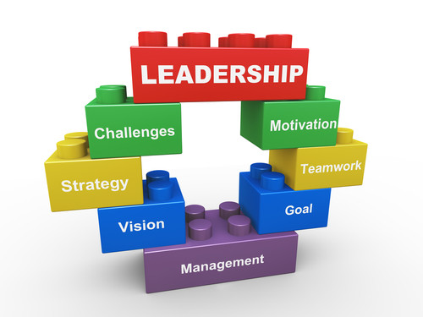
W5 Lecture
Leadership styles
Obviously, the leader of any organization
as well as any other administrator - has to be
a manager at least some of the time. Many are in fact excellent managers, and keep the organization running smoothly on a number of levels. The issue here is the style that person adopts as a leader. If the leader sees management as the primary purpose, he/she's a managerial leader, and will have a very different slant on leadership than if the style is essentially democratic, for instance.

Slide 32
W5 Lecture
Leadership styles
3. Democratic. A democratic leader understands that there is no organization without its people. The leader looks at his/her and others' positions in terms of responsibilities rather than status, and often consults in decision-making. While he/she solicits, values, and takes into account others' opinions, however, the leader sees the ultimate responsibility for decision-making as his/her own. The leader accepts that authority also means the buck stops with him. Although he/she sees the organization as a cooperative venture, he knows that he ultimately has to face the consequences of the decisions alone.

Slide 33
W5 Lecture
Leadership styles
Democratic leadership invites the participation of staff members and others, not only in decision-making, but in shaping the organization's vision. It allows everyone to express opinions about how things should be done, and where the organization should go. By bringing in everyone's ideas, it enriches the organization's possibilities. But it still leaves the final decisions about what to do with those ideas in the hands of a single person.
Some models of democratic leadership might put the responsibility in the hands of a small group - a management team or executive committee - rather than an individual.

Slide 34
W5 Lecture
Leadership styles
Effects on the organization. Democratic leadership, with its emphasis on equal status, can encourage friendships and good relationships throughout the organization. (In more hierarchical organizations, clerical staff and administrators are unlikely to socialize, for instance; in a democratically-led organization, such socialization often happens.) It helps people feel valued when their opinions are solicited, and even more so if those opinions are incorporated into a final decision or policy.

Slide 35
W5 Lecture
Leadership styles
What a democratic leadership doesn't necessarily do - although it can - is establish staff ownership of the organization and its goals. Although everyone may be asked for ideas or opinions, not all of those are used or incorporated in the workings of the organization. If there is no real discussion of ideas, with a resulting general agreement, a sense of ownership is unlikely. Thus, democratic leadership may have some of the drawbacks of autocratic leadership - a lack of buy-in - without the advantages of quick and clear decision-making that comes with the elimination of consultation.

Slide 36
W5 Lecture
Leadership styles
4. Collaborative. A collaborative leader tries to involve everyone in the organization in leadership. The leader is truly first among equals, in that he/she may initiate discussion, pinpoint problems or issues that need to be addressed, and keep track of the organization as a whole, rather than of one particular job. But decisions are made through a collaborative process of discussion, and some form of either majority or consensus agreement. Toward that end, a collaborative leader tries to foster trust and teamwork among the staff as a whole.

Slide 37
W5 Lecture
Leadership styles
A collaborative leader has to let go of the need for control or power or status if leader is to be effective.
Leader’s goal is to foster the collaborative process, and to empower the group - whether the staff and others involved in an organization, or the individuals and organizations participating in a community initiative - to control the vision and the workings of the organization.
Leader must trust that, if people have all the relevant information, they'll make good decisions...and must make sure that they have that information, and provide the facilitation that assures those good decisions.

Slide 38
W5 Lecture
Leadership styles
Effects on the organization. Collaborative leadership comes as close as possible to ensuring that members of the organization buy into its vision and decisions, since they are directly involved in creating them.
It also comes closest to reflecting the concepts of equality and empowerment included in the philosophy and mission of so many grass roots and community-based organizations. It thus removes much of the distrust that often exists between line staff and administrators.

Slide 39
W5 Lecture
Leadership styles
David Chrislip and Carl E. Larson identify four characteristics of the collaborative leader:
  Inspiring commitment and action. The collaborative leader helps people develop the vision and passion to start and maintain the work.
  Leading as a peer problem solver. The collaborative leader facilitates problem solving by modeling and teaching a process, and by helping others bring their experience and ideas to bear.
  Building broad-based involvement. The collaborative leader invites everyone concerned into an inclusive process.

Slide 40
W5 Lecture
Leadership styles
  Sustaining hope and participation. Reaching goals may take a long time. The collaborative leader both helps the group set interim goals so it can see progress, and, by example and in other ways, helps to maintain the passion and commitment to keep going when there's no end in sight.
Collaborative leaders also generally foster close relationships among staff members, making for more communication and cross-fertilization in their work, and leading to more effective ways to accomplish the organization's goals.

Slide 41
W5 Lecture
Leadership styles
On the downside, management can be neglected in favor of building a collaborative organization. Even more to the point, collaborative decision-making can be excruciating. Depending upon the group, ideas can be talked to death, and insignificant disagreements about insignificant areas of policy can take hours to resolve.
Collaborative decision-making can be democratic - based on a majority vote after discussion - or dependent on arriving at consensus, with a range of possibilities in between. Consensus decision-making is particularly difficult, in that it requires everyone to agree before a decision can be made.

Slide 42
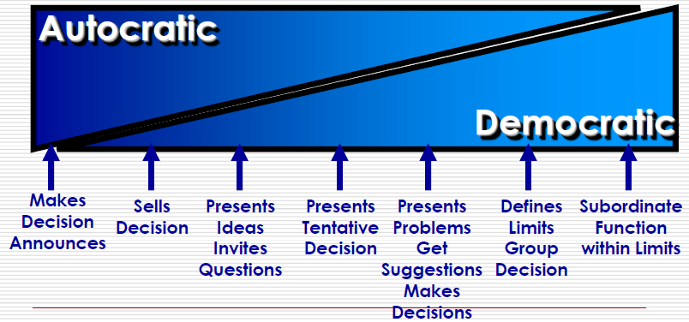
W5 Lecture
Leadership styles
Notes:
Makes decision annonces

Slide 43
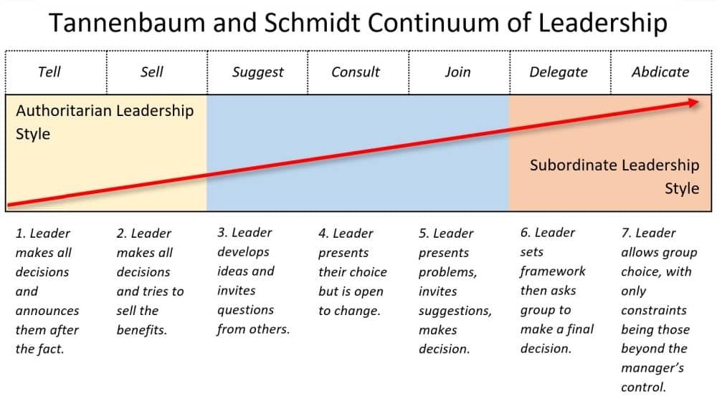
W5 Lecture
Leadership styles
تنازل

Slide 44
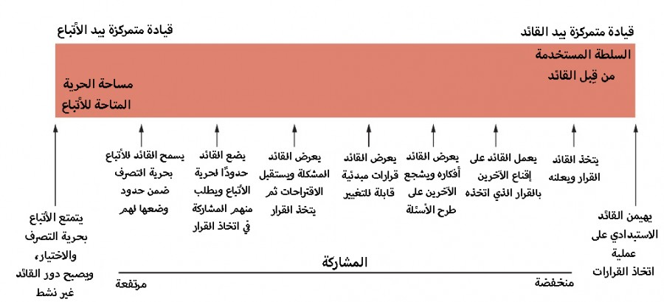
W5 Lecture
Leadership styles
Live
نموذج تانينباوم وشميت
Notes:
Makes decision annonces

Slide 45
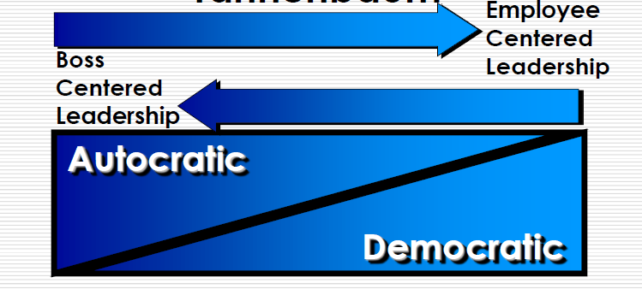
W5 Lecture
Leadership styles

Slide 46
How do you determine what is an appropriate style?
W5 Lecture

Slide 47
W5 Lecture
What is an appropriate style?
It is probably true that any leader uses a range of different styles at different times.
It is important to realize that different styles may be appropriate at different times, and for different purposes.
In an emergency, no one would suggest sitting down and making a group decision about what to do. There has to be decisive action, and one person has to take it as soon as possible.
Good leaders usually have a style that they consciously use most of the time, but they're not rigid. They change as necessary to deal with whatever comes up.

Slide 48
W5 Lecture
What is an appropriate style?
There are at least two other factors that have to be considered when choosing a leadership style.
Leadership style must be consistent with what people in the organization expect. You can try to change their expectations and perceptions of how an organization should be run - that's part of leadership - but you have to start by meeting them at least halfway, or you'll never get close enough to talk about it.

Slide 49
W5 Lecture
What is an appropriate style?
If you're trying to turn a system that's been autocratic into a collaborative one, you have to accept that most people in the system not only won't welcome the change, and that some won't even understand what you're suggesting. You also have to accept that they've probably developed their own methods of getting around the rigidity of the system that they'll continue to use, even if the system is no longer rigid.
It can take a long time just to get your ideas across, and longer to help people overcome their suspicions and break old habits. A few may never be able to. You need patience, and the willingness to act occasionally in ways you'd rather not.

Slide 50
W5 Lecture
What is an appropriate style?
Finally, your style needs to be consistent with the goals, mission, and philosophy of your organization. An organization cannot remain faithful to its mission if its internal structure is at odds with its guiding principles. An organization dedicated to empowerment of the target population, for instance, must empower its staff as well. For most grass roots and community-based organizations, this consistency would mean using some variation of a democratic or collaborative style.

Slide 51
How do you choose and develop a leadership style?
W5 Lecture

Slide 52
W5 Lecture
Develop a leadership style
What kind of leader do you want to be? Perhaps even more important, how would you be most effective as a leader? What kind of leadership style would be of the most benefit to your organization, and would allow you to be the best leader you could be?
Most real leaders use a combination of styles.

Slide 53
W5 Lecture
Develop a leadership style
Start with yourself.
Think about the needs of the organization or initiative.
Observe and learn from other leaders.
Use the research on leadership.
Believe in what you're doing.
Be prepared to change.

Slide 54
W5 Lecture
Develop a leadership style
Start with yourself.
Use what you know about your own personality, and about how you've exercised leadership in the past. Neither of these has to determine what you choose now - people can change, especially if they believe that what they've done before was ineffective or inconsistent with their values - but it's important to be honest with yourself about who you are. That honesty has two aspects:
  First, be clear with yourself about what your natural tendencies and talents are.
  Second, acknowledge and be true to your beliefs. If you have a real philosophical commitment to a particular leadership style, it will probably be easier for you to change your behavior to match that style than to live with knowing you're betraying your principles.

Slide 55
W5 Lecture
Develop a leadership style
Some questions you might ask yourself to start:
• How great is my need to be in control?
• How willing am I to trust others to do their jobs?
• How patient am I?
• How organized am I?
• How good are my people skills? (Are you comfortable with other people? Do people seem to comfortable with you? When you're with others, do you spend most of your time talking? Listening? About even? Do people seek you out for help or advice? Do you consider yourself a good judge of people?)

Slide 56
W5 Lecture
Develop a leadership style
Think about the needs of the organization or initiative.
An organization that responds to situations where it has to act quickly may need more decisive and directive leadership. Some groups may have an impassioned vision, but don't have the practical skills - financial management, scheduling, etc. - to achieve it.
You can adapt most styles to most situations, but don't neglect the real needs of the organization in your calculations. You may need to practice a different style at the beginning from the one that you want to assume over the long term, in order to solve problems in the organization, or to get people on board.

Slide 57
W5 Lecture
Develop a leadership style
Observe and learn from other leaders.
Think about how leaders you've worked for or with exercised leadership. What were their styles, and were they effective? How did they handle different kinds of situations? How did they make you and others feel? Try to watch others in action, and talk to them about how they see what they do. What do you like about how they operate? What don't you like? What can you incorporate into your own style?
Find a mentor. If there's a leader whom you particularly admire, and that person is accessible, talk with him/her about leadership issues - about how he/she perceives what he/she's doing, how he/she'd handle particular situations and why, etc.

Slide 58
W5 Lecture
Develop a leadership style
Use the research on leadership.
There are lots of resources available on leaders and on both the theory and practice of leadership.
They 'll give you a lot more ideas about leadership styles, and help you refine your own thinking about what leadership is and what kind of leader you'd like to be.
Believe in what you're doing.
If you've thought it through carefully, and believe in the way you practice leadership, that will be projected to others. If you believe in yourself, they'll believe in you, too.

Slide 59
W5 Lecture
Develop a leadership style
Be prepared to change.
No matter how well you're doing, it's not perfect - it never is, and never will be. Be prepared to find for yourself or hear from others the negative as well as the positive, to consider it carefully and objectively, and to make corrections if necessary. That way, you can not only become a good leader, but continue to be one.

Slide 60
W5 Lecture
Develop a leadership style
Finally, Leadership style depends on the leader's and organization's conception of what leadership is, and on the leader's choice of leadership methods. Depending how those fit together, a leader might adopt one of a variety styles, each reflected in the way the organization operates and the way its staff members relate to one another. Some (very stereotyped) possibilities:
Autocratic - totally in control, making all decisions himself
Managerial - concerned with the smooth operation, rather than the goals and effectiveness, of the organization
Democratic - consulting with others, encouraging equality within the organization, but making final decisions herself
Collaborative - sharing leadership, involving others in all major decisions, spreading ownership of the organization.

Slide 61
W5 Lecture
Develop a leadership style
Another way of looking at leadership is to categorize it as either transactional or transformational.
Combining this view with that based on the four styles makes it easier to understand how leaders operate and make decisions. It also makes clear that different styles may be appropriate for different purposes, and that most leaders shift back and forth among several in the course of a day, even if there is one that characterizes them.
You can choose and develop leadership styles and skills by assessing your own tendencies and talents; understanding the needs of the organization or initiative; observing other leaders and finding a mentor; believing in yourself, and being prepared to change.

Slide 62
Conclusion
Lecture objectives
We learned about
  Styles of Leadership
    Autocratic
    Managerial
    Democratic
    Collaborative
    How do you determine what is an appropriate style?
    How do you choose and develop a leadership style?

Slide 63
W5 Lecture
References
Rabinowitz, P. (n.d.). Leadership and Management chapter 13:16. Community Tool Box. Retrieved January 4, 2023, from https://ctb.ku.edu/en/table-of-contents
Bli-Group-Wp. (2011). Leadership Course material. Amideast Egypt. Business Intelligence, Training & Consulting, http://bli-group.com/
Jaiswal, S. (2022, November 30). Leadership theories for every manager in 2022: Leadership: Emeritus India. Emeritus. Retrieved February 11, 2023, from https://emeritus.org/in/learn/leadership-theories-for-every-manager-in-2022/
Simplilearn. (2023, January 18). 10 major leadership theories every manager should master in 2023. Simplilearn.com. Retrieved February 11, 2023, from https://www.simplilearn.com/top-leadership-theories-every-manager-should-know-article
Drew, chris. (2022, October 23). Tannenbaum and Schmidt Leadership Continuum – Pros & Cons. Helpful Professor. Retrieved February 23, 2023, from https://helpfulprofessor.com/tannenbaum-and-schmidt/

Slide 64


