Slide 1

Risk Management
Prepared by Dr. Nael Zabel
Lecture 4
MGM 510
Risk Management

Slide 2

Lecture 4
Topics to Cover in Week 4
Scope of risk management.
Importance of risk management
Specialist areas of risk management
Representation of risk management
8Rs and 4Ts of [hazard] risk management
Enterprise Risk Management
Levels of risk management sophistication

Slide 3
Lecture 4
Scope of risk management
Risk management is the set of activities within an organization undertaken to deliver the most favourable outcome and reduce the volatility التقلبات of that outcome.
Historically, the term risk management has been used to describe an approach that was applied only to hazard risks.
The discipline is now developing in a way that will enable risk management to make a contribution to the improved management of control risks and opportunity risks.

Slide 4
Lecture 4
Importance of risk management
Managing the organization
Variable cost or availability of raw materials
Cost of retirementتقاعد/pensionمعاش/social benefits
Desire to deliver greater shareholder value

Slide 5
Lecture 4
Importance of risk management
Greater transparency required from organizations.
Pace وتيرة of change in business ever increases.
Impact of e-commerce on all aspects of business life
Increased reliance on information technology (IT) systems

Slide 6
Lecture 4
Importance of risk management
Increasing importance of intellectual property (IP) الملكية الفكرية
Greater supply chain complexity/dependency
Reputation becomes more and more important
Reputational damage ضرر سمعة– especially to worldwide brands

Slide 7
Lecture 4
Importance of risk management
High-profile losses and failures ruin reputationsتدمير السمعة
Regulatory pressures الضغوط التنظيميةcontinue to increase
Changes/variation in national legislative requirements
Joint ventures becoming more common

Slide 8
Lecture 4
Importance of risk management
Changes in the marketplace
Changing commercial and marketplace environment
Globalization of customers, suppliers and products
Increased competition in the marketplace

Slide 9
Lecture 4
Importance of risk management
Greater customer expectations, often led by competitors
Need to respond more rapidly to stakeholder expectations
More volatile marketsالأسواق المتقلبة with less customer loyalty

Slide 10
Lecture 4
Importance of risk management
Diversification تنويعleads to working in unfamiliar areas
Constant need to make bold strategic decisions
Short-term success required, without long-term detriment
Product innovation and continuous improvements

Slide 11
Lecture 4
Importance of risk management
Rapid changes in (consumer) product technology
Threats to world/national economy
Threat of influenza or other pandemics
Potential for international organized crime

Slide 12
Lecture 4
Specialist areas of risk management
●● Project risk management;
●● Clinical/medical risk management;
●● Energy risk management;
●● Financial risk management;
●● IT risk management.

Slide 13
Lecture 4
Representation of risk management
Risk management has well-established stages that make up the risk management process, These stages build into valuable risk management activities, each of which makes an important contribution.
There are many ways of representing the risk management process, and each of the standards mentioned in provides a slightly different description.

Slide 14
Lecture 4
8Rs and 4Ts of [hazard] risk management
Recognition or identification of risks and identification of the nature of the risk and the circumstances in which it could materialize.
Rating or evaluation of risks in terms of magnitude and likelihood to produce the ‘risk profile’ that is recorded in a risk register.
Ranking or analysing the current or residual level of risk against the established risk criteria or risk appetite.

Slide 15
Lecture 4
8Rs and 4Ts of [hazard] risk management
4. Responding to significant risks, including decisions on the appropriate action regarding the following options:
  ●● tolerate; تحمل
  ●● treat; علاج
  ●● transfer; نقل
  ●● terminate. انهاء

Slide 16
Lecture 4
8Rs and 4Ts of [hazard] risk management
5. Resourcing controls to ensure that adequate arrangements are made to introduce and sustain necessary control activities.
6. Reaction planning and/or event management. For hazard risks, this will include disaster recovery or business continuity planning.

Slide 17
Lecture 4
8Rs and 4Ts of [hazard] risk management
7. Reporting and monitoring of risk performance, actions and events and communicating on risk issues, via the risk architecture of the organization.
8. Reviewing the risk management system, including internal audit procedures and arrangements for the review and updating of the risk architecture, strategy and protocols.

Slide 18
Lecture 4
The activities associated with risk management
●● recognition of risks;
●● rating of risks;
●● ranking against risk criteria;
●● responding to significant risks;

Slide 19
Lecture 4
The activities associated with risk management
●● resourcing controls;
●● reaction (and event) planning;
●● reporting of risk performance;
●● reviewing the risk management system.

Slide 20
Lecture 4
Enterprise Risk Management
Enterprise Risk Management (‘ERM’) is a strategic business discipline that supports the achievement of an organization’s objectives by addressing the full spectrum of its risks and managing the combined impact of those risks as an interrelated risk portfolio.

Slide 21
Lecture 4
Enterprise Risk Management
Enterprise Risk Management (‘ERM’) is the process of identifying and addressing methodically the potential events that represent risks to the achievement of strategic objectives, or to opportunities to gain competitive advantage.

Slide 22
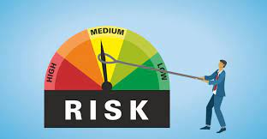
Lecture 4
Enterprise Risk Management
Risk management is an essential element of the strategic management of any organisation and should be embedded in the ongoing activities of the business.

Slide 23
Lecture 4
Enterprise Risk Management
The fundamental elements of ERM are the assessment of significant risks and the implementation of suitable risk responses.
Risk responses include: acceptance or tolerance of a risk; avoidance or termination of a risk; risk transfer or sharing via insurance, a joint venture or other arrangement; and reduction or mitigation of risk via internal control procedures or other risk prevention activities.

Slide 24
Lecture 4
Enterprise Risk Management
Other important ERM concepts include the risk philosophy or risk strategy, risk culture and risk appetite. These are expressions of the attitude to risk in the organisation, and of the amount of risk that the organisation is willing to take. These are important elements of governance responsibility.

Slide 25
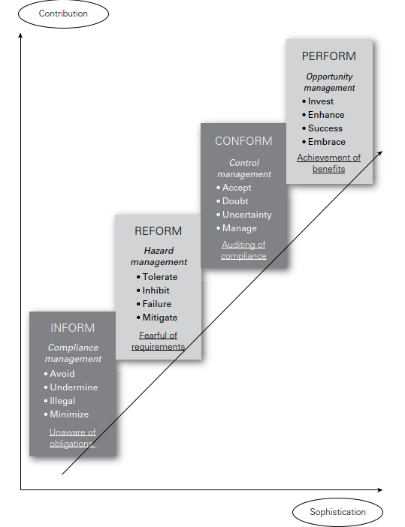
Levels of risk management sophistication
Lecture 4

Slide 26
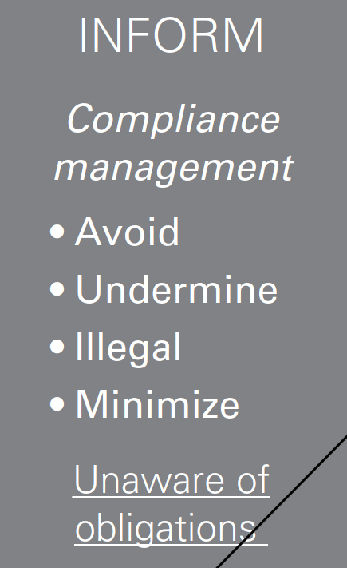
Lecture 4
Levels of risk management sophistication
At first, an organization may be unaware of the legal and contractual obligations that it faces. In that case, it will be necessary to inform the organization of its obligations in relation to the risk.

Slide 27
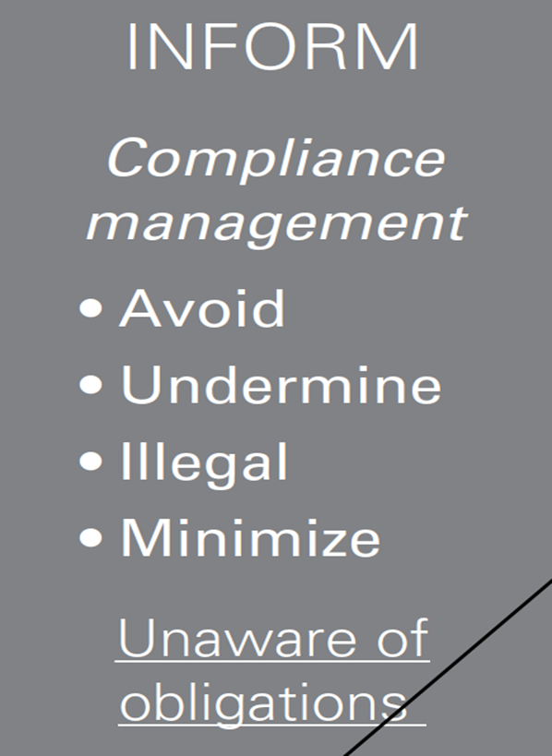
Lecture 4
Levels of risk management sophistication
As the level of sophistication develops, the organization
will become aware of the need to comply with obligations and the more general need for improved risk management.

Slide 28
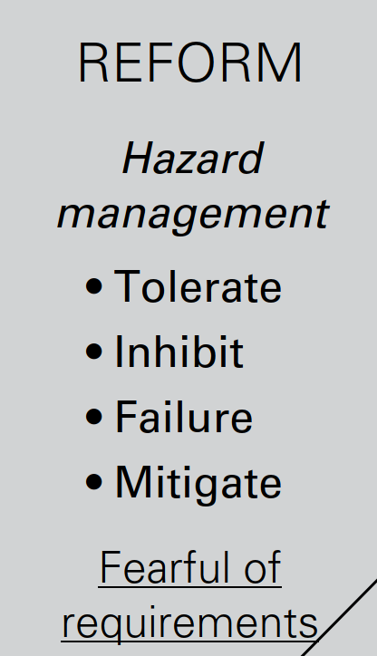
Lecture 4
Levels of risk management sophistication
Once it is aware of obligations, there will be a need for the organization to reform اصلاح in response to the hazard risks. As the organization responds to the risk.

Slide 29
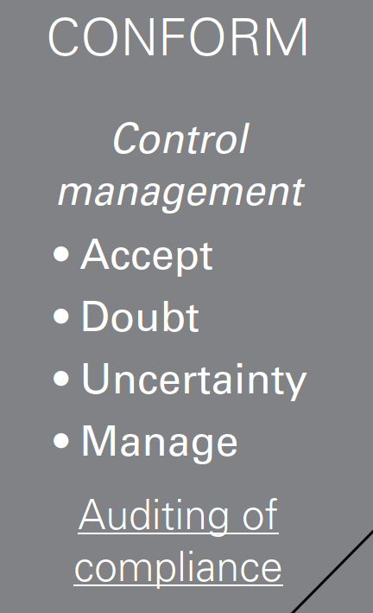
Lecture 4
Levels of risk management sophistication
it will seek to conform to the appropriate risk control standards.

Slide 30
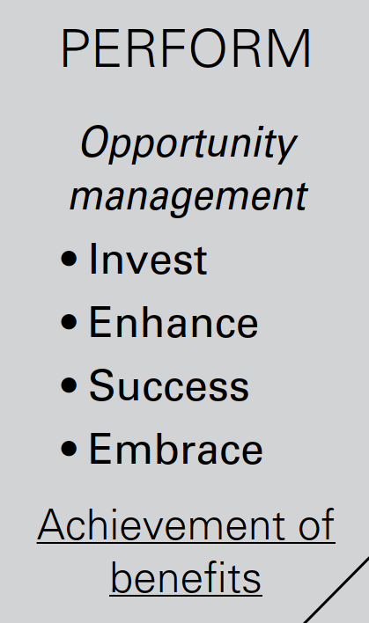
Lecture 4
Levels of risk management sophistication
After this stage, the organization may realize that there are benefits to be obtained from the risk.
The organization will then have the ability to perform and view the risk as an opportunity risk

Slide 31
Levels of risk management sophistication
Lecture 4
As the level of sophistication increases and risk management professionals become aware of the alternative approaches to risk management, they should value the contribution that can be made by other approaches.

Slide 32
Lecture 4
Development in risk management
The development in risk management approach can be summarized as follows:
  ●● Compliance management must not be undertaken in a fragmented manner, even if excellent standards of compliance are achieved.

Slide 33
Lecture 4
Development in risk management
●● Hazard management specialists may find that there has been a trend towards a desire to retain more insurable risks (and buy less insurance) as a result of a more holistic approach to risk management.
●● Control management specialists must not squeeze entrepreneurial spirit and effort out of the organization.

Slide 34
Lecture 4
Development in risk management
●● Strategic planners must recognize that risk management tools and techniques can contribute to better strategic decisions and the successful exploitation of business opportunities.

Slide 35
Lecture 3
Thank You

