Slide 1



Master of Science in Artificial intelligent
Lecture 1
AI511
Foundations of Artificial Intelligence
Prepared by
Prof. Lamiaa Fattouh Ibrahim
www.midocean.ae

Slide 2
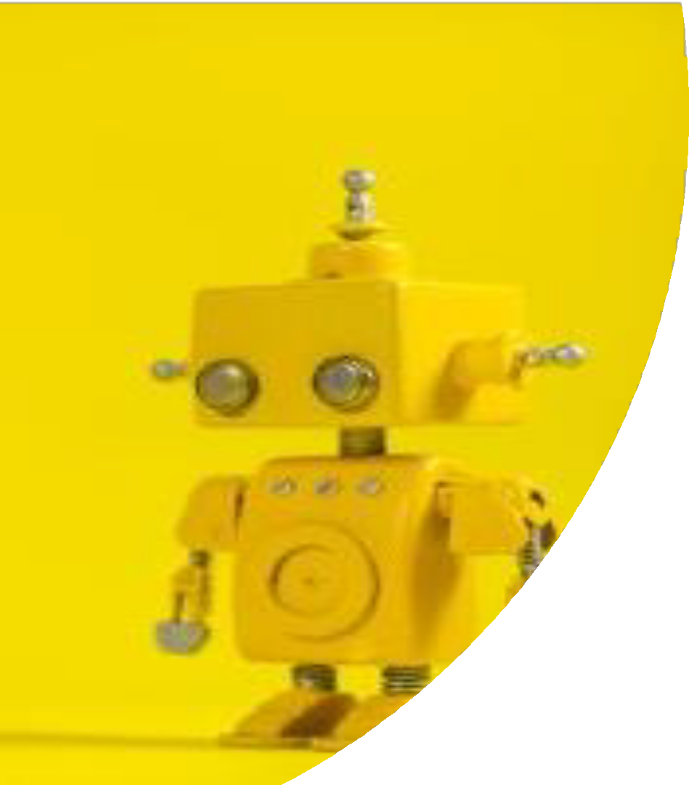
An Introduction to Artificial Intelligence

Slide 3
This lecture covers the following
Chapter 1 (Introduction) from Stuart J. Russell and Peter Norvig, "Artificial Intelligence: A Modern Approach," Third Edition (2010), by Pearson Education Inc.
… AND …
  Chapter 1 (AI: History and Applications) from George F. Luger, "Artificial Intelligence: Structures and strategies for complex problem solving, " Fifth edition (2005), Pearson Education Limited.
Resourcesfor thislecture

Slide 4
Outline
What is Intelligence
Some Foundations of Artificial Intelligence
What is Intelligence?
What is Artificial Intelligence?
Systems that act like humans
  Turing Test; the Imitation Game …
  The Chinese room argument
  Strong vs. Weak AI Hypotheses
Systems That Think Like Humans
Systems that Think Rationally
Systems that Act Rationally

Slide 5


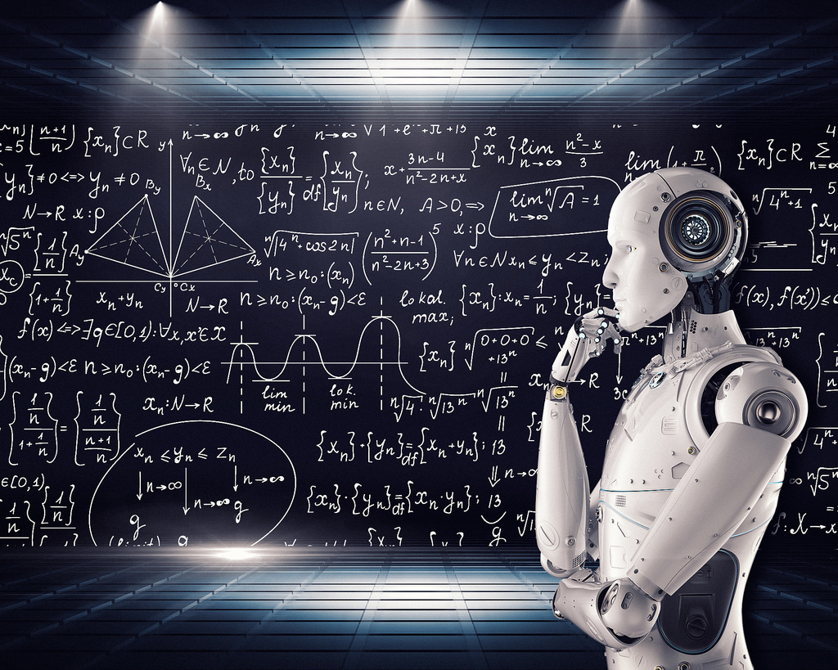
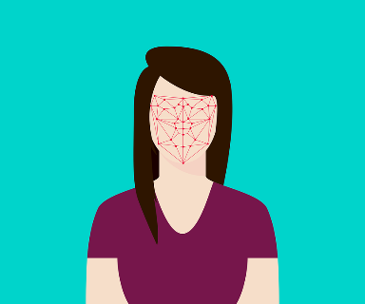
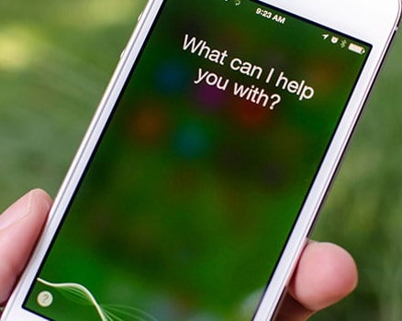

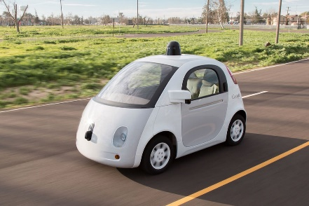
ARTIFICIAL INTELLIGENCE:INTRODUCTION
Artificial Intelligence does not only mean robots or Sci-Fi movies!
Artificial Intelligence applications are everywhere!
Google search engine, amazon recommender systems, Facebook facial recognition (tagging), Siri

Slide 6

MACHINE LEARNING AND ARTIFICIAL INTELLIGENCE: PROCESS
Machine learning is the study of algorithms that teach computers to learn from experience.
Through experience (more training data), computers can continuously improve their performance.
STEP 1
STEP 3
STEP 5
Feed training data
Find patterns
Learn from experience
STEP 2
STEP 4
Analyze Data
Perform prediction/Make a decision

Slide 7
MACHINE LEARNING: BIG PICTURE
ARTIFICIAL INTELLIGENCE
Science that enables computers to mimic human intelligence. Subfields: Machine Learning, robotics, and computer vision
MACHINE LEARNING
Subset of AI that enable machines to improve at tasks with experience
SUPERVISED LEARNING
Training algorithms using labeled input/output data.
CLASSIFICATION
REGRESSION
UNSUPERVISED LEARNING
Training algorithms with no labeled data. It attempts at discovering hidden patterns on its own.
CLUSTERING
REINFORCEMENT LEARNING
Algorithm take actions to maximize cumulative reward.

Slide 9
Some Foundations of Artificial Intelligence
P h i l o s o p h y
Can formal rules be used to draw valid conclusions?
How does the mind arise from a physical brain?
Where does knowledge come from?
How does knowledge lead to action?
M a t h e m a t i c s
What are the formal rules to draw valid conclusions? Logic
What can be computed? Algorithm
How do we reason with uncertain information? Probability
N e u r o s c i e n c e
How do brains process information?
P s y c h o l o g y
How do humans and animals think and act?

Slide 10
E c o n o m i c s
How should we make decisions so as to maximize payoff?
How should we do this when others may not go along?
How should we do this when the payoff may be far in the future?
C o m p u t e r E n g i n e e r i n g
How can we build an efficient computer?
Control theory and cybernetics
How can artefacts operate under their own control?
L i n g u i s t i c s
How does language relate to thought?

Slide 11
What is Intelligence?
INTELLIGENCE
Judgment, otherwise called “good sense,” “practical sense,” “initiative,” the faculty of adapting one's self to circumstances ... auto-critique ~ Alfred Binet (July 8, 1857 – October 18, 1911) was a French psychologist who invented the first practical intelligence test (An intelligence quotient (IQ); a total score derived from one of several standardized tests designed to assess human intelligence)
“...the resultant of the process of acquiring, storing in memory, retrieving, combining, comparing, and using in new contexts information and conceptual skills.” ~Lloyd G. Humphreys (December 12, 1913 – September 7, 2003) was an American psychologist

Slide 12
INTELLIGENCE
“the capacity to learn and solve problems” (Websters dictionary)
  in particular
the ability to solve novel problems
the ability to act rationally
the ability to act like humans
Knowledge Transfer

Slide 13

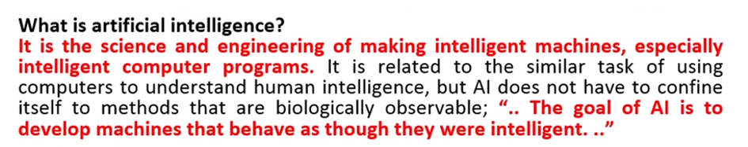
What is Artificial Intelligence?
Lisp Language=> List processing Language

Slide 14
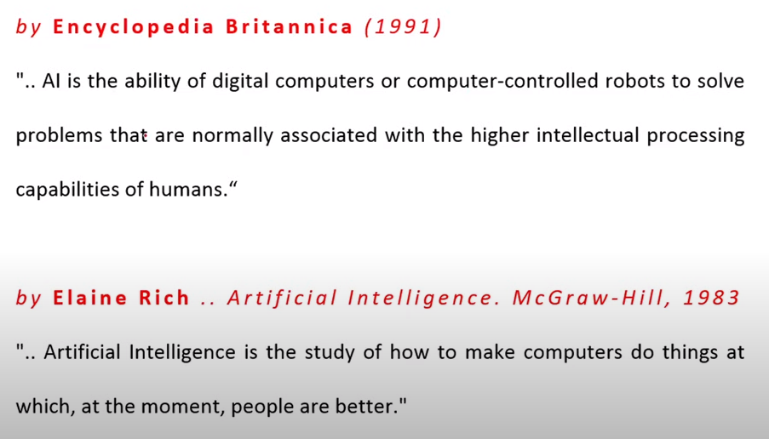
What is Artificial Intelligence?

Slide 15
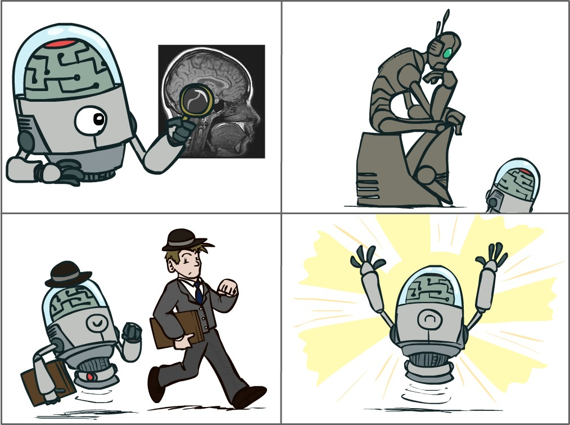








What is Artificial Inteligence?
Four main approaches that have been followed, each by different people with different methods
Acting Humanly
Thinking Humanly
Thinking Rationally
Acting Rationally

Slide 16
What is Artificial Inte ligence?
Systems that act like humans | Systems that think rationally
“The study of how to make computers do things at which, at the moment, people are better” (Rich and Knight, 1991) “The art of creating machines that perform functions that require intelligence when performed by people.” (Kurzweil, 1990) | “The study of mental faculties through the use of computational models” (Charniack and McDermott, 1985). “The study of the computations that make it possible to perceive, reason, and act.” (Winston, 1992)
Systems that think like humans | Systems that act rationally
“The automation of activities that we associate with human thinking, such as decision making, problem solving, learning” (Bellman, 1978) “The exciting new effort to make computers think … machines with minds, in the full and literal sense.” (Haugeland, 1985) | “AI .. is concerned with intelligent behavior in artifacts (Nilsson, 1998) “Computational Intelligence is the study of the design of intelligent agents.” (Poole et al., 1998)

Slide 17
What is Artificial Inte ligence?
Systems that act like humans | Systems that think rationally
“The study of how to make computers do things at which, at the moment, people are better” (Rich and Knight, 1991) “The art of creating machines that perform functions that require intelligence when performed by people.” (Kurzweil, 1990) | “The study of mental faculties through the use of computational models” (Charniack and McDermott, 1985). “The study of the computations that make it possible to perceive, reason, and act.” (Winston, 1992)
Systems that think like humans | Systems that act rationally
“The automation of activities that we associate with human thinking, such as decision making, problem solving, learning” (Bellman, 1978) “The exciting new effort to make computers think … machines with minds, in the full and literal sense.” (Haugeland, 1985) | “AI .. is concerned with intelligent behavior in artifacts (Nilsson, 1998) “Computational Intelligence is the study of the design of intelligent agents.” (Poole et al., 1998)

Slide 18
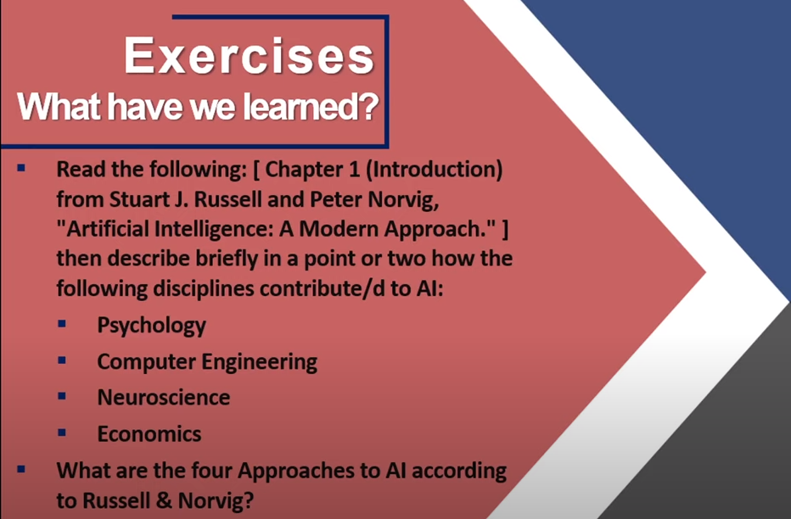

Slide 19

Systems that Act Like Humans …
?!

Slide 20
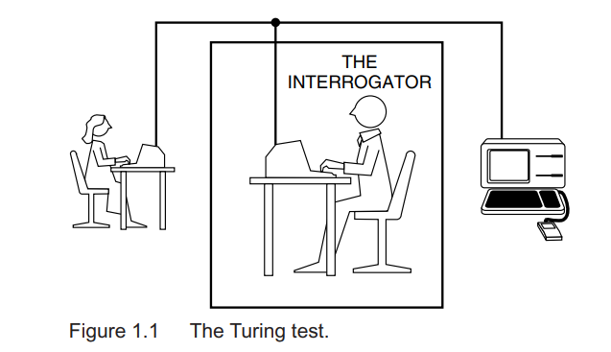
Systems that Act Like Humans
Turing Test; the Imitation Game…
In Turing’s (1950) paper “Computing machinery and intelligence”:
Can machines think ? ≡ (identical to) Can machines behave intelligently?
Operational test for intelligent behavior: the Imitation Game
AI SYSTEM

Slide 21
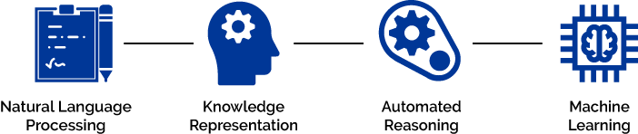

Systems that Act Like Humans
Turing Test; the Imitation Game…
Turing test (1950): Can a human interrogator tell whether (written) responses to her (written) questions come from a human or a machine?
  Natural Language Processing
  Knowledge Representation
  Automated Reasoning
  Machine Learning
19
•

Slide 22
  Natural Language Processing (NLP)
    Natural Language Understanding
    Natural Language Synthesis or generation
    Knowledge Representation
    to store knowledge
Speech recognition

Slide 23
  Automated Reasoning: to use the stored information and answer questions and to draw new conclusion.
  Machine Learning : to adapt to new circumstances and to detect and extrapolate patterns.

Slide 24
Total Turing Test (extended to include physical aspects of human behavior):
  Computer Vision
  Robotics

Slide 25
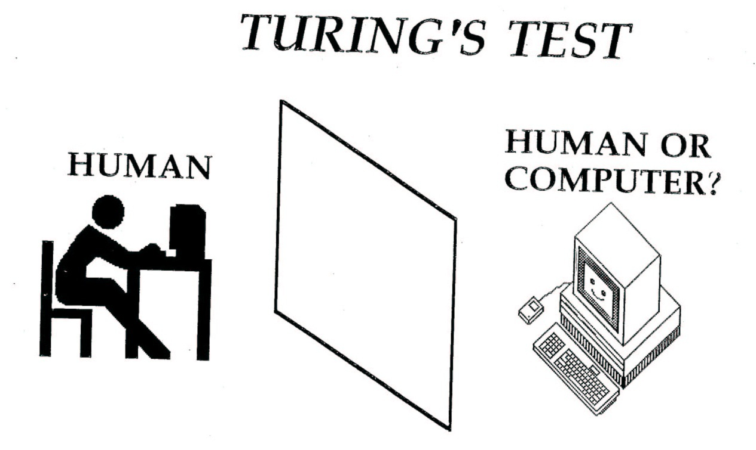
Turing’s Test
If the human cannot tell whether the responses from the other side of a wall are coming from a human or computer, then the computer is intelligent. Machine pass the Turing’s Test.
25

Slide 26
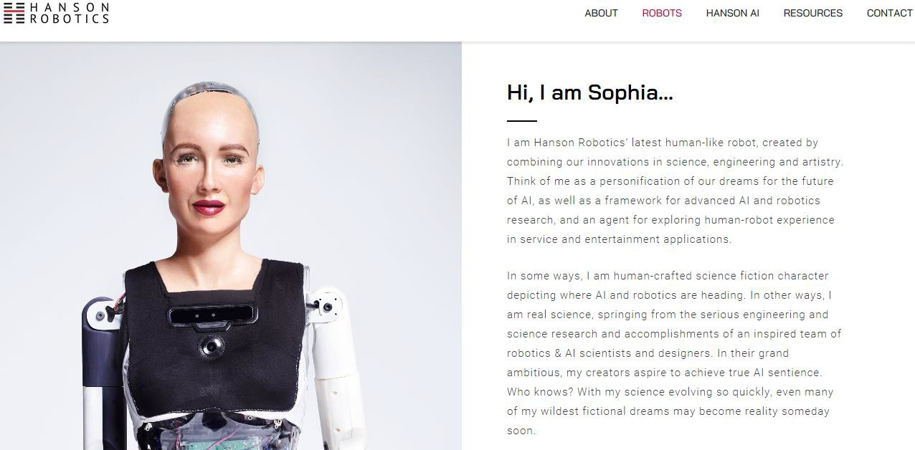
Total Turing Test?
Butwhydowewantaninteligentsystem toactlikeahuman?
- Because for many tasks, humans are still the Gold Standard.

Slide 27
Systems that Act Like Humans
Turing Test; the Imitation Game…
Turing test (1950): Can a human interrogator tell whether (written) responses to her (written) questions come from a human or a machine?
  Natural Language Processing
  Knowledge Representation
  Automated Reasoning
  Machine Learning
Total Turing Test (extended to include physical aspects of human behavior):
  Computer Vision
  Robotics
•

Slide 28
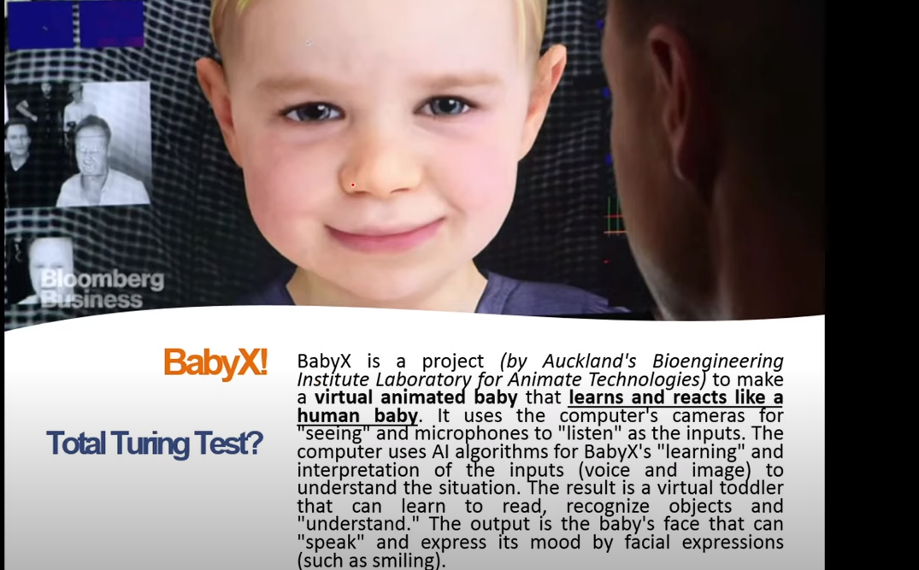


Slide 29
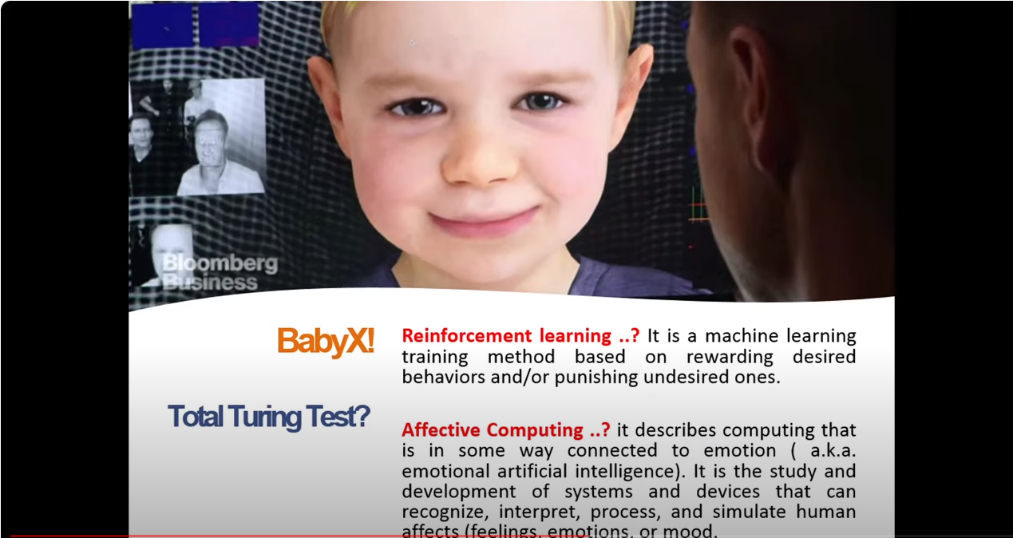

Slide 30
Systems that Act Like Humans
The Chinese Room Argument
John Rogers Searle (born July 31, 1932) is an American philosopher
“Searle's thought experiment begins with this hypothetical premise: suppose that artificial intelligence research has succeeded in constructing a computer that behaves as if it understands Chinese. It takes Chinese characters as input and, by following the instructions of a computer program, produces other Chinese characters, which it presents as output. Suppose, says Searle, that this computer performs its task so convincingly that it comfortably passes the Turing test: it convinces a human Chinese speaker that the program is itself a live Chinese speaker. To all of the questions that the person asks, it makes appropriate responses, such that any Chinese speaker would be convinced that they are talking to another Chinese-speaking human being.”
The question Searle wants to answer is this: does the machine literally "understand" Chinese? Or is it merely simulating the ability to understand Chinese? Searle calls the first position "strong AI" and the latter "weak AI".

Slide 31
Systems that Act Like Humans
The Chinese Room Argument
(Continued)
Searle then supposes that he is in a closed room and has a book with an English version of the computer program, along with sufficient paper, pencils, erasers, and filing cabinets. Searle could receive Chinese characters through a slot in the door, process them according to the program's instructions, and produce Chinese characters as output. If the computer had passed the Turing test this way, it follows, says Searle, that he would do so as well, simply by running the program manually.
Searle asserts that there is no essential difference between the roles of the computer and himself in the experiment. Each simply follows a program, step-by- step, producing a behaviour which is then interpreted as demonstrating intelligent conversation. However, Searle would not be able to understand the conversation.
Searle argues that without "understanding" (or "intentionality"), we cannot describe what the machine is doing as "thinking" and since it does not think, it does not have a "mind" in anything like the normal sense of the word. Therefore, he concludes that
"strong AI" is false.
22

Slide 32
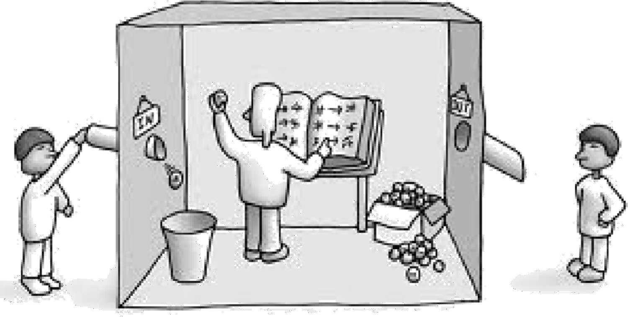
Systems that Act Like Humans
The Chinese Room Argument
(Continued)
If person inside does a great job of answering questions, can we
say he or she understands?
Even if she or he is only blindly following rules?
(Obviously, the ‘person inside’ is acting like an AI program)

Slide 33
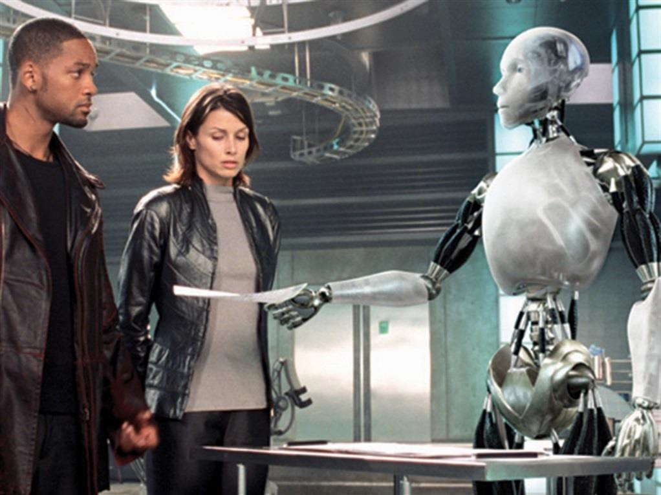
Systems that Act Like Humans
The Chinese Room Argument
(Continued)
Strong vs. Weak AI Hypotheses?
WEAK AI Hypothesis; We can accurately simulate animal / human intelligence in a computer.
STRONG AI Hypothesis; We can create algorithms that are intelligent
(conscious?)
Do you remember
Sonny, 2004
the robot from the
science-fiction / action film "I, Robot"?

Slide 34
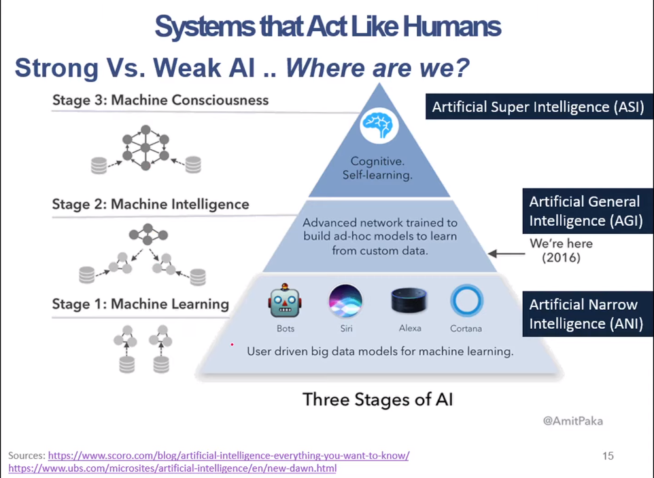
Systems that Act Like Humans
Strong Vs. Wek AI .. Where are we?
25

Slide 35
What is Artificial Inte ligence?
Systems that act like humans | Systems that think rationally
“The study of how to make computers do things at which, at the moment, people are better” (Rich and Knight, 1991) “The art of creating machines that perform functions that require intelligence when performed by people.” (Kurzweil, 1990) | “The study of mental faculties through the use of computational models” (Charniack and McDermott, 1985). “The study of the computations that make it possible to perceive, reason, and act.” (Winston, 1992)
Systems that think like humans | Systems that act rationally
“The automation of activities that we associate with human thinking, such as decision making, problem solving, learning” (Bellman, 1978) “The exciting new effort to make computers think … machines with minds, in the full and literal sense.” (Haugeland, 1985) | “AI .. is concerned with intelligent behavior in artifacts (Nilsson, 1998) “Computational Intelligence is the study of the design of intelligent agents.” (Poole et al., 1998)

Slide 36
What is Artificial Inte ligence?
Systems that act like humans | Systems that think rationally
“The study of how to make computers do things at which, at the moment, people are better” (Rich and Knight, 1991) “The art of creating machines that perform functions that require intelligence when performed by people.” (Kurzweil, 1990) | “The study of mental faculties through the use of computational models” (Charniack and McDermott, 1985). “The study of the computations that make it possible to perceive, reason, and act.” (Winston, 1992)
Systems that think like humans | Systems that act rationally
“The automation of activities that we associate with human thinking, such as decision making, problem solving, learning” (Bellman, 1978) “The exciting new effort to make computers think … machines with minds, in the full and literal sense.” (Haugeland, 1985) | “AI .. is concerned with intelligent behavior in artifacts (Nilsson, 1998) “Computational Intelligence is the study of the design of intelligent agents.” (Poole et al., 1998)

Slide 37
Systems that Think Rationa ly
Logic: formalize idealized or right thinking, i.e. irrefutable reasoning processes. That is; patterns of argument that always yield correct conclusions when supplied with correct premises:
“Socrates is a man; all men are mortal; therefore Socrates is mortal.”
  Logistic tradition in AI aims to build computational frameworks based on logic, that is, describe problem in formal logical notation and apply general deduction procedures to solve it.
  Then use these frameworks to build intelligent systems.
Some examples are (Propositional Logic) and (Logic Programming).
More advanced logic-based representations:
  Semantic Networks

Slide 38
What is Artificial Inte ligence?
Systems that act like humans | Systems that think rationally
“The study of how to make computers do things at which, at the moment, people are better” (Rich and Knight, 1991) “The art of creating machines that perform functions that require intelligence when performed by people.” (Kurzweil, 1990) | “The study of mental faculties through the use of computational models” (Charniack and McDermott, 1985). “The study of the computations that make it possible to perceive, reason, and act.” (Winston, 1992)
Systems that think like humans | Systems that act rationally
“The automation of activities that we associate with human thinking, such as decision making, problem solving, learning” (Bellman, 1978) “The exciting new effort to make computers think … machines with minds, in the full and literal sense.” (Haugeland, 1985) | “AI .. is concerned with intelligent behavior in artifacts (Nilsson, 1998) “Computational Intelligence is the study of the design of intelligent agents.” (Poole et al., 1998)

Slide 39
Systems that Act Rationally
The “think rationally” approach focuses on correct inference.
But more is needed for rational behavior, e.g.
  How to behave when there is no provably correct thing to do (i.e.
reasoning under uncertainty).
  Fully reactive behavior (instinct vs. reason).

Slide 40
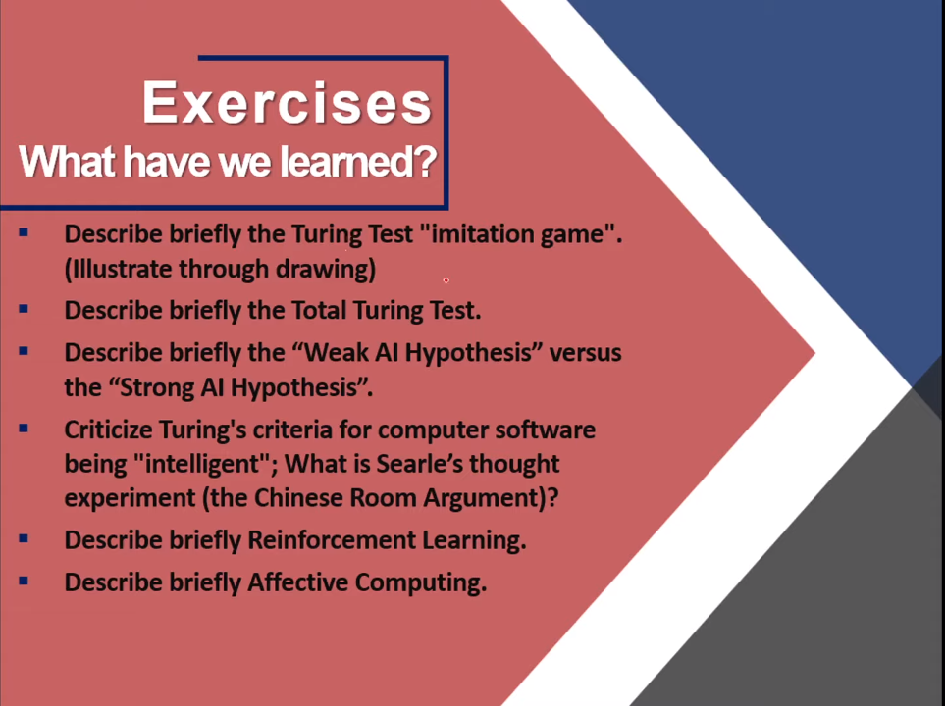

Slide 41
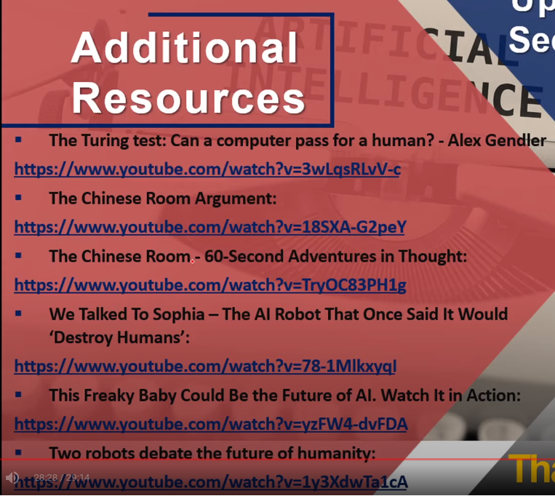
Intelligent Agents

Slide 42



Thank You

