Slide 1


Prepared by Dr. Rana Maya
REA 621
Real Estate market analysis
Lecture 4

Slide 2



Data Sources and collection method for market analysis
Lecture 4
REA621
Real Estate market analysis
Prepared by
Dr. Rana Maya

Slide 3

lecture
Abstract
04
This lecture introduces the main types of data used in market analysis—primary and secondary data—and explains how each contributes to understanding market conditions, demand, supply, pricing, and risk.

Slide 4

lecture
04
Contents
1. Demographic Data Sources
2. Consumer Surveys and Focus Groups
3. Documentation of Historical Supply Trends and Current Conditions
4. Importance of Fieldwork
5. Documentation of Historical and Future Construction Activity
6. Case study: Competitive Market Analysis

Slide 5
lecture
04
  Learning outcomes
By the end of the lecture, you will be able to:
• Identify key demographic data sources used in market analysis.
• Explain how consumer surveys and focus groups support market demand analysis.
• Describe historical supply trends and current market conditions using documented data.
• Recognize the importance of fieldwork in verifying market information.
• Analyze historical and future construction activity to assess market supply changes.
• Apply competitive market analysis concepts through a practical case study.

Slide 6
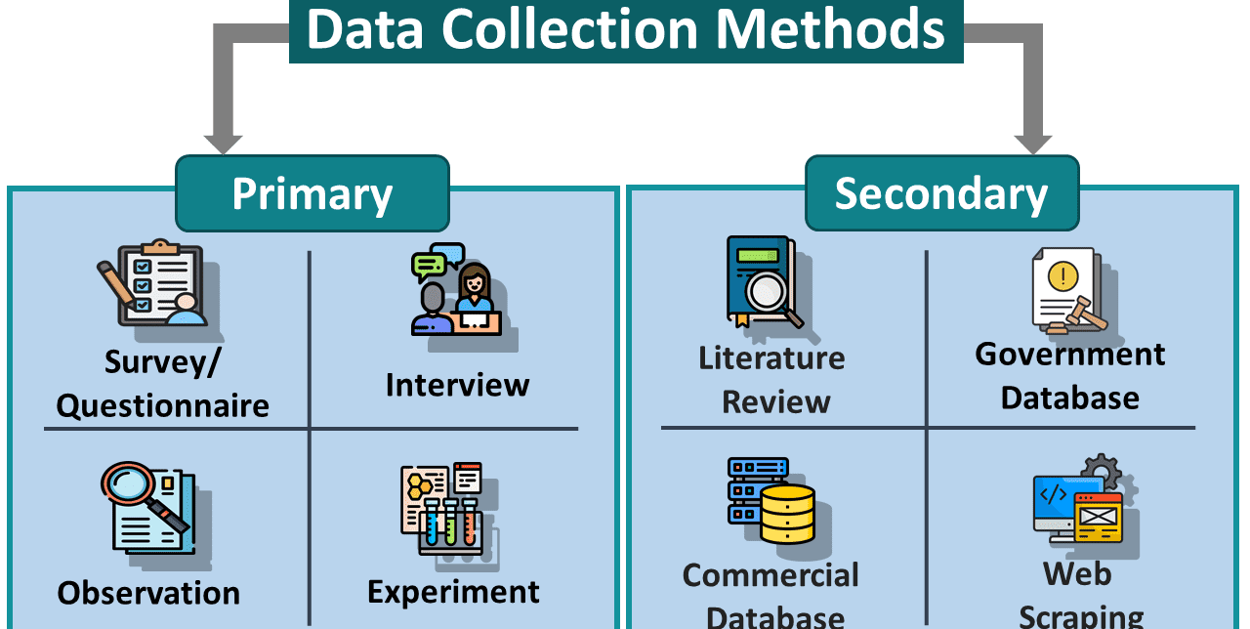
Effective market analysis depends on the quality, reliability, and relevance of the data used. Accurate market insights cannot be achieved without clearly identifying appropriate data sources and applying systematic data collection methods.
It provides a foundation for producing credible, evidence-based market analysis that supports sound investment and planning decisions.
It is often necessary to rely on a combination of sources to assemble a complete picture.
Why?

Slide 7

1. Demographic Data Sources
Local conditions may not precisely mirror national trends. Not every metropolitan area benefits from a national economic boom, and some communities will survive a national recession relatively unscathed. As a result, real estate market studies usually give greater weight to metropolitan area economic indicators than to nationwide statistics.
Census Bureau Products
Generate detailed data from a sample of households regarding household income, occupation of employed persons, educational attainment, and other social and economic characteristics.
The ACS now provides these data indicators each year
www.data.census.gov

Slide 8

1. Demographic Data Sources
Census Bureau Products
Indicators that are of greatest interest to real estate market analysts include these:
■ Population and household estimates.
■ Population characteristics (age distribution, median age,
gender, educational attainment, race, Hispanic ethnicity).
■ Geographic mobility in the past year, with limited
information on destination of persons who moved.
■ Marital status and marital history.
■ Employment status; employed persons by industry and occupation.

Slide 9
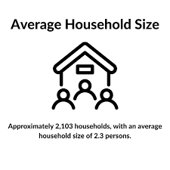
1. Demographic Data Sources
Census Bureau Products
■ Commuting data (journey to work, place of work, transportation to work, travel time).
■ Household size (persons per household).
■ Household types: families (married couples, single parent families, other related persons living together) and nonfamilies (unrelated persons living together, single-person households).
■ Total housing units and occupancy/vacancy status.
■ Owner/renter tenure.

Slide 10
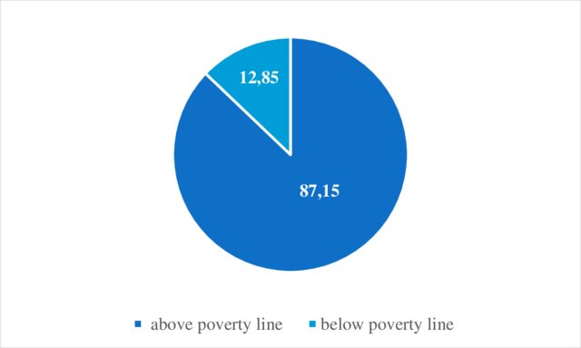
1. Demographic Data Sources
Census Bureau Products
■ Age of housing units (year built).
■ Housing unit types (single-family detached and attached, multifamily buildings by units )
■ Housing unit sizes (number of rooms, but not square footage).
■ Rents (distribution of rents paid, median and average rent).
■ Estimated home values (distribution, median and average)
■ Household income and family income distributions (mean [average] and median incomes).
■ Vehicles available to household members.
■ Poverty status.

Slide 11

1. Demographic Data Sources
State and Metropolitan Agency Sources
Many states and regional planning agencies prepare their own population estimates or projections. The data are used primarily for transportation planning or in areas with strong growth management programs.
Statistics on employment by industry and by occupations are also provided.

Slide 12
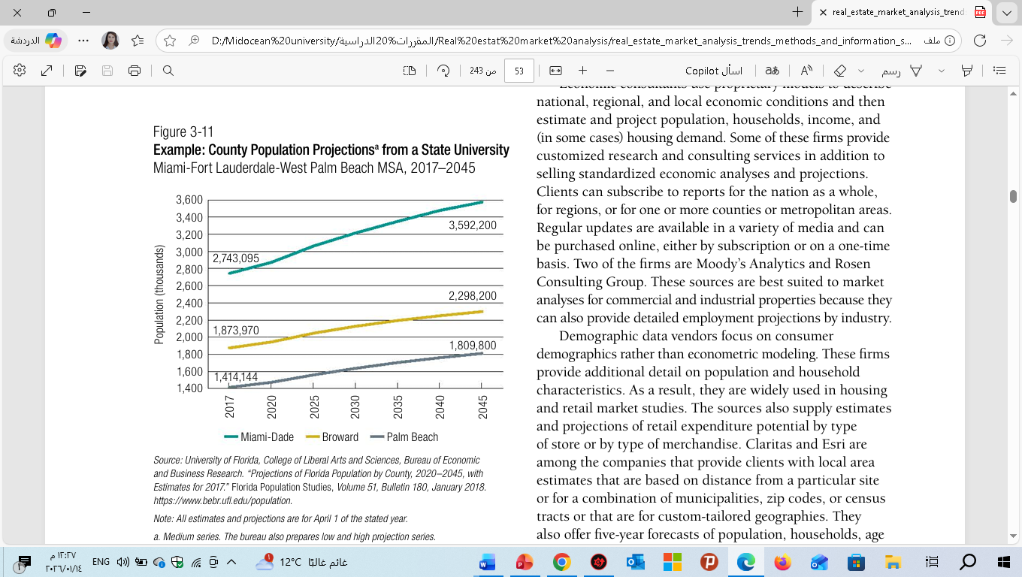
1. Demographic Data Sources
University Sources
Many universities, both private and public, have demographic
and economic research institutes that provide instruction in
analytic techniques and offer practical experience for current
and future practitioners.

Slide 13

1. Demographic Data Sources
Private Sources
-Private data vendors have stepped in to provide estimates and projections not issued by the Census Bureau or state/local agencies.
-Some of these firms provide customized research on consumer demographics and consulting services in addition to selling standardized economic analyses and projections.

Slide 14
2.Consumer Surveys and Focus Groups
The market analyst and the
client can learn about what the characteristics of potential customers are and what aspects of a proposed real estate
development are most important to them?
Surveys and focus groups can be very useful in real estate market analysis because they directly provide information
on consumer opinions and preferences.

Slide 15

2.Consumer Surveys and Focus Groups
They also offer five-year forecasts of population, households, age Real Estate Market Analysis to a homebuilder about model home features that were most appealing to visitors. More generally, survey research can accomplish the following:
■ Tell owners of existing retail properties (or developers considering new construction or major renovations).
■ Indicate how frequently consumers are patronizing restaurants at various price points. ■ Identify what previous customers (buyers or tenants) liked and disliked about a building or an entire development project.

Slide 16

2.Consumer Surveys and Focus Groups
Gauge customer interest in new concepts or features not previously seen in the market.
Reveal which factors (location, price or rent, and amenities) are most important in customers’ decision-making.
Suggest how much tenants or buyers would be willing to pay for space in a project.
Tell owners how current tenants feel about property management and maintenance.
Provide information on prospects’ demographic characteristics that can be cross-tabulated with their responses to substantive questions.

Slide 17
2.Consumer Surveys and Focus Groups
Apartment buildings have online portals
allowing them to contact tenants and, in turn, tenants can send feedback to management.
Hotel operators contact recent visitors after they check out. to ask about their satisfaction with purchases or visits.

Slide 18

2.Consumer Surveys and Focus Groups
A complete market study report should include a map that shows where the property sits within the metropolitan area or a major city. At a smaller scale, a map should show the boundaries of the primary and secondary market areas, location of the site, nearby interstate highways, and key
Developers are tempted to assume that they know their future customers’ needs and preferences. This assumption is a common, but potentially serious, misconception.

Slide 19
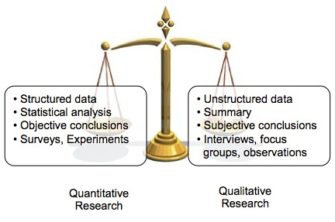
2.Consumer Surveys and Focus Groups
Qualitative research does not produce statistics; rather, it allows for more detailed exploration into customer perceptions of the product, competition, shopping habits, housing preferences, and so on
Quantitative and qualitative research
Quantitative research provides statistics on customer characteristics and the proportion

Slide 20

2.Consumer Surveys and Focus Groups
Survey research companies maintain respondent panels— households who agree to participate in surveys.
The companies know the location and demographic characteristics of their panelists (age, race/ethnicity, gender, owner/renter tenure).
If the panels are sufficiently large, the survey firm can send email links to panelists who live in the target market area. When responses are returned, the firm can check to be sure the respondents are representative of market area households as a whole, using Census sources such as the ACS.

Slide 21

2.Consumer Surveys and Focus Groups
Surveys provide an educated guide for developing a property, marketing the product, and keeping it competitive, but adhering to survey results cannot guarantee success. Using such data can, however, reduce the risk of making wrong decisions and maximize the likelihood of building a marketable product

Slide 22
2.Consumer Surveys and Focus Groups
Identifying Targets and Respondents
The first thing that must be done is to identify the characteristics of the people who should participate in the study.
They are used to select the area from which survey respondents will be drawn and to screen survey participants. For example:
An office developer would want to learn more about the plans of existing tenants who are in the developer’s market area and whose leases will expire within the next 36 months
Commuters who use a train station could be asked about the types of stores they patronize during, before, or after work, as well as what new shops and services they would be likely to use

Slide 23

2.Consumer Surveys and Focus Groups
Using Quantitative Research
Quantitative research is conducted when it is necessary to predict the target group’s behavior with a degree of statistical accuracy.
An example of what can be learned is either the percentage of people who are likely to shop at a certain store or shopping center or the share of office tenants in older buildings who are likely to move rather than renew their leases.

Slide 24
2.Consumer Surveys and Focus Groups
Given that all 8 billion people on the planet must live somewhere, how do we organize ourselves?
Quantitative research (statistically valid and reliable) usually requires a large sample size.
Typically, a minimum of 200 or more completed surveys from targeted respondents will be needed; requirements will be much higher if the client wants to know about the characteristics, preferences, and perceptions of particular subgroups.

Slide 25

2.Consumer Surveys and Focus Groups
Given that all 8 billion people on the planet must live somewhere, how do we organize ourselves?
Mail Surveys
Mail surveys are fairly easy to administer.
Once the firm conducting the survey has identified the target respondents, it should obtain a list of potential recipients and select a sample for mailing.
Sources include :
current customer or tenant lists
municipal mailing lists
business address lists,
membership rosters
and other commercially available lists—all of which the market analyst or survey firm can purchase from reputable marketing companies
Response rates for mail surveys conducted for private projects are usually low, but a short survey will probably draw more responses than a lengthy questionnaire will

Slide 26

2.Consumer Surveys and Focus Groups
Mail Surveys
A major drawback of mail surveys is that respondents may not represent the population at large
Another concern may be the length of time needed to obtain the required number of responses.

Slide 27

2.Consumer Surveys and Focus Groups
lecture
Numerous areas of contemporary economics are connected to urban economics. My early professional goal was to become a macroeconomist. Understanding the causes and effects of booms and recessions is the goal of macroeconomists. Additionally, they aim to comprehend the
Telephone Surveys
Potential respondents can be reached using random-digit dialing within particular exchanges or using purchased phone number lists. However, phone surveys are increasingly difficult to administer.
Although telephone surveys can be completed more quickly than mail surveys, processing them still takes a few weeks.
Surveyors may have to call respondents multiple times before a qualified interview is completed.
Refusal rates are high, and many of the sampled phone numbers will not be usable.

Slide 28

2.Consumer Surveys and Focus Groups
Online Surveys
Online surveys are growing in popularity because households can answer them on their cellphones, tablets, or desktops. They are relatively inexpensive and fast to administer (popular programs such as Surveymonkey.com are helpful). Even so, the audience is limited to online respondents who know about the survey because they have received an email or text message asking them to click on a link that takes them to the survey.
Although it can be easy to put a consumer survey online, the results can suffer from the same limitations intrinsic to mail questionnaires—respondents may not represent the target market as a whole. In other words, these are “surveys of the willing.”

Slide 29

2.Consumer Surveys and Focus Groups
Intercept Surveys
In-person intercept surveys are conducted at high-traffic locations, such as shopping malls, transit stations, arenas, or pedestrian-oriented urban business districts.
Intercepts are inexpensive and easy to administer. However, they cannot ensure that respondents meet specific demographic or psychographic criteria (although the interviewer can screen participants who meet age or gender requirements).
Despite the limitations, intercepts can provide a reasonably reliable portrait of shopping center and business district patrons and their purchasing habits

Slide 30
2.Consumer Surveys and Focus Groups
Example: Using Consumer Surveys in Real Estate Market Analysis
Property Type: Residential Apartments
Location: Urban District (Middle-Income Area)
Purpose: Identify housing preferences, affordability, and demand characteristics for a proposed residential project.
Survey Design and Sample
Survey method: Structured questionnaire (online and in-person)
Sample size: 250 households
Target group: Middle-income renters aged 25–50
Sampling method: Stratified random sampling by income level
Response rate: 68%

Slide 31
2.Consumer Surveys and Focus Groups
| Priority Factor | % Selecting as “Very Important” |
| ----------------------- | ------------------------------- |
| Proximity to work | 72% |
| Parking availability | 65% |
| Public transport access | 58% |
| Security | 76% |
| Retail/services nearby | 49% |
3. Key Survey Questions (Examples)
What type of housing do you currently occupy?
What is your preferred apartment size?
What is your maximum affordable monthly rent?
Which location factors are most important to you?
Would you consider relocating to a new residential project in this area?
Priority Factor | % Selecting as
Proximity to work | 72%
Parking availability | 65%
Public transport access | 57%
Security | 76%
Retail/services nearby | 49%

Slide 32
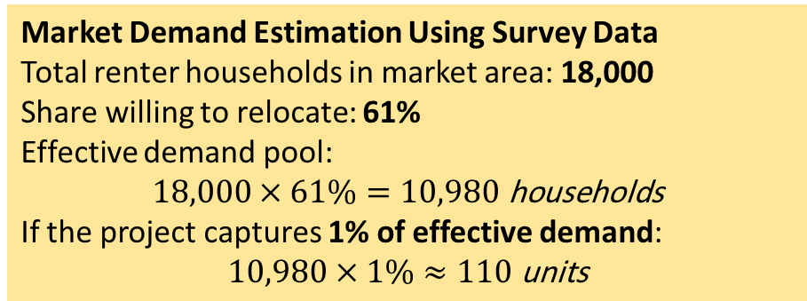
2.Consumer Surveys and Focus Groups
| Priority Factor | % Selecting as “Very Important” |
| ----------------------- | ------------------------------- |
| Proximity to work | 72% |
| Parking availability | 65% |
| Public transport access | 58% |
| Security | 76% |
| Retail/services nearby | 49% |
Market Demand Estimation Using Survey Data
Total renter households in market area: 18,000
Share willing to relocate: 61%
Effective demand pool:
$$18,000×61\%=10,980 \text{households}$$
If the project captures 1% of effective demand:
$$10,980×1\%≈110 \text{units}$$
Willingness to Relocate
Yes: 61%
Maybe: 23%
No: 16%
Over 60% potential demand for new, well-priced housing.
Application to Project Design
Based on survey findings: Unit mix:
  2-Bedroom: 50%
  1-Bedroom: 30%
  3-Bedroom: 20%
Target rent: SAR 3,000–4,000/month
Key amenities: parking, security, proximity to work

Slide 33
2.Consumer Surveys and Focus Groups
Using Qualitative Research
Using Qualitative Research
Qualitative research is usually conducted with a small number of respondents. Although this type of research is not statistically projectable, it allows perceptions to be probed in depth
Respondents are screened for specific demographic and psychographic criteria.
Groups usually comprise no more than 10 to 12 participants.
Multiple focus groups can be used to see variations in the perceptions and reactions of different targets.
A professionally trained facilitator is usually hired to conduct the discussion
The focus group is the most common type of qualitative
research because it provides a good balance between accuracy and cost

Slide 34
2.Consumer Surveys and Focus Groups
Examples of how qualitative research can be applied to specific real estate projects
A residential builder can conduct focus groups with consumers who are potential buyers or renters, asking them about their space requirements or getting their reactions to possible architectural elevations, building materials, interior finishes, appliances, or color schemes.
An office and industrial real estate agent might use focus groups with potential tenants. The agent may have access to information on leases that will expire in the next 12 to 18 months, allowing him or her to zero in on businesses that represent potential tenants for a new or renovated building

Slide 35

2.Consumer Surveys and Focus Groups
Any survey research, whether quantitative or qualitative, is a single component of a comprehensive market study and cannot replace the vital information that is gathered through other market analysis techniques.

Slide 36
3.Documentation of Historical Supply Trends and Current Conditions
The supply section of a market study looks at current conditions in light of past performance trends.
In addition, key indicators for the local market area are compared with metropolitan area or countywide data.
The greatest detail is presented for those properties deemed to be most competitive with the subject site.
The study assesses the strengths and limitations of competitive buildings objectively.
It also discusses known additions to future supply (under construction or approved) as well as other potential competitors not yet underway.
The amount of space in the planning pipeline should be compared with historical data to determine whether future construction levels are sustainable.

Slide 37

3.Documentation of Historical Supply Trends and Current Conditions
The size of the current inventory (number of housing units; square feet of office
How much the inventory has increased over time
The analyst must explain the reasons for any significant deviation from areawide norms
Inventory quality (often expressed as class A, class B, or class C)
Anticipated near-term new construction.

Slide 38
3.Documentation of Historical Supply Trends and Current Conditions
Number of units or square feet or space yet to be absorbed in projects already completed or under construction.
Current vacancy rates (including available sublet space for multitenant office
Sales prices, rent levels, or hotel room rates over time
Long-term supply of land that is zoned for the land use being examined (if known)

Slide 39
3.Documentation of Historical Supply Trends and Current Conditions
Breaking Down the Numbers: Property Types, Location, and Class
Property type: Residential properties are classified by tenure (for sale or for rent) and physical characteristics (single-family detached, townhouse, or condominium; walk-up or elevator buildings).
Geographic submarkets: Office buildings tend to cluster in or near downtowns, near transit stations, or at highway-oriented suburban nodes
Class: Office, industrial, and apartment buildings are categorized as class A, B, or C, depending on the property’s age, quality, and amenities. A property does not have to be less than five years old to be deemed class A, but it needs to be well maintained and retrofitted with the amenities desired by today’s tenants

Slide 40
3.Documentation of Historical Supply Trends and Current Conditions
Analyzing Rents and Prices
Rent trends are a key part of the metropolitan area or county market overview
A report analyzing trends in the metropolitan area or one of its submarkets should provide data on average and median rents (or sales prices for homes and condominiums) and how they have changed over the past five years or more
Rents for office, industrial, and retail properties are typically expressed as annual rate per square foot of leasable area.17 Measurable space varies by type of property. Office rents are typically calculated on the basis of net rentable area, while shopping centers report gross leasable area. Apartment rents are usually shown on a per-month basis.

Slide 41

3.Documentation of Historical Supply Trends and Current Conditions
Brokerage Reports
Summaries of current and historical market conditions (inventory, rents, occupancy rates, leasing activity, net absorption) are available for many larger metropolitan areas and their submarkets with national brokerage and investment advisory firms.
Local firms will be very familiar with individual properties as well as marketwide conditions.

Slide 42

3.Documentation of Historical Supply Trends and Current Conditions
Consultants, Associations, and Trade Media
Organizations that represent real estate professionals can be useful sources of information on supply trends, both at the national level and in individual metropolitan areas. These groups include:
the International Council of Shopping Centers
National Association of Home Builders
NAIOP, the Commercial Real Estate Development Association
National Association of Realtors

Slide 43


3.Documentation of Historical Supply Trends and Current Conditions
Private Vendors
State housing or community development agencies have websites where landlords can post available affordable apartments and provide information on unit sizes, features, and rents. Such lists can provide a road map for the market analyst, but more complete information usually has to be obtained through field visits or telephone interviews.
https://reidin.com
https://www.cbre.com
https://meaccurate.com/
https://www.dubizzle.com/

Slide 44
4.Importance of Fieldwork
Although the quantity and quality of statistical information on competitive supply is continually improving, even the best inventory reports cannot substitute for field observations
Preparing a thorough market analysis also requires “kicking the bricks”—determining how a competitor’s location, surrounding uses, design, amenities, and other features compare with the subject property
Interviews with building managers or leasing staff members can enhance an analyst’s understanding of an area’s market dynamics,

Slide 45
5.Documentation of Historical and Future Construction Activity
Strong economy → higher demand for space → rents rise (Space Market).
Higher rents → higher property prices (Asset Market).
Higher prices → new construction (Development Industry).
Developers need financing → capital market provides money.
New supply → feeds back into space market, affecting rents and vacancies.
This creates cycles of boom and bust.
Accurately gauging the demand and supply balance requires careful consideration of the future construction pipeline
Commercial and industrial properties already under construction will be among the most important competitors for a proposed development that has yet to line up financing and break ground
Some local government agencies, such as economic development authorities or planning departments, periodically update lists of projects that have received planning approvals but have not yet been started

Slide 46
6.Case study: Competitive Market Analysis-Proposed Mid-Rise Residential Apartment Building
No. | Year Built | Total Size | Unit Sizes | Asking Rent & Concessions | Utilities Included | Occupancy Rate
1 | 2018 | 120 units | 1BR: 65 sqm2BR: 95 sqm | SAR 38,000–55,000/yearNo concessions | Water included | 92%
2 | 2015 | 90 units | 2BR: 90 sqm3BR: 120 sqm | SAR 50,000–70,000/year1 month free rent | Water & electricity included | %88
3 | 2020 | 150 units | Studios: 45 sqm1BR: 70 sqm | SAR 42,000–60,000/yearMoving allowance SAR 2,000 | Water included | 95%
4 | 2012 | 80 units | 2BR: 100 sqm3BR: 140 sqm | SAR 65,000–85,000/yearNo concessions | Not included | 90%

Slide 47
6. City Real Estate Market (Example)
Here’s the timeline graph showing Dubai’s real estate cycle:
bust: steep decline due to oversupply and global financial crisis.
Additional Observations
Location Advantages:
  Properties located near Prince Sultan Road and the Corniche benefit from strong accessibility and proximity to commercial centers.
  Horizon Towers has a competitive advantage due to its proximity to public transport and retail services.
Tenant Mix:
  Predominantly middle- to upper-middle-income professionals and expatriate families.
  High demand for 1- and 2-bedroom units due to affordability and household size trends.
Market Performance:
  Newer properties (built after 2018) show higher occupancy rates (above 92%).
  Concessions are limited, indicating a relatively balanced rental market.

Slide 48
6. City Real Estate Market (Example)
Figure 2. Housing supply elasticity and equilibrium outcomes (illustrative).
Analyst’s Conclusion
The competitive set demonstrates strong occupancy levels (88%–95%), indicating stable rental demand in North Jeddah. Asking rents suggest the market can support annual rents between SAR 40,000 and SAR 60,000 for mid-quality residential units. The subject property is expected to compete effectively by offering modern design, efficient unit layouts, and selective rent concessions during the initial lease-up period.

Slide 49

Conclusion
The art and science of market analysis requires judgment and vision as well as facts. Once market analysts have completed fieldwork, collected data, and prepared maps and tables, they must synthesize the findings and reach conclusions about a proposed project’s marketability or the future performance of an existing property.
lecture
04
Exercise
Use quantitative and qualitative research tools to do market analysis for your new proposed project?

Slide 50



Thank You

