Slide 1

Strategic And Operational Risk Management
PMG630
Prepared by
Dr. Ayman Hassan
  Lecture .7 “Tools and Techniques” CCA-ALARB “

Slide 2


Chapter 3
Tools and Techniques
fault Tree analysis
FTA
Prepared by
Dr. Ayman Hassan

Slide 3

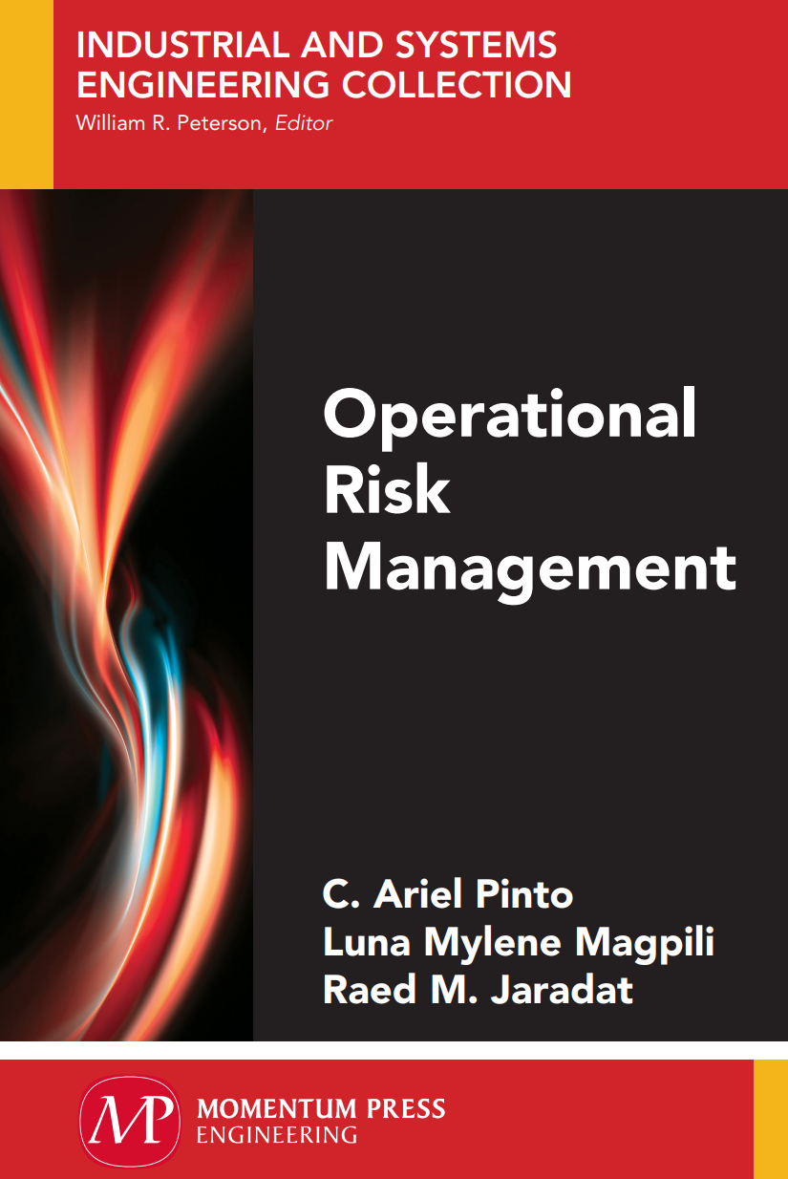
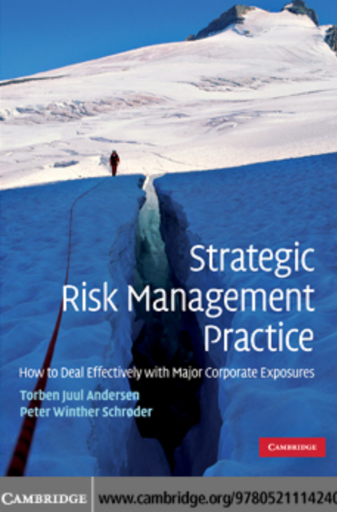
Important Note, 1
r
REF, 1
REF,2

Slide 4
Lecture No.7, The Content
Summary of the previous lecture
Introduction
Cause and Consequences Analysis “ CCA ”
Historical overview
Where and when using
Forms and models
As Low As Reasonably Practicable “ ALARP ”
How, Where, and When “ ALARP “
Some fallacies about ALARP
Pay attention
References & Resources

Slide 5
Cause and Consequences Analysis
CCA : Deeply Analysing to Identify Root Causes and Potential Consequences
CCA is a modeling technique that uses graphical methods and diagrams.
CCA is an analytical method for tracing and exposing the chains of events related to a particular risk event of interest.
CCA serves as a visual chronological description of failures from its initiation to the final outcomes.

Slide 6
Cause and Consequences Analysis
Also known as Cause-and-Effect Diagrams.
Fishbone Diagrams
Ishikawa Diagrams
Herringbone Diagrams
and Fishikawa Diagrams.

Slide 7
Historical overview
Cause and Effect Analysis was devised by professor Kaoru Ishikawa, a pioneer of quality management, in the 1960s. The technique was then published in his 1990 book, "Introduction to Quality Control.“
The diagrams that you create with are known as Ishikawa Diagrams or Fishbone Diagrams (because a completed diagram can look like the skeleton of a fish).
Although it was originally developed as a quality control tool, you can use the technique just as well in other ways. For instance, you can use it to:
Discover the root cause of a problem.
Uncover bottlenecks in your processes.
Identify where and why a process isn't working.

Slide 8
When using CCA
When you have a serious problem, it's important to explore all of the things that could cause it, before you start to think about a solution.
That way you can solve the problem completely, first time round, rather than just addressing part of it and having the problem run on and on.
Cause and Effect Analysis gives you a useful way of doing this. This diagram-based technique, which combines Brainstorming with a type of Mind Map, pushes you to consider all possible causes of a problem, rather than just the ones that are most obvious

Slide 9
Where To use CCA
CCA is an effective tool for illustrating the relationships between causes and consequences, especially when examining complex causal event chains where many possible causes and consequences connect to a single event.
CCA is commonly used for analysis of security and safety problems.
CCA can be applied as a stand-alone tool in managing risk as well as a support for other tools such as FMEA and HAZOP

Slide 10
Where To use CCA
It can also be useful for determining requirements for risk management in the design and development of a new system.
It can be used for assessing an existing system’s performance standards, risk management strategies, and accountability.
CCA can be applied as a stand-alone tool in managing risk as well as a support for other tools such as FMEA and HAZOP.
Cause and Effect Analysis is a technique that helps you identify all the likely causes of a problem. This means that you can find and fix the main cause, first time around, without the problem running on and on.

Slide 11
So Why Using CCA?
Helps to determine the Root Cause of a Problem.
To identify the Key Inputs variables – Primary, Secondary and Tertiary causes.
Helps in identifying the possible cause for variation present in a process.
Increases knowledge of a process and its factors.
Helps to identify areas for data collection.

Slide 12
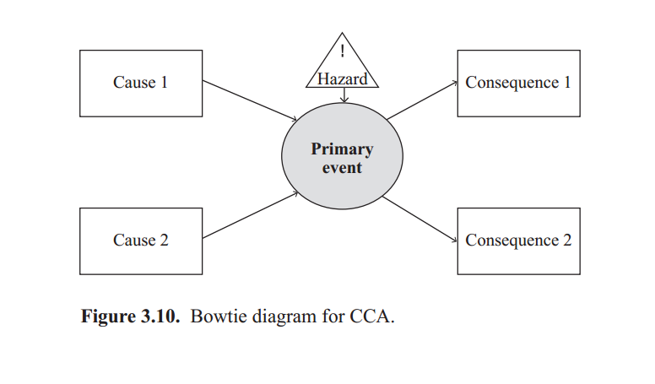
Forms and models, 1
a bow-tie

Slide 13
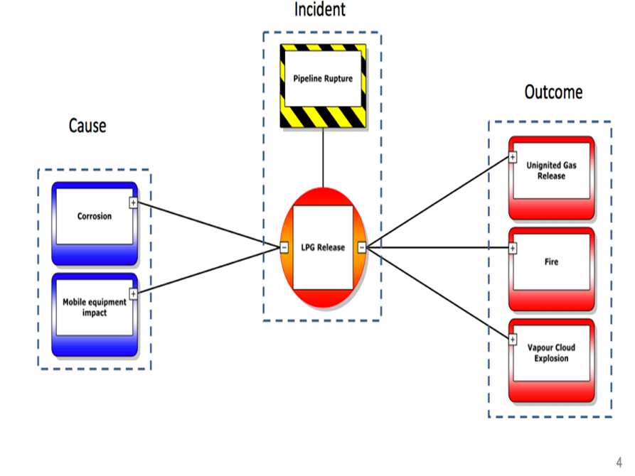
What is a bow-tie?
A bow-tie diagram summaries the risks associated with a particular hazard in a pictorial form.
It gets its name from the bowtie shape of the diagram, which separates proactive and reactive risk management.
The starting point is to map out the incident using a hazard and the ‘top event’, or point at which the hazard becomes active.

Slide 14
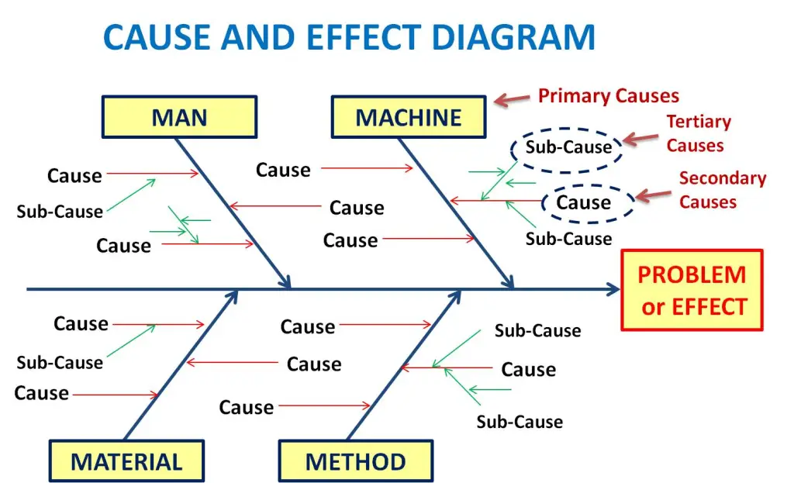
Forms and models,2
Fishbone Diagram

Slide 15
Forms and models
Fishbone Diagram
Developed by Kaoru Ishikawa of Japan.
To find out probable or potential that contributes to problem/effect.
The brainstorming technique is used to identify potential causes.
4M or 6M factors analysis done in brainstorming.
“4M or 6M factors are – Man, Machine, Method, Material, Measurement, and Mother nature also called Environment “
Helps to identify the root cause of the problem

Slide 16
SO,….. CCA Format, 1
CCA, similar to FTA, uses diagrams to represent failure events and their connections that define pathways to a particular risk event of interest.
However, unlike FTA, CCA is organized according to a timeline.
The simplest version of a CCA is structured like a bowtie shown in Figure 3.10 where the risk event (the primary event) is positioned in the middle of the bowtie.
The sequence of events that are considered causes is drawn to the left of the bowtie. These events are initiating events that lead up to the primary event.

Slide 17
SO,….. CCA Format, 2
The initiating events can be drawn as an FTA where several levels and sublevels of causality are depicted and where the top event is the primary event.
As described in the earlier section, FTA is useful to show how various events may combine to lead up to the primary event.
The sequence of events that are considered consequences is drawn to the right of the bowtie.
These events occur as a result of the primary event and are known as the damage chain.
Damage chains can be drawn as an event tree analysis (ETA) to enumerate the possible follow-up risk events (consequences) that may arise from the primary event.

Slide 18
An example,1
For example, consider the primary event a fire starts. The follow-up events that are considered are (1) fire detection, (2) fire alarm, and (3) fire sprinkler. For each follow-up event, possible outcomes are enumerated.
For fire detection, two things can possibly happen—the fire detection works or fire detection does not work. Note that in this example, each succeeding event has two possible mutually متبادل exclusive outcomes that can occur.
In many cases, there may be more than two outcomes.

Slide 19
An example,2
CCA can be used fairly directly for quantification of risk and probabilities, but the diagrams can become exhaustive and cumbersome.
Because of this,
CCA is not as widely used as FTA or ETA.
Fault and event trees are easier to follow and so tend to be preferred for presentation of the separate parts of the analysis.

Slide 20
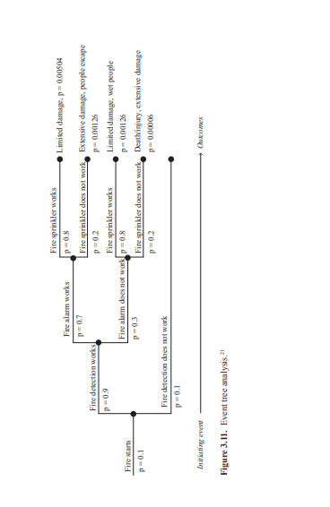
An example,3

Slide 21
Generalized steps for CCA
1. Define the system of interest.
2. Identify the primary event.
3. Generate the initiating chain (similar to FTA if applicable).
Determine the underlying causes of the event.
For each underlying cause, identify the causes or initiating events.
Repeat until the underlying cause becomes uncontrollable.

Slide 22
Generalized steps for CCA
4. Generate the damage chain (similar to ETA if applicable).
  • Determine follow-up events.
  • For each follow-up event, identify the consequences.
  • Repeat until all outcomes are exhausted.

Slide 23
Generalized steps for CCA
Step1:Identifies the primary event. Consider an FMEA worksheet of a brewing process shown in Figure 3.12. The FMEA defines the primary event from one of its failure modes, bad batch (shaded in gray).
The CCA focuses on this primary event as illustrated in Figure 3.13.
As shown in the example, the CCA can be used to extensively detail the causes of failure and their effects.
Step2: Generates the initiating events. The bowtie structure is applied as a simplified form of CCA. Underlying causes of a bad batch include incorrect strain of yeast added, too much yeast added, worth too cold, and expired or contaminated yeast.

Slide 24
Generalized steps for CCA
Consider the first cause—incorrect strain of yeast added.
How can this happen?
It can happen when (1) the operator selects the incorrect yeast or (2) the supplier mislabels the yeast.
The initiating events are ordered sequentially from left to right and events that cause other events are connected by links such as those used in an FTA.
Step3 : Generates the damage chain. The consequence of a bad batch is either it is scrapped or it is distributed, which can result in loss of customer, consumer getting sick, fines, or loss of license.

Slide 25
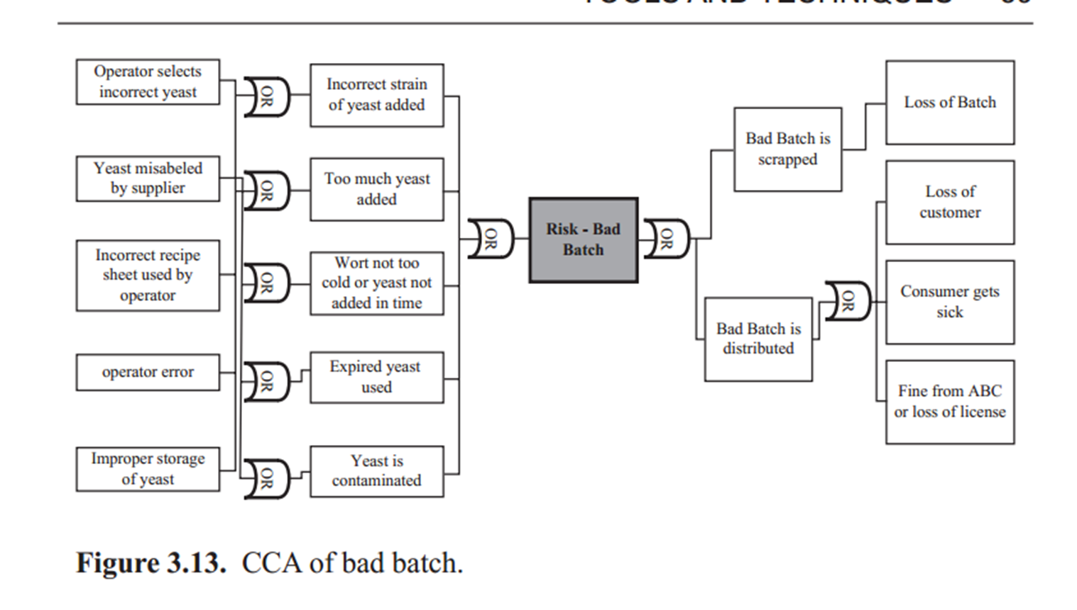
Generalized steps for CCA

Slide 26
As Low As Reasonably Practicable, ALARP
ALARP is a principle and not a technique like those described in the earlier sections of this chapter.
The ALARP principle supports the notion that residual risk shall be as low as reasonably practicable. Since safety (i.e., zero risk) cannot be guaranteed and the cost of addressing risk can be excessive if pursued without limits, ALARP provides an approach to help derive a justifiable level of riskiness and set tolerable risk levels.

Slide 27
As Low As Reasonably Practicable, ALARP
The approach involves judgment in weighing the riskiness and the cost of attaining such levels. Thus, the concept also includes accepting a certain level of risk because of the deliberate decision to bear it rather than address it.
The ALARP principle is also similar to SFAIRP (so far as is reasonably practical).

Slide 28
How we use ALARP
Using "reasonably practicable" allows us to set goals for duty-holders, rather than being prescriptive. This flexibility is a great advantage but it has its drawbacks, too.
Deciding whether a risk is ALARP can be challenging because it requires duty-holders and us to exercise judgement. In the great majority of cases, we can decide by referring to existing 'good practice' that has been established by a process of discussion with stakeholders to achieve a consensus about what is ALARP. For high hazards, complex or novel situations, we build on good practice, using more formal decision-making techniques, including cost-benefit analysis, to inform our judgement.

Slide 29
Why do I need to know about ALARP?
The concept of "reasonably practicable" lies at the heart of the British health and safety system.
It is a key part of the general duties of the Health and Safety at Work etc.
Act 1974 and many sets of health and safety regulations that we and Local Authorities enforce. HSC's policy is that any proposed regulatory action (Regulations, guidance, campaigns, etc.) should be based on what is reasonably practicable.
In some cases, however, this may not be possible because the Regulations implement a European directive or other international measure that adopt a risk control standard different from "reasonably practicable" (ie different from what is ALARP).
Because ALARP is fundamental to the work of the whole organization, it is important that everyone, whatever their role, knows about it. Here are some specific reasons for you to know about ALARP and its relationship with good practice, but this is not an exhaustive list.

Slide 30
Why do I need to know about ALARP?
Policy makers and those engaged in Programme delivery need to know about ALARP because when you make proposals for HSC/E action to control health or safety risks, you need to make sure that, as far as possible, those controls will reduce the risks to employees (or other people, as the case may be) ALARP.
Enforcers need to know about ALARP because you will have to decide whether duty-holders have reduced their risks ALARP and so have complied with the law.
Technical specialists in HSE need to know about ALARP because you advise colleagues in HSE about whether control measures reduce risks ALARP and you help identify standards of risk control that are ALARP.

Slide 31
Where and When to use ALARP
ALARP is used primarily to address the questions
-What can be done to detect, control, and manage them?
-What are the alternatives? And –
-What are the effects beyond? Given that a risk study has been undertaken, whether through an FMEA, HAZOP, PHA, or other techniques, decision makers are then presented with recommended or proposed measures to treat the particular risk events.
At this point, decision makers need to decide if a certain risk is to be addressed.

Slide 32
Where and When to use ALARP
If it is, how much of the risk should be addressed.
Or if it is not, whether the risk can be reasonably accepted or tolerated.
ALARP is a way of thinking that aids making such decisions.
The approach can also be applied preemptively during the recommendation step of risk studies.

Slide 33
Where and When to use ALARP
Several factors are likely to be considered when deciding whether or not a risk has been reduced as far as reasonably practicable:
Health and safety guidelines and codes of practice
Manufacturer's specifications and recommendations
Industry practice
International standards and laws
Suggestions from advisory bodies
Comparison with similar hazardous events in other industries
Cost of further measures would be disproportionate to the risk reduction they would achieve

Slide 34
Some fallacies about ALARP
Fallacy 1, Ensuring that risks are reduced ALARP means that we have to raise standards continually
Our decision about what is ALARP will also be affected by changes in knowledge about the size or nature of the risk presented by a hazard. If there is sound evidence to show that a hazard presents significantly greater risks than previously thought, then of course we should press for stronger controls to tackle the new situation. However, if the evidence shows the hazard presents significantly lesser risks than previously thought, then we should accept a relaxation in control provided the new arrangements ensure the risks are ALARP.

Slide 35
Fallacy 2 - If a few employers have adopted a high standard of risk control, that standard is ALARP
Some organizations implement standards of risk control that are more stringent than good practice.
They may do this for a number of reasons, such as meeting corporate social responsibility goals, or because they strive to be the best at all they do, or because they have reached an agreement with their staff to provide additional controls.
It does not follow that these risk control standards are reasonably practicable, just because a few organizations have adopted them. Until such practices are evaluated and recognized by HSE as representing good practice, you should not seek to enforce them (whether at a policy level or an operational one).
It is also acceptable for a duty holder to choose to relax from a self-imposed higher standard to one which is accepted as ALARP (eg just meeting the requirements of a relevant ACOP).

Slide 36
Fallacy 3 - Ensuring that risks are reduced ALARP means that we can insist on all possible risk controls
ALARP does not mean that every measure that could possibly be taken (however theoretical) to reduce risk must be taken.
Sometimes, there is more than one way of controlling a risk.
These controls can be thought of as barriers that prevent the risk being realized and there is a temptation to require more and more of these protective barriers, to reduce the risk as low as possible. (The so-called "belt and braces" approach.)
You must remember that ALARP means that a barrier can be required only if its introduction does not involve grossly disproportionate cost

Slide 37
Fallacy 4 - Ensuring that risks are reduced ALARP means that there will be no accidents or ill-health
ALARP does not represent zero risk.
We have to expect the risk arising from a hazard to be realized sometimes, and so for harm to occur, even though the risk is ALARP., This is an uncomfortable thought for many people, but it is inescapable., Of course, we should strive to make sure that duty-holders reduce and maintain the risks ALARP, and we should never be complacent but, nevertheless, we have to accept that risk from an activity can never be entirely eliminated unless the activity is stopped.
This relates to the issue of the "tolerability" of a risk, which is covered in detail in Reducing Risks, Protecting People (PDF) (88 pages).
It also goes some way to explaining why risk assessments feed into contingency planning.

Slide 38
ALARP Format
In ALARP, “reasonable practicability” involves weighing a risk against the benefits.
And “low” suggests a reduction of risk to a level wherein the benefits arising from further risk reduction are disproportionate to the time, cost, and technical difficulty of implementing further risk reduction measures.

Slide 39
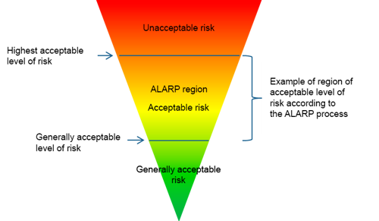
ALARP Format
The level of risk at which additional reduction of the risk is unnecessary.
It may be expressed quantitatively in the same way as the highest acceptable level of risk.
If a risk is found to be at this level or less in connection with a risk assessment, is not necessary to reduce the risk further.
The ALARP triangle in figure 1 indicates the position of the generally acceptable level of risk.

Slide 40
ALARP Format
Figure 1 : The ALARP region is the risk level between the highest acceptable level of risk and the generally acceptable level of risk. Risk reduction in this region must be carried out in accordance with the ALARP principle.
Workplace assessment
An expression originating from the Danish Working Environment Act. A workplace assessment includes an assessment of health and safety concerns and an action plan on how to resolve any workplace health and safety issues, including risks of major accidents. Absenteeism due to sickness must be included in the assessment. In the present context, a workplace assessment corresponds to a risk assessment combined with a plan for reducing the risks.

Slide 41
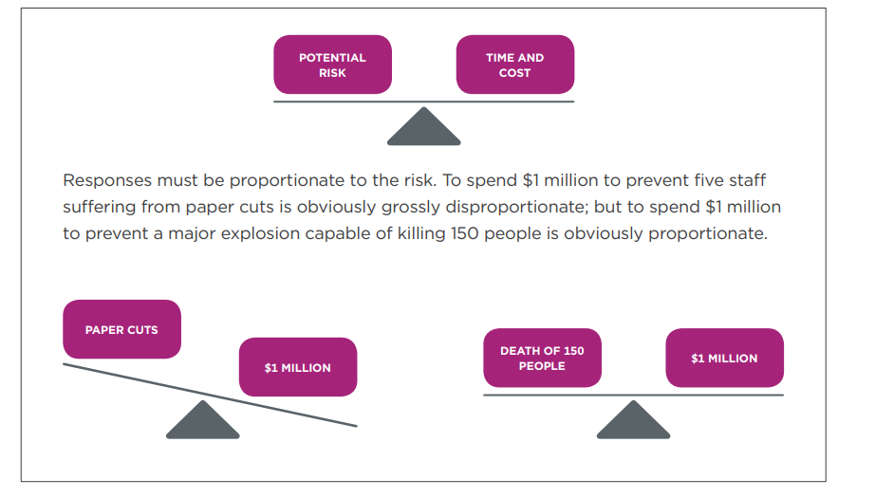
Finally - pay attention

Slide 42
Finally - pay attention
If you are not using a common control to manage the risk, then you should think about: How likely is the risk to occur
The more likely a risk is to occur, the more should be done to eliminate or minimize the risk.
Your response should be proportionate to the risk. How severe is the harm that might result from the risk
More should be done to eliminate the risk if death or serious injury is a possible or likely result.
The greater the potential harm, the greater the response required.
What you know or ought to reasonably know about the risk and the ways of eliminating or minimizing it
You are expected to find out if there are any ways to eliminate or minimise the risk.
Doing a risk assessment, talking to workers, other PCBUs in the industry and health and safety representatives, and looking at health and safety records and processes of others will help inform decisions. The WorkSafe website is also a valuable resource.

Slide 43
Finally - pay attention
The availability of the control measures, and how suitable are they for the specific risk
How a risk is eliminated or minimized will depend on the situation, type of work, work
environment etc.
This is where you will need to apply judgement to figure out the best
actions to take.
As a final step, consider if the cost of setting up control measures is grossly disproportionate to the risk.
Note: Cost is rarely an excuse for not setting up a necessary control for a risk.

Slide 44
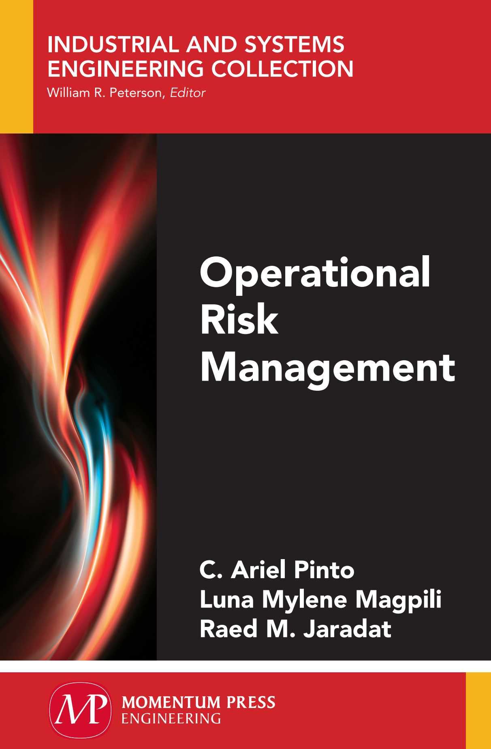
10. References & Resources
Causal Chain - Tool/Concept/Definition (thwink.org)
https://www.hse.gov.uk/enforce/expert/alarpglance.htm
https://en.wikipedia.org/wiki/As_low_as_reasonably_practicable
https://offshore.at.dk/en/regulations/wea-guidelines/alarp-principle/
http://www.worksafe.govt.nz/worksafe/information-guidance/all-guidance-items/hswa-fact-sheets/reasonably-practicable/reasonably-practicable.pdf

Slide 45

01
My Best Wishes …
* Dr. Ayman Hassan *

