Slide 1

Strategic And Operational Risk Management
PMG630
Prepared by
Dr. Ayman Hassan
  Lecture .5 “Tools and Techniques” Failure Modes and Effects Analysis, FMEA

Slide 2


Chapter 3
Tools and Techniques
Failure Modes and Effects Analysis, FMEA
Prepared by
Dr. Ayman Hassan
www.midocean.ae

Slide 3



Important note, 1
r
REF, 1
REF,2
www.midocean.ae

Slide 4
Lecture No.5, The Content
Summary of the previous lecture “chapter.3 “
Introduction
Failure Modes and Effects Analysis, FMEA
The Basics of – FMEA
Criteria for FMEA Analysis
Where and when to use FMEA?
The 5 steps of the FMEA process
Application to example
Conclusions
10. References & Resources
www.midocean.ae

Slide 5

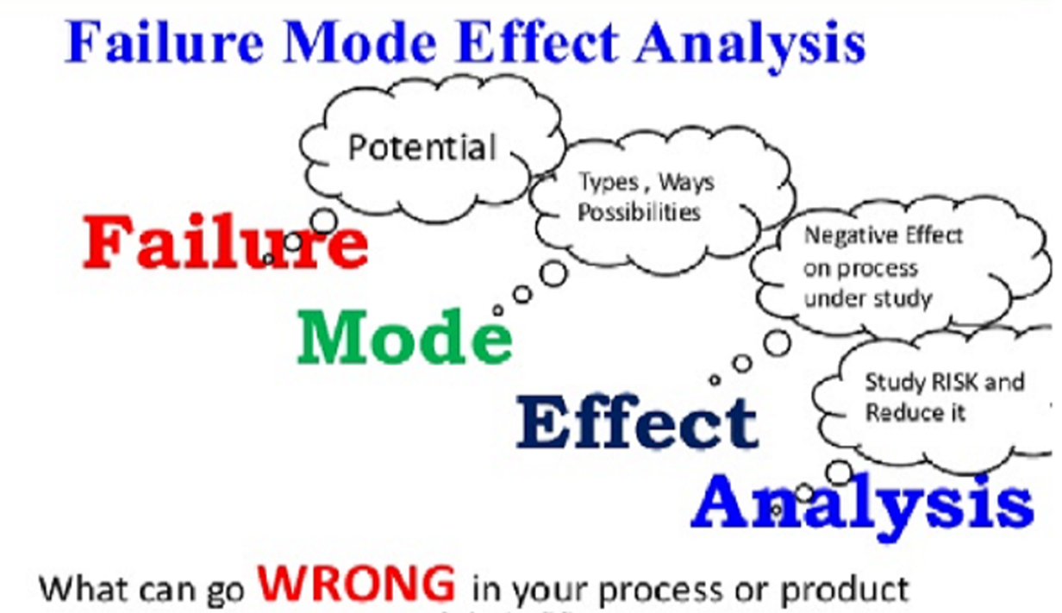
www.midocean.ae

Slide 6
What is Failure Mode and Effects Analysis?
Failure Modes and Effects Analysis (FMEA) is a systematic, proactive method for evaluating a process to identify where and how it might fail ?
It is to assess the relative impact of different failures, in order to identify the parts of the process that are most in need of change.
www.midocean.ae

Slide 7
So, note : Failure Mode and Effects Analysis?
We must pay attention at the beginning... We are studying a tool that identifies and analyses two important parts:
Failure Mode and Effects Analysis
Failure Mode
FM
Effects Analysis
EA
FMEA
www.midocean.ae

Slide 8
Failure Mode and Effects Analysis
FMEA is a top-down quantitative technique applied to identify failures in a design, a process, a system, or an existing product, equipment, or service.
FMEA is used to analyze elements or components of a system, their interactions and their effects on the operation of the system as a whole.
The term failure modes pertains to ways in which functional elements may fail.
The term effects analysis describes the consequences of those failures and any existing prevention or control measures to address them.
www.midocean.ae

Slide 9
Failure Mode and Effects Analysis
Thus, FMEA similar to HAZOP also examines how existing system capabilities detect failures and manage such failures.
Correspondingly, risks are ranked based on the likelihood and consequences of failure, as well as the current system’s ability to detect and manage failure if they do occur.
Similar to PHA and unlike HAZOP and JSA, FMEA further assesses the likelihoods of occurrence of these failures.
www.midocean.ae

Slide 10
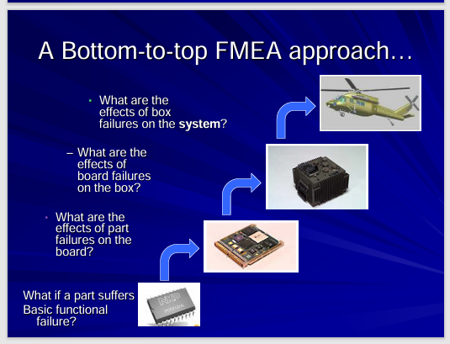
A Bottom-to-top FMEA approach
www.midocean.ae

Slide 11
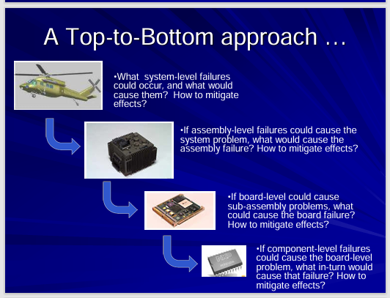
A Top-to-Bottom FMEA approach
www.midocean.ae

Slide 12
The Basics of - FMEA
FMEA is a qualitative and systematic tool, usually created within a spreadsheet, to help practitioners anticipate what might go wrong with a product or process. In addition to identifying how a product or process might fail and the effects of that failure, FMEA also helps find the possible causes of failures and the likelihood of failures being detected before occurrence.
Used across many industries, FMEA is one of the best ways of analyzing potential reliability problems early in the development cycle, making it easier for manufacturers to take quick action and mitigate failure. The ability to anticipate issues early allows practitioners to design out failures and design in reliable, safe and customer-pleasing features.
www.midocean.ae

Slide 13
Criteria for FMEA Analysis
An FMEA uses three criteria to assess a problem:
1- The severity of the effect on the customer,
2- How frequently the problem is likely to occur and
3- How easily the problem can be detected.
Participants must set and agree on a ranking between 1 and 10 (1 = low, 10 = high) for the severity, occurrence and detection level for each of the failure modes.
Although FMEA is a qualitative process, it is important to use data (if available) to qualify the decisions the team makes regarding these ratings.
www.midocean.ae

Slide 14
Where and when to use FMEA?
FMEA is used to study a variety of systems and products that are more detailed and complex such as those in the aviation and electronics industry.
More often, it is applied as periodic review throughout the life of the system to accommodate changes within the system and its environment.
www.midocean.ae

Slide 15
Where and when to use FMEA?
It is applicable in both the design and operation phases, particularly in the development of operational risk management strategies.
It is useful for redesigning existing systems for a new application as well.
FMEA is also used for risk and safety auditing and accident investigations.
www.midocean.ae

Slide 16
The 5 steps of the FMEA process
The five most basic steps when conducting FMEA include identifying potential failures and effects, determining the severity of each, gauging the likelihood of each failure occurring, failure detection, and assigning a risk priority number.
Each step is described in greater detail as following.
www.midocean.ae

Slide 17
Step 1: Identify potential failures and effects
The first FMEA step is to analyze functional requirements and their effects and identify all potential areas of failure.
It’s important to consider that failure modes in one component can induce failure in others. List all failure modes per function and consider the ultimate effect(s) of each failure mode. Examples of failure effects include overheating, noise, abnormal shutdown, or user injury.
www.midocean.ae

Slide 18
Step 2: Determine severity
Severity refers to how serious the consequences and effects are of a failure.
A number of severity is assigned to each failure, with one being the lowest severity and 10 being the highest. Typical FMEA severity ratings are as follows:
        1 - No effect, no danger
        2 - Very minor – usually noticed only by very observant users
        3 - Minor – only a minor part of the system is affected; the failure is noticed by average users
        4-6 - Moderate – most users are merely inconvenienced and/or annoyed
        7-8 - High – there is a loss of primary function; users are dissatisfied
        9-10 - Very high – failure constitutes a safety hazard and can cause injury or death, or the product becomes inoperative ,and customers become angry
www.midocean.ae

Slide 19
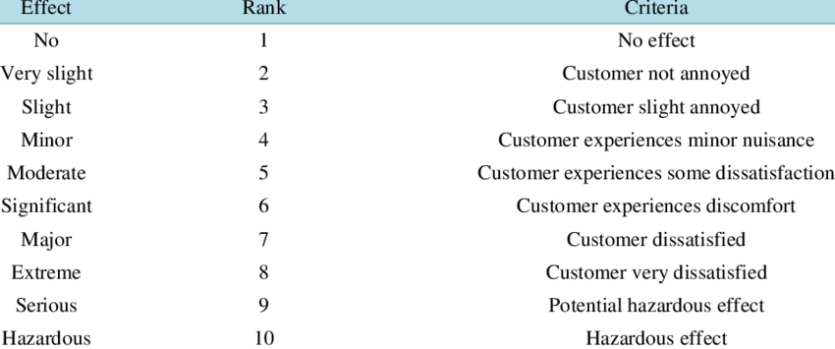
Step 2: Determine severity, Table 1E
(PDF) Assessment and Risk Management of Potential Hazards by Failure Modes and Effect Analysis (FMEA) Method in Yazd Steel Complex (researchgate.net)
www.midocean.ae

Slide 20
Step 2: Determine severity, Table 2 A
التاثير | الترتيب | المعايير
لا تأثير | 1 | لا
العميل غير منزعج | 2 | طفيف جدا
العميل منزعج حديا | 3 | طفيف حديا
العميل منزعج | 4 | بسيط متوسط
العميل يشعر بعدم الرضا | 5 | متوسط
العميل يشعر بعدم الراحة | 6 | ظاهر الخطورة
العميل غير راض بشكل كبير | 7 | خطورة كبير
العميل غير راض جدا " خطير" | 8 | خطورة كبيرة جدا
فقدان رضا العميل تماما | 9 | خطورة توجب التدخل بجديه
فقدان العميل نفسه تأثير خطير جدا | 10 | خطر للغاية
www.midocean.ae

Slide 21
Step 3: Measure likelihood of occurrence
Examine and document the cause(s) of each failure mode and how often failure occurs. Look at similar processes or products and their documented failure modes. Examples of causes can include incorrect algorithms, insufficient or excess voltage, the temperature or humidity of the operating environment. Failure modes are also assigned a number based on occurrence, with 1 being the lowest and 10 being the highest.
            1 - No documented failures on similar products or processes
            2-3 - Low - relatively few failures occur
            4-6 - Moderate - there are some occasional failures
            7-8 - High - repeated failures are experienced
            9-10 - Very high - failure is almost certain ,and the results in a hazard
www.midocean.ae

Slide 22
Step 4: Failure detection
Determine corrective actions and when they should be tested for effictiveness and efficiency.
Verify and inspect procedures within the design of the system or process. A detection value is assigned to each failure indicating how likely the failure will be detected, and ranks the ability of identified actions to remedy or remove defects or detect failures. The higher the value of D, the more likely the failure will not be detected.
1 - Fault is certain to be detected by testing
2 - Fault is almost certain to be detected by testing
3 - High probability that testing will detect the fault
4-6 - Moderate probability that tests will detect the fault
7-8 - Low probability that testing will detect the fault
9-10 - Fault will be passed undetected to the end-user/customer
www.midocean.ae

Slide 23
Step 5: Calculate the risk priority number (RPN)
Risk priority numbers (RPNs) influence which actions will be taken against failure modes.
RPN is calculated from the values of severity, occurrence, and detection as :
RPN = Severity * Occurrence * Detection (or RPN = S x O x D)
RPN should be calculated for the entire design and/or process and documented in the FMEA. The highest RPNs should get the highest priority for corrective measures. These measures can include a variety of actions including new inspections, tests or procedures, design changes, different components, added redundancy, modified limits, etc.
www.midocean.ae

Slide 24
General steps for FMEA, 1
1. Define the system and the scope of the study.
2. Identify the key functional objectives.
3. For each objective, identify the ways failure can occur (the failure modes).
4. For each failure mode, identify the consequences (effects) if failure occurs.
5. Rate the consequences in terms of severity.
6. Identify the root causes for each failure mode.
www.midocean.ae

Slide 25
General steps for FMEA, 2
7. Rate each root cause in terms of chance of occurrence.
8. Identify current preventive and control measures for each root cause.
9. For each root cause and failure, rate how well or early they can be detected and addressed.
10. Calculate the risk priority number (RPN) based on the consequences, occurrence, and detection.
11. Identify the failures that are considered critical.
12. Determine additional preventive or control measures as needed.
www.midocean.ae

Slide 26
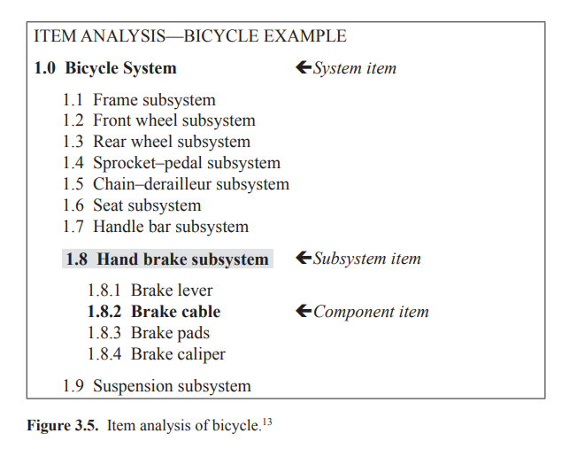
Explanation of Step1 identifies the system and the scope of the study.
FMEA can be a comprehensive look at the total system as a whole, or it may focus on certain subsystems, elements, or components.
As an example, consider the bicycle as a system of interest.
An item analysis of the bicycle system is shown in Figure 3.5.
www.midocean.ae

Slide 27
After identified the scope of the study…
After completing the identification of the system of study, which the FMEA worksheet in Figure 3.6 will focus on the subsystem that has been identified, which is the handbrake subsystem, which is referred to as item 1.8 (shaded in grey) in the bicycle component analysis in Figure 3.5.
We begin preparing the FMEA working paper... as follows
www.midocean.ae

Slide 28
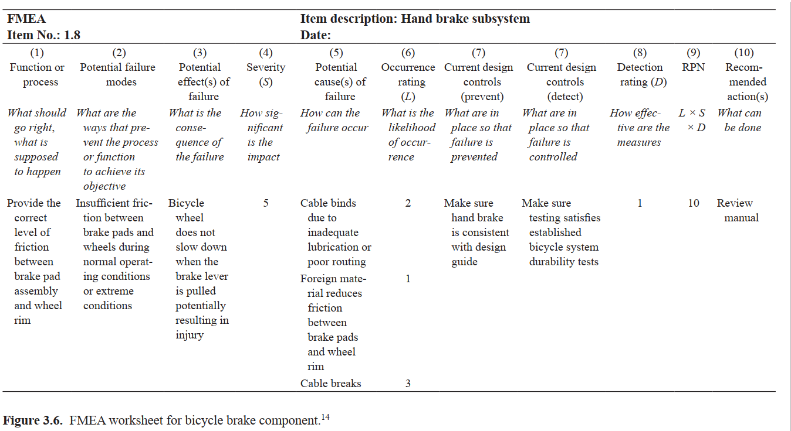
An example
www.midocean.ae

Slide 29
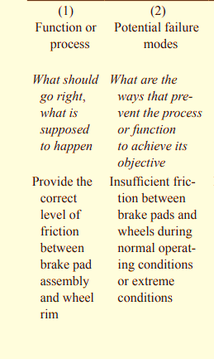
Explanation of example, FMEA worksheet column 1-2
• What should go right?
{ Column 1: Functional objectives of the subsystem or component
• What can go wrong?
{ Column 2: Failure modes that prevent the achievement of
objectives
• What are the causes and consequences?
The failure modes are described as risk events.
www.midocean.ae

Slide 30
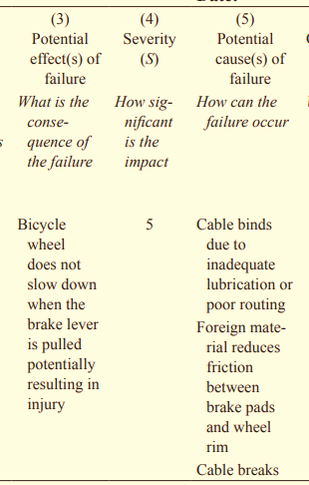
Explanation of example, FMEA worksheet column 3,4,5
{ Column 3: Consequences of failure (labeled effects in the FMEA worksheet)
{ Column 4: Severity (S) of the consequences
{ Column 5: Potential causes of failure
www.midocean.ae

Slide 31
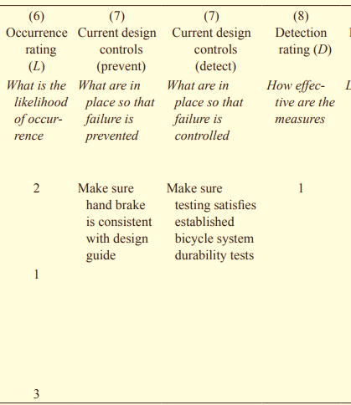
Explanation of example, FMEA worksheet column 6,7,8
• What are the likelihood or chances of occurrence?
{ Column 6: Likelihood (L) of each causes or failure (labeled
occurrences in the FMEA worksheet)
• What can be done to detect,control,and manage them?
{ Column 7: Existing detection, prevention, and control measures
{ Column 8: Rating for existing detection (D), prevention, and control measures
www.midocean.ae

Slide 32
Explanation of example, FMEA worksheet column 9,10
{ Column 9: The risk score determined by the likelihood, severity, and effectiveness of existing detection, prevention, and
control measures to address failure, evaluated as L ×S ×D
{ Column 10: Recommendations for additional prevention and
control measures to address the failures, their causes, and
consequences
www.midocean.ae

Slide 33
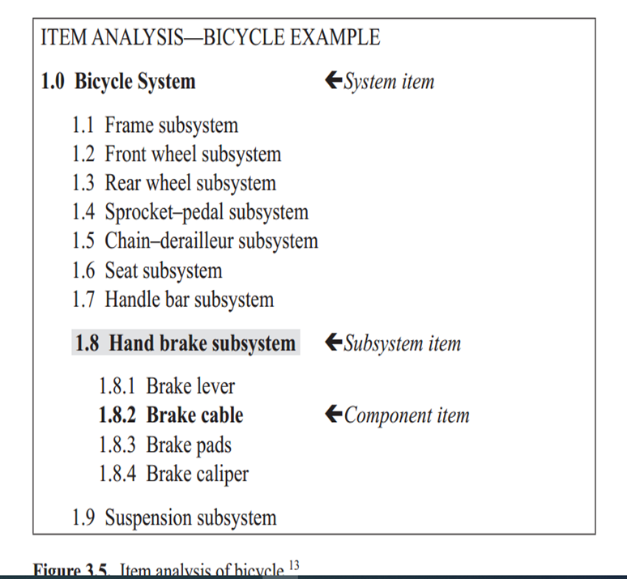
Applying the steps of the FMEA tool-1
Step1, identifies the system and the scope of the study.
FMEA can be a comprehensive look at the total system as a whole, or it may focus on certain subsystems, elements, or components.
As an example, consider the bicycles a system of interest.
An item analysis of the bicycle system is shown in Figure 3.5.
www.midocean.ae

Slide 34
Applying the steps of the FMEA tool-2
The FMEA worksheet focuses on a particular subsystem, the hand brake subsystem, and refers to Item 1.8 (shaded in gray) in the item analysis of the bicycle in Figure 3.5.
www.midocean.ae

Slide 35
Applying the steps of the FMEA tool-3
Step 2 identifies the key functional objectives of the system, subsystem, or component of interest.
It describes what the component is supposed to do to achieve the functional objective—description of what needs to go right.
Thus for the bicycle, one of its critical functions is the ability to stop safely within a required distance under all operating conditions.
www.midocean.ae

Slide 36
Applying the steps of the FMEA tool-4
This function is achieved through the hand brake by providing the correct level of friction between the brake pad assembly and the wheel rim when the brake lever is pulled.
This information is entered in Column 1 of the FMEA worksheet.
It describes what the hand brake subsystem is supposed to do to achieve the function of stopping or braking
(What should go right?).
www.midocean.ae

Slide 37
Applying the steps of the FMEA tool-5
Step 3 identifies the failure modes.
Column 1 defines what the component is supposed to do,
Column 2 describes what can happen (What can fail?) that will prevent the component from doing what it is supposed to do.
In other words, the failure modes are the different ways the component can fail to accomplish its functional objective.
For the bicycle, one potential failure mode is having insufficient friction between the brake pad and wheel rim during normal or extreme conditions such as heavy rains. This information is entered in Column 2 of the FMEA worksheet. Note that it is important to describe in detail the conditions in which the failure mode can occur.
www.midocean.ae

Slide 38
Applying the steps of the FMEA tool-6
Step 4 identifies the consequences (effects) on the system as a whole, its elements, and the environment for each failure mode.
It helps to ask What happens when this failure occurs?
What does the user experience because of this failure? For the bicycle, insufficient friction means the bicycle wheel does not slow down when the brake lever is pulled, potentially resulting in collision, loss of control, and eventual injury.
This information is entered in Column 3 of the FMEA worksheet.
www.midocean.ae

Slide 39
Applying the steps of the FMEA tool-7
What does the user experience because of this failure? For the bicycle, insufficient friction means the bicycle wheel does not slow down when the brake lever is pulled, potentially resulting in collision, loss of control, and eventual injury.
This information is entered in Column 3 of the FMEA worksheet.
Step 5 provides a severity rating for each effect. Rating scales such as those used in Lecture 2 can be used. For the bicycle, the worse potential result of the identified failure mode is safety failure; the severity is evaluated as catastrophic (see Table 2.2).
A level 5 is entered in Column 4.
www.midocean.ae

Slide 40
Applying the steps of the FMEA tool-8
Step 6 identifies all potential root causes for each failure mode. What specifically causes this failure mode to occur? Here it is important to establish the causal chain of events to identify root causes. For the bicycle example, there are three potential causes for having insufficient friction between the brake pads and wheel rim
1) failure of cable binds due to inadequate lubrication or poor routing, (2) foreign material on brake pad or wheel rim that reduces friction, (3) cable itself breaks, and (4) brake lever misalignment. This information is entered in Column 5 in the FMEA worksheet.
www.midocean.ae

Slide 41
Applying the steps of the FMEA tool-9
Step 7 rates the root causes according to their likelihood of occurrence.
This rating evaluates the chance of failure because of a particular root cause. It follows that if a particular root cause is more likely to occur, then failure from this root cause is also more likely.
For the bicycle, the cable breaking is the most likely cause of insufficient friction among the causes. Using Table 2.3, its likelihood of occurrence is moderately possible and given a rating of 3. This information is entered in Column 6 in the FMEA worksheet.
Steps 8 and 9 describe and rate the effectiveness of preventive and control measures that currently exist. Each measure is evaluated according to how well or early the failure mode or its cause can be detected and addressed before the effects occur. Detection is rated on a scale from 1 to 5, where 1 means the control is absolutely certain to detect the cause or failure and 5 means the inability for detection.
www.midocean.ae

Slide 42
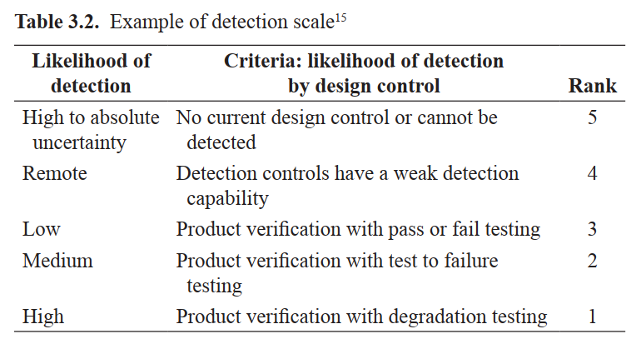
Applying the steps of the FMEA tool-10
For the bicycle example, detection of the cable binding due to inadequate lubrication or poor routing is given a rating of 2. This is due to the quality and testing process in the manufacturing of bicycles. Table 3.2 can be used to determine a detection rating. The information for steps 8 and 9 are entered in Column 7 and Column 8 of the FMEA worksheet, respectively.
www.midocean.ae

Slide 43
Applying the steps of the FMEA tool-11
One can also evaluate reactive measures. Specifically, how the system is able to detect failure after the cause has already happened; and how the system is able to address the failure before the impact of the effects occurs. For example, if the bicycle had an indicator or an alarm that the hand brake subsystem has failed. This measure can inform the user to use alternative means for stopping or breaking.
In step 10, upon identifying the likelihood (L), consequences (S) of failure modes, and the current system’s ability to address (D) the causes of failure, failure modes are then evaluated for criticality using a risk score similar to PHA. For FMEA, the risk score is known as the RPN and can be derived by multiplying L ×S ×D, corresponding to Columns 4, 6, and 8 respectively. The RPN score entered in Column 9 can provide guidance for ranking potential failures in the order they should be addressed.
www.midocean.ae

Slide 44
Applying the steps of the FMEA tool-12
Step 11 describes recommendations and proposed additional preventive control measures if necessary. Particular attention is given to proposals that will decrease the likelihood of occurrence, lower the severity of the consequences, or increase the capability or effectiveness to detect early and mitigate the causes of failure. Part of the recommendation should include the organizational functions responsible for these actions and target completion dates. This information is entered in Column 10 of the FMEA worksheet.
www.midocean.ae

Slide 45
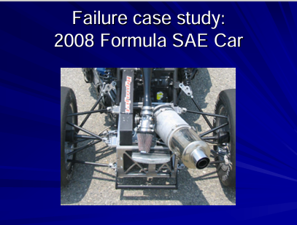

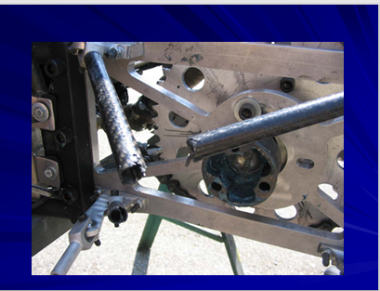
Think….. Case Study, 1
www.midocean.ae

Slide 46
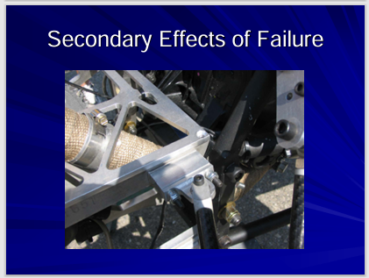
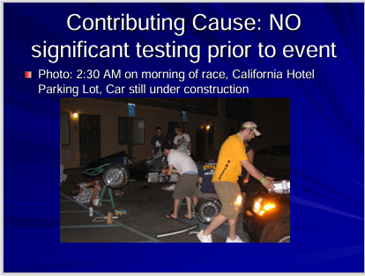

Think….. Case Study, 2
www.midocean.ae

Slide 47

10. References & Resources
Causal Chain - Tool/Concept/Definition (thwink.org)
http://www.fmeainfocentre.com/examples/36VbatFMEA. pdf http://www.fmeainfocentre.com/examples/FMEAworkshe pdf et.pdf http://www.fmeainfocentre.com/examples/xfmea_dfmea. “ Product Design Hall, 2001
www.midocean.ae

Slide 48

01
My Best Wishes …
* Dr. Ayman Hassan *
www.midocean.ae

