Slide 1

Advanced Project Management APM
Prepared by Dr. Ahmad Al Ghamdi
Lecturer by Waseem Al Tabbaa
PMG 506
Advanced Project Management (APM)

Slide 2
Advanced Project Management
Prepared by Dr. Ahmad Al Ghamdi
Lecturer by Waseem Al Tabbaa
Lecture 10
PMG 506
Monitoring and Information System

Slide 3


Lecture 10
Monitoring and Information System

Slide 4
Lecture 10
Monitoring and Information System
Monitoring is collecting, recording, and reporting information concerning any and all aspects of project performance that the project manager or others in the organization wish to know. In our discussion it is important to remember that monitoring, as an activity, should be kept distinct from controlling (which uses the data supplied by monitoring to bring actual performance into approximate congruence with planned performance), as well as from evaluation (through which judgments are made about the quality and effectiveness of project performance).

Slide 5
Lecture 10
Monitoring and Information System
10.1 THE PLANNING-MONITORING-CONTROLLING CYCLE
We have stressed the need to plan, check on progress, compare progress to the plan, and take corrective action if progress does not match the plan. The key things to be planned, monitored, and controlled are time (schedule), cost (budget), and performance (specifications). These, after all, encompass the fundamental objectives of the project.
The planning (budgeting and scheduling) methods we propose “put the hassles up front.” They require a significantly greater investment of time and energy early in the life of the project, but they significantly reduce the extent and cost of poor performance and time/cost overruns. Note that this is no guarantee of a trouble-free project, merely a decline in the risk of failure.
It is useful to perceive the control process as a closed-loop system, with revised plans and schedules (if warranted) following corrective actions. The planning-monitoring-controlling cycle is continuously in process until the project is completed.

Slide 6
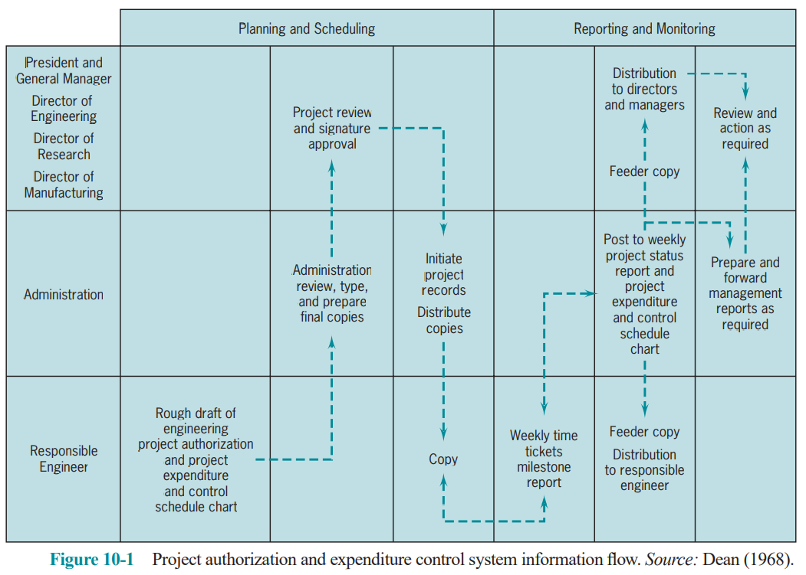
Lecture 10
Monitoring and Information System
10.1 THE PLANNING-MONITORING-CONTROLLING CYCLE
Note the direction of the flows, information flowing from the bottom toward the top and authority flowing from the top down.
Experience tells us that it is also desirable, that the planning- monitoring-controlling cycle be the normal way of life in the parent organization.

Slide 7
Lecture 10
Monitoring and Information System
10.1 THE PLANNING-MONITORING-CONTROLLING CYCLE
Designing the Monitoring System
The first step in setting up any monitoring system is to identify the key factors to be controlled.
The best sources of items to be monitored are the project action plan and the risk management plan.
How to Collect Data
At this point in the construction of a monitoring system, it is necessary to define precisely what pieces of information should be gathered and when.
Frequency counts
A simple tally of the occurrence of an event. The data are usually easy to collect and are often reported as events per unit time or events as a percent of a standard number.
2. Raw numbers
Dates, dollars, hours, physical amounts of resources used, and specifications are usually reported in this way. These numbers are reported in a wide variety of ways, but often as direct comparisons with an expected or standard number.

Slide 8
Lecture 10
Monitoring and Information System
10.1 THE PLANNING-MONITORING-CONTROLLING CYCLE
3. Subjective numeric ratings
These numbers are subjective estimates, usually of a quality, made by knowledgeable individuals or groups.
4. Indicators
When the PM cannot measure some aspect of system performance directly, it may be possible to find an indirect measure or indicator.
5. Verbal measures
Measures for such performance characteristics as “quality of team member cooperation,” “morale of team members,” or “quality of interaction with the client” frequently take the form of verbal characterizations.
The purpose of the monitoring system is to gather and report data. The purpose of the control system is to act on the data. To aid the project controller, it is helpful for the monitor to carry out some data analysis. Significant differences from plan should be highlighted or “flagged” so that they cannot be overlooked by the controller.

Slide 9
Lecture 10
Monitoring and Information System
10.2 INFORMATION NEEDS AND REPORTING
The monitoring system ought to be constructed so that it addresses every level of management, but reports need not be of the same depth or at the same frequency for each level.
Lower-level personnel have a need for detailed information about individual tasks and the factors affecting such tasks. Report frequency is usually high.
For the senior management levels, overview reports describe progress in more aggregated terms with less individual task detail unless senior management has a special interest in a specific activity or task. Reports are issued less often.
The Reporting Process
The relationship of project reports to the project action plan or WBS is the key to the determination of both report content and frequency. Reports must contain data relevant to the control of specific tasks that are being carried out according to a specific schedule. The frequency of reporting should be great enough to allow control to be exerted during or before the period in which the task is scheduled for completion.

Slide 10
Lecture 10
Monitoring and Information System
10.2 INFORMATION NEEDS AND REPORTING
The PM must make sure that relevant information about progress is always included—and reported in a way it cannot be overlooked. It is also counterproductive to delay reporting on a current or immediately potential crisis until the next routine report is due.
There are many benefits of detailed, timely reports delivered to the proper people. Among them are:
• Mutual understanding of the goals of the project
• Awareness of the progress of parallel activities and of the problems associated with coordination among activities
• More realistic planning for the needs of all groups and individuals working on the project
• Understanding the relationships of individual tasks to one another and to the overall project
• Early warning signals of potential problems and delays in the project
• Minimizing the confusion associated with change by reducing delays in communicating the change
• Faster management action in response to unacceptable or inappropriate work

Slide 11
Lecture 10
Monitoring and Information System
10.2 INFORMATION NEEDS AND REPORTING
• Higher visibility to top management, including attention directed to the immediate needs of the project
• Keeping the client and other interested outside parties up to date on project status, particularly regarding project costs, milestones, and deliverables.
Report Types
For the purposes of project management, we can consider three distinct types of reports: routine, exception, and special analysis.
The routine reports are those issued on a regular basis; but, regular does not necessarily refer to the calendar. For senior management, the reports will usually be periodic, but for the PM and lower-level project personnel, milestones may be used to trigger routine reports. At times, it may be useful to issue routine reports on resource usage periodically, occasionally on a weekly or even daily basis.

Slide 12
Lecture 10
Monitoring and Information System
10.2 INFORMATION NEEDS AND REPORTING
Exception reports are useful in two cases. First, they are directly oriented to project management decision making and should be distributed to the team members who will have prime responsibility for decisions or who have a clear “need to know.” Second, they may be issued when a decision is made on an exception basis and it is desirable to inform other managers as well as to document the decision—in other words, as part of a sensible procedure for protecting oneself.
Special analysis reports are used to disseminate the results of special studies conducted as part of the project or as a response to special problems that arise during the project. Usually they cover matters that may be of interest to other PMs, or make use of analytic methods that might be helpful on other projects. Studies on the use of substitute materials, evaluation of alternative manufacturing processes, availability of external consultants, capabilities of new software, and descriptions of new governmental regulations are all typical of the kinds of subjects covered in special analysis reports. Distribution of these reports is usually made to anyone who might be interested.

Slide 13
Lecture 10
Monitoring and Information System
10.2 INFORMATION NEEDS AND REPORTING
Meetings
There is no doubt that meetings of project teams are necessary and often helpful. The main complaints are that they are interminably long, come to no conclusions, and waste everyone’s time.
A few simple rules can remove most of the pain associated with project meetings:
• Use meetings for making group decisions or getting input for important problems.
• Have preset starting and stopping times as well as a written agenda. “do not penalize those
who show up on time by making them wait for those who are tardy”.
• Make sure that you (and others) do your homework prior to the meeting. Be prepared!
• If you chair the meeting, take your own minutes. Distribute the minutes as soon as possible
after the meeting, no later than the next work day.
• Avoid attributing remarks or viewpoints to individuals in the minutes. Also, do not report votes
on controversial matters.

Slide 14
Lecture 10
Monitoring and Information System
10.2 INFORMATION NEEDS AND REPORTING
• Avoid overly formal rules of procedure. A project meeting is not a parliament, though courtesy
is always in order.
• If a serious problem or crisis arises, call a meeting for the purpose of dealing with that issue
only.
Common Reporting Problems
There are three common difficulties in the design of project reports.
First, there is usually too much detail, both in the reports themselves and in the input being solicited from workers.
A second major problem is the poor interface between the project information system and the parent firm’s information system. Data are rarely comparable, and interaction between the PM and the organization’s accountants is often strained.
The third problem concerns a poor correspondence between the planning and the monitoring systems. If the monitoring system is not tracking information directly related to the project’s plans, control is meaningless.

Slide 15
Lecture 10
Monitoring and Information System
10.3 EARNED VALUE ANALYSIS
Individual task performance must be monitored carefully because the timing and coordination between individual tasks is important. But overall project performance is the crux of the matter and must not be overlooked. One way of measuring overall performance is by using an aggregate performance measure called earned value.
The Earned Value Chart and Calculations
There are several conventions used to aid in estimating percent completion:
• The 50–50 rule Fifty percent completion is assumed when the task is begun, and the remaining 50 percent when the work is complete.
• The 0–100 percent rule. This rule allows no credit for work until the task is complete.
• Critical input use rule. This rule assigns task progress according to the amount of a critical input that has been used.
• The proportionality rule. This commonly used rule is also based on proportionalities, but uses time (or cost) as the critical input. It thus divides actual task time-to-date by the scheduled time for the task to calculate percent complete.

Slide 16
Lecture 10
Monitoring and Information System
10.3 EARNED VALUE ANALYSIS
These rough guides to “percent completion” are not meant to be applied to the project as a whole, though sometimes they are, but rather to individual activities.
Cost (or sometimes the spending) Variance (CV) is the difference between the amount of money we budgeted for the work that has been performed to date, that is, the earned value, EV, and the actual cost of that work (AC).
CV = EV – AC (overrun is negative)
Schedule Variance (SV) is the difference between the EV and the cost of the work we scheduled to be performed to date, or the planned value (PV).
SV = EV – PV (behind is negative)
Time Variance (TV) is the difference in the time scheduled for the work that has been performed (ST) and the actual time used to perform it (AT).
TV = ST – AT (delay is negative)

Slide 17
Lecture 10
Monitoring and Information System
10.3 EARNED VALUE ANALYSIS
Cost Performance Index (CPI) = EV/AC
Schedule Performance Index (SPI) = EV/PV
Time Performance Index (TPI) = ST/AT
Use of ratios is particularly helpful when an organization wishes to compare the performance of several projects (or project managers), or the same project over different time periods.

Slide 18
Lecture 10
Monitoring and Information System
10.3 EARNED VALUE ANALYSIS
Cost Performance Index (CPI) = EV/AC
Schedule Performance Index (SPI) = EV/PV
Time Performance Index (TPI) = ST/AT
Use of ratios is particularly helpful when an organization wishes to compare the performance of several projects (or project managers), or the same project over different time periods.

Slide 19
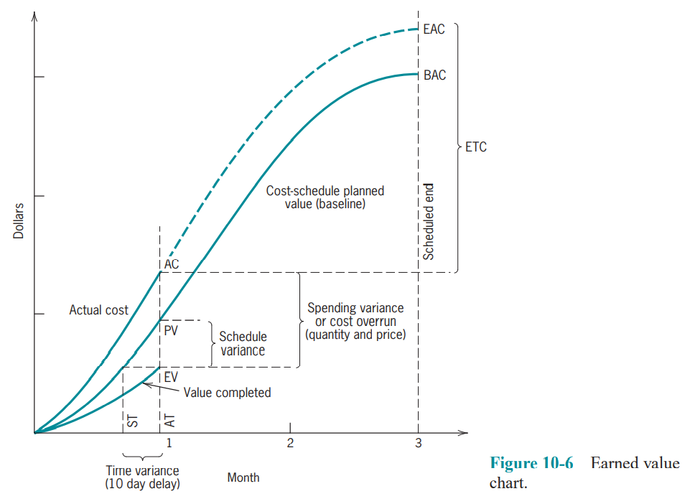
Lecture 10
Monitoring and Information System
10.3 EARNED VALUE ANALYSIS

Slide 20
Lecture 10
Monitoring and Information System
10.3 EARNED VALUE ANALYSIS
Example:
Assume that operations on a work package were expected to cost $1,500 to complete the package. They were originally scheduled to have been finished today. At this point, however, we have actually expended $1,350, and we estimate that we have completed two-thirds of the work. What are the cost and schedule variances?
PV = $1500
AC = $1350
Work completed = 2/3
EV = $1500 X 2/3 = $1000
cost variance (CV) = EV - AC
= 1,000 – 1,350 = - $350

Slide 21
Lecture 10
Monitoring and Information System
10.3 EARNED VALUE ANALYSIS
schedule variance (SV) = EV – PV
= 1000 - 1,500 = -$500
CPI = EV/AC
= 1,000/1,350 = 0.74
SPI = EV/PV
= 1,000/1,500 = 0.67
In other words, we are spending at a higher level than our budget plan indicates, and given what we have spent, we are not as far along as we should be (i.e., we have not completed as much work as we should have).

Slide 22
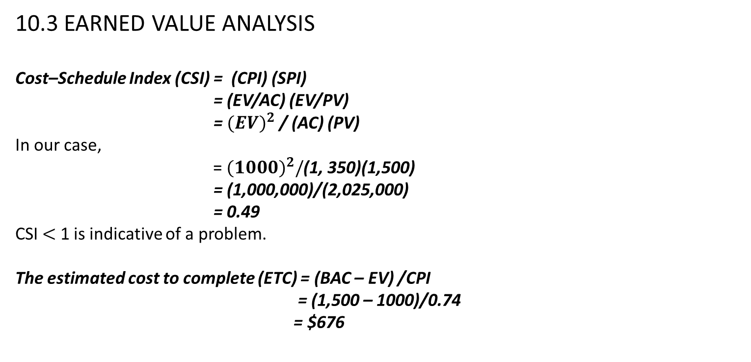
Lecture 10
Monitoring and Information System
10.3 EARNED VALUE ANALYSIS
Cost–Schedule Index (CSI) = (CPI) (SPI)
= (EV/AC) (EV/PV)
= ${(EV)}^{2}$ / (AC) (PV)
In our case,
= ${(1000)}^{2}/$(1, 350)(1,500)
= (1,000,000)/(2,025,000)
= 0.49
CSI $<$ 1 is indicative of a problem.
The estimated cost to complete (ETC) = (BAC – EV) /CPI
= (1,500 – 1000)/0.74
= $676

Slide 23
Lecture 10
Monitoring and Information System
10.3 EARNED VALUE ANALYSIS
estimated cost at completion (EAC) = ETC + AC
= 676 + 1,350
= $2,026

Slide 24
Lecture 10
Monitoring and Information System
Summary
In this chapter, we reviewed the monitoring function, relating it to project planning and control, and described its role in the project implementation process. The requirements for monitoring were discussed, in addition to data needs and reporting considerations. Last, some techniques for monitoring progress were illustrated and some computerized PMISs were described.
Specific points made in the chapter were:
• It is important that the planning-monitoring-controlling cycle be a closed loop cycle based on the same structure as the parent system.
• The first task in designing the monitoring system is to identify the key factors in the project action plan to be monitored and to devise standards for them. The factors should concern results, rather than activities.
• The data collected are usually either frequency counts, numbers, subjective numeric ratings, indicators, or verbal measures.
• Project reports are of three types: routine, exception, and special analysis.

Slide 25
Lecture 10
Monitoring and Information System
Summary
• Project reports should include an amount of detail appropriate to the target level of management with a frequency appropriate to the need for control (i.e., probably not weekly or other such regular basis). More commonly, reports occur near milestone dates
• Three common project reporting problems are too much detail, poor correspondence to the parent fi rm’s reporting system, and a poor correspondence between the planning and monitoring systems.
• The earned value chart depicts scheduled progress, actual cost, and actual progress (earned value) to allow the determination of spending, schedule, and time variances.
In the next chapter, we move into the final phase of project implementation, project control. We discuss the different types of control and describe some techniques useful to the PM in controlling the project.

Slide 26
Lecture 10
Monitoring and Information System
GLOSSARY
Cost (or spending) Variance The budgeted cost of the work performed less the actual cost of the work performed.
Earned Value An approach for monitoring project progress that relies on the budgeted cost of activities completed to ascribe value.
Variance A deviation from plan or expectation.
Schedule Variance The budgeted cost of work completed less the budgeted cost of work scheduled at this time.
Time Variance The scheduled time for the work completed less the actual time.

Slide 27
Lecture 10
Monitoring and Information System
Thank you

