Slide 1

Welcome To Microsoft Word

Slide 2
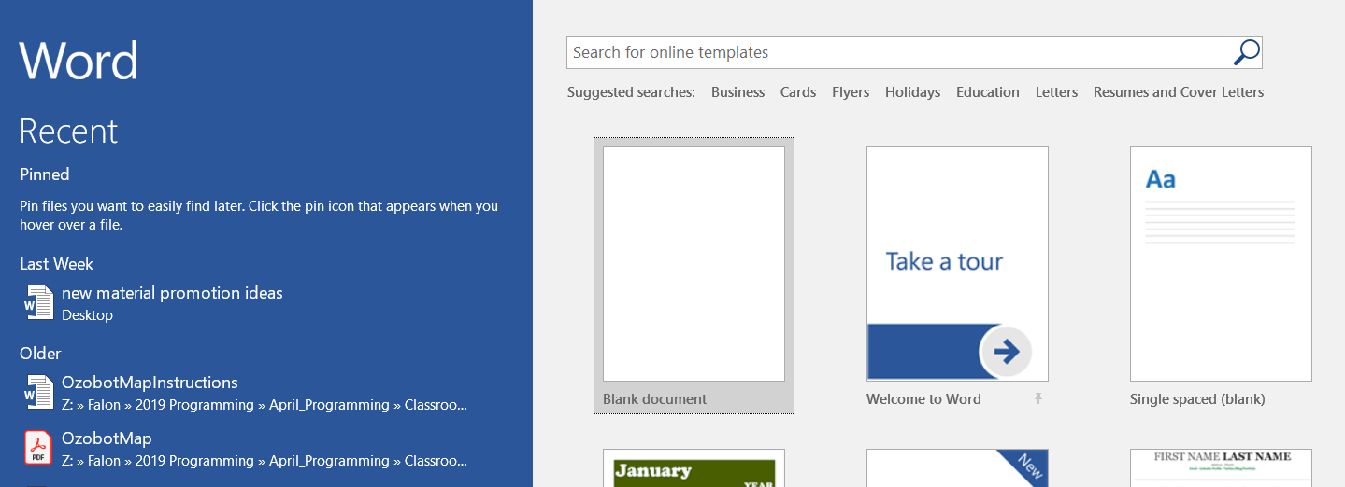
Word Interface
When Word is opened the Word Start Screen will appear
The start screen allows you to create a new document
by choosing from the list of pre-made templates

Slide 3
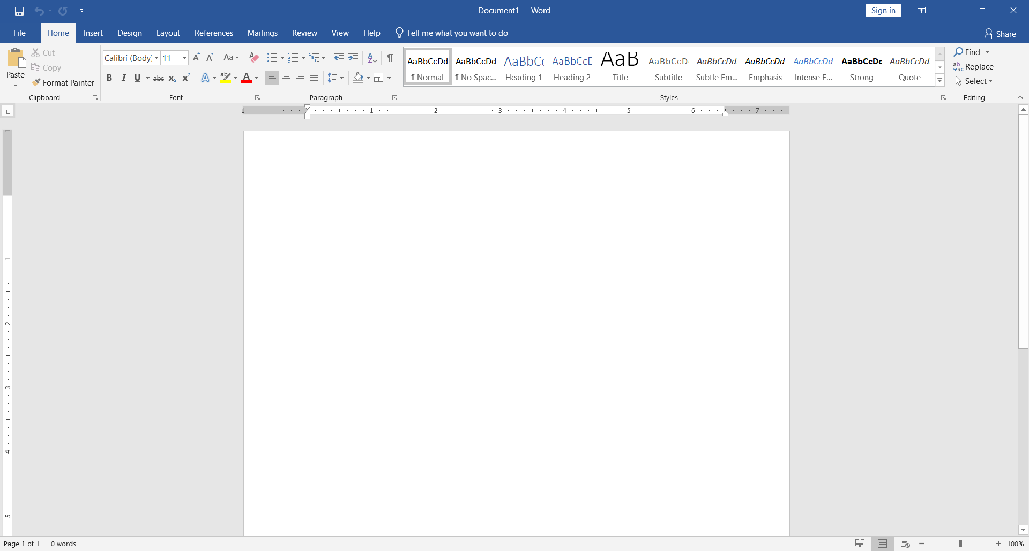
Blank Page Overview

Slide 4
The Ribbon
The Ribbon contains multiple tabs, each with several groups of tools. The tools provided in the ribbon will help you complete common tasks in Word.
The Ribbon has nine tabs:
File
Home
Insert
Design
Layout

Slide 5
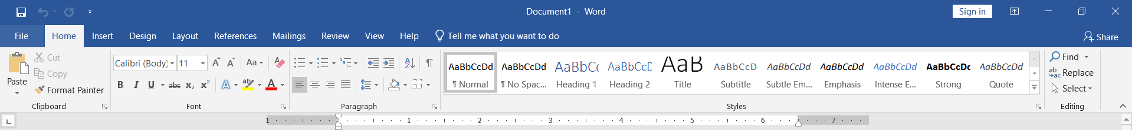
Home tab
The Home tab gives you access to some of the most used commands for working with Word, including copying and pasting, formatting, aligning paragraphs, and choosing document styles.
The Home tab is selected by default whenever you open Word.

Slide 6
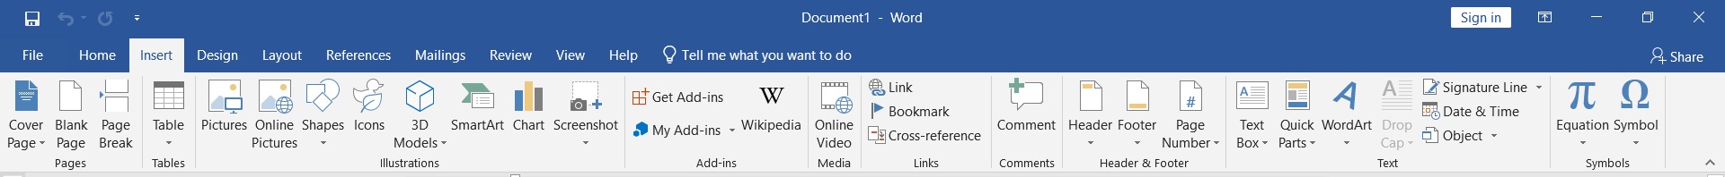
Insert tab
The Insert tab allows you to insert pictures, charts, tables, shapes, cover pages, and more to your document, which can help you communicate information visually and add style to your document.

Slide 7
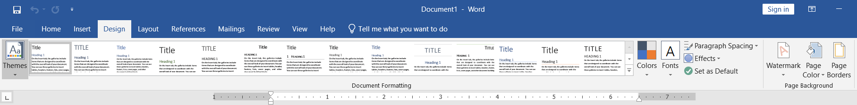
Design tab
The Design tab gives you access to a variety of design tools, including document formatting, effects and page borders, which can give you document a polished look.

Slide 8
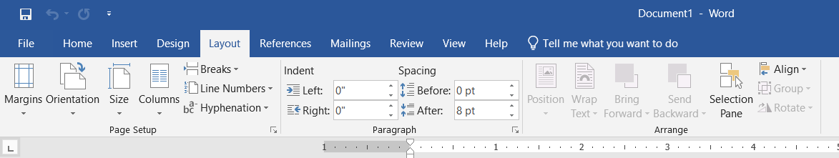
Layout tab
The Layout tab allows you to change the print formatting of your document, including margin width, page orientation, page breaks, and more. These tools will be helpful when preparing to print a document.

Slide 9
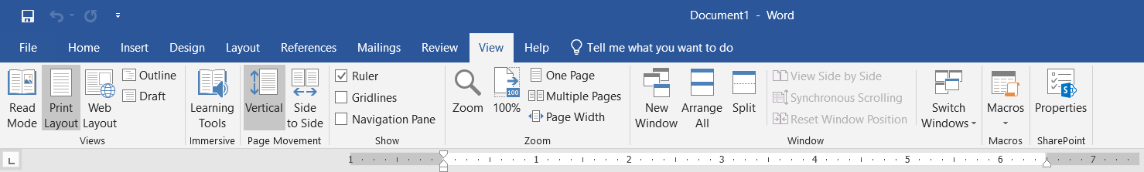
View tab
The View tab allows you to switch between different views for your document and split the screen to view two parts of your document at once. These tools will also be helpful when preparing to print a document.

Slide 10
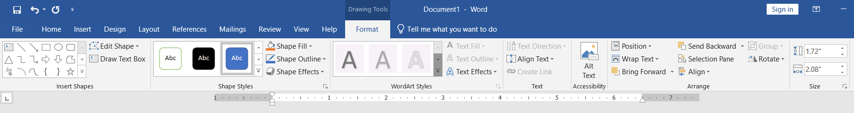
Format
Contextual tabs under Format will appear on the Ribbon when working with certain items, such as tables and pictures. These tabs contain special tools that can help you format items as needed.

Slide 11
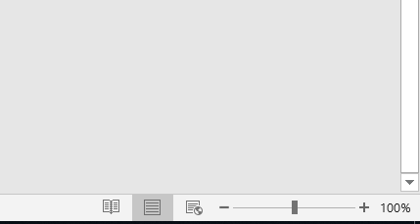
Document Views
Can choose to view your document in Read Mode, Print Layout, or Web Layout. These views can be useful for various tasks.
To change document views, locate and select the desired document view tool in the bottom-right corner of the Word window.
Print Mode
Read Mode
Web
Mode

Slide 12
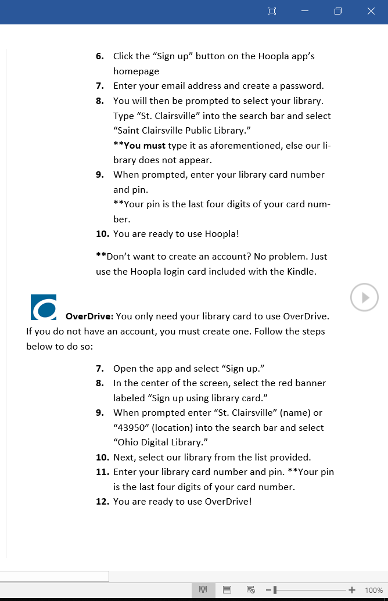
Read Mode
In this view, all of the editing tools are hidden so your document fills the screen. Arrows appear on the left and right side of the screen to toggle through the pages of your document.

Slide 13
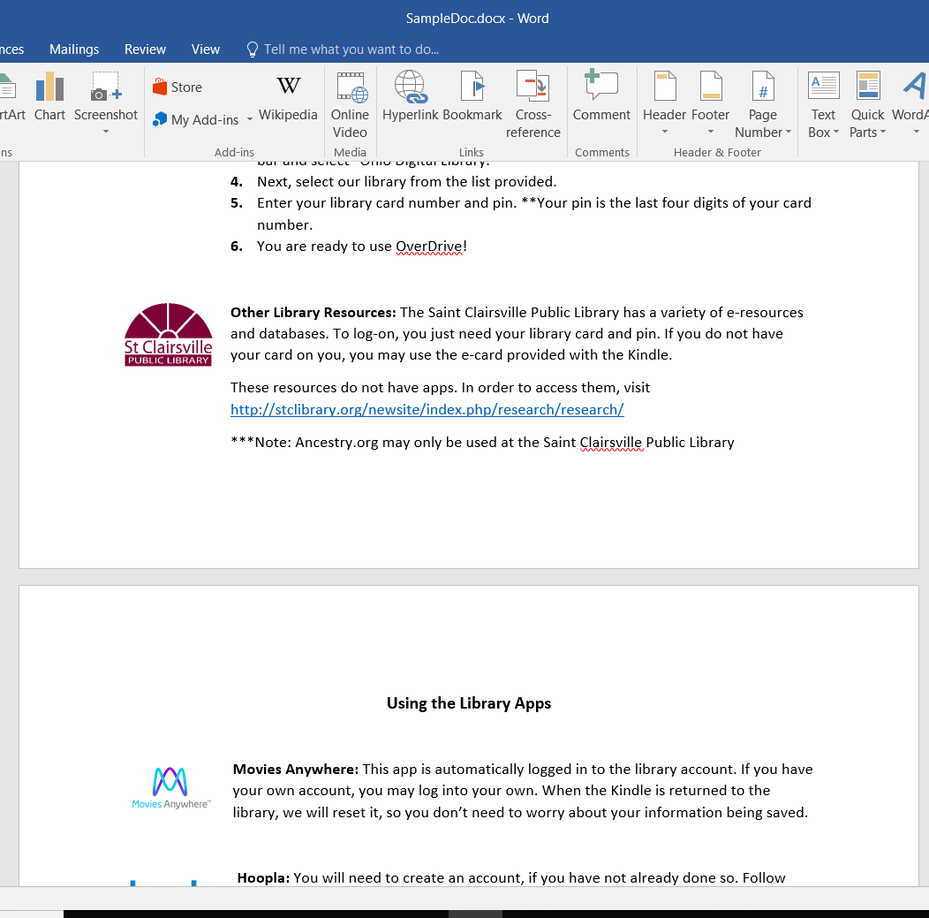
Print Mode
This is the default view where you create and edit your document.
There are page breaks in between each page, indicating how your document will look when printed.
Page Breaks

Slide 14
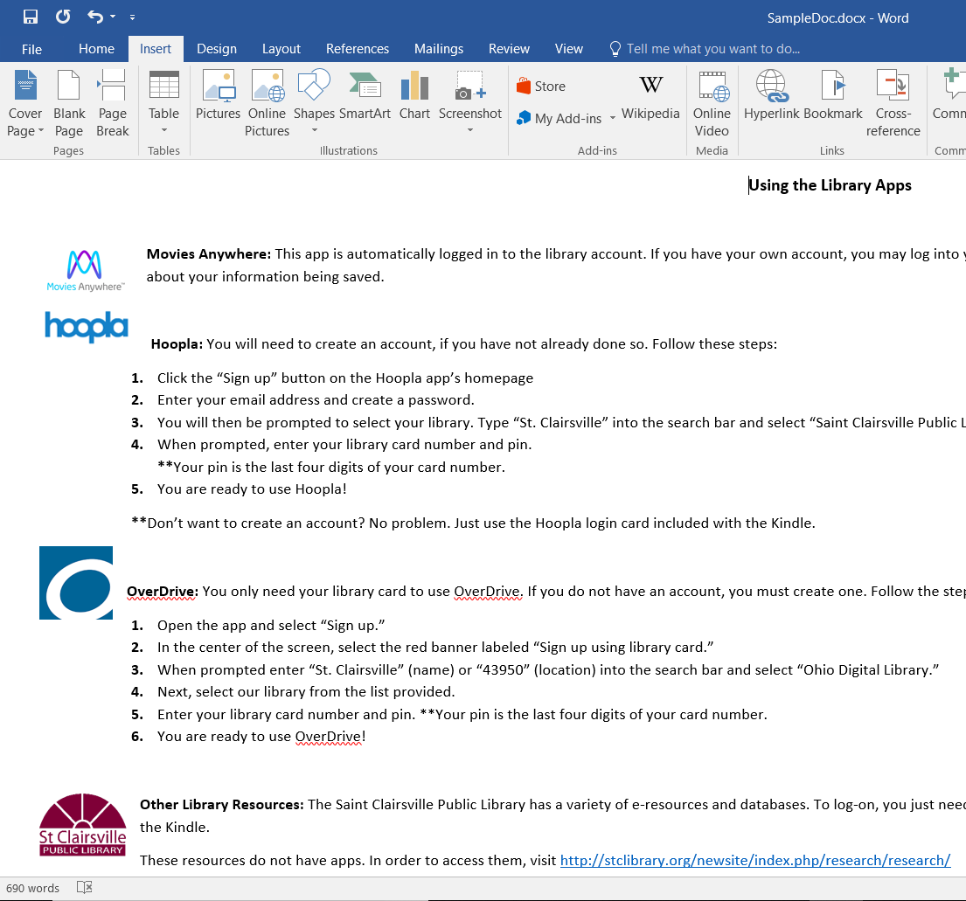
Web Layout
This view removes page breaks. It can help you visualize how your document will display as a webpage.
No Page Breaks

Slide 15
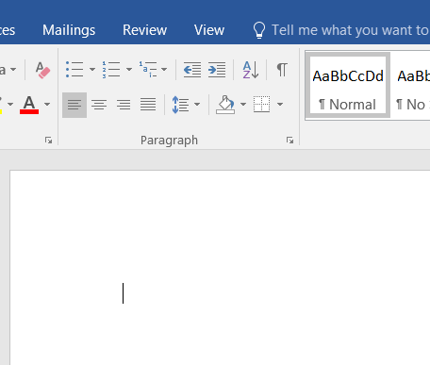
Blank document
Blank document: When a new, document opens, the insertion point is located in the top left corner of the page.

Slide 16
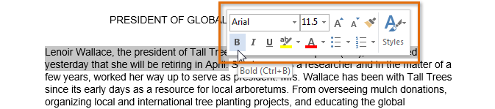
Selecting Text
When select text or images in Word, a toolbar will appear
How to delete text:
Highlight the text the you wish to delete then hit the “Delete” key on the keyboard.

Slide 17

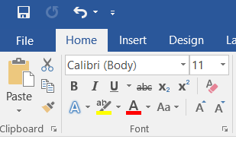
Copy and Paste Text
To copy and paste text:
Copying text creates a duplicate of the text.
1. Select the text you wish to copy
2. Click the Copy command on the Home tab or right click the selected text and click Copy.

Slide 18
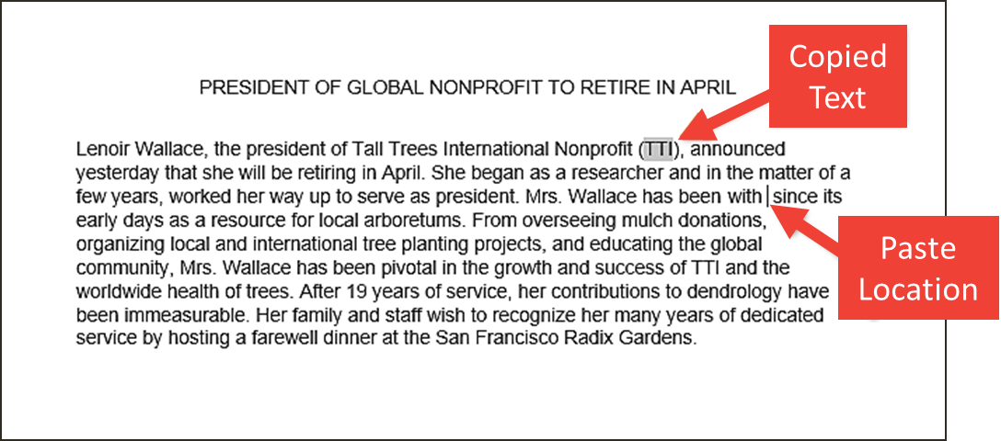
Copy and Paste Text (Cont.)
3. Place the insertion point where you wish the text to appear.
Click the Paste command on the Home tab or right click and click paste.
Then the copied text will appear.

Slide 19
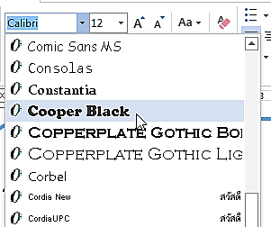
How to Change Font
On the Home tab click the drop-down arrow next to the Font box. A menu of font styles will appear.
Move the mouse over the list of font styles, then select the font you would like to use
4. The font will change in the document.

Slide 20
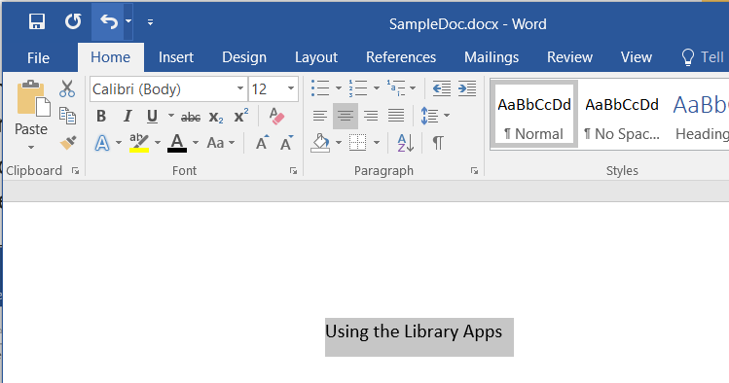
Changing Font Size
Select the text you wish to change.

Slide 21
Changing Font Size (Cont.)
Select the desired font size formatting option
Font size drop-down arrow: On the Home tab, click the Font size drop-down arrow. A menu of font sizes will appear. When you move the mouse over the various font sizes, a live preview of the font size will appear in the document.

Slide 22
Font Color
Select the text you wish to change.
On the Home tab, click the Font Color drop-down arrow. The Font Color menu appears
Move the mouse over the various font colors. A live preview of the color will appear in the document.

Slide 23
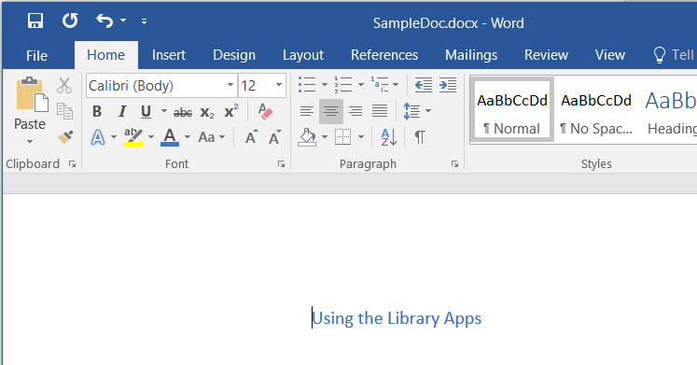
Font Color (Cont.)
Select the font color you wish to use.
The font color will change in the document.

Slide 24
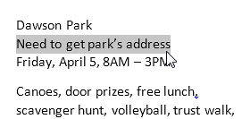
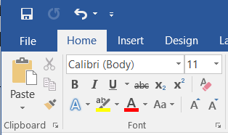
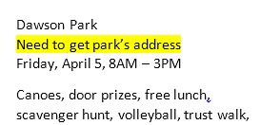
Highlight Text
Highlighting text can be useful when marking important text in your document.
Select the text you wish to highlight.
2. From the Home tab, click the Text Highlighter Color drop-down arrow.
3. Select the desired highlight color.

Slide 25
Bold, Italic, and Underline
Select the text you wish to change.
On the Home tab click the Bold (B), Italic (I), or Underline (U) command in the Font group.
3. The selected text will be modified in the document.

Slide 26
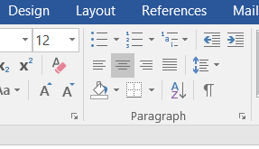
Changing Text Alignment
Select the text you wish to modify.
On the Home tab, select one of the four alignment options from the paragraph section
Align Text left
Center
Align Text Right
Justify

Slide 27
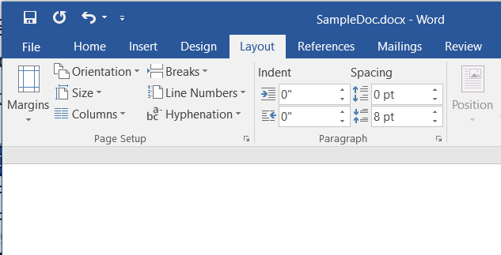
Page Orientation
To change page orientation:
Select the Page Layout tab.
Click the “Orientation” command in the Page Setup Section.
A drop-down menu will appear. Click either “Portrait” or “Landscape” to change the page orientation.
Once one is selected the page will change.

Slide 28
Changing Page Size
To change the page size:
Word has a variety of predefined page sizes to choose from.
1. Select the “Layout” tab, then click the “Size” command.
2. A drop-down menu will appear. The current page size is highlighted

Slide 29
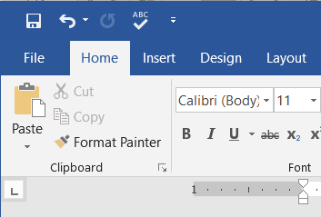
File Tab
File Tab gives you various options for saving, opening a file, printing, and sharing your document.
To access Backstage view:
1. Click the file tab

Slide 30
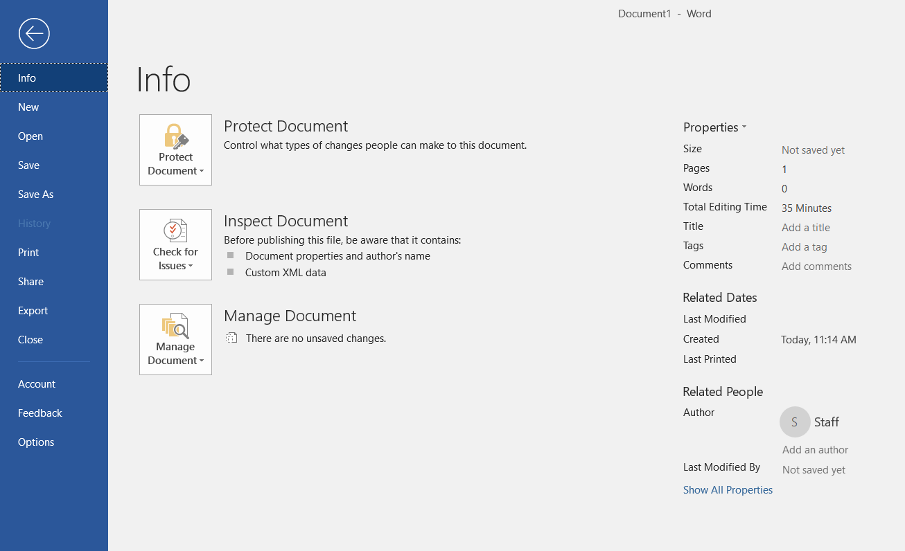
File Tab(Cont.)

Slide 31
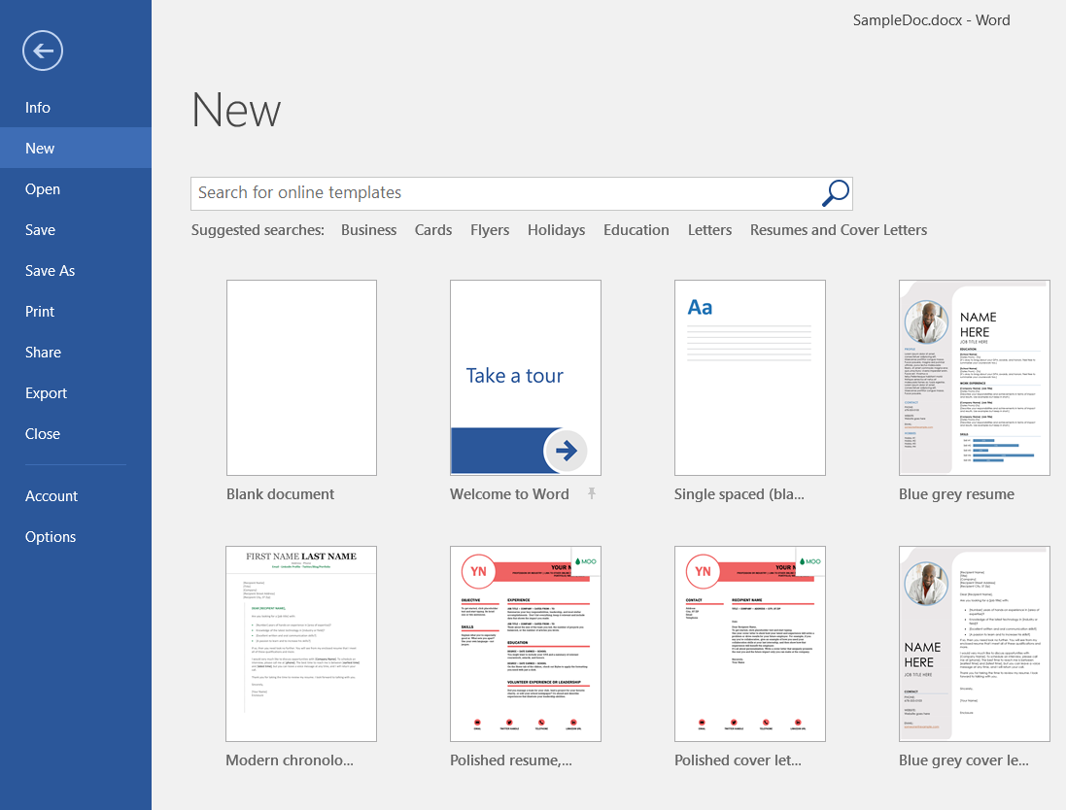
New Document
To begin a new project in Word
1. Select the file tab. Backstage view will appear.
2. Select New, then click a template.
3. A new, document will appear.

Slide 32
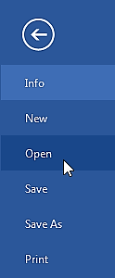
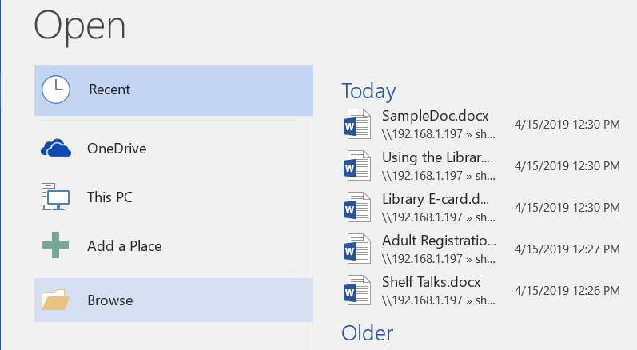
How to: Open an Existing Document
1. Navigate to Backstage view, then click Open.
2. Choose “Browse”

Slide 33
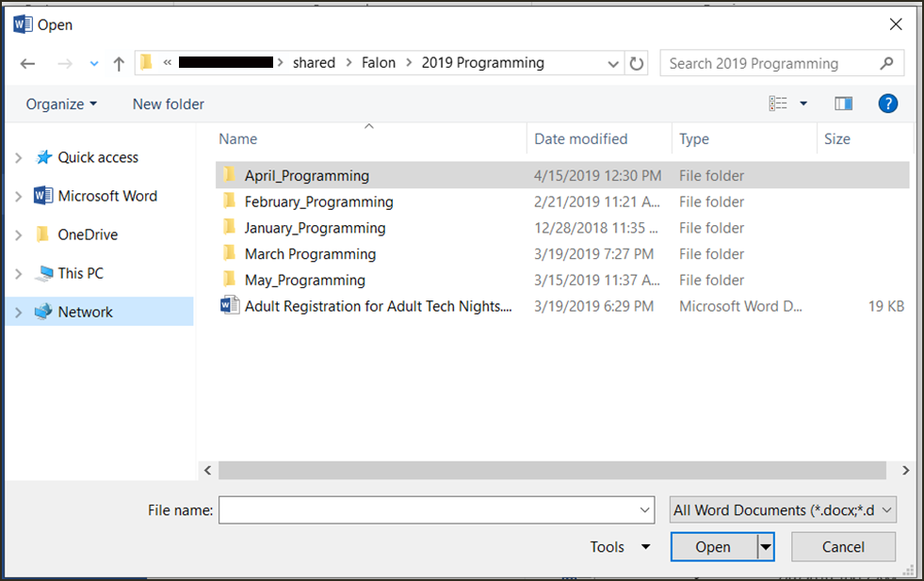
How to: Open an Existing Document (Cont.)
3. The Open dialog box appears. Locate and select your document, then click Open.

Slide 34
Save and Save As
In Word there are two says to save a file, SAVE and SAVE AS.
SAVE is used when a document is open or edited to save what you are working on.
SAVE AS is used to save the document to a location and change the name of the document.
It is important to save your document whenever you start a new project or make changes to an existing one.
Saving early and often can prevent you work from being lost.

Slide 35
To Save a Document
1. Locate and select the Save command on the Quick Access toolbar.
If you are saving the document for the first time Save As will appear in Backstage view.
3. You will then need to choose where to save the file and give it a file name.

Slide 36
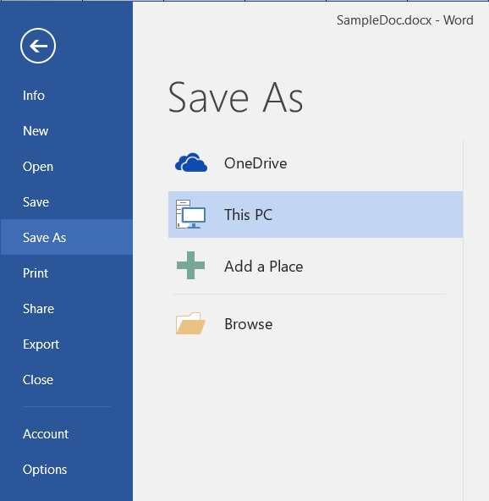

Slide 37
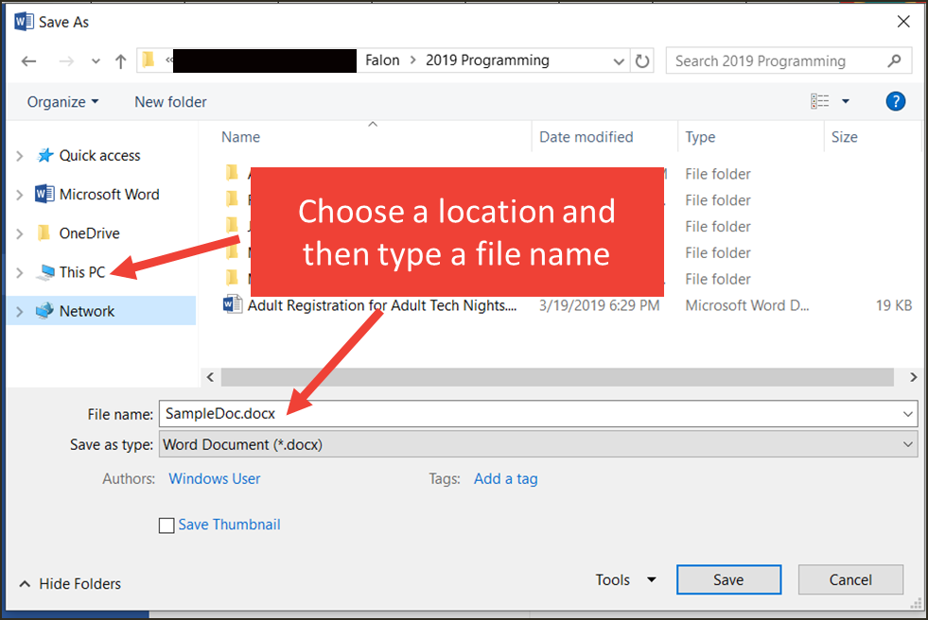
To Save a Document (Cont.)
The Save As dialog box will appear. Select the location where you wish to save the document.
Enter a file name for the document, then click Save.

Slide 38
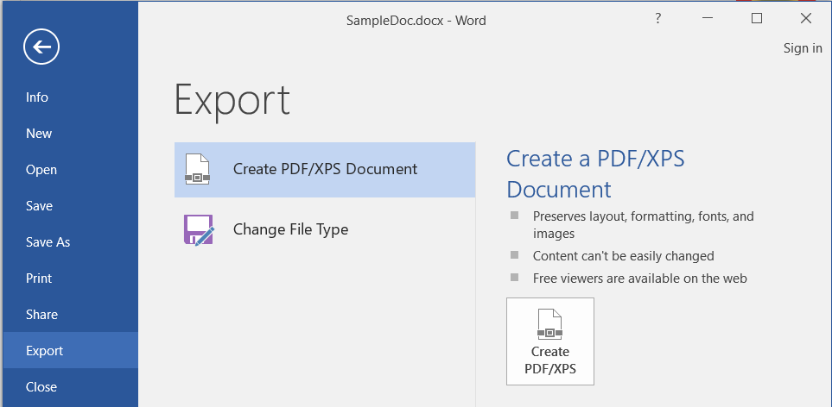
How To: Export Word to PDF
Click the File tab.
Click Export, then select Create PDF/XPS.

Slide 39
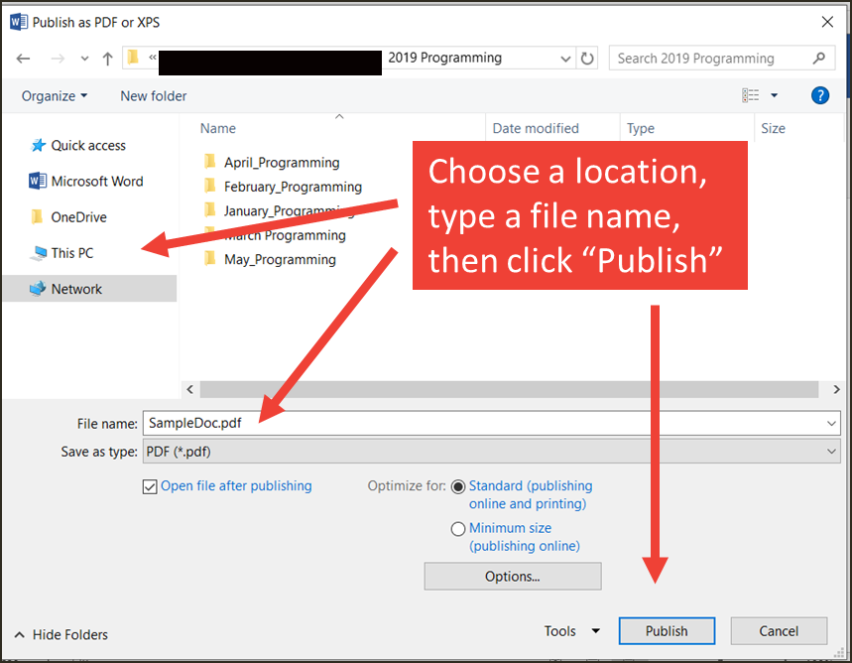
How To: Export Word to PDF (Cont.)
3. The Save As dialog box will appear. Select the location where you wish to export the documents, enter a file name, then click Publish.

Slide 40
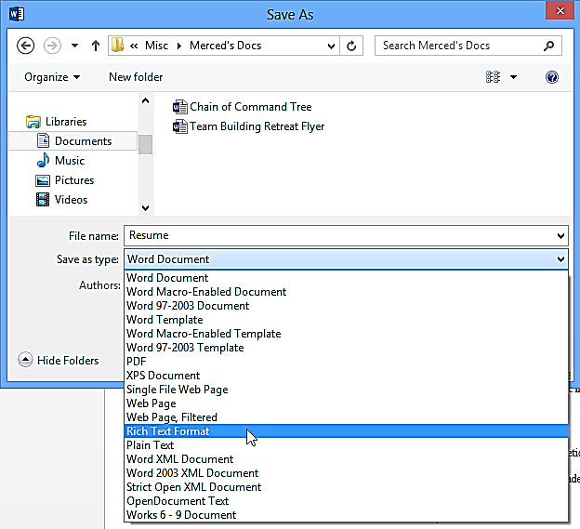
Exporting to Other File Types (Cont.)
You can also use the Save As type: drop-down menu in the Save As dialog box to save documents in a variety of file types.

Slide 41
Thank You ☺

