Slide 1


English Course- Intermediate Level
Prepared by
Ahmed Soliman

Slide 2



Lecture 3
www.midocean.ae

Slide 3
Listening: car insurance
Grammar: Types of Sentences
www.midocean.ae

Slide 4
Listening
car insurance
www.midocean.ae

Slide 5
Vocabulary
run into (verb): crash into
– Unfortunately, we ran into a deer that jumped into the road.
alongside (preposition): next to
– My wife drove her alongside me as I ran in the marathon.
distracted (adjective): unable to concentrate
– I was distracted by the loud music, and I didn’t see the stoplight.
a rip off (noun): something that is very expensive
– The car was a rip off. It broke down one week after I bought it.
fork out (or over) (verb): pay money
– I had to fork out $3,000 to repair my car.
(be) loaded (adjective): have a lot of money
– Her boyfriend is loaded and buys her anything she wants.
www.midocean.ae

Slide 6
https://www.esl-lab.com/intermediate/car-insurance/
1- The man wants to go to ______.
the gym
work
school
www.midocean.ae

Slide 7
2- The man has had two _______ violations recently.
speeding
parking
seat belt
3- Then, the man ran into a police car while he was ________.
texting
drinking
eating
www.midocean.ae

Slide 8
4- The man has to take a defensive driving course for ______.
$250
$200
$225
5- The man doesn't want to take the class because ______.
the class only meets on weeknights
he doesn't have a lot of money
he didn't deserve a ticket
www.midocean.ae

Slide 9
Grammar
Types of Sentences
www.midocean.ae

Slide 10
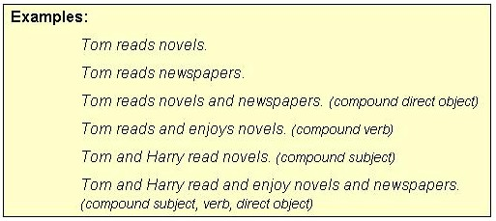
1- A SIMPLE SENTENCE has one independent clause.
www.midocean.ae

Slide 11
Punctuation note: NO commas separate two compound elements (subject, verb, direct object, indirect object, subjective complement, etc.) in a simple sentence.
www.midocean.ae

Slide 12
2. A COMPOUND SENTENCE has two independent clauses joined by
A. a coordinating conjunction (for, and, nor, but, or, yet, so),
B. a conjunctive adverb (e.g. however, therefore), or
C. a semicolon alone.
www.midocean.ae

Slide 13
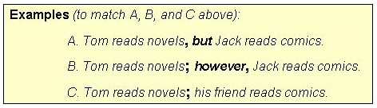
www.midocean.ae

Slide 14
Punctuation patterns (to match A, B, and C above):
A. Independent clause, coordinating conjunction independent clause.
B. Independent clause; conjunctive adverb, independent clause.
C. Independent clause; independent clause.
www.midocean.ae

Slide 15
3. A COMPLEX SENTENCE has one dependent clause (headed by a subordinating conjunction or a relative pronoun ) joined to an independent clause.
www.midocean.ae

Slide 16
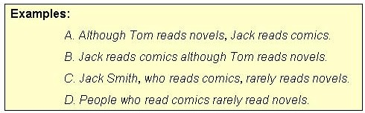
www.midocean.ae

Slide 17
4. A COMPOUND-COMPLEX SENTENCE has two independent clauses joined to one or more dependent clauses.
www.midocean.ae

Slide 18
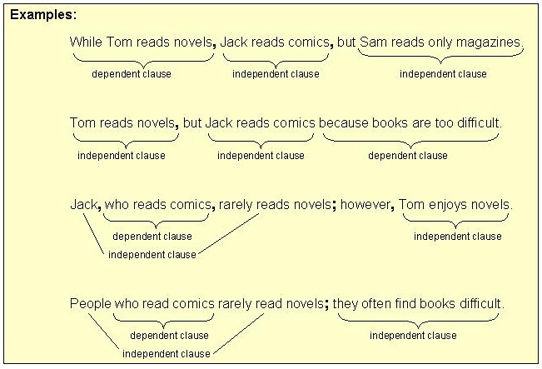
www.midocean.ae

Slide 19




Thank You

