Slide 1



Build a Small Network
Lecture 10
CCNA – Introduction to Networks V7.0 (ITN)
Prepared by
Dr. Abdelrhman Ahmed

Slide 2
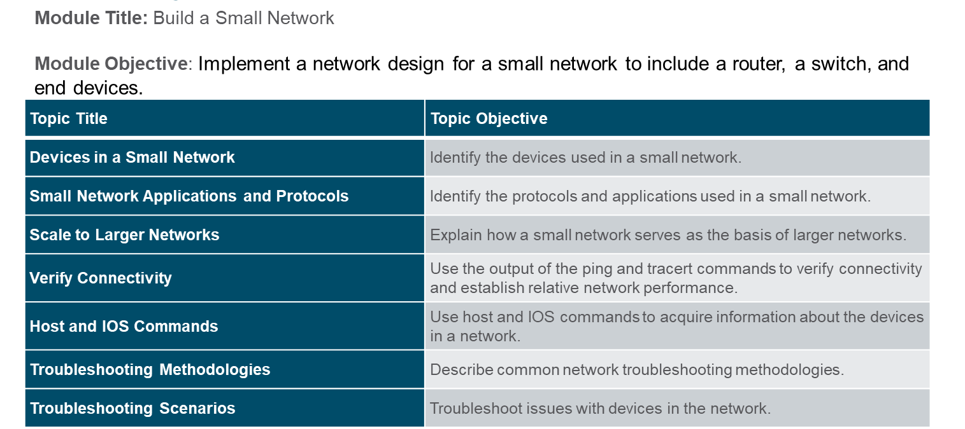
Chapter
Module Objectives
10

Slide 3
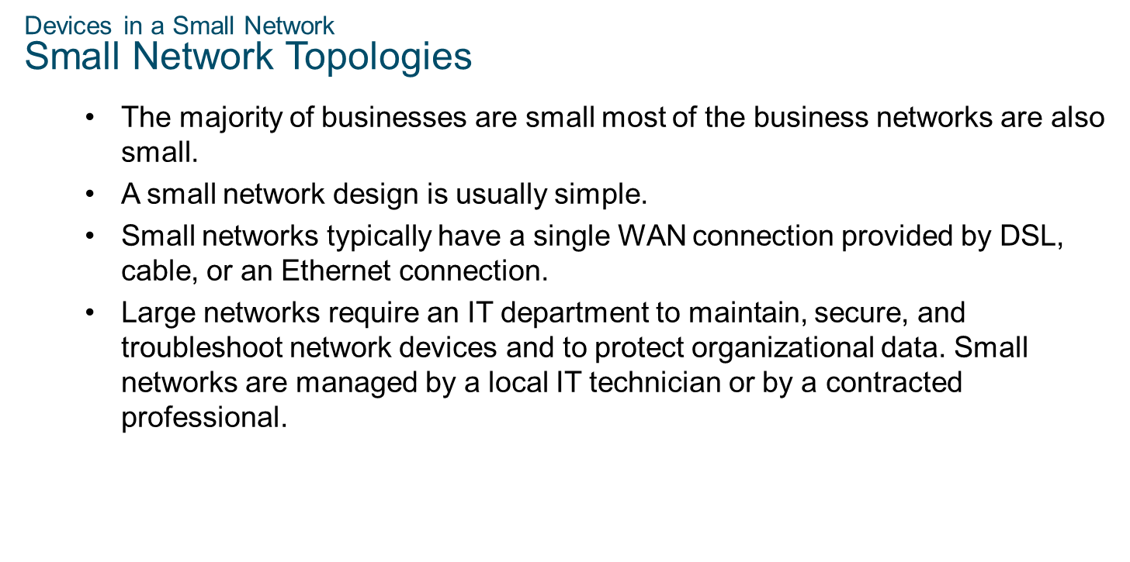
Chapter
Devices in a Small Network
10

Slide 4
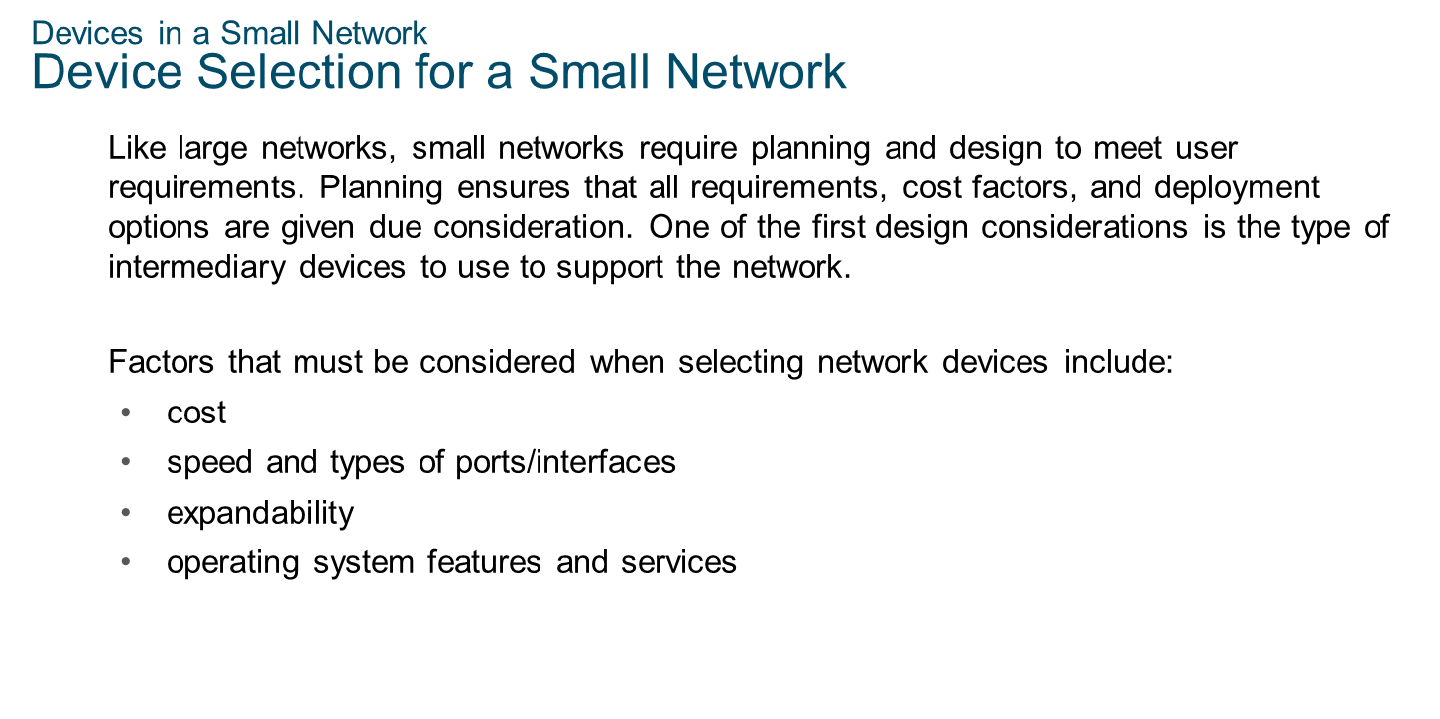
Chapter
Devices in a Small Network
10

Slide 5
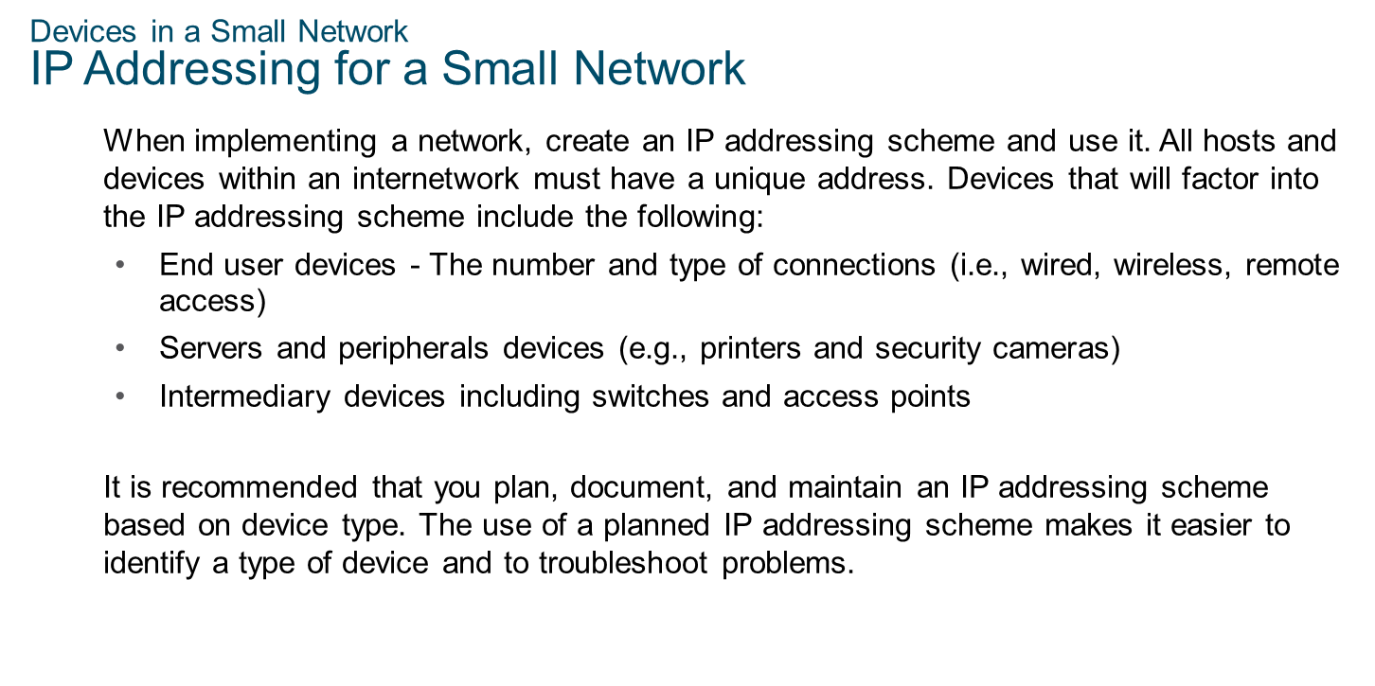
Chapter
Devices in a Small Network
10

Slide 6
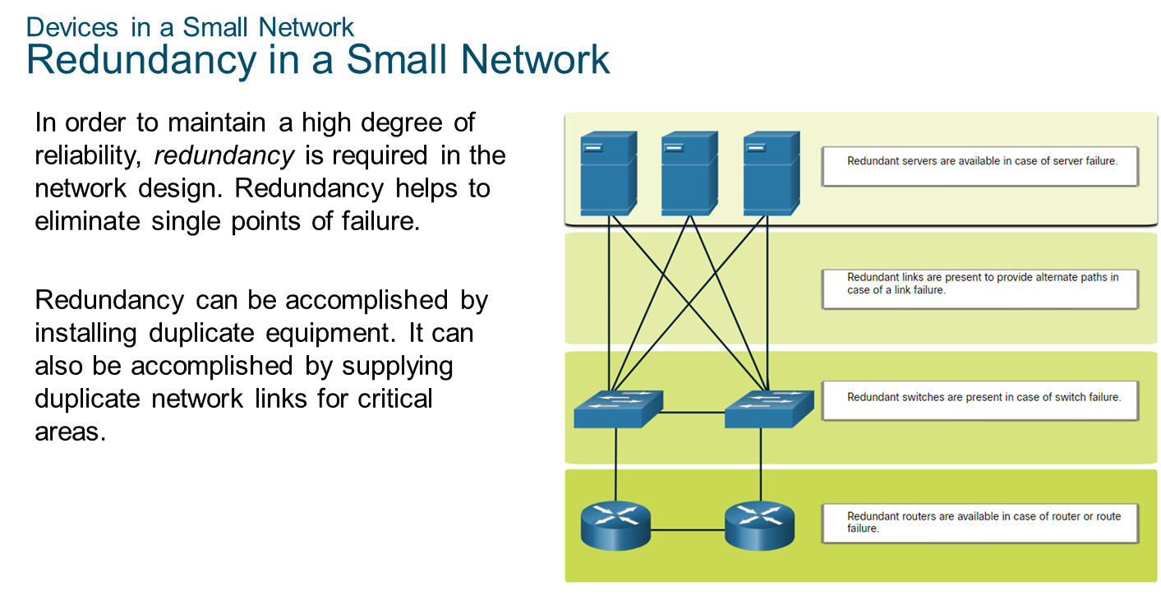
Chapter
Devices in a Small Network
10

Slide 7
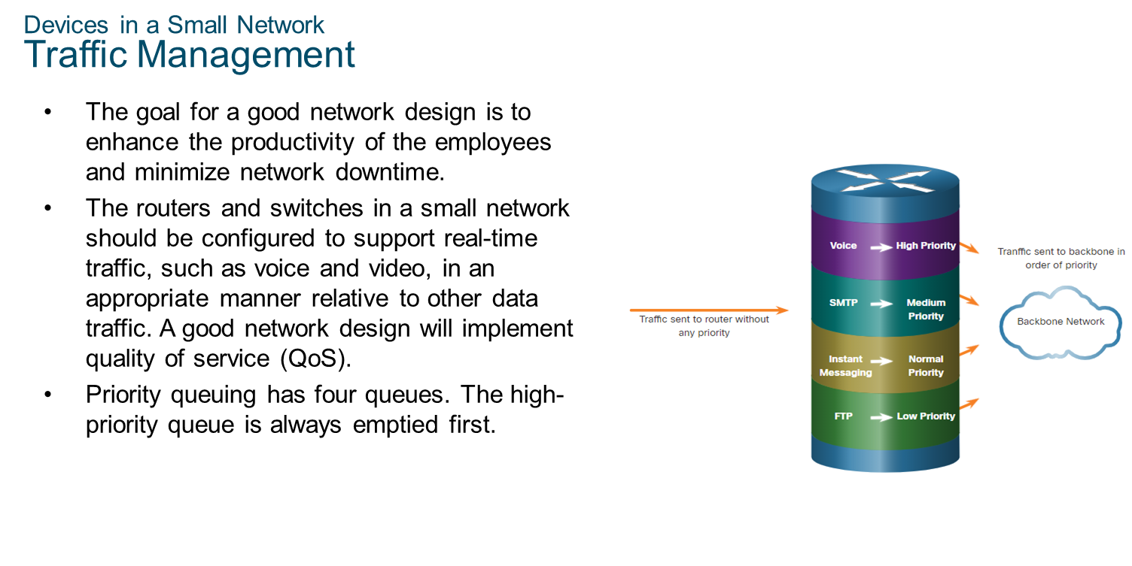
Chapter
Devices in a Small Network
10

Slide 8
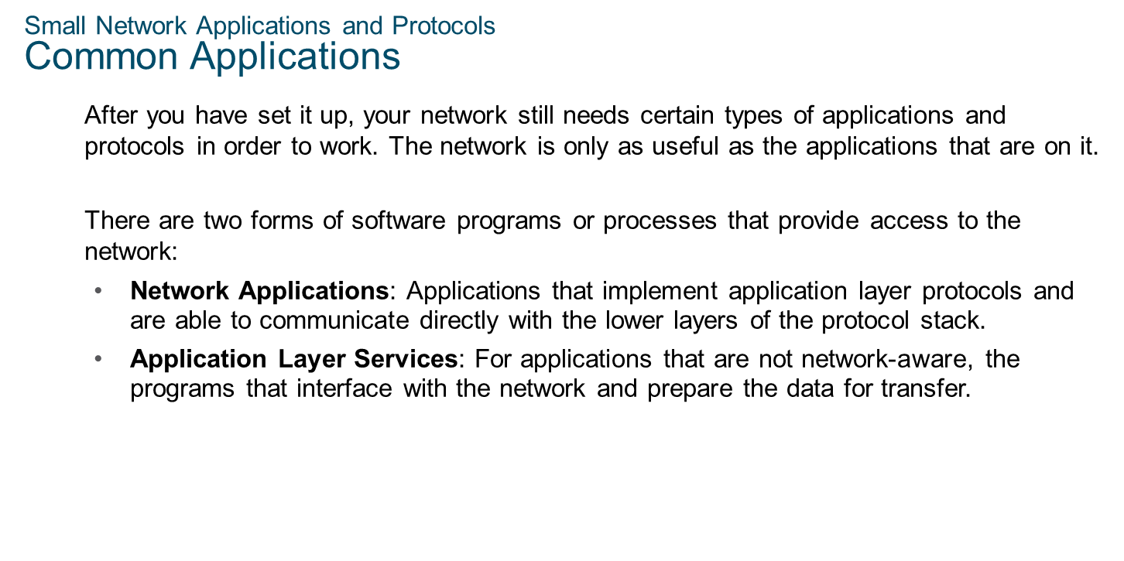
Chapter
Small Network Applications and Protocols
10

Slide 9
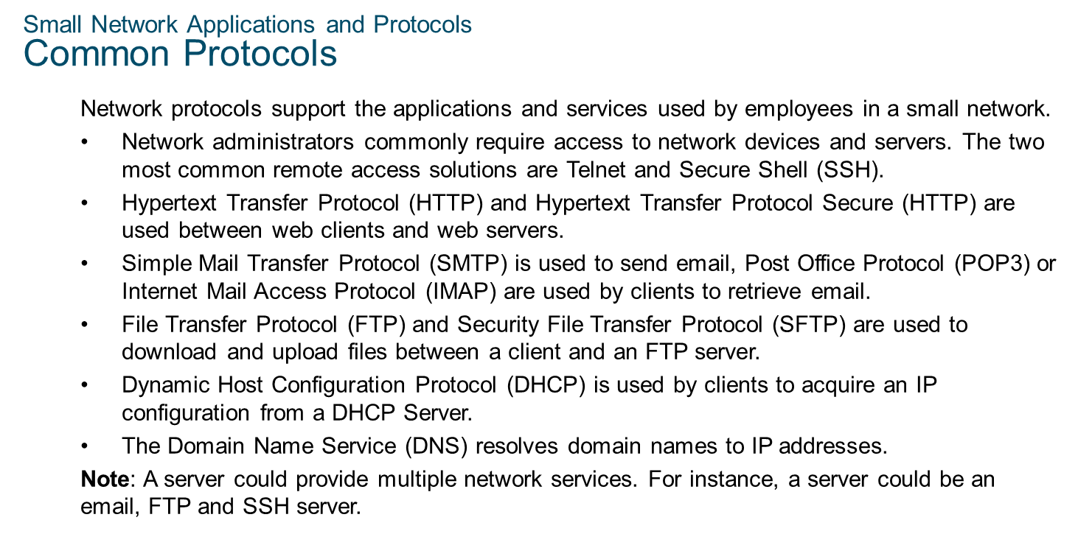
Chapter
Small Network Applications and Protocols
10

Slide 10
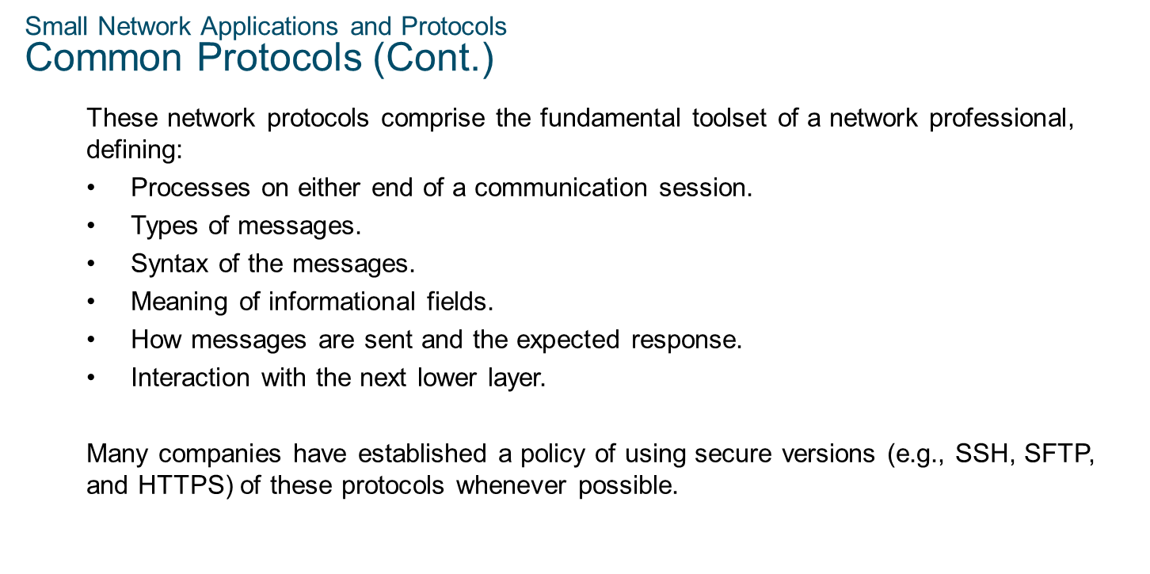
Chapter
Small Network Applications and Protocols
10

Slide 11
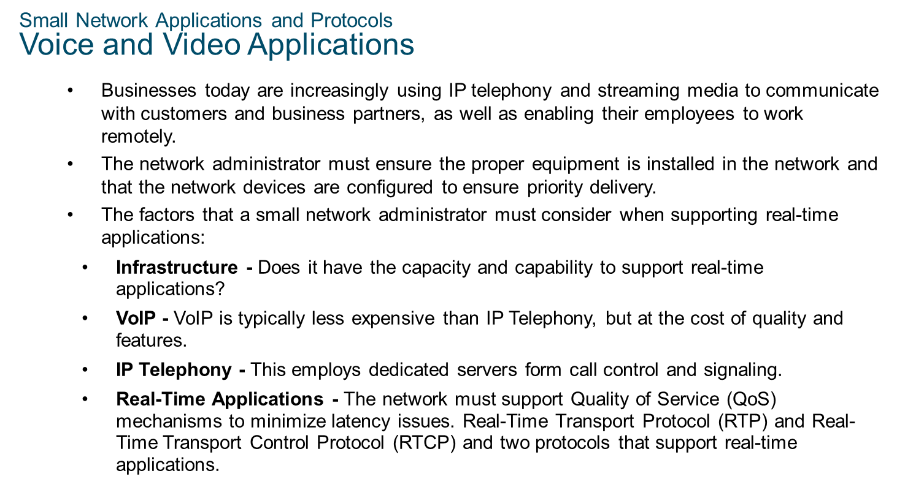
Chapter
Small Network Applications and Protocols
10

Slide 12
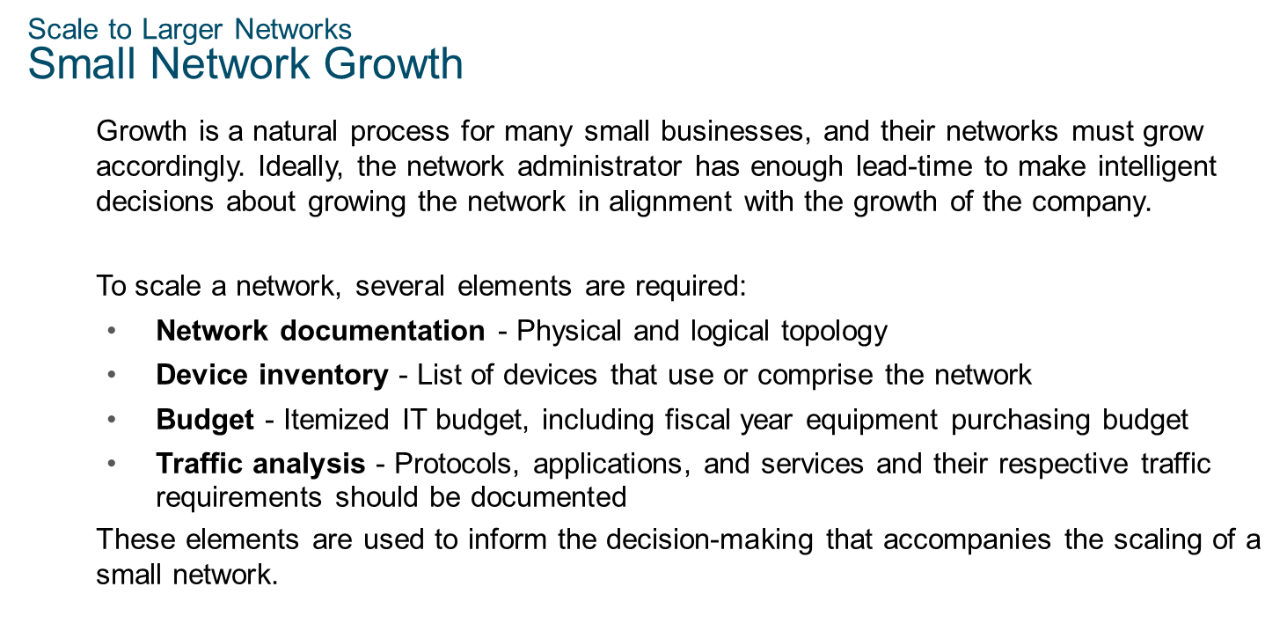
Chapter
Scale to Large Networks
10

Slide 13
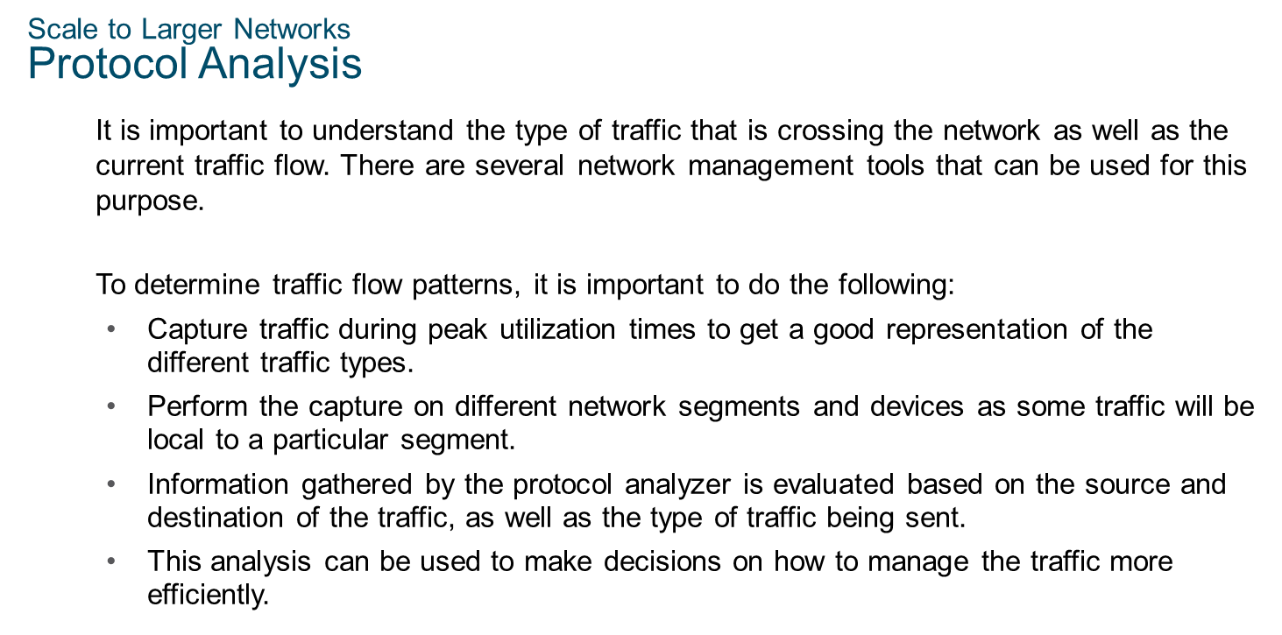
Chapter
Scale to Large Networks
10

Slide 14
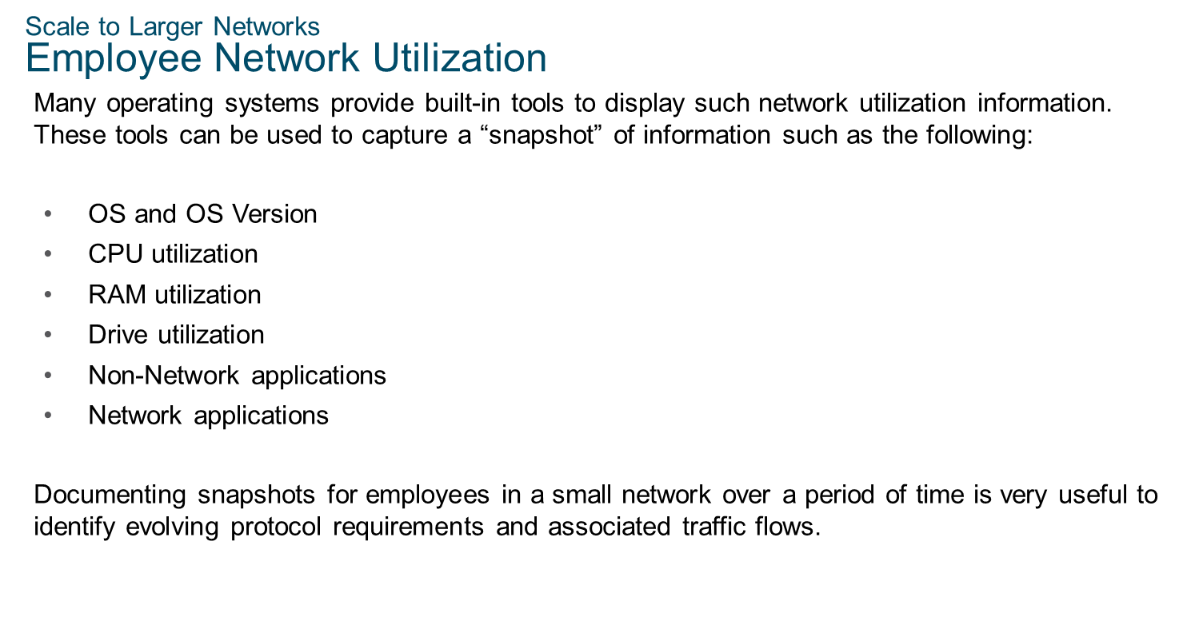
Chapter
Scale to Large Networks
10

Slide 15
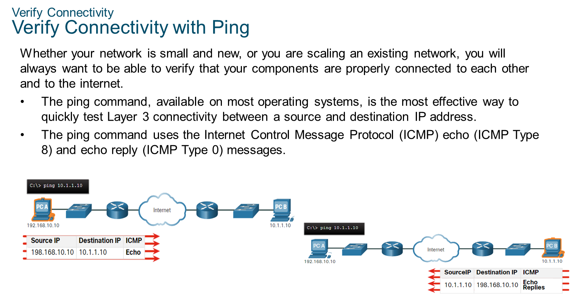
Chapter
10
Verify Connectivity

Slide 16
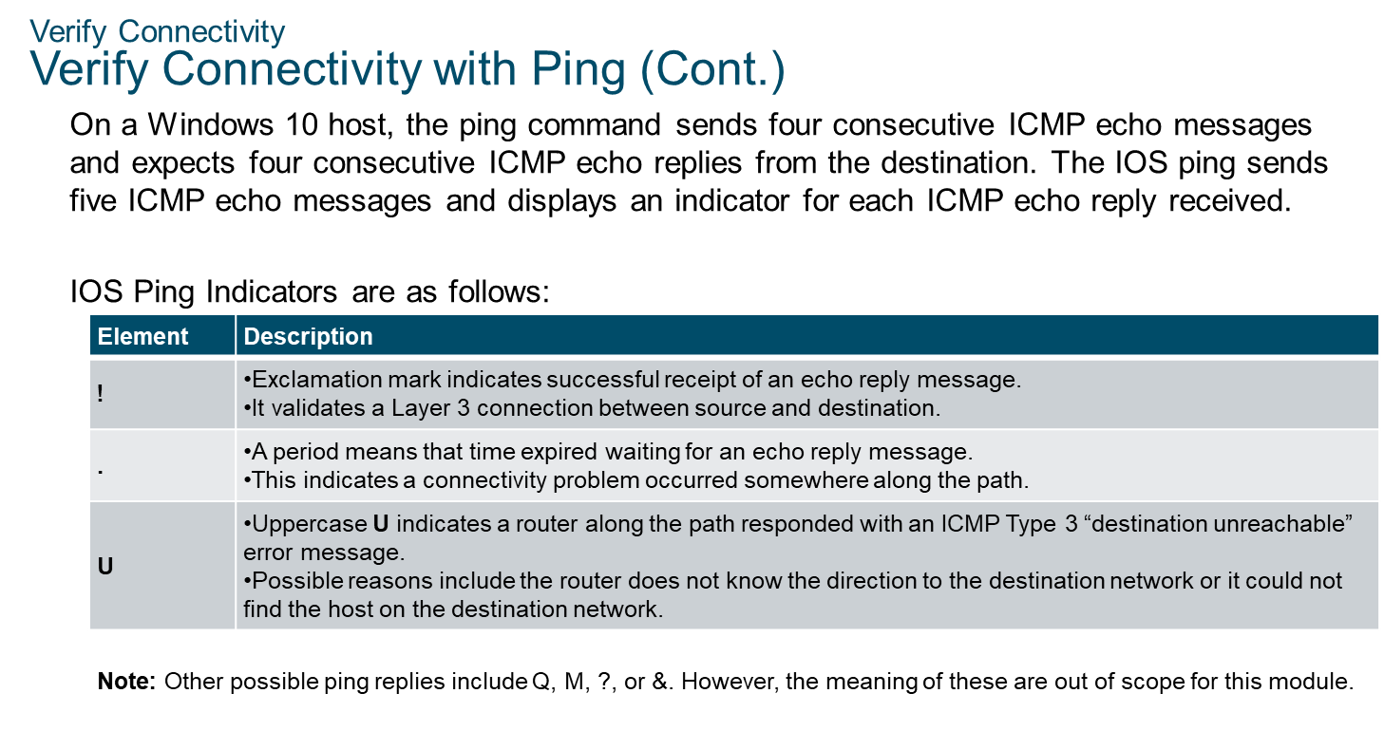
Chapter
10
Verify Connectivity

Slide 17
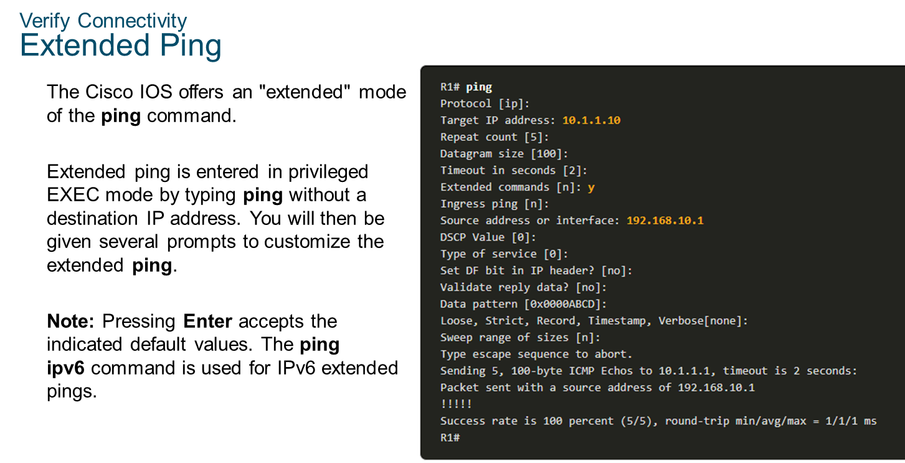
Chapter
10
Verify Connectivity

Slide 18
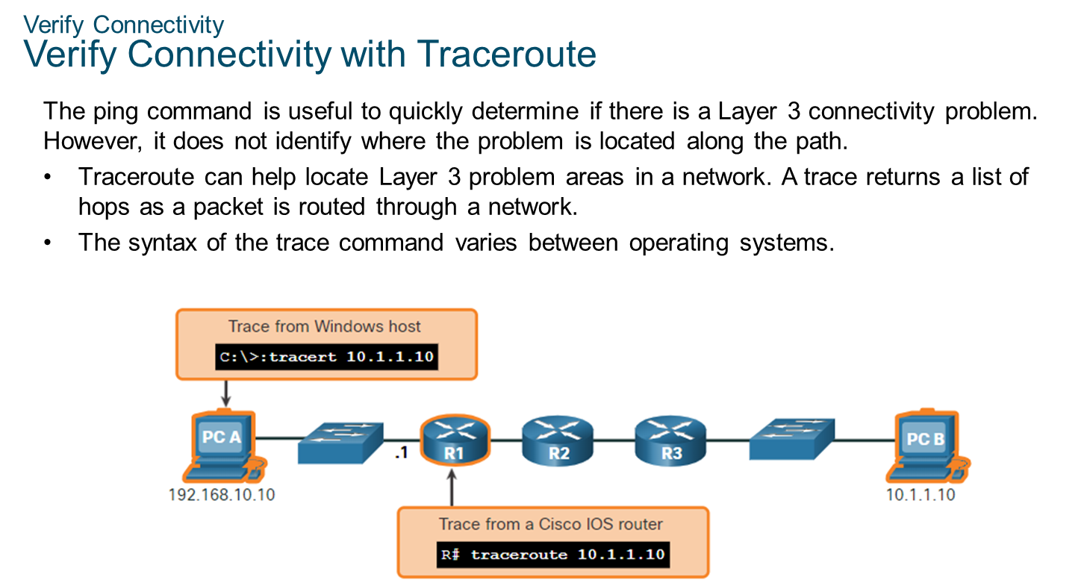
Chapter
10
Verify Connectivity

Slide 19
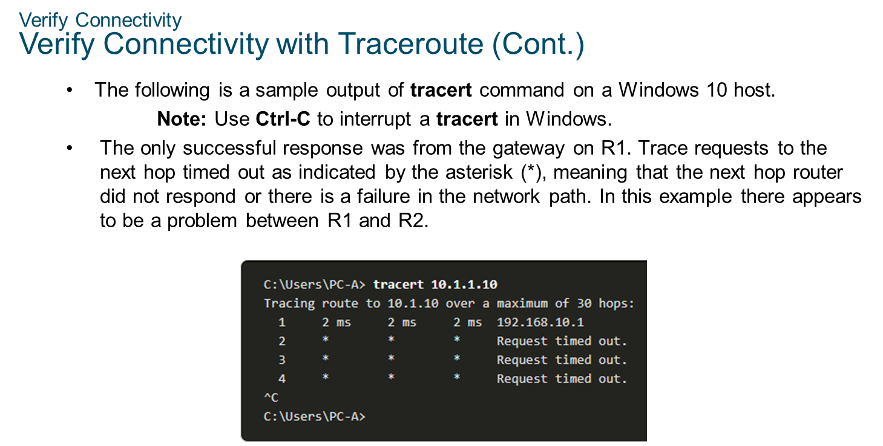
Chapter
10
Verify Connectivity

Slide 20
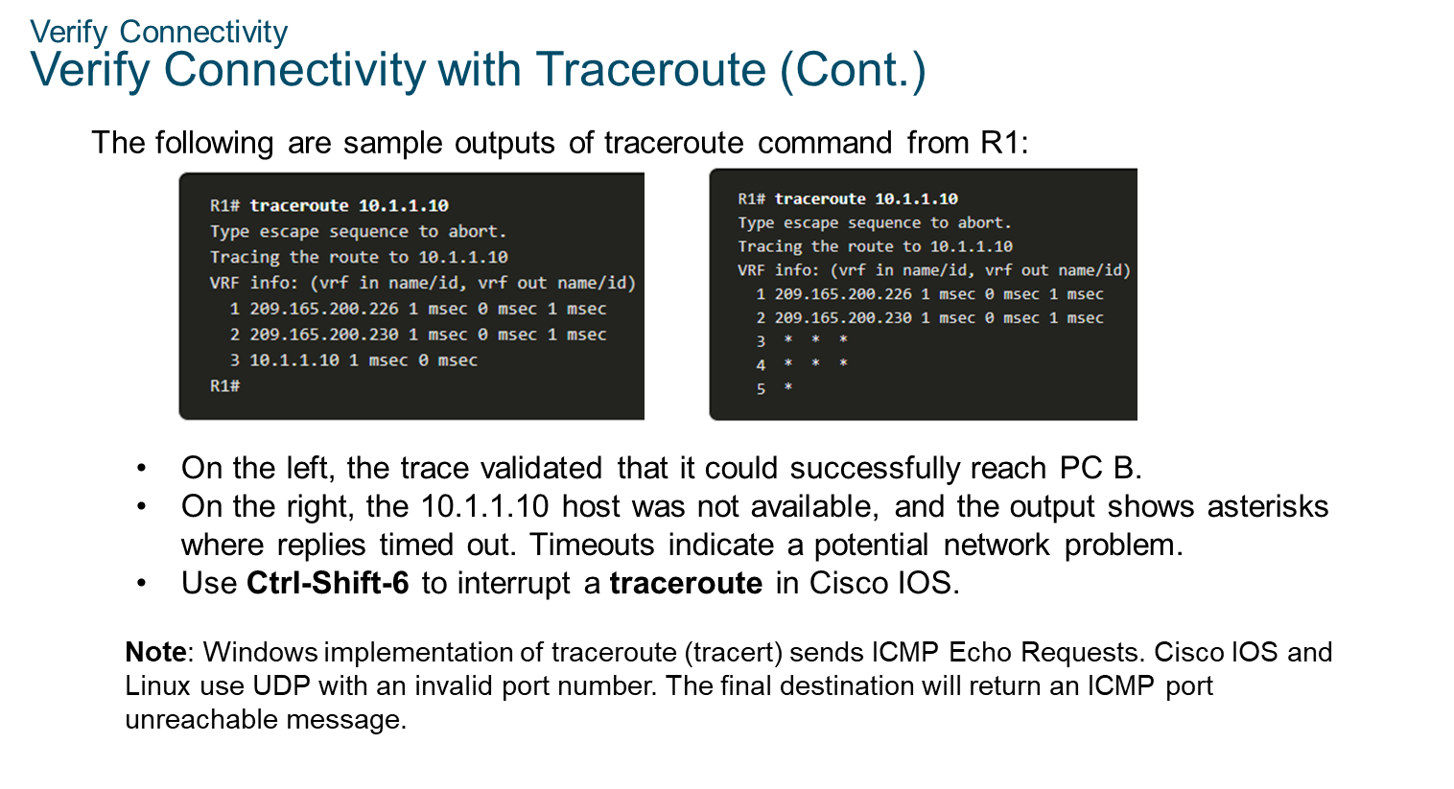
Chapter
10
Verify Connectivity

Slide 21
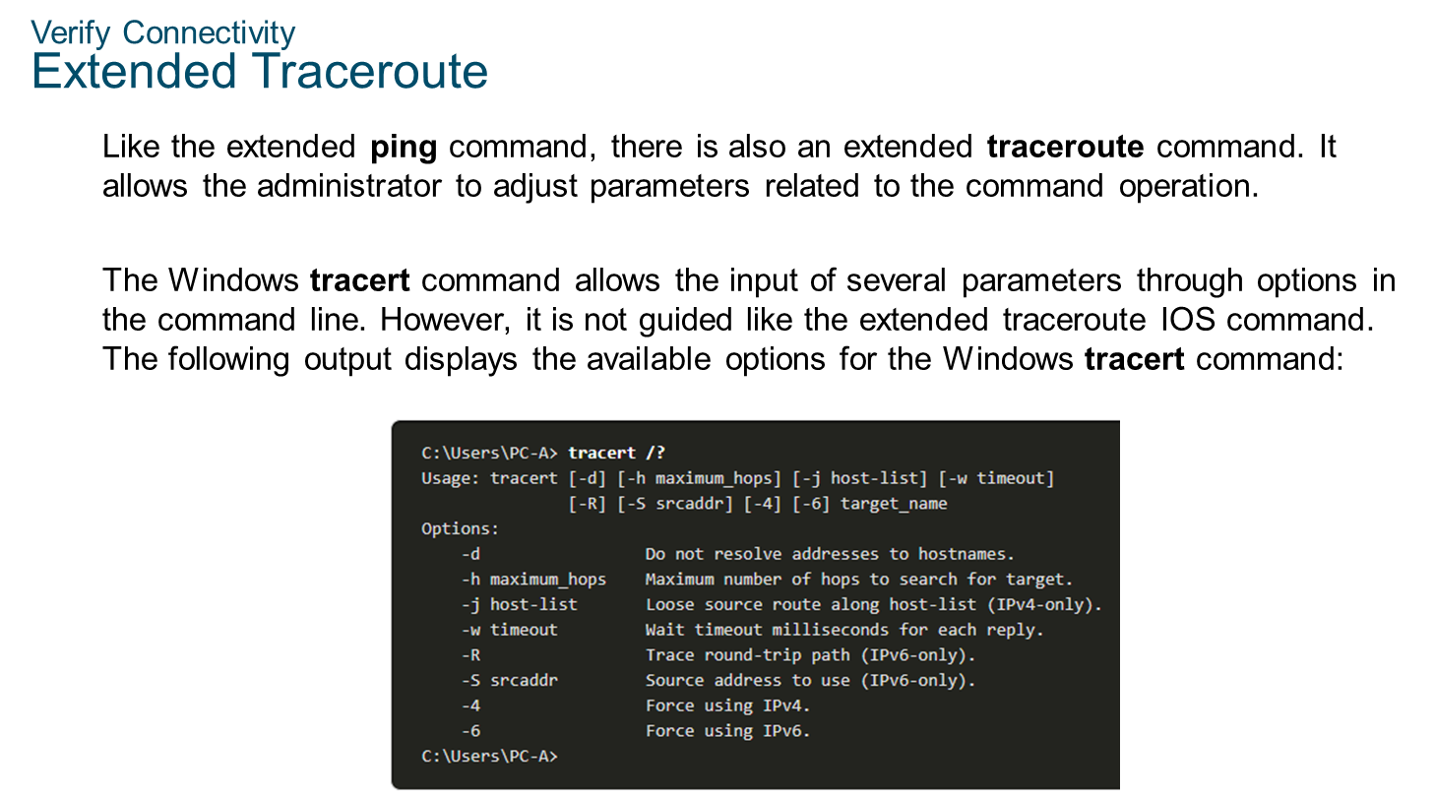
Chapter
10
Verify Connectivity

Slide 22
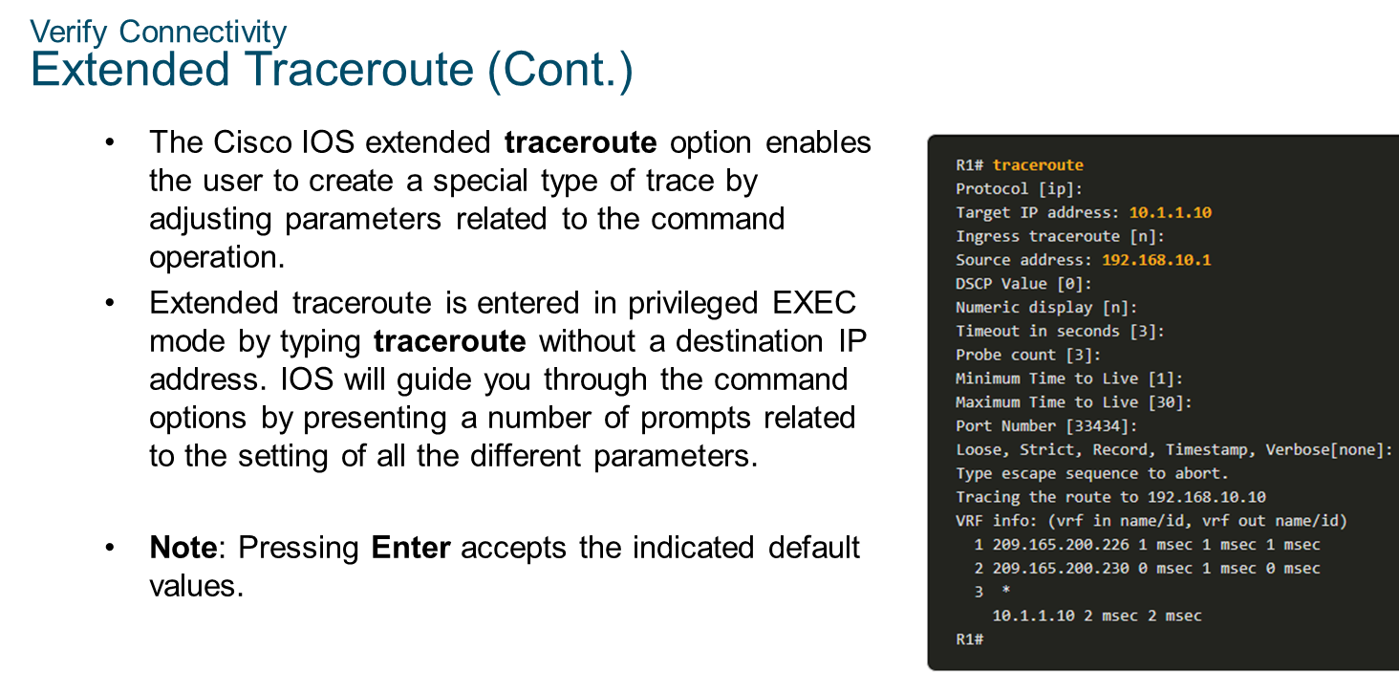
Chapter
10
Verify Connectivity

Slide 23
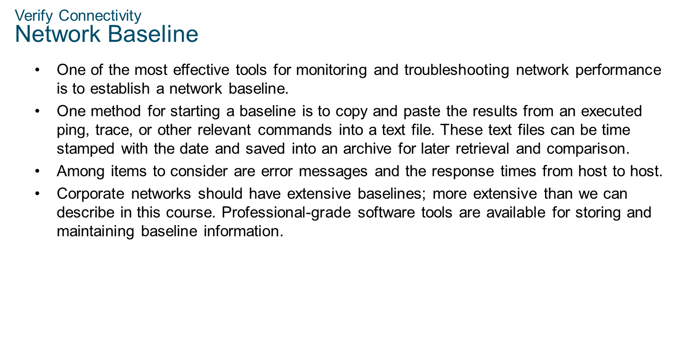
Chapter
10
Verify Connectivity

Slide 24
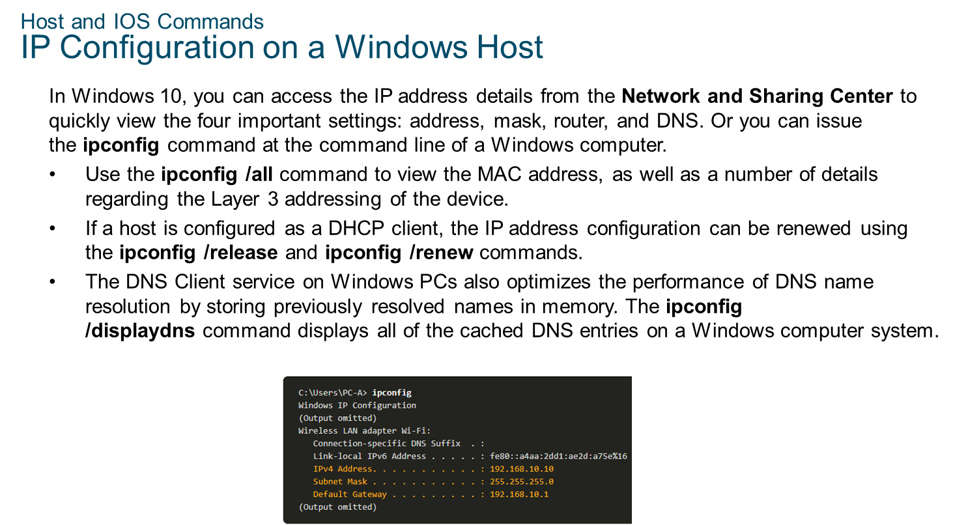
Chapter
10
Host and IOS Commands

Slide 25
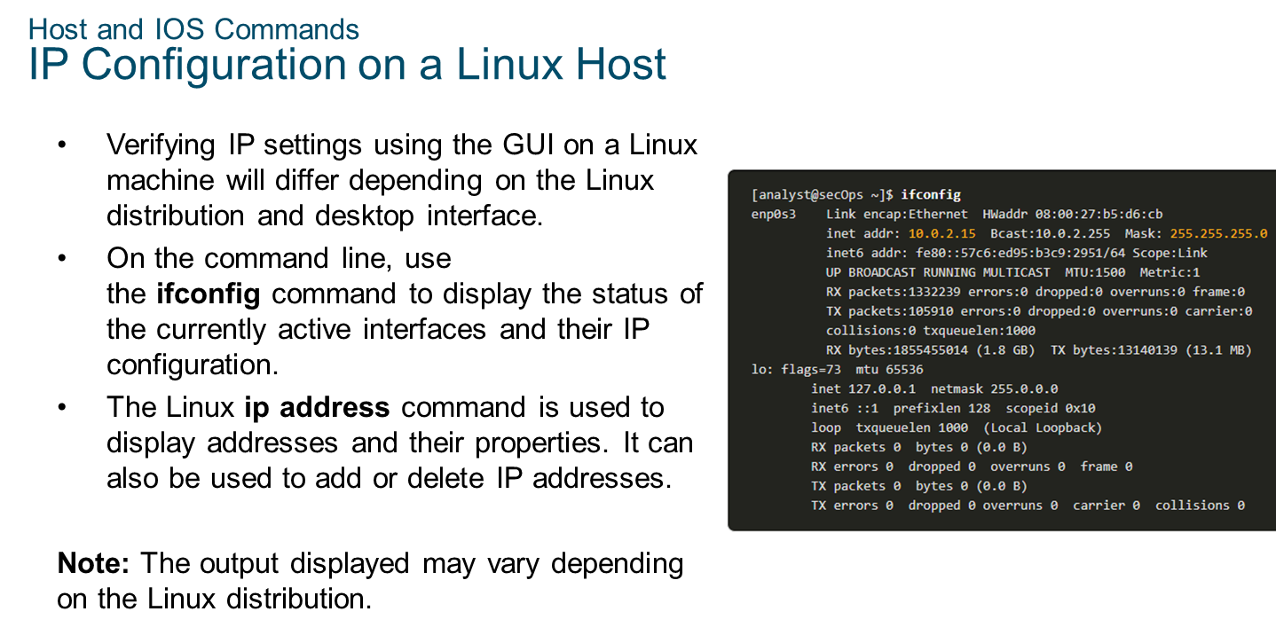
Chapter
10
Host and IOS Commands

Slide 26
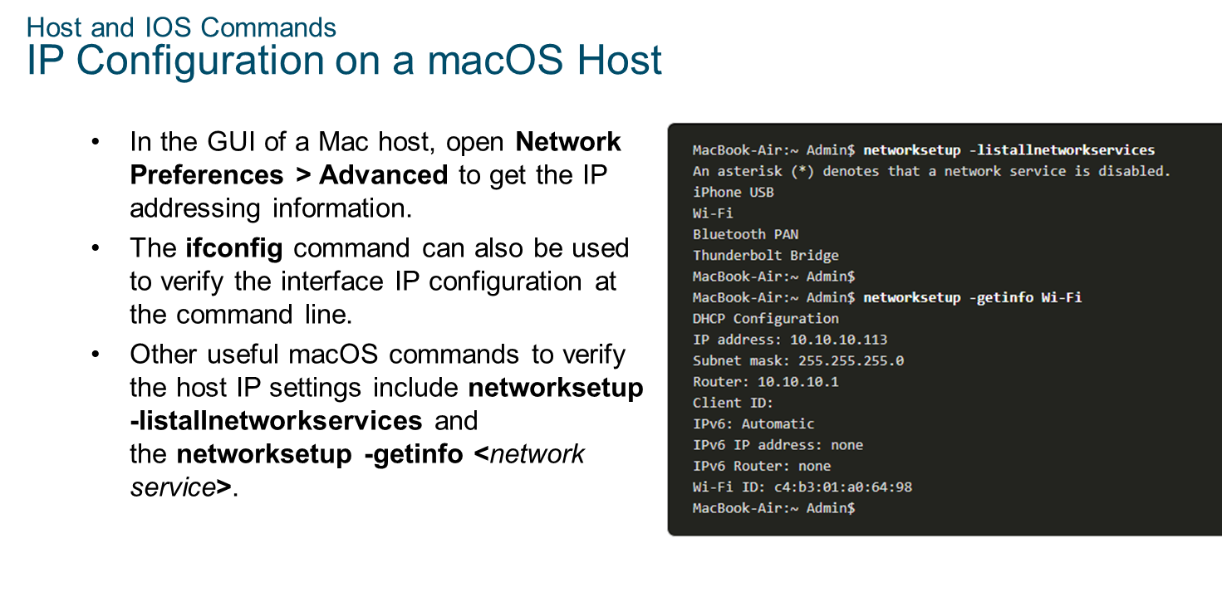
Chapter
10
Host and IOS Commands

Slide 27
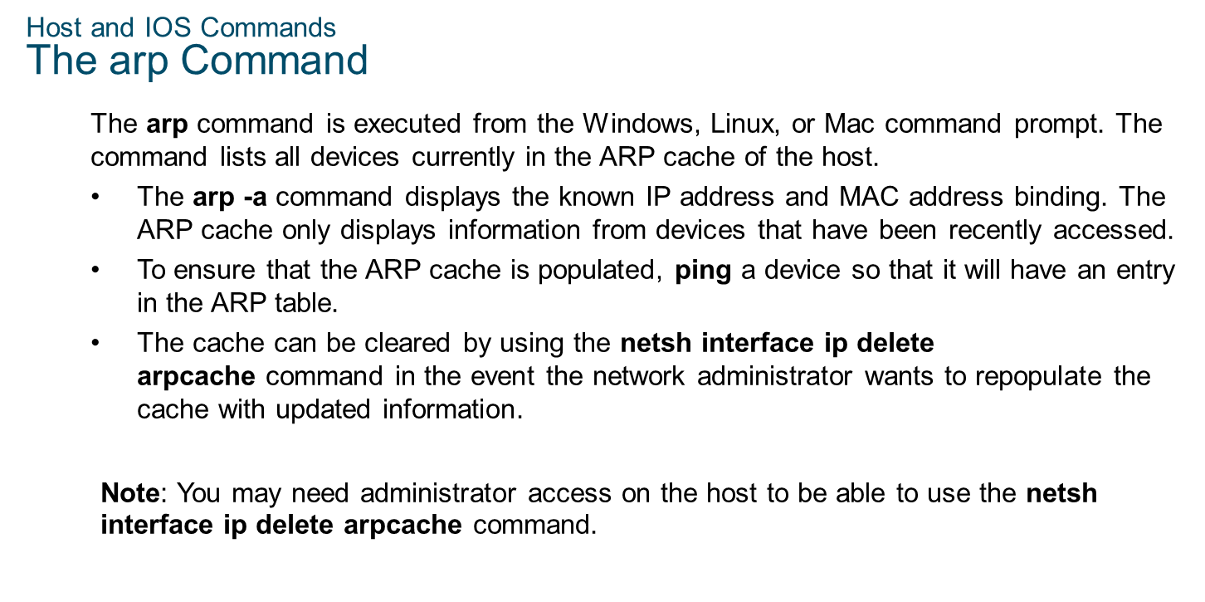
Chapter
10
Host and IOS Commands

Slide 28
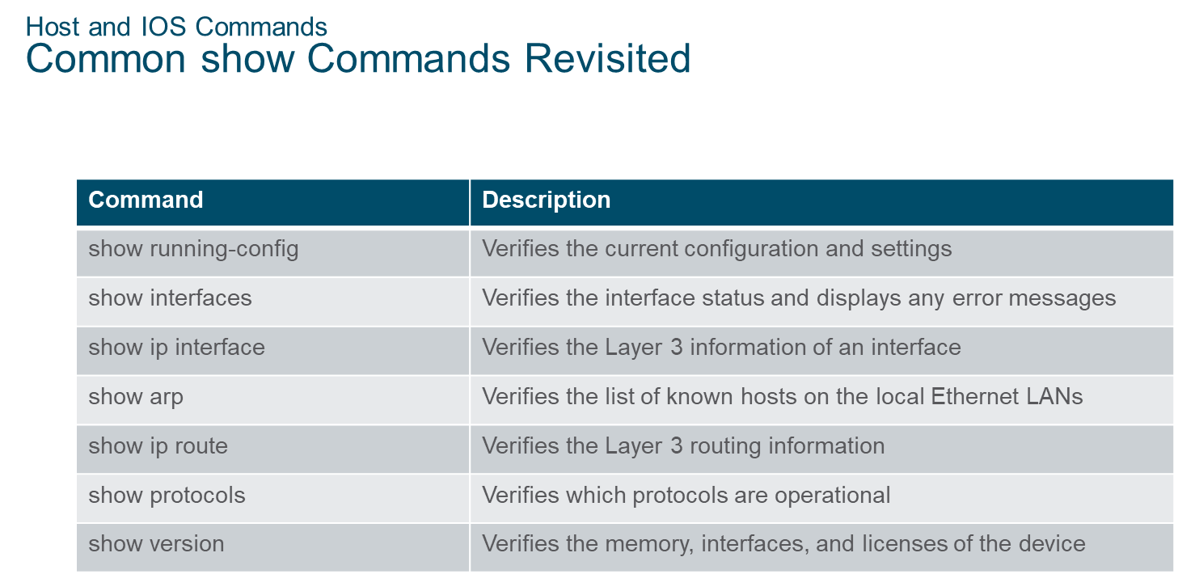
Chapter
10
Host and IOS Commands

Slide 29
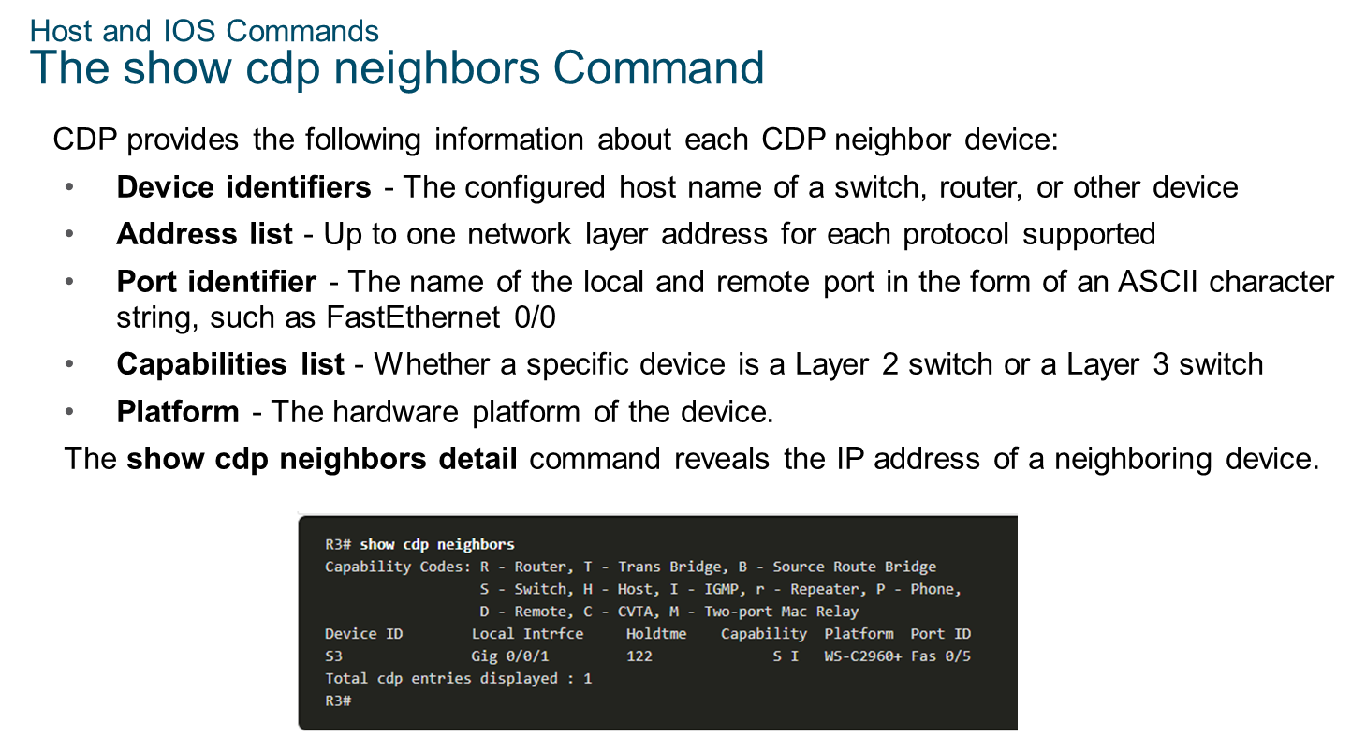
Chapter
10
Host and IOS Commands

Slide 30
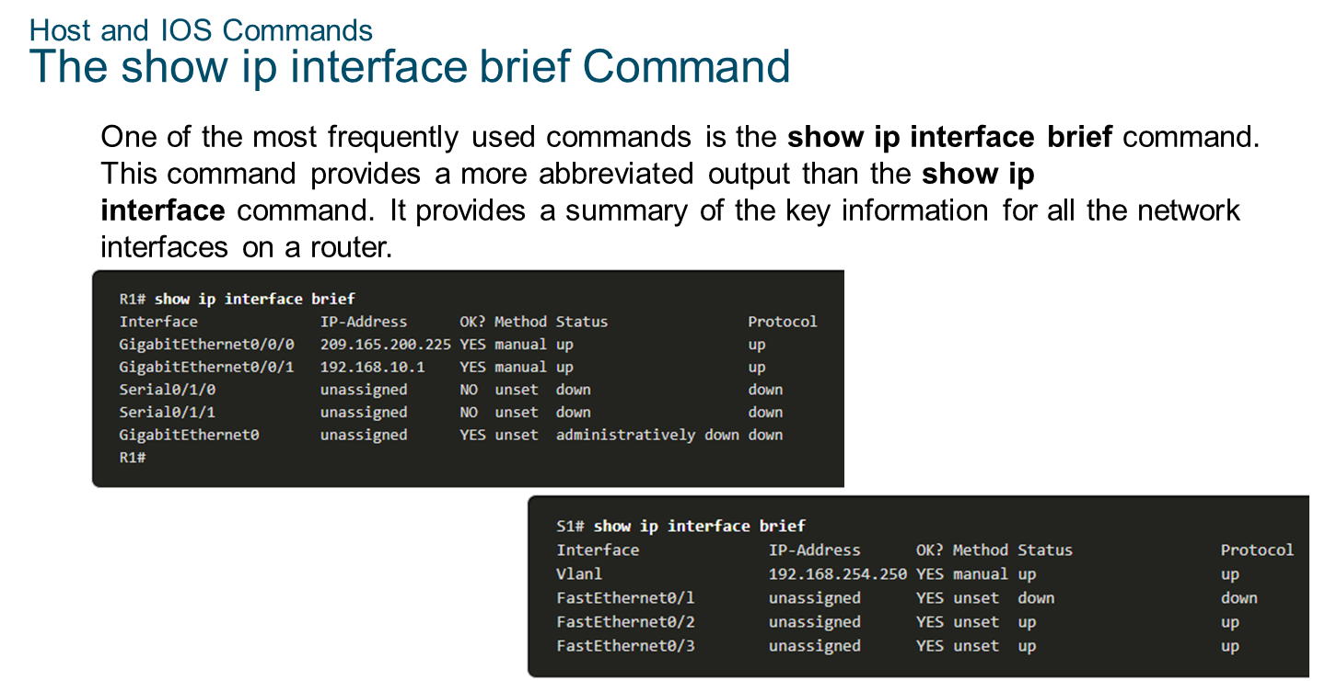
Chapter
10
Host and IOS Commands

Slide 31
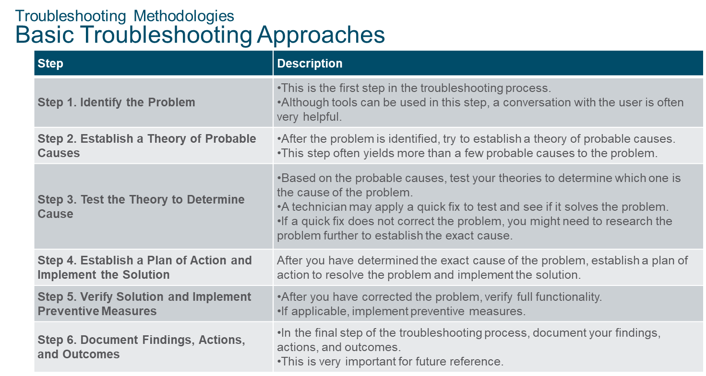
Chapter
10
Troubleshooting Methodologies

Slide 32
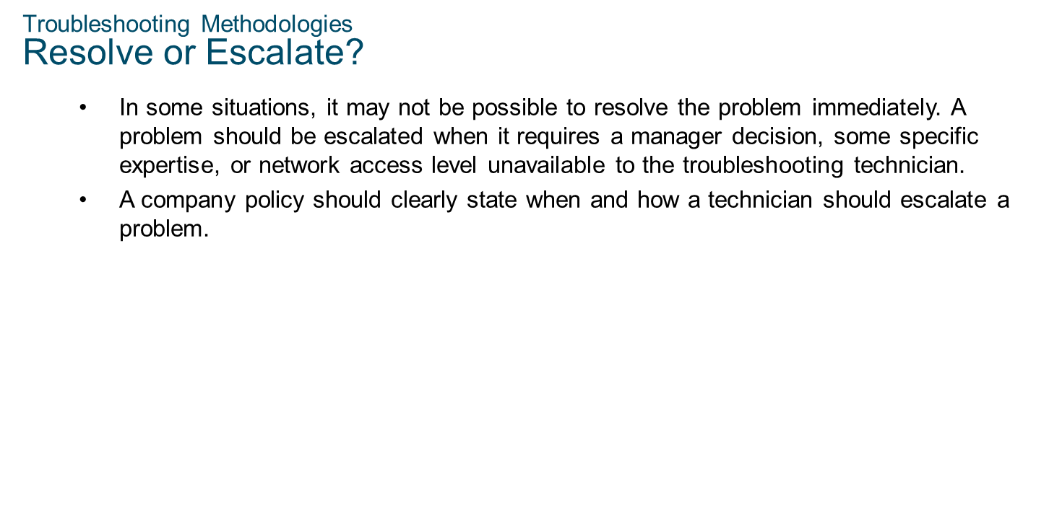
Chapter
10
Troubleshooting Methodologies

Slide 33
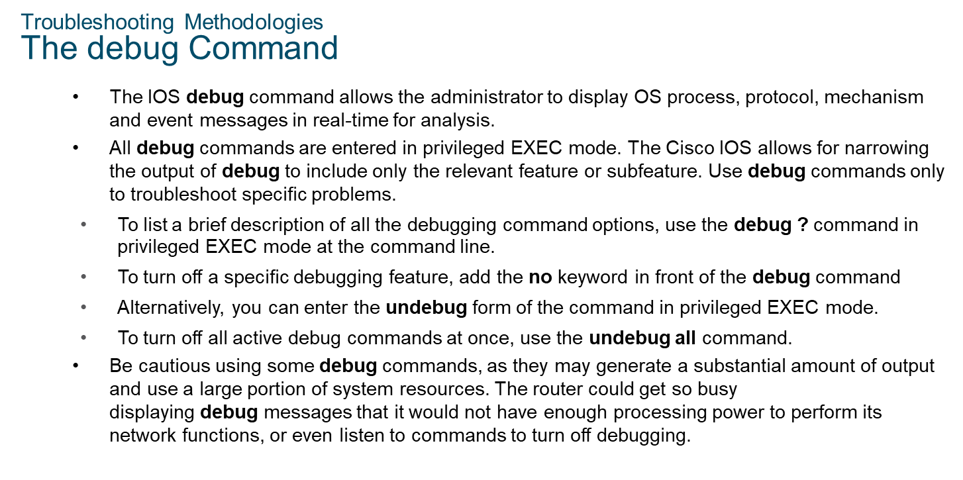
Chapter
10
Troubleshooting Methodologies

Slide 34
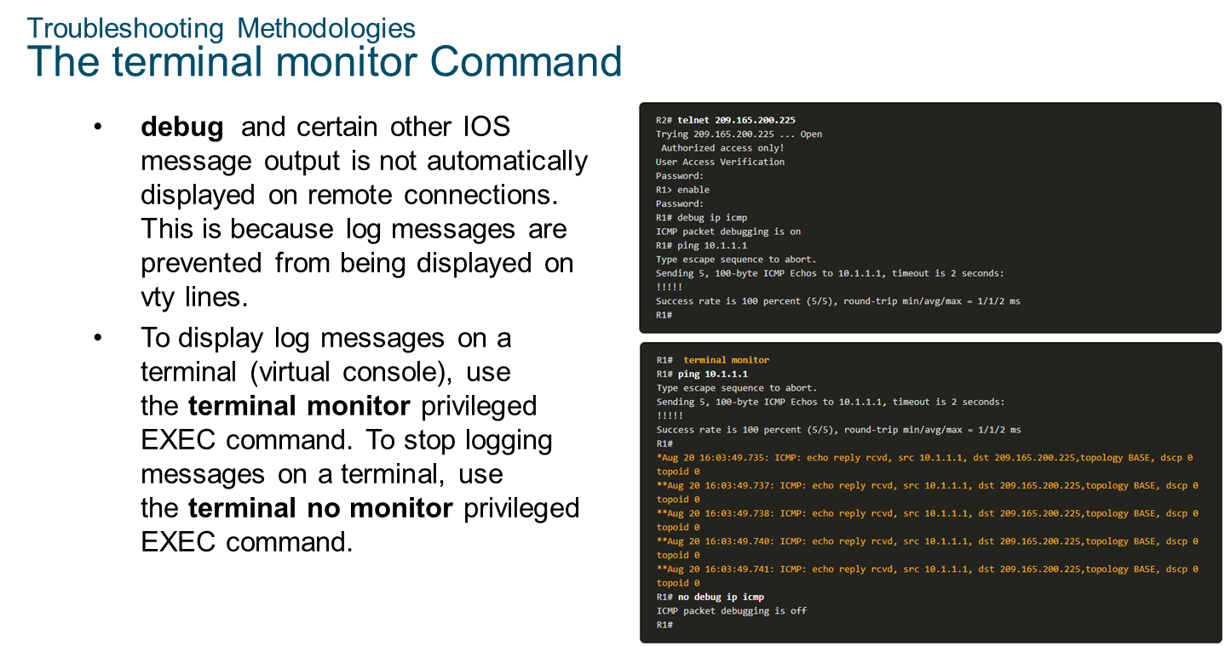
Chapter
10
Troubleshooting Methodologies

Slide 35
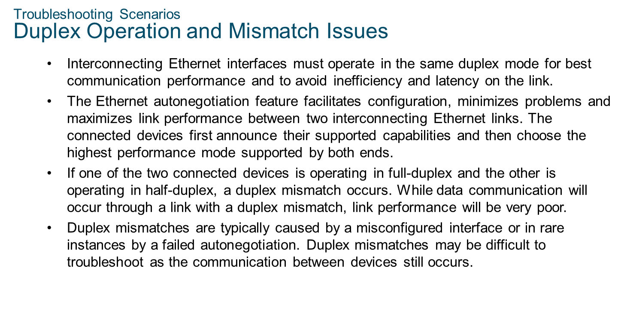
Chapter
10
Troubleshooting Scenarios

Slide 36
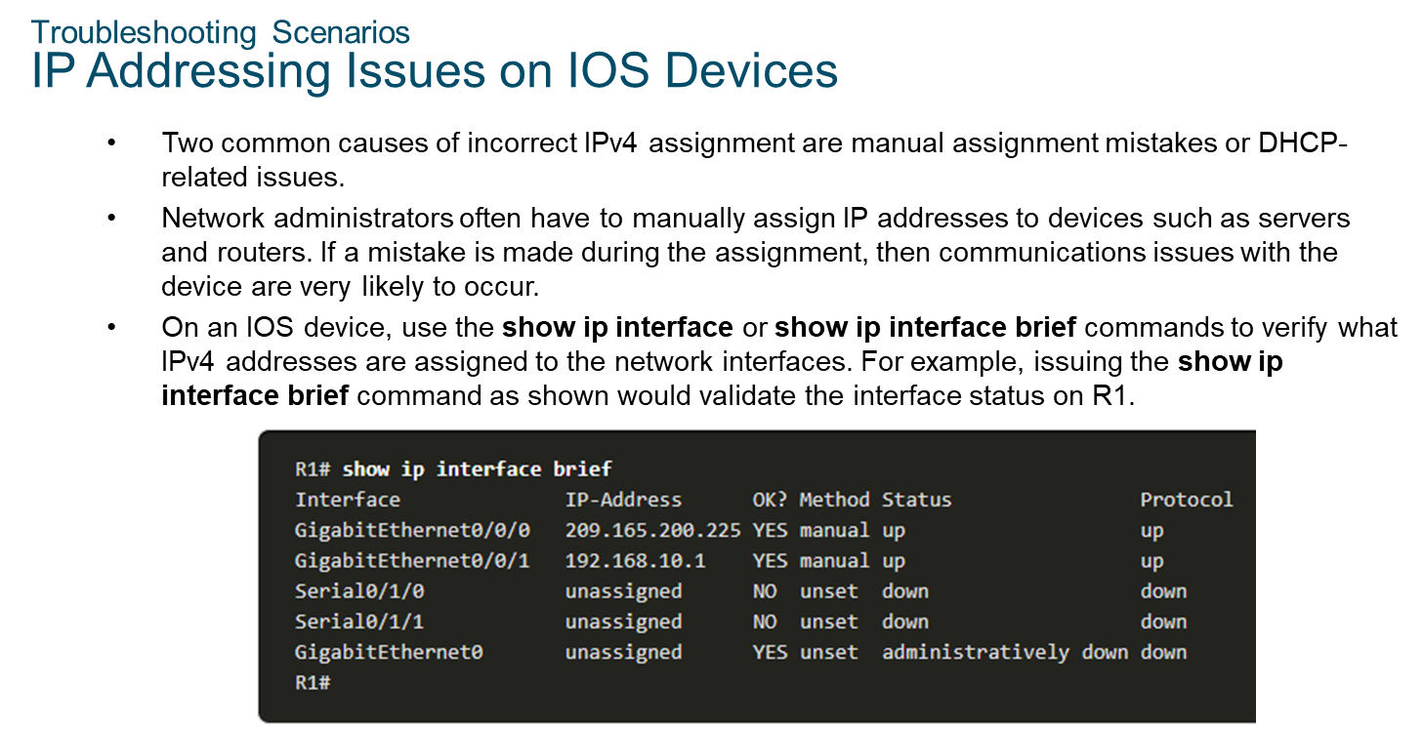
Chapter
10
Troubleshooting Scenarios

Slide 37
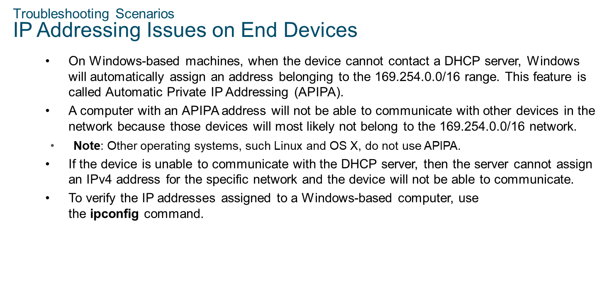
Chapter
10
Troubleshooting Scenarios

Slide 38
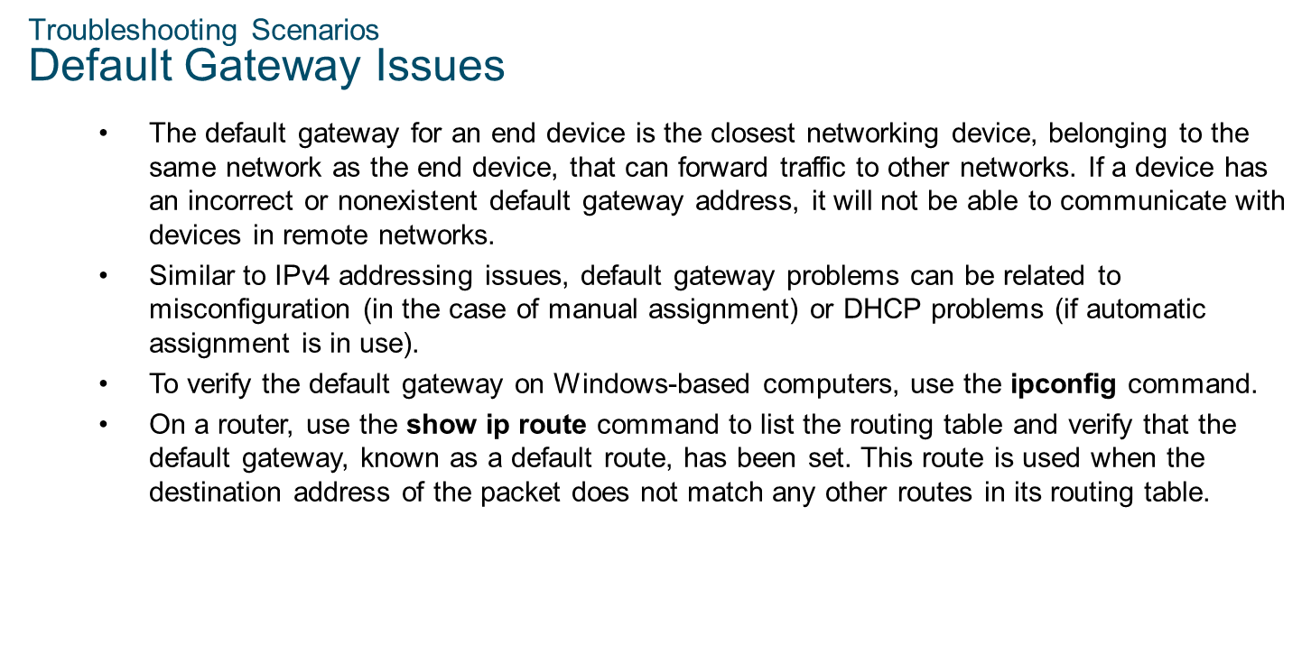
Chapter
10
Troubleshooting Scenarios

Slide 39
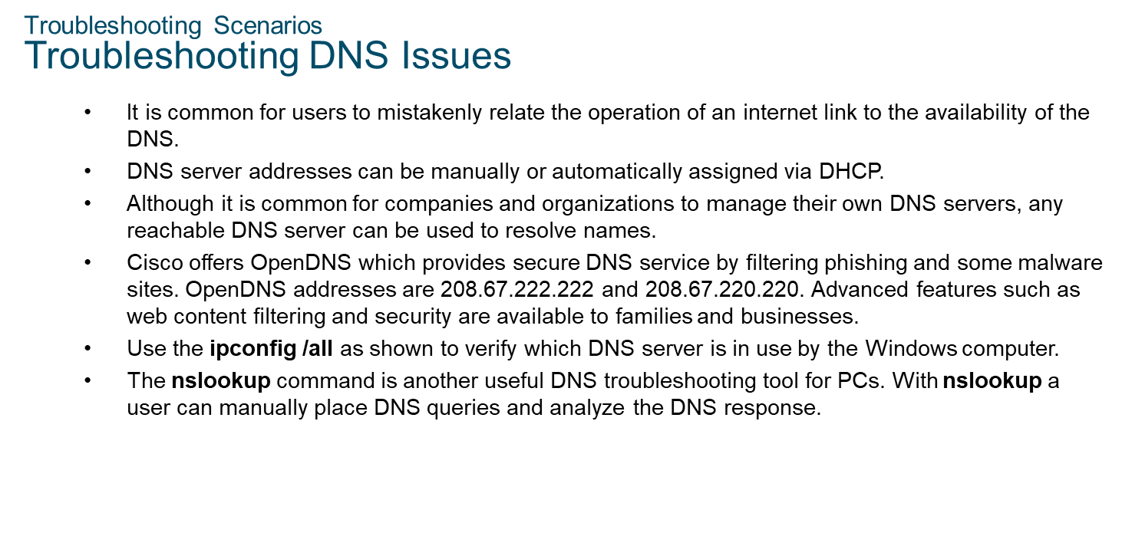
Chapter
10
Troubleshooting Scenarios

Slide 40
Chapter
Cisco 8000 Series: AI-Ready WAN & Core Routers
10
Positioning
Flagship routing platform for service providers & large enterprises
Designed for the AI-era internet backbone & cloud WANs
Key Enhancements (2025 Update)
3× throughput improvement
Deep integration of SD-WAN, SASE, NGFW
Native support for quantum-resistant cryptography
High-density 400G & 800G routing
Use Cases
Core backbone
Data-center interconnect (DCI)
Cloud providers & telcos

Slide 41
Chapter
Cisco Silicon One: The Core Technology
10
Why Silicon One Is Critical Now
Unified architecture across routers & switches
Helps Cisco eliminate multiple ASIC families
Built for AI fabrics & hyperscale cloud
2025 Silicon Updates
P200 (used in 8223 Router)
Q200 (used in Catalyst 9500X)
Dramatic improvements in:
  Watts per Gbps
  Latency
  Scalability

Slide 42
Chapter
Modern Cisco AI-Ready Data Center
10
Spine Layer
Nexus 9364E-SG2
  800G performance
  EVPN-VXLAN fabric core
  Ultra-low latency
Leaf Layer
Nexus 9300 series
  Connects compute, storage, and AI nodes
Connected Devices
GPU / AI Clusters
Compute Servers
Storage Arrays

Slide 43
Chapter
Cisco SD-WAN + SASE (2025)
10
New Capabilities
AI-powered traffic prediction
Zero-trust network segmentation
Native CASB + firewall integration
Stronger cloud-security tie-ins with Cisco Umbrella
Improved WAN Optimization
30–40% better application throughput
Encrypted analytics for visibility without decryption

Slide 44
Chapter
Security Enhancements in Latest Cisco Devices
10
Integrated Security Engines
NGFW
IPS/IDS
Encrypted traffic analytics (ETA)
AI-behavior inspection
Quantum-Ready Security
PQC (post-quantum cryptography)
Crypto-agile architecture

Slide 45
Chapter
Deployment Recommendations
10
Small / Medium Enterprises
Catalyst 9300 / 9400
Meraki MX / MS (cloud-managed)
Large Campuses
Catalyst 9500X
Catalyst 9600
Hyperscale / AI Data Centers
Nexus 9364E-SG2
Cisco 8223 Router
Cisco 8000 Series Backbone

Slide 46
Chapter
Conclusion
10
Cisco’s 2025 portfolio focuses on:
  AI-optimized networking
  High-density 800G fabrics
  Secure WAN & SASE integration
  Unified ASIC architecture (Silicon One)
The newest devices (8223 Router, Nexus 9364E-SG2, Catalyst 9600/9500X) offer massive scalability and future-proofing.

Slide 47



Thank You

