Slide 1





Lecture: #04
Malware and Countermeasures in OS
Dr. Hesham Abou Elfetouh
Cybersecurity Department
Faculty of Informatics
Midocean University
Secure Operating Systems (CYB610)
www.midocean.ae

Slide 2
Chapter
Outline
04
    This chapter covers the following topics and concepts
Types of Malware
Relocation
Base/Bounds Registers
Buffer Overflows
Cross Site Scripting (XSS) Attacks
Validating Input Syntax
2
www.midocean.ae
Secure Operating Systems

Slide 3
Chapter
Introduction
04
In Previous Lecture you learned:
Operating System Functions
Operating system Security attack types
Principles of Secure OS Design
Protecting an OS from Malicious Software
Memory and Address Protection
Linux Security
3
www.midocean.ae
Secure Operating Systems

Slide 4
Chapter
CHAPTER 4 GOALS
04
When you complete this chapter, you will be able to:
Define the difference between types of Malware
Explain the Virus Effects
Determine the Virus Signatures
Build a Protected Memory and Address
Explain what is the memory corruption defenses
How to validating input syntax
4
www.midocean.ae
Secure Operating Systems

Slide 5
Chapter
Operating system Security attack types
04
Malware Attack:
A generic term for software that has a malicious purpose
Is software that is intentionally included or inserted in a system for a harmful purpose.
Different forms of malicious software (malware) Intended to
Cause distress to a user
Damage files or systems
Disrupt ordinary computer and network functions
Examples
Viruses, worms
Logic bomb
Trojan horses
Spy-wares
New ones: Spam/scam, Slammer, Nimda, e-payment frauds, etc...
5
www.midocean.ae
Secure Operating Systems

Slide 6
Chapter
Types of Malware
04
Name | Description
Virus | Attaches itself to a program and propagates copies of itself to other programs
Worm | Program that propagates copies of itself to other computers
Logic bomb | Triggers action when condition occurs
Trojan horse | Program that contains unexpected additional functionality
Backdoor (trapdoor) | is a secret entry point into a program that allows someone that is aware of the backdoor to gain access without going through the usual security access procedures.
Auto-rooter | Malicious hacker tools used to break into new machines remotely
Kit (virus generator) | Set of tools for generating new viruses automatically
Spammer programs | Used to send large volumes of unwanted e-mail
Flooders | Used to attack networked computer systems with a large volume of traffic to carry out a denial of service (DoS) attack
Keyloggers | Captures keystrokes on a compromised system
Zombie | Program activated on an infected machine that is activated to launch attacks on other machines
Rootkit | Set of hacker tools used after attacker has broken into a computer system and gained root-level access
6
www.midocean.ae
Secure Operating Systems

Slide 7
Chapter
Types of Malware (cont.)
04
Code Type | Characteristics
Rabbit | Code that replicates itself without limit to exhaust resources
Time bomb | Code that triggers action when a predetermined time occurs
Dropper | Transfer agent code only to drop other malicious code, such as virus or Trojan horse
Hostile mobile code agent | Code communicated semi-autonomously by programs transmitted through the web
Script attack, JavaScript, Active code attack | Malicious code communicated in JavaScript, ActiveX, or another scripting language, downloaded as part of displaying a web page
7
www.midocean.ae
Secure Operating Systems

Slide 8
Chapter
Types of Malware (cont.)
04
Code Type | Characteristics
RAT (remote access Trojan) | Trojan horse that, once planted, gives access from remote location
Bot | Semi-autonomous agent, under control of a (usually remote) controller or “herder”; not necessarily malicious
Browser hijacker | Code that changes browser settings, disallows access to certain sites, or redirects browser to others
Tool or toolkit | Program containing a set of tests for vulnerabilities; not dangerous itself, but each successful test identifies a vulnerable host that can be attacked
Scareware | Not code; false warning of malicious code attack
8
www.midocean.ae
Secure Operating Systems

Slide 9
Chapter
Malware attacks…
04
Infection mechanisms
  First, the virus should search for and detect objects to infect
  Installation into the infectable object
    Writing on the boot sector
    Add some code to executable programs
    Add some code to initialization/auto-executable programs
Trigger mechanism
  Date
  Number of infections
  First use
Effects: It can be anything
  A message
  Deleting files
  Formatting disk
  Overloading processor/memory
  Etc.
9
www.midocean.ae
Secure Operating Systems

Slide 10
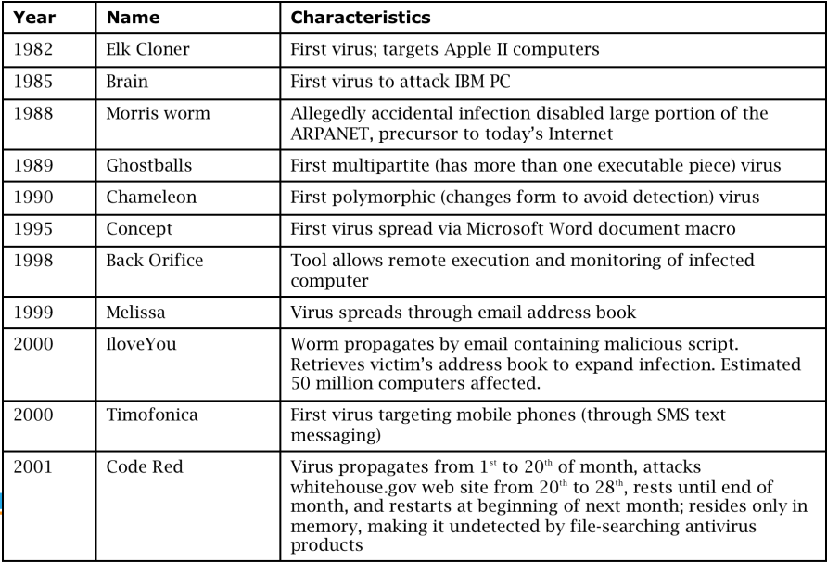
Chapter
History of Malware
04
10
www.midocean.ae
Secure Operating Systems
Notes:
A buffer overflow attack is a common cyberattack that deliberately exploits a buffer overflow vulnerability where user-controlled data is written to memory. By submitting more data than can fit in the allocated memory block, the attacker can overwrite data in other parts of memory.

Slide 11
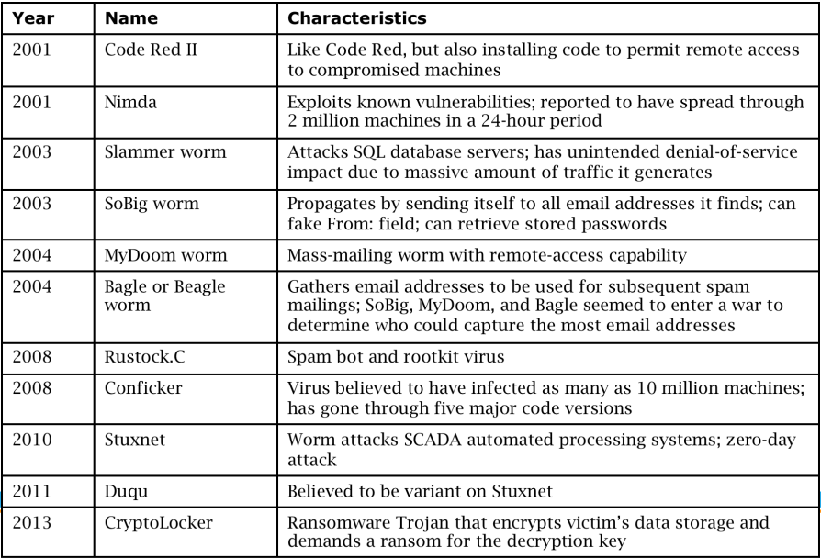
Chapter
History of Malware (cont.)
04
11
www.midocean.ae
Secure Operating Systems

Slide 12
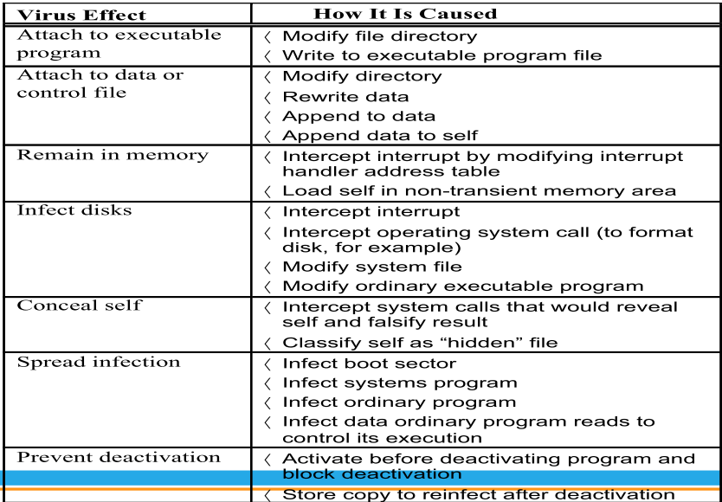
Chapter
Virus Effects
04
12
www.midocean.ae
Secure Operating Systems

Slide 13
Chapter
Countermeasures for Users
04
Use software acquired from reliable sources
Test software in an isolated environment
Only open attachments when you know them to be safe
Treat every website as potentially harmful
Create and maintain backups
13
www.midocean.ae
Secure Operating Systems

Slide 14
Chapter
Virus Detection
04
Virus scanners look for signs of malicious code infection using signatures in program files and memory
Traditional virus scanners have trouble keeping up with new malware—detect about 45% of infections
Detection mechanisms:
Known string patterns in files or memory
Execution patterns
Storage patterns
14
www.midocean.ae
Secure Operating Systems

Slide 15
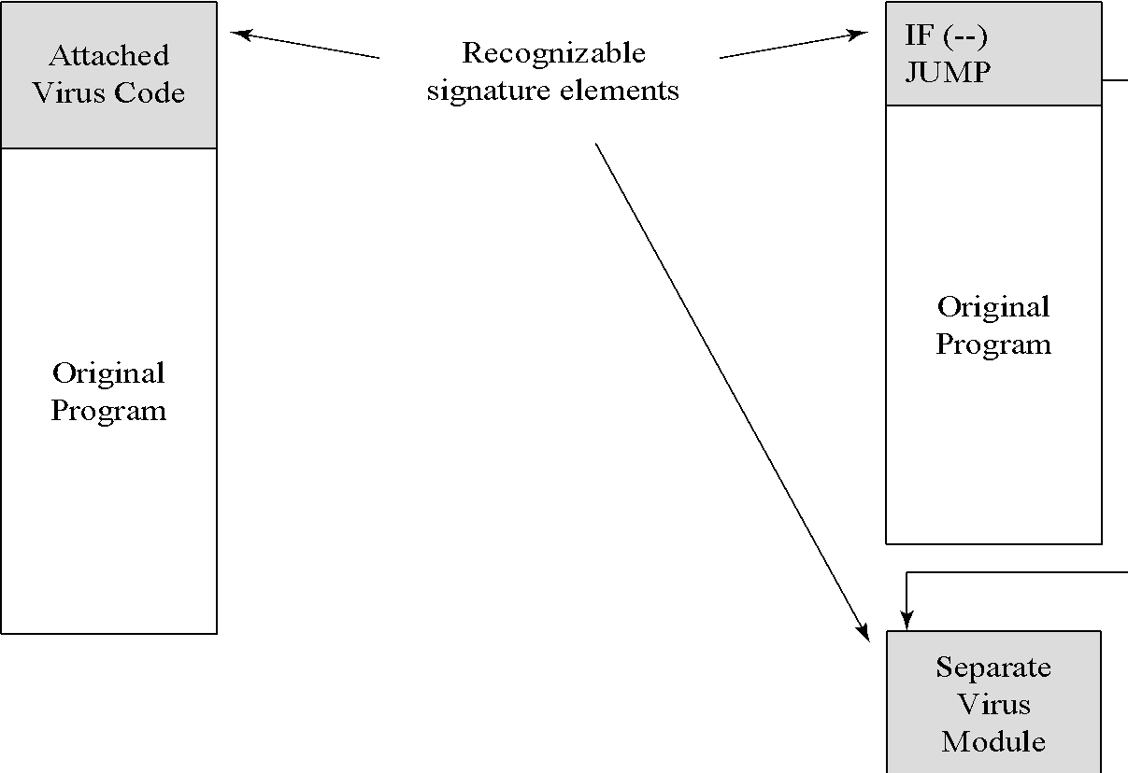
Chapter
Virus Signatures
04
Alternatively known as a virus definition, a virus signature is the fingerprint of a virus. It is a set of unique data, or bits of code, that allows it to be identified. Antivirus software uses a virus signature to find a virus in a computer file system, allowing to detect, quarantine, and remove the virus. In the antivirus software, the virus signature is called a definition file or DAT file.
15
www.midocean.ae
Secure Operating Systems

Slide 16
Chapter
Memory and Address Protection
04
The most obvious problem of multiprogramming is preventing one program from affecting the data and programs in the memory space of other users.
Fence
Relocation
Base/Bounds Registers
Tagged Architecture
Segmentation
Paging
Combined Paging with Segmentation
16
www.midocean.ae
Secure Operating Systems

Slide 17
Chapter
Relocation
04
Is the process of taking a program written as if it began at address 0 and changing all addresses to reflect the actual address at which the program is located in memory.
By adding a constant relocation factor to each address of the program.
The relocation factor is the starting address of the memory assigned for the program.
17
www.midocean.ae
Secure Operating Systems

Slide 18
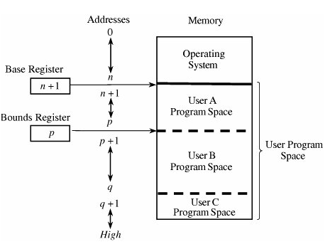
Chapter
Base/Bounds Registers
04
18
www.midocean.ae
Secure Operating Systems

Slide 19
Chapter
Base/Bounds Registers(cont.)
04
  By previous methods with two or more users, none can know in advance where a program will be loaded for execution.
  The relocation register solves the problem by providing a base or starting address.
  All addresses inside a program are offsets from that base address.
  A variable fence register is generally known as a base register.
19
www.midocean.ae
Secure Operating Systems

Slide 20
Chapter
Base/Bounds Registers(cont.)
04
Context Switch
When execution changes from one user's program to another's, the operating system must change the contents of the base and bounds registers to reflect the true address space for that user.
This change is part of the general preparation, called a context switch.
Erroneous addresses inside a user's address space can still affect that program because the base/bounds checking guarantees only that each address is inside the user's address space.
20
www.midocean.ae
Secure Operating Systems

Slide 21
Chapter
Base/Bounds Registers(cont.)
04
For example, a user error might occur when a subscript is out of range or an undefined variable generates an address reference within the user's space but, unfortunately, inside the executable instructions of the user's program.
We can solve this overwriting problem by using another pair of base/bounds registers, one for the instructions (code) of the program and a second for the data space.
21
www.midocean.ae
Secure Operating Systems

Slide 22
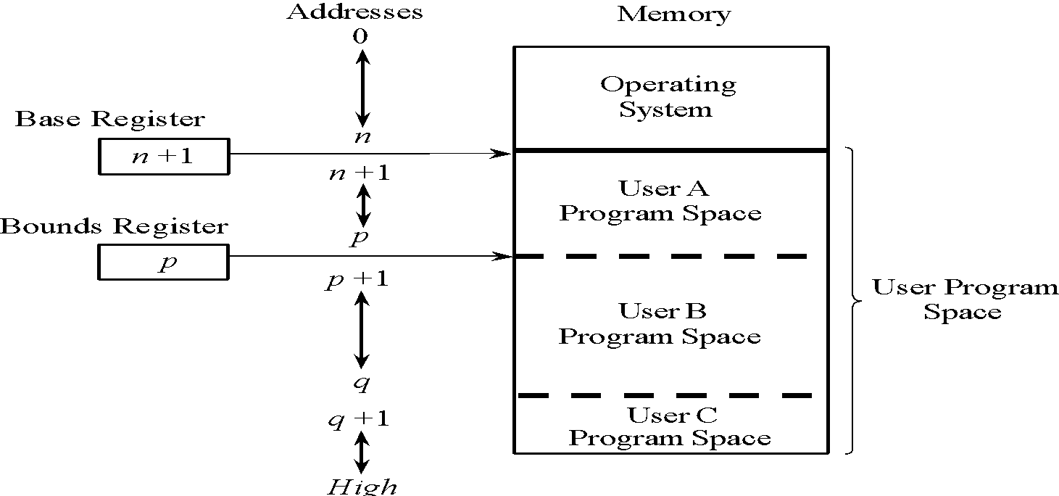
Chapter
Two Base/Bounds Registers
04
22
www.midocean.ae
Secure Operating Systems

Slide 23
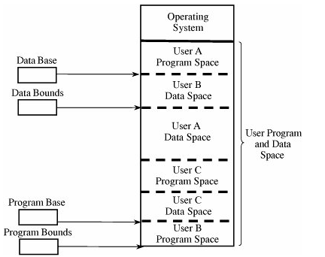
Chapter
Two Base/Bounds Registers
04
23
www.midocean.ae
Secure Operating Systems

Slide 24
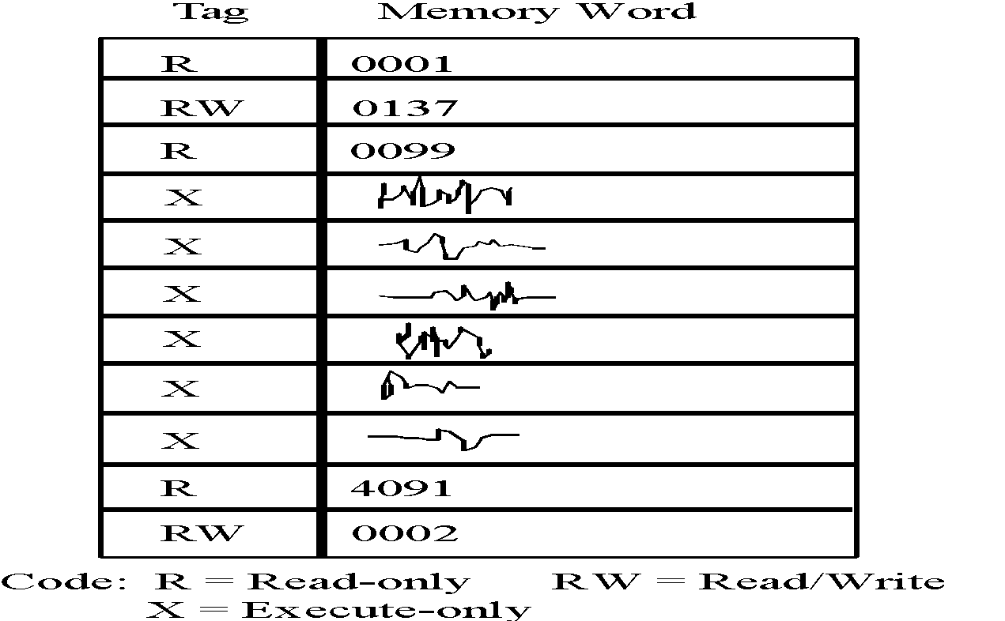
Chapter
Tagged Architecture
04
24
www.midocean.ae
Secure Operating Systems

Slide 25
Chapter
Overwriting Memory for Execution
04
Overwrite the program counter stored in the stack
Overwrite part of the code in low memory, substituting new instructions
Overwrite the program counter and data in the stack so that the program counter points to the stack
25
www.midocean.ae
Secure Operating Systems

Slide 26
Chapter
Harm from Buffer Overflows
04
Overwrite:
Another piece of your program’s data
An instruction in your program
Data or code belonging to another program
Data or code belonging to the operating system
Overwriting a program’s instructions gives attackers that program’s execution privileges
Overwriting operating system instructions gives attackers the operating system’s execution privileges
26
www.midocean.ae
Secure Operating Systems

Slide 27
Chapter
Overflow Countermeasures
04
Staying within bounds
Check lengths before writing
Confirm that array subscripts are within limits
Double-check boundary condition code for off-by-one errors
Limit input to the number of acceptable characters
Limit programs’ privileges to reduce potential harm
Many languages have overflow protections
Code analyzers can identify many overflow vulnerabilities
27
www.midocean.ae
Secure Operating Systems

Slide 28
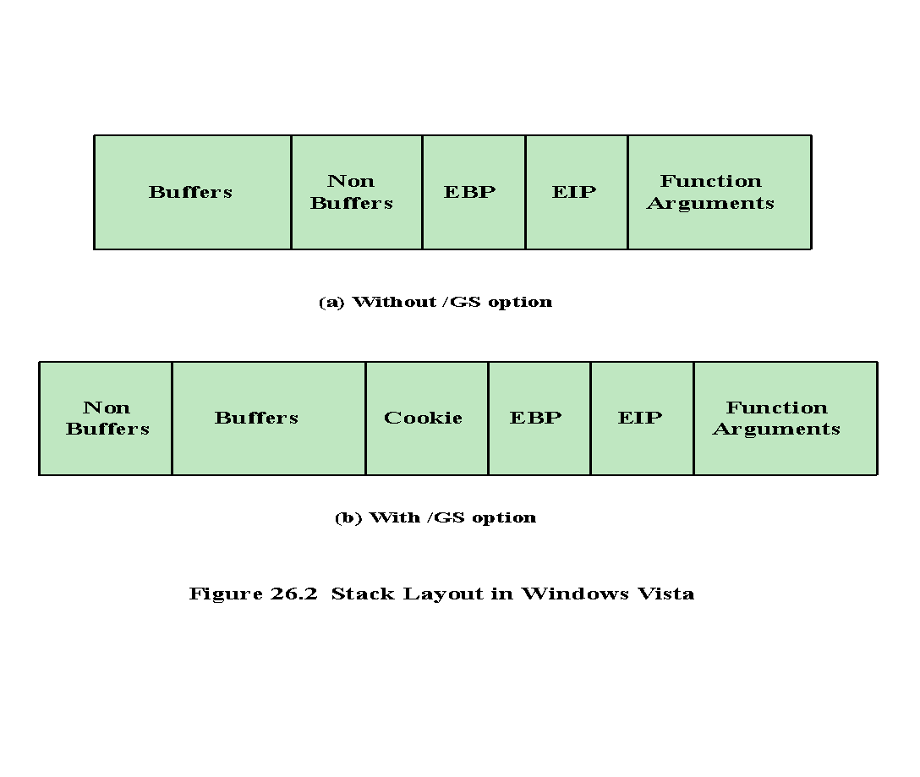
Chapter
Memory Corruption Defenses
04
Normally a function’s stack looks like the Figure
Note the stacks EBP (extended base pointer) and EIP (extended instruction pointer). When the function returns, it must continue execution at the next instruction after the instruction that called this function.
The CPU does this by taking the values off stack & populating the EBP & EIP registers.
If the attacker can overflow the buffer on the stack, they can overrun the data used to populate the EBP & EIP registers with values & change the application’s execution flow.
28
www.midocean.ae
Secure Operating Systems

Slide 29
Chapter
Memory Corruption Defenses
04
A cookie has been inserted between stack data and function return address. This random value is checked when the function exits, and if the cookie is corrupted, the application is halted.
Buffers on the stack are placed in higher memory than no buffers, such as function pointers, and scalar values to make it harder for some attacks to succeed.
By switching the order around, the attacker must take advantage of a buffer underrun, which is rarer, to successfully corrupt the function pointer. There are variants of the buffer overrun that will still corrupt a function pointer, such as corrupting a stack frame in higher memory.
29
www.midocean.ae
Secure Operating Systems

Slide 30
Chapter
Prevention Strategies
04
The 2010 Australian Signals Directorate (ASD) lists the “Top 35 Mitigation Strategies”.
Note: implementing just the top four of these strategies would have prevented at least 85% of the targeted cyber intrusions investigated by ASD
The top four strategies for prevention are:
White-list approved applications
Patch third-party applications and operating system vulnerabilities
Restrict administrative privileges
Create a defense-in-depth system
30
www.midocean.ae
Secure Operating Systems

Slide 31
Chapter
Prevention Strategies (cont.)
04
  Possible for a system to be compromised during the installation process before it can install the latest patches
  Building and deploying a system should be a planned process designed to counter this threat
  Process must:
  Assess risks and plan the system deployment
  Secure the underlying OS and then the key applications
  Ensure any critical content is secured
  Ensure appropriate network protection mechanisms are used
  Ensure appropriate processes used to maintain security
31
www.midocean.ae
Secure Operating Systems

Slide 32
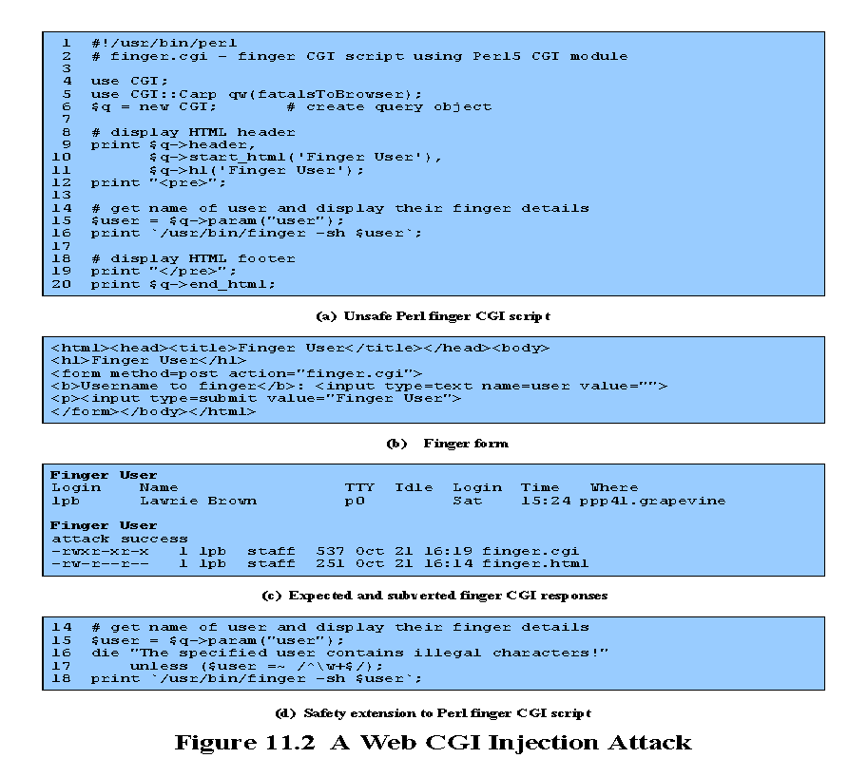
Chapter
04
Injection Attacks
Most often occur in scripting languages
  Flaws relating to invalid handling of input data, specifically when program input data can accidentally or deliberately influence the flow of execution of the program
  This script contains a critical vulnerability.
  The value of the user is passed directly to the finger program as a parameter.
  If the identifier of a legitimate user is supplied, for example, lpb, then the output will be the information on that user.
  The attacker is able to run any program on the system with the privileges of the Web server.
  Encourage reuse of other programs and system utilities where possible to save coding effort
32
www.midocean.ae
Secure Operating Systems

Slide 33
Chapter
Cross Site Scripting (XSS) Attacks
04
Another broad class of vulnerabilities concerns inputs provided to a program by one user that is subsequently output to another user. Such attacks are known as cross-site scripting (XSS) attacks because they are most commonly seen in scripted Web applications. This vulnerability involves the inclusion of script code in the HTML content of a Web page displayed by a user’s browser
Cross-site scripting attacks exploit this assumption and attempt to bypass the browser’s security checks to gain elevated access privileges to sensitive data belonging to another site. These data can include page contents, session cookies, and a variety of other objects.
The attacker includes the malicious script content in data supplied to a site. If this content is subsequently displayed to other users without sufficient checking, they will execute the script assuming it is trusted to access any data associated with that site.
Consider the widespread use of guestbook allowing comments, which are subsequently viewed by other users. Unless the contents of these comments are checked and any dangerous code removed, the attack is possible.
33
www.midocean.ae
Secure Operating Systems
Notes:
إنفاذ تقاسم المواردللحفاظ على النزاهة والاتساق (القسم النقدي)

Slide 34
Chapter
Cross Site Scripting (XSS) Attacks
04
Attacks where input provided by one user is subsequently output to another user
Commonly seen in scripted Web applications
  Vulnerability involves the inclusion of script code in the HTML content
  Script code may need to access data associated with other pages
  Browsers impose security checks and restrict data access to pages originating from the same site
Exploit assumption that all content from one site is equally trusted and hence is permitted to interact with other content from the site
XSS reflection vulnerability
  Attacker includes the malicious script content in data supplied to a site
34
www.midocean.ae
Secure Operating Systems
Notes:
إنفاذ تقاسم المواردللحفاظ على النزاهة والاتساق (القسم النقدي)

Slide 35
Chapter
Validating Input Syntax
04
  Given that the programmer cannot control the content of input data, it is necessary to ensure that such data conform with any assumptions made about the data before subsequent use. If the data are textual, these assumptions may be that the data contain only printable characters, have certain HTML markup, are the name of a person, a user-id, an e-mail address, a filename, and/or a URL.
  Alternatively, the data might represent an integer or other numeric value. A program using such input should confirm that it meets these assumptions. An important principle is that input data should be compared against what is wanted, accepting only valid input. The alternative is to compare the input data with known dangerous values.
  The problem with this approach is that new problems and methods of bypassing existing checks continue to be discovered. By trying to block known dangerous input data, an attacker using a new encoding may succeed. By only accepting known safe data, the program is more likely to remain secure.
  This type of comparison is commonly done using regular expressions. It may be explicitly coded by the programmer or may be implicitly included in a supplied input processing routine. A regular expression is a pattern composed of a sequence of characters that describe allowable input variants. An appropriate reference should be consulted for the language in use.
  If the input data fail the comparison, they could be rejected. In this case a suitable error message should be sent to the source of the input to allow it to be corrected and reentered. Alternatively, the data may be altered to conform.
35
www.midocean.ae
Secure Operating Systems
Notes:
Discretionary Access Control
التحكم في الوصول التقديرية
Accountability and Audit
المسألة والتطبيق والمراجعة

Slide 36
Chapter
Validating Input Syntax
04
It is necessary to ensure that data conform with any assumptions made about the data before subsequent use
Input data should be compared against what is wanted
Alternative is to compare the input data with known dangerous values
By only accepting known safe data the program is more likely to remain secure
36
www.midocean.ae
Secure Operating Systems

Slide 37
Chapter
Alternate Encodings
04
The issue of multiple, alternative encodings of the input data could occur because the data are encoded in HTML or some other structured encoding that allows multiple representations of characters.
Growing requirement to support users around the globe, The Unicode character set is now widely used for this purpose. It is the native character set used in the Java language, for example. It is also the native character set used by operating systems such as Windows XP and later.
A Unicode character can be encoded to accommodate many programs, databases, and other computer and communications applications. Any specific character is supposed to have a unique encoding.
Consider the consequences of multiple encodings when validating input. There is a class of attacks that attempt to supply an absolute pathname for a file to a script that expects only a simple local filename. The common check to prevent this is to ensure that the supplied filename does not start with “/” and does not contain any “../” parent directory references.
If this check only assumes the correct, encoding of slash, then an attacker using one of the longer encodings could avoid this check.
37
www.midocean.ae
Secure Operating Systems

Slide 38
Chapter
Alternate Encodings
04
May have multiple means of encoding text
Growing requirement to support users around the globe and to interact with them using their own languages
Unicode used for internationalization
  Many Unicode decoders accept any valid equivalent sequence
Canonicalization
  Transforming input data into a single, standard, minimal representation
  Once this is done the input data can be compared with a single representation of acceptable input values
38
www.midocean.ae
Secure Operating Systems

Slide 39
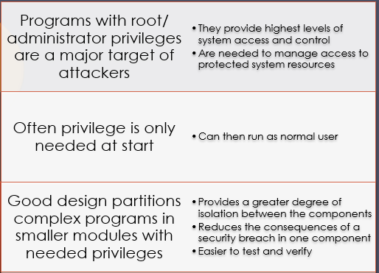
Chapter
Vulnerable Compiled Programs
04
Programs can be vulnerable to PATH variable manipulation
  Must reset to “safe” values
If dynamically linked may be vulnerable to manipulation of LD_LIBRARY_PATH
  Used to locate suitable dynamic library
  Must either statically link privileged programs or prevent use of this variable
Use of Least Privilege
Privilege escalation
  Exploit of flaws may give attacker greater privileges
Least privilege
  Run programs with least privilege needed to complete their function
Determine appropriate user and group privileges required
  Decide whether to grant extra user or just group privileges
Ensure that privileged program can modify only those files and directories necessary
39
www.midocean.ae
Secure Operating Systems

Slide 40
Chapter
Safe Temporary Files
04
Many programs use temporary files. Often in common, shared system area
Must be unique, not accessed by others
Commonly create name using process ID
  Unique, but predictable
  Attacker might guess and attempt to create own file between program checking and creating
Secure temporary file creation/use requires use of random names
Programs may use functionality and services of other programs
  Security vulnerabilities can result unless care is taken with this interaction
    Such issues are of particular concern when the program being used did not adequately identify all the security concerns that might arise
    Occurs with the current trend of providing Web interfaces to programs
    Burden falls on the newer programs to identify and manage any security issues that may arise
Issue of data confidentiality/integrity
Detection and handling of exceptions and errors generated by interaction is also important from a security perspective
40
www.midocean.ae
Secure Operating Systems

Slide 41
Chapter
Summary
04
Types of Malware
Relocation Base/Bounds Registers and Tagged Architecture
The difference between types of Malware
The Virus Effects
The Virus Signatures
Protected Memory and Address
Buffer Overflows
Cross Site Scripting (XSS) Attacks
The memory corruption defenses
Validating input syntax
41
www.midocean.ae
Secure Operating Systems

Slide 42



Thank You

