Slide 1



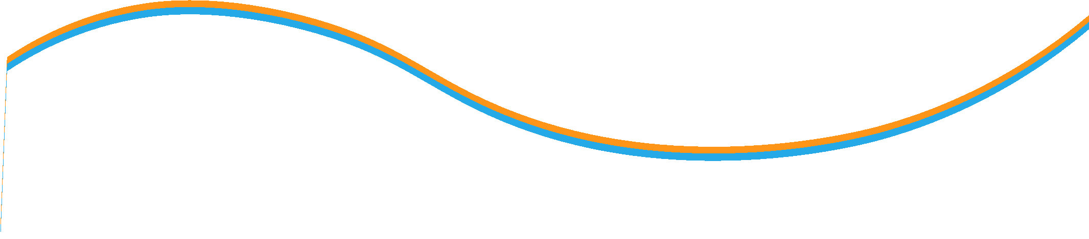

Financial Accounting
Prepared by Dr. Mohamed Hamouda
Lecture 6
Plant Assets, Natural Resources, and Intangibles

Slide 2
Financial Accounting
Prepared by Dr. Mohamed Hamouda
Lecture 6
Plant Assets, Natural Resources, and Intangibles

Slide 3

Financial Accounting
Prepared by Dr. Mohamed Hamouda
Lecture 6
Plant Assets, Natural Resources, and Intangibles

Slide 4
C 1
Plant Assets, Natural Resources, and Intangibles
Notes:
Plant assets are tangible assets that are actively used in the operations of the entity. We fully expect these assets, sometimes referred to as property, plant, and equipment, to benefit more than one accounting period.

Slide 5
Plant Assets
C 1
Tangible in Nature
Actively Used in Operations
Expected to Benefit Future Periods
Called Property, Plant, & Equipment
Notes:
Plant assets are tangible assets that are actively used in the operations of the entity. We fully expect these assets, sometimes referred to as property, plant, and equipment, to benefit more than one accounting period.

Slide 6
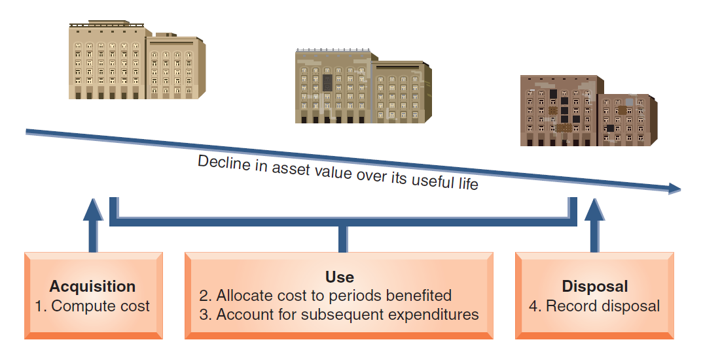
Plant Assets
C 1
Notes:
The four main issues in accounting for plant assets are shown on this screen: (1) computing the costs of plant assets, (2) allocating the costs of most plant assets (less any salvage amounts) against revenues for the periods they benefit, (3) accounting for expenditures such as repairs and improvements to plant assets, and (4) recording the disposal of plant assets.

Slide 7

Cost Determination
C 1
Purchase
price
All expenditures needed to prepare the asset for its intended use
Acquisition
Cost
Acquisition cost excludes financing charges and
cash discounts
Notes:
The cost of a plant asset includes the purchase price as well as all costs necessary to get the asset in place and ready for its intended use. We record the purchase price net of any cash discounts available. We will add freight, unpacking, assembling, installing, and testing costs to the net invoice price to arrive at the final cost.
Finance charges are not included in the cost of an asset. If we elect to finance the purchase over a period of time, the interest cost is charged as an expense when incurred.

Slide 8

Land
C 1
Title insurance premiums
Purchase
price
Delinquent
taxes
Real estate
commissions
Surveying
fees
Title search and transfer fees
Land is not depreciable.
Notes:
Land is not a depreciable plant asset. In addition to the purchase price, there are many costs generally incurred in connection with the acquisition. Many of these costs are related to obtaining legal title to the land.

Slide 9
Land Improvements
C 1
Parking lots, driveways, fences, walks, shrubs, and lighting systems.
Depreciate
over useful life of improvements.
Notes:
Land improvements are depreciated over their useful life. Land improvements include parking lots, driveways, fences, sidewalks, landscaping, and any outdoor lighting systems.
While the costs of these improvements increase the usefulness of the land, they are charged to a separate Land Improvement account so that their costs can be allocated to the periods they benefit.

Slide 10

Buildings
C 1
Cost of purchase or construction
Title fees
Brokerage
fees
Attorney fees
Taxes
Notes:
Whether we purchase or construct a building, the cost should include the purchase price plus any attorney fees or title fees. If we construct the building, the cost will include all the necessary construction costs as well as the costs we have just mentioned.

Slide 11
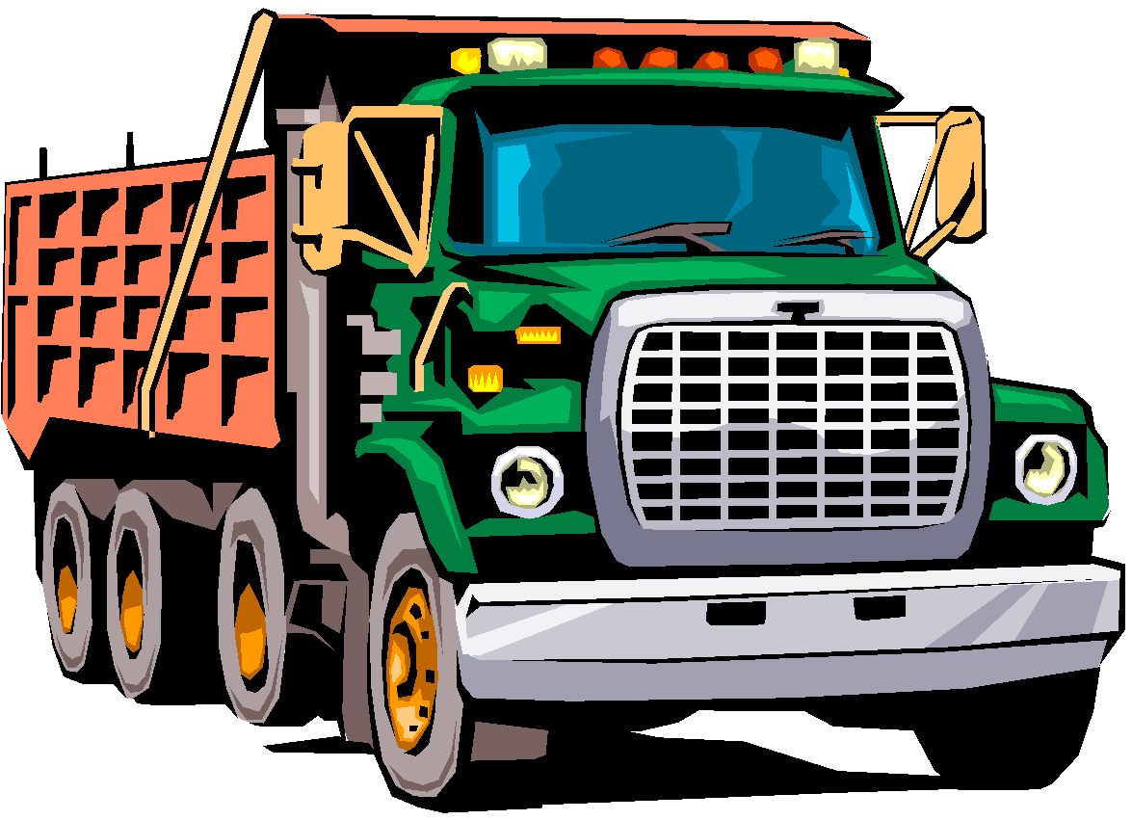
Machinery and Equipment
C 1
Purchase
price
Taxes
Transportation
charges
Installing,
assembling, and
testing
Insurance while
in transit
Notes:
The costs of machinery and equipment consist of all costs normal and necessary to purchase them and prepare them for their intended use. These include the purchase price, taxes, transportation charges, insurance while in transit, and the installing, assembling, and testing of the machinery and equipment.

Slide 12
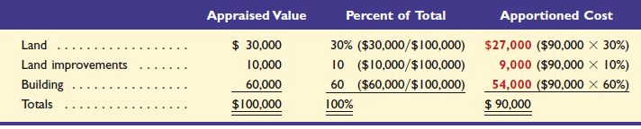
Lump-Sum Asset Purchase
P 1
The total cost of a combined purchase of land and building is separated on the basis of their relative fair market values.
CarMax paid $90,000 cash to acquire a group of items consisting of land appraised at $30,000, land improvements appraised at $10,000, and a building appraised at $60,000. The $90,000 cost will be allocated on the basis of appraised values as shown:
Notes:
Oakley paid $90,000 cash to acquire a group of items consisting of land appraised at $30,000, land improvements appraised at $10,000, and a building appraised at $60,000. The $90,000 cost will be allocated on the basis of appraised values. It is not uncommon to have a lump-sum purchase of assets. The most common example may be when purchasing a building and land. Remember, the land is not depreciable but the land improvement and building are depreciable. We must assign a portion of the purchase price separately to the land, land improvements and building. When faced with this type of problem, accountants normally divide the cost between the assets on the basis of relative fair market values.
Begin by calculating the relative fair value as a percent of the total fair value. The total fair value is $100,000. The land has an appraised value of $30,000, so land is valued at 30% of the total ($30,000 divided by $100,000). We do a similar calculation for land improvements and the building. Next, multiply the percentages we just calculated times the actual cost of the lump-sum purchase to determine the amount assigned to each asset. In the case of land, we multiply 30% times $90,000 and assign $27,000 to the land account. Then continue the process of land improvements and the building.

Slide 13
Depreciation
P 1
Depreciation is the process of allocating the cost of a plant asset to expense in the accounting periods benefiting from its use.
Balance Sheet
Income Statement
Acquisition
Cost
Cost
Expense
Allocation
(Unused)
(Used)
Notes:
Depreciation is a process of cost allocation. We allocate the cost of the asset to expense over its useful life in some rational and systematic manner. We do not want to confuse asset valuation, an economic concept, with allocation.
The unused portion of the asset’s cost appears on the balance sheet. We allocate a portion of the cost to expense on the income statement each accounting period. Let’s look at some very common methods of calculating depreciation expense.

Slide 14

Factors in Computing Depreciation
P 1
The calculation of depreciation requires three amounts for each asset:
1. Cost
2. Salvage Value
3. Useful Life
Notes:
Regardless of the method used to calculate depreciation expense, we must know three variables: the asset’s cost; the estimated salvage value we expect to receive at the end of its useful life, and the estimated useful life of the asset. The salvage value of a asset is an estimate of the asset’s value at the end of its benefit period. This is the amount the owner expects to receive when disposing of the asset. The useful life of a plant asset is the length of time it is productively used in a company’s operations. Once these three amounts are known, we select the depreciation method that we will use to calculate depreciation expense.

Slide 15
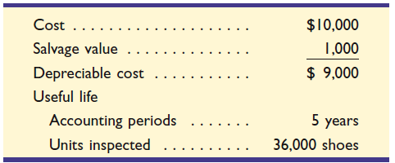
Depreciation Methods
P 1
Straight-line
Units-of-production
Declining-balance
Asset we will depreciate in future screens
Notes:
There are three popular methods of calculating depreciation expense. The easiest and most widely used method is called straight-line depreciation.
When equipment use varies from period to period, the units-of-production depreciation method can better match expenses with revenues. Units-of-production depreciation charges a varying amount to expense for each period of an asset’s useful life depending on its usage.
The third method is called the declining-balance method. Under this method, we take more depreciation expense in the early years of the asset’s life and lower amounts of depreciation in later years. Several income-tax depreciation calculations are based on the declining balance method.
We will use this to illustrate depreciation using the three methods listed. Let’s begin by looking at straight-line depreciation.

Slide 16
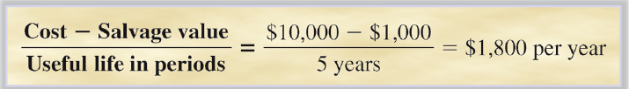
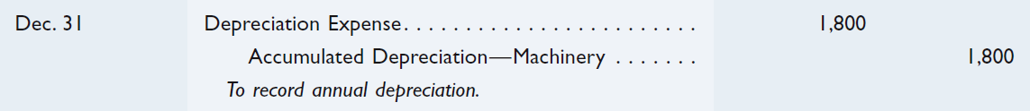
Straight-Line Method
P 1
Notes:
Depreciation expense for any given period is determined by taking the asset’s cost less its estimated salvage value and dividing this amount by the asset’s estimated useful life. If we calculate annual depreciation, we would express the useful life in years. Let’s use our specific example to calculate annual straight-line depreciation.
As you can see, straight-line depreciation is $1,800 per year. We subtract the salvage value of $1,000 from the cost of the machinery and divide that amount by 5 years. Now let’s prepare the journal entry to record depreciation expense.
To record annual depreciation on this asset, we debit Depreciation Expense for $1,800, and credit Accumulated Depreciation – Machinery for the same amount. Accumulated depreciation is another contra asset account. Accumulated depreciation is subtracted from the cost of the asset to arrive at what is called book value. The book value is the amount shown on the balance sheet.

Slide 17
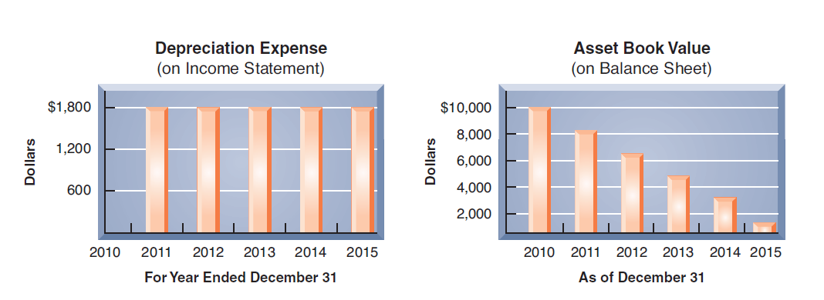
Straight-Line Method
P 1
For year ended December 31
As of December 31
Balance Sheet Presentation
Machinery | $ 10,000
Less: accumulated depreciation | 3,600 |  | $ 6,400
Notes:
In this graph of each year’s depreciation expense, you can clearly see the straight-line nature of the method. Now we have a graph of the asset’s book value at the end of each year. Once again, we have a straight line that slopes down and to the left. You can see that the contra asset account, accumulated depreciation, is subtracted from the cost of the machinery on the balance sheet. The book value at the end of year 2 of $6,400 is disclosed.

Slide 18
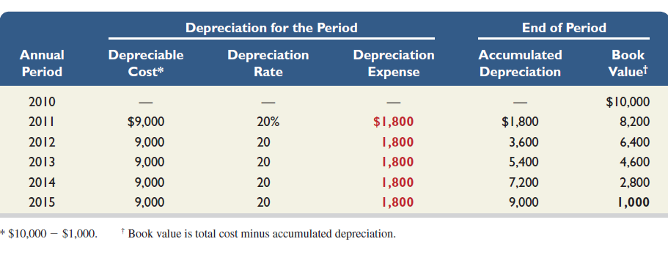
Straight-Line Depreciation Schedule
P 1
Notes:
We can compute the straight-line depreciation rate, defined as 100% divided by the number of periods in the asset’s useful life. For the inspection machine, this rate is 20% (100% ÷ 5 years). We use this rate, along with other information, to compute the machine’s straight-line depreciation schedule as shown on your screen. Note three points in this exhibit. First, depreciation expense is the same each period. Second, accumulated depreciation is the sum of current and prior periods’ depreciation expense. Third, book value declines each period until it equals salvage value at the end of the machine’s useful life.

Slide 19
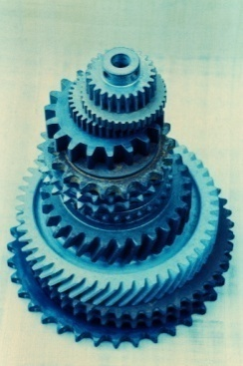
Units-of-Production Method
P 1
Step 1:
Depreciation
Per Unit
Cost - Salvage Value
Total Units of Production
=
Step 2:
Number of Units Produced
in the Period
Depreciation
Expense
Depreciation
Per Unit
×
=
Notes:
Under the units-of-production method, the first step is to calculate the depreciation expense per unit of production. Take the asset’s cost less its salvage value and divide this amount by the total estimated number of units that will be produced by the assets. Once we complete the first step, we may calculate depreciation expense for the period. Multiply the depreciation expense per unit that we determined in step one by the number of units produced in the current period. Let’s look at a specific example.

Slide 20

Units-of-Production Method
P 1
Assume that 7,000 units were inspected during 2011. Depreciation would be calculated as follows:
Step 1:
Depreciation
Per Unit
Cost - Salvage Value
Total Units of Production
$9,000
36,000
= $0.25/unit
=
=
Step 2:
Number of Units Produced
in the Period
Depreciation
Expense
Depreciation
Per Unit
= $0.25 × 7,000 = $1,750
=
×
Notes:
Let’s calculate depreciation in 2011 for our machinery. Assume 7,000 units were inspected during the year. We now apply our two-step process.
Step 1: First, we calculate the depreciation expense per unit inspected. Subtract salvage value of $1,000 from cost of $10,000, to get the basis of depreciation of $9,000. Divide the basis for depreciation by the total number of inspections expected during the periods benefited by the machine of 36,000, and we get a depreciation expense per unit inspected of 25 cents.
Step 2: Multiplying $0.25 per unit times the 7,000 units inspected results in $1,750 of depreciation for 2011.

Slide 21
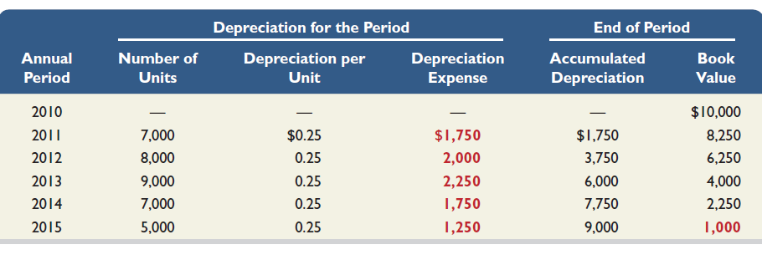
Units-of-Production
Depreciation Schedule
P 1
Units produced and sold during the period.
Notes:
Depreciation for the first year is $1,750 (7,000 shoes at $0.25 per shoe). Depreciation for the second year is $2,000 (8,000 shoes at $0.25 per shoe). Other years are similarly computed. Our schedule shows that (1) depreciation expense depends on unit output, (2) accumulated depreciation is the sum of current and prior periods’ depreciation expense, and (3) book value declines each period until it equals salvage value at the end of the asset’s useful life.

Slide 22
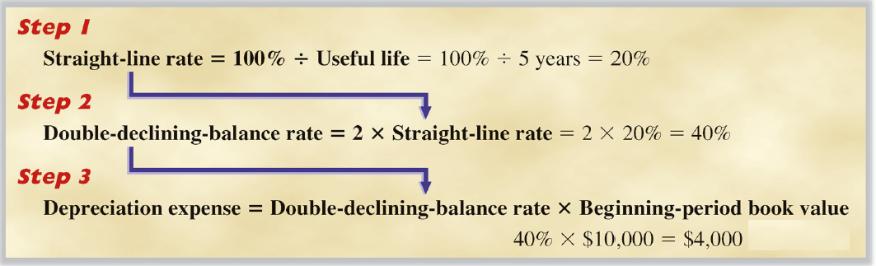
Double-Declining-Balance Method
P 1
Notes:
Declining-balance methods yield larger depreciation expense in the early years of an asset’s life and less depreciation in later years. The most popular declining-balance method is called double-declining balance (DDB) method.
Step 1: To calculate depreciation expense for 2011 under the double-declining-balance we first calculate the straight-line depreciation rate. We do this by dividing 100% by the asset’s useful life. In our specific case, we divide 100% by the five-year useful life to get a straight-line rate of 20%.
Step 2: We calculate the double-declining-balance rate. We do this by multiplying the straight-line rate times two. In our case that would be 20% times two, or 40%, the double-declining balance rate of depreciation.
Step 3: Finally, we calculate depreciation expense for 2011. To do this, we multiply the double-declining rate times the book value of the asset at the beginning of the period. Recall that book value is equal to cost less accumulated depreciation. Under the double-declining-balance method, we ignore estimated salvage value (remember, book value is equal to the cost of the asset minus the accumulated depreciation). The beginning book value (cost less accumulated depreciation) is $10,000. Depreciation expense for 2011 is $4,000, 40% times $10,000. Don’t forget that salvage value is not used in the double-declining-balance method. We base depreciation expense on the book value of the asset at the beginning of the year.

Slide 23
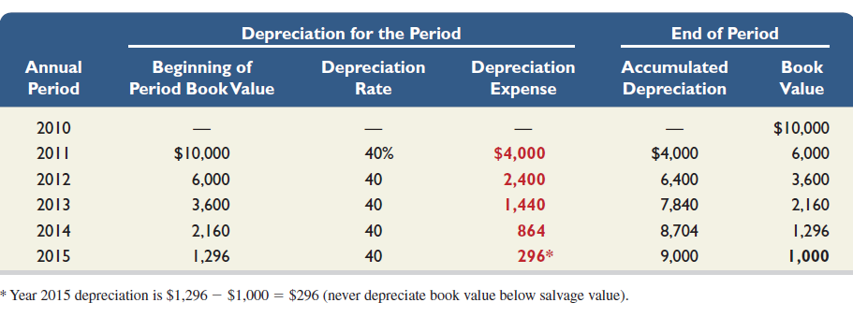
Double-Declining-Balance Method
P 1
Notes:
At the start of the second year, the book value of the asset was $6,000 (cost of $10,000 less accumulated depreciation of $4,000). To determine depreciation expense, we multiply the book value of $6,000 times our rate of 40% to yield $2,400. This table of the necessary calculation using the double-declining-balance method of depreciation.
We always want the book value to be equal to estimated salvage value at the end of the asset’s useful life, but it just will not work properly using the double-declining-balance method. So in the last year of the asset’s useful life, we must determine the depreciation expense necessary to make the book value equal to salvage value. In our case, that amount is $296. We calculate the amount by subtracting the salvage value from the book value of the asset in the previous period, or $1,000 subtracted from $1,296, to arrive at the proper amount of depreciation in the last year.

Slide 24
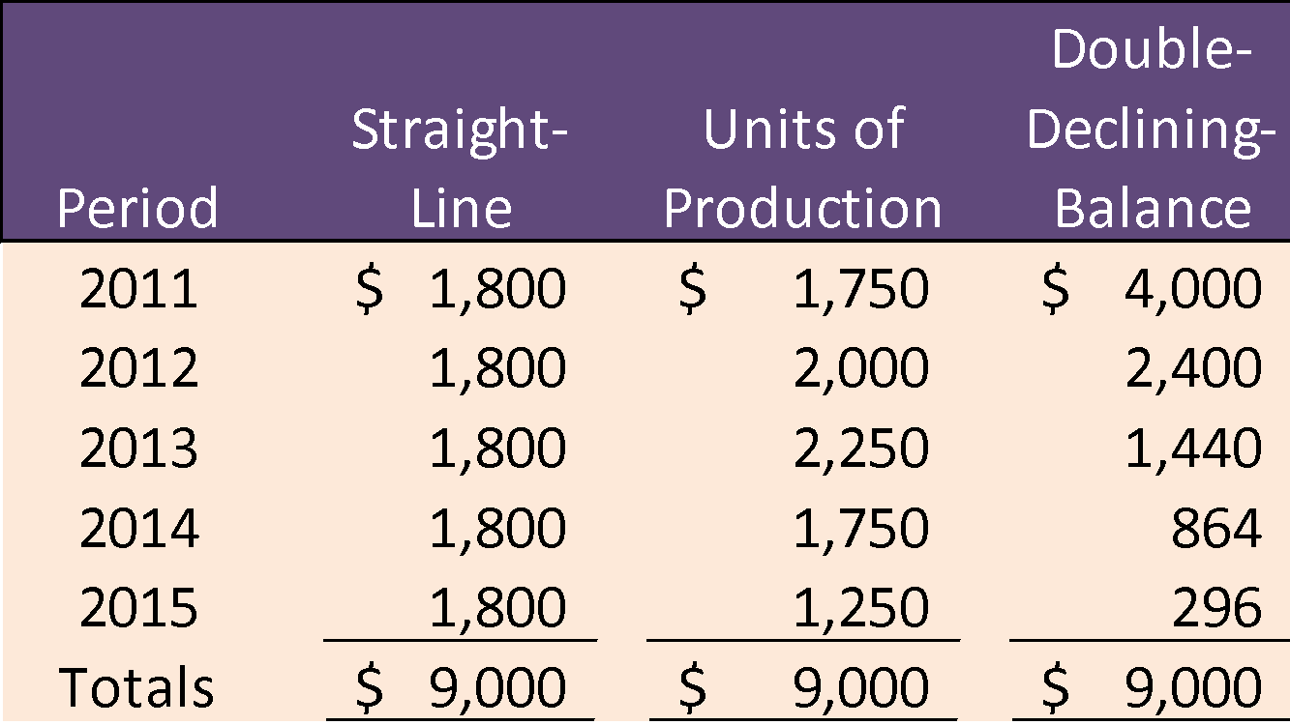
Comparing Depreciation Methods
P 1
Notes:
These two graphs show annual depreciation expense under the three methods of depreciation we have examined. Each method starts with a total cost of $10,000 and ends with the salvage value of $1,000. There are differences in the pattern of depreciation expense over the useful life of the asset. Double-declining-balance records more depreciation in the early years and lesser amounts in the later years of the asset’s useful life. It is important to know that about 85 percent of all companies use the straight-line method of depreciation.

Slide 25

Depreciation for Tax Reporting
P 1
Most corporations use the Modified Accelerated Cost Recovery System (MACRS) for tax purposes.
MACRS depreciation provides for rapid write-off of an asset’s cost in order to stimulate new investment.
Notes:
When filing a tax return, most corporations use the modified accelerated cost recovery system developed by the Internal Revenue Service. Because the title of the method is so long, most accountants refer to the tax method as MACRS. MACRS is an accelerated depreciation method. It was designed to permit companies to quickly write-off the cost of plant assets and thereby stimulate investment in new plant assets. Under the Modified Accelerated Cost Recovery System, companies may elect to use straight-line depreciation for some assets but are required to use MACRS for most types of assets. MACRS is not acceptable for financial reporting purposes.

Slide 26
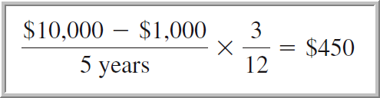
Partial-Year Depreciation
C 2
When a plant asset is acquired during the year, depreciation is calculated for the fraction of the year the asset is owned.
Cost | $ 10,000
Salvage value | 1,000
Depreciable cost | $ 9,000
Useful life
Accounting periods | 5 years
Units inspected | 36,000 units
Assume our machinery was purchased on October 8, 2010. Let’s calculate depreciation expense for 2010, assuming we use straight-line depreciation.
Notes:
To this point, we have discussed depreciation of an asset that was purchased at the beginning of the year. Assume our machinery was purchased on October 8, 2010. Let’s calculate depreciation expense for 2010.
From our previous work, we know that annual depreciation using the straight-line method is $1,800. The asset was purchased on October 8, 2010, so it was only in service during the months of October, November, and December, or three months of the year. We need to depreciate the asset for three months in 2010, so we multiply the annual depreciation by three-twelfths to get depreciation for the period of $450.

Slide 27
Change in Estimates for Depreciation
C 2
Predicted
salvage value
Predicted
useful life
Depreciation
is an estimate
Over the life of an asset, new information may come to light that indicates the original estimates were inaccurate.
Notes:
Depreciation is based on estimates of salvage value and useful life. During the useful life of an asset, new information may indicate that these estimates are inaccurate. If our estimate of an asset’s useful life and/or salvage value changes, what should we do? The answer is to use the new estimate to compute depreciation for current and future periods. This means that we revise the depreciation expense computation by spreading the cost yet to be depreciated over the remaining useful life. This approach is used for all depreciation methods.

Slide 28
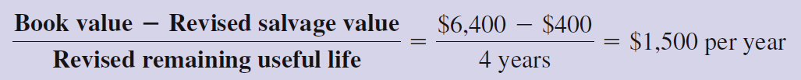
Change in Estimates for Depreciation
C 2
Let’s look at our machinery from the previous examples and assume that at the beginning of the asset’s third year, its book value is $6,400 ($10,000 cost less $3,600 accumulated depreciation using straight-line depreciation). At that time, it is determined that the machinery will have a remaining useful life of 4 years, and the estimated salvage value will be revised downward from $1,000 to $400.
Notes:
Let’s return to our machinery and assume that at the beginning of the asset’s third year, its book value is $6,400 ($10,000 cost less $3,600 accumulated depreciation using straight-line depreciation). At that time, it is determined that the machinery will have a remaining useful life of 4 years (instead of the previous estimate of 3 years), and the estimated salvage value will change from $1,000 to $400.
In this example, we take the book value at the date of change, $6,400, subtract the estimated salvage value of $400, and divide the total by the new remaining life of four years. The revised depreciation is $1,500 per year for the remaining four years of the asset’s life. A change in accounting estimate is reflected in current and future financial statements, not in prior statements.

Slide 29
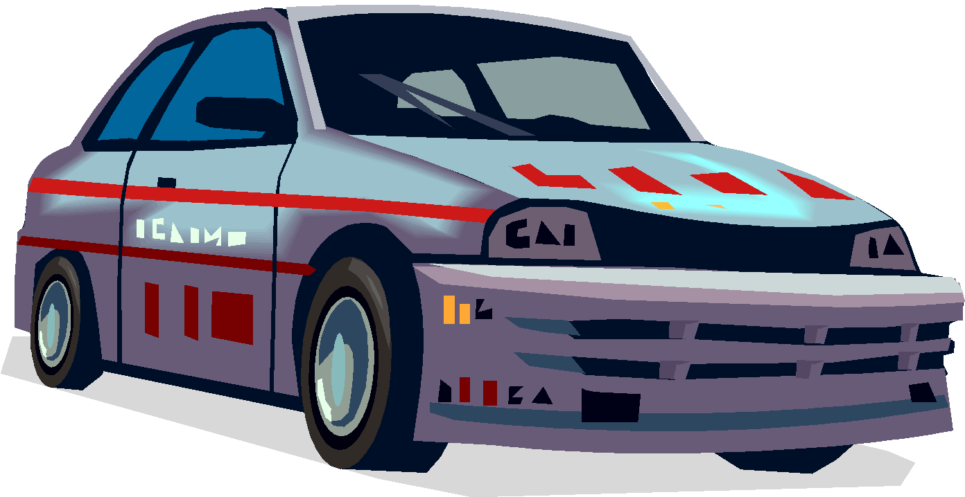
Reporting Depreciation
C 2
Dale Jarrett Racing Adventure
Office furniture and equipment |  | $ 54,593
Shop and track equipment |  | 202,973
Race vehicles and other |  | 975,084
Property and equipment, gross |  | 1,232,650
Less: accumulated depreciation |  | 628,355
Property and equipment, net |  | $ 604,295
Notes:
Both the cost and accumulated depreciation of plant assets are reported on the balance sheet or in its notes. Dale Jarrett Racing Adventure reports its property and equipment as shown on your screen. For most companies, total accumulated depreciation is subtracted for the total cost of property, plant, and equipment.

Slide 30
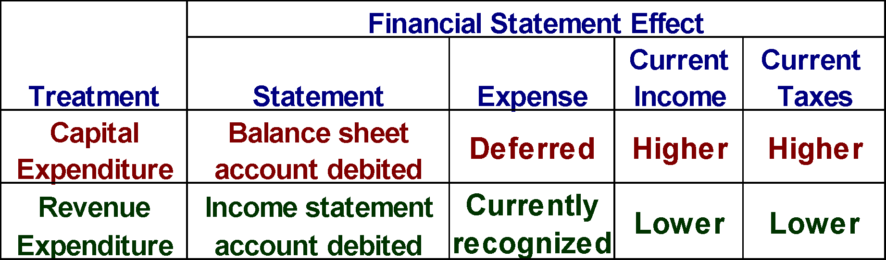
Additional Expenditures
C 3
If the amounts involved are not material, most companies expense the item.
Notes:
After a plant asset is purchased, the company may incur additional expenditures on that asset. These expenditures may be for repairs and maintenance, overhauls, upgrading the asset, and similar expenditures. In recording these expenditures, it must decide whether to capitalize or expense them (to capitalize an expenditure is to debit the asset account). The issue is whether these expenditures are reported as current period expenses or added to the plant asset’s cost and depreciated over its remaining useful life.
One way to handle these types of expenditures is to treat them as a capital expenditure and charge the amount to a balance sheet account like the asset or accumulated depreciation. In most cases, the capital expenditure represents an additional cost of plant assets that provide benefits extending beyond the current period. In some cases, the expenditures may be treated as a revenue expenditure and charged to current period income as an expense. For each expenditure subsequent to acquisition of a plant asset, we must decide if the expenditure is to be treated as a capital or revenue expenditure.

Slide 31
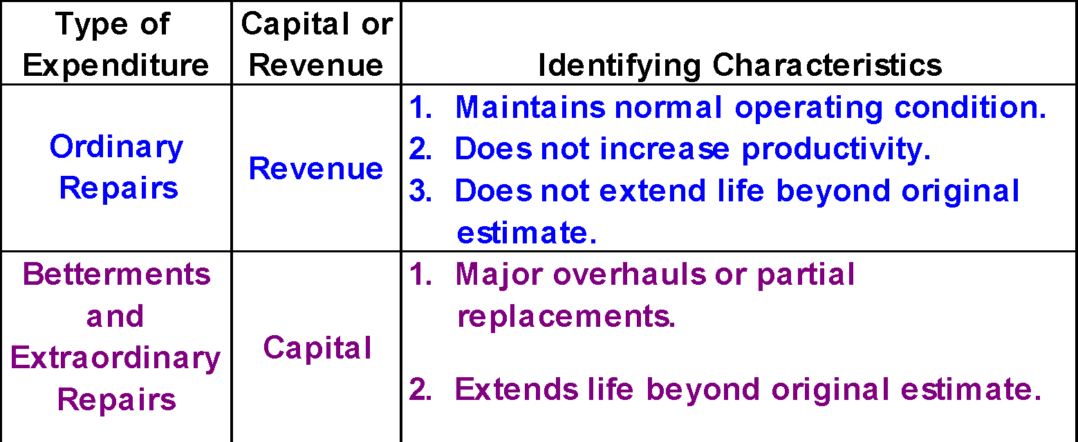
Revenue and Capital Expenditures
C 3
Notes:
Generally, subsequent expenditures for ordinary repairs are treated as revenue expenditures and charged to current period income as an expense. Subsequent expenditures that are for betterments are classified as extraordinary repairs. These should be treated as capital expenditures and charged to the asset account. Let’s look at the proper accounting for the disposal of plant assets.

Slide 32
Disposals of Plant Assets
P 2
Update depreciation
to the date of disposal.
Journalize disposal by:
Recording cash
received (debit)
or paid (credit).
Recording a
gain (credit)
or loss (debit).
Removing accumulated
depreciation (debit).
Removing the
asset cost (credit).
Notes:
Whenever we dispose of a plant asset, the first thing we do is update depreciation to the date of disposal. After completing the update, we can prepare the journal entry. We do so by recording a debit to the cash account, if cash was received, or credit the cash account, if cash was paid by the company. In addition, we must determine whether a gain or loss is associated with the disposal. A gain is recorded with a credit, just like revenue, and a loss is recorded with a debit, just like an expense account. We complete the entry by removing the plant asset’s cost from our books with a credit, and remove the related accumulated depreciation with a debit.
Let’s see how we calculate the gain or loss associated with the disposal.

Slide 33
Discarding Plant Assets
P 2
Update depreciation
to the date of disposal.
If Cash > BV, record a gain (credit).
If Cash < BV, record a loss (debit).
If Cash = BV, no gain or loss.
Journalize disposal by:
Recording cash
received (debit)
or paid (credit).
Recording a
gain (credit)
or loss (debit).
Removing accumulated
depreciation (debit).
Removing the
asset cost (credit).
Notes:
If the amount of cash received is greater than the book value of the asset (cost less accumulated depreciation), a gain is associated with the disposal.
If the cash received is less than the book value of the asset, a loss will be recorded.
When the amount of cash is exactly equal to the book value of the asset, there will be no gain or loss in connection with the disposal.
Now let’s look at a specific example of disposal of a plant asset.

Slide 34

Discarding Plant Assets
P 2
A machine costing $9,000, with accumulated depreciation of $9,000 on December 31st of the previous year was discarded on June 5th of the current year. The company is depreciating the equipment using the straight-line method over eight years with zero salvage value.
Notes:
Equipment costing $9,000, with accumulated depreciation of $9,000 on December 31st of the previous year was discarded on June 5th of the current year. The company is depreciating the equipment using the straight-line method over eight years with zero salvage value. Since the asset is fully depreciated, the journal entry to record the discard of the asset is to debit Accumulated Depreciation – Machinery for $9,000, and credit the Machinery account for the same amount. Both the asset and accumulated depreciation have been removed from the books of the company.

Slide 35
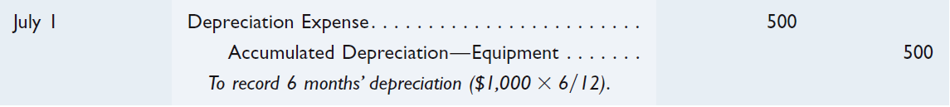

Discarding Plant Assets
P 2
Equipment costing $8,000, with accumulated depreciation of $6,000 on December 31st of the previous year was discarded on July 1st of the current year. The company is depreciating the equipment using the straight-line method over eight years with zero salvage value.
Step 1: Bring the depreciation up-to-date.
Step 2: Record discarding of asset.
Notes:
After depreciation is brought up-to-date, the balance in the accumulated depreciation account is $6,500. Next, we record the discarding of the equipment with a debit to Accumulated Depreciation – Equipment for $6,500, a debit to Loss on Disposal of Equipment for $1,500, and a credit to the Equipment account for cost of $8,000. This loss is computed by comparing the equipment’s $1,500 book value ($8,000 less $6,000 less $500) with the zero net cash proceeds. The loss is reported in the Other Expenses and Losses section of the income statement. Discarding an asset can sometimes require a cash payment that would increase the loss.

Slide 36
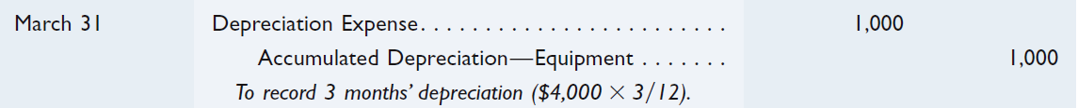
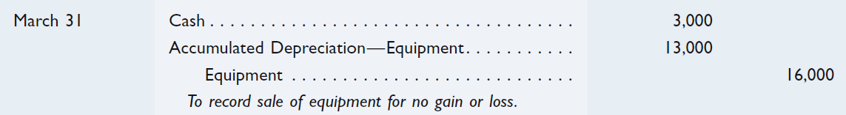
Selling Plant Assets
P 2
On March 31st, BTO sells equipment that originally cost $16,000 and has accumulated depreciation of $12,000 at December 31st of the prior calendar year-end. Annual depreciation on this equipment is $4,000 using straight-line depreciation. The equipment is sold for $3,000 cash.
Step 1: Update depreciation to March 31st.
Step 2: Record sale of asset at book value ($16,000 - $13,000 = $3,000).
Notes:
On March 31st, BTO sells equipment that originally cost $16,000 and has accumulated depreciation of $12,000 at December 31st of the prior calendar year-end. Annual depreciation on this equipment is $4,000 using straight-line depreciation. The equipment is sold for $3,000 cash. The first step in the accounting process it to bring the depreciation up to the date of the sale. Three month’s depreciation equals $1,000, so we will debit Depreciation Expense and credit Accumulated Depreciation – Equipment for $1,000.
Next, we calculate the book value of the equipment at the date of sale. In our case, the book value is $3,000, cost of $16,000 less accumulated depreciation of $13,000. Now we can record the sale of the asset at book value. The journal entry is to debit Cash for $3,000, debit Accumulated Depreciation – Equipment for $13,000, and credit Equipment for $16,000.

Slide 37
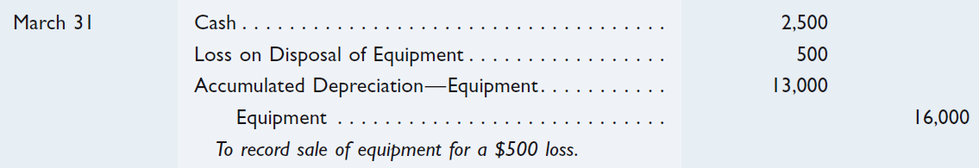
Selling Plant Assets
P 2
On March 31st, BTO sells equipment that originally cost $16,000 and has accumulated depreciation of $12,000 at December 31st of the prior calendar year-end. Annual depreciation on this equipment is $4,000 using straight-line depreciation. The equipment is sold for $2,500 cash.
Step 1: Update depreciation to March 31st.
Step 2: Record sale of asset at a loss (Book value $3,000 - $2,500 cash received).
Notes:
As before, we must bring the depreciation up-to-date as of March 31st. The journal entry is to debit Depreciation Expense for $1,000 and credit Accumulated Depreciation – Equipment for the same amount. The balance in the accumulated depreciation account is now $13,000.
To determine the gain or loss on the transaction, we compare the book value of the equipment to the cash received in the sale. In our case, the cash received is less than the book value of the equipment, so we will recognize a loss on the sale of $500.
The entry to record the sale of the equipment is to debit Cash for $2,500, debit Loss on Disposal of Equipment for $500, and debit Accumulated Depreciation – Equipment for $13,000. To complete the entry, we will credit the Equipment account for $16,000.

Slide 38

Natural Resources
P 3
Total cost,
including
exploration and
development,
is charged to
depletion expense
over periods
benefited.
Extracted from
the natural
environment
and reported
at cost less
accumulated
depletion.
Examples: oil, coal, gold
Notes:
Natural resources abound. We have accounting issues with oil, coal, timber, gold, gravel, and a wide variety of other natural resources. In general, natural resources can be thought of as anything extracted from our natural environment. As accountants, we report natural resources at their cost less accumulated depletion. The depletion we will study in this text is very similar to units-of-production depreciation. The cost of any natural resource must include all exploration and development costs as well as extraction costs. A portion of these total costs will be charged to income each period through the depletion expense account. Let’s see how this works.

Slide 39
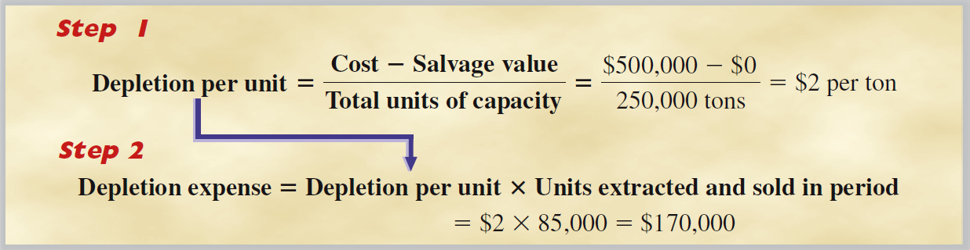
Cost Determination and Depletion
P 3
Let’s consider a mineral deposit with an estimated 250,000 tons of available ore. It is purchased for $500,000, and we expect zero salvage value.
Notes:
We begin the process of calculating depletion expense by determining the depletion expense per unit of natural resource. The numerator of the equation contains the resource cost less any estimated salvage value. The denominator of the equation is our estimated total capacity of the natural resource we expect to extract. For our example, the cost of the mineral deposits are $500,000, and the company expects to extract 250,000 tons of ore. There will be no salvage value after all the ore is extracted.
The first step is to calculate the cost per ton extracted. In our example, the cost is $2 per ton. The next step it to calculate the depletion expense. Given that 85,000 tons of ore was extracted this period at a cost of $2 per ton, the depletion expense is $170,000.

Slide 40
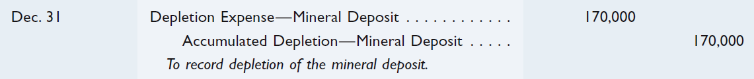
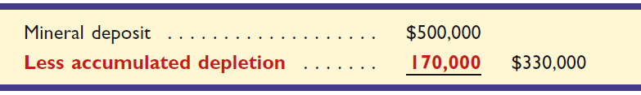
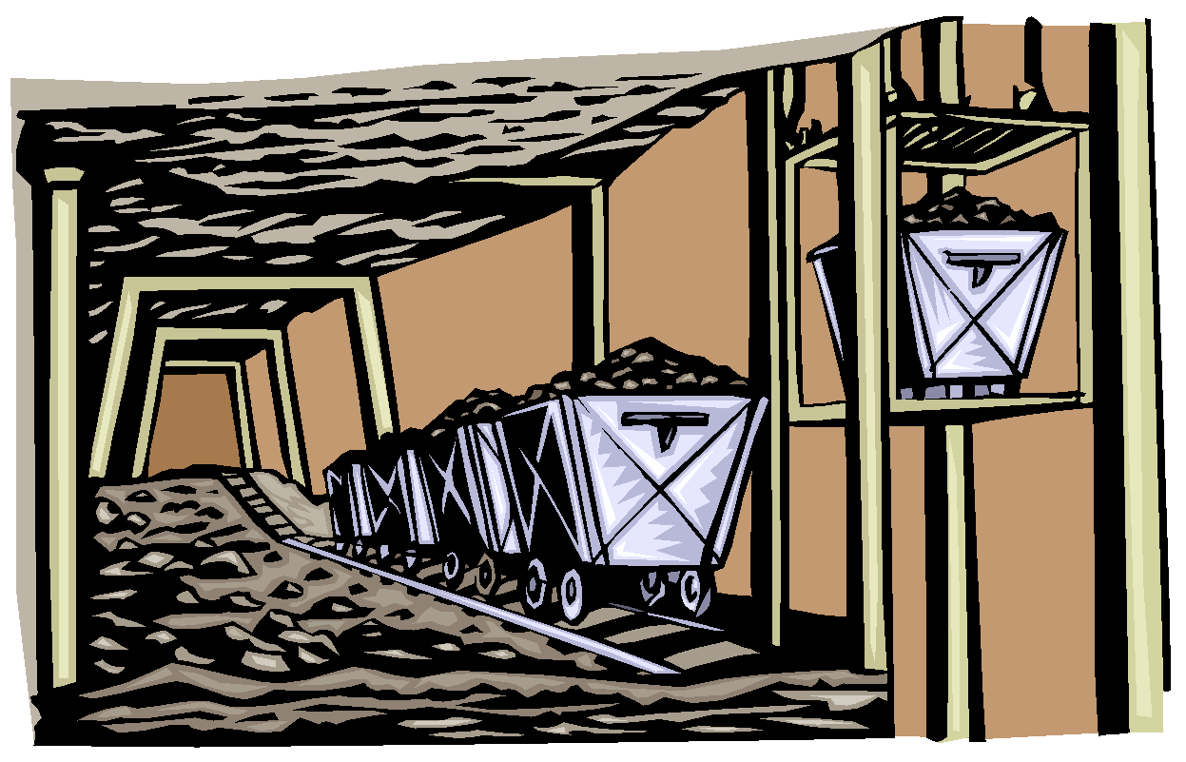
Depletion of Natural Resources
P 3
Depletion expense in the first year would be:
Balance Sheet presentation of natural resources:
Notes:
If the company extracts and sells 85,000 during the year, depletion expense will be $170,000 (85,000 tons times $2 per ton). The journal entry to record depletion is to debit Depletion Expense – Mineral Deposit for $170,000, and credit Accumulated Depletion – Mineral Deposit for the same amount.
On the current period balance sheet, the company will show the cost of the mineral deposits of $500,000 less the accumulated depletion of $170,000, for a net amount of $330,000.

Slide 41
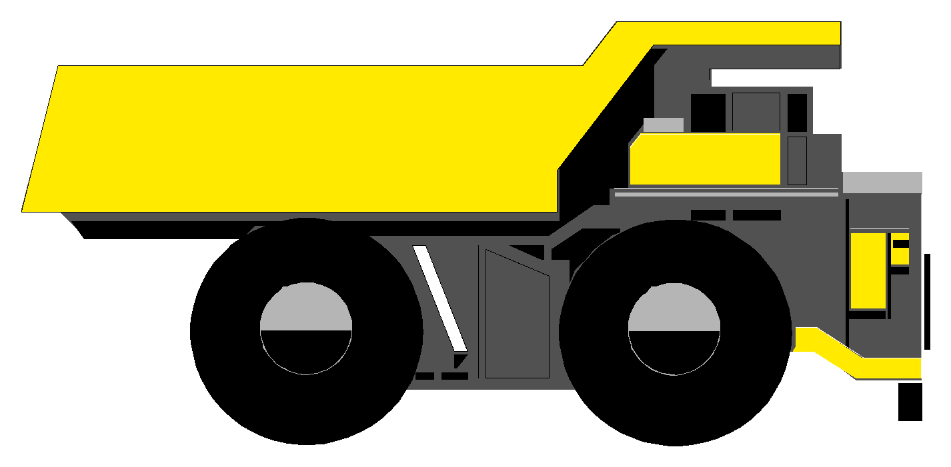
Plant Assets Used in Extracting
P 3
Specialized plant assets may be required to extract the natural resource.
These assets are recorded in a separate account and depreciated.
Notes:
The development and extraction of many types of natural resources require highly specialized plant assets. Just think of the use of off-shore drilling platforms for oil and gas production. These specialized assets are recorded in a separate account from the natural resource and depreciated over their useful lives.
If a machine is permanently installed in a mine and 10% of the ore is mined and sold in the period, then 10% of the machine’s cost (less any salvage value) is allocated to depreciation expense. The same procedure is used when a machine is abandoned once resources have been extracted. If, however, a machine will be moved to and used at another site when extraction is complete, the machine is depreciated over its own useful life.

Slide 42
Intangible Assets
P 4
Noncurrent assets
without physical
substance.
Often provide
exclusive rights
or privileges.
Intangible
Assets
Useful life is
often difficult
to determine.
Usually acquired
for operational
use.
Notes:
Intangible assets lack physical substance and that makes it difficult to determine the asset’s useful life or any residual value. Many intangible assets involve exclusive rights or privileges. We will review the major types of intangible assets and related accounting on the remaining screens.

Slide 43
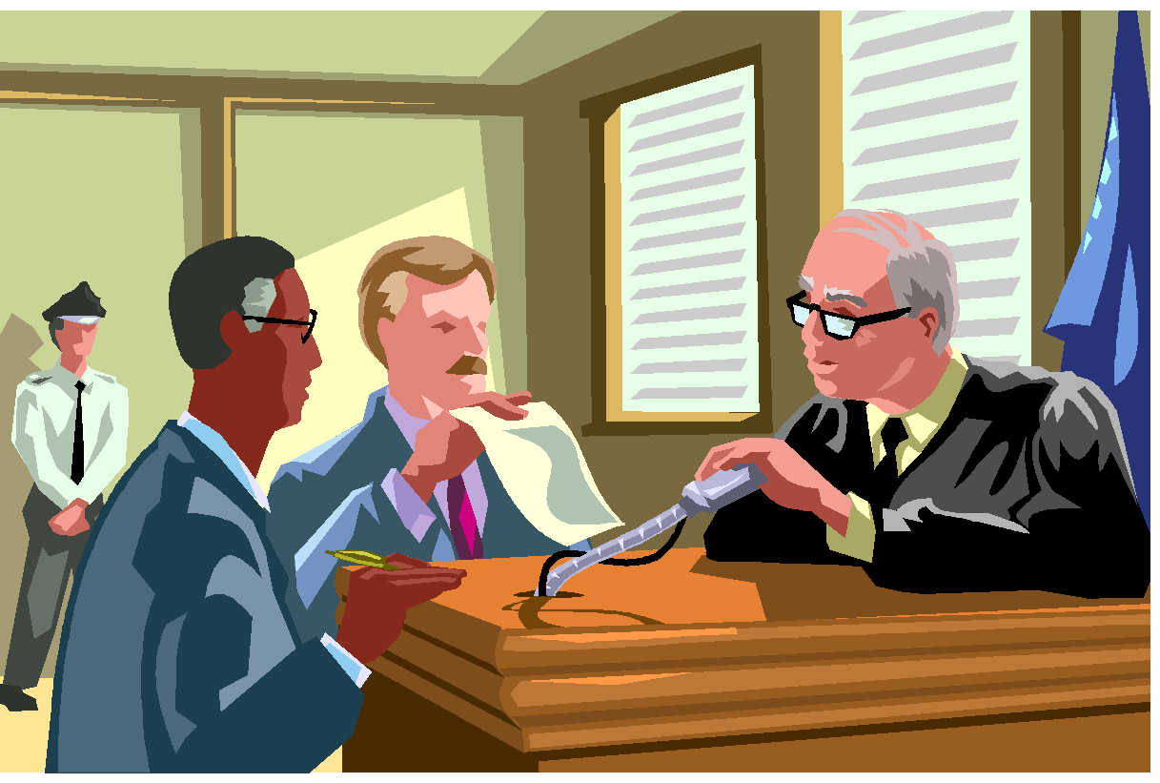
Cost Determination and Amortization
P 4
Record at current cash equivalent cost, including purchase price, legal fees, and filing fees.
Patents
Copyrights
Leaseholds
Leasehold Improvements
Franchises and Licenses
Goodwill
Trademarks and Trade Names
Other Intangibles
Notes:
Intangible assets are normally recorded at the purchase price plus any legal or related fees. Intangible assets with limited lives should be amortized over the period benefited using the straight-line method. Intangible assets with unlimited lives should be carried at unimpaired value. There should be an annual evaluation of the intangible asset to make sure that there has been no impairment in value.

Slide 44

Global View
There is one area where notable differences exist, and that is in accounting for changes in the value of plant assets (between the time they are acquired and disposed of). Namely, how does IFRS and U.S. GAAP treat decreases and increases in the value of plant assets subsequent to acquisition?
Decreases in the Value of Plant Assets
Both U.S. GAAP and IFRS require that an impairment in value be recognized.
Increases in the Value of Plant Assets
U.S. GAAP prohibits recording increase in value of plant assets. IFRS permits upward asset revaluation.
Notes:
There is one area where notable differences exist, and that is in accounting for changes in the value of plant assets (between the time they are acquired and disposed of). Namely, how does IFRS and U.S. GAAP treat decreases and increases in the value of plant assets subsequent to acquisition?
Decreases in the Value of Plant Assets: Both U.S. GAAP and IFRS require that an impairment in value be recognized. U.S. GAAP revalues impaired plant assets to fair value whereas IFRS revalues them to a recoverable amount (defined as fair value less costs to sell).
Increases in the Value of Plant Assets: U.S. GAAP prohibits companies from recording increases in the value of plant assets. However, IFRS permits upward asset revaluations. Namely, under IFRS, if an impairment was previously recorded, a company would reverse that impairment to the extent necessary and record that increase in income.

Slide 45
Total Asset Turnover
A1
Total Asset
Turnover
Net Sales
Average Total Assets
=
Provides information about a company’s
efficiency in using its assets.
Company | $ in millions | 2008 | 2007 | 2006 | 2005
Molson Coors | Net sales | $ 4,774 | $ 6,191 | $ 5,845 | $ 5,507
 | Average total assets | 11,934 | 12,528 | 11,701 | 8,228
 | Total asset turnover | 0.40 | 0.49 | 0.50 | 0.67
Boston Beer | Net sales | $ 398 | $ 342 | $ 285 | $ 238
 | Average total assets | 208 | 176 | 137 | 113
 | Total asset turnover | 1.91 | 1.94 | 2.09 | 2.10
Notes:
Total asset turnover is equal to the net sales for the period divided by the average total assets. The average total assets is computed by taking the beginning balance of total assets, adding the ending balance, and dividing the result by two. Total asset turnover provides us with information about how efficiently a company uses its assets. Here are two companies in the same industry. Notice the steady decline of the asset turnover at Molson Coors and the relatively stable and higher asset turnover at Boston Beer.

Slide 46
10A – Exchanging Plant Assets
P5
Many plant assets such as machinery, automobiles, and office equipment are disposed of by exchanging them for newer assets. In a typical exchange of plant assets, a trade-in allowance is received on the old asset and the balance is paid in cash. Accounting for the exchange of assets depends on whether the transaction has commercial substance.
Commercial substance implies the company’s future cash flows will be altered.
Notes:
Many plant assets such as machinery, automobiles, and office equipment are disposed of by exchanging them for newer assets. In a typical exchange of plant assets, a trade-in allowance is received on the old asset and the balance is paid in cash. Accounting for the exchange of assets depends on whether the transaction has commercial substance. Commercial substance implies the company’s future cash flows will be altered.
If an asset exchange has commercial substance, a gain or loss is recorded based on the difference between the book value of the asset(s) given up and the market value of the asset(s) received. If an asset exchange lacks commercial substance, no gain or loss is recorded.

Slide 47
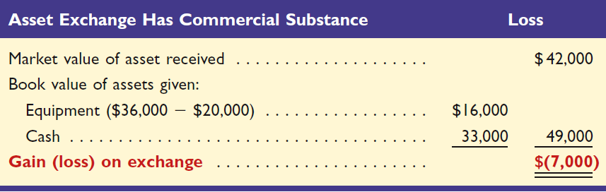
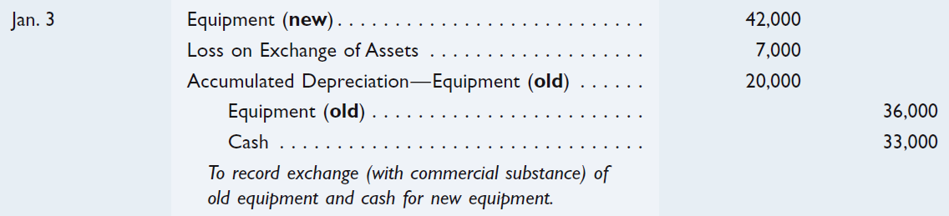
Exchange with Commercial
Substance: A Loss
P5
A company acquires $42,000 in new equipment. In exchange, the company pays $33,000 cash and trades in old equipment. The old equipment originally cost $36,000 and has accumulated depreciation of $20,000 (book value is $16,000). This exchange has commercial substance. The old equipment has a trade-in allowance of $9,000.
Notes:
A company acquires $42,000 in new equipment. In exchange, the company pays $33,000 cash and trades in old equipment. The old equipment originally cost $36,000 and has accumulated depreciation of $20,000 (book value is $16,000). This exchange has commercial substance. The old equipment has a trade-in allowance of $9,000.
The gain or loss is calculated by comparing the market value of the asset received to the book value of the asset given up. In our case, the book value of the two assets given up (book value of old equipment plus cash) are greater than the market value of the asset received, so we will recognize a loss of $7,000.
The journal entry is debit Equipment for $42,000 (new), debit Loss on Exchange of Assets for $7,000, debit Accumulated Depreciation – Equipment for $20,000, credit Equipment for $36,000 (old), and credit Cash for $33,000.

Slide 48
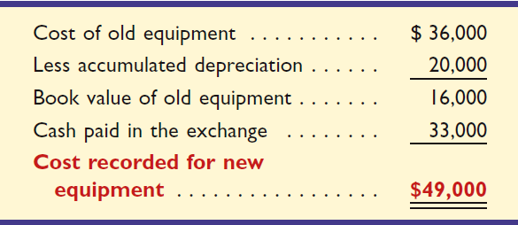
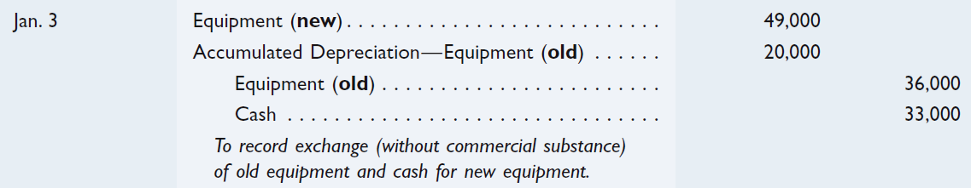
Exchanges Without Commercial
Substance
P5
Let’s assume the same facts as on the previous screen except that the market value of the new equipment received is $52,000 and the transaction lacks commercial substance.
Notes:
Let’s assume the same facts as presented on the previous screen except that the market value of the new equipment received is $52,000 and the transaction lacks commercial substance.
Because the transaction is without commercial substance, no gain or loss will be recognized. The new equipment received will be recorded at the book value of the asset(s) given up. In our example, we gave up an old piece of equipment with a book value of $16,000 plus cash of $33,000.
The journal entry to record the exchange is to debit Equipment for $49,000, debit Accumulated Depreciation – Equipment for $20,000, credit Equipment for $36,000 and credit cash for $33,000. Remember, no gain or loss is recognized when the exchange lacks commercial substance.

Slide 49

End
Notes:
End of Chapter 10.

