Slide 1



Information Systems
Prepared by Dr. Amjad Qtaish
IT372
Information Systems
Lecture 01

Slide 2




Module 1: An Overview
Information Systems
Chapter 1: An Introduction to Information Systems
Chapter 2: Information Systems in Organizations
Dr. Amjad Qtaish
Faculty of Informatics
Midocean University
Information Systems (IT372)

Slide 3

Chapter
Outline
01
    An Overview:
Information and System Concepts
Information System (IS), its Functions
Why Firms use IS
Dimensions of IS
Contemporary Approaches to IS
Business Information Systems
Electronic and Mobile Commerce
Management Level Systems
Enterprise Systems
Collaboration Systems
Summary
Information Systems, Dr. Amjad Qtaish
3

Slide 4
Chapter
Learning Objectives
01
    An Overview:
Discuss why is it important to study and understand information systems
Distinguish between data, information and importance of valuable information
Discuss why organizations use Information Systems
Identify the dimensions of Information Systems
Identify Business Information Systems (E-business, Management Level, Enterprise, Collaboration)
Information Systems, Dr. Amjad Qtaish
4

Slide 5
Chapter
Information Concepts
01
Data: raw facts, such as employee number, number of hours worked in a week, inventory part numbers etc.
Alphanumeric data, Image data, Audio data, Video data
Information: collection of facts organized so that they have additional value beyond the value of facts themselves
Process: set of logically related tasks performed to achieve a defined outcome, or simply turning data into information.
However, certain rules and regulations can be set up to organize data into useful and valuable information
Knowledge: is the awareness and understanding of a set of information and the ways that information can be made useful to support a specific task or reach a decision
Information Systems, Dr. Amjad Qtaish
5

Slide 6
Chapter
Information Concepts
01
Characteristics of valuable information
  Accessible
  Accurate
  Complete
  Economical
  Flexible
  Relevant
  Reliable
  Secure
  Simple
  Timely
  Verifiable
The value of information is directly linked to how it helps decision makers achieve their organization’s goals
Information Systems, Dr. Amjad Qtaish
6

Slide 7
Chapter
System Concepts
01
System: is a set of elements or components that interact to accomplish goals
The relationships among the elements determine how the system works
Most systems are composed of smaller subsystems that support the larger system
Changes in subsystems cannot be made without considering the effect on other subsystems and on the system as a whole.
Goal conflict occurs when a subsystem’s goals are inconsistent with the goals of another subsystem or with the system as a whole.
Goal congruence occurs when a subsystem achieves its goals while contributing to the organization’s overall goal.
Information Systems, Dr. Amjad Qtaish
7

Slide 8
Chapter
Information System (IS)
01
Why is Information System important?
  We interact with IS personally and professionally
  Transforming businesses
  Globalization and Opportunities
IS effects all areas of the businesses
  Manufacturing
  Accounting
  Human Resources
  Marketing
  Top Management
Information Systems, Dr. Amjad Qtaish
8

Slide 9
Chapter
Information System (IS)
01
Set of interrelated components
Collect, process, store, and distribute information
  →By computers and software as a tool
Support decision making, coordination, control, problem analysis and create new product
Provide solutions to changes/challenges in business environment
Another definition
  IS is an integrated Human-Machine system that combines hardware, software, databases and telecommunications networks. It collects data and processes it into information used for decision making at all levels of the organization.
Information Systems, Dr. Amjad Qtaish
9

Slide 10
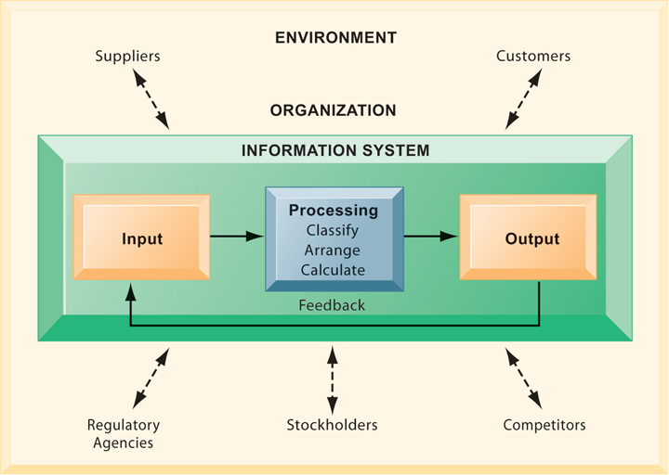
Chapter
Functions of an Information System
01
An information system contains information about an organization and its surrounding environment. Three basic activities—input, processing, and output—produce the information organizations need. Feedback is output returned to appropriate people or activities in the organization to evaluate and refine the input. Environmental actors, such as customers, suppliers, competitors, stockholders, and regulatory agencies, interact with the organization and its information systems.
Information Systems, Dr. Amjad Qtaish
10

Slide 11
Chapter
Why Firms Use IS
01
To achieve 6 strategic business objectives
  Operational excellence
  New products, services, and business models
  Customer and supplier intimacy
  Improved decision making
  Competitive advantage
  Survival
Information Systems, Dr. Amjad Qtaish
11

Slide 12
Chapter
Why Firms Use IS
01
Operational Excellence
  Achieving higher levels of efficiency and productivity in business operations, plus changes in management behaviour
  Example: Wal-Mart’s Retail Link system links suppliers to stores for in-time replacements
New Products/ Services/ Business Model
  Business model: describes how company produces, delivers, and sells product or service to create wealth
  Information systems and technology a major enabling tool for new products, services, business models
    E.g. Apple’s iPod, iTunes online music business
Information Systems, Dr. Amjad Qtaish
12

Slide 13
Chapter
Why Firms Use IS
01
Customer and Supplier Intimacy
  Serving customers well leads to customers returning, which raises revenues and profits
  Intimacy with suppliers allows them to provide vital inputs, which lowers costs
    E.g. JCPenney’s information system which links sales records to contract manufacturer
Improved decision making
  Managers need right information at right time
  IS provide real-time data for making decisions
  E.g. Verizon’s Web-based digital dashboard to provide managers with real-time data on customer complaints, network performance, line outages, etc.
  Results in restoration and repairing fast and effective
Information Systems, Dr. Amjad Qtaish
13

Slide 14
Chapter
Why Firms Use IS
01
Competitive Advantage
  Achieve higher sales and profit through using IS by:
    Doing things better
    Charging less for superior products
    real time responding
  Using the internet is competitive advantage
Survival
  Information technologies are necessity of doing business
    Industry-level changes, e.g. Citibank’s introduction of ATMs
Information Systems, Dr. Amjad Qtaish
14

Slide 15
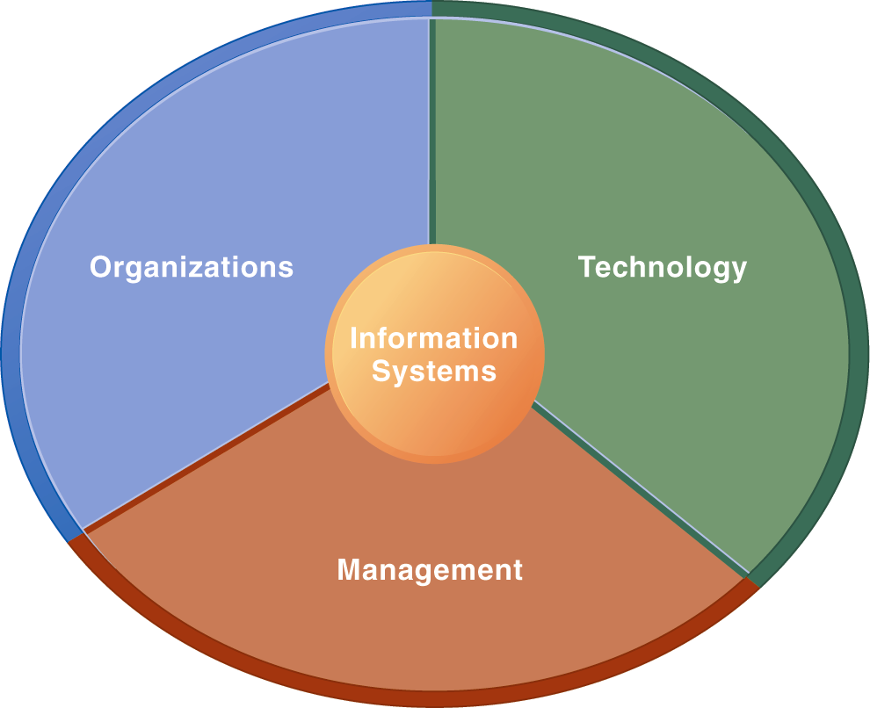
Chapter
Dimensions of Information System (IS)
01
Using IS effectively depends on the understanding of organization , technology and management
Only computer literacy is not important, rather broader IS literacy is important to implement a productive IS and this field of MIS is to achieve it
Information System Literacy
How and Why technology is applied in business
Information Systems, Dr. Amjad Qtaish
15

Slide 16
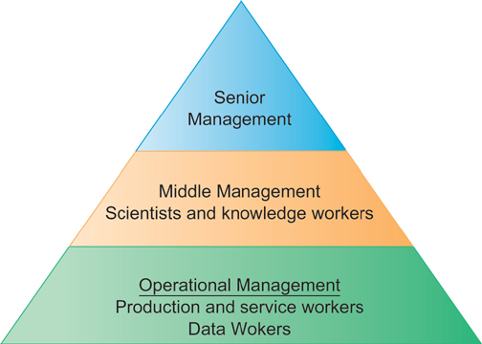
Chapter
Dimensions of Information System (IS)
01
Organization
  Key elements : People, Structure, Business Processes, Politics, Culture
  Organizational structure has different levels and specialities
Information Systems, Dr. Amjad Qtaish
16

Slide 17
Chapter
Dimensions of Information System (IS)
01
Management
  Make decisions, formulate action plan and solve organizational problem
  Managers set organizational strategy for responding to business challenges
  In addition, managers must act creatively:
    Creation of new products and services
    Occasionally re-creating the organization
Information Systems, Dr. Amjad Qtaish
17

Slide 18
Chapter
Dimensions of Information System (IS)
01
Technology
  Hardware: physical equipment used for input, output, processing, storage
    E.g. Event Data Readers (EDR) in vehicles
  Software: computer programs that control and coordinate the hardware
    E.g. Fab Lab – controls automatic cutter, milling machines
  Data management technology: deals with software that are used to organize data on physical storage media
  Network and telecommunications technology: contains both hardware and software that are used to link various computer devices
    E.g. investment firms use telecomm to connect with brokers and traders
  Internet: worlds largest Network
  WWW: service provided by the internet
  IT infrastructure: platform to build the IS
Information Systems, Dr. Amjad Qtaish
18

Slide 19
Chapter
UPS Case Study
01
Company: United Parcel Service (UPS)
  Package delivery
  Started in 1907, now has 408,000 employees and 96000 vehicles
Process: automated package tracking system
  Scannable label attached to package
  Info from “smart” tag goes to central computer
  At centre traffic route made for drivers
  Delivery Information Acquisition Device (DIAD) access info through wireless n/w
  Through bar code info at various points goes to central computer
  Info available on UPS website
Information Systems, Dr. Amjad Qtaish
19

Slide 20
Chapter
UPS Case Study
01
Inputs, Processing, Output of UPS PTS
  Info about sender, destination and time of arrival, progress data
  Info transmitted central computer to distribution centre, route calculation
  Tracking status, printed label, driver’s route
Technologies used and why
  Handheld computers, bar code scanners, wireless communications, desktop commuters, UPS data storage technology, UPS tracking software, Internet (Web site)
  Reason: high level service in low price
Information Systems, Dr. Amjad Qtaish
20

Slide 21
Chapter
UPS Case Study
01
Strategic Business Objectives Achieved
  Operational Excellence
    Customers and download and print labels
    Drivers traffic route
  Customer Intimacy
    Inform about estimated time
    Package status report
  New Service
    Point Sales Order Management System (OMS)
  Competitive Advantage
    Achieved by above mentioned implementations
Information Systems, Dr. Amjad Qtaish
21

Slide 22
Chapter
Global Challenges
01
Globalization has impact on organizations and its IS
Thomas Friedman “The World is Flat”
Individuals from all over the world compete with other individuals, companies and countries through Internet
Where there are International opportunities, there are challenges and obstacles as well
  Cultural and language challenges
  Time and distance challenges
  Infrastructure challenges
  Currency challenges
  Technology transfer issue
  Product and Services challenges
Information Systems, Dr. Amjad Qtaish
22

Slide 23
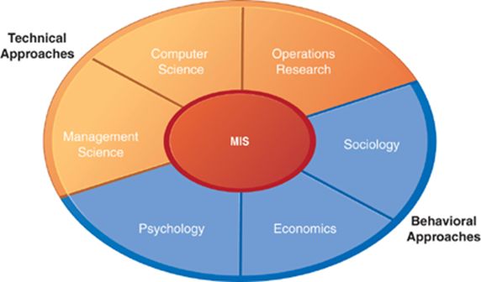
Chapter
Contemporary Approaches to IS
01
IS is a multidisciplinary field
The study of information system deals with issues and insights contributed from technical and behavioural disciplines
Information Systems, Dr. Amjad Qtaish
23

Slide 24
Chapter
Contemporary Approaches to IS
01
Technical approach
  Emphasizes mathematically based models
    Computer science theories of commutation ,data storage
    management science: models of DM and practices
    operations research: optimizing selected parameters of org.
Behavioural approach
  Behavioural issues like strategic business integration, design implementation, management
    Psychology: how decision makers use formal information
    Economics: how IS change the control and cost structures
    Sociology: how system affect individuals and groups
Information Systems, Dr. Amjad Qtaish
24

Slide 25
Chapter
Contemporary Approaches to IS
01
The sociotechnical systems
  Use of computer-based information systems in business firms
  Combines work of CS, management, and operating research toward developing system solutions to real word problems
  Concerned with behavioural issues of development, use and impact of IS
main actors
  Suppliers of hardware and software
  Business firms
  Managers and employees
  Firm’s environment (legal, social, cultural context)
Key: training, learning and planned change
Information Systems, Dr. Amjad Qtaish
25

Slide 26
Chapter
Business Information Systems
02
Purpose: help employees in organizations accomplish routine and special tasks
Different IS support different interests, specialities and levels in the organizations
e-commerce, m-commerce
Management Level Systems
Enterprise Systems
Collaborative Systems
Information Systems, Dr. Amjad Qtaish
26

Slide 27
Chapter
Electronic and Mobile Commerce
02
E-business: refers to use of digital technology and Internet to execute the major business processes
  Accounting, finance, manufacturing, HR activities,
  E-business strategy is flexible and adaptable
E-commerce: any business transaction (buying and selling) executed electronically
  B2B, B2C, C2C
  Also offers opportunities for small businesses
M-commerce: transactions happening anywhere, anytime (using wireless communications)
Information Systems, Dr. Amjad Qtaish
27

Slide 28
Chapter
Management Level Systems
02
Transaction Processing System (TPS)
Organized collection of people, procedures, software, devices and databases used to record and complete business transactions
  Sales, receipts, payroll, paying suppliers
  Purpose: answer routine questions and track flow of transactions
  Tasks predefined and highly structured
  Managers need TPS to monitor the status of internal operations
Management Information Systems (MIS)
Organized collection of people, procedures, software, databases and devices that provide routine information to managers ad decision makers
  Purpose: operational efficiency
  Marketing, finance, production
  Generate reports from data and information supplied by TPS
  Managers use this to monitor and control the business and predict future performances
Information Systems, Dr. Amjad Qtaish
28

Slide 29
Chapter
Management Level Systems
02
Decision Support Systems (DSS)
Organized collection of people, procedures, software, databases and devices that support problem-specific decision making
  Use information from TPS and MIS, plus external sources
  Purpose: solving unique problems, solutions may not be fully predefined
  Supports decision making process by analysing data and suggesting alternatives
Executive Support Systems (ESS)
  Used by senior management
  Judgement, evaluation, insight
  Information presented through portal in the form of digital dashboard
Information Systems, Dr. Amjad Qtaish
29

Slide 30
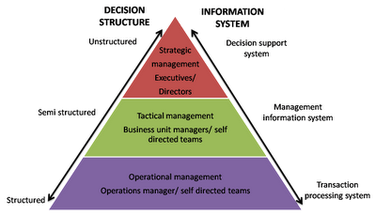
Chapter
Management Level Systems
02
Information Systems, Dr. Amjad Qtaish
30

Slide 31
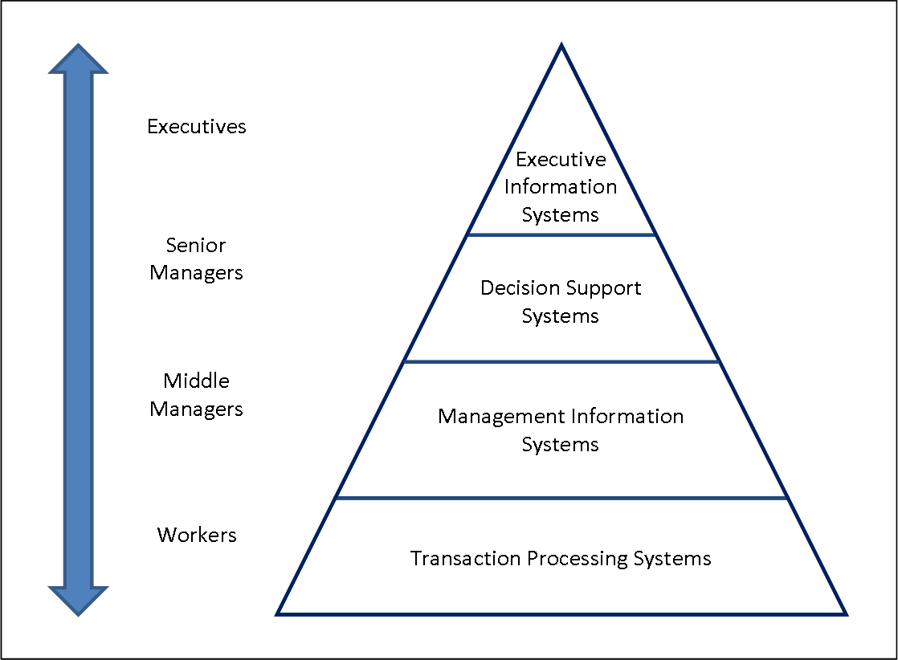
Chapter
Management Level Systems
02
Information Systems, Dr. Amjad Qtaish
31

Slide 32
Chapter
Case Study: Dominos Pizza Tracker
02
Company: Domino’s Pizza
Problem: Customers not happy with home delivery and pizza
Competitive Advantage needed
  Good Pizza
  Excellent customer service
Point of sale system – Pulse
  Captures purchase and payment data using computers, automated cash registers , scanners etc.
  Improved customer service, reduced mistakes, shorter training time
Information Systems, Dr. Amjad Qtaish
32

Slide 33
Chapter
Case Study: Dominos Pizza Tracker
02
Pulse Evolution
  Think client model to thin client model
  networked stations with little processing power collect data
  Info goes to one machine for processing
  Benefit: easier to update and secure
Ordering system: Pizza Tracker
  Simulated photographic version of pizza shown while ordering
  View progress of pizza ordered online
  Improved customer relationship
Information Systems, Dr. Amjad Qtaish
33

Slide 34
Chapter
Case Study: Dominos Pizza Tracker
02
Systems
  Point of sale system
  Online ordering system
Business Processes
  Purchase and payments at physical locations
  Managing online orders for pizza
Business performance
  Help in maintaining consistent and efficient management functions
  Taking and customizing orders, maintaining sales figures, compiling customer info
Online Pizza tracker
  Showing photographic version of the pizza and giving view of the progress of the pizza order
Information Systems, Dr. Amjad Qtaish
34

Slide 35
Chapter
Enterprise Systems
02
Different kinds if IS in a firm work together
The challenge to get them all work together as one corporate system (information integration )
Solution: enterprise applications (systems) that span functional areas
  Executing business processes across the firm
  coordinate business processes closely
Information Systems, Dr. Amjad Qtaish
35

Slide 36
Chapter
Collaboration Systems
02
Collaboration: working with others to achieve shared and explicit goals
  E.g. members in a team collaborate to complete a task
  Investments in collaborative technologies brought improvements
  Categories of Collaborative Software Tools
    E-mail and instant messaging
    Collaborative Writing
    Event Scheduling
    Audio Conferencing
    Video Conferencing
    White boarding
    Document sharing (wikis)
Information Systems, Dr. Amjad Qtaish
36

Slide 37
Chapter
Collaboration Systems
02
E-mail and Instant Messaging
  Major communication and collaboration tool
  IM allows real time conversation with multiple people
Social Networking
  Corporate tool for sharing ideas and collaborating
  LinkedIn.com provides networking services to business professionals
Wikis
  Major wiki: Wikipedia
  Contribute and edit text content and graphics
  Major repository for unstructured corporate knowledge
Information Systems, Dr. Amjad Qtaish
37

Slide 38
Chapter
Collaboration Systems
02
Virtual Meeting Systems
  Reason: to reduce travel costs by business professionals
  Briefing, training courses, management consulting, inspirational chats
  Telepresence: integrated audio-video technology that allows the person to give the appearance of being present at the location of meeting
Information Systems, Dr. Amjad Qtaish
38

Slide 39
Chapter
Summary
02
IS instrument for creating value to firms
The value of information is directly linked to how it helps decision makers achieve the organization’s goals
Information systems must be applied thoughtfully and carefully so that society and industry can reap maximum benefits.
Technology usage, how it helps the business
Globalization and it’s challenges
Sociotechnical systems
Business Information Systems (E-business, Management Level, Enterprise, Collaboration)
Information Systems, Dr. Amjad Qtaish
39

Slide 40



Thank You

