Slide 1


Chi-Square Test
Prepared by Dr. Hesham Mousli
MHA 613
Statistics in Healthcare
Lecture 6

Slide 2

Chapter
INTENDED OBJECTIVES
06
Understand the purpose of the Chi-square test and its applications in healthcare management.
Learn the step-by-step process of conducting a Chi-square test.
Identify and apply the assumptions required for a valid Chi-square test.
Develop skills to accurately interpret and communicate the results of a Chi-square test.

Slide 3
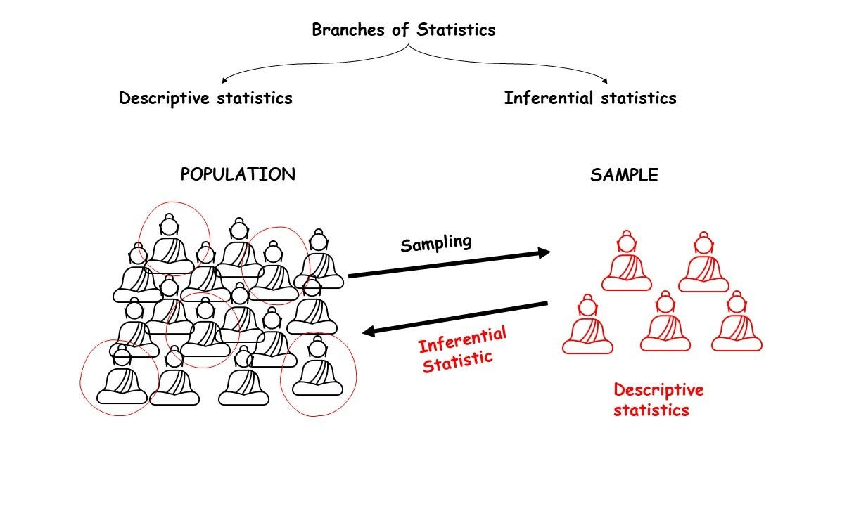

Slide 4
Chapter
Research Question
06
In a rural healthcare setting, health officials are investigating whether there is an association between vaccination status and the incidence of a particular infectious disease. Data is collected from individuals, noting whether they have been vaccinated and whether they contracted the disease within the past year.

Slide 5

Chapter
Research Question
06
Is there a significant association between vaccination status and disease status?

Slide 6


Chapter
Research Question
06
Does Vaccination status have an impact on Contracting the disease?

Slide 7
Chapter
Hypotheses Statements
06
Null Hypothesis: There is no significant association between vaccination status and the incidence of the disease.
Alternative Hypothesis: There is a significant association between vaccination status and the incidence of the disease.

Slide 8
Comparing two or more proportions (Categorical data)
(Chi-Square test) (Χ²)
Chapter
06
A Pearson’s Chi-Square test is a statistical hypothesis test for comparing the proportions of two categorical variables.
It allows you to test whether the two categorical variables compared are related to each other (dependent) or they are unrelated (independent).

Slide 9
Chapter
Chi-Square test
06
The chi-square test is a statistical method used to determine if there is a significant association between two categorical variables.
It assesses whether the observed frequencies in a contingency table match the expected frequencies if there is no relationship between the variables.

Slide 10
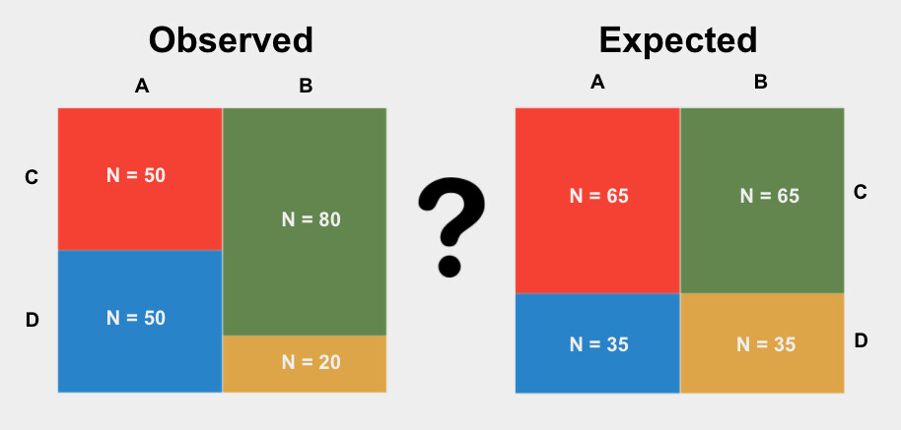

Slide 11
Chapter
Chi-Square test steps summary
06
The data are obtained, initially, as frequencies, i.e. the numbers with and without the characteristic in each group.
A table in which the entries are frequencies is called a contingency table; when this table has two rows and two columns it is called a 2 × 2 table.

Slide 12
Chapter
Chi-Square test steps summary
06
The contingency table shows the observed frequencies in the four cells corresponding to each row/column combination, the four marginal totals (the frequency in a specific row or column, and the overall total (Grand total) = n.
We can calculate the frequency that we would expect in each of the four cells of the table if H0 was true (the expected frequencies).

Slide 13
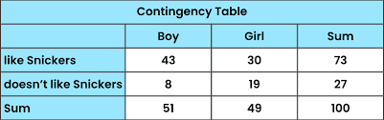
Chapter
Chi-Square test steps summary
06
Row total
Grand total
Column total

Slide 14
Chapter
Chi-Square test steps summary
06
5. Then we go on to calculate the Chi-Square test statistic as well as the resulting test P-value.
6. Compare the resulting P-value versus the value of 0.05 to decide which hypothesis to accept and which one to reject.

Slide 15
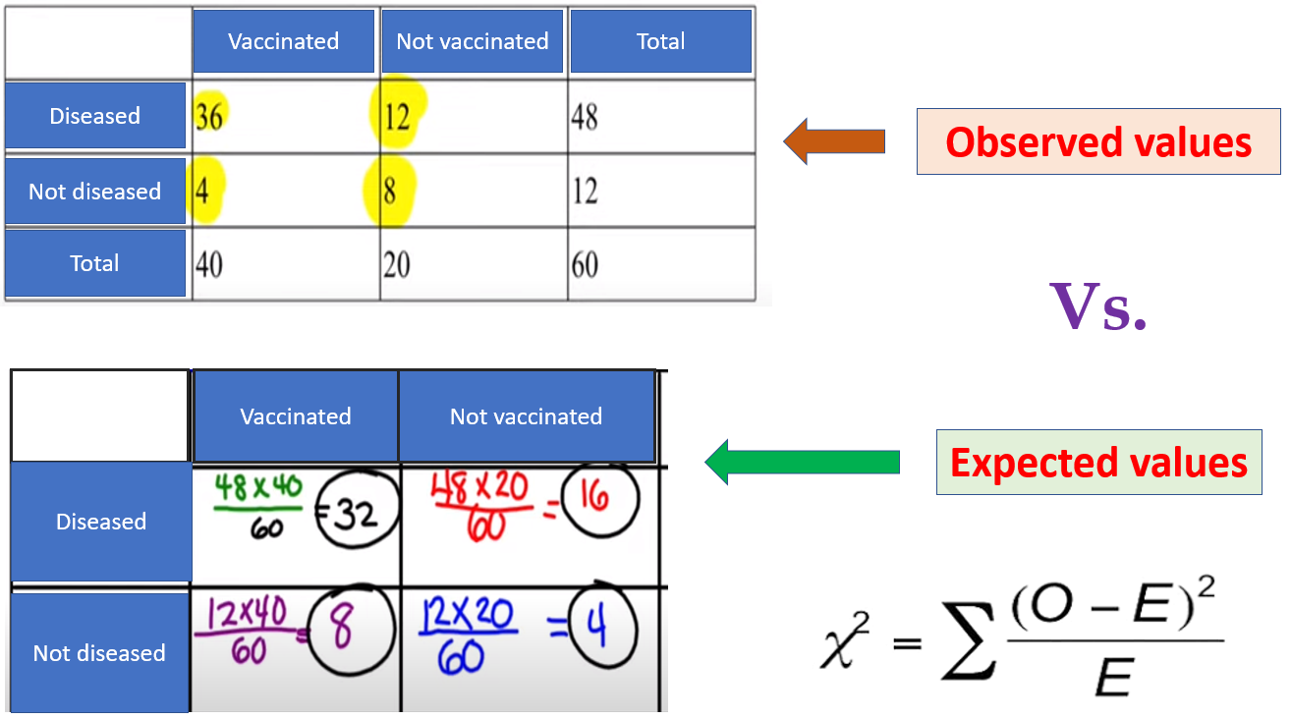

Slide 16
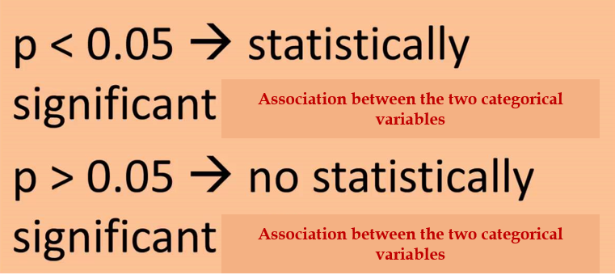

Slide 17
Chapter
Chi-Square test Assumptions
06
The rows (and columns) of the table are mutually exclusive, implying that each individual can belong to only one row and only one column.
The usual, although being conservative, approach requires that the expected frequency in each of the four cells is at least five.

Slide 18
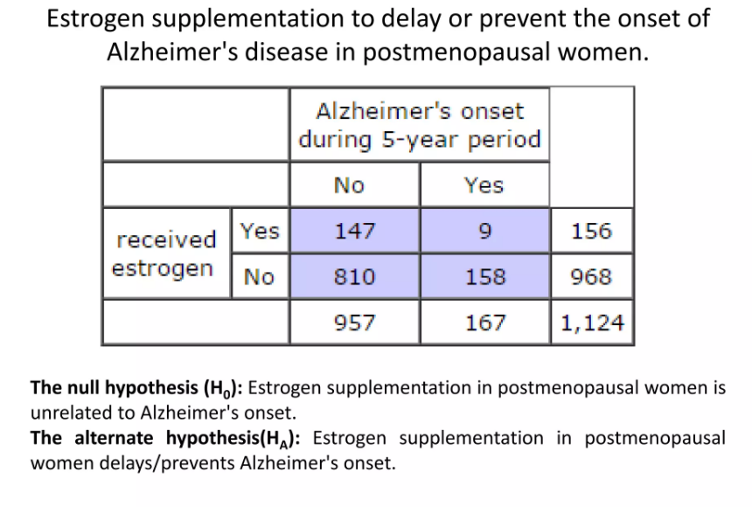

Slide 20

How can I apply Chi-Square (X²) Practically?

Slide 21
Chapter
Case Scenario (1)
06
A hospital wants to determine if there is a difference in patient satisfaction between telemedicine and in-person consultations. The responses were collected in the form of satisfied/not satisfied responses.

Slide 22
Chapter
Case Scenario (1)
06
Null Hypothesis (H0): There is no association between the type of consultation (telemedicine vs. in-person) and patient satisfaction levels.
Alternative Hypothesis (H1): There is an association between the type of consultation and patient satisfaction levels.

Slide 23
Chapter
Chi-Square test steps summary
06
 | Telemedicine consultation | In-person consultation
Satisfied | 54 | 20
Not satisfied | 10 | 66

Slide 24
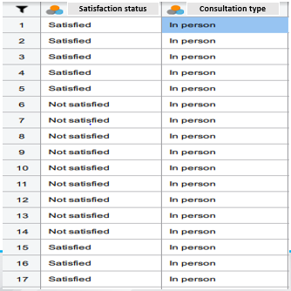

Slide 25
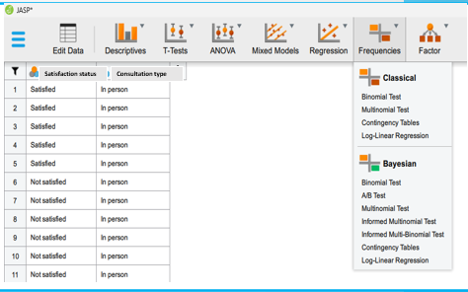

Slide 26
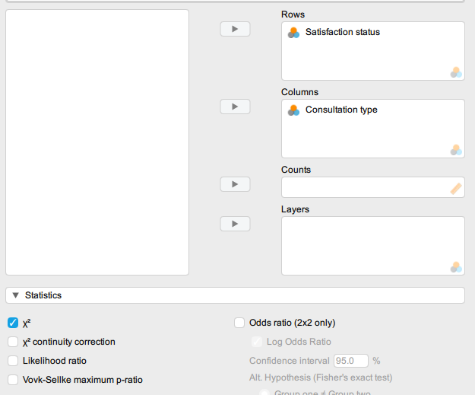

Slide 27
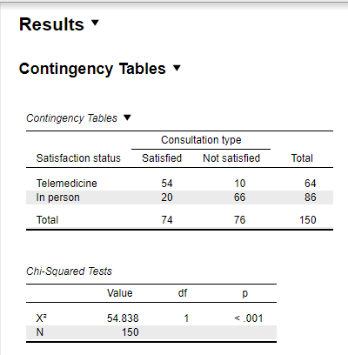

Slide 28
Chapter
Case Scenario (1)
06
Since p = 0.01 < 0.05, we reject the null hypothesis (H0).
There is sufficient evidence to conclude that there is a statistically significant association between the type of consultation (telemedicine vs. in-person) and patient satisfaction levels.

Slide 29
Chapter
Case Scenario (2)
06
A healthcare facility assesses whether compliance with infection control protocols differs among staff in different departments (e.g., Surgery, ICU, General Wards).

Slide 30
Chapter
Case Scenario (2)
06
Null Hypothesis (H0): There is no significant association between compliance with infection control protocols and the department.
Alternative Hypothesis (H1): There is a significant association between compliance with infection control protocols and the department.

Slide 31
Chapter
Chi-Square test steps summary
06
 | Compliant | Not compliant
Surgery | 11 | 15
ICU | 25 | 23
General Wards | 27 | 24

Slide 32
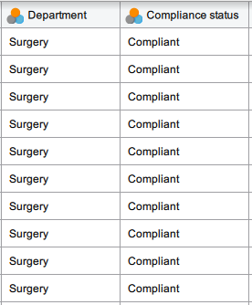

Slide 33
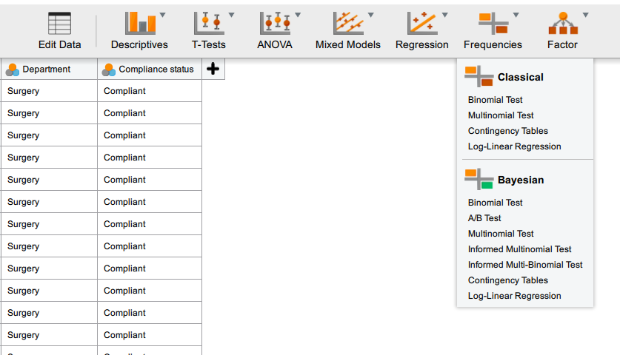

Slide 34
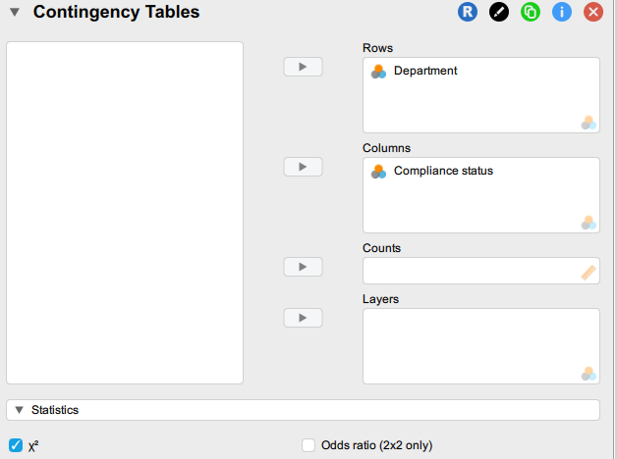

Slide 35
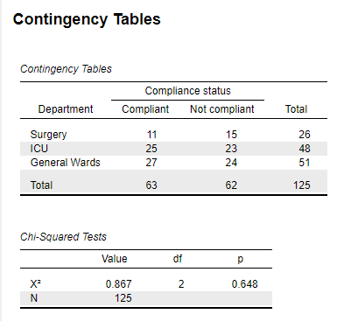

Slide 36
Chapter
Case Scenario (2)
06
Since p = 0.648 > 0.05, we reject the alternative hypothesis (H1).
There is insufficient evidence to conclude that compliance with infection control protocols differs among staff in different departments. Compliance appears to be independent of the department.

Slide 37
Chapter
TO WRAP UP
06
The Chi-square test is a statistical method used to determine if there is a significant association between categorical variables.
Data for a Chi-square test is organized into a contingency table, which displays observed frequencies in each cell for the combinations of categories.
This resulting P-value is then compared to a significance level, commonly 0.05, to determine whether to reject or retain the null hypothesis.
The Chi-square test requires mutually exclusive categories & that the expected frequencies in each cell should generally be at least five.

Slide 38



Thank You

