Slide 1

Direct Marketing
Prepared by Dr. Perihan Salah
MKT728
6

Slide 2

Direct Marketing
Lecture 6
MKT728
The Role of IMC Planning Process

Slide 3
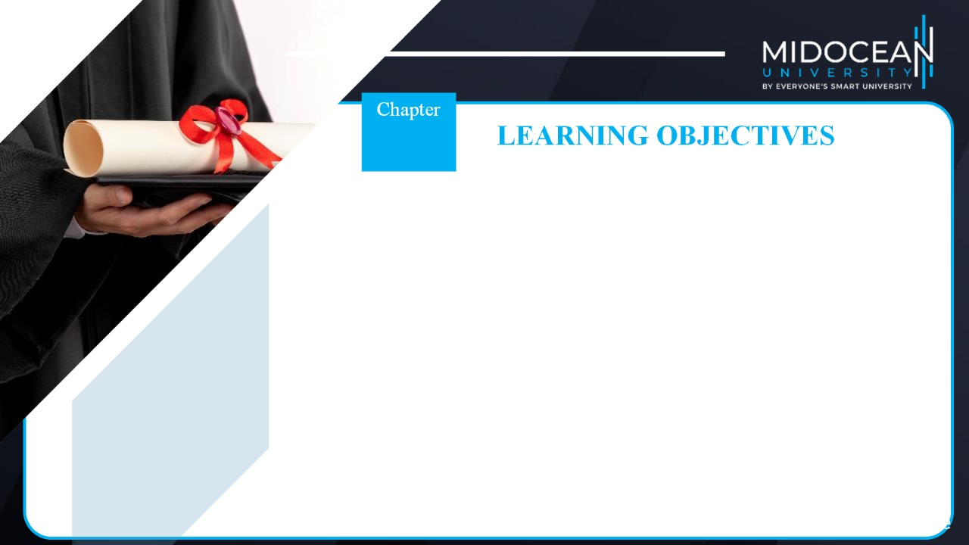
06
To recognize the area of direct marketing as a communications tool
To know the strategies and tactics involved in direct marketing
To demonstrate the use of direct-marketing media
To determine the scope and effectiveness of direct marketing

Slide 4
Direct Marketing
Interactive system of marketing (instant feedback)
Uses one or more advertising media (TV, SM..) to effect a measurable response and/or transaction at any location
Uses a set of direct-response media (billboard call for action)
Direct-response media: Tools by which direct marketers implement the communication process

Slide 5

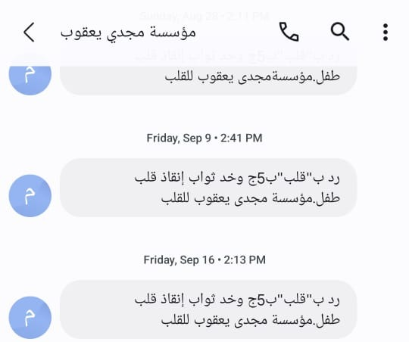
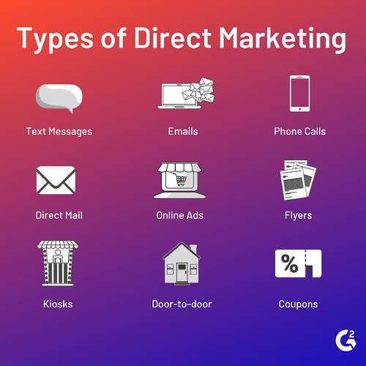
Direct Marketing

Slide 6

Factors that Led to the Growth of Direct Marketing (Importance)
Development and expansion of the Postal Service (Burda magazines-newspapers and magazines coupons – Ikea catalogue through subscription)
Consumer credit cards (buy – donate online)
Changing structure of society and market (due to weather/distance)
Technological advances (paypal-vodafone cash-fawry)

Slide 7
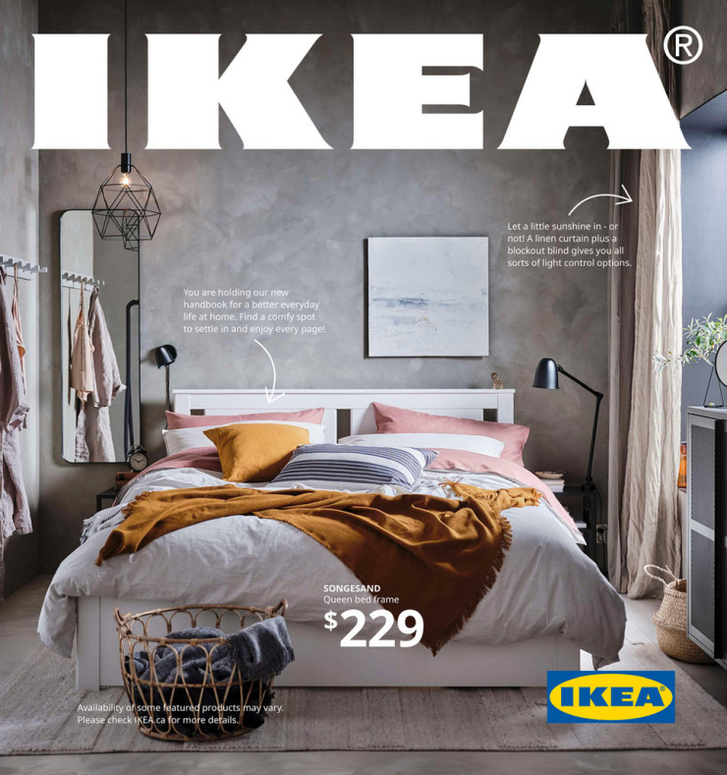
Factors that Led to the Growth of Direct Marketing (Importance)
Changing values and lifestyles (buy online)
More sophisticated marketing techniques
The industry’s improved image (low image in past while now good image)

Slide 8
Factors that Led to the Growth of Direct Marketing (Importance)
Direct marketing is one of the fastest growing forms of promotion in terms of dollar expenditures.
A number of factors have led to this extraordinary growth.
  Development and expansion of the Postal Service, which made catalogs available to both urban and rural dwellers.
  Consumer credit cards, which make it easy for consumers to purchase.

Slide 9
Factors that Led to the Growth of Direct Marketing (Importance)
  The changing structure of American society and the market - Money-rich, time-poor society
  Technological advances that make it easier for consumers to shop and for marketers to reach targeted consumers. These include electronic media and the Internet.
  Miscellaneous factors including changing values, more sophisticated marketing techniques, and the industry’s improved image.

Slide 10
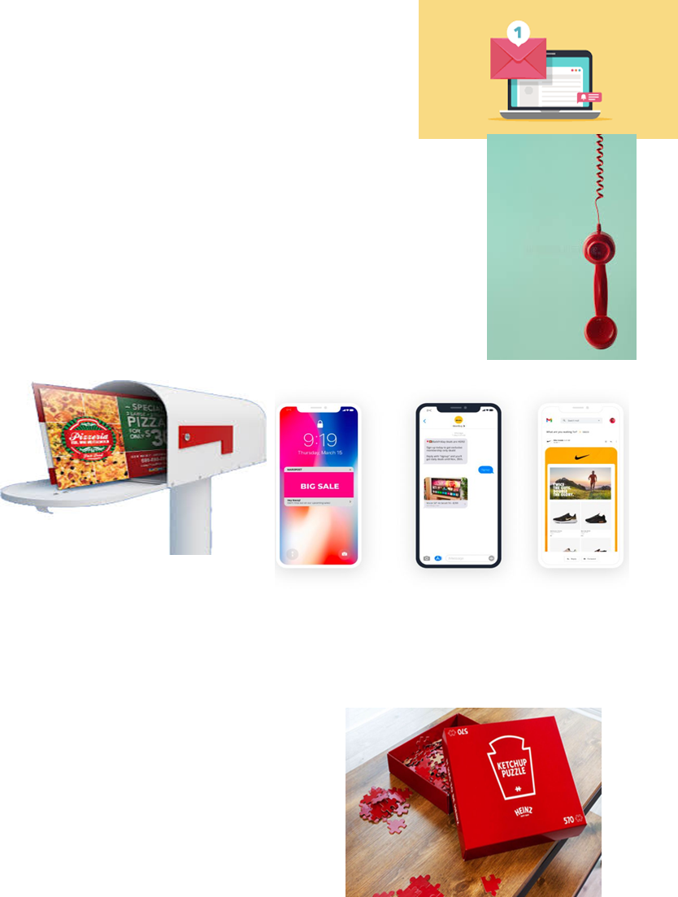
Role of Direct Marketing in the IMC Program
Combines:
  Advertising and public relations
  (donations & funds)
  Personal selling and sales promotions
  happy hours
  Support media

Slide 11
Role of Direct Marketing in the IMC Program
Direct marketing can be used in combination with other elements of the promotional mix and can work synergistically with these tools.
  Combined with advertising - Direct marketing itself is a form of advertising
  Combined with public relations - Public relations activities often employ direct-response techniques to do such things as solicit funds
  Combined with personal selling - Telemarketing and direct selling are two methods of personal selling used to generate sales

Slide 12
Role of Direct Marketing in the IMC Program
  Combined with sales promotions - Direct-mail pieces are often used to notify consumers of a sales promotion or event
  Combined with support media - Adding a promotional product to a direct mailer increases response rates

Slide 13
Role of Direct Marketing in the IMC Program
Companies decide:
  Program objectives (why DM- to inform or to give discount or to address niche)
  Which markets to target and the strategies (mail-catalogue-telephone – booth in mall) to use
  How to evaluate the program’s effectiveness
  **DM is not personal selling or sales promotion it is in between ☺

Slide 14
Role of Direct Marketing in the IMC Program
To successfully implement direct-marketing programs, companies must make a number of decisions. As in other marketing programs, they must determine:
what the program’s objectives will be,
which markets to target,
what direct-marketing strategies will be employed, and
how to evaluate the effectiveness of the program

Slide 15
Direct-Marketing Objectives
To seek a behavioral response (to know directly how they perceive my brand-observe behavior)
To build an image (using WOM let people talk about me)

Slide 16
Direct-Marketing Objectives
To maintain customer satisfaction (vodafone call survey after visiting-send for new collection/sales) CRM-sending messages
To inform and/or educate customers in an attempt to lead to future actions (tell new msg to form attitude, I have something new. Instead of doing event, I will go to your place at CFC)

Slide 17
Direct-Marketing Objectives
The direct marketer usually seeks a direct behavioral response.
Many organizations use direct marketing to build an image, maintain customer satisfaction, and inform and/or educate customers in an attempt to lead to future actions

Slide 18
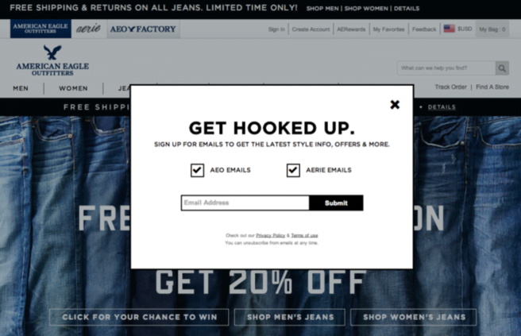
Direct-Marketing Approaches
One-step approach: Medium is used directly to obtain an order (no consent, do I agree to let u talk to me? Do u approve to use ur contacts/send offers?)

Slide 19

Direct-Marketing Approaches
Two-step approach: Uses more than one medium
  First effort - Screens potential buyers
  Second effort - Generates the response
  (1st collect data & do screening then get the most appropriate segment then take their consent to send promotions. Keeps asking every time for consent)

Slide 20
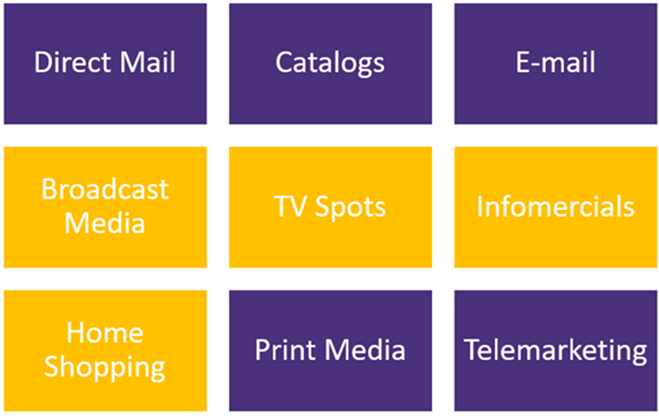

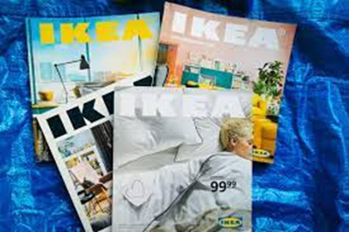
Direct-Marketing Media (Direct Response Media)

Slide 21
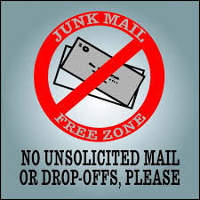
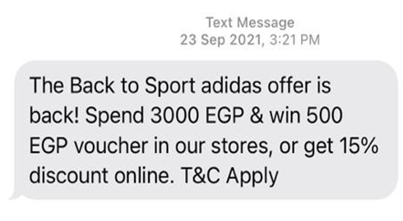
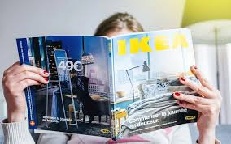
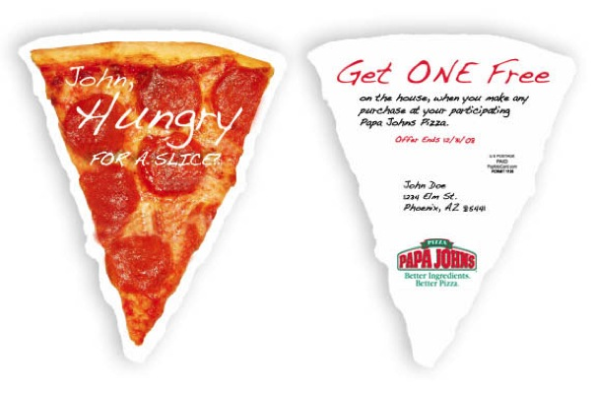
Direct Mail
Unsolicited mail (spam/junk)
Advertisers spend substantially on this medium
Keys to success
  Mailing list: Database from which names are generated (collect data while paying on cashier)
  Ability to segment markets and offers (wrong real estate calls are they willing to buy?)
  Threat – The Internet

Slide 22


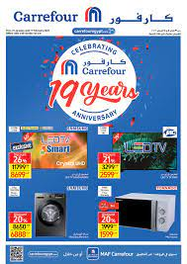
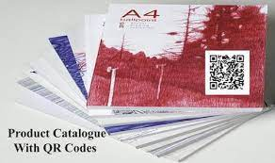


Catalogs and E-mail
Catalogs
  Number of catalogs mailed is decreasing
  Available on the Internet for consumer and business-to-business customers

Slide 23
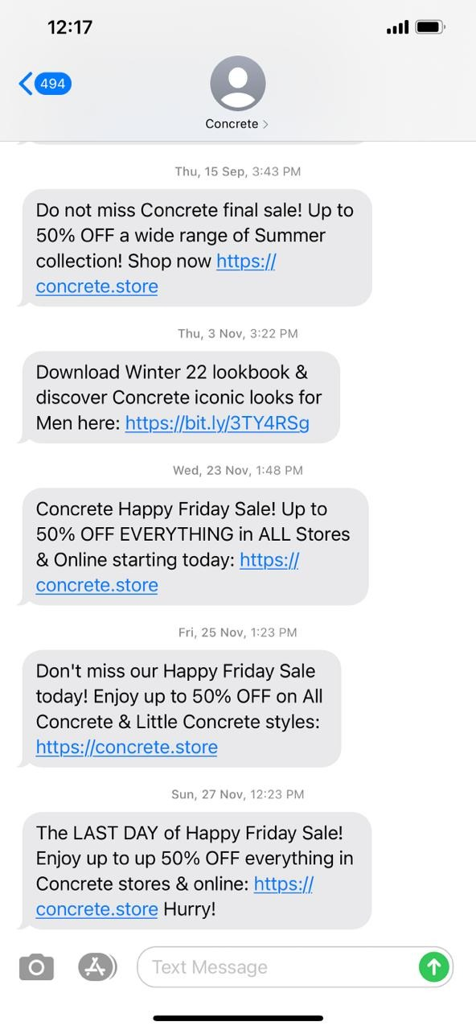
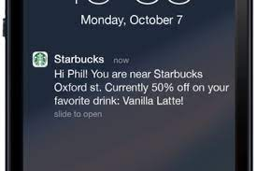
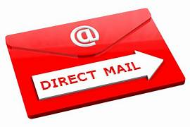
E-mail
E-mail: Electronic version of
regular mail
  Direct mail on the Internet
  Lower cost and higher effectiveness
  than traditional direct mail
  Spam: Electronic equivalent
  of junk mail (no reply no direct response)

Slide 24
Broadcast media and TV spots
Broadcast media
  Categories - Television and radio
  Direct-response advertising: Sales response for the offered product is solicited, through the one- or two-step approach
  Support advertising: Supports other forms of advertising

Slide 25

Broadcast media and TV spots
TV spots
  Short-form programs, include direct-response commercials seen on TV

Slide 26
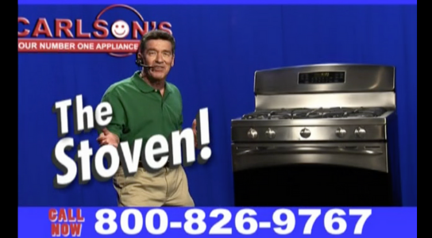
Infomercial and Home Shopping
Infomercial: Long commercial designed for 30-minute or 1-hour time slot
  Designed to be viewed as a regular TV show
  Effective with a broad demographic base

Slide 27
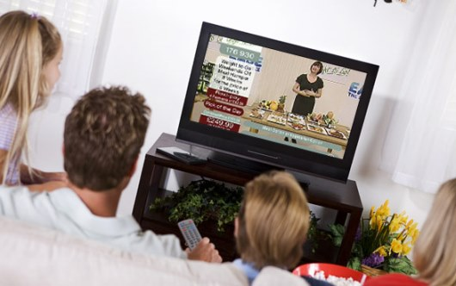
Infomercial and Home Shopping
Home shopping
  Substantial growth due to toll-free telephone numbers and widespread use of credit cards

Slide 28

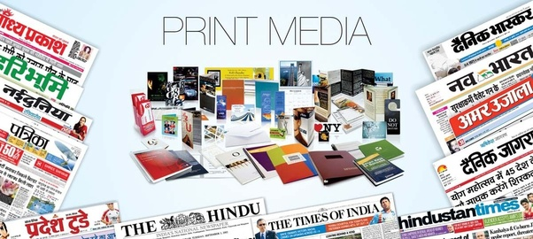
Print Media and Telemarketing
Print media
  Difficult to use for direct marketing
    Ads compete with the clutter of other ads
    Space is relatively expensive
    Response rates and profits are low

Slide 29

Print Media and Telemarketing
Telemarketing: Sales by telephone
  Declined due to its potential for fraud and deception, and for annoyance

Slide 30

Direct Selling
Direct, personal presentation, and sales in consumers’ homes
  Repetitive person-to-person selling - Salesperson visits the buyer’s location to sell frequently purchased products

Slide 31



Direct Selling
  Nonrepetitive person-to-person selling - Salesperson visits the buyer’s location to sell infrequently purchased products (Books)

Slide 32

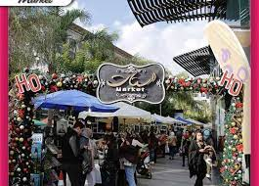





Direct Selling
  Party plans - Salesperson offers products to groups of people through parties and demonstrations

Slide 33
Evaluating the Effectiveness of Direct Marketing
Cost per order (CPO): Evaluates the relative effectiveness of an ad based on the number of calls generated (100 calls for xclusive card & 10 buy)
How many calls received asking about my product (associations) how do u know about us and who told u about us. Mention my name while paying to take commission. Am interested but can’t buy now. No thanQ

Slide 34
Evaluating the Effectiveness of Direct Marketing
Customer Lifetime Value (CLTV): Determines the dollar value associated with a long-term relationship with a customer
  Helps determine if a customer should be acquired
  Optimizes existing customers’ service levels

Slide 35

Advantages and Disadvantages of Direct Marketing
Advantages
  Selective reach (supposed to validate my DB)
  Segmentation capabilities
  Frequency
  Testing (CLTV & CPO)
  Timing (when to call or send, in meeting)
  Personalization
  Costs (low)
  Measures of effectiveness

Slide 36

Advantages of Direct Marketing
Advantages of using direct marketing:
  Selective reach - Advertisers can reach a large number of people, while minimizing waste coverage.
  Segmentation - Purchased lists allow segmentation based on geographic area, occupation, demographics, job title, and more
  Frequency - How often the target market is exposed to the ad. Inexpensive mediums allow more frequent ad runs
  Testing - Direct marketing allows for easy testing of the effectiveness of the overall program as well as specific elements.
  Timing - Direct marketing materials can often be put together and distributed quickly, unlike other media, which require long-range planning.
  Personalization - No other advertising medium can personalize the message as well as a direct media.
  Costs - Direct marketing costs can be high, but the actual CPM may be low due to the ability to specifically target the audience and eliminate waste coverage.
  Measures of effectiveness - Feedback is often immediate and always accurate.

Slide 37
Advantages and Disadvantages of Direct Marketing
Disadvantages
  Image factors (Junk, inbound call for action ad & outbound call ppl not in my list)
  Accuracy (misleading data, changed his no or address)
  Content support (limited mood creation)
  Rising costs (data is expensive)
  Do Not Contact lists (Block)

Slide 38
Disadvantages of Direct Marketing
Disadvantages of using direct marketing.
  Image factors - The mail segment of this industry is often referred to as junk mail, and junk emails fare no better. Direct-response ads on TV are often low-budget ads for lower-priced products, which contributes to the image that something less than the best products are marketed this way.
  Accuracy - Computerization has greatly improved the accuracy and currency of lists, but the cost of generating a lead can be expensive depending on the quality desired.
  Content support - Mood creation is limited to the surrounding program and/or the editorial content.
  Rising costs - As postal rates and print costs increase, direct-mail profits are directly impacted.
  Do not contact lists - Now exist for both land and cell phones, and a Do Not Contact list for junk mail is under consideration by the FTC

Slide 39
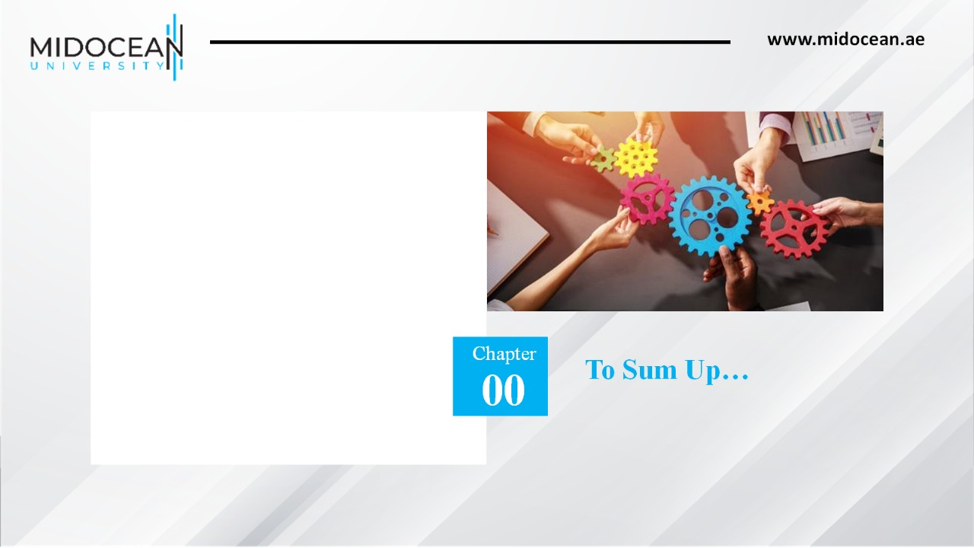
Recognized the area of direct marketing as a communications tool
Knew the strategies and tactics involved in direct marketing
Demonstrated the use of direct-marketing media
Determined the scope and effectiveness of direct marketing
06

Slide 40


