Slide 1

Business Mathematics
Prepared by Dr. Faisal Hasan
Lecture NO 10
MTH 112
Business Mathematics

Slide 2
Business Mathematics
Prepared by Dr. Faisal Hasan
Lecture NO 10
MTH 112
Business Mathematics

Slide 3
Business Mathematics
Prepared by Dr. Faisal Hasan
Lecture NO 10
MTH 112
Business Mathematics

Slide 4

Topics
Chapter 1: Mathematical preliminaries
Chapter 2: The straight line and applications
Chapter 3: Functions and Graphs
Chapter 4: Limits and Continuity
Chapter 5: Financial Mathematics
Chapter 6: Differentiation
Chapter 7: Methods of Differentiation
Chapter 8: Function of several variables
Chapter 9: Integration and applications
Chapter 10: Linear algebra and applications

Slide 5
Chapter
10
Linear Algebra and Applications
Matrices Notation and Terminology
A general m x n matrix A as
The entry that occurs in row i and column j of matrix A will be denoted .

Slide 6
Chapter
10
Linear Algebra and Applications
A matrix A with n rows and n columns is called a square matrix of order n, and the shaded entries
are said to be on the main diagonal of A.

Slide 7
Chapter
10
Linear Algebra and Applications
Two matrices are defined to be equal if they have the same size and their corresponding entries are equal.

Slide 8
Chapter
10
Linear Algebra and Applications
Consider the matrices
  If x=5, then A=B.
  For all other values of x, the matrices A and B are not equal.
  There is no value of x for which A=C since A and C have different sizes.

Slide 9
Chapter
10
Linear Algebra and Applications
Rectangular display of vectors in rows and columns
Can inform about the same vector intensity at different times or different voxels at the same time
Vector is just a n x 1 matrix
Square (3 x 3) Rectangular (3 x 2) d _{i j} : i^{th} row, j^{th} column
Defined as rows x columns (R x C)

Slide 10
Chapter
10
Linear Algebra and Applications
If A is any matrix and c is any scalar, then the product cA is the matrix obtained by multiplying each entry of the matrix A by c. The matrix cA is said to be the scalar multiple of A.

Slide 11
Chapter
10
Linear Algebra and Applications

Slide 12
Chapter
10
Linear Algebra and Applications

Slide 13
Chapter
10
Linear Algebra and Applications
For the matrices
  We have
  It common practice to denote (-1)B by –B.

Slide 14
Chapter
10
Linear Algebra and Applications
If A and B are matrices of the same size, then the sum A+B is the matrix obtained by adding the entries of B to the corresponding entries of A.
Vice versa, the difference A-B is the matrix obtained by subtracting the entries of B from the corresponding entries of A.
Note: Matrices of different sizes cannot be added or subtracted.

Slide 15
Chapter
10
Linear Algebra and Applications
Consider the matrices
  Then
  The expressions A+C, B+C, A-C, and B-C are undefined.

Slide 16
Chapter
10
Linear Algebra and Applications
Addition
  Commutative: A+B=B+A
  Associative: (A+B)+C=A+(B+C)
Subtraction
- By adding a negative matrix

Slide 17
Chapter
10
Linear Algebra and Applications
Transposition
column row row column

Slide 18
Chapter
10
Linear Algebra and Applications

Slide 19
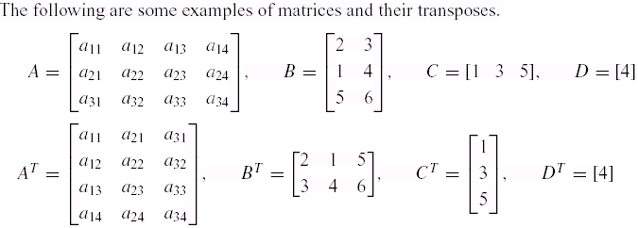
Chapter
10
Linear Algebra and Applications

Slide 20

Chapter
10
Linear Algebra and Applications
Observe that
In the special case where A is a square matrix, the transpose of A can be obtained by interchanging entries that are symmetrically positioned about the main diagonal.

Slide 21
Chapter
10
Linear Algebra and Applications
Definition
If A is a square matrix, then the trace of A ,denoted by tr(A), is defined to be the sum of the entries on the main diagonal of A .The trace of A is undefined if A is not a square matrix.

Slide 22
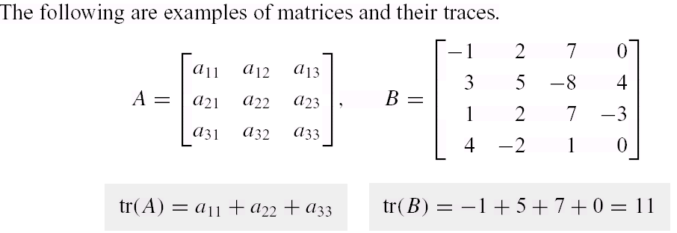
Chapter
10
Linear Algebra and Applications

Slide 23
Chapter
10
Linear Algebra and Applications
Multiplication method:
Sum over product of respective rows and columns
X
=
Define output matrix
A
B
=
=

Slide 24
Chapter
10
Linear Algebra and Applications
Matrix multiplication is NOT commutative
AB≠BA
Matrix multiplication IS associative
A(BC)=(AB)C
Matrix multiplication IS distributive
A(B+C)=AB+AC
(A+B)C=AC+BC

Slide 25
Chapter
10
Linear Algebra and Applications
Identity matrix
Is there a matrix which plays a similar role as the number 1 in number multiplication?
Consider the nxn matrix:

Slide 26
Chapter
10
Linear Algebra and Applications
Matrix inverse
Definition. A matrix A is called nonsingular or invertible if there exists a matrix such that:

Slide 27
Chapter
10
Linear Algebra and Applications
Matrix inverse

Slide 28
Chapter
10
Linear Algebra and Applications
Find the inverse of the matrix

Slide 29
Chapter
10
Linear Algebra and Applications

Slide 30
Chapter
10
Linear Algebra and Applications
Find the inverse of the matrix

Slide 31
Chapter
10
Linear Algebra and Applications

Slide 32
Chapter
10
Linear Algebra and Applications
Find the inverse of the matrix

Slide 33
Chapter
10
Linear Algebra and Applications

Slide 34
Chapter
10
Linear Algebra and Applications
Determinants
If is a square matrix of order 1,
then |A| = | a₁₁ | = a₁₁
If is a square matrix of order 2, then
|A| = = a₁₁a₂₂ – a₂₁a₁₂

Slide 35
Chapter
10
Linear Algebra and Applications
Example

Slide 36
Chapter
10
Linear Algebra and Applications

Slide 37
Chapter
10
Linear Algebra and Applications
Solution of System of 2 Linear Equations (Cramer’s Rule)
Let the system of linear equations be

Slide 38
Chapter
10
Linear Algebra and Applications
then the system is consistent and has unique solution.

Slide 39
Chapter
10
Linear Algebra and Applications
Example
Using Cramer's rule , solve the following system of equations 2x-3y=7, 3x+y=5

Slide 40
Chapter
10
Linear Algebra and Applications
Using Cramer's rule , solve the following system of equations 2x-3y=7, 3x+y=5

Slide 41
Chapter
10
Linear Algebra and Applications
Example
Using Cramer's rule , solve the following system of equations x+2y=10, 5x+8y=40

Slide 42
Chapter
10
Linear Algebra and Applications
Using Cramer's rule , solve the following system of equations x+2y=10, 5x+8y=40

Slide 43
Chapter
10
Linear Algebra and Applications
Example
Using Cramer's rule , solve the following system of equations 3x+y=12, 5x-y=4

Slide 44
Chapter
10
Linear Algebra and Applications
Using Cramer's rule , solve the following system of equations 3x+y=12, 5x-y=4

Slide 45
Chapter
10
Un solved examples

Slide 46
Chapter
10
Un solved examples
Find the inverse of the matrix

Slide 47
Chapter
10
Un solved examples
Find the inverse of the matrix

Slide 48
Chapter
10
Un solved examples

Slide 49
Chapter
10
Un solved examples
Using Cramer's rule , solve the following system of equations 2x+y=1, 4x-y=5

