Slide 1

Problem Solving as Search & State Space Search
Dr. Mohamed Mostafa
AI 511
Foundations of Artificial Intelligence
Lecture 5

Slide 2


  Uniform-Cost Strategy
Heuristic Function
  Definition
  Examples of Evaluation function
  8-Puzzle
More on Heuristic Search & Functions
  Heuristic Reduction
    A* Algorithm
    Hill Climbing Strategy
Practice Exercises
01

Slide 3
Resources for this lecture
  Chapter 3 (Structures & Strategies for State Space Search; sections 3.2, and 3.3) and Chapter 4 (Heuristic Search) from George F. Luger, "Artificial Intelligence: Structures and strategies for complex problem solving, " Sixth edition (2009), Pearson Education Limited..
  .. AND ..
  Introduction to Artificial Intelligence Course,. Dr. Amr S. Ghoneim

Slide 4
Uniform-Cost Strategy
The goal of the Uniform-Cost Strategy is to find the lowest-cost path from a starting node to a goal node in a weighted graph or tree.
Unlike other search algorithms like Breadth-First Search (BFS) or Depth-First Search (DFS), UCS prioritizes nodes based on their cumulative cost from the starting node.
cost of the path from the starting node to node
C(n)=cost of the path from the starting node to node n

Slide 5
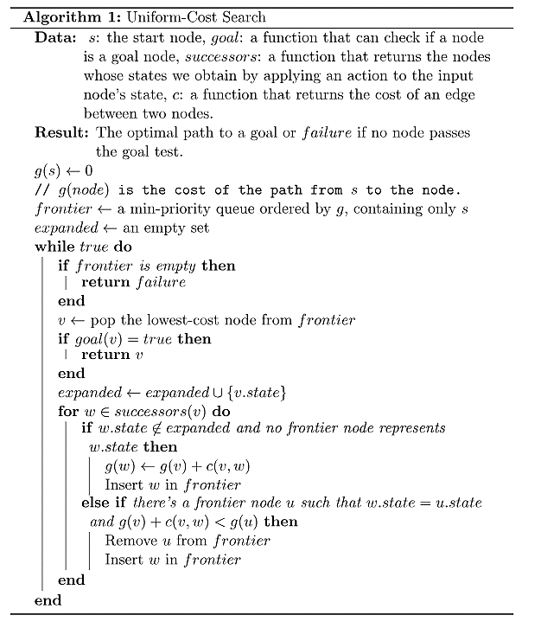
Uniform-Cost Strategy

Slide 6
Uniform-Cost Strategy
S
0
3
0
4
8
A
B
C
9
2
D
2
I
1
F
5
E
1
J
7
G

Slide 7
Uniform-Cost Strategy
S
0
S0
0
4
3
8
A
B
C
9
2
D
2
I
1
F
5
E
1
J
7
G

Slide 8
Uniform-Cost Strategy
S
0
S0
A3 B8 C4
3
0
4
S0
8
A
3
B
8
C
4
9
2
D
2
I
1
F
5
E
1
J
7
G

Slide 9
Uniform-Cost Strategy
S
0
S0
A3 B8 C4
D5 B8 C4
4
3
0
S0
A3
Need to be sorted
8
A
3
B
8
C
4
9
C4 D5 B8
2
D
2
I
5
1
F
5
E
1
J
7
G

Slide 10
Uniform-Cost Strategy
S
0
S0
A3 B8 C4
D5 B8 C4
I13 D5 B8
4
3
0
S0
A3
C4
8
A
3
B
8
C
4
9
C4 D5 B8
2
Need to be sorted
D
2
13
I
D5 B8 I13
5
1
F
5
E
1
J
7
G

Slide 11
Uniform-Cost Strategy
S
0
S0
A3 B8 C4
D5 B8 C4
I13 D5 B8
E6 B8 I13
S0
A3
C4
D5
3
0
4
8
C4 D5 B8
A
3
B
8
C
4
9
2
D
2
13
I
D5 B8 I13
5
1
F
5
E
6
1
J
7
G

Slide 12
Uniform-Cost Strategy
S
0
S0
A3 B8 C4
D5 B8 C4
I13 D5 B8
E6 B8 I13
G13 B8 I13
S0
A3
C4
D5
E6
3
0
4
8
C4 D5 B8
A
3
B
8
C
4
9
2
D
2
D5 B8 I13
13
I
5
1
F
5
E
6
1
J
7
G
13

Slide 13
Uniform-Cost Strategy
S
0
S0
A3 B8 C4
D5 B8 C4
I13 D5 B8
E6 B8 I13
G13 B8 I13
S0
A3
C4
D5
E6
3
0
4
8
C4 D5 B8
A
3
B
8
C
4
9
2
D
2
D5 B8 I13
13
I
5
1
F
5
E
6
1
J
Need to be sorted
7
B8 G13 I13
G
13
B8
F10 G13 I13

Slide 14
Uniform-Cost Strategy
S
0
S0
A3 B8 C4
D5 B8 C4
I13 D5 B8
E6 B8 I13
G13 B8 I13
S0
A3
C4
D5
E6
3
0
4
8
C4 D5 B8
A
3
B
8
C
4
9
2
D
2
D5 B8 I13
13
I
5
1
F
5
10
E
6
1
J
7
B8 G13 I13
G
11
B8
F10
F10 G13 I13
G11 G13 I13

Slide 15
Uniform-Cost Strategy
S
0
S0
A3 B8 C4
D5 B8 C4
I13 D5 B8
E6 B8 I13
G13 B8 I13
S0
A3
C4
D5
E6
3
0
4
8
C4 D5 B8
A
3
B
8
C
4
9
2
D
2
D5 B8 I13
13
I
5
1
F
5
10
E
6
1
J
7
B8 G13 I13
G
11
B8
F10
F10 G13 I13
G11 G13 I13

Slide 16

Informed Search
[ Heuristic Search ]

Slide 17
Heuristic Function
Purpose: The main purpose of a heuristic function h(N) is to guide an algorithm or decision-making process by providing an estimate of the solution's quality or the cost associated with reaching it.
f(N) can be any function you want, but will it work?
Examples: Heuristic functions h(N) can take various forms depending on the problem domain:
  In pathfinding problems, a common heuristic is the Euclidean distance between two points in a grid or the Manhattan distance.
  In scheduling problems, a heuristic might prioritize tasks based on their deadlines or resource requirements.

Slide 18
Heuristic Function
Function h(N) that estimate the cost of the cheapest path from node N to goal node.
Example: 8-puzzle
5
8
1
2
3
h(N) = number of misplaced tiles
= 6
4
2
1
4
5
6
7
3
6
7
8
N
goal
Source: Dr. Amr S. Ghoneim Lectures

Slide 19
Heuristic Function
Function h(N) that estimate the cost of the cheapest path from node N to goal node.
Example: 8-puzzle
5
8
1
2
3
h(N) = sum of the distances of
every tile to its goal position
= 2 + 3 + 0 + 1 + 3 + 0 + 3 + 1
= 13
4
2
1
4
5
6
7
3
6
7
8
N
goal
Source: Dr. Amr S. Ghoneim Lectures

Slide 20
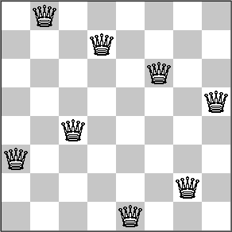

Heuristic Function
h(N) = 3
h(N) = 0
h(N) = 6
h(N) = Count the number of pairs in
attack

Slide 21
Best First Search
The best first search uses the concept of a priority queue and heuristic search.
The aim is to reach the goal from the initial state via the shortest path.
Best First Search Algorithm
Create 2 empty lists: OPEN and CLOSED
Start from the initial node (say N) and put it in the ‘ordered’ OPEN list
Repeat the next steps until the GOAL node is reached
  If the OPEN list is empty, then EXIT the loop returning ‘False’
  Select the first/top node (say N) in the OPEN list and move it to the CLOSED list. Also, capture the information of the parent node
  If N is a GOAL node, then move the node to the Closed list and exit the loop returning ‘True’. The solution can be found by backtracking the path
  If N is not the GOAL node, expand node N to generate the ‘immediate’ next nodes linked to node N and add all those to the OPEN list
  Reorder the nodes in the OPEN list in ascending order according to an evaluation function f(n)

Slide 22
Best First Search
Closed List
Open List
S
S
0
Node | h(N)
S | 14
A | 7
B | 4
C | 16
D | 5
E | 3
F | 10
G | 0
I | 9
j | 8
A
B
C
D
I
F
E
J
G

Slide 23
Best First Search
Closed List
S
Open List
S
A(7) B(4) C(16)
S
0
Node | h(N)
S | 14
A | 7
B | 4
C | 16
D | 5
E | 3
F | 10
G | 0
I | 9
j | 8
A
B
C
D
I
F
E
J
G

Slide 24
Best First Search
Closed List
S, B
Open List
S
A(7) C(16)
A(7) C(16) F(10)
S
0
Node | h(N)
S | 14
A | 7
B | 4
C | 16
D | 5
E | 3
F | 10
G | 0
I | 9
j | 8
A
B
C
D
I
F
E
J
G

Slide 25
Best First Search
Closed List
S
S, B
S, B, A
Open List
S
A(7) C(16) F(10)
S
0
Node | h(N)
S | 14
A | 7
B | 4
C | 16
D | 5
E | 3
F | 10
G | 0
I | 9
j | 8
A
B
C
D
I
F
E
J
G

Slide 26
Best First Search
Closed List
S
S, B
S, B, A
Open List
S
A(7) C(16) F(10)
C(16) F(10) D(5)
S
0
Node | h(N)
S | 14
A | 7
B | 4
C | 16
D | 5
E | 3
F | 10
G | 0
I | 9
j | 8
A
B
C
D
I
F
E
J
G

Slide 27
Best First Search
Closed List
S
S, B
S, B, A
S, B, A, D
Open List
S
A(7) C(16) F(10)
C(16) F(10)
C(16) F(10) E(3)
S
0
Node | h(N)
S | 14
A | 7
B | 4
C | 16
D | 5
E | 3
F | 10
G | 0
I | 9
j | 8
A
B
C
D
I
F
E
J
G

Slide 28
Best First Search
Closed List
S
S, B
S, B, A
S, B, A, D
S, B, A, D, E
Open List
S
A(7) C(16) F(10)
C(16) F(10)
C(16) F(10)
C(16) F(10) G(0)
S
0
Node | h(N)
S | 14
A | 7
B | 4
C | 16
D | 5
E | 3
F | 10
G | 0
I | 9
j | 8
A
B
C
D
I
F
E
J
G

Slide 29
Best First Search
Closed List
S
S, B
S, B, A
S, B, A, D
S, B, A, D, E
S, B, A, D, E, G
Open List
S
A(7) C(16) F(10)
C(16) F(10)
C(16) F(10)
C(16) F(10)
GOAL
S
0
Node | h(N)
S | 14
A | 7
B | 4
C | 16
D | 5
E | 3
F | 10
G | 0
I | 9
j | 8
A
B
C
D
I
F
E
J
G
S → A → D → E → G

Slide 30
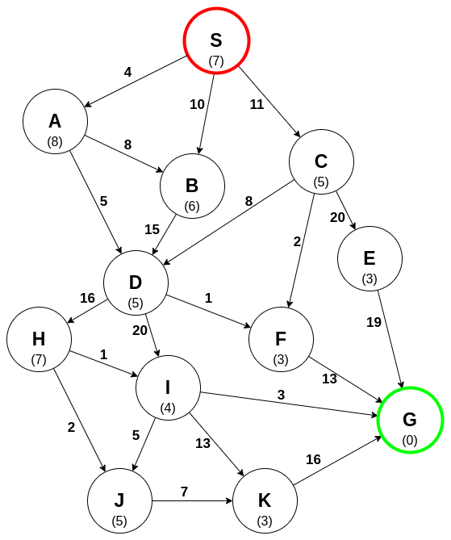
A* Algorithm
It is an informed search algorithm that selects the most promising node based on a heuristic evaluation function.
It is a searching algorithm that is used to find the shortest path between an initial and a final point.
f(x) = g(x) + h(x)
- g(x) represents the cost to get to node x
- h(x) represents the estimated cost to arrive at the goal node from node x.
Source: Codecademy

Slide 31
A* Algorithm
Algorithm Steps
Initialize a tree with the root node being the start node S.
Remove the top node from the open list for exploration.
Add the current node to the closed list.
Add all nodes that have an incoming edge from the current node as child nodes in the tree.
Update the lowest cost to reach the child node.
Compute the evaluation function for every child node and add them to the open list.
Source: Codecademy

Slide 32
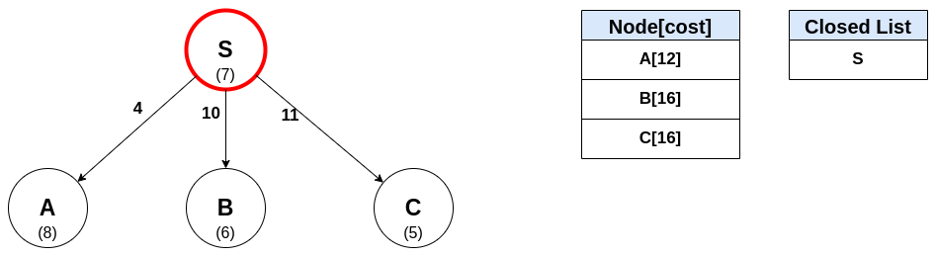
A* Algorithm
Source: Codecademy

Slide 33
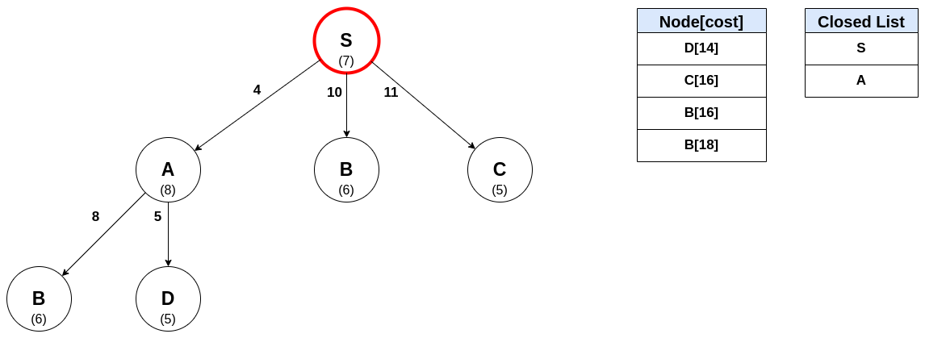
A* Algorithm
Source: Codecademy

Slide 34
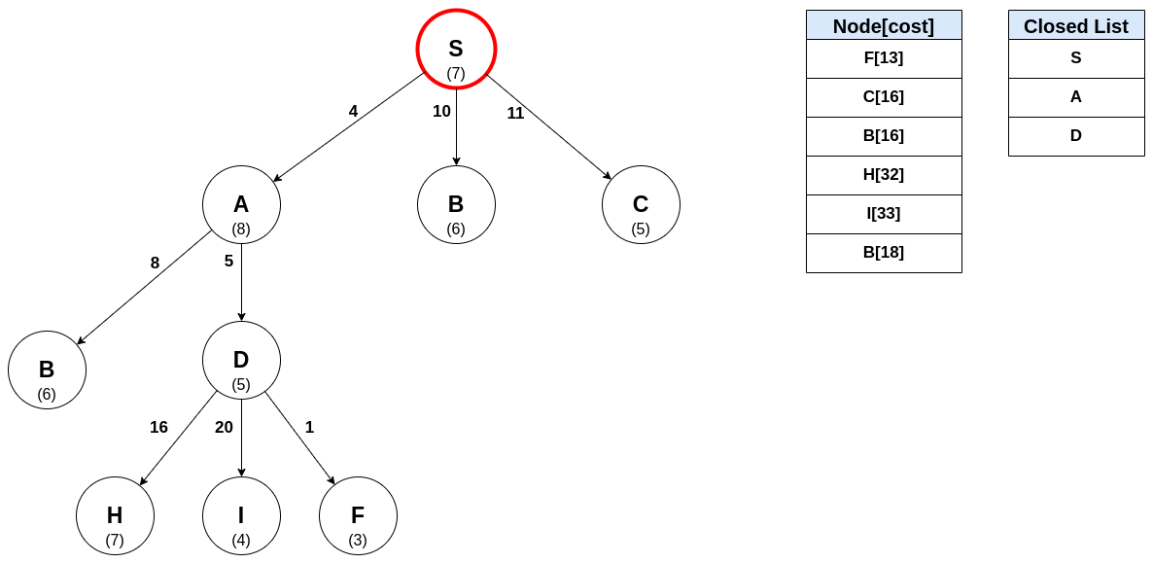
A* Algorithm
Source: Codecademy

Slide 35
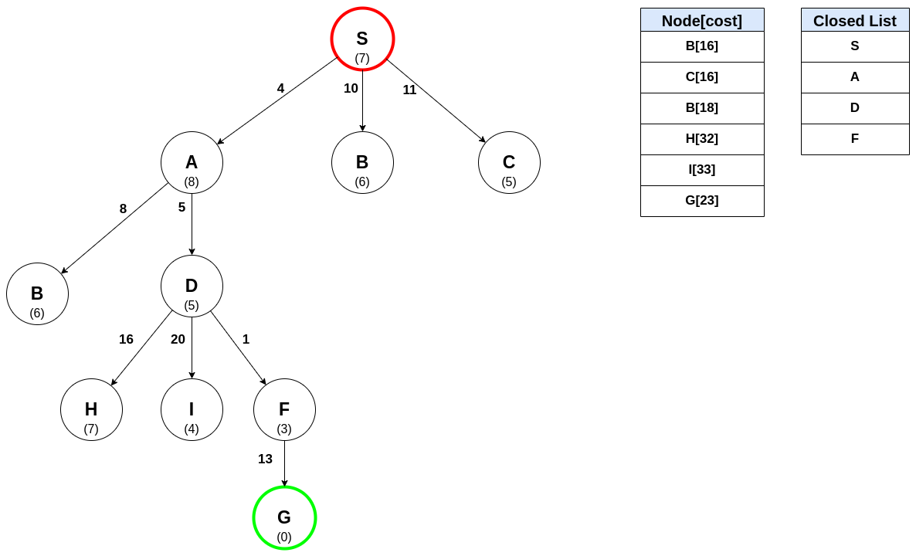
A* Algorithm
Source: Codecademy

Slide 36
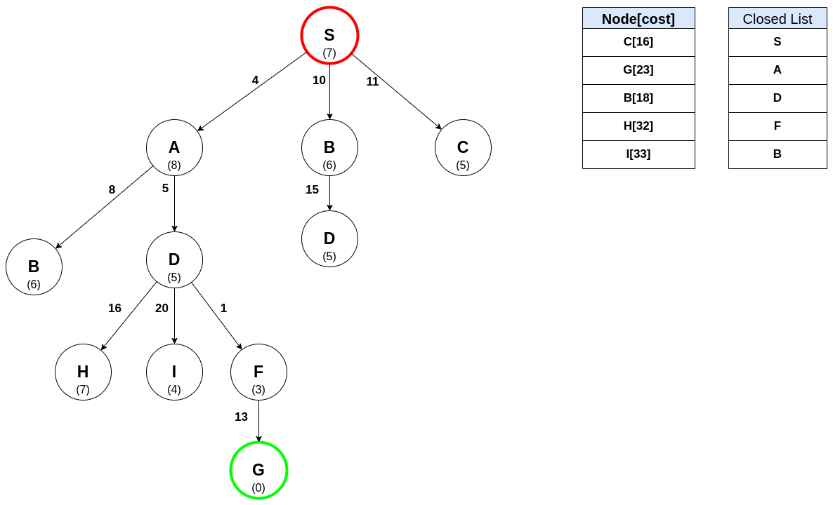
A* Algorithm
Source: Codecademy

Slide 37
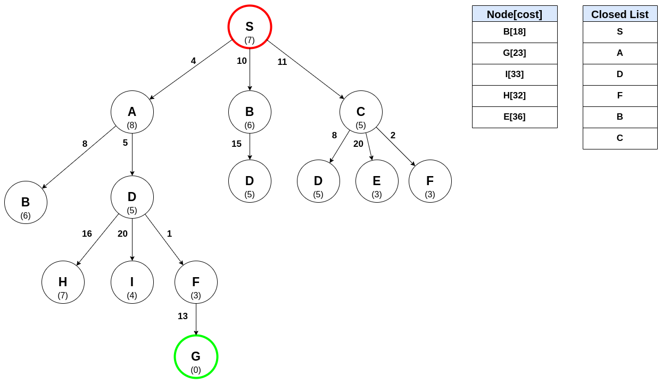
A* Algorithm
Source: Codecademy

Slide 38
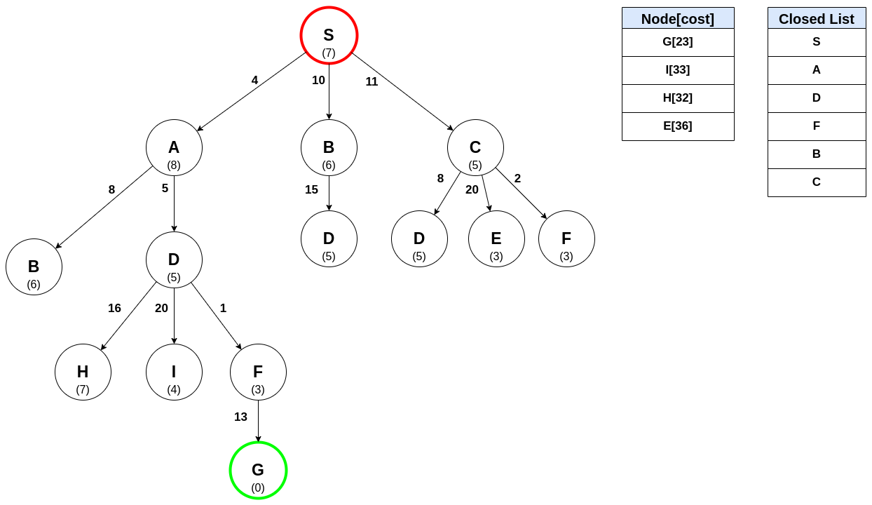
A* Algorithm
Source: Codecademy

Slide 39
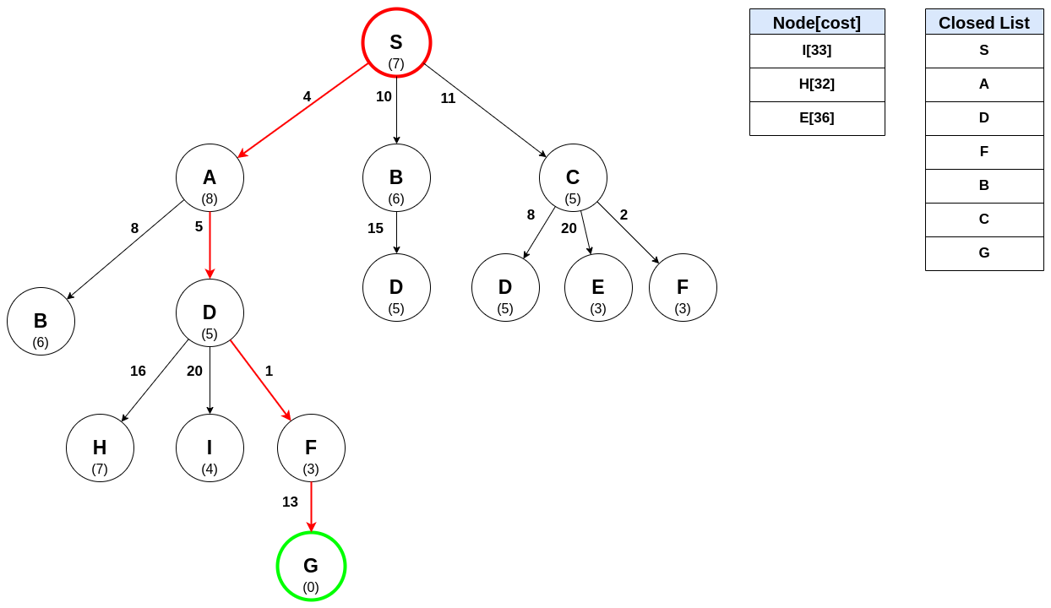
A* Algorithm
Source: Codecademy

Slide 40
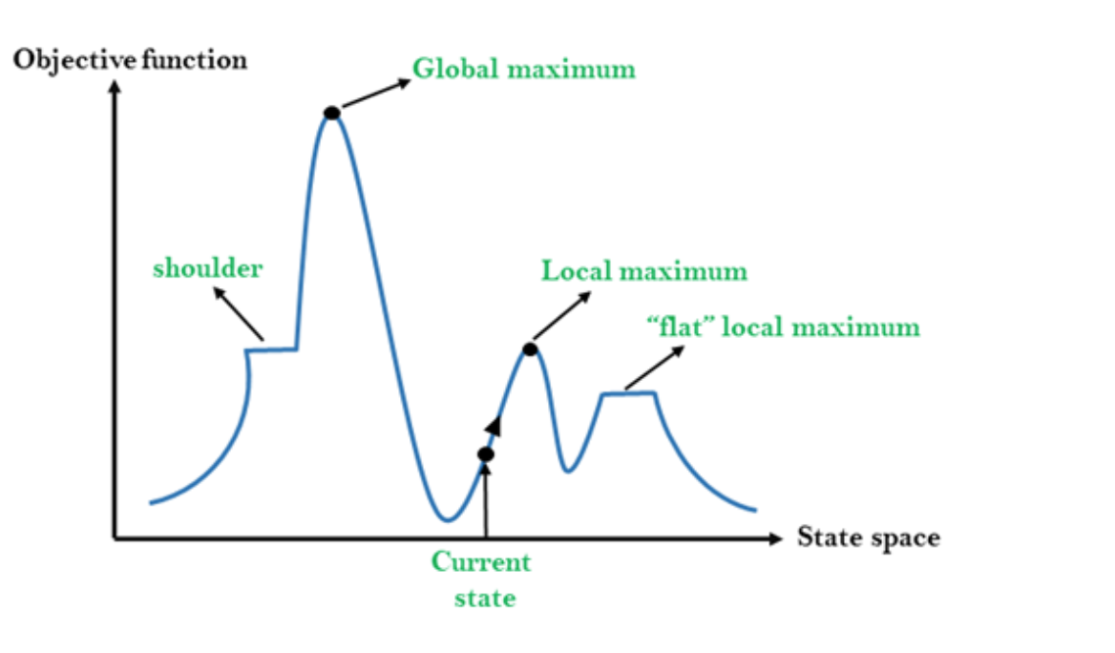
Hill Climbing
The hill climbing search algorithm is a local search algorithm used for optimization problems. It is designed to find the highest point or the best solution within a given search space by iteratively exploring neighboring solutions.
Algorithm Steps:
Initialization: Start with an initial solution within the search space.
Evaluation: Evaluate the quality of the current solution using an objective function or fitness measure.
Neighbor Generation: Generate neighboring solutions by making small modifications to the current solution.
Selection: Choose the best neighboring solution based on its objective function value.
Comparison: Compare the objective function value of the best neighboring solution with the current solution.
Iteration: Repeat the process until a termination condition is met.
Source: Codecademy

Slide 41
Hill Climbing
Types of Hill Climbing Algorithm:
  Simple hill Climbing:
    Simple Hill Climbing is a basic variant of the hill climbing algorithm.
  Steepest-Ascent hill-climbing:
    represents an advancement over the basic hill climbing algorithm. In this approach, during each iteration, it thoroughly assesses all nearby solutions. Among these neighboring solutions, it picks the one that provides the most substantial enhancement in the objective function.
  Stochastic hill Climbing:
  Stochastic Hill Climbing is a probabilistic variant of the hill climbing algorithm.
  Instead of always selecting the best neighboring solution, it randomly selects a neighboring solution with a probability based on its quality.
  This introduces an element of randomness into the search process, allowing the algorithm to escape local optima and explore a wider range of solutions.
  Stochastic Hill Climbing is particularly useful for optimization problems with a large search space or multiple local optima.

Slide 42
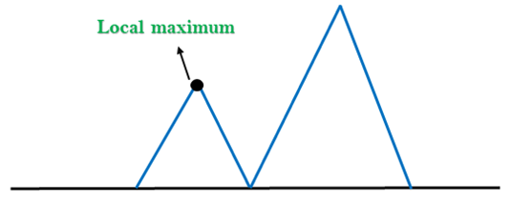
Hill Climbing
Problems in Hill Climbing Algorithm:
1. Local Maximum: A local maximum is a peak state in the landscape which is better than each of its neighboring states, but there is another state also present which is higher than the local maximum.
Solution: Backtracking technique can be a solution of the local maximum in state space landscape. Create a list of the promising path so that the algorithm can backtrack the search space and explore other paths as well.
Source: JavaPoints

Slide 43
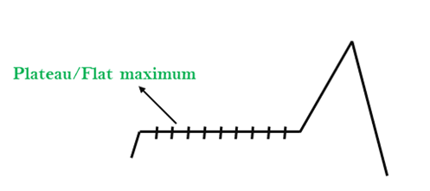
Hill Climbing
Problems in Hill Climbing Algorithm:
2. Plateau: A plateau is the flat area of the search space in which all the neighbor states of the current state contains the same value, because of this algorithm does not find any best direction to move. A hill-climbing search might be lost in the plateau area.
Solution: The solution for the plateau is to take big steps or very little steps while searching, to solve the problem. Randomly select a state which is far away from the current state so it is possible that the algorithm could find non-plateau region
Source: JavaPoints

Slide 44
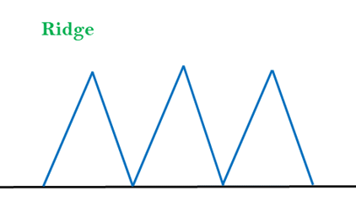
Hill Climbing
Problems in Hill Climbing Algorithm:
3. Ridges: A ridge is a special form of the local maximum. It has an area which is higher than its surrounding areas, but itself has a slope, and cannot be reached in a single move.
Solution: With the use of bidirectional search, or by moving in different directions, we can improve this problem.
Source: JavaPoints

Slide 45
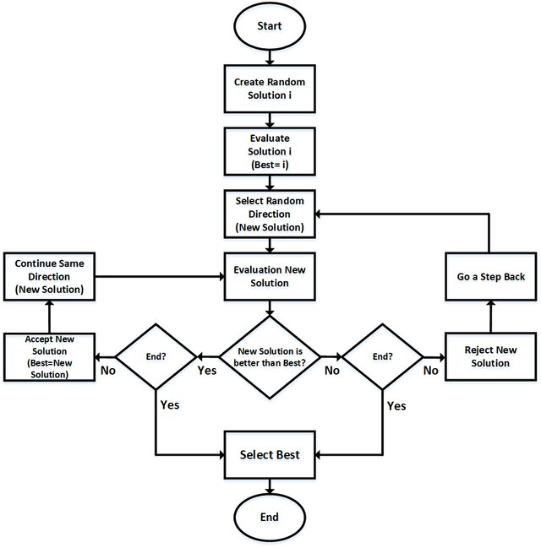
Hill Climbing Real-World Applications

Slide 46
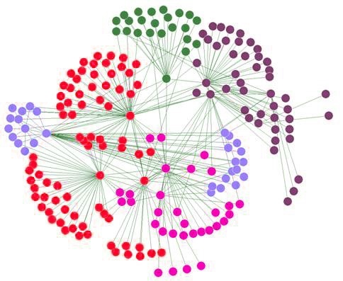
Hill Climbing Real-World Applications
Network Routing
  Hill Climbing can be employed to enhance the efficiency of routing decisions, leading to optimized data packet traversal across the network. By continuously refining the selection of routes, Hill Climbing aids in minimizing congestion and reducing latency, ultimately improving the overall performance of the network.

Slide 47

Hill Climbing Real-World Applications
Game Strategy Optimization
  Hill Climbing is used to optimize game strategies and decision-making processes. For example, it can fine-tune the behavior of non-player characters (NPCs) in video games to make them more challenging or responsive.
  .

Slide 48
Additional Resources
  A* Search Algorithms
  https://www.codecademy.com/resources/docs/ai/search-algorithms/a-star-search
  Greedy-best-first algorithms
  ttps://www.codecademy.com/resources/docs/ai/search-algorithms/greedy-best-first-search

Slide 49
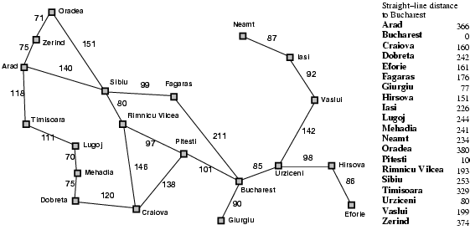
Exercises
Consider the following problem from Arad to Budapest :
Perform a Uniform Cost Search to find the shortest path.

Slide 50



Thank You

