Slide 1



Object Oriented Programming
Prepared by Dr. Yasser Abdelhamid
IT223
Object Oriented Programming
Lecture 06

Slide 2

outline
Java control statements
Decision making
If statement
Switch statement
For loop
While loop
Do-while loop
Break statement
Continue statement

Slide 3
Control statements

Slide 4
Control statements
Control statements are used to change the sequence of executing program code to fulfil the desired logic of the program.

Slide 5
Control statements
Java provides three types of control flow statements.
Decision Making statements
  if statements
  switch statement
Loop statements
  do while loop
  while loop
  for loop
  for-each loop
Jump statements
  break statement
  continue statement

Slide 6
Decision-Making statements

Slide 7
decision-making statements
According to a conditional expression which gives a Boolean value (True/False), decision-making statements control the program flow.

Slide 8
if statement
Syntax:
  if ( <condition> ) {
  <statement1> ;
  }
  Example:
  public class Student {
    public static void main(String[] args) {
      int x = 10;
      int y = 12;
      if (x+y > 20) {
      System.out.println("x + y is greater than 20");
      }
    }
  }
We use this form when we want to execute a code block when a condition is true.

Slide 9
if else statement
Syntax:
  if ( <condition> ) {
  <statement1>;
  }
  else {
  <statement2>;
  }
  Example:
  public class Student {
    public static void main(String[] args) {
      int x = 10;
      int y = 12;
      if(x+y < 10) {
      System.out.println("x + y is less than 10");
      } else {
      System.out.println("x + y is greater than 20");
      }
    }
  }
We use this form when we want to execute a code block when a condition is true, and execute another code block if it is false.

Slide 10
if-else-if
Syntax:
  if( <condition1> ) {
  <statement1>;
  }
  else if( <condition2> ) {
  <statement2>;
  }
  else {
  <statement3>;
  }
We use this form when we have multiple conditions and multiple code blocks to execute when each of these conditions is true.

Slide 11
Example:
public class Student {
  public static void main(String[] args) {
    String city = “Unknown";
    if(city == “Cairo") {
    System.out.println("city is Cairo");
    }else if (city == “Aswan") {
    System.out.println("city is Aswan");
    }else if(city == “Alexandria") {
    System.out.println("city is Alexandria");
    }else {
    System.out.println(city);
    }
  }
}
We use this form when we have multiple conditions and multiple code blocks to execute when each of these conditions is true.

Slide 12
nested if statement
Syntax:
  if(<condition1>) {
  <statement1>;
  if(<condition 2>) {
  <statement 2>;
  }
  else {
  statement 2;
  }
  }
Nested conditions implement logical AND of multiple conditions

Slide 13
nested if statement
public class Student {
  public static void main(String[] args) {
    String address = “12";
    if(address.endsWith(“2")) {
    if(address.contains(“1")) {
    System.out.println(“String is 12");
    }else {
    System.out.println(“String ends with 2");
    }
    }
  }
}

Slide 14
switch statement
Switch statement is an easy way to implement multiple if statements.
The case variables can be int, short, byte, char, or enumeration.
String type is also supported since version 7 of Java
Cases cannot be duplicated.
Break statement terminates the switch block when the condition is satisfied.
Break statement is optional, if not used, next case is executed.

Slide 15
switch statement
Syntax:
  switch (<expression>){
  case <value 1>:
  <statement1>;
  break;
  .
  .
  .
  case <value N>:
  <statement>;
  break;
  default:
  <default statement>;
  }

Slide 16
switch statement
public class Student {
  public static void main(String[] args) {
    int num = 2;
    switch (num){
      case 0:
        System.out.println("number is 0");
        break;
      case 1:
        System.out.println("number is 1");
        break;
      default:
      System.out.println(num);
    }
  }
}

Slide 17
for loop

Slide 18
loop statements
A loop statement is a code block that needs to repeated.
  a specific number of times
  while a condition holds
  until a condition occurs
An iteration is a single pass of a loop.
The Java for loop is used to repeat a part of the program several times.
It is the perfect choice when the number of iterations is known.

Slide 19
for loop statement
Syntax:
  for( [<initialization>] ; [<condition>] ; [<increment/decrement>]){
  <statement>;
  }
  <Initialization> is executed once when the loop starts. Here, we can initialize the iterator variable, or we can use an already initialized variable. It is an optional condition.
  <condition> is executed each iteration to decide whether to execute the for loop code block or not. It must return boolean value either true or false. It is an optional condition.
  <increment/decrement> : It changes the value of the iterator variable either by incrementing or decrementing its value. It is an optional condition.
  <statement> is executed each iteration until <condition> turns to false.

Slide 20
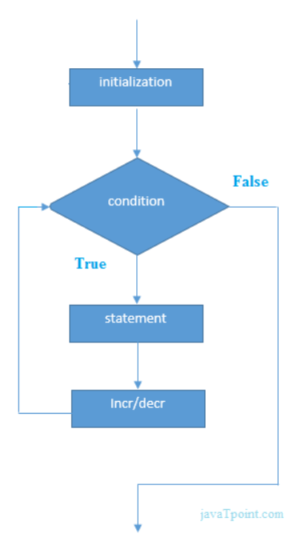
for loop statement

Slide 21
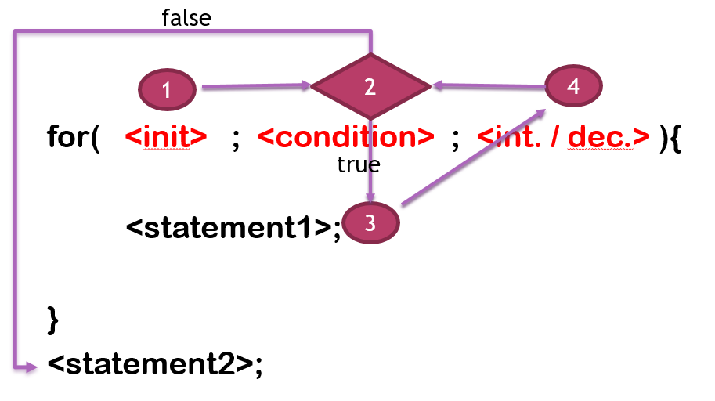
For loop statement execution

Slide 22
Examples
public static void main(String[] args) {
for( int i=1; i<=5 ; i++ ){
System.out.println( i );
}
}
What is the output of this method?
What is the value of i after the loop?

Slide 23
Java Nested for Loop
public static void main(String[] args) {
  for(int i=1;i< 8;i++){
    for(int j=1;j< 3;j++){
    System.out.println(i+" "+j);
    }
    // ??? What is the value of j here
  }
  // ??? What is the value of i here
}

Slide 24
Example
public static void main(String[] args) {
  for(int i=1;i<=5;i++){
    for(int j=1;j<=i;j++){
    System.out.print("* ");
    }
    System.out.println(); //new line
    }
  }
}
What is the output of this program?

Slide 25
example
public static void main(String[] args) {
  int k=6;
  for(int i=1;i<=k;i++){
    for(int j=k;j>=i;j--){
    System.out.print("* ");
    }
    // What if i put break statement here?
    System.out.println();
  }
}
What is the output of this program?

Slide 26
infinitive loop
for(;;){ }
Is this a correct statement?
What does it do?

Slide 27
Assignment 1
Using for loop…
Draw an equilateral triangle.
Draw an isosceles triangle.
Draw a rectangle.
Draw a rhombus.
Draw a parallelogram.

Slide 28
While Loop

Slide 29
While Loop
Syntax:
  while (<condition>){
  <statement>;
  <Increment / decrement>;
  }

Slide 30
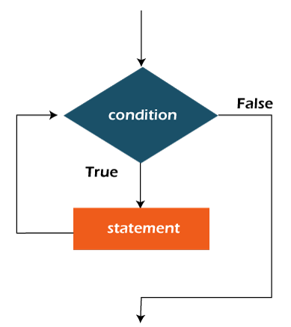
While Loop
while loop is used to iterate a code block repeatedly as long as a specified condition is true.

Slide 31
example
public static void main(String[] args) {
int i=1;
while(i<10){
System.out.println(i);
i++;
}
}
What is the output of this program?
Reverse it.

Slide 32
Assignment 2
Implement an infinite loop using while statement.
Redo assignment 1 using while statement.

Slide 33
do-while loop

Slide 34
do-while loop statement
Syntax:
  do {
  <statement>;
  <increment/decrement>;
  } while ( <condition>);
  <statement> is executed each iteration until <condition> turns to false.
  <condition> is executed each iteration to decide whether to execute the do-while loop code block or not. It must return boolean value either true or false.
  <increment/decrement> : It changes the value of the iterator variable either by incrementing or decrementing its value.
  Notice that the do-while code block is executed at least once.

Slide 35
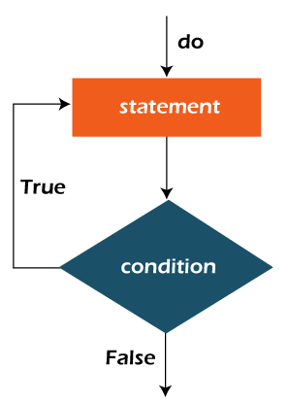
do-while loop statement

Slide 36
Examples
public class DoWhileExample {
  public static void main(String[] args) {
  int i=1;
  do{
  System.out.println(i);
  i++;
  } while( i<=3 );
  }
}
What is the output of this method?
What is the value of i after the loop?

Slide 37
Break statement
  public class BreakExample {
    public static void main(String[] args) {
    for(int i=1;i<=10;i++){
    if(i==5){
    break;
    }
    System.out.println(i);
    }
    }
  }
  What is the output of this program?
  What is the value of i after the loop?

Slide 38
Example
public class BreakExample {
  public static void main(String[] args) {
  for(int i=1;i<=3;i++){
  for(int j=1;j<=3;j++){
  if(i==2&&j==2){
  break;
  }
  System.out.println(i+" "+j);
  }
  }
  }
}

Slide 39
Continue Statement
The Java continue statement is used to continue the loop.
Example:
  public class ContinueExample {
    public static void main(String[] args) {
      for(int i=1;i<=10;i++){
      if(i==5){
      continue;
      }
      System.out.println(i);
      }
    }
  }

Slide 40
example
  public class ContinueExample2 {
    public static void main(String[] args) {
    for(int i=1;i<=3;i++){
    for(int j=1;j<=3;j++){
    if(i==2&&j==2){
    continue;
    }
    System.out.println(i+" "+j);
    }
    }
    }
  }

Slide 41
SUmmary
Java control statements
Decision making
If statement
Switch statement
For loop
While loop
Do-while loop
Break statement
Continue statement

Slide 42


Thank You

