Slide 1


DIGITAL MARKETING
APPLICATIONS
Prepared by Dr. HEBA ZIAD
COURSE CODE - MKT720
lecture 5

Slide 2
Relationship marketing using digital platforms
Chapter at a glance
Main topics
Using social media to improve customer loyalty and advocacy
Using big data and artificial intelligence to support data
Applications of artificial intelligence in marketing
Lecture 5
COURSE CODE - MKT720

Slide 3
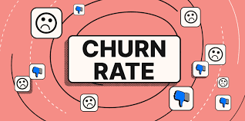
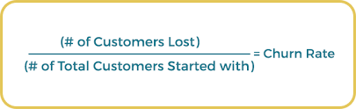
Relationship marketing using digital platform
building long-term relationships with customers is essential for any sustainable business , the advent of digital marketing means that comparing and switching providers of different services is easier than previously. yet improved insights about our audience and new personalized messaging channels give new opportunities to build relationship and encourage loyalty and decrease churn rates. failure to build relationships repeat visitors and sales has caused the failure of many online startups, which have forfeited large expenditure on customer acquisition.
, relationship marketing, direct marketing and database marketing have combined to enable customer relationship management (CRM). More recently, marketing automation technology has been widely used across businesses to create rules that schedule more relevant emails and personalized communications on company websites.
Churn rates The percentage of customers who end their relationship with a company, typically calculated as the number of customers who left a company during a period divided by total customers at the beginning of the period. It is straightforward to calculate for subscription businesses, but requires a definition of‘ active customers' for other types of business, such as retailing.

Slide 4
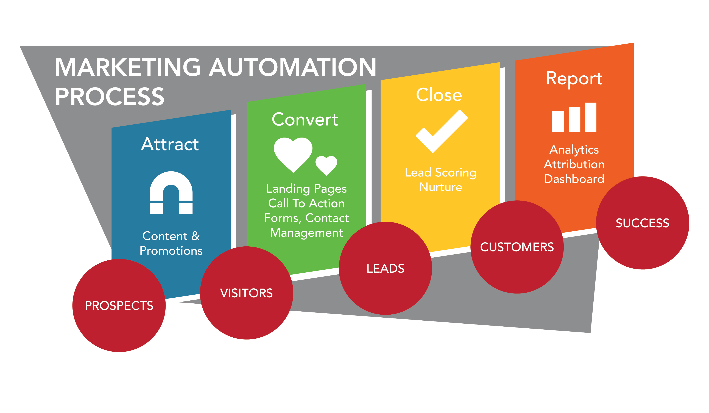
Marketing automation is a potentially powerful digitally-enabled technique since it can provide more relevant, more contextual messaging to customers, which has an improved response and value to customers because of its relevance. Marketing automation can support different touch-points across the lifecycle For prospect and customer communications in larger enterprises, the management of these messages is now often known as marketing orchestration - part of the 'always-on' approach to communications used to deliver relevant messages, The analogy of a conductor and their orchestra is appropriate since it suggests the large number of people who need to be aligned in their actions at the right time.
Given the challenge of churn and the difficulty in achieving customer engagement with the increase in media fragmentation and the development of high-attention media such as social networks, the need for developing a structured, automated approach to communicating with customers across the lifecycle has become more urgent.
Customer relationship management (CRM) A marketing-led approach to building and sustaining long-term business with customers.
Marketing automation technology Enables businesses to automate tasks in the marketing and sales process to deliver more relevant communications, typically delivered as personalized emails and website messages.

Slide 5
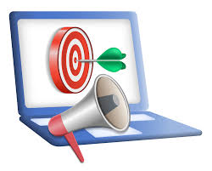
Every customer interaction or response to a communication should be followed up by a series of relevant communications delivered by the right combinations of channel (web, email, phone, direct mail) to elicit a response or further dialogue. This is contextual marketing, where the aim is to deliver relevant messages that fit the current context of what the customer is interested in according to the searches they have performed, the type of content they have viewed or the products they have recently purchased.
Why is context marketing important?
Context marketing converts better.
When you're creating marketing that's targeted at people's point of need, it stands to reason that marketing will perform much better for you, because you aren't delivering marketing content that's misaligned with their interests or stage in the buyer’s journey.
Context marketing increases retention.
When you have context around your relationship with a contact, you're able to provide more personalized and relevant marketing content that's targeted to their needs.
Marketing orchestration Designing customer contact strategies to deliver the most relevant, most responsive messages integrated across different communications channels based on customer context. Communications strategies are managed by marketing automation systems using rules or Artificial Intelligence based on Big Data analysis rather than manually created campaigns.
Contextual marketing refers to online and mobile marketing that provides targeted advertising based upon user information, such as the search terms they’re using or recent web-browsing activity ,The goal is to present ads to customers representing products and services they are already interested in.

Slide 6
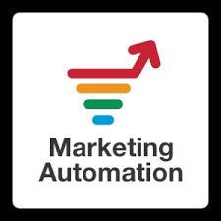
Marketing automation is the term currently used to describe a closely related approach known as one-to-one marketing. However, owing to the costs of managing relationships on an individual level, many companies will apply marketing automation to tailor communications and offers to customer segments or groups, rather than individuals.
(Marketing automation is all about getting more done with fewer resources)
One-to-one marketing A unique dialogue occurs between a company and individual customers (or groups of customers with similar needs) using automation and personalization to increase relevance.
Electronic customer relationship management
(E-CRM)Using digital communications technologies to maximize sales to existing customers and encourage continued usage of online services through techniques including database, personalized web messages, customer services, email and social media marketing. Today, CRM is synonymous with E-CRM.

Slide 7

Social media marketing has many applications throughout the customer lifecycle, but arguably, it is most effective when it is used to develop existing relationships and encourage advocacy to create brand awareness and favorability. This advocacy is not limited to customers, it can also involve influencers, partners and employees.
What is Organic Reach?
“organic” social media is distinct from “paid” social media. “Organic reach” is the number of people you can reach for free by simply posting to your company’s social media. “Paid reach” is when you pay for ads to reach a targeted group of users on a social platform.
Organic social media marketing
It's common practice to distinguish between organic and paid social media marketing activities in a similar way to organic and paid search marketing. Organic social involves using social networks and customer communities to develop relationships, share positive opinions through social media amplification and manage negative social media comments.

Slide 8
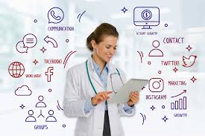
What is social media marketing & why it is important?
Social media marketing is based on how we can use consumer-to-consumer (C2C) interactions to increase awareness of our brand through social media amplification while minimizing negative mentions. To apply this effectively for communications, we have to recognize that social media involves participation in discussions and sharing of ideas and content, which is often facilitated by social networks but can occur in other locations.
Social media is the term commonly given to Internet and mobile-based channels and tools that allow users to interact with each other and share opinions and content. As the name implies, social media involves the building of communities or networks and encouraging participation and engagement.
Social media amplification
A method of increasing awareness of a brand through organic and paid sharing of social media updates via social networks as organic social posts and adverts are displayed in the stream of social network users,

Slide 9
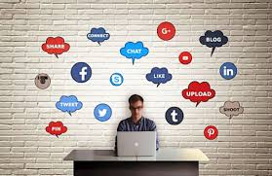
Benefits of social media marketing
With such widespread usage and versatility, social media is one of the most effective free channels for marketing your business today. Here are some of the specific benefits of social media marketing:
Humanize your business: Social media enables you to turn your business into an active participant in your market. Your profile, posts, and interactions with users form an approachable persona that your audience can familiarize and connect with, and come to trust.
Drive traffic: Between the link in your profile, blog post links in your posts, and your ads, social media is a top channel for increasing traffic to your website where you can convert visitors into customers. Plus, social signals are an indirect SEO factor.
Generate leads and customers: You can also generate leads and conversions directly on these platforms, through features like Instagram/Facebook shops, direct messaging, call to action buttons on profiles, and appointment booking capabilities.
Increase brand awareness: The visual nature of social media platforms allows you to build your visual identity across vast audiences and improve brand awareness. And better brand awareness means better results with all your other campaigns.
Build relationships: These platforms open up both direct and indirect lines of communication with your followers through which you can network, gather feedback, hold discussions, and connect directly with individuals.

Slide 10
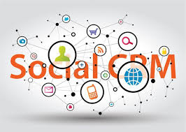
What is social CRM?
Social CRM is a philosophy and way of looking at business in which, as well as putting the client at the center of the organization, the organization is involved in communication with the client in all media, including, of course, social networks.
Social CRM
The process of managing customer-to-customer conversations to engage existing customers, prospects and other stakeholders with a brand and so enhance customer relationship management.

Slide 11
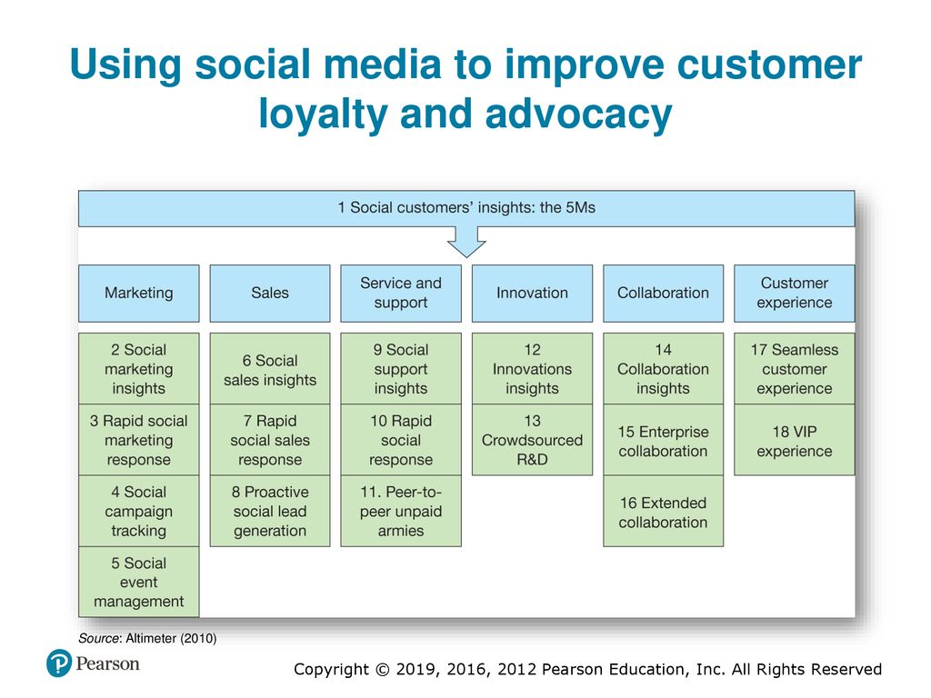

Slide 12
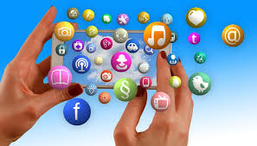
The value of social media in collecting customer insights across different business function.
Marketing. Monitoring, analysis and response of customer conversations through social listening tools.
Sales. Understanding where prospects are discussing selection of products and services offered by you and competitors and determining the best way to get involved in the conversation to influence sales and generate leads.
Service and support. Customer self-help through forums provided by you and neutral sites.
Innovation. Using conversations to foster new product development or enhance online offerings is one of the most exciting forms of social CRM.
Collaboration. This is e-business collaboration within an organization through an intranet and other software tools to encourage all forms of collaboration that support business process.
Customer experience. enhance the customer experience and add value to a brand

Slide 13
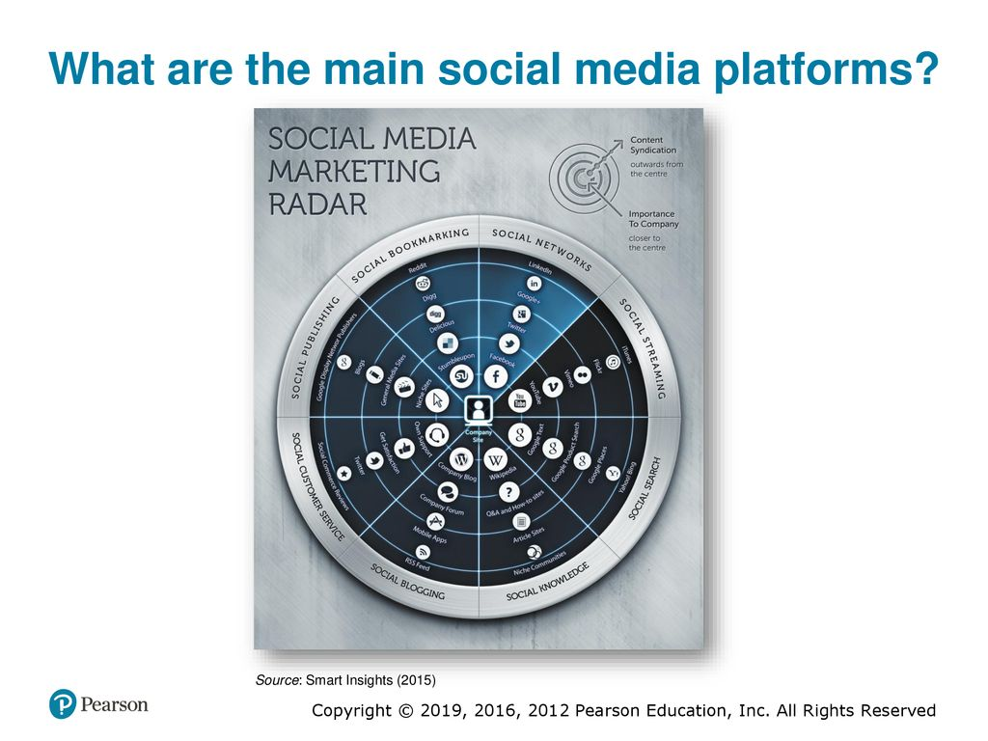

Slide 14
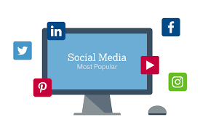
1 Social networks. In some countries the core social platforms where people interact through social networks are Facebook ,Instagram, and snapchat for consumer audiences LinkedIn for business audiences and Twitter for both.
2 Social publishing and news. Nearly all newspapers and magazines, whether broad or niche, now have an online presence with the option to participate through comments on articles, blogs or communities.
3 Social commenting in blogs. A company blog can form the hub of your social media strategy and you can look at tapping into others' blogs, whether company or personal or through blog outreach.
4 Social niche communities. These are communities and forums independent of the main networks.
5 Social customer service. Services as well as companies' own customer-support forums, are increasingly important for responding to customer complaints, particularly in some sectors such as mobile phone and network providers.

Slide 15
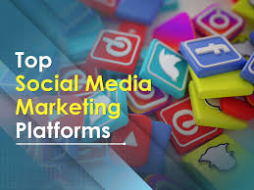
6 Social knowledge. These are reference social networks such as Yahoo! Answers, and Wikipedia. They show how any business can engage its audience by solving their problems and subtly showing how products have helped others.
7 Social bookmarking. Bookmarking sites such as Delicious™ (www.del.icio.us.com) are today relatively unimportant.
8 Social streaming. Rich and streaming media sites including photos (e.g. Pinterest), video and podcasting.
9 Social search. When Google+ was launched search engines incorporated more social features such as voting for sites via a Google+ 1. With the wane in popularity of Google+ in recent years, these features are seen less commonly today.
10 Social commerce. involves reviews and ratings on products and sharing of coupons on deals.

Slide 16
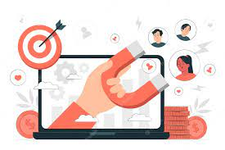
engagement as 'marketing's new key metric, given the rapidly increasing online media fragmentation and the challenges of keeping customers engaged with brands given the proliferation of choice. Customer engagement is sometimes used to refer to engaging customers in the short term, on a single touchpoint, such as whether someone dwells on the site for a significant time or whether they interact with an email. Instead, customer engagement really refers to the long-term ability of a brand to gain a customer's attention on an ongoing basis.
The commercial aim of engagement is to maximize customer value through using customer interactions to lead to more profitable relationships.
WHAT IS Customer engagement?
Repeated interactions through the customer lifecycle prompted by online and offline communications aimed at strengthening the long-term emotional, psychological and physical investment a customer has with a brand.
WHAT IS Media fragmentation
Describes a trend towards increasing choice and consumption of a range of media in terms of different channels such as web and mobile and also within channels - for example, more TV channels, radio stations, magazines, more websites. Media fragmentation implies increased difficulty in reaching target audiences.

Slide 17
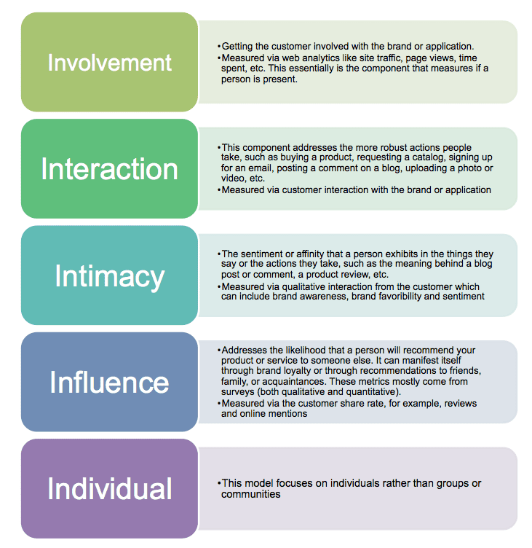
Forrester created a measure of engagement has four parts which can be measured both online and offline, was termed the 5Is although their focus was on 4 specific elements beginning with the letter ‘I’.
What are the 5Is?
The 5Is stand for the level of involvement, interaction, intimacy, and influence an individual has with a brand over time.

Slide 18
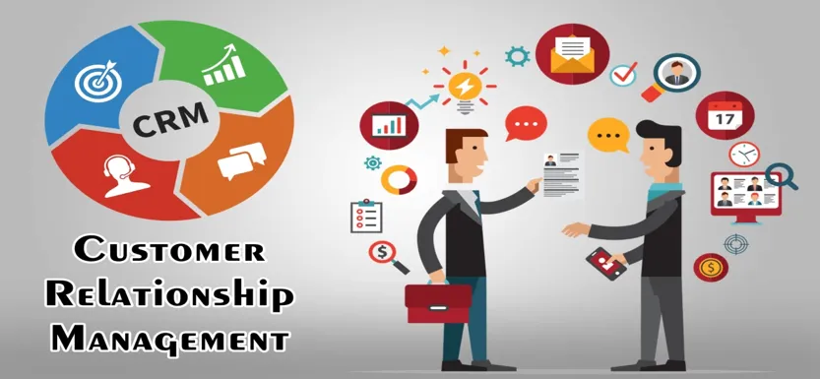
BENEFITS OF USING CRM TO SUPPORT CUSTOMER ENGAGEMENT
Using digital platforms for relationship marketing involves integrating the customer database with websites and messaging to make the relationship targeted and personalized .Through doing this, marketing can be improved by:
Targeting more cost-effectively. Lower cost.
Gamification
Permission marketing.
Mass customization of the marketing messages (and possibly the product).
Increased depth and breadth of information (and improved nature of relationship).
Deeper customer understanding and more relevant communications can be delivered through a sense-and-respond approach.
Delivering loyalty programmer .
Inbound marketing The customer is proactive in actively seeking out a solution and interactions with brands are attracted through content, search and social media marketing.
Gamification The process of applying game thinking and mechanics to engage an audience by rewarding them for achievements and sharing.
Sense-and-respond communications Delivering timely, relevant communications to customers as part of a contact strategy based on assessment of their position in the customer lifecycle and monitoring specific interactions with a company's website, emails and staff.

Slide 19
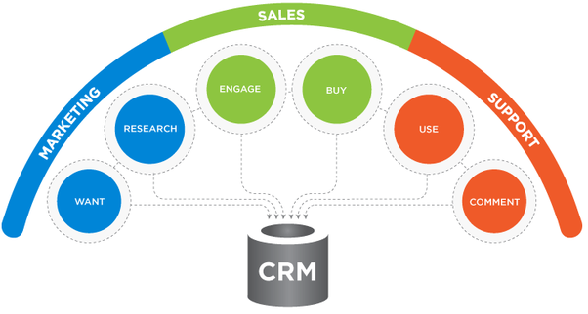
MARKETING APPLICATIONS OF CRM
CRM systems support the following marketing applications:
1 Sales force automation (SFA). Sales representatives are supported in their account management through tools to arrange and record customer visits
2 Customer service management. Representatives in contact Centre's respond to customer requests for information by using an intranet to access databases containing information on the customer, products and previous queries. It is more efficient and may increase customer convenience if customers are given the option of web self-service, i.e. accessing support data through a web interface
3 Managing the sales process. This can be achieved through e-commerce sites, or in a B2B context by supporting sales representatives by recording the sales process (SFA).
4 Customer communications management. Managing communications integrated across different channels including direct mail, email, mobile messaging, personalized web messages and social networks.
5 Analysis. Through technologies such as data warehouses and approaches such as data mining, which are explained further later in the chapter, customers' characteristics, their purchase behavior and campaigns can be analyzed in order to optimize the marketing mix.
Web self-service Customers perform information Requests and web interface rather than by contact with customer support staff.

Slide 20

Database technology is at the heart of delivering these CRM applications. Often the database is accessible through an intranet website by employees or an extranet by customers or partners, providing an interface onto the entire customer relationship management system. Email is used to manage many of the inbound, outbound and internal communications managed by the CRM system.
A workflow system is often used for automating CRM processes. For example, a workflow system can remind sales representatives about customer contacts or can be used to manage service delivery, such as the many stages of arranging a mortgage.

Slide 21
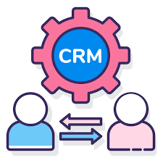
The three main types of customer data held as tables in customer databases for CRM are typically:
Personal and profile data. These include contact details and characteristics for profiling customers, such as age and gender (B2C), and business size, industry sector and the individual's role in the buying decision (B2B).
Transaction data. A record of each purchase transaction including specific product purchased, quantities, category, location, date and time and channel where purchased.
Communications interactions data. A record of which customers have been targeted by campaigns and their response to them (outbound communications). Also includes a record of inbound visits to a website, customer service and support enquiries and sales representative interactions.
The behavioral data available through 2 and 3 are very important for targeting customers to more closely meet their needs. Initially, simple automation approaches to send a series of customer-nurturing emails, for example, were used. Today, analysis of complex data sets and applying Artificial Intelligence enables us to deliver far more relevant one-to-one communications.

Slide 22

USING BIG DATA AND ARTIFICAL INTELLIGENCE TO SUPPORT DATA – DRIVEN MARKETING
Big Data' is a high-level term used to describe analysis techniques and systems that explore. the large volumes of data that are now captured by businesses.
Marketing application of Big Data exploit the different types of data now collected when businesses interact was their audiences.
What is big data?
Big data is the large volume of structured and unstructured information that gets flooded into a company on a daily basis. The importance of big data is not the amount of information a company receives but rather how they choose to organize the data to understand the actions, needs, wants, and buying habits of their consumers.
Big Data' for marketing "Big Data' refers to applications to gain value from the increasing Volume, Velocity and Variety of data integrated from different sources These enhance insight to deliver more relevant communications through techniques such as marketing automation and social CRM..

Slide 23

The two main benefits of Big Data for marketing are:
• identifying insights such as trends and patterns through analysis of large, complex interrelated data sets, which can inform future strategies and tactics.
• identifying success factors to make communications more relevant by improving messaging - for example, by selecting the best timing, copy or offers.

Slide 24
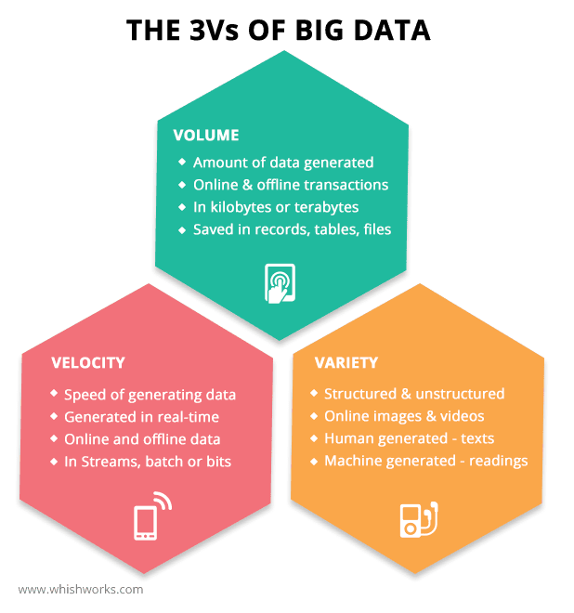
The opportunity and challenge of Big Data for marketing is often described from a technical point-of-view using the three dimensions, or vectors
• Data Volume refers to the increase in data that is now available for online interactions with websites and social media.
• Data Velocity shows how marketers now have access to real-time data, such as real time analytics of interactions on web and mobile sites and also social media interactions.
• Data Variety shows how new types of unstructured data, including, again, social media interactions, offer potential too. This also suggests the potential of integrating different sources of data to gain more customer insight.

Slide 25
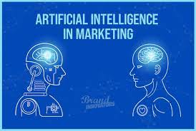
The key question for marketers given access to the potential new types of data is: how do we harness it? Through integrating new types of data from different systems and sources there is clearly the option to mine new data about how businesses interact with customers to encourage purchase.
Ultimately, the main application of Big Data in marketing is used to
increase the relevance of communications using the marketing automation techniques.
Techniques such as predictive modelling are used to send more relevant, contextual emails or web personalized banners to customers in order to generate response.
Some have argued that 'Big Data' it is a term created by systems vendors and consultants to generate demand for services that have been previously available under another label.
Since initial launch of the Big Data concept, new Artificial Intelligence and machine learning technologies have developed to help marketers analyze and apply the insights.

Slide 26
What Is Artificial Intelligence in Marketing?
Artificial intelligence marketing (AI Marketing) is leveraging customer data and AI concepts like machine learning to anticipate your customer’s next move and improve the customer journey.
Advancements in artificial intelligence offer companies better ways to do that. AI can help build more effective marketing strategies, improve the customer journey, and change how businesses attract, nurture, and convert prospects. The graphic below shows how marketers can incorporate AI and machine learning into every customer lifecycle step.
Artificial Intelligence Software and services that perform tasks previously requiring human analysis and interaction. Marketing applications of Al typically aim to improve business-to-customer communications including targeting media, personalized messaging and customer service interactions
Machine learning Creating and applying predictive models and algorithms with the ability to learn without being explicitly programmed. The computer models then make predictions of success based on patterns extracted from historical data. These are used to define rules, which are implemented to automate tasks such as targeting media or emails to the most valuable segments with the most relevant creative offer and timing.

Slide 27
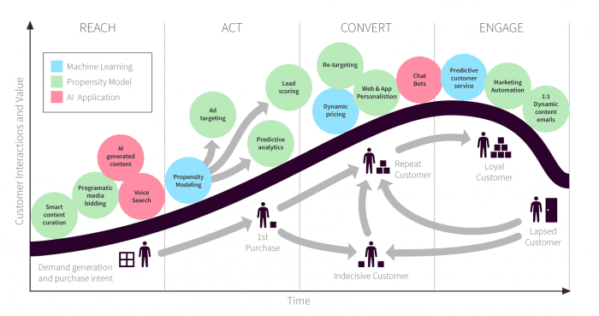


Slide 28

15 Applications of Artificial Intelligence in Marketing. The most effective AI technologies for marketing across the customer life-cycle
Artificial intelligence innovation is an intriguing issue in advertising right now, however AI is a wide term covering a wide scope of various advances. Man-made consciousness implies any innovation that tries to copy human knowledge, which covers an immense scope of capacities, for example, voice and picture recognition, machine learning strategies and semantic search. Advertisers like to play with the most recent energizing innovations and hit into about AI for picture recognition, speech recognition, preventing data leaks, or even targeting drones at remote communities. All well and good. But how are marketers supposed to do anything with that information? It's just hype, you can't implement it.
That is the reason in our AI and Machine Learning briefing for individuals we have recognized fifteen AI systems that organizations of all sizes can execute, as opposed to strategies which just real tech goliaths can commit assets to. We've plotted the methods over the customer lifecycle so you can perceive how every AI strategy can help bring your clients down the marketing funnel.

Slide 29


Reach - Attract visitors with a range of inbound techniques
Reach involves using techniques such as content marketing, SEO and other 'earned media' to bring visitors to your site and start them on the buyer's journey. AI & applied propensity models can be used at this stage to attract more visitors and provide those that do reach your site with a more engaging experience.
AI generated content
This is a really interesting area for AI. AI can't write a political opinion column or a blog post on industry-specific best practice advice, but there are certain areas where AI generated content can be useful and help draw visitors to your site.
For certain functions AI content writing programs are able to pick elements from a dataset and structure a ‘human sounding’ article.
AI writers are useful for reporting on regular, data-focused events. Examples include quarterly earnings reports, sports matches, and market data. If you operate in a relevant niche such as financial services, then AI generated content could form a useful component of your content marketing strategy. There are now solutions from vendors available and returning good results in copywriting for Facebook Ads, Email subject lines and nurturing emails.

Slide 30
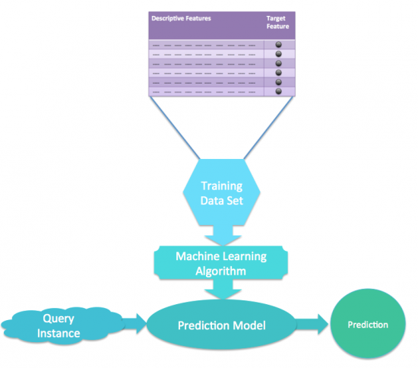
2. Smart Content Curation
AI powered content curation allows you to better engage visitors on your site by showing them content relevant to them. This technique is most commonly found in the 'customers who bought X also bought Y' section on many sites, but can also be applied to blog content and personalizing site messaging more widely. It's also a great technique for subscription businesses, where the more someone uses the service, more data the machine learning algorithm has to use and the better the recommendations of content become. Think of Netflix's recommendation system being able to consistently recommend you shows you'd be interested it.

Slide 31
3. Voice search
Voice search is another AI technology, but when it comes to using it for marketing, it's about utilizing the technology developed by the major players (Google, Amazon, Apple) rather than developing your own capability. Voice search will change future SEO strategies, and brands need to keep up. Brand that nail voice search will leverage gains in organic traffic with high purchase intent thanks to increased voice search traffic due to AI driven virtual personal assistants.
4. Programmatic Media Buying
Programmatic Media buying can use propensity models generated by machine learning algorithms to more effectively target ads at the most relevant customers. Programmatic ads need to get smarter in the wake of Google's recent brand safety scandal. It was revealed ads placed programmatically through Google's ad network were appearing on terrorist's websites. AI can help here by recognizing questionable sites and removing them from the list of sites ad's can be placed on.

Slide 32
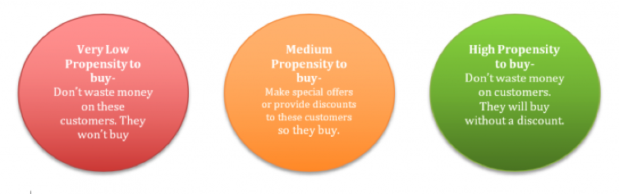
Act - Draw visitors in and make them aware of your product
5. Propensity modeling
propensity modeling is the goal of a machine learning project. The machine learning algorithm is fed large amounts of historical data, and it uses this data to create a propensity model which (in theory) is able to make accurate predictions about the real world. The simple diagram below shows the stages of this process.
6. Predictive analytics
Propensity modeling can be applied to a number of different areas, such as predicting the likely hood of a given customer to convert, predicting what price a customer is likely to convert at, or what customers are most likely to make repeat purchases. This application is called predictive analytics, because it uses analytics data to make predictions about how customers behave. The key thing to remember is that a propensity model is only as good as the data provided to create it, so if there are errors in your data or a high level of randomness, it will be unable to make accurate predictions.

Slide 33

7. Lead scoring
Propensity models generated by machine learning can be trained to score leads based on certain criteria so that your sales team can establish how 'hot' a given lead is, and if they are worth devoting time to. This can be particularly important in B2B businesses with consultative sales processes, where each sale takes a considerable amount of time on the part of the sales team. By contacting the most relevant leads, the sales team can save time and concentrate their energy where it is most effective. The insights into a leads propensity to buy can also be used to target sales and discounts where they are most effective.
8. Ad targeting
Machine learning algorithms can run through vast amounts of historical data to establish which ads perform best on which people and at what stage in the buying process. Using this data they can serve them with the most effective content at the right time. By using machine learning to constantly optimize thousands of variables you can achieve more effective ad placement and content than traditional methods. However, you'll still need humans to do the creative parts!

Slide 34
Convert - nudge interested consumers into becoming customers
9. Dynamic pricing
All marketers know that sales are effective at shifting more product. Discounts are extremely powerful, but they can also hurt your bottom line. If you make twice as many sales with a two-thirds smaller margin, you've made less profit than you would have if you didn't have a sale.
Sales are so effective because they get people to buy your product that previously wouldn't have considered themselves able to justify the cost of the purchase. But they also mean people that would have paid the higher price pay less than they would have.
Dynamic pricing can avoid this problem, by targeting only special offers only at those likely to need them in order to convert. Machine learning can build a propensity model of which traits show a customer is likely to need an offer to convert, and which are likely to convert without the need for an offer. This means you can increase sales whilst not reducing your profit margins by much, thus maximizing profits.
10. Web & App Personalization
Using a propensity model to predict a customer's stage in the buyer's journey can let you serve that customer, either on an app or on a web page, with the most relevant content. If someone is still new to a site, content that informs them and keeps them interested will be most effective, whilst if they have visited many times and are clearly interested in the product then more in-depth content about a product's benefits will perform better.

Slide 35
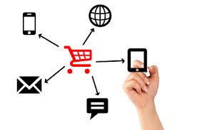
11. Chat bots
Chabot's mimic human intelligence by being able to interpret consumer’s queries and complete orders for them. You might think chat bots are extremely difficult to develop and only huge brands with massive budgets will be able to develop them. But actually, using open chat bot development platforms, it's relatively easy to create your own chat bot without a big team of developers.
12. Re-targeting
Much like with ad targeting, machine learning can be used to establish what content is most likely to bring customers back to the site based on historical data. My building an accurate prediction model of what content works best to win back different types of customers, machine learning can be used to optimize your retargeting ads to make them as effective as possible.
Predictive analytics Using data mining and statistical modelling to predict future outcomes, for example by scoring customer propensity to respond to a specific offer.

Slide 36
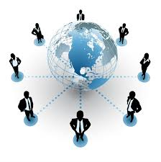
Engage - Keep your customers returning
13. Predictive customer service
It's far easier to make repeat sales to your existing customer base than it is to attract new customers. So keeping your existing customers happy is key to your bottom line. This is particularly true in subscription-based business, where a high churn rate can be extremely costly. Predictive analytics can be used to work out which customers are most likely to unsubscribe from a service, by assessing what features are most common in customers who do unsubscribe. It's then possible to reach out to these customers with offers, prompts or assistance to prevent them from churning.
14. Marketing automation
Marketing automation techniques generally involve a series of rules, which when triggered initiative interactions with the customer. But who decided these rules? Generally, a marketer who's basically guessing what will be most effective. Machine learning can run through billions of points of customer data and establish when are the most effective times to make contact, what words in subject lines are most effective and much more. These insights can then be applied to boost the effectiveness of your marketing automation efforts.
15. dynamic emails
applying insights generated from machine learning can create extremely effective 1 dynamic emails. Predictive analytics using a propensity model can establish a subscribers propensity to buy certain categories, sizes and colors through their previous behavior and displays the most relevant products in newsletters. The product stock, deals, pricing is all correct at the time of opening the email.

Slide 37


Thank You

