Slide 1


Financial Statements
Prepared by Dr. Omar Al-kasasbeh
FNT 615
Finance Concepts
Lecture 3

Slide 2



Finance Concepts
FNT 615
Finance Concepts
Prepared by
Dr. Omar Al-kasasbeh

Slide 3
Lecture
3
Financial Statements

Slide 4
Lecture
3
Table of contents
3.1 The Income Statement
3.2 The Balance Sheet
3.3 The Statement of Cash Flows
3.4 Operating Cash Flow and Free Cash Flow to the Firm (FCFF)
3.5 Common-Size Statements
3.6 Reporting Financial Activity Rates

Slide 5
Lecture
3
People say that accounting is the “language of business.” Using the language of business, accountants are able to communicate the financial performance and health of a firm via four key financial statements. These statements are the income statement, balance sheet, statement of owner’s equity, and statement of cash flows. Each statement provides different insights into a firm’s performance and financial health. Though some users may favor one or two statements over another, they are best used together to get a full picture.

Slide 6
Lecture
The Income Statement
3
Functionality of the Income Statement
The income statement shows a firm’s performance over a specific period of time. The statement helps financial statement users understand the sales generated during the period and the expenses incurred to generate those sales. If the expenses are smaller than the sales, the net result is profitability, or net income, rather than a net loss. Breaking the income statement down into smaller pieces provides a more transparent view of the firm’s performance, allowing users to see more clearly what areas of the business incurred expenses. This is helpful to management in driving improvements and to outside users in assessing performance.
.

Slide 7
Lecture
3
Sales and Gross Profit
The first section of the income statement begins with sales. Though financial statements are required to follow a certain format, account names can differ slightly from one firm to another. You may see the first line, often referred to as the top line, called sales, sales revenue, revenue, service revenues, and other similar titles. All of these titles are meant to reflect the sales generated by selling product to customers in the day-to-day business. On X’s income statement in Figure 5.2, we see its top line referred to as Sales.

Slide 8
Lecture
3
Firms report their sales and any reductions to sales separately on the income statement. They begin with gross sales, which includes all sales to customers. Clear Lake reported gross sales of $105,000 last year and $126,000 this year. The next line is sales returns and allowances, which is deducted from gross sales in order to find net sales. Clear Lake’s sales returns and allowances were $5,000 and $6,000 respectively, leaving the company with net sales of $100,000 and $120,000 respectively ($ 105,000- $5,000 and $126,000- $6,000)

Slide 9
Lecture
3
Common examples of costs included in cost of goods sold include direct labor, direct materials, and the overhead assigned to the product in production. For a service business, this would include its direct labor and any materials used to deliver its services. For a retail firm like Clear Lake, this would include the costs of all the goods it purchased for resale. Clear Lake’s COGS is seen at $50,000 and $60,000 for the prior and current years. Note that different types of companies will have different types of costs deducted in their Cost of Goods section. Clear Lake is a retailer, or merchandiser that buys good to resell.
Their cost of goods includes the cost of goods they purchased to resell.

Slide 10
Lecture
3
Gross profit is a reflection of how profitable the firm’s performance was in its core business function. It includes only the core business and direct costs of performing that business. If the company were a shoe company, gross profit would show how profitable the company was in simply making the shoes it sold. If it were a bakery, gross profit would show how profitable the company was in simply baking the goods it sold

Slide 11
Lecture
3
Income from Operations
Gross profit is a very helpful measure, but it is only the first of several provided by the income statement. After gross profit is calculated, other operating expenses are deducted in order to calculate the firm’s income from operations, also commonly called operating income. Common operating costs found in this section include building rent and utilities, property taxes, wages and salaries, and other overhead costs.

Slide 12
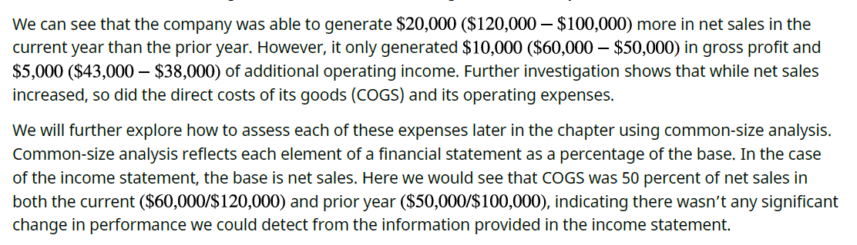
Lecture
3

Slide 13
Lecture
3
Net Income

Slide 14
Lecture
3
we move on to net income, or what is commonly referred to as the bottom line. Net income (or loss) reflects the net impact of all financial transactions for the firm, including those that are caused by events outside the normal course of business. The most common items deducted from operating income to arrive at net income include interest expense, gains/losses, and income tax expense.

Slide 15
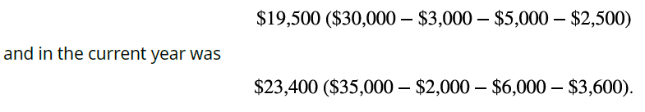
Lecture
3
EBITDA (Earnings before Interest, Taxes, Depreciation, and Amortization) Now that we have a full income statement, we can look at another commonly used measure of financial performance called EBITDA. EBITDA stands for earnings before interest, taxes, depreciation, and amortization. Amortization is similar to depreciation. It is the spreading of the cost of an intangible asset over the course of its useful life. Intangible assets are long-term assets that lack physical substance, such as patents and copyrights.

Slide 16
Lecture
3

Slide 17
Lecture
3
The Balance Sheet

Slide 18
Lecture
3
Recall that the income statement shows the performance of a firm over the course of time. The classified balance sheet shows the financial state of a company as of a specific point in time. It is a key distinction between the two statements. The classified balance sheet is prepared in sections that align with the accounting equation. Remember, the accounting equation reflects the assets (items owned by the organization) and how they were obtained (by incurring liabilities or provided by owners). Liabilities are debts owed to other parties. Stated differently, every asset has a claim against it by creditors and/or owners.
Assets = Liabilities + owner’s equity
The classified balance sheet is thus broken down into three sections; assets, liabilities, and owner’s equity.

Slide 19
Lecture
3
If prepared correctly, the total assets on the balance sheet equals the total liabilities and owner’s equity sections of the balance sheet.
The classified balance sheet is considered or termed classified when the assets and liabilities within the balance sheet are grouped into even smaller sections: current and noncurrent (see Figure 5). Both assets and liabilities are broken down on the balance sheet into current and noncurrent classifications in order to provide more detail and transparency as well as abide by the convention of reporting in descending order of liquidity. Current assets are those that can be used or converted to cash within a year. Common examples of current assets include cash, inventory, accounts receivable, and short-term investments. Assets that will be in use longer than a year are considered noncurrent.

Slide 20
Lecture
3
Clear Lake Sporting Goods has cash, accounts receivable, inventory, short-term investments, and equipment. It rents its facilities, so it has no buildings on its balance sheets. Of all its assets, only the equipment is long term. The assets section for Clear Lake’s classified balance sheet is shown in Figure

Slide 21
Lecture
3
We’ve covered the assets side of the accounting equation; now let’s turn our attention to the other side of the equation and the other two sections of the balance sheet: liabilities and equity. Just like the assets section, the liabilities section is broken down between current and noncurrent. Current liabilities are those that will be due within a year. Common examples of current liabilities include accounts payable, wages payable, and unearned revenue.

Slide 22
Lecture
3
The stockholders’ equity section of the balance sheet for corporations contains two primary categories of accounts. The first is contributed capital, which is funds paid in by owners. The second category is earned capital, which is funds earned by the corporation as part of business operations. On the balance sheet, retained earnings is a key component of the earned capital section, while the stock accounts such as common stock, preferred stock, and additional paid-in capital are the primary components of the contributed capital section.

Slide 23
Lecture
3
Importance of the Balance Sheet
Now that we have gone to all the work to carefully assemble a classified balance sheet, what do we use it for?
The answer lies within the accounting equation itself. Think of the accounting equation from a “sources and claims” perspective. Under this approach, the assets (items owned by the organization) were obtained by incurring liabilities or were provided by owners. Stated differently, every asset has a claim against it by creditors and/or owners. The balance sheet shows us what the firm has (its assets), who owns them (equity), and who the firm owes (its liabilities).

Slide 24
Lecture
3
Limitations of the Balance Sheet
The balance sheet is indeed a very helpful financial statement, but it also poses challenges. First, assets on the balance sheet, under generally accepted accounting principles (GAAP), are recorded at historical cost. Historical cost is simply the cost paid for the item at the time it was purchased. Changes in market value of bigticket
items like land or buildings are not reflected in the balance sheet. Land remains at historical cost, and depreciable items like buildings are reflected at their current book value (historical cost less accumulated depreciation). If the asset has appreciated over time, higher market value of the assets would not be seen on the balance sheet. Estimates are another limitation of the balance sheet. Items on the balance sheet such as allowance for doubtful accounts and allowance for bad debt are based on estimates.

Slide 25
Lecture
3
The useful lives for calculating depreciation is another common estimate. If these estimates are incorrect, the net value of the asset can be under- or overstated. Another key limitation is the fact that a balance sheet reflects balances at only one given point in time. This means that the account value could have been quite different on the day before or the day after the date of the balance sheet. For example, if a firm were concerned with certain ratios or investor/lender expectations of its cash balance, it could choose to not pay several vendor payments in the last week of December. Thus, on December 31, the firm reflects a high cash balance on its balance sheet..

Slide 26
Lecture
3
The Statement of Cash Flows

Slide 27
Lecture
3
Importance of the Statement of Cash Flows Remember, most firms use accrual accounting. Revenues and expenses are recorded when they occur, not necessarily when cash moves. This can create timing differences between profits and cash flows. A firm can be profitable and still not have an adequate flow of cash. The opposite is also true: it can experience a net loss and still have cash on hand. Earning a profit is wonderful, but it is not the only goal an organization has. It must also have adequate cash flow to support daily operations. To support cash planning and to provide external financial statement users such as lenders and investors information about the firm’s cash flow, the statement of cash flows is prepared. Cash flow is also a crucial metric for determining the value of a company.

Slide 28
Lecture
3
The statement of cash flows also helps external users determine the driving forces behind the firm’s cash flows. They can see if cash is generated primarily by daily operations or if cash is being generated or consumed by events outside the firm’s normal course of business. There are two key methods of preparing the statement: direct and indirect. FASB (Financial Accounting Standards Board) favors the direct method. Despite that, the most common method used by far in general practice is the indirect method. The direct method lists cash flows directly from revenues and expenses, whereas the indirect method reconciles income to cash flows

Slide 29
Lecture
3
To provide clear information about what areas of the business generated and used cash, the statement of cash flows is broken down into three key categories: operating, financing, and investing. The operating section reflects cash flows generated by and used by the day-to-day operations of the business. Investing activities include investments in other firms as well as investments in the firm itself (items like machinery, land, or other fixed assets). Finally, financing activities are those used to provide funds to run the business (loans, interest).

Slide 30
Lecture
3

Slide 31
Lecture
3
Clear Lake’s statement of cash flows begins with the current year net income of $35,000 from the income statement. Next, noncash expenses are deducted. Clear Lake’s only noncash expense on their current year income statement is depreciation of $3,600. Since deprecation is an expense that reduces income but is not actually paid out in cash in the current period, it must be added back to net income to reconcile net income to cash flow.

Slide 32
Lecture
3

Slide 33
Lecture
3
Operating Cash Flow and Free Cash Flow to the Firm (FCFF)

Slide 34
Lecture
3
Operating Cash Flow
Now that we have a statement of cash flows prepared, we can move on to a few key elements of the statement used to assess organizational cash management performance. Operating cash flow, or net cash flow from operating activities, is calculated in the first section of the statement of cash flows. It depicts the cash
generated (or used by) the primary business activities. Remember, operating cash flow is calculated under the indirect method by adjusting net income for noncash expenses like depreciation and adjustments for changes in current asset and liability accounts (changes in working capital).

Slide 35
Lecture
3
Operating cash flow is helpful in assessing organizational cash management performance as it relates to the core business function operations. Key management practices in this area can have a profound impact on the firm’s cash flow. Practices and policies include customer payment terms, collection policies and practices, and vendor payment terms. Though changing a customer or vendor payment terms will not change the profit or loss for the firm, it will have an impact on the timing to cash flows. This is a key element of managing operational cash flow.

Slide 36
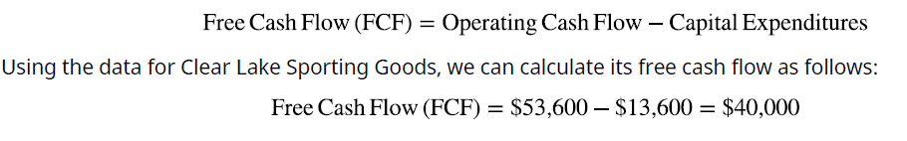
Lecture
3
Free Cash Flow
Free cash flow (FCF) is calculated by taking operating cash flows less capital expenditures. Free cash flow is an important measure, as it depicts the cash available to support the business’s operations and maintain its fixed assets. It is commonly used by investors as part of their overall evaluation of an investment, as it is a key measure of cash flow management practices and a firm’s ability to generate enough cash to cover operations and capital assets and it shows if there is any left over for other considerations such as dividend payments, debt repayment, and contributions to increase working capital for future growth.

Slide 37
Lecture
3
Managing Cash Flow
Managing cash flow is not an easy task. A firm has a myriad of places that its cash flows from or to. However, there are a few key areas to place attention in order to manage or improve cash flows. First, consider where cash is coming from customers. Managing terms and collection efforts with customers can have a significant impact on a firm’s cash flow. For example, a customer with terms of net 10 will likely yield payment quite Quickly 10 days, give or take. A customer with terms of net 60, on the other hand, will require roughly 60 days to collect assuming they pay on time. The 50-day difference between these two examples means that the firm will go 50 additional days having expended the resources to provide the customer their good or service, but with no cash flow yet to cover it.
The same theory holds true on the opposite side with accounts payable and the vendors a firm uses

Slide 38
Lecture
3
It is important to assess both sides of cash flow and the impact it has on the firm as well as the customer and vendor relationships it maintains. Some customers may not have difficulty negotiating a more favorable payment term in order for the firm to improve its cash flow. Others, however, may not be willing to accept shorter payment terms. In order to be competitive in the industry, the firm must assess the customer relationships, industry standards, and its own ability to support cash flow when considering its customer payment terms. When there is a gap in cash flow, it is crucial that it is recognized early, with proper cash flow forecasting, so financing can be obtained to bridge the gap. A common tool used to manage the ebb and flow of cash flow for a firm is an open line of credit with a bank. This allows the firm to borrow and repay from month to month as cash flow fluctuates.

Slide 39
Lecture
3
Reporting Financial Activity

Slide 40
Lecture
3
Defining Accounting Periods
An accounting period can be any period of time, but the most common accounting periods are months, quarters, and a year. Accounting periods are important, particularly in accrual accounting, so there are clear cutoffs for recording transactions. It is important to note that Generally Accepted Accounting Principles (GAAP) require companies to provide quarterly financial statements.
Time Period Principle
Providing information to financial statement users in a timely fashion brings us to our next key topic, which is the time period principle. In order for information to be useful, it must be timely. This means that financial statement users need to get the statements quickly enough to be able to make relevant decisions with them.

Slide 41
Lecture
3
Fiscal versus Calendar Year Though a firm may present financial statements monthly, quarterly, and annually, not all time periods are created equal. Firms have the option to choose between a fiscal and a calendar year. The calendar year, which begins January 1 and ends December 31, is the traditional year we are accustomed to. The calendar year, however, doesn’t always work well with a firm’s business cycle. Due to seasonality or other factors, a firm may choose to adopt a fiscal year with their own beginning and end date.
The Annual Report
The report details the firm’s operations and performance for the year and its current financial conditions. The report contains general company information, the firm’s financial statements, notes to the financial statements, various required disclosures pertaining to accounting policies, the management discussion and analysis (MD&A) statement, a letter from the CEO to the shareholders, and the firm’s audit report.

Slide 42
Lecture
3
Summary

Slide 43
Lecture
References
3
Julie Dahlquist, and Rainford Knight. (2022). Principles of finance. OpenStax.

Slide 44



Thank You

