Slide 1


Slide 2


Slide 3

Learning Objectives:

Slide 4
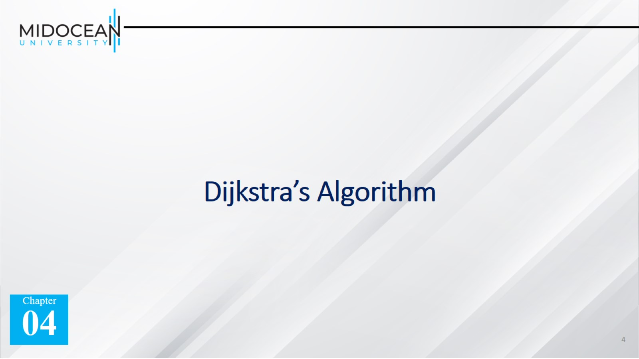
Dijkstra’s Algorithm

Slide 5
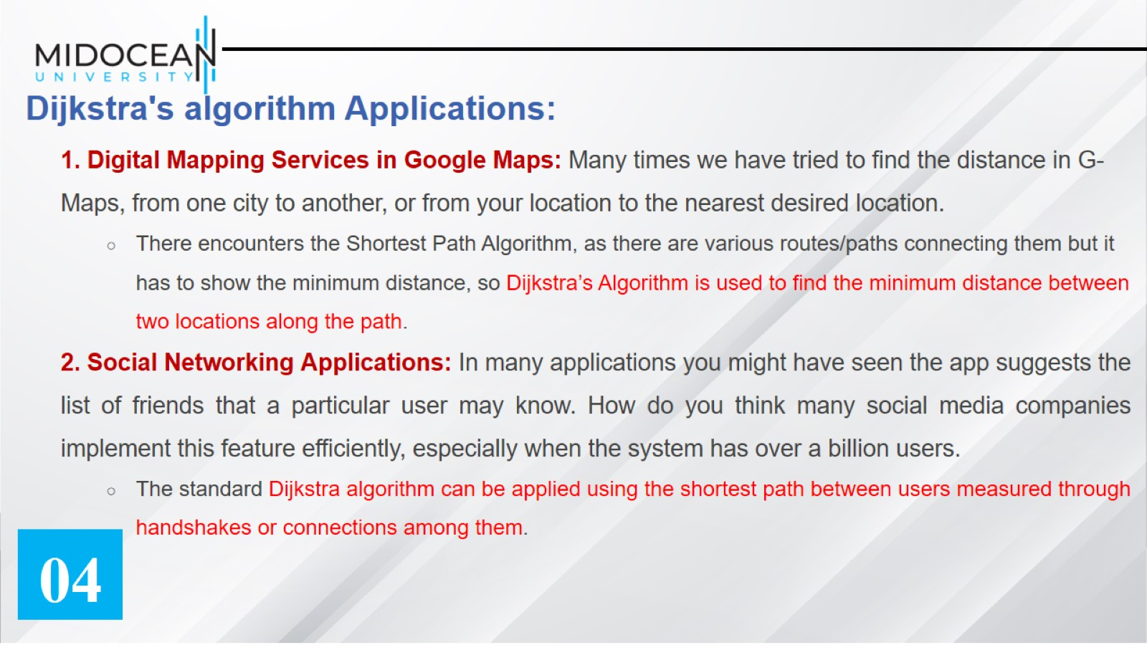
Dijkstra's algorithm Applications:

Slide 6
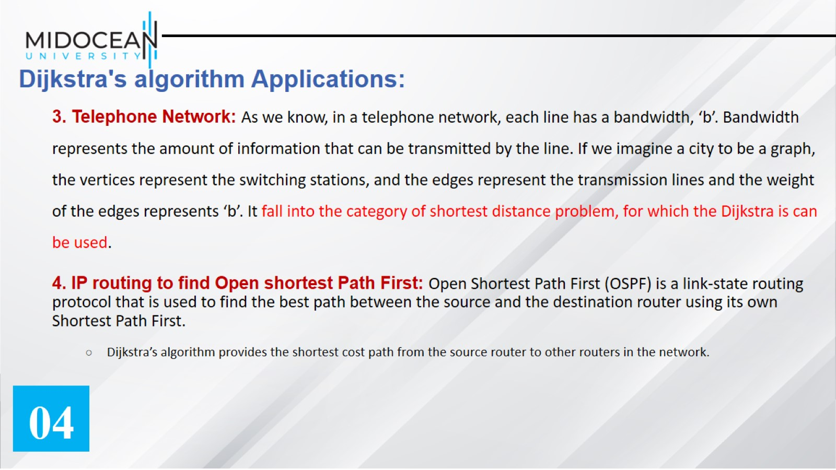
Dijkstra's algorithm Applications:

Slide 7
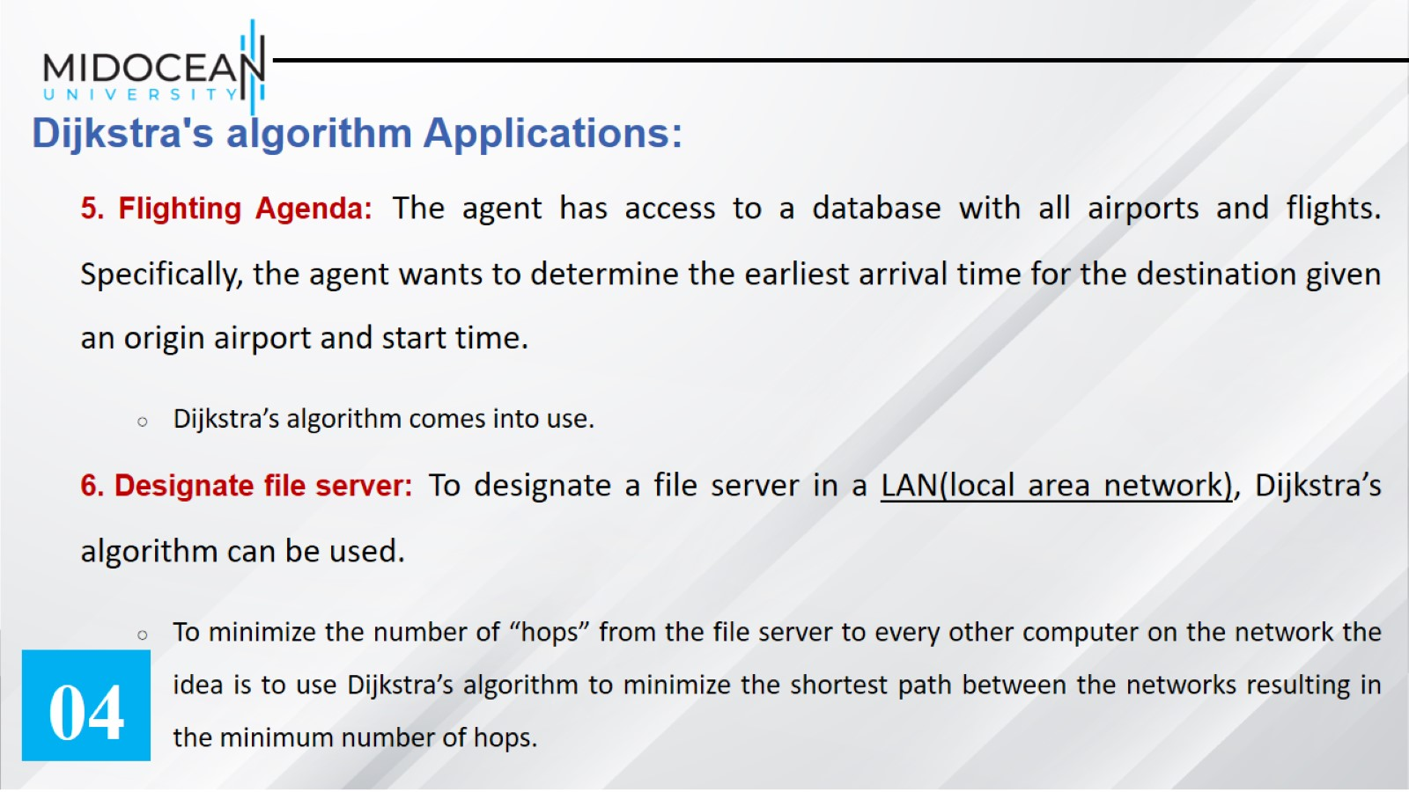
Dijkstra's algorithm Applications:

Slide 8
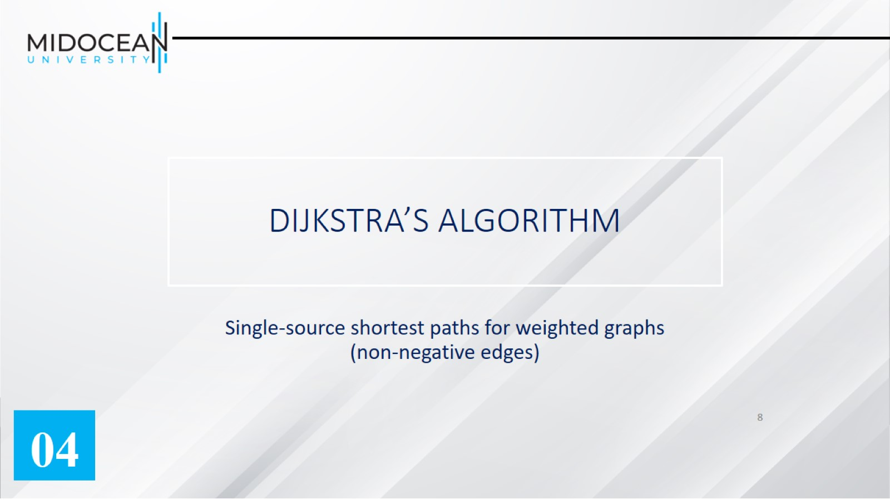
DIJKSTRA’S ALGORITHM

Slide 9
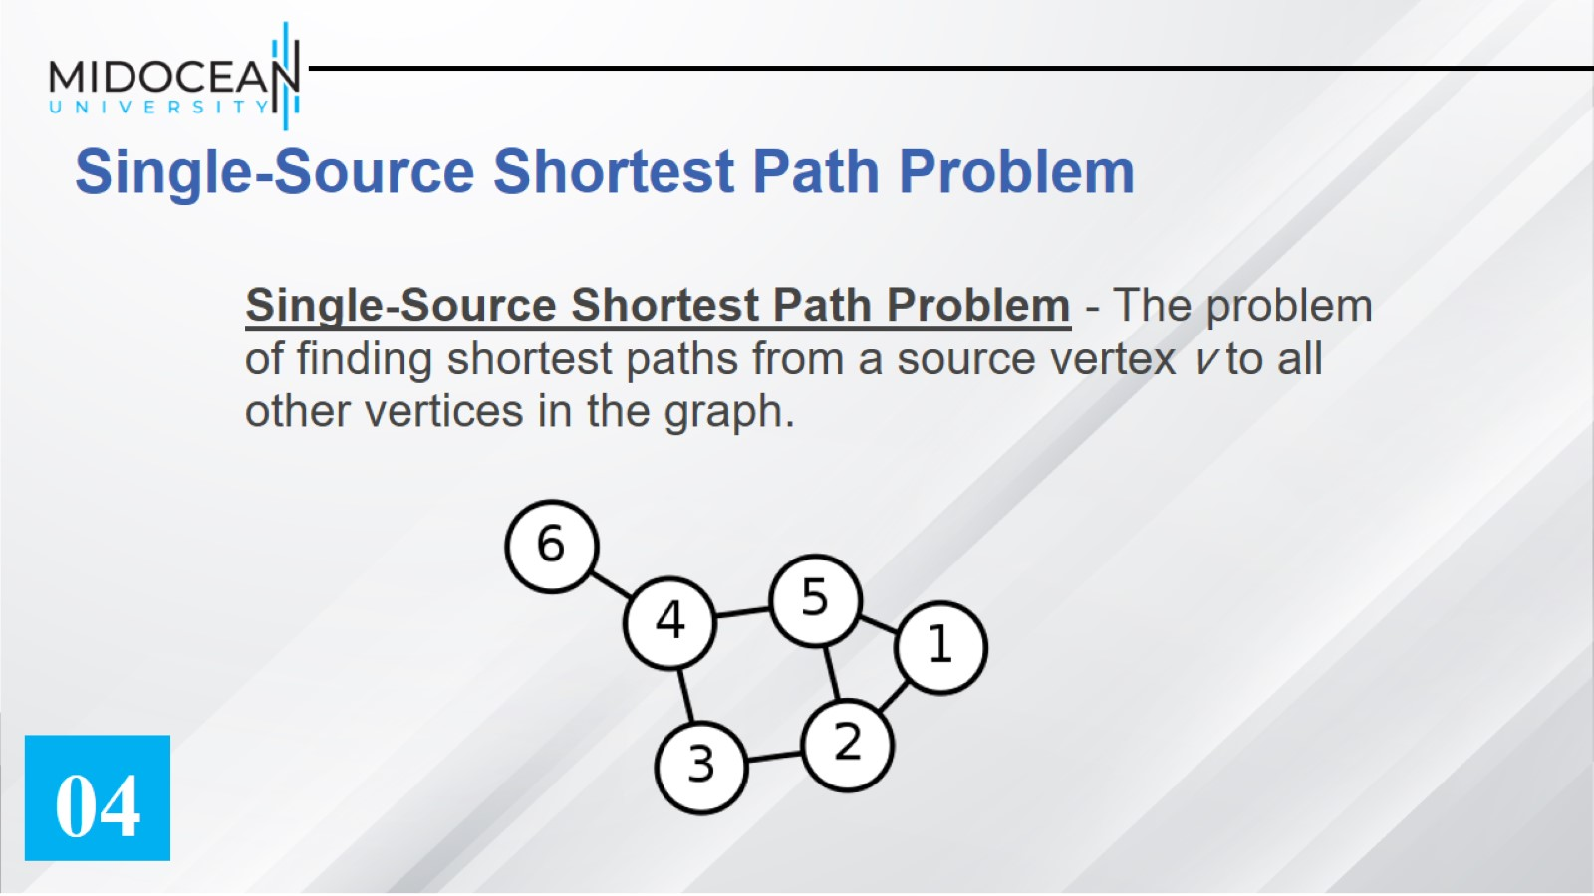
Single-Source Shortest Path Problem

Slide 10
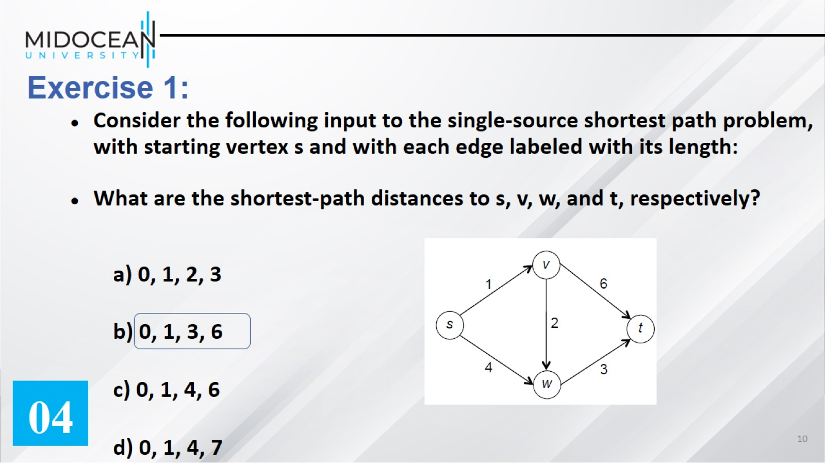
Exercise 1:

Slide 11
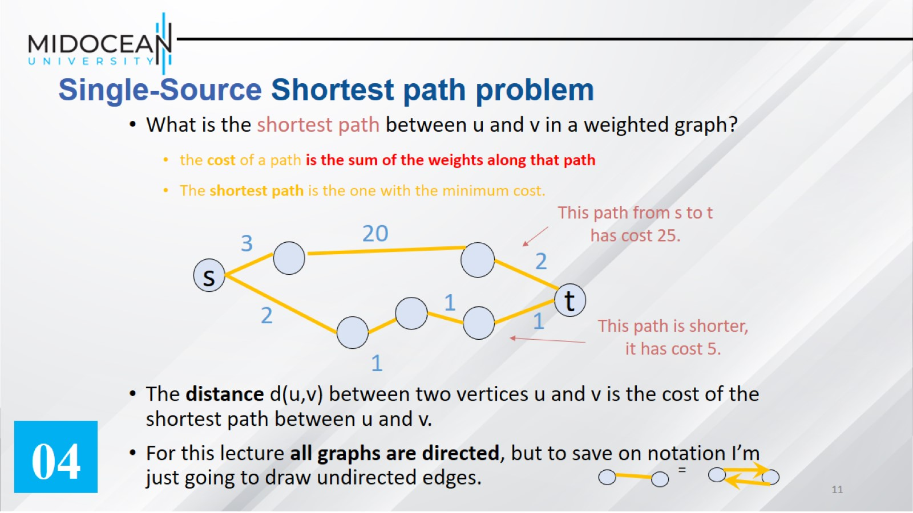
Single-Source Shortest path problem

Slide 12
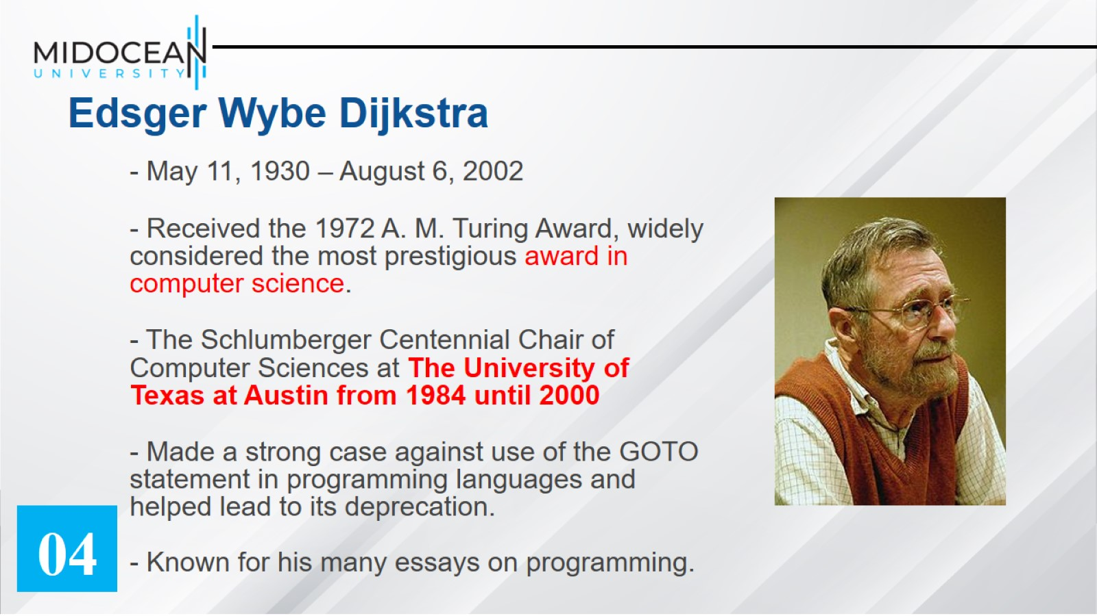
Edsger Wybe Dijkstra

Slide 13
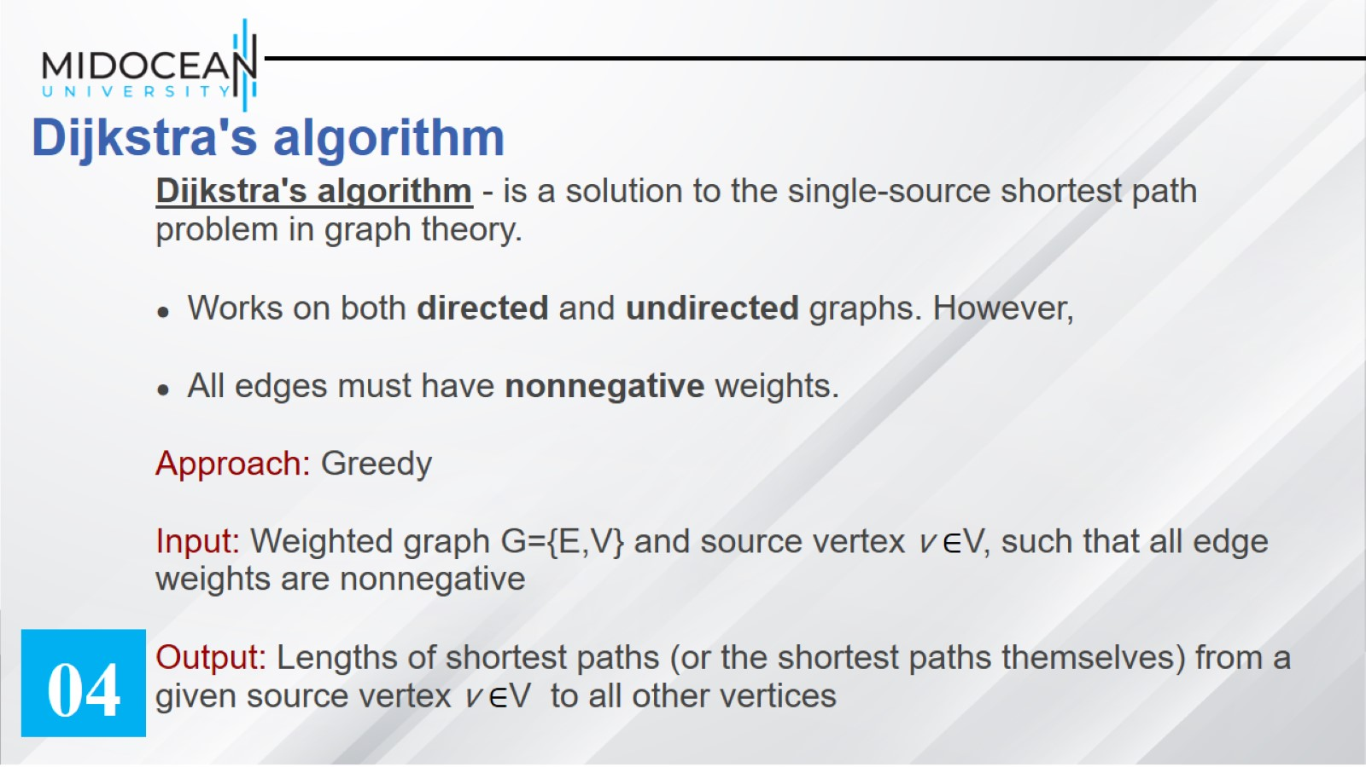
Dijkstra's algorithm

Slide 14
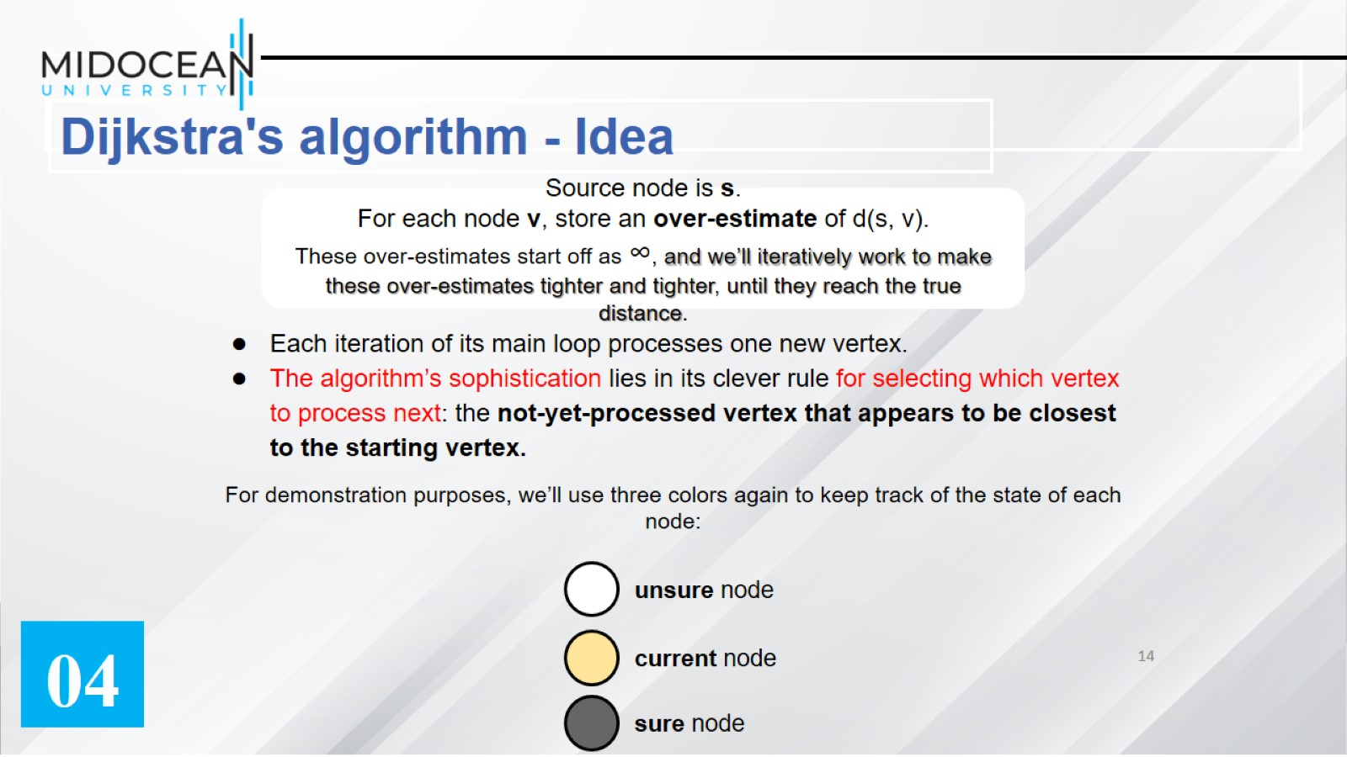

Slide 15
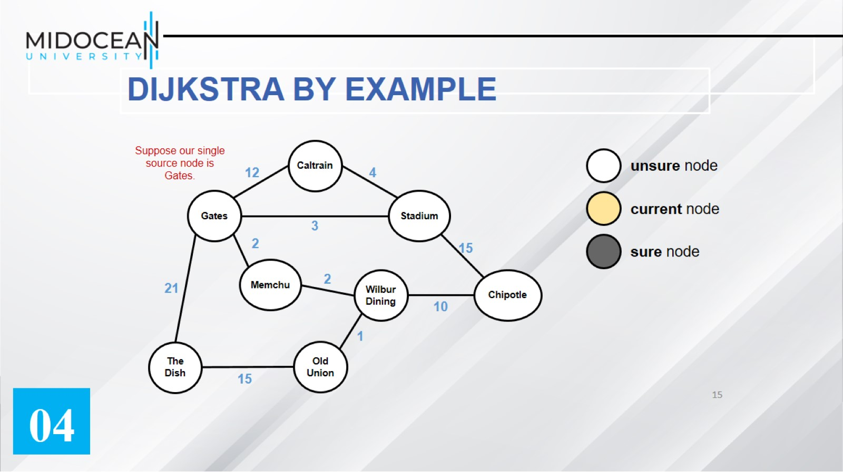
DIJKSTRA BY EXAMPLE

Slide 16
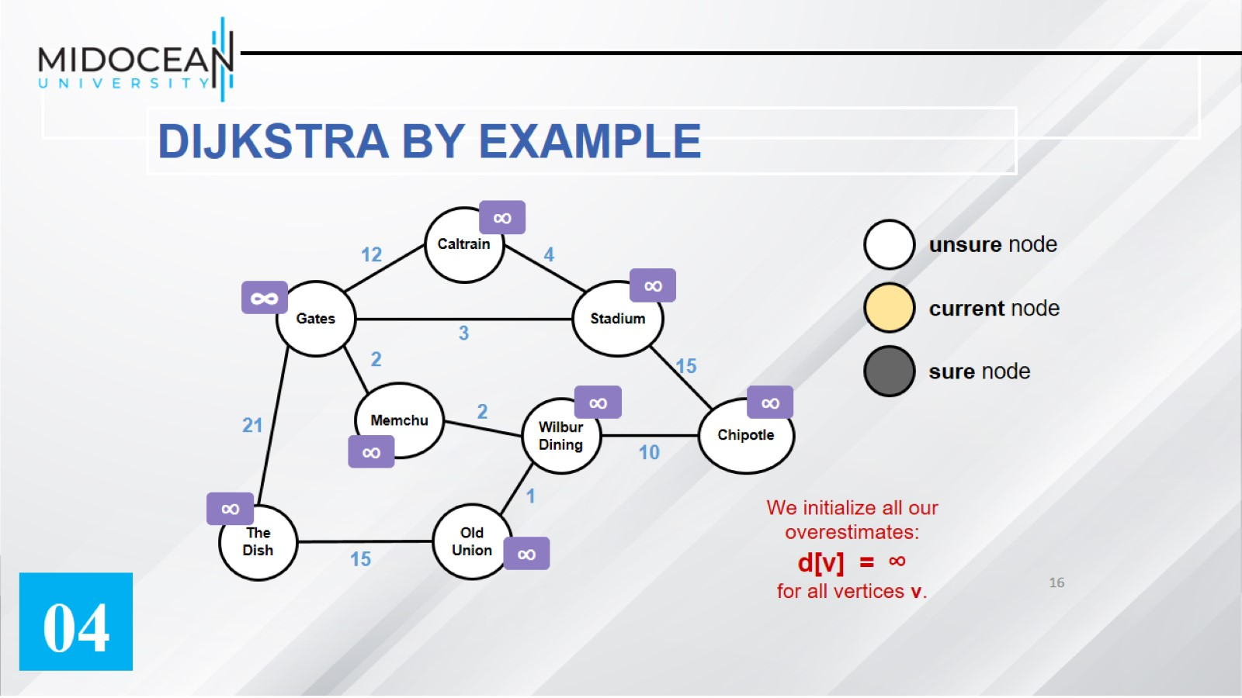

Slide 17
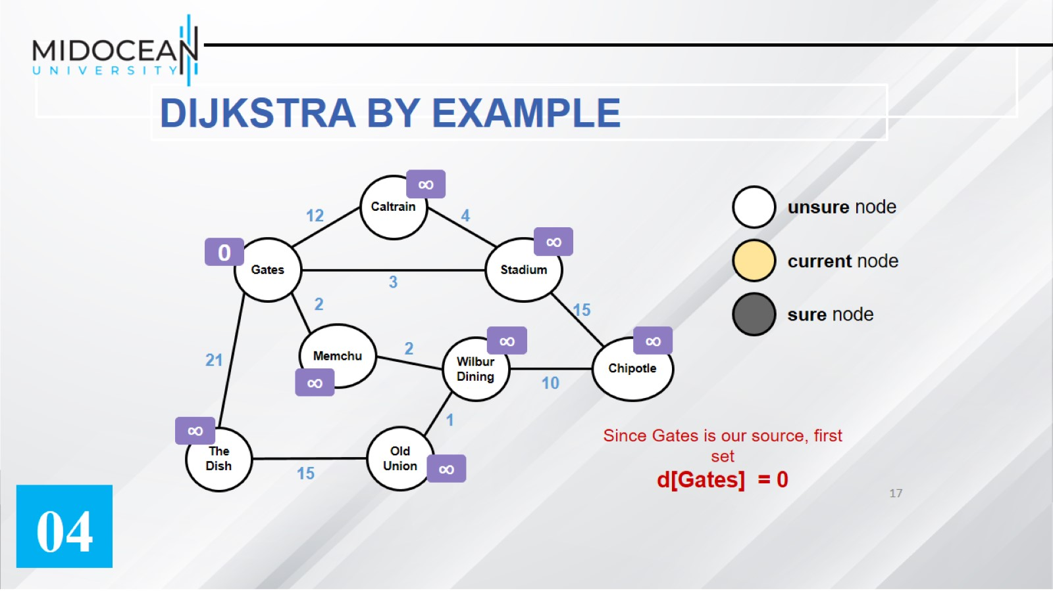

Slide 18
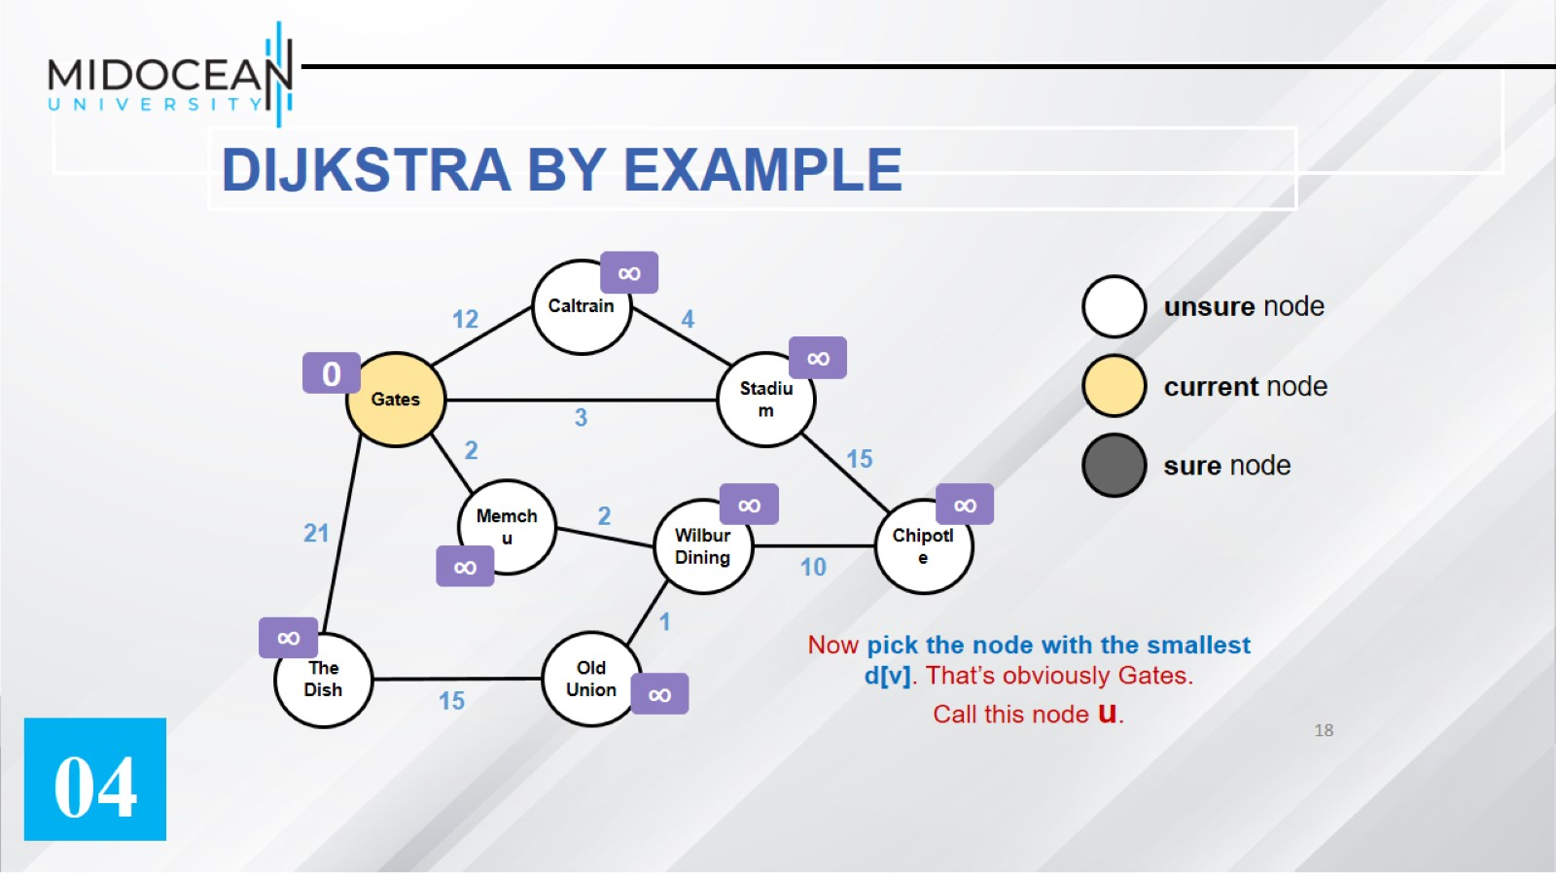

Slide 19
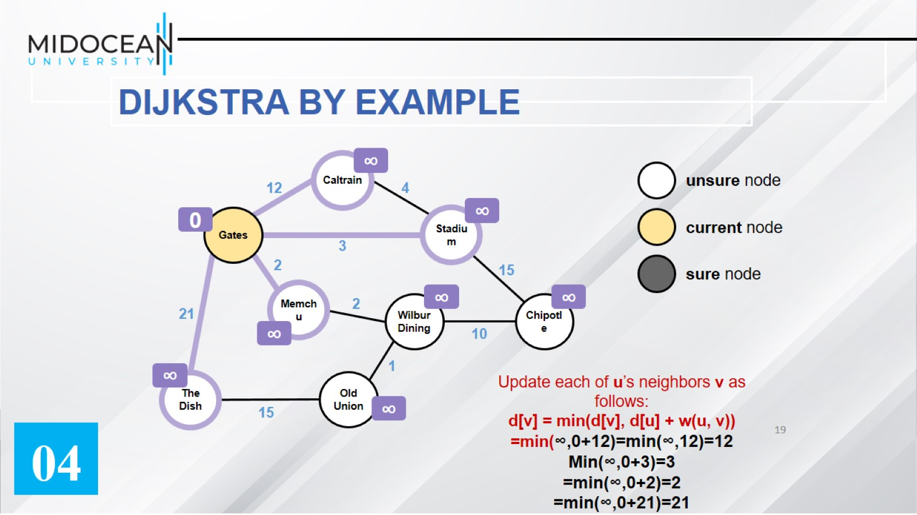

Slide 20
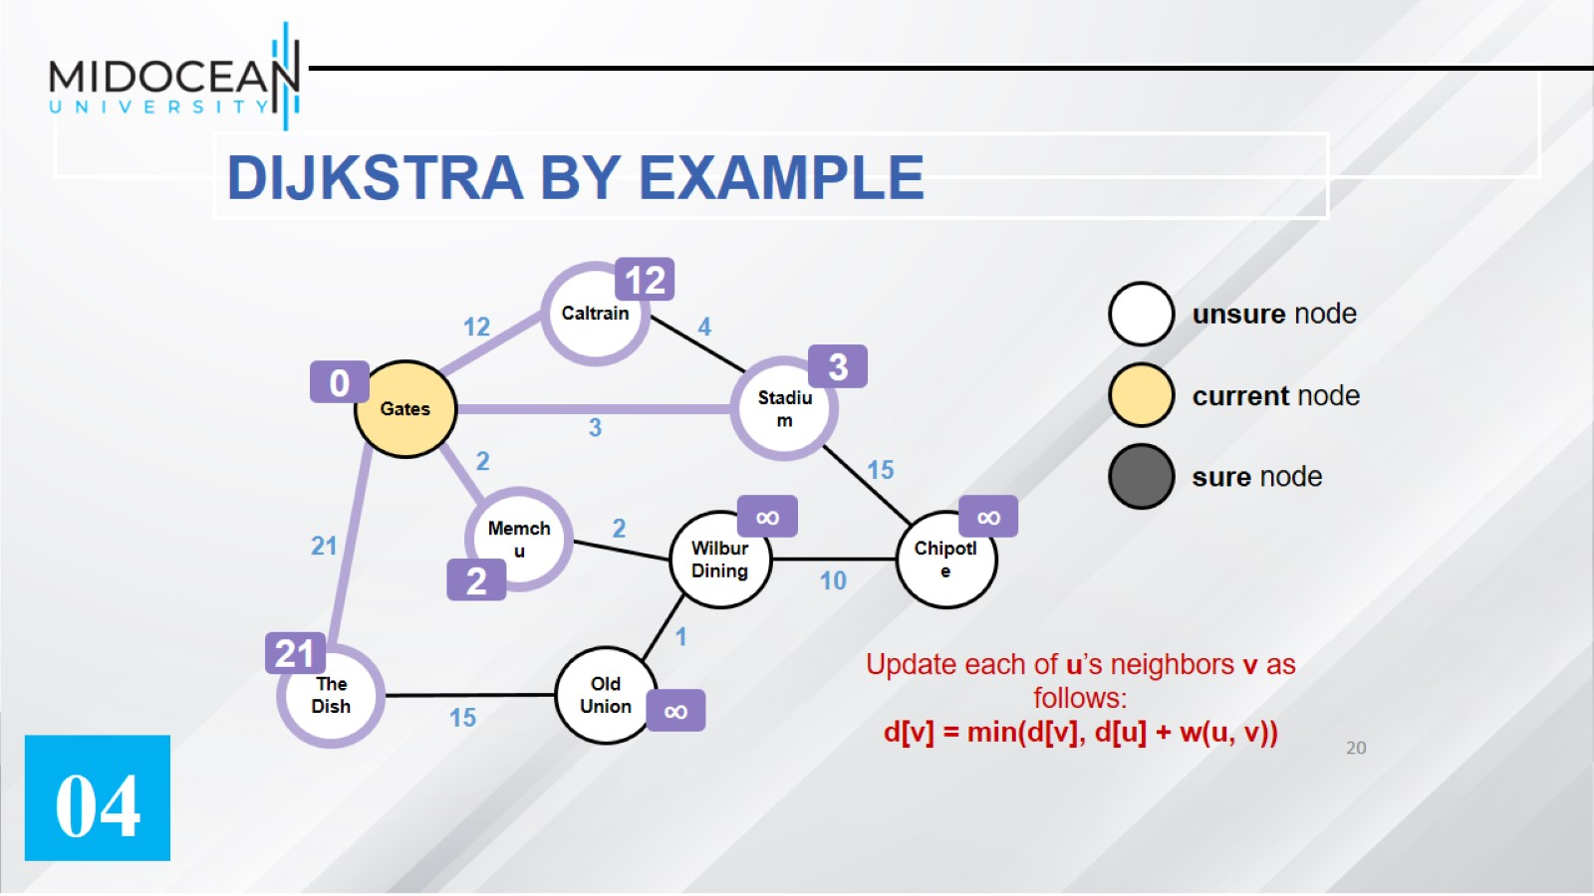

Slide 21
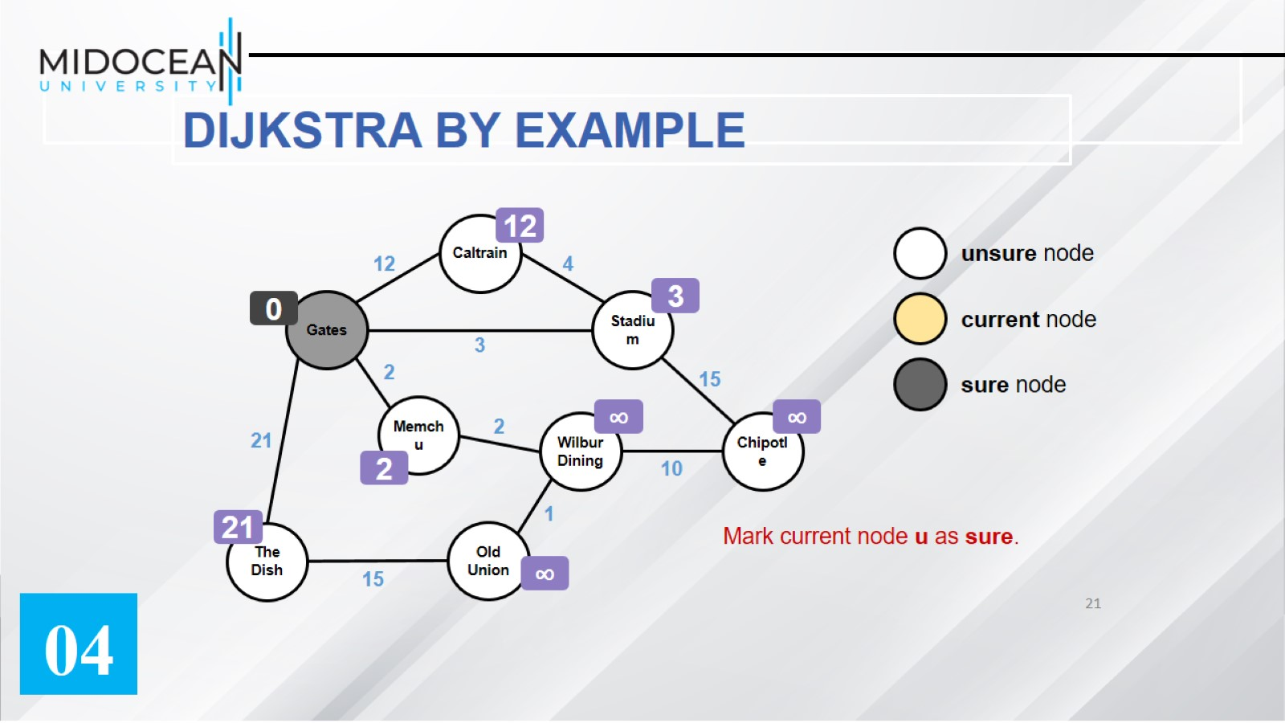

Slide 22
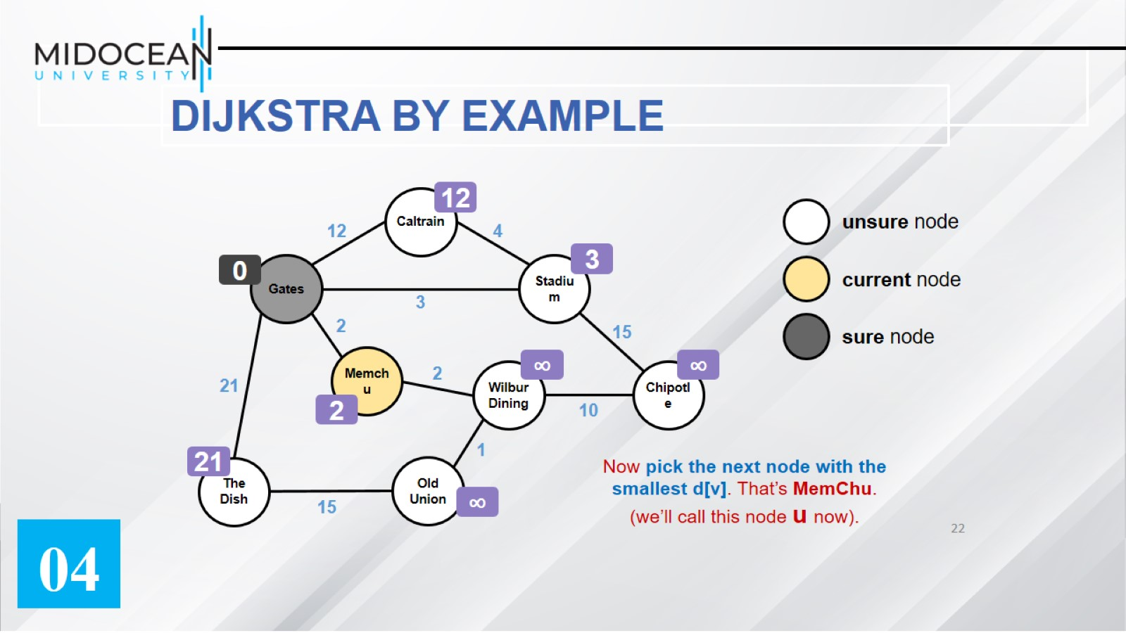

Slide 23
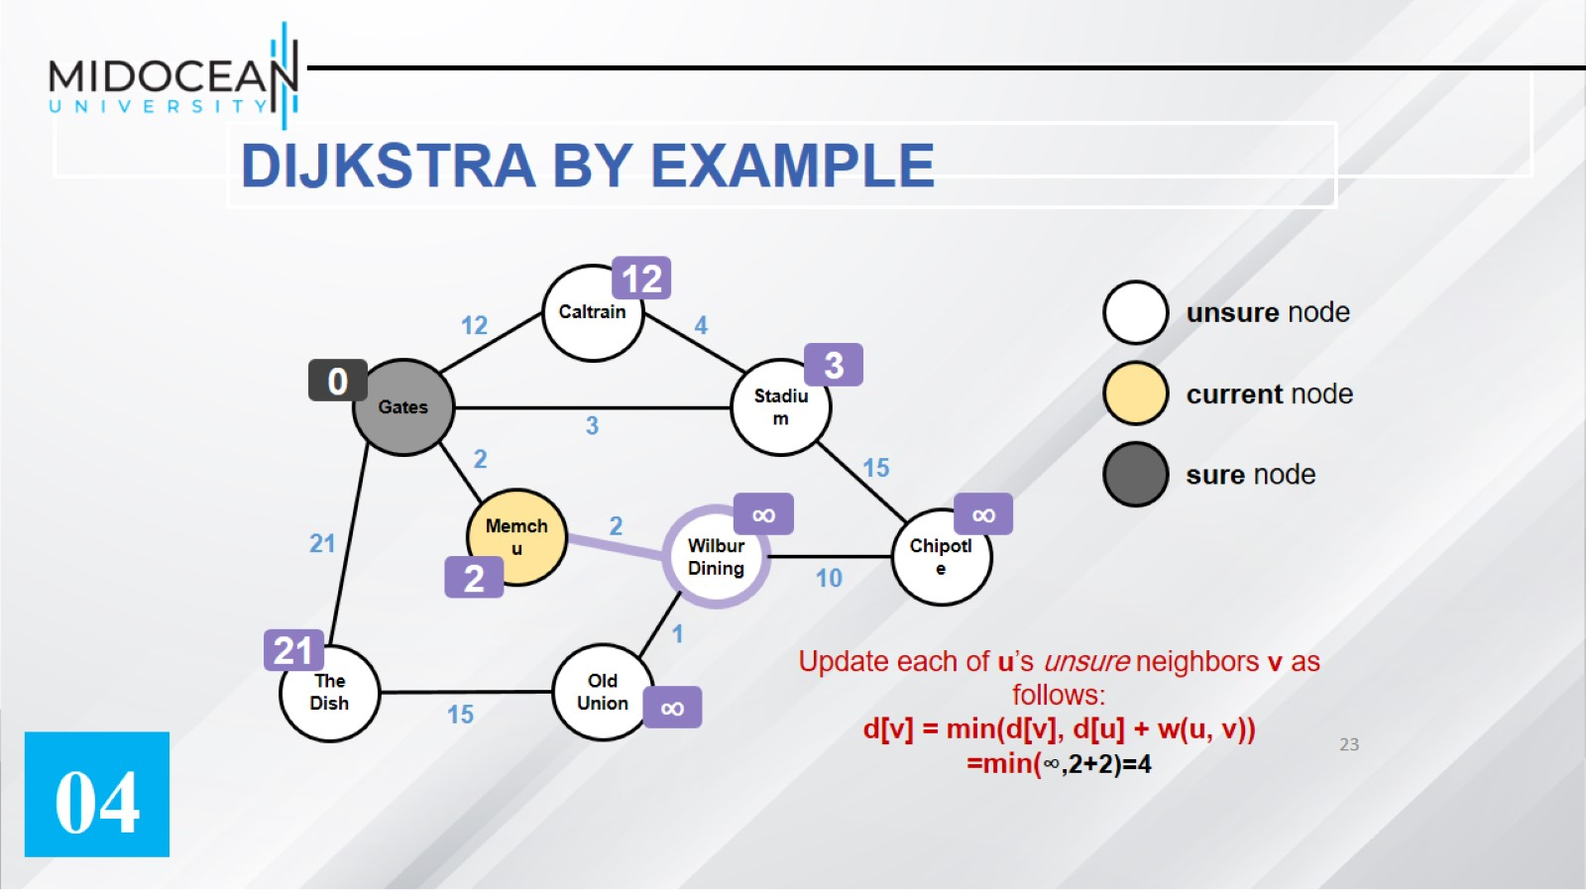

Slide 24
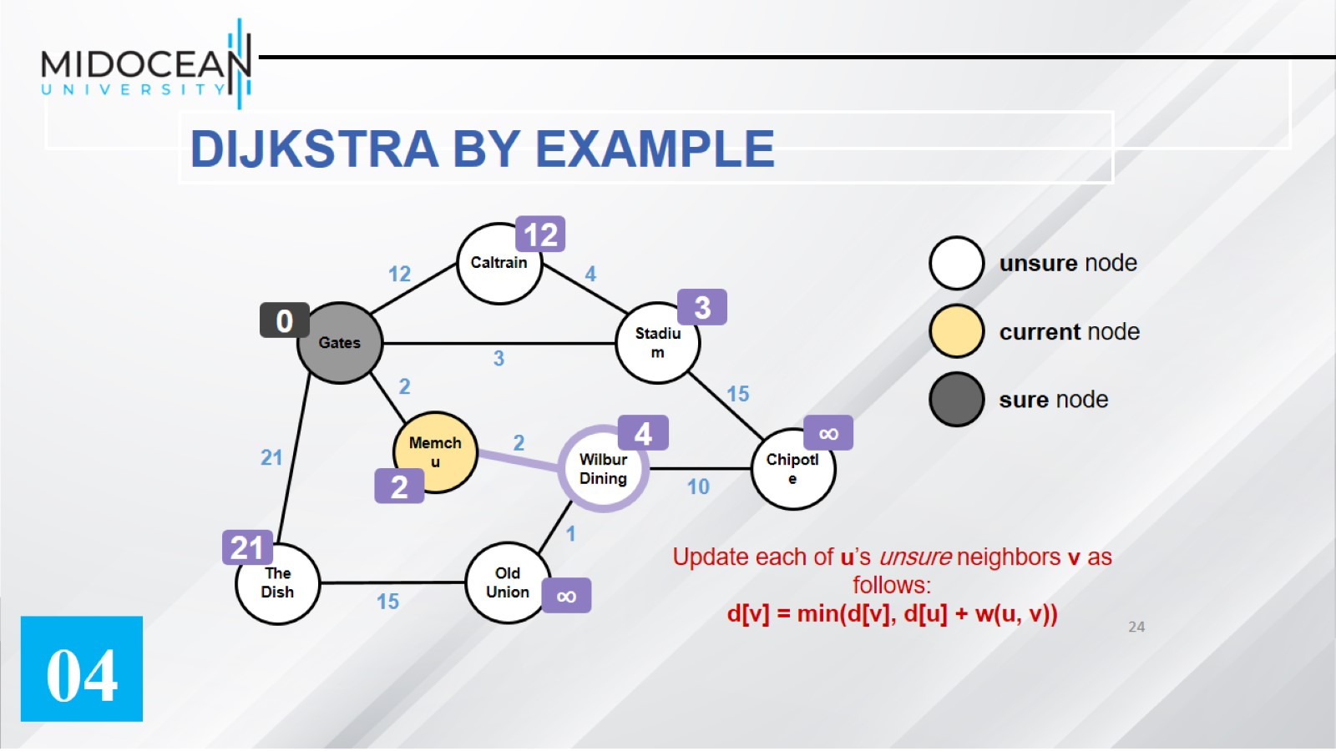

Slide 25
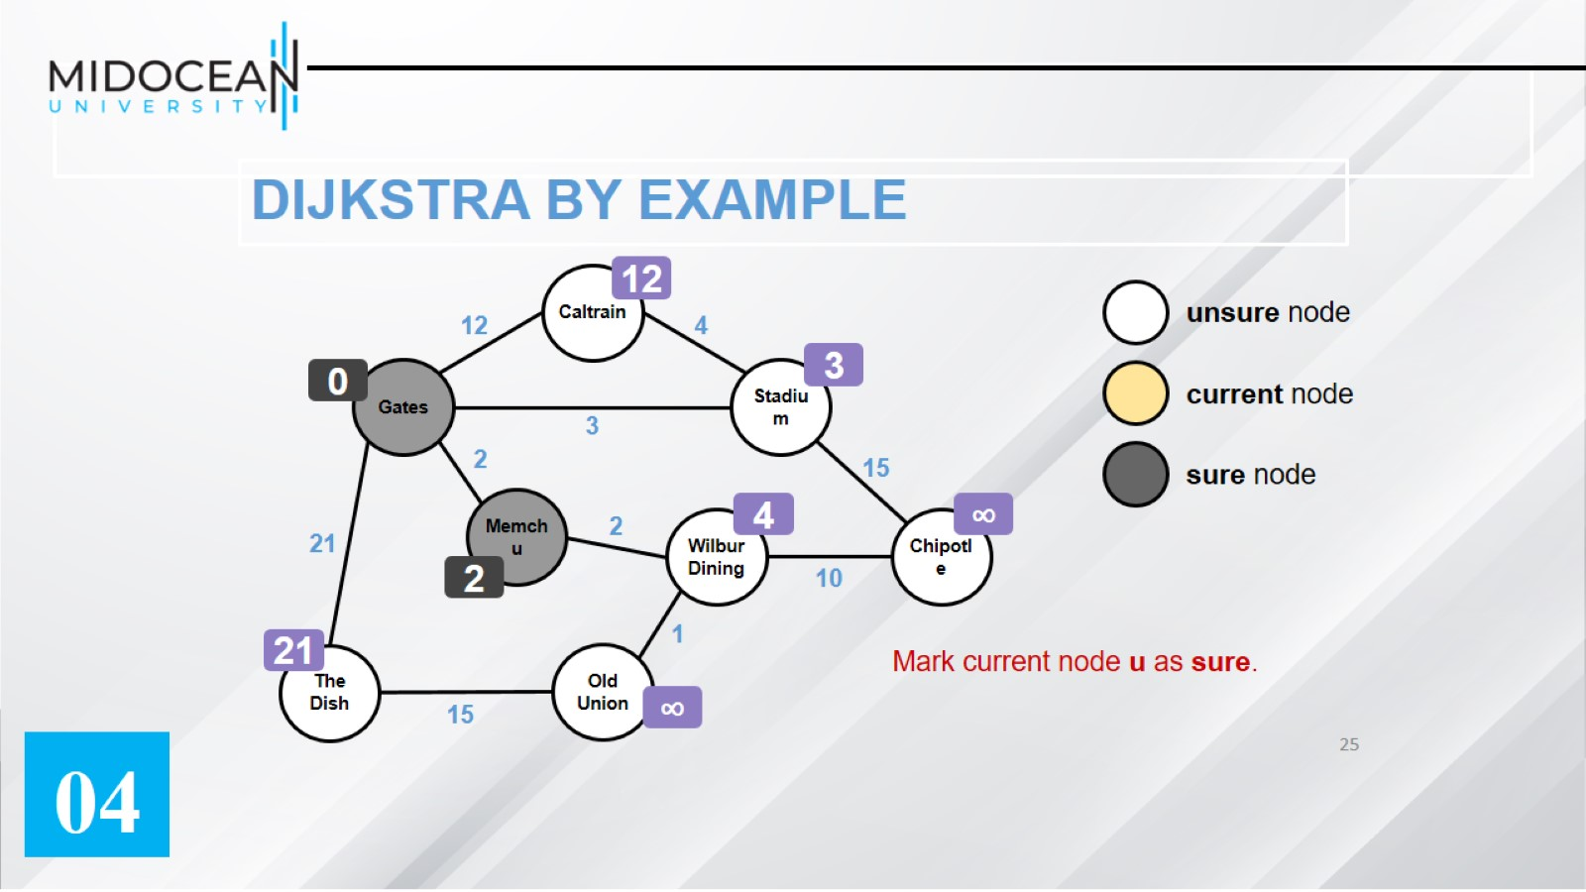
DIJKSTRA BY EXAMPLE

Slide 26
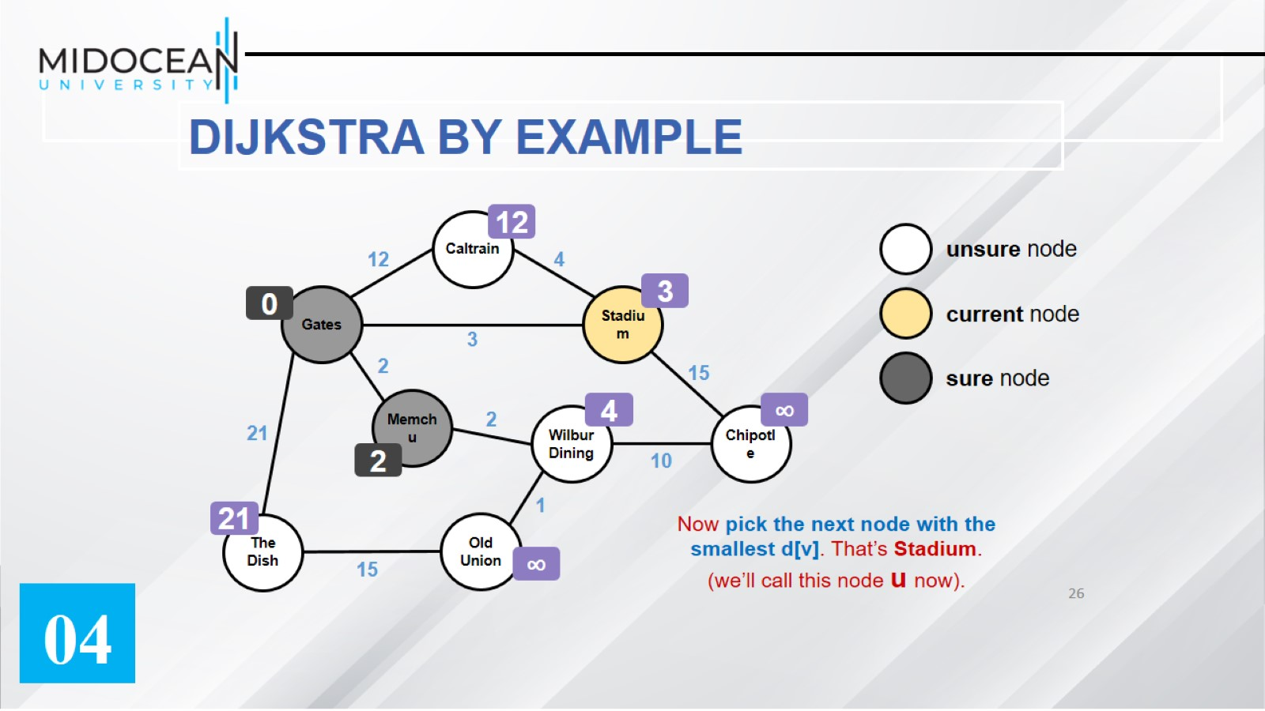

Slide 27
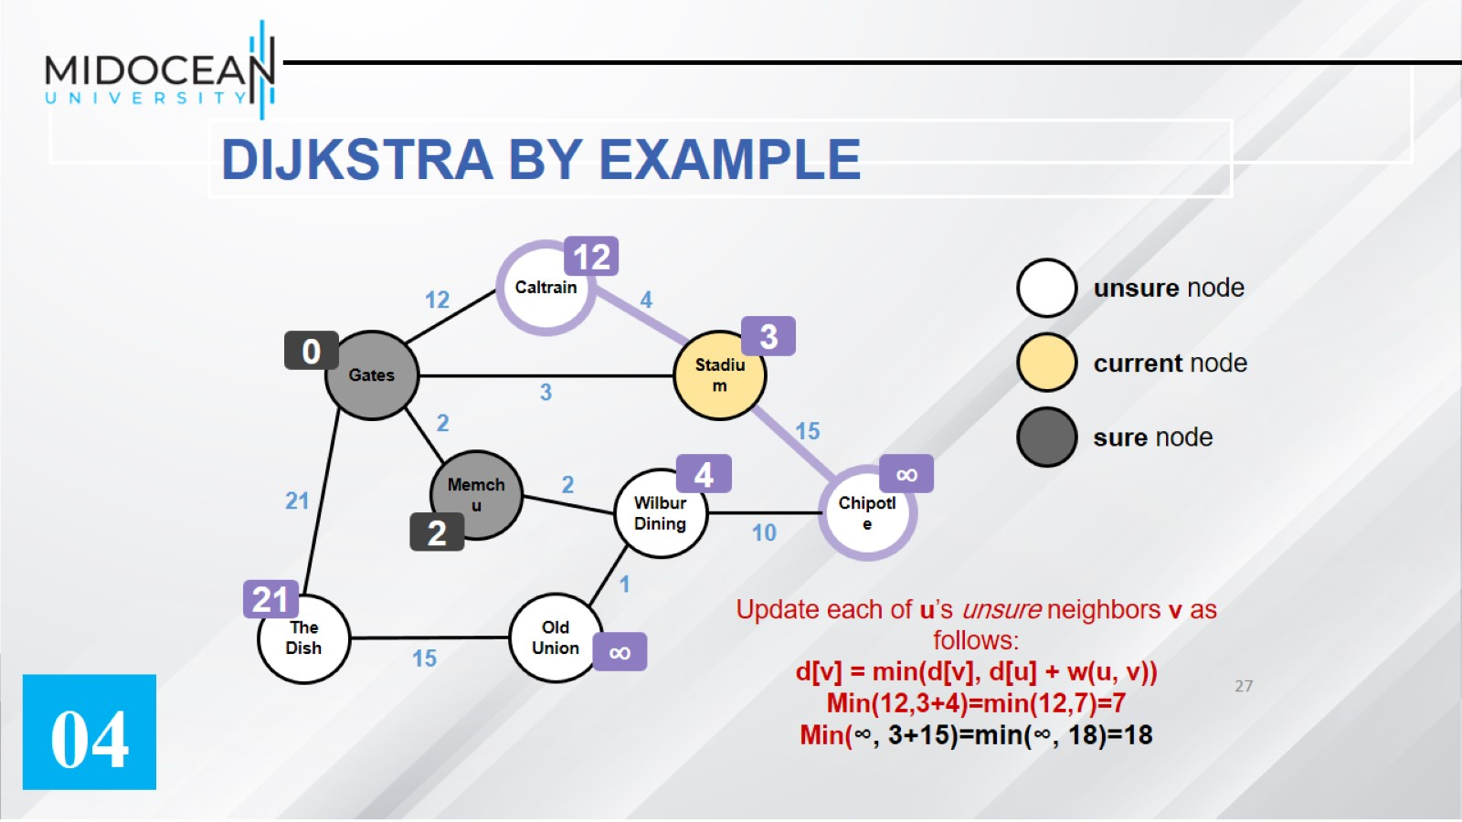

Slide 28
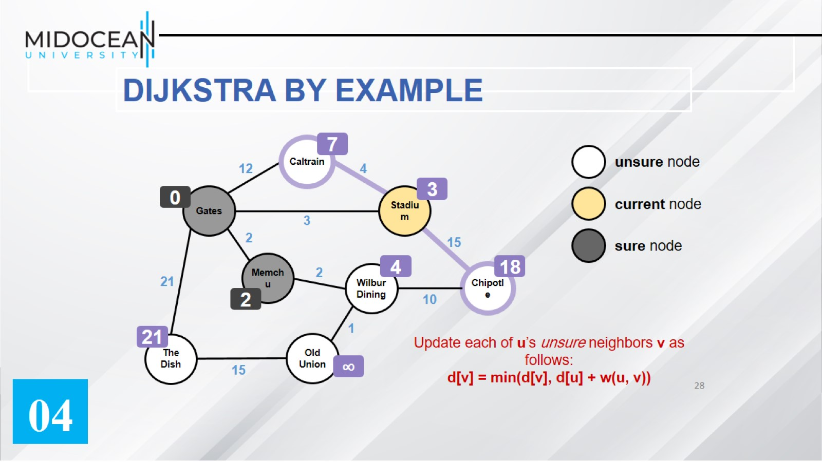

Slide 29
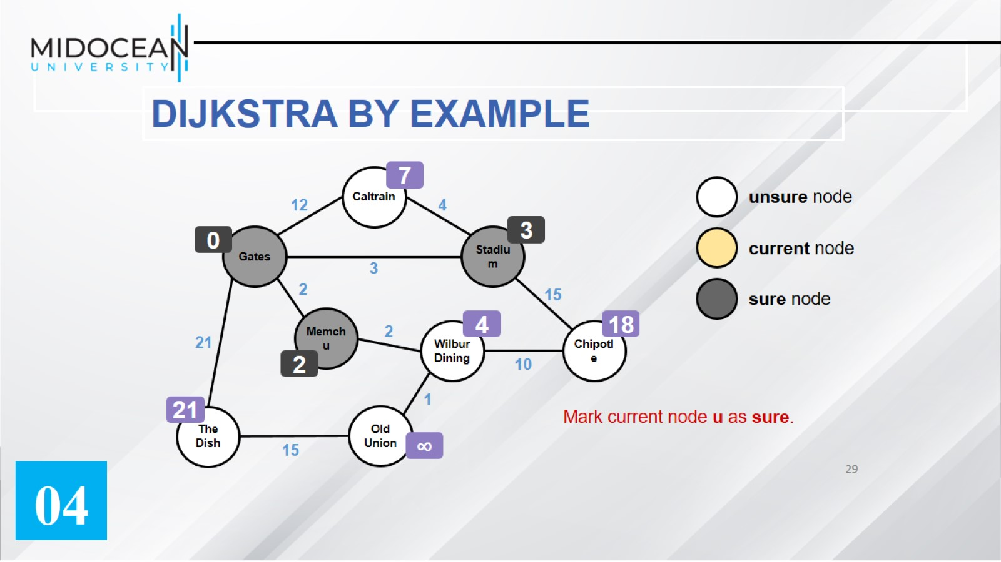

Slide 30
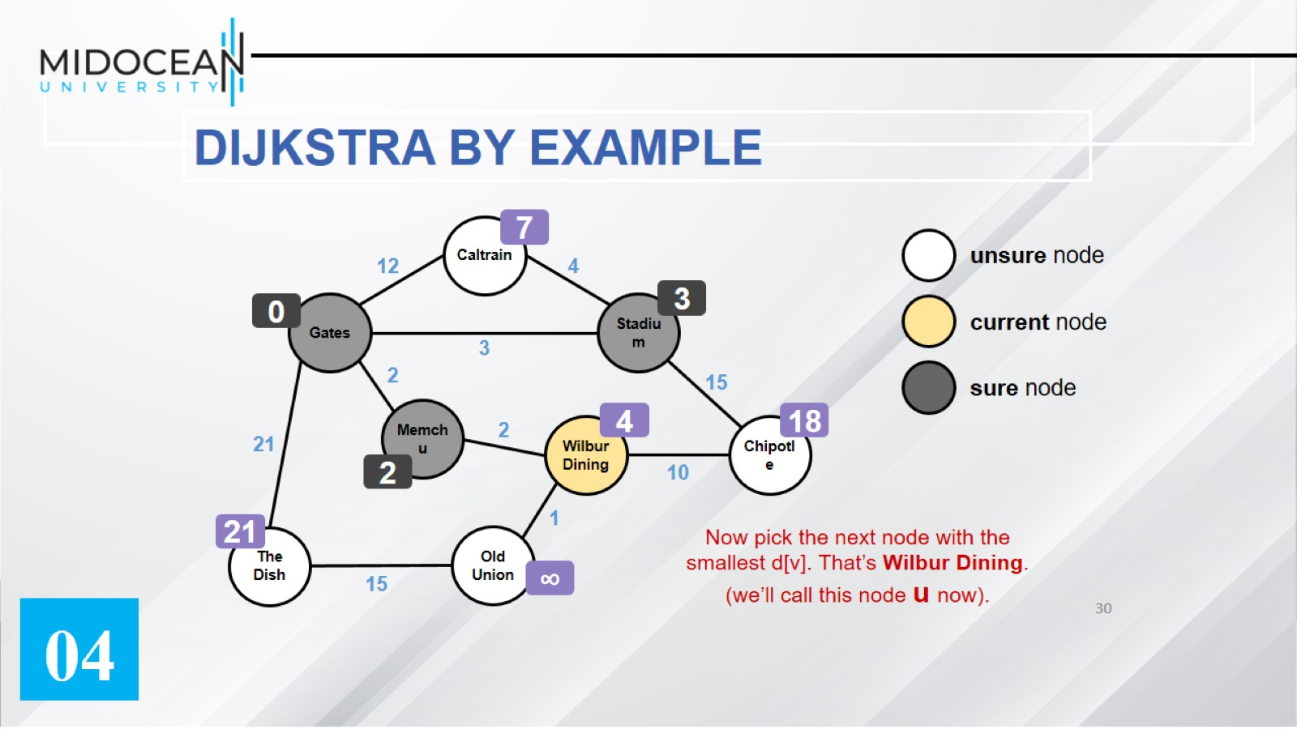

Slide 31
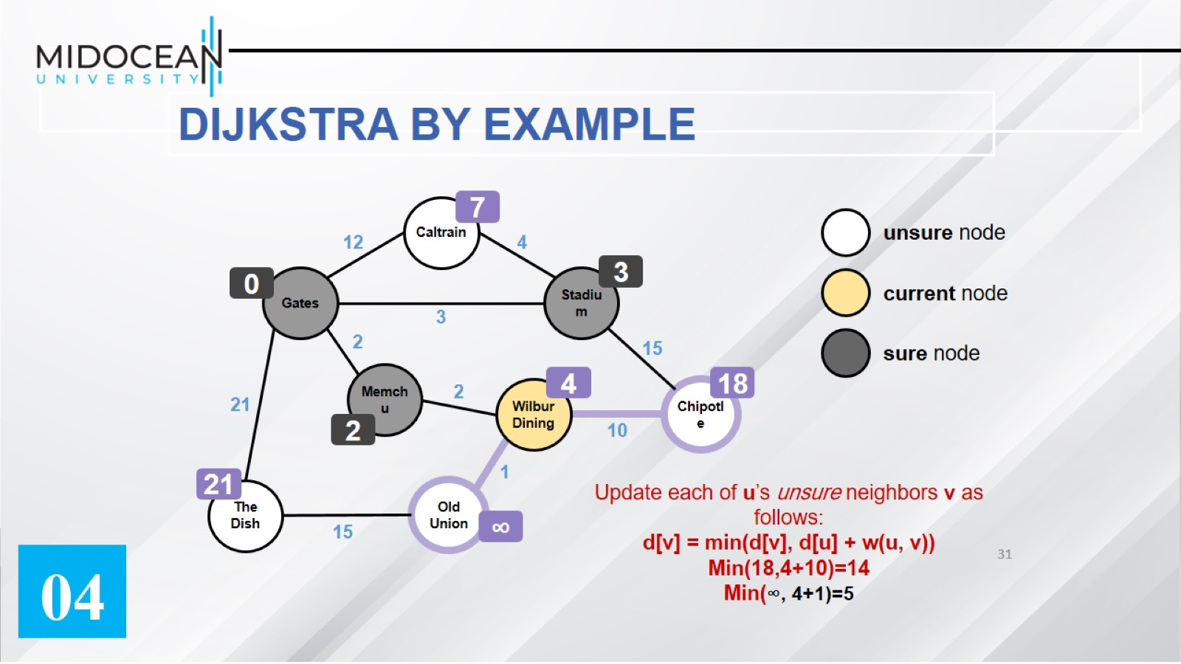

Slide 32
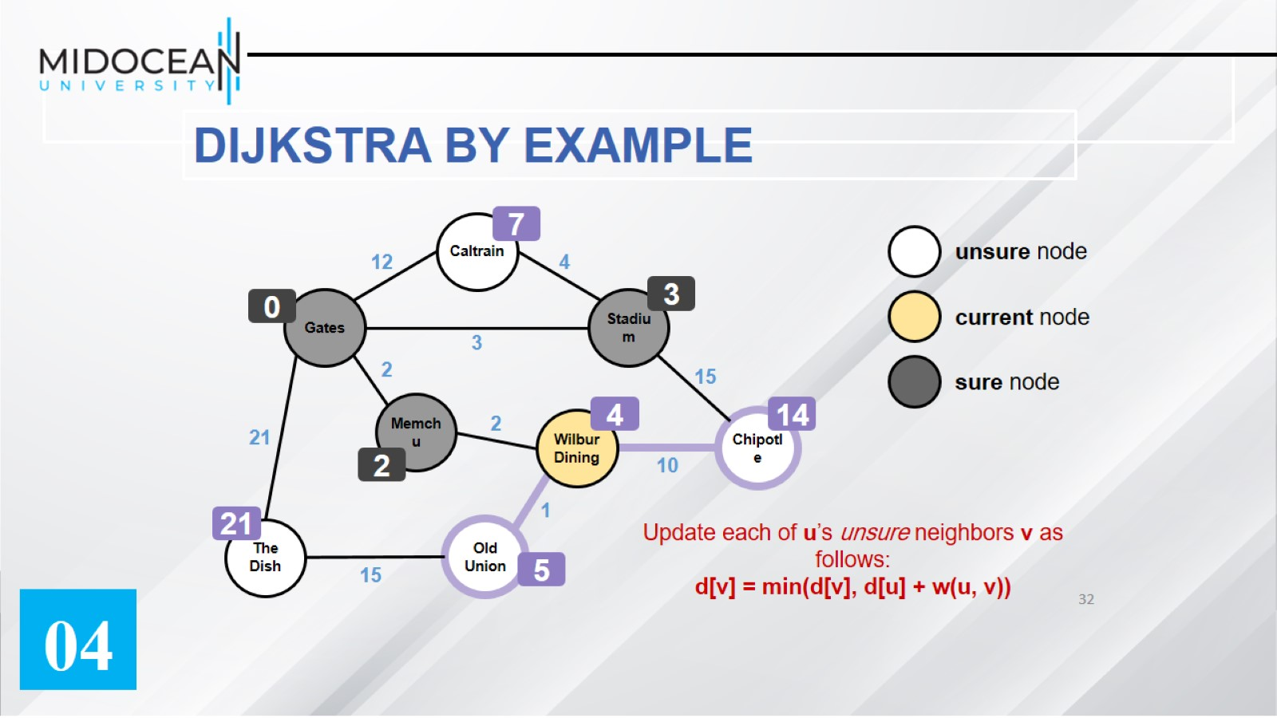

Slide 33
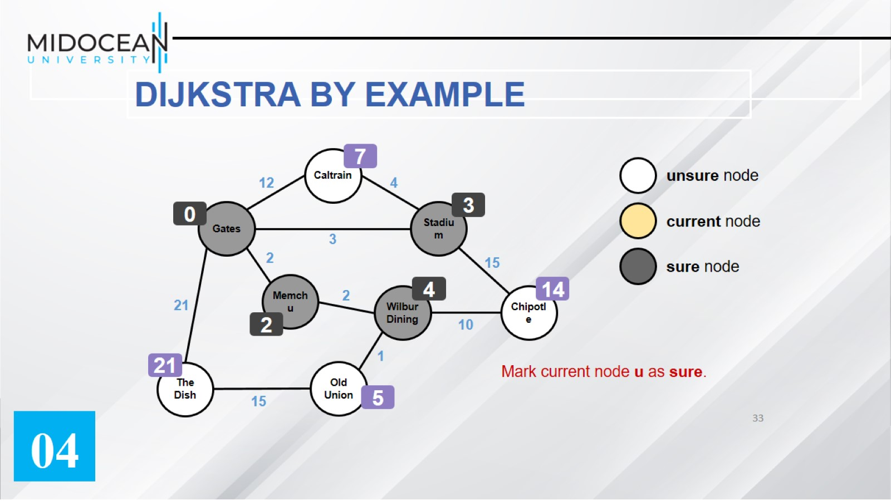

Slide 34
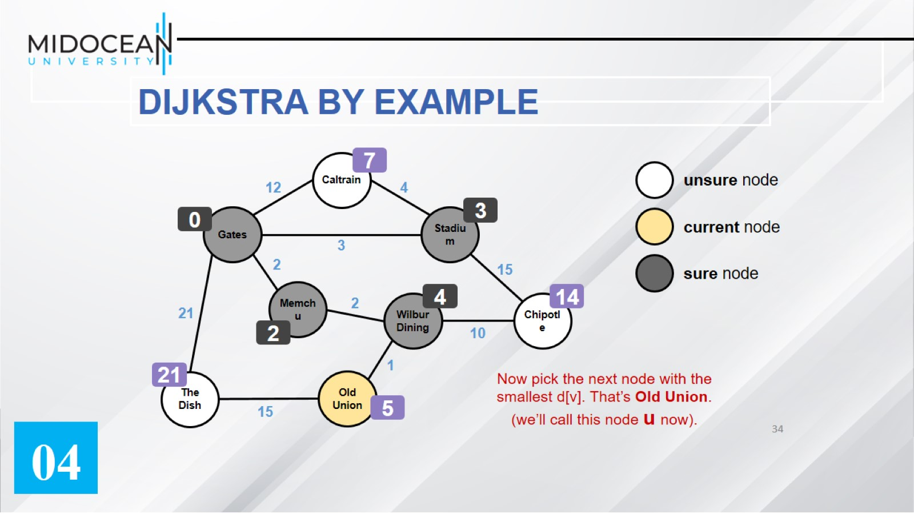

Slide 35
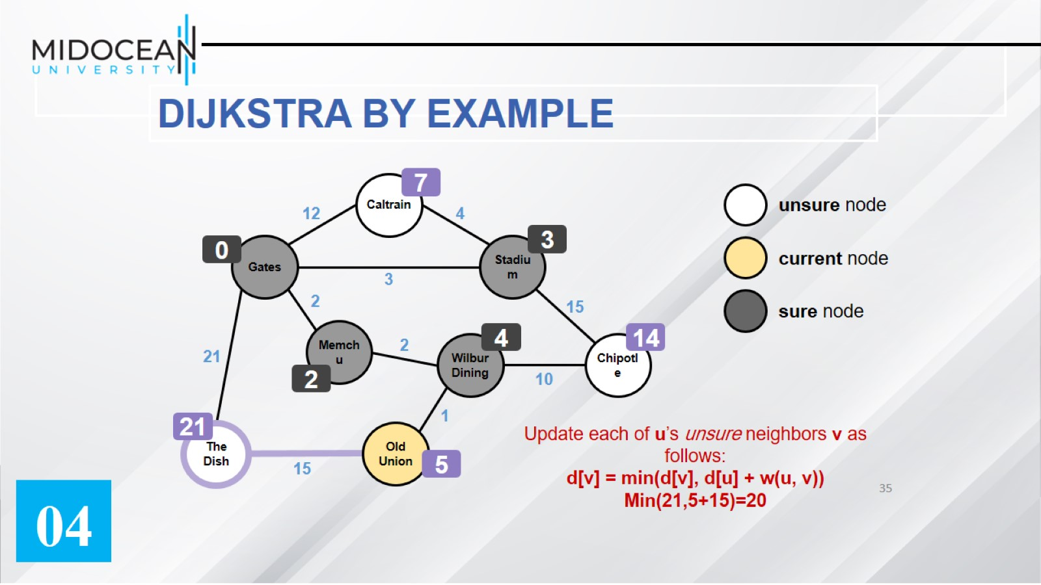

Slide 36
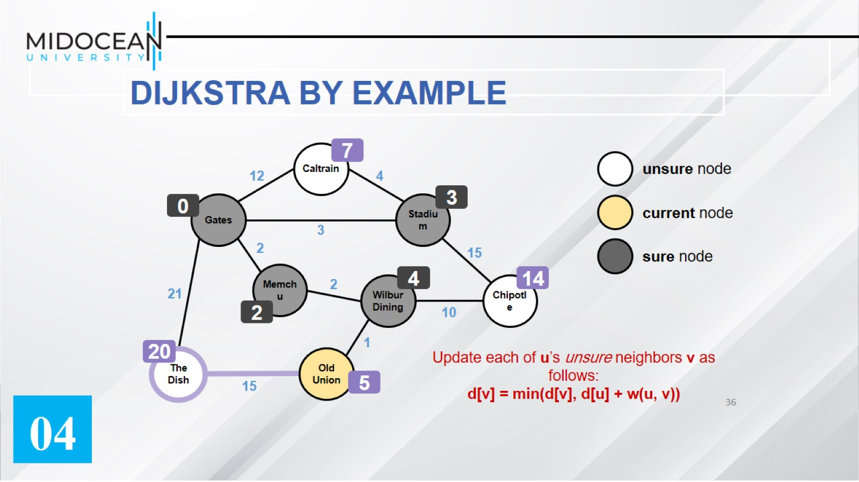

Slide 37
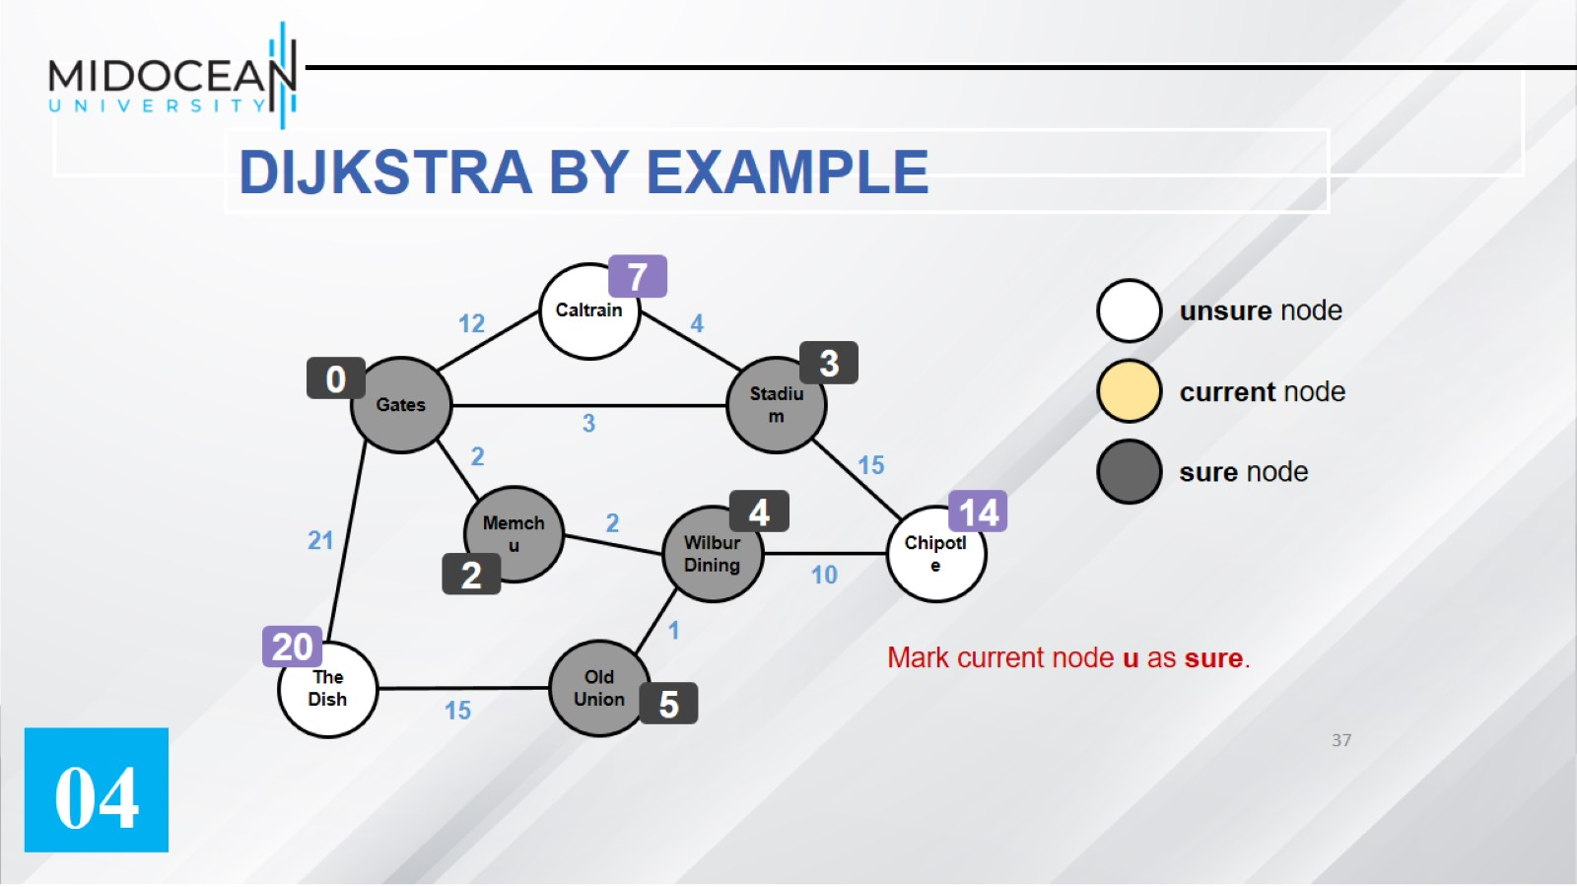

Slide 38
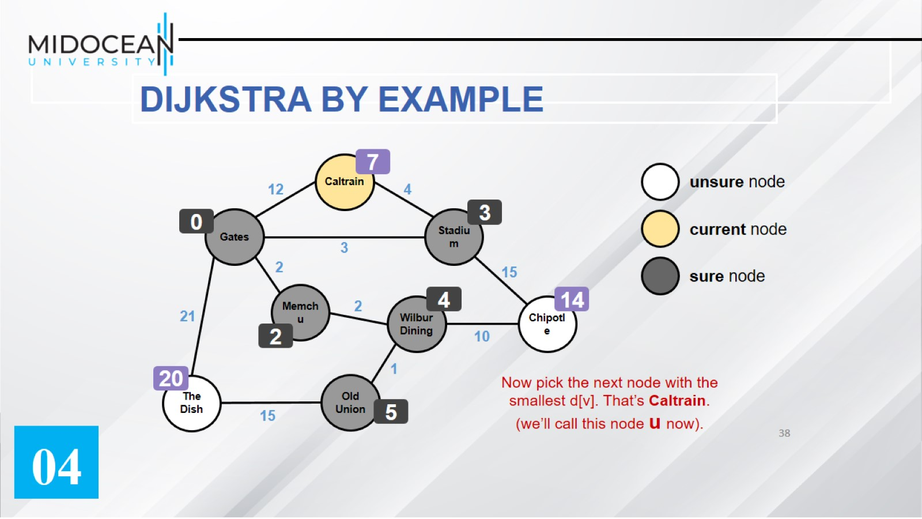

Slide 39
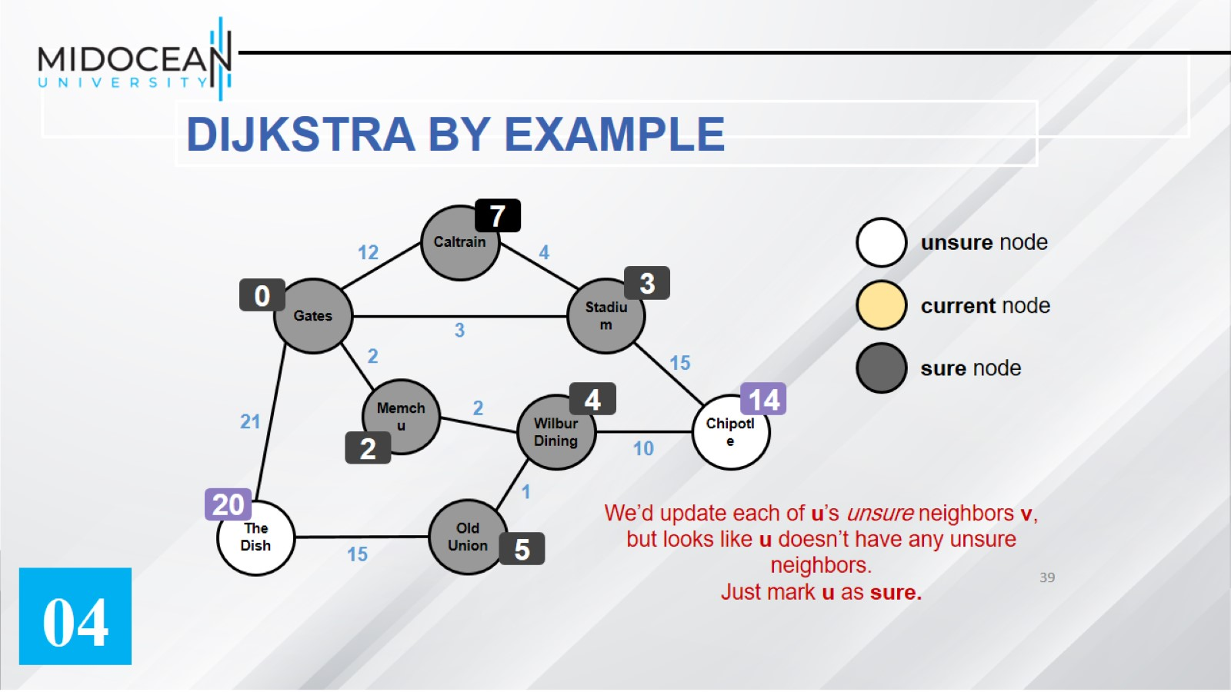

Slide 40
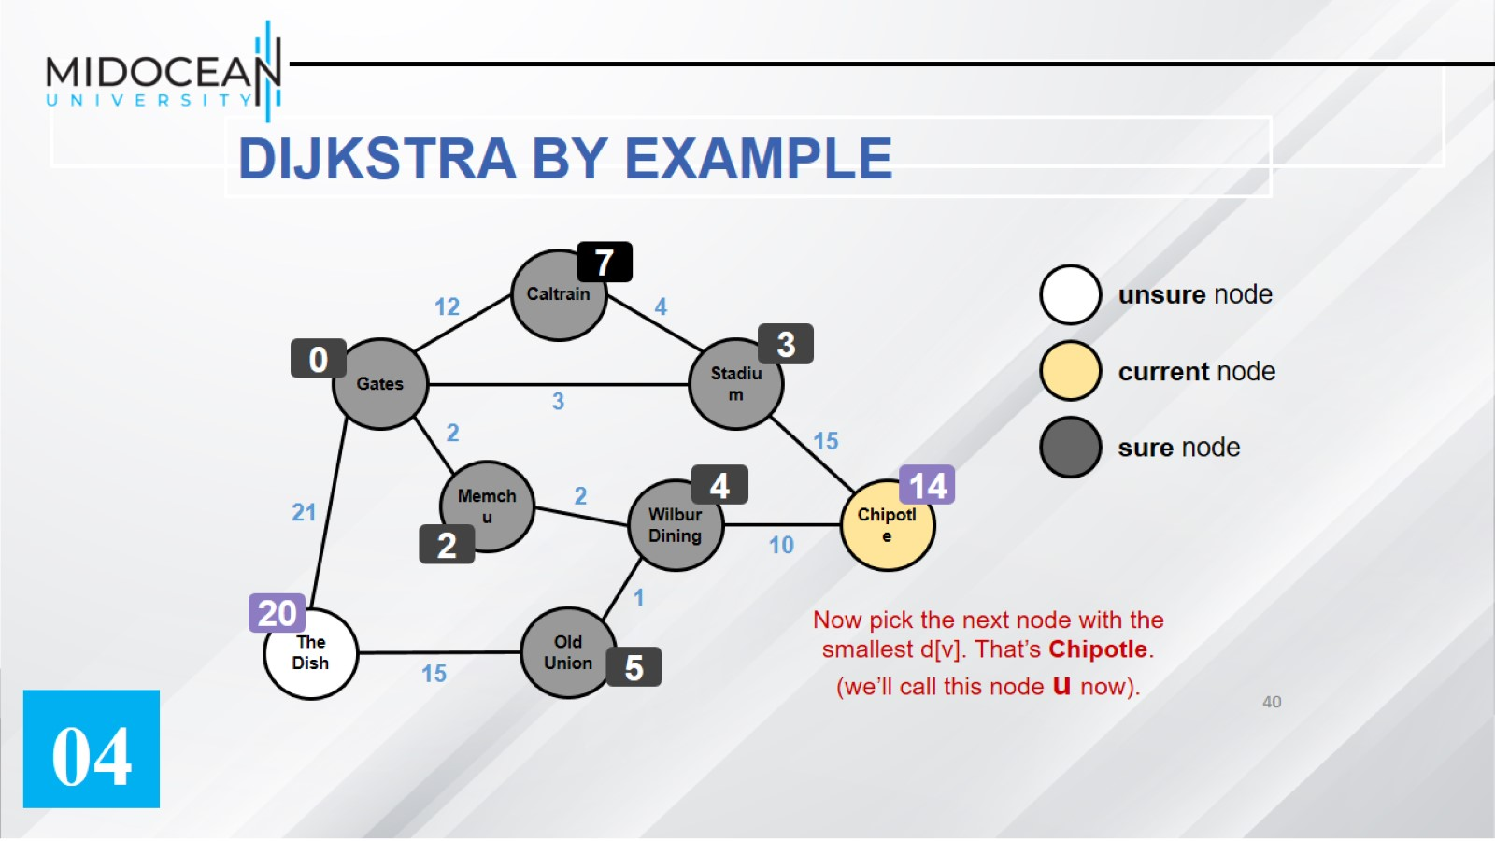

Slide 41
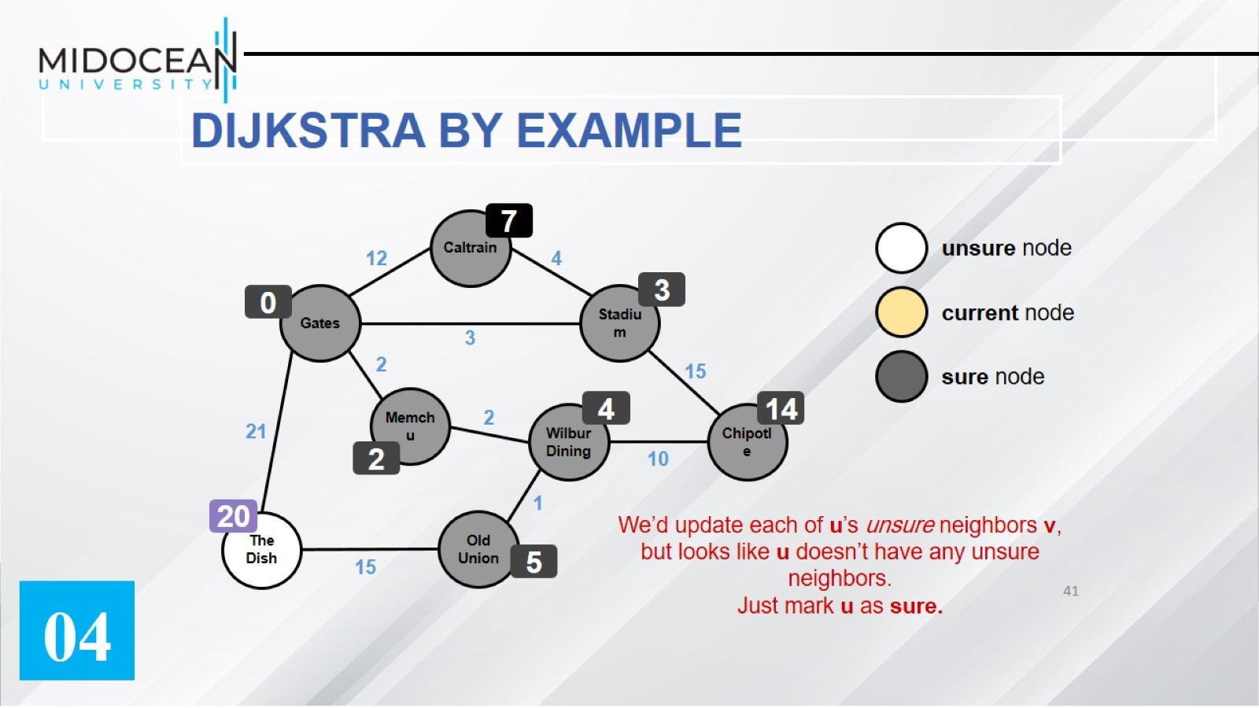

Slide 42
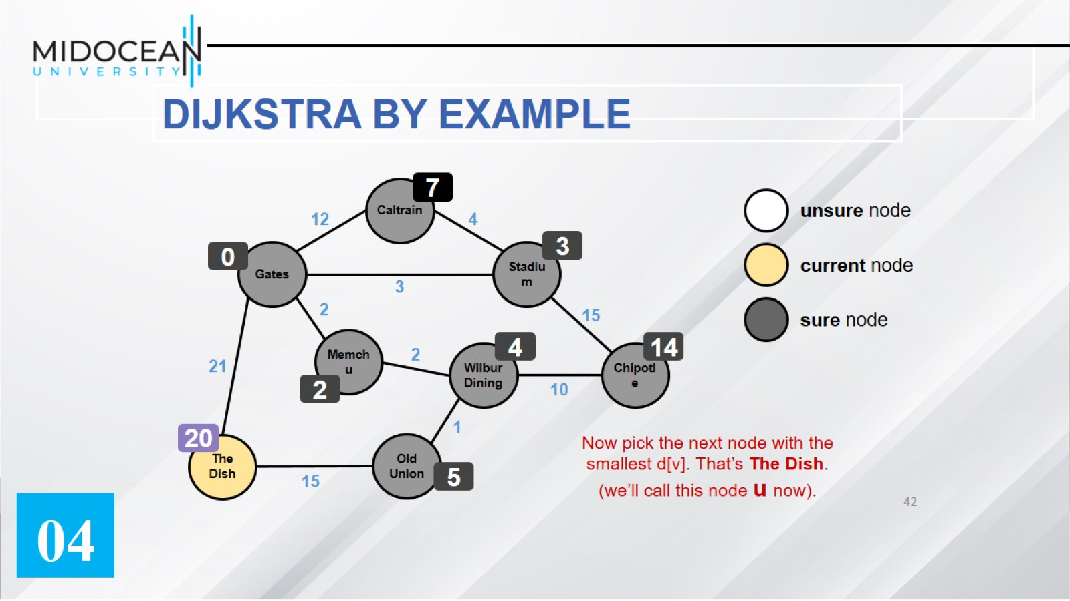

Slide 43
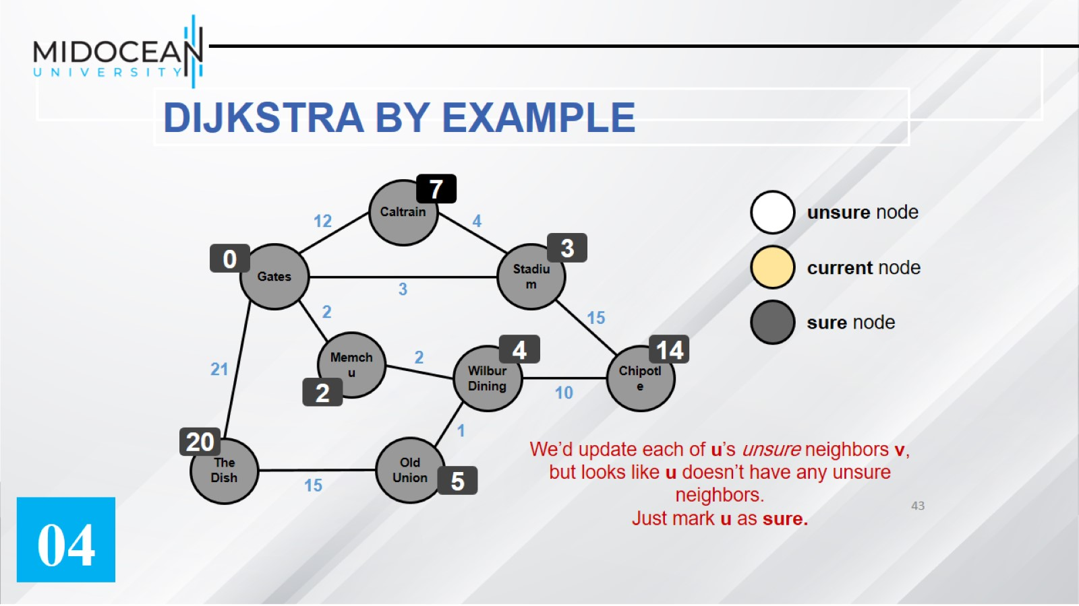

Slide 44
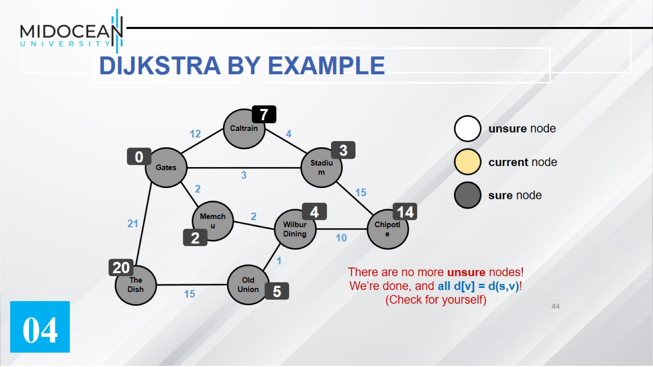

Slide 45


Slide 46
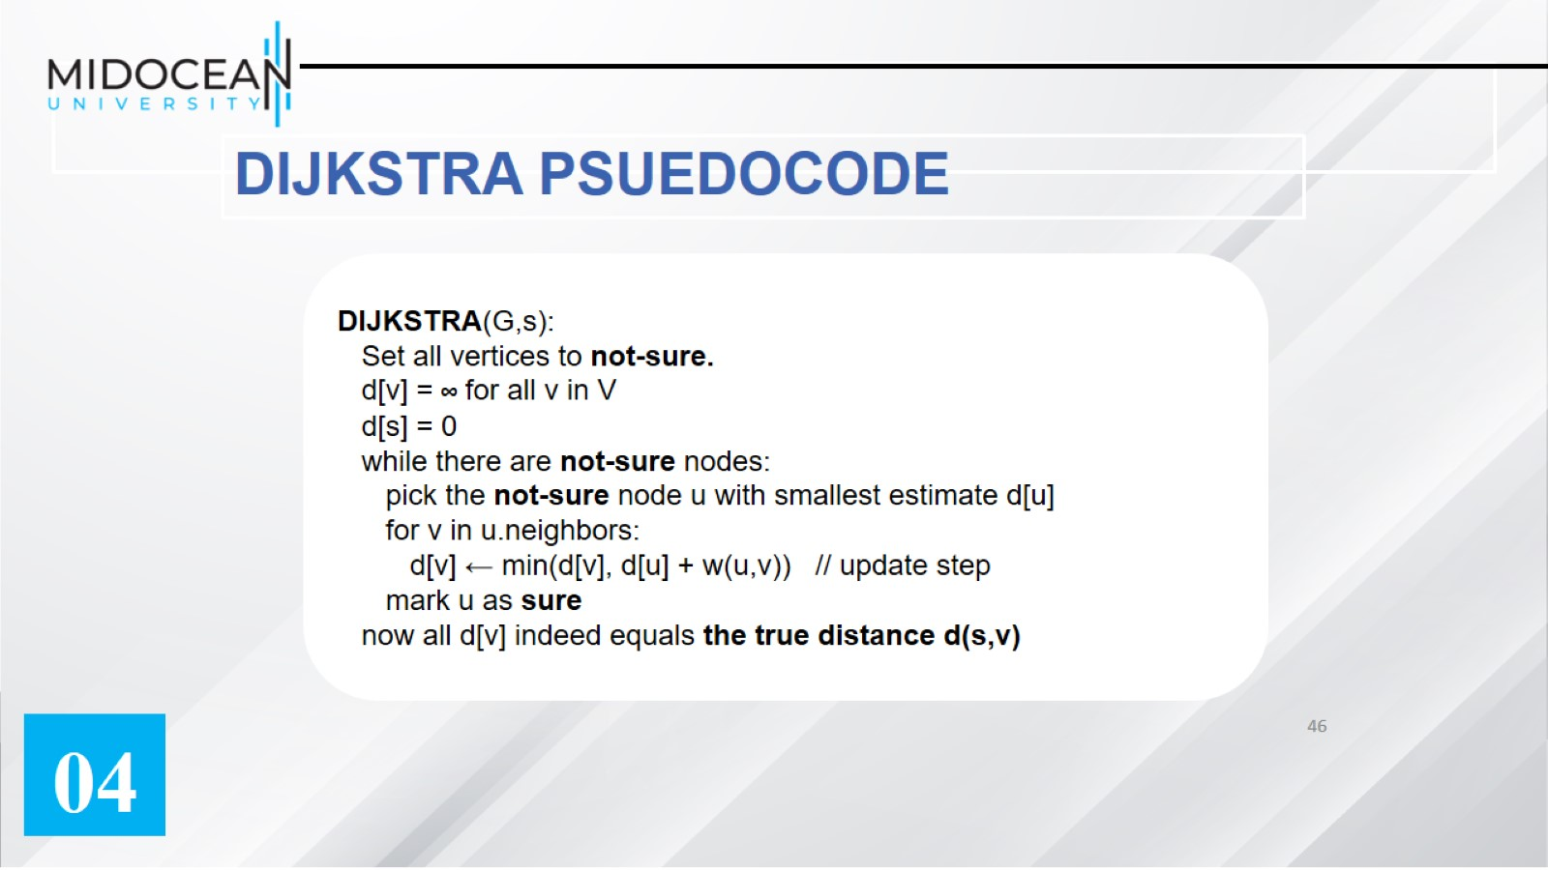
DIJKSTRA PSUEDOCODE

Slide 47
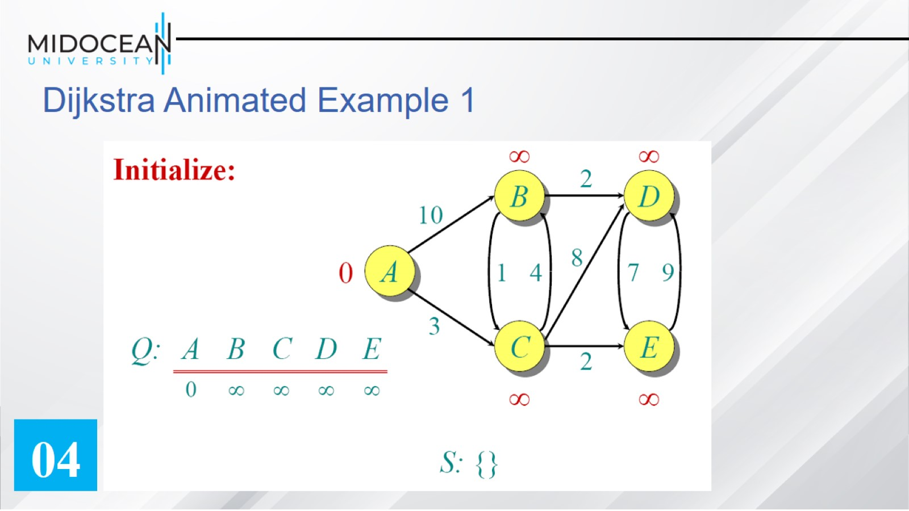
Dijkstra Animated Example 1

Slide 48
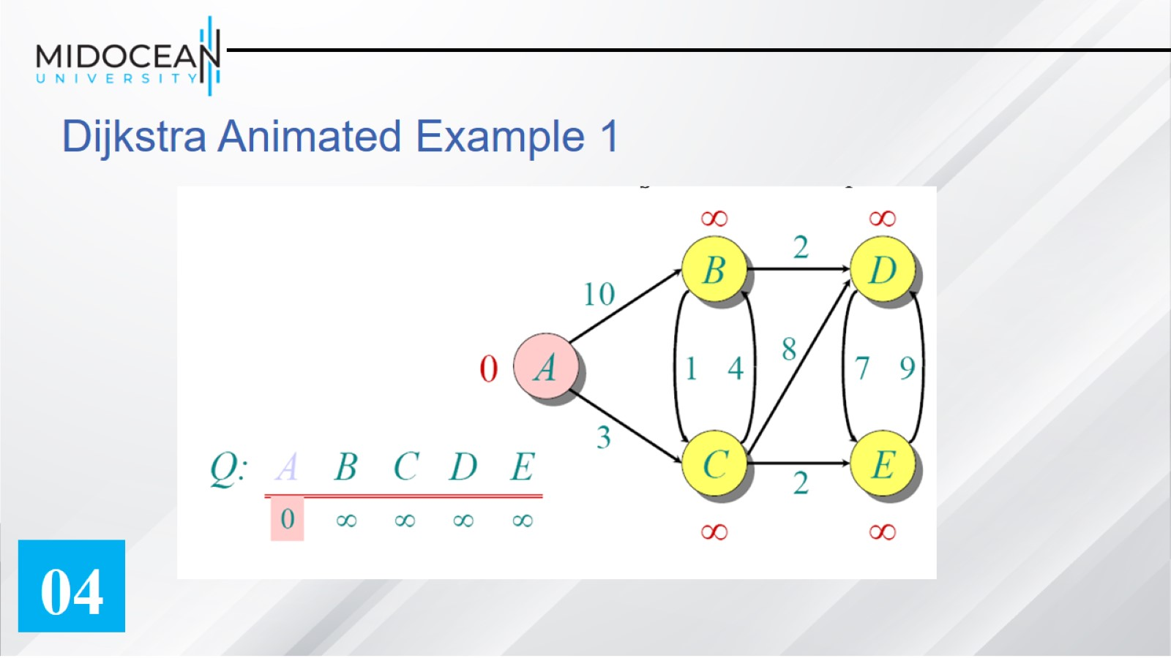
Dijkstra Animated Example 1

Slide 49
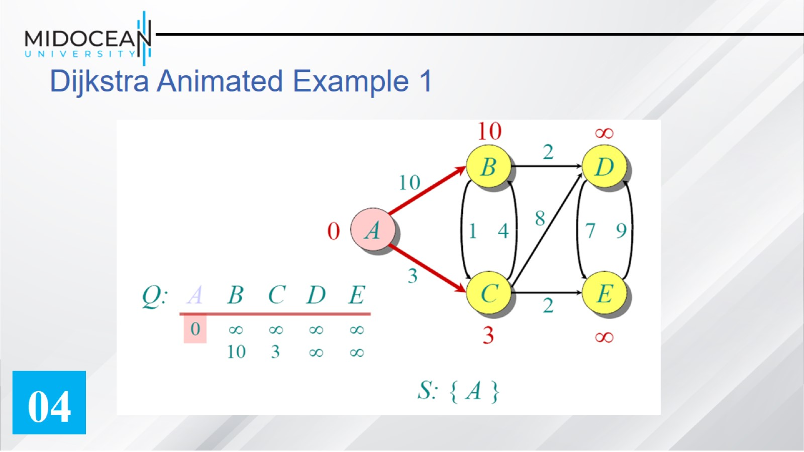
Dijkstra Animated Example 1

Slide 50
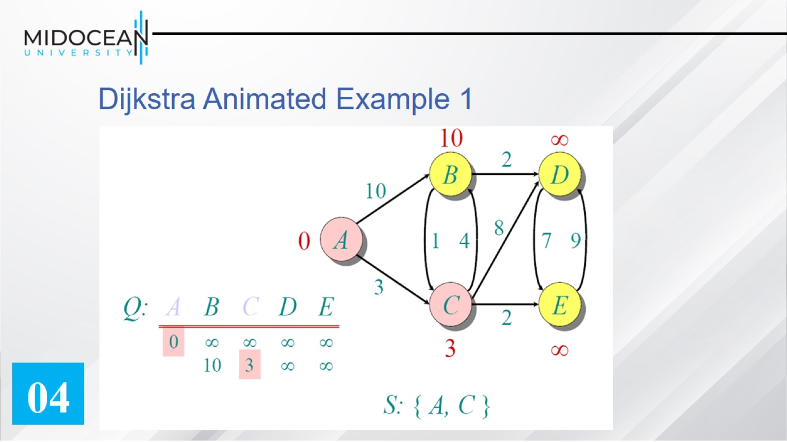
Dijkstra Animated Example 1

Slide 51
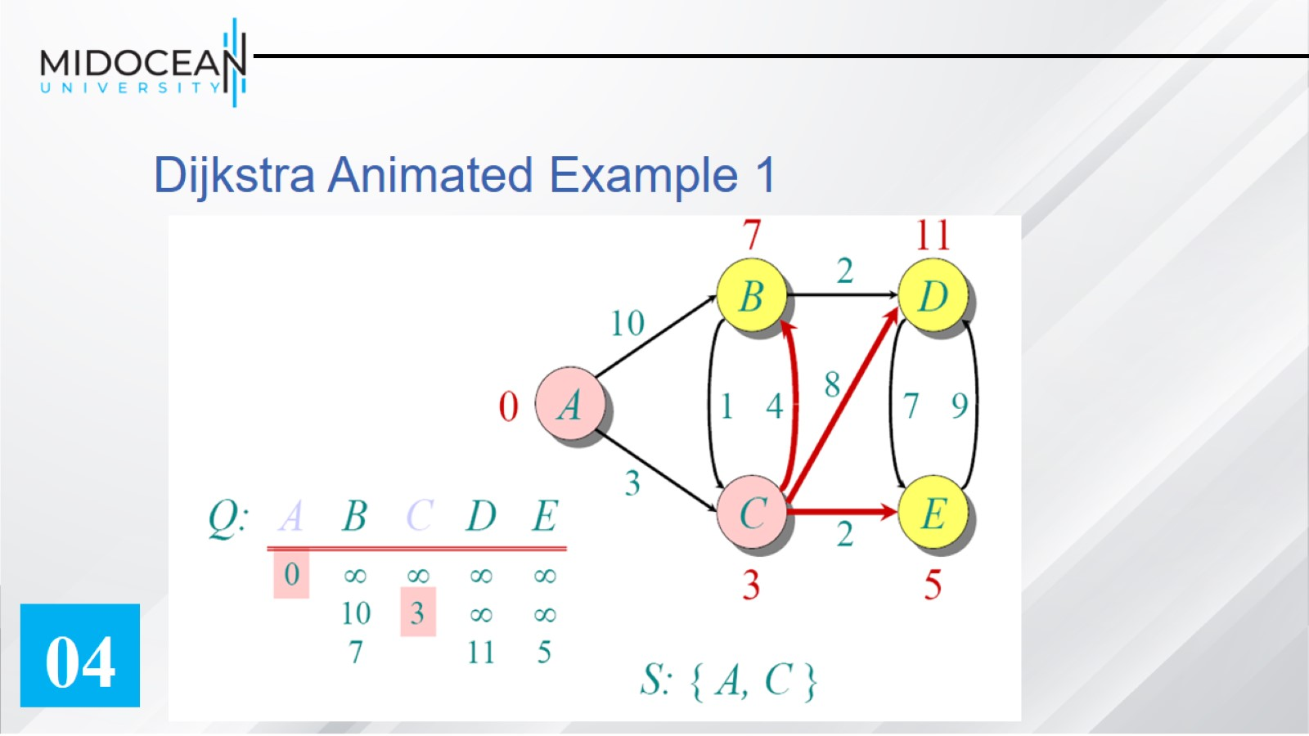
Dijkstra Animated Example 1

Slide 52
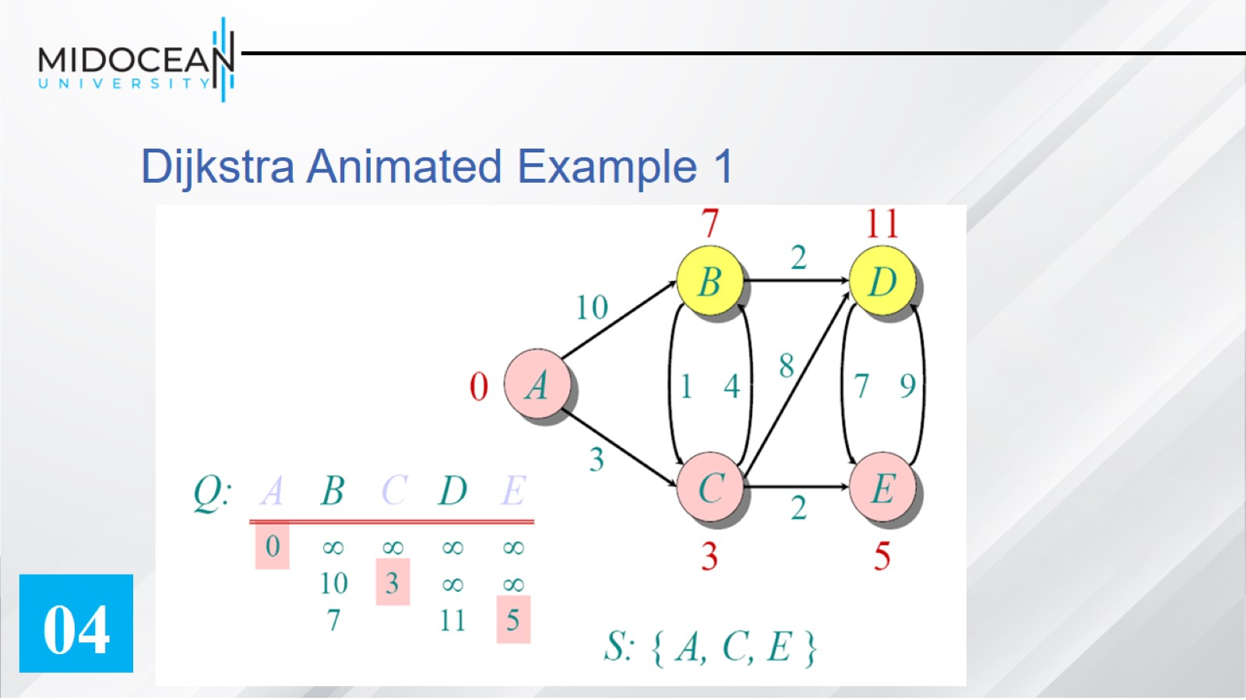
Dijkstra Animated Example 1

Slide 53
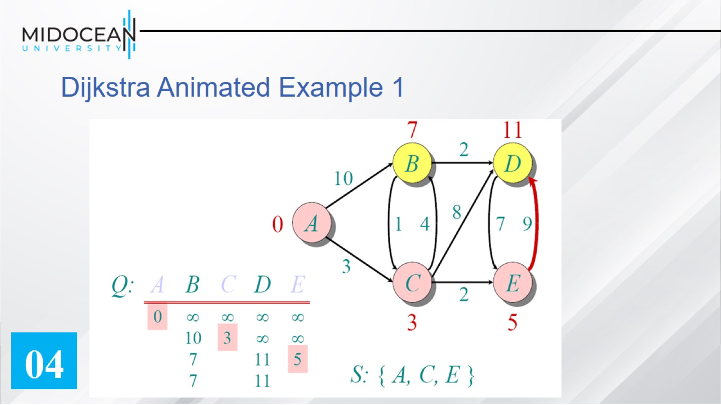
Dijkstra Animated Example 1

Slide 54
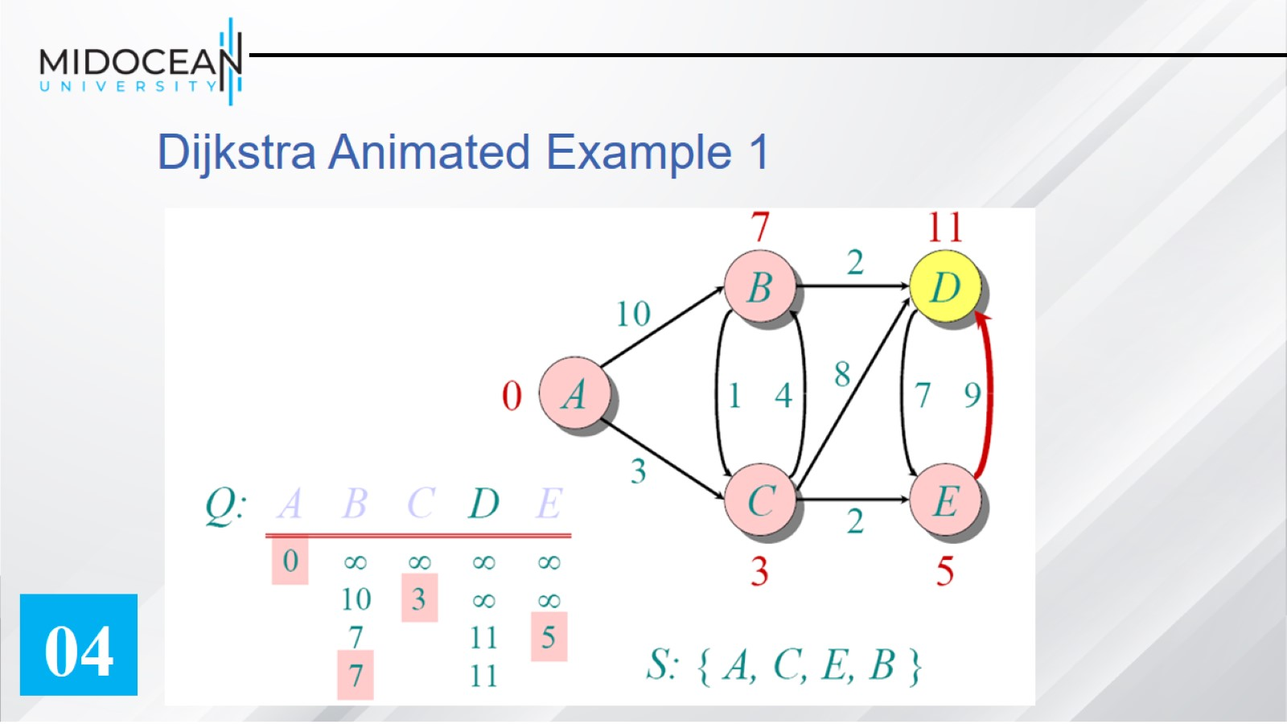
Dijkstra Animated Example 1

Slide 55

Dijkstra Animated Example 1

Slide 56

Dijkstra Animated Example 1

Slide 57

Dijkstra Example 2

Slide 58

Dijkstra Example 2

Slide 59

Dijkstra's algorithm

Slide 60

Dijkstra's algorithm

Slide 61

Exercise 2:

Slide 62

Dijkstra’s algorithm running time

Slide 63

Applications of Dijkstra's Algorithm

Slide 64

Applications of Dijkstra's Algorithm

Slide 65


Slide 66

1. Introduction

Slide 67

2. Recent Developments in Data Structures

Slide 68

2. Recent Developments in Data Structures

Slide 69

3. Recent Developments in Algorithms

Slide 70

3. Recent Developments in Algorithms

Slide 71

4. Modern Applications of DSA in Real Life

Slide 72


Slide 73

Skills Needed for the Future:

Slide 74

Conclusion:

Slide 75


